Slide 1
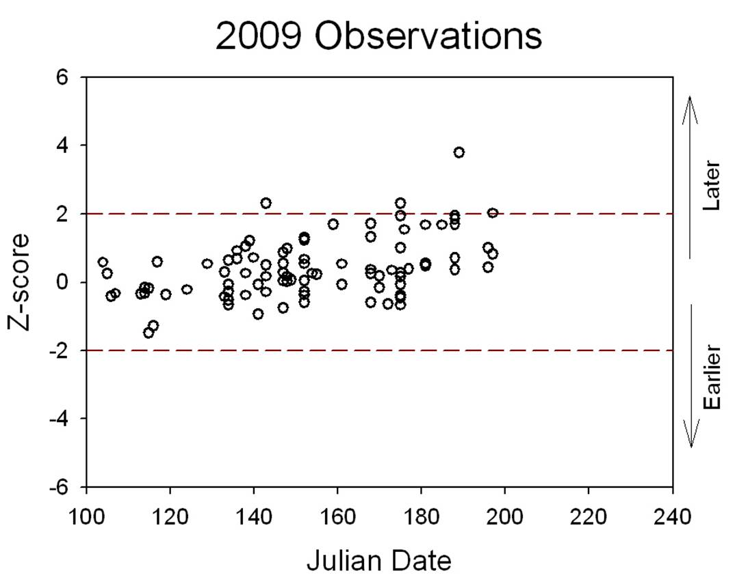
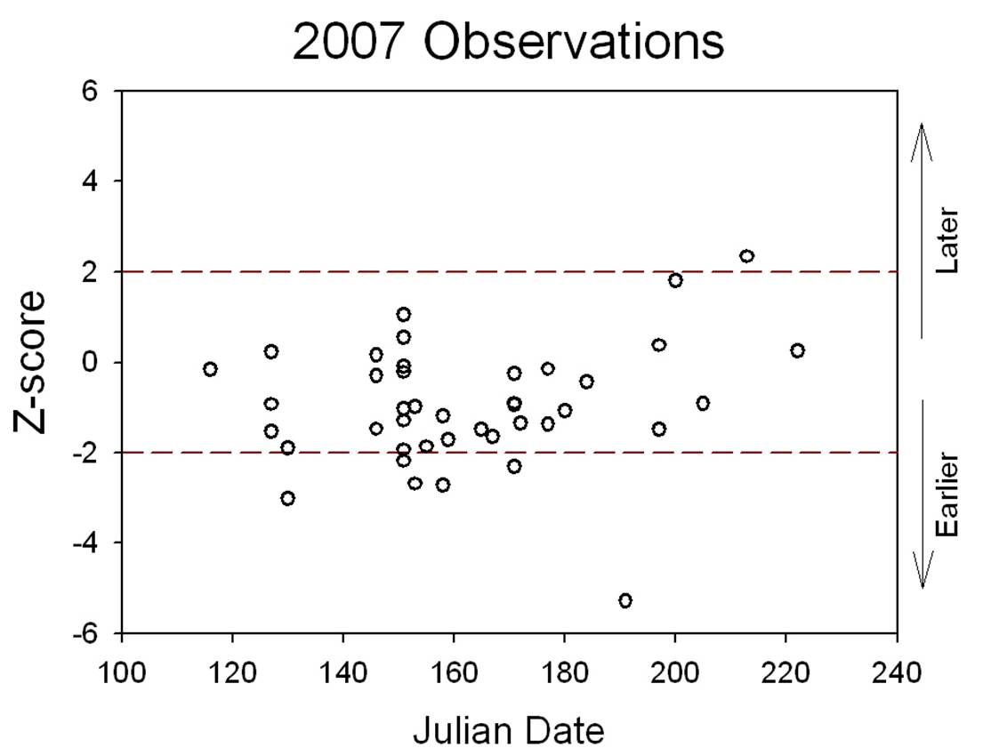
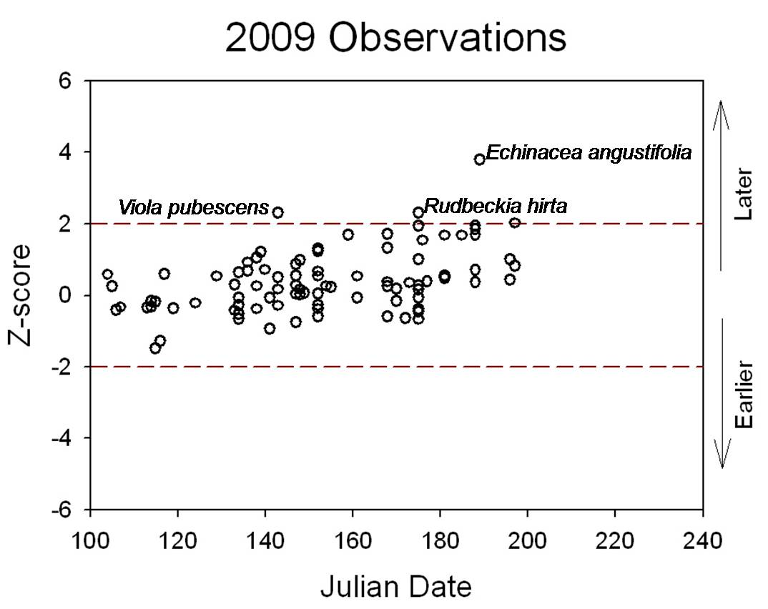
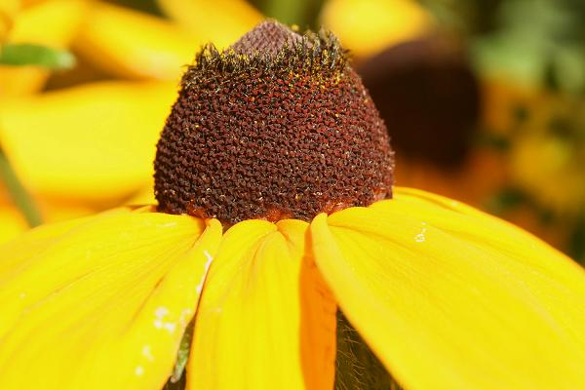
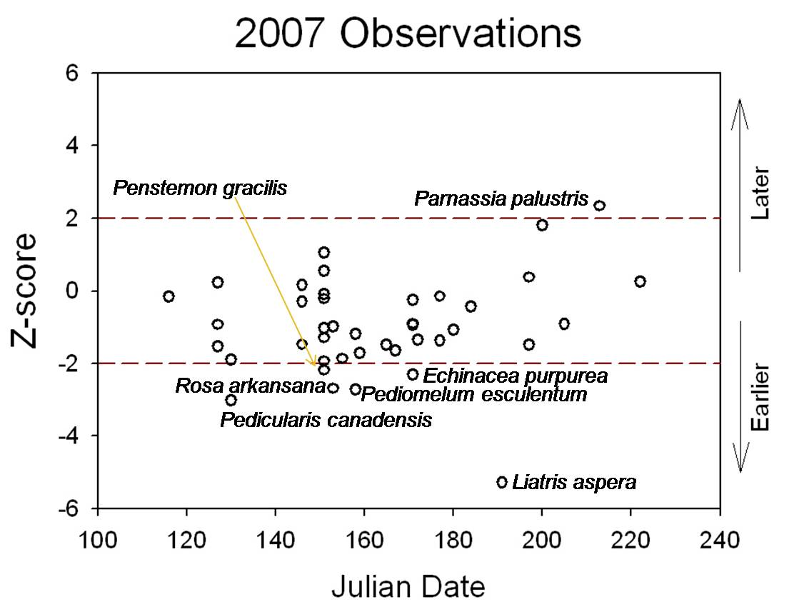
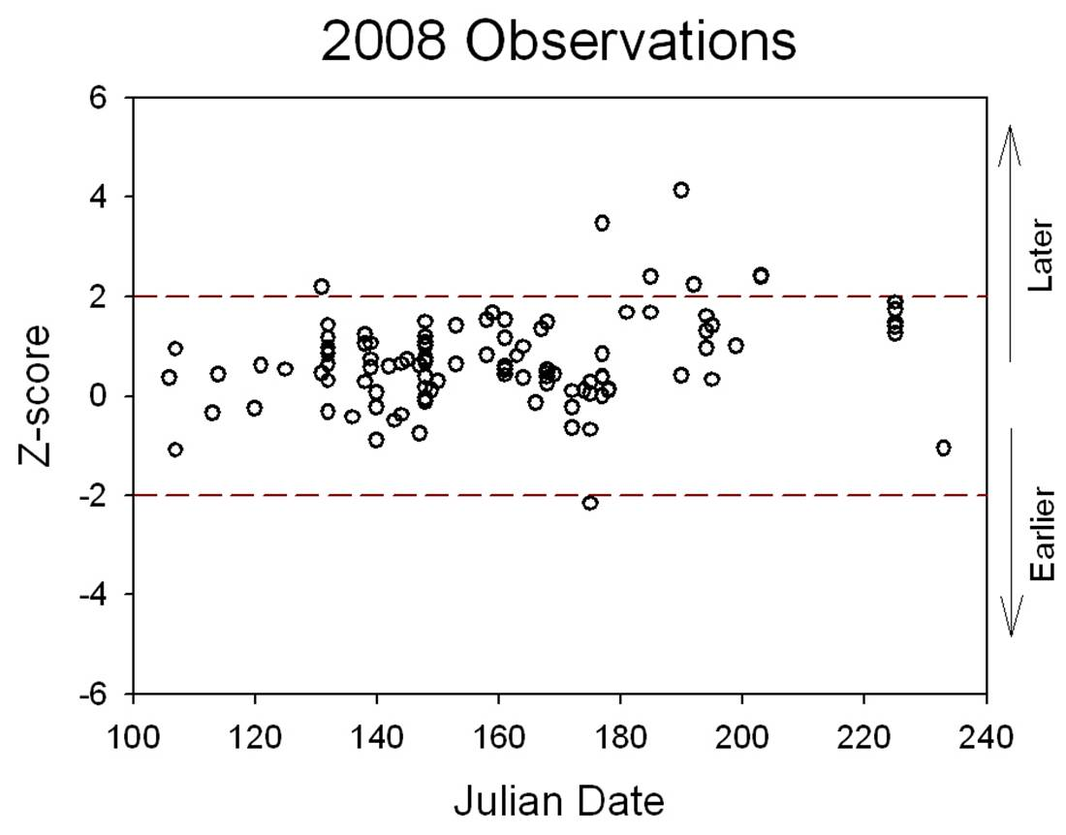
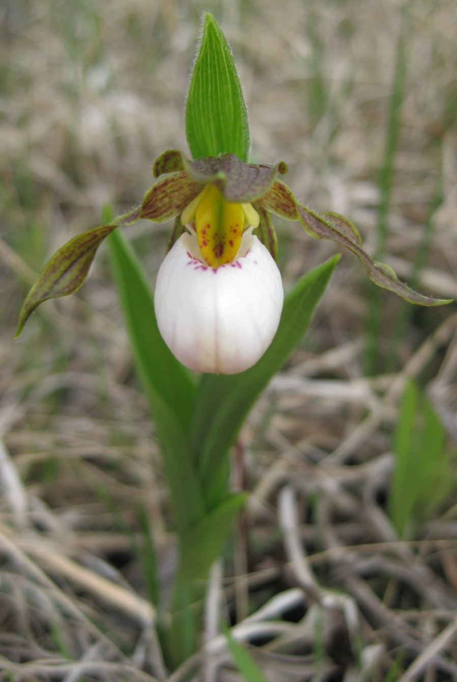
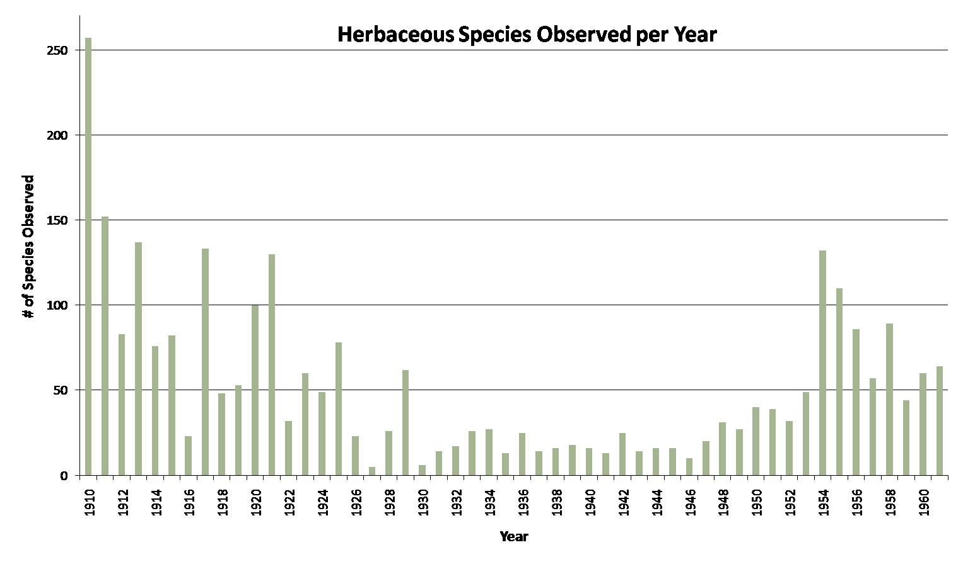
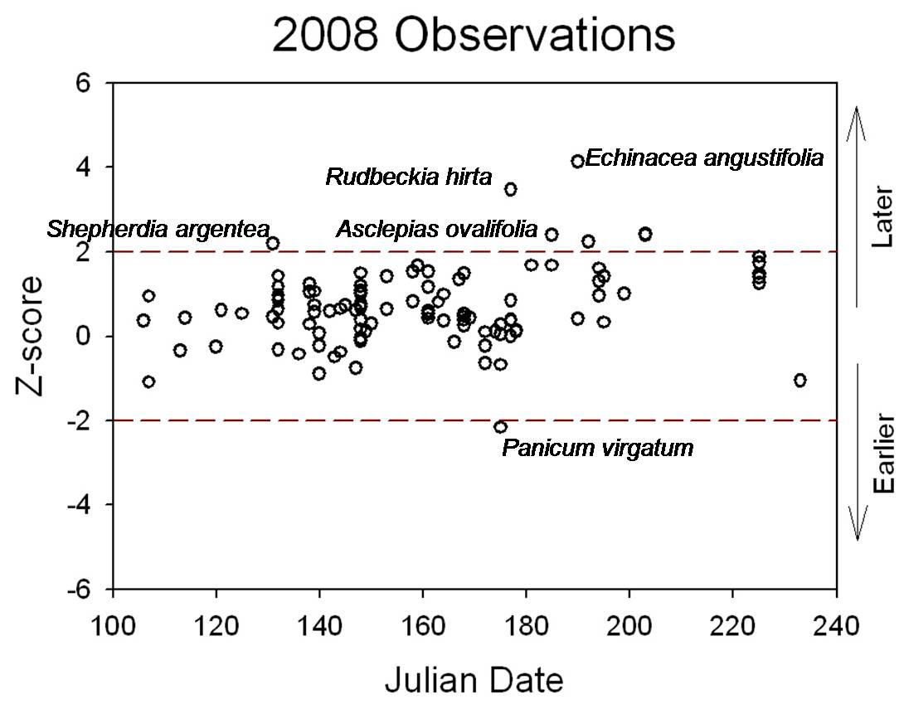
Early flowering of plants in the Northern Great Plains linked to increasing spring temperatures over 100 years
Kelsey L. Dunnell & Steven E. Travers, Department of Biological Sciences, North Dakota State University
Introduction
Air temperatures in the Great Plains have increased as the global climate has changed over the past thirty years. We compared the first flowering times of over 100 species of plants in the Northern Red River Valley region of North Dakota and Minnesota in spring 2007, 2008, and 2009 to first flowering times of the same species in 1910 to 1961 based on archived data. Our goal was to better understand potential ecological consequences of climate change.
Objectives
Analyze O.A. Stevens’ data of first flowering times
Compare first flowering times of plants between 2007-2009 & 1910- 1961
Determine if flowering times of different species have changed
Materials & Methods
Dr. O. A. Stevens studied the phenology of plants at NDSU from 1910-1961
Recorded the first flowering date of 753 species in Fargo area & Bluestem Prairie Preserve - 5,821 acre section of tall grass prairie 15 miles east of Fargo, ND.
Are plants flowering earlier or later compared to last century?
We recorded the first flowering dates for many of the same species from 2007 to 2009
Used z-score to determine if flowering times are earlier or later than in 1910-1961 (a shift of more than 2 standard deviations is indicated by -2 < z > 2)
If z is negative then the flowering date is earlier than the mean; if positive then the date is later
Results
Conclusions
Fargo temperatures have increased over the last 100 years
Growing season is getting longer
Some species are flowering much earlier or much later than they did in the 51 years prior to global climate change
Flowering time also depends on the year
In recent years that were warmer than 1910-1961, 15% of plant species flowered earlier than ever
In recent years with temperatures typical of 1910-1961, some species flower later than ever
Changes in flowering patterns of local plants over 100 years are consistent with both short term (plastic) & long term (evolutionary) shifts by plants in response to climate change
Implications
Shifting to earlier or later flowering times may disrupt pollination interactions and therefore reproductive success
Warmer temperatures & longer growing seasons can increase plant exposure to new diseases
Figure 6: The z-scores of observations of first flowering dates taken in 2009. Each circle represents a different plant species.
Earlier= 0/91 0.0%
Later= 3/91 3.3%
Figure 1: Mean annual air temperatures have increased in Fargo, ND over past 100 years. Dark circles indicate years of Stevens observations.
Figure 4: The z-scores of observations of first flowering dates taken in 2007. Each circle represents a different plant species.
Earlier= 6/41 14.63%
Later= 1/41 2.44%
Figure 2: Length of growing season (# days between last frost of spring and first frost of fall) has increased in Fargo, ND over past 100 years.
Figure 5: The z-scores of observations of first flowering dates taken in 2008. Each circle represents a different plant species.
Earlier= 1/105 0.95%
Later= 7/105 6.67%
Figure 3: The number of herbaceous species observed by O.A. Stevens from 1910 to 1961

