Slide 1
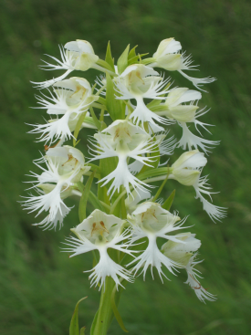
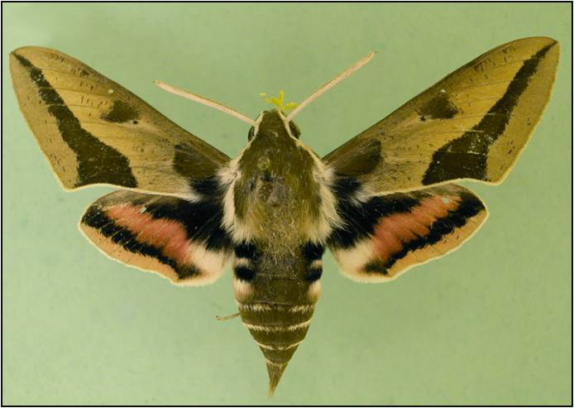
Reproductive Dynamics and Population Genetics of the Western Prairie Fringed Orchid
Andrew Ross & Steven Travers, North Dakota State University; Department of Biological Sciences
The Western Fringed Prairie orchid, Platanthera praeclara is a federally protected, endangered, orchid that occurs in small, isolated populations due to habitat destruction. The restricted number of potential mates places P. praeclara populations at risk of inbreeding depression and inability to adapt to a changing environment due to loss of genetic diversity. The genetic structure and gene flow of P. praeclara populations are not well understood. This project investigates both the genetic structure and gene flow separately using two related approaches.
Main question: What is the regional population genetic structure and the pattern of gene flow of western fringed prairie orchids?
Two experiments are necessary
Sphinx moth: a major
orchid pollinator
P. praeclara in bloom
Objective #1: Determine the genetic diversity of the orchid populations
G
Objective #2: Determine gene flow among the Populations
N
F
H
E
Experiment #1 Methods
Fargo
C
Experiment #2 Methods
Sampling and DNA Extraction
-Leaf tissue collected from each flowering plant in
eight local populations.
-All plants were tagged with a unique number, the
location of every plant was recorded using GPS.
-DNA was extracted from each sample.
B
Sampling andDNA extraction
-Traps will be set over orchids in two large populations
and the pollinia collected from the insects . Mature
seeds will also be sampled.
-DNA will be extracted from the pollinia and seeds.
Fingerprinting and Paternity Anylisis
-The DNA from the pollinia and seeds will be
fingerprinted with the same method as the leaf tissue.
-A paternity analysis will compare the samples to
orchids in the local population providing information on gene flow within and between populations.
A
D
The distribution of eight local P. praeclara populations.
Genetic Fingerprinting
-Each plant will be fingerprinted by scoring genotypes at 10-15 microsatellite loci
-Each sample will be compared to all other samples
in the same and different populations.
-Genetic data will be used to quantify genotypic and allelic diversity as well as levels of inbreeding for all eight populations.
Population | Number of plants | Map letter
Sheyenne Grasslands A annex ditch | 130 | A
Bluestem | 26 | B
Hartke | 7 | C
Sheyenne Grasslands Viking Ditch | 35 | D
Ulen | 55 | E
Syre | 2 | F
Dalby | 5 | G
Bicentennial | 1 | H
Implications
-If genetic structure and gene flow data indicate a greater rate of genetic diversity
among rather than within populations; reproductive isolation of individual
populations may be the cause. Future management of populations may need to
focus on mitigating the loss of genetic diversity.
-If an absence of genetic structure and evidence for among-population gene flow indicate a greater rate of diversity within rather than among populations; the populations are most likely not reproductively isolated and are members of a meta population. Current management practices may be adequate to maintain the orchid populations.
The range of P. praeclara
Pollinator traps

