Slide 2
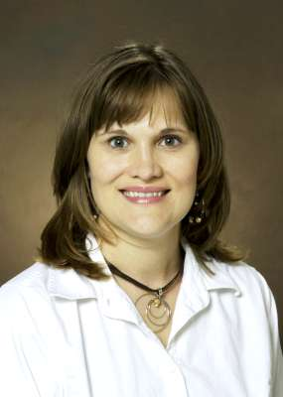
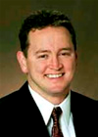
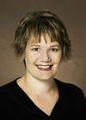
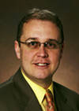
Division of Student Affairs Representatives for Equity, Diversity and Global Outreach
Equity and Diversity
Liaisons
Equity and Diversity
Advisory Council
Angela Seewald-Marquardt
Learning Services & Orientation Coordinator
Angela.Seewald-Marquardt@ndsu.edu
Steve Winfrey
Director, Memorial Union
Steve.Winfrey@ndsu.edu
Rhonda Kitch
Associate Director
Registration and Records
Rhonda.K.Kitch@ndsu.edu
Rian Nostrum
Director
Residence Life
Rian.Nostrum@ndsu.edu

Slide 3
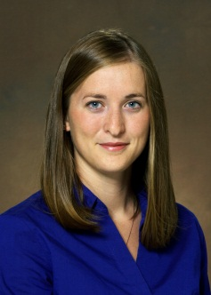


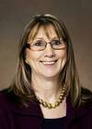
Division of Information Technology Representatives for Equity, Diversity and Global Outreach
Equity and Diversity
Liaisons
Equity and Diversity
Advisory Council
Amber Rasche
Communications Coordinator
Information Technology Services
Amber.Rascher@ndsu.edu
Cathy Hanson
IT Staff Development Coordinator
Cathy.Hanson@ndsu.edu
Theresa Semmens
Chief IT Security Officer
Information Technology Services
Theresa.Semmens@ndsu.edu

Slide 4
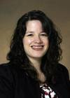
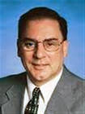
Division of Research, Creative Activities and Technology Transfer Representatives for Equity, Diversity and Global Outreach
Equity and Diversity
Liaisons
Equity and Diversity
Advisory Council
Shelly Sandstrom
Administration Technician
Center for Nanoscale Science & Engineering
Shelly.Sandstrom@ndsu.edu
Phil Boudjouk
Vice President for Research, Creative Activities and Technology Transfer (RCATT)
Philip.Boudjouk@ndsu.edu

Slide 5

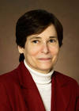
Library Representatives for Equity, Diversity and Global Outreach
Equity and Diversity
Liaisons
Equity and Diversity
Advisory Council
Emily Hoadley
Office Assistant
Emily.Hoadley@ndsu.edu
Michele Reid
Dean
Michele.Reid@ndsu.edu

Slide 6
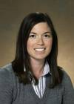
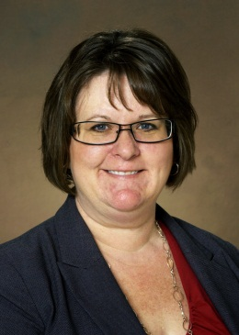
Division of Equity, Diversity and Global Outreach
Equity and Diversity
Liaisons
Equity and Diversity
Advisory Council
Amy Knudson
International Student Advisor/ Alumni Outreach Coordinator
Office of International Programs
Amy.Knudson@ndsu.edu
Kara Gravley-Stack
Director, Diversity Initiatives
Office of Multicultural Programs
Kara.Gravley-Stack@ndsu.edu

Slide 7
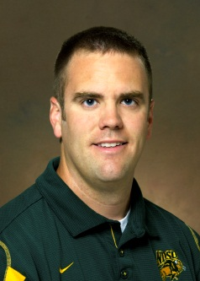

NDSU Athletics Representatives for Equity, Diversity and Global Outreach
Equity and Diversity
Liaisons
Equity and Diversity
Advisory Council
Michael Kjellerson
Assistant Athletic Trainer
NDSU Athletics
Michael.Kjellerson@ndsu.edu
Lynn Dorn
Women’s Athletic Director
NDSU Athletics
Lynn.Dorn@ndsu.edu

Slide 8
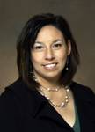
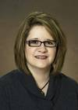

Division of Finance and Administration Representatives for Equity, Diversity and Global Outreach
Equity and Diversity
Liaisons
Equity and Diversity
Advisory Council
Jill Spacek
HR Administrator
Human Resources /Payroll Jill.Spacek@ndsu.edu
Jen Baker
Loss Control and Claims Specialist
University Police and Safety Office
Jennifer.Baker@ndsu.edu

Slide 9

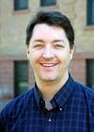
NDSU Extension Service Representatives for Equity, Diversity and Global Outreach
Equity and Diversity
Liaisons
Equity and Diversity
Advisory Council
Lynette Flage
NDSU Extension Service Northeast District Director Lynette.Flage@ndsu.edu
Sean Brotherson
Assistant Professor/Family Science Specialist
NDSU Extension Service
Child Development & Family Science
Sean.Brotherson@ndsu.edu

Slide 10
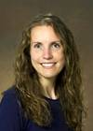
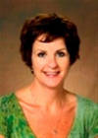
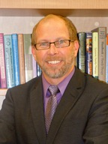
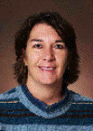
College of Human Development and Education Representatives for Equity, Diversity and Global Outreach
Equity and Diversity
Liaisons
Equity and Diversity
Advisory Council
Michelle Pearson
CFT Program Coordinator
Human Development & Education
Michelle.Pearson@ndsu.edu
Nicole German
Assistant Professor, Health, Nutrition & Exercise Science
Human Development & Education
Nicole.German@ndsu.edu
Tom Stone Carlson
Associate Professor
Human Development and Family Science
Tom.Carlson@ndsu.edu
Kim Overton
Assistant Professor of Practice
School of Education
Kimberly.Overton@ndsu.edu

Slide 11

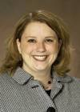
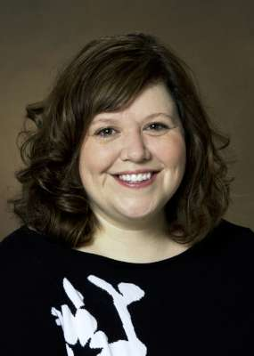
College of Pharmacy, Nursing and Allied Sciences Representatives for Equity, Diversity and Global Outreach
Equity and Diversity
Liaisons
Equity and Diversity
Advisory Council
Daniel Friesner
Associate Dean for Student Affairs & Faculty Development
College of Pharmacy, Nursing & Allied Sciences
Daniel.Friesner@ndsu.edu
Sara Wald
Director of Advancement
College of Pharmacy, Nursing & Allied Sciences
Sara.Wald@ndsu.edu
Dana Davis
Director of Recruitment
Dean’s Office, Pharmacy, Nursing & Allied Sciences
Dana.Davis@ndsu.edu

Slide 12
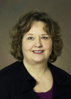

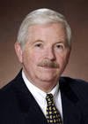
College of Business Representatives for Equity, Diversity and Global Outreach
Equity and Diversity
Liaisons
Equity and Diversity
Advisory Council
Barb Geeslin
Senior Assistant to the Dean’s
College of Business
Barb.Geeslin@ndsu.edu
Wei Zhang
Associate Professor
Accounting & Information Systems
Wei.Zhang@ndsu.edu
Ron Johnson
Dean
College of Business Administration
Ronald.D.Johnson@ndsu.edu

Slide 13
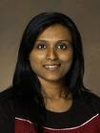
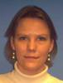
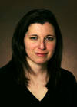
College of Science and Mathematics Representatives for Equity, Diversity and Global Outreach
Equity and Diversity
Liaisons
Equity and Diversity
Advisory Council
Febina Mathew
Advisor/Lecturer
Department of Biological Sciences
Febina.Mathew@ndsu.edu
Stephanie Sculthorp
Administrative Secretary
Computer Science
Stephanie.Sculthorp@ndsu.edu
Wendy Troop-Gordon
Assistant Professor
Psychology
Wendy.Troop@ndsu.edu

Slide 14


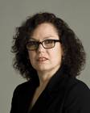
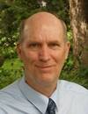
College of Arts, Humanities and Social Sciences Representatives for Equity, Diversity and Global Outreach
Equity and Diversity
Liaisons
Equity and Diversity
Advisory Council
Christopher Whitsel
Assistant Professor of Sociology
Sociology & Anthropology
Christopher.Whitsel@ndsu.edu
Terry Jackson
Administrative Secretary
History, Philosophy & Religious Studies
Terry.Jackson@ndsu.edu
Betsy Birmingham
Associate Professor
English
Elizabeth.Birmingham@ndsu.edu
Kent Sandstrom
Dean
Arts, Humanities and Social Sciences
Kent.Sandstrom@ndsu.edu

Slide 15
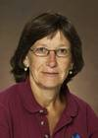
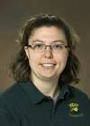
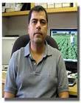
College of Agriculture, Food Systems and Natural Resources Representatives for Equity, Diversity and Global Outreach
Equity and Diversity
Liaisons
Equity and Diversity
Advisory Council
Harlene Hatterman-Valenti
High-Value Crops Specialist
Plant Sciences
H.Hatterman.Valenti@ndsu.edu
Julie Hochhalter
Greenhouse Manager
AES Administrative Facilities
Julie.A.Hochhalter.1@ndsu.edu
Juan Osorno
Assistant Professor
AES Plant Science
Juan.Osorno@ndsu.edu

Slide 16
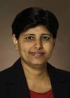
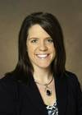
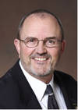
College of Engineering and Architecture Representatives for Equity, Diversity and Global Outreach
Equity and Diversity
Liaisons
Equity and Diversity
Advisory Council
Sumathy Krishnan
Professor
Mechanical Engineering
Sumathy.Krishnan@ndsu.edu
Nancy Rossland
Assistant to the Dean, College Relations
Dean’s Office, Engineering & Architecture
Nancy.Rossland@ndsu.edu
Gary Smith
Dean
Engineering & Architecture
Gary.Smith@ndsu.edu

