Slide 1
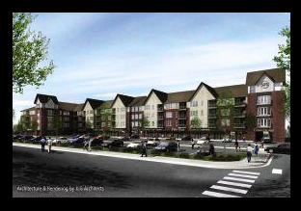
Community Counseling Services
North Dakota State University, Fargo
College of Human Development and Education

Slide 2
COUNSELING SERVICES
Counseling can be an excellent method to explore
Relationship challenges,
Self-awareness / self-care,
Stress,
Anxiety,
Depression,
Grief,
and other personal/social/emotional issues.

Slide 3
What is counseling?
Counseling offers a trusting, confidential relationship from which anyone can benefit. Life offers everyone challenges and counseling helps individuals meet those challenges in healthy ways.

Slide 4
OVERVIEW OF SERVICES
NDSU Community Counseling Services (CCS) provides counseling services by advanced graduate students. Student counselors are supervised by NDSU faculty and doctoral students.
All students and faculty are expected
to adhere to the American Counseling
Association’s Code of Ethics.

Slide 5

OVERVIEW OF SERVICES
NDSU CCS provides services to people of ages 4 years and beyond. Counseling services are available to:
Individuals
Couples
Families
Groups

Slide 6
NDSU CCS
Fees
The fees for services are based on a small sliding scale. However, no client will be refused services based on inability to pay.
Hours
NDSU CCS operates Monday through Thursday. Hours are flexible to accommodate client needs, including evening hours. NDSU CCS follows the NDSU academic calendar.

Slide 7
Community Counseling Services
1919 N. University Drive
Fargo, ND 58108
To make an appointment, call
701.231.9750

