Slide 1
University Involvement Portfolio (UIP)
Student Activities Office
Fall, 2012

Slide 2
What is the UIP?
It is a self-reported record of leadership roles, honors, campus and community involvement and learning outside the classroom.
Because Student Government supports the Org Sync product for student organization management, NDSU is able to access the ePortfolio program, which we have adapted into our University Involvement Portfolio.
This is currently a free program that is available to all NDSU students, staff and faculty.

Slide 3
Why
Easy way to explain how campus involvement contributed in developing top qualities* employers look for, including the:
Ability to influence others, analyze problems, and make decisions
Possession of a strong work ethic, motivation and personal adaptability
Demonstration of leadership, interpersonal competence, integrity, teamwork skills, good communication and organization skills
*Qualities as reported from the NDSU Career Center, 2012

Slide 4
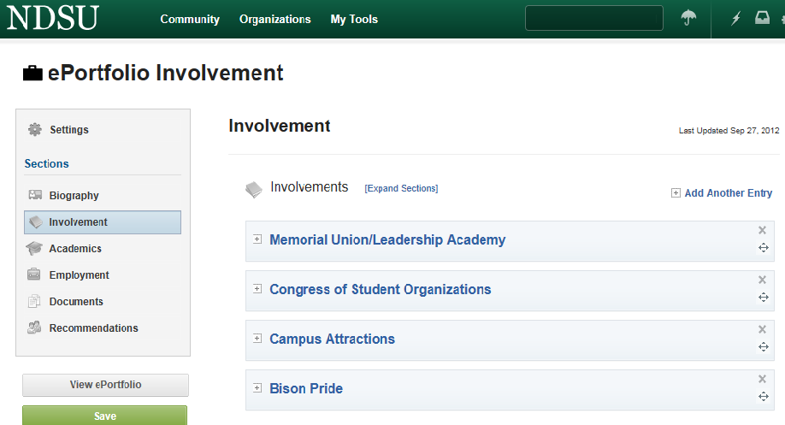
Contents
Biography
Involvement
Academics
Employment
Documents
Recommendations
Notes:
What is the UIP?
Self-made record of leadership roles, honors, campus & community involvement and learning outside the classroom

Slide 5
The next slides will show you how easy it is to create your own University Involvement Portfolio.
How to start…

Slide 6
Sign Into your Org Sync Portal

Slide 7
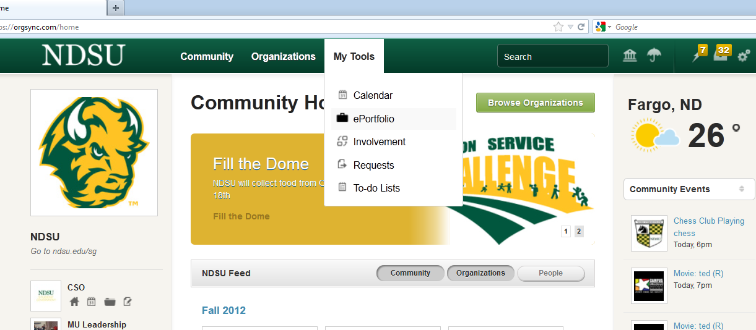
Hover over the “My Tools” at the top and click on “ePortfolio”

Slide 8
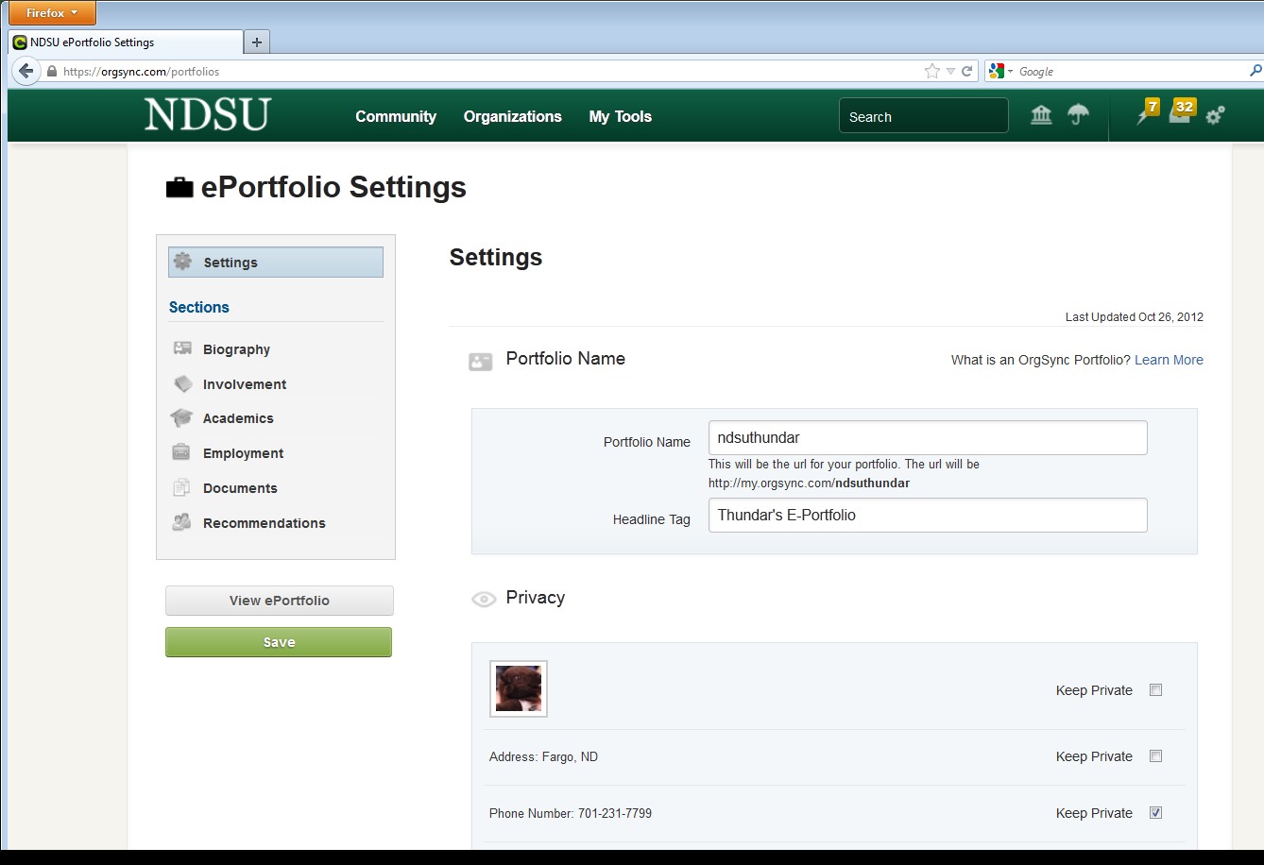
You will see your current University Involvement Portfolio! Here is where you need to create your portfolio’s name (1) and Headline Tag (2)
1
2

Slide 9
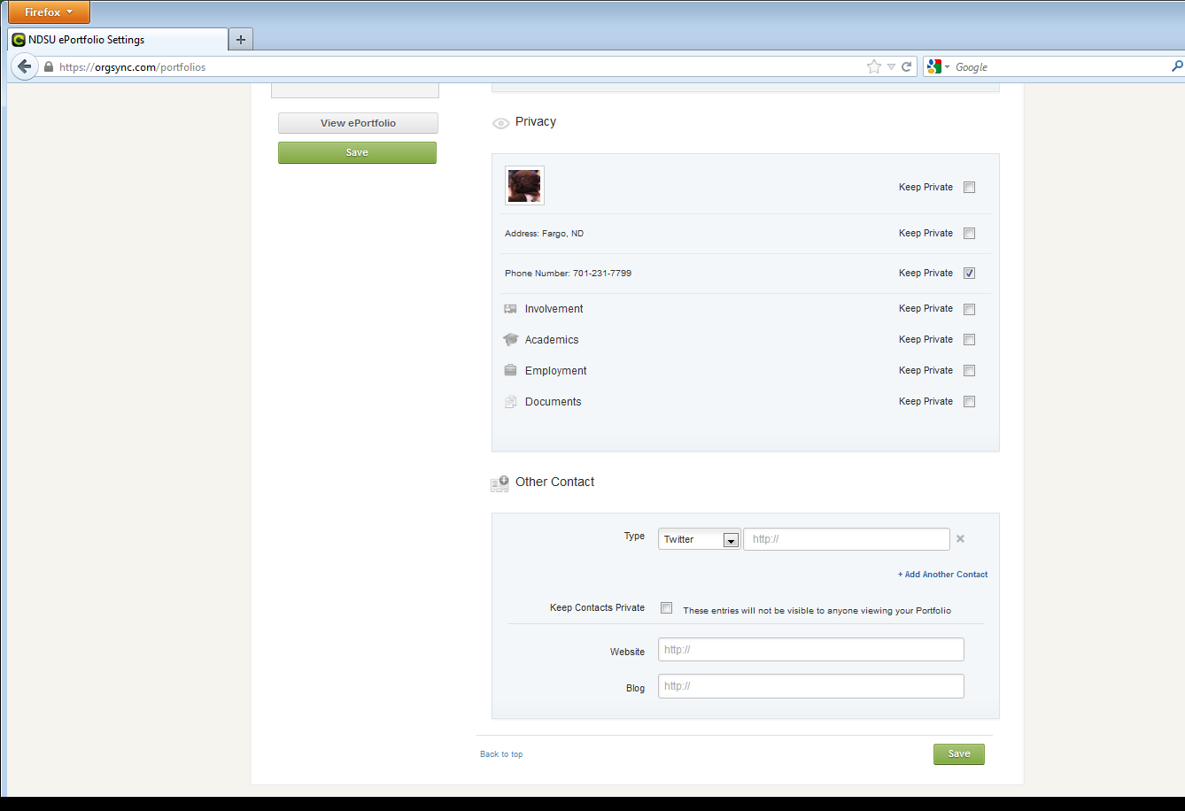
When scrolling through the first page of your UIP, you can make items private or public.
You can add other contact accounts to your UIP here.
Be sure to Save your additions!

Slide 10
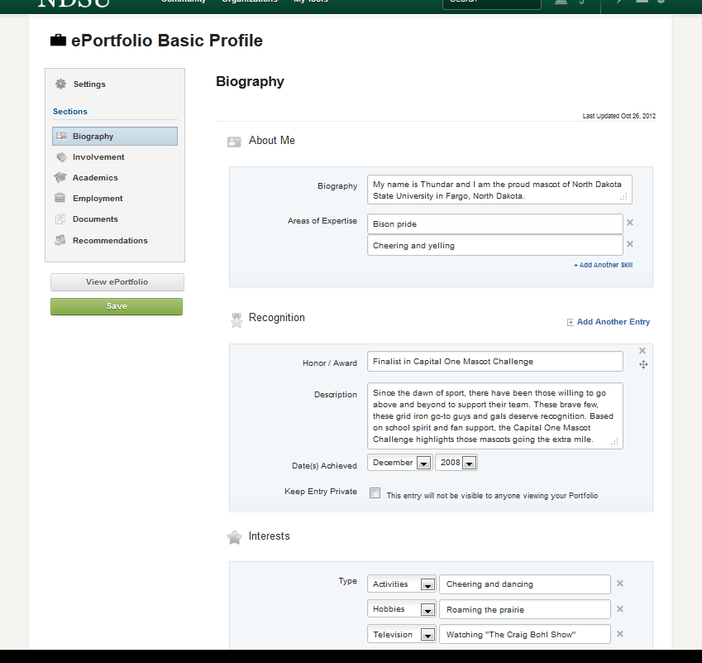
The Biography Section
Include a general overview of your skills, recognition and interests

Slide 11
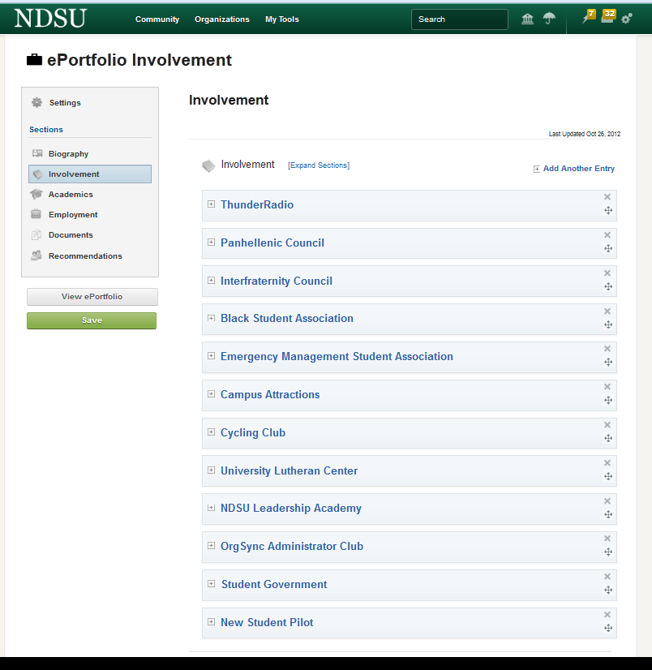
The Involvement Section
The organizations that you are involved in on Org Sync will be listed in the Involvement Section.
You can choose which of these you want to keep public, as well as those you may want to remove

Slide 12
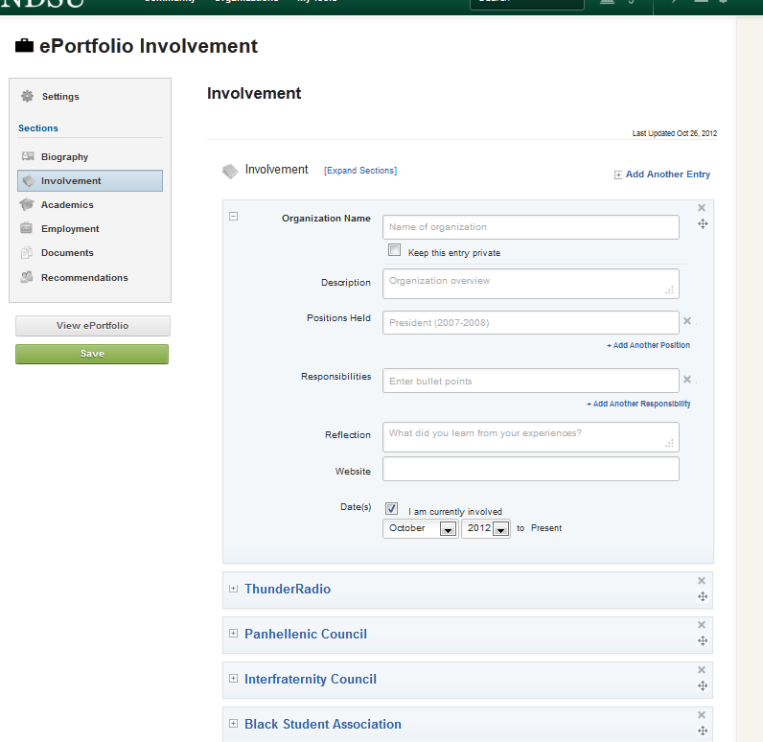
Adding another involvement entry
You can add entries to your involvement by clicking here.

Slide 13
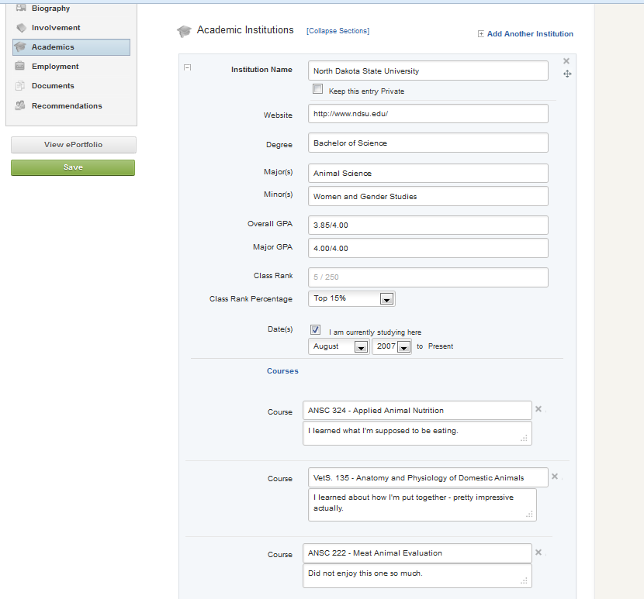
The Academics Section
This section allows you to enter information about your university courses.

Slide 14
The Employment Section
This section is nice because you can copy information from your resume, as well as add additional material that will assist you in preparing for applications and interviews!

Slide 15
The Documents Section
Add your resume and any other interesting documents.
Document Ideas:
Essays
Class Projects
Presentations
Course work
Etc.

Slide 16
The Recommendation Section
This section allows you to ask for and display electronic recommendations.

Slide 17
The final product!
After you save your UIP, you can click the View ePortfolio to see what the public will see when you send them the link.

Slide 18
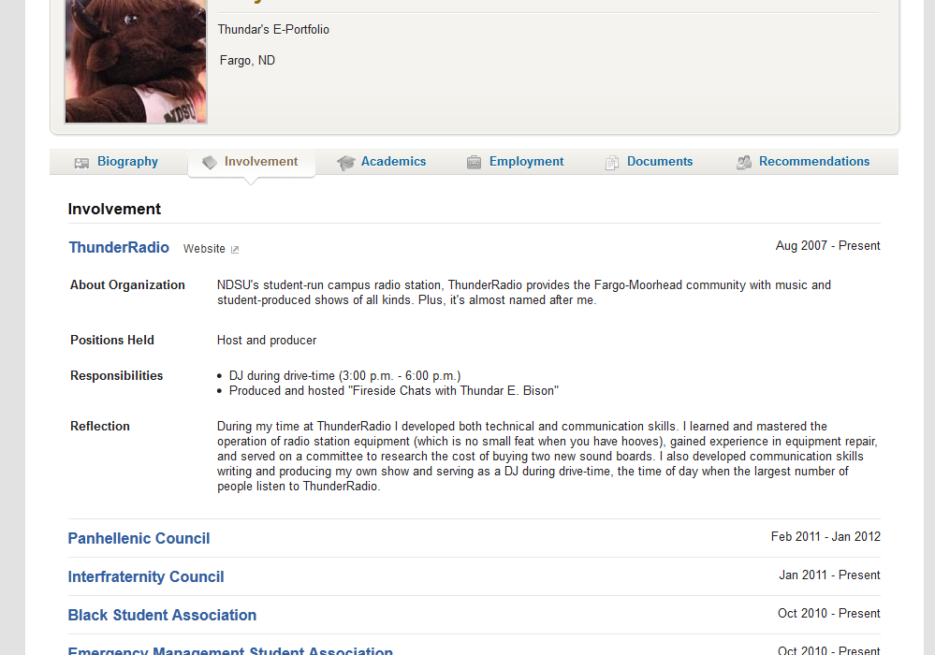
What your UIP will look like online:
This is an example of what the Involvement Section would look like.
Each of the tabs can be clicked to view the different section of your UIP.

Slide 19
Where/How to use your UIP
Writing of application materials
Revising your resume
Preparing for interviews
Reflection Tool
Additional Documents on an application
Other…

Slide 20
Testimonials
“The UIP will help keep track of organizations and service project I’ve been involved with on campus. It will be a good resource for building resumes and writing cover letters.”
-Tyson Morlock (Senior, Electrical Engineering)
“The UIP gives you a chance to reflect on what you learned as a student leader. When a job interviewer asks you what you learned as a member of a student organization, you will know exactly how to explain your skills.”
–Drew Espeseth (BS 2010, Communication)

