Slide 1
-NDSU Tuition Cap Exception- A Campus Community Request From the Students, Faculty and Staff
Dr. Dean L. Bresciani, President
North Dakota State University
SBHE; May 9, 2011

Slide 2
A Campus Community Request
For 11 years in a row, NDSU has experienced record admissions demand from students
by SBHE policy, NDSU has limited control over admissions
Over the same timeframe, NDSU research productivity has more than tripled
NDSU over the past decade:
is the second leading economic engine in ND
is the largest and most productive System campus
creates more new technologies, long-term businesses, and jobs, than any other aspect of ND
history making national & international recognition for ND

Slide 3
A Campus Community Request
However, over the same timeframe--based on the historic/current System funding mechanism of peer equity:
NDSU has received a steadily diminishing level of support
From 55% to 39% of peers
Now the lowest of all 11 System campuses
Even with this request, will remain the lowest of all 11 System campuses

Slide 4
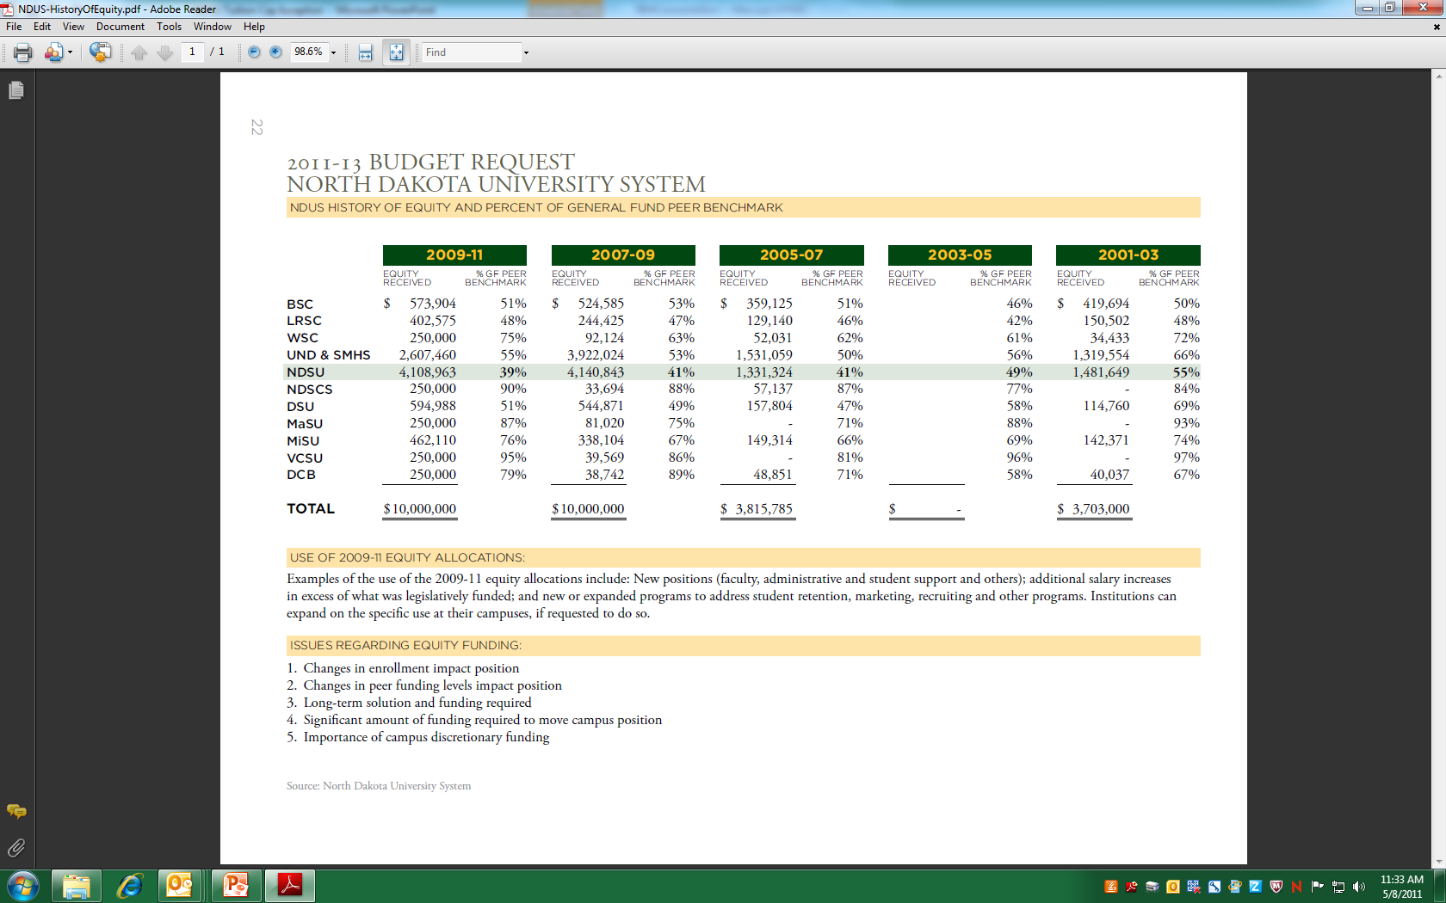
A Campus Community Request

Slide 5
A Campus Community Request
The peer equity model, or its calculus, has increasingly become recognized as flawed
A simple “per-student” model of ND general fund allocation might be another way of looking at NDSU’s current situation
we all want taxpayer higher ed support to be well invested

Slide 6
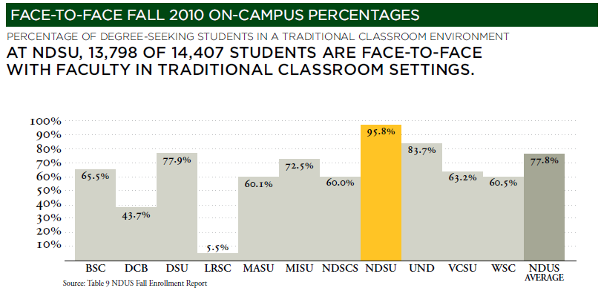
A Campus Community Request

Slide 7
Allocation Per FTE Campus General Fund Budget FTE Students Student
VCSU | $16,368,001 | 1,790 | $9,144
MaSU | $11,629,616 | 1,366 | $8,514
NDSCS | $31,607,155 | 4,293 | $7,362
WSC | $7,696,999 | 1,143 | $6,734
MiSU | $34,623,707 | 5,834 | $5,935
UND | $125,036,783 | 21,647 | $5,776
UND SOMS | $41,115,401 | 1,677 | $24,517
DCB | $5,862,372 | 1,030 | $5,692
DSU | $21,223,737 | 4,255 | $4,988
LRSC | $7,956,210 | 1,789 | $4,447
NDSU | $108,367,622 | 25,285 | $4,286
BSC | $24,204,005 | 6,368 | $3,801
Based on 2009-11 Adjusted State General Fund Operating Base Appropriation; prepared by Legislative Council staff May 2011

Slide 8
A Campus Community Request
It may be helpful to know:
Request is consistent with NDSU’s annual tuition increase average for the past decade
8.8 vs. 8.15
a .65% change?
Year | Annual FT Tuition Rate | % Increase
2002 | $2,754 | 5.80%
2003 | $2,904 | 5.50%
2004 | $3,374 | 16.20%
2005 | $3,981 | 18.00%
2006 | $4,359 | 9.50%
2007 | $4,773 | 9.50%
2008 | $5,013 | 5.00%
2009 | $5,264 | 5.00%
2010 | $5,448 | 3.50%
2011 | $5,639 | 3.50%
10 year avg |  | 8.15%
2012 | $6,135 | 8.80%

Slide 9
A Campus Community Request
Expense reduction a constant priority for the past two years
Illustrative measures to control costs/balance budget:
10% for academic departments, in spite record enrollment growth
19% for all/other administrative areas, in spite of record enrollment growth
Not filling senior leadership, many full time, and even part time positions
Increasing number of unfilled department chair positions; lack of funds
President must personally approve filling any position on the NDSU campus
Cancelling leased classrooms even though space in critically short supply
Auxiliary reserves have been tapped to extent possible
Faculty/Staff professional development grant discontinued
Reduced to almost non-existent marketing efforts
Reduced already low student scholarships by $1,000,000

Slide 10
A Campus Community Request
NDSU has never before been more successful, more productive or contributed more to North Dakota:
But can no longer maintain what it is doing
SIMPLY PUT, NOTHING LEFT TO CUT

Slide 11
A Campus Community Request
Illustratively, that means of the general fund appropriated departments at NDSU:
An “Average” department:
Salaries-Faculty $1,200,000.00 81.91%
Salaries-Staff $125,000.00 8.53%
Salaries-other/grad $100,000.00 6.83%
Operating $40,000.00 2.73%
TOTAL: $1,465,000.00 annually for a SINGLE “average” department

Slide 12
A Campus Community Request: Summary
STUDENTS, with strong faculty and staff agreement, are:
NOT asking for an additional state or legislative allocation
NOT asking for changed or additional SBHE allocation
ONLY asking to increase their own tuition, to protect the educational experience they appreciate as one of the best and most affordable in the country
from the annual average of 8.15% to 8.8%...so that NDSU can simply “break even”

