Slide 1

Community of Respect
PROVIDING CULTURAL AWARENESS
AND UNDERSTANDING TO THE NDSU COMMUNITY
Notes:
Casey

Slide 2
Please complete the Pre-Assessment and “I Am From” forms
Notes:
Casey
And the “I am From” handout

Slide 3

Module 1
What is culture?
Understanding ourselves and others
Notes:
Casey

Slide 4
What is Culture?
Learning Outcomes
Identify own culture
How cultures differ
How culture influences behavior
Notes:
Casey

Slide 5
What is Culture?
Defining culture
What are cultural values?
What about stereotypes?
What are generalizations?
Do personal behavior or personality count?
Notes:
Casey
Workbook – page 5
Culture is the relatively stable set of inner values and beliefs generally held by groups of people in countries or regions and the noticeable impact those values and beliefs have on one’s outward behaviors and environment. It is not something you are born with but something you are born into and learn through imitation or teaching; the story we tell others about ourselves; what people need to know to function well in any society
Cultural values are principles or qualities that a group of people will tend to see as good, right or worthwhile.
Stereotypes are usually a negative statement made about a group of people; they emerge when we apply one behavior to a whole group; an over-simplification of a group. (refer to exercise in workbook – page 6)
Generalizations – looking at a large number of people and drawing certain conclusions from what we see; often an oversimplified view; becomes damaging when it is too broad, out of date, or the information we use to form the generalization contains biases. Some generalizations are based on scientific researcher and can, therefore, be reliable (but not foolproof) statements about cultural tendencies.
Culture is not:
Universal behavior – what all people do (eat, sleep, use language, etc.)
Personal behavior – no two people from the same culture will behave in identical ways
Personality – a peculiar set of characteristics that a person is born with that set him/her apart from all others

Slide 6
What is my Culture?
Learning Activity:
Draw a picture of what culture is –
My Culture is like . . . , or
Culture is like . . .
Work in small groups, sharing what your drawing means to you.
Notes:
Casey

Slide 7

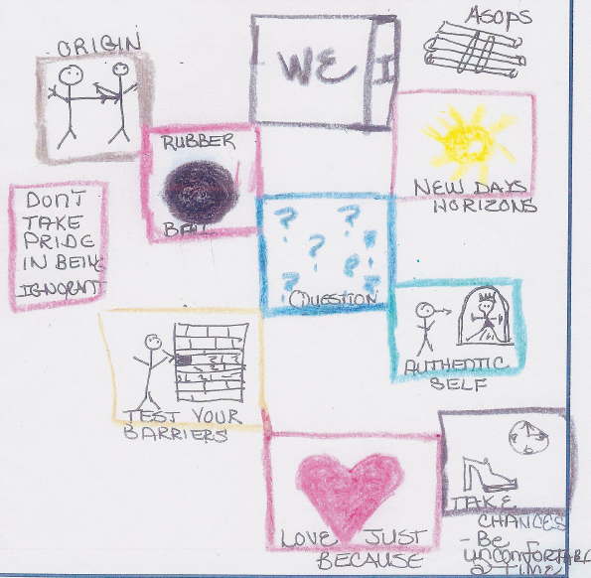
My culture looks like . . .
Notes:
Casey
Handouts at table
Activity: (10 minutes)
Draw a picture of what your culture looks like
At tables, discuss each individuals drawings, look for commonalities and differences.
Discuss in large group

Slide 8
What is Culture?
Debriefing of Module I
Notes:
Casey
Review the terms:
Culture
Cultural Values
Stereotypes
Generalizations

Slide 9
Module II
Our Community Mosaic
Notes:
Gennifer

Slide 10
My Community Mosaic
Learning Outcomes
Verbal elements of culture
Non-verbal elements of culture
Cross cultural components impacting communication processes
Culturally based values and attitudes that influence behavior
Notes:
Gennifer

Slide 11
My Community Mosaic
Cultural Dialogue Exercise – Part I
Answer Two Questions
What is the point of the conversation?
Do both speakers have the same understanding?
Notes:
Gennifer
Copies of 2 dialogues will be at each table.

Slide 12

Explicit Culture
Behaviors
Attitudes
Values
Explicit Culture – What we perceive
with our senses.
Notes:
Gennifer
Copies will be at each table
Culture is like an iceberg.
What we can see from above – the Explicit Culture: behaviors; attitudes; values – is the smallest part of culture.

Slide 13

Implicit Culture
Below the Waterline-
Concepts and ideas that differ from culture to culture.
Communication Preferences
Styles of Interaction/
Relationships
World Views
Notes:
Gennifer
Copies will be at each table
The Implicit culture: communication preferences; styles of interaction and relationships; and world views - is below the surface, harder to learn about cultures that are not your own. However, these are the underlying parts that can provide the framework for the Explicit Culture.

Slide 14
Cultural Values Exercise
Cultural Values
To understand behaviors, seek to understand the values and beliefs that drive them
Values Scale Exercise
There are no “right” answers
Trust your instincts
Notes:
Alicia

Slide 15
Cultural Values Exercise
Read the description for each cultural scale.
Place a vertical line on the continuum to indicate your cultural preferences.
Try not to analyze too deeply.
What is your first response – your “gut” reaction?
There are no wrong answers!
Notes:
Alicia
Handout with the definitions will be on each table
Don’t try to analyze too deeply – go with your gut instinct. There are no wrong answers.

Slide 16
Personal Cultural Scales
Concept of Self
Individualist Collectivist
Power Distance
Low High
Concept of Time
Monochronic Polychronic
Notes:
Alicia
Copies of 6 cultural Values will be on each table.
Concept of Self – do you see yourself primarily as an individual or as a member of a group?
Power Distance – not just physical distance; how likely are you to place a high or low value on authority?
Concept of time – monochronic = based on a standard clock, want to be on time; polychronic = time is viewed more flexibly than just a clock

Slide 17
Personal Cultural Scales
Degree of Directness
Direct Indirect
Attitude Toward Work
Achievement Quality of Life
Importance of Face
Less Important More Important
Notes:
Alicia
Directness – direct = focus attention on what is actually being said; indirect = context and non-verbals are more important than just what is said
Attitude toward work - achievement oriented= “live to work” ; quality of life oriented = “work to live”
Importance of Face – “saving face”

Slide 18
Debrief Cultural Values
What is the basis for how we interpret the behaviors of others?
Why is understanding your own cultural values important?
Was it easy to identify your own cultural values?
Why do you think you fall differently on the continuum than the general population?
Notes:
Alicia

Slide 19
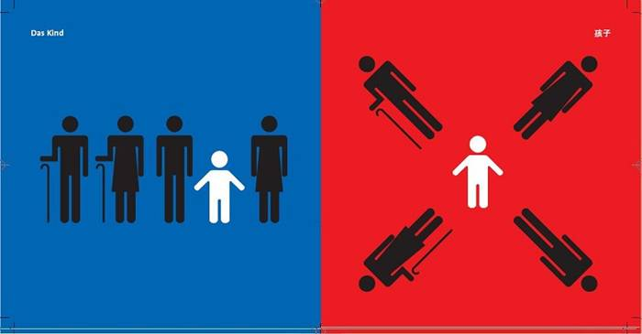
Graphics below was created by Berlin-based Chinese artist Yang Liu The Family
Notes:
Alicia

Slide 20
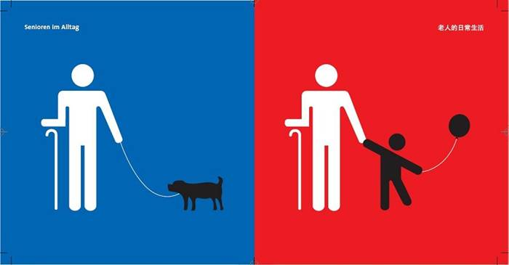
Life of the Elderly by Yang Liu
Notes:
Alicia

Slide 21
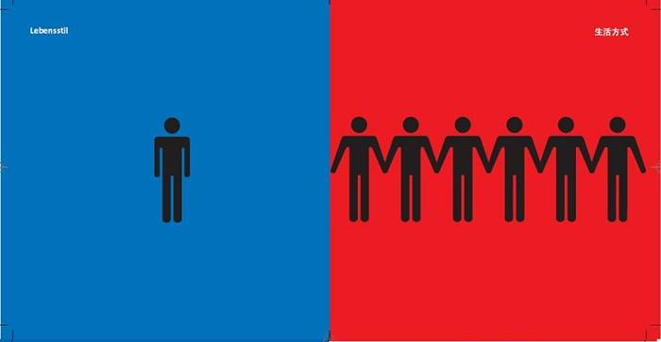
Way of Life by Yang Liu
Notes:
Alicia

Slide 22
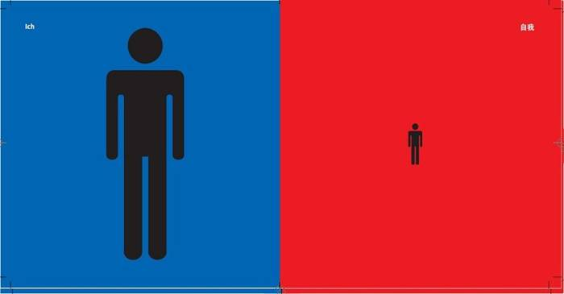
A View of Myself by Yang Liu
Notes:
Alicia

Slide 23
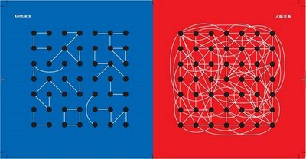
Contacts by Yang Liu
Notes:
Alicia

Slide 24
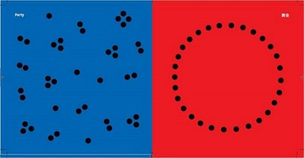
Parties by Yang Liu
Notes:
Alicia

Slide 25
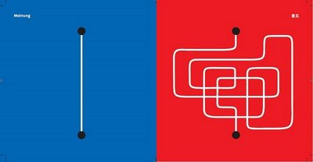
Opinions by Yang Liu
Notes:
Alicia

Slide 26

Handling Problems by Yang Liu
Notes:
Alicia

Slide 27
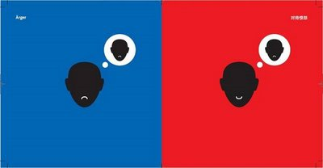
Anger/Displeasure by Yang Liu
Notes:
Alicia

Slide 28
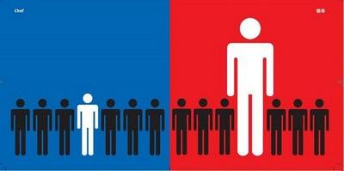
The Boss by Yang Liu
Notes:
Alicia

Slide 29
Cultural Diagrams
Friendships and Relationships
Communication Preferences
Achievement Over Time
Personal vs. Societal Responsibility
Reasoning Patterns
Notes:
Angela

Slide 30

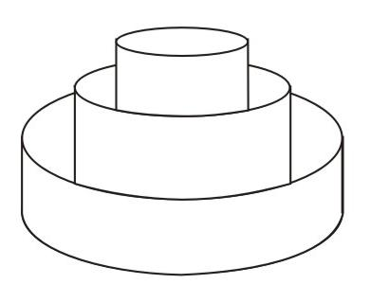
Styles of Interaction/ Relationships: Friendship Patterns
U.S. / Western Friendships
Notes:
Angela
In the first set of diagrams. Who are these people in the outer circle – talk about acquaintances – what is the greeting. What is the level of confidence you might give to this level of friendship?
How do people in the U.S. and other Western societies label people that lie in the outer circle?
Which circle would most likely be engaged in a conversation about politics or religion?
Which group would be valued most in terms of trust?
Look at the “wedding cake” diagram. How difficult is it to make friendships in U.S. Western societies?

Slide 31

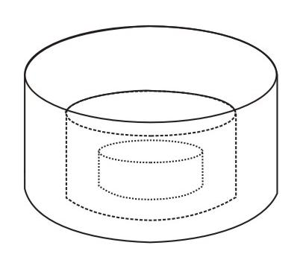
Styles of Interaction/ Relationships: Friendship Patterns
Non - Western Friendships
Notes:
Angela
How do the people in the outer ring in Non-Western Friendships compare to those in the outer ring or U.S. or Western societies?
Why would there be so many more people in the inner circle of these cultures than in the U.S. Western societies?
Look at the inverted Wedding cake diagram. How difficult to you think it is to get inside the first level of friendship.

Slide 32
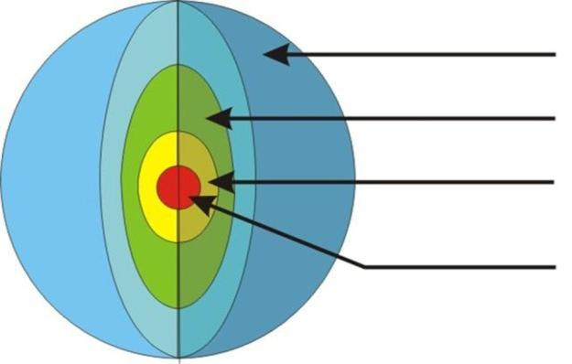
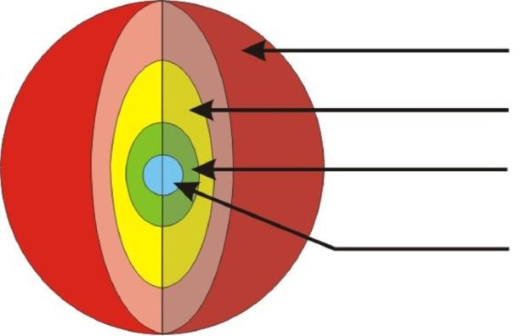
Styles of Interaction: Communication Preferences
Explicit verbal communication
Low
Context
Opinions
Values
Feelings not
as important
Context and feelings matter
Values
Opinions
High
Context
Words convey a minimal part of the message
Notes:
Angela

Slide 33
Cultural Priorities:
Achievement over Time
Cultural Priorities: Achievement over time:
Focus
on
Function/ Relationships
Results
Time Passing
Results
Focus
on
Results/Tasks
Time Passing
Notes:
Angela

Slide 34
Cultural Perspectives: Personal vs. Societal Responsibility
Universalists/Generalists:
Rule Dominated
Particularistic:
Relationship Dominated
Notes:
Angela

Slide 35
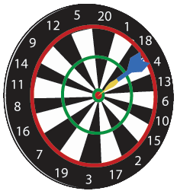
Styles of Interaction: Reasoning Patterns
Start with the Conclusion
End with the Conclusion
BELIEF
IDEA
FACT
PERSPECTIVE
FEELINGS
IDEA
CONCLUSION
FACT
INTERPRETATION
FACT
Notes:
Angela

Slide 36

Styles of Interaction: Reasoning Patterns, cont.
Arrive at the Conclusion All at Once
Notes:
Angela

Slide 37
Cultural and Space
Proximity
Intimate Distance
Personal Distance
Social Distance
Public Distance
Notes:
Angela

Slide 38
Gestures Are Not Universal!
What do these gestures really mean?
Notes:
Angela
Copies of quiz will be at table
Answers for all questions are C & D
Discuss how some gesture may mean something or nothing – or could have multiple meanings.

Slide 39
Cultural Perspectives: Voices
Notes:
Kara
Handout – Voices Exercise will be on each table
Choose a few that meet the needs of your audience. Ask for volunteers to read them. Ask participants what they heard about each exercise:
What specific behaviors did you recognize in the monologues?
What were the expectations of the different parties involved?
What values did you pick up on in the monologues?
How did culture play a role in the perspectives of each of the speakers?

Slide 40
Dialogues Exercise
Part II
Analyze the dialogue again
Do both speakers have the same understanding?
Look for the values that may be influencing behavior
Use the terminology
Beware stereotypes
Notes:
Kara

Slide 41
Communications Styles Debrief
Values and resulting behaviors are embedded in human interactions
Remember that the largest part of the iceberg is below the surface
Misunderstandings can be avoided
Notes:
Kara

Slide 42
Cultural Perspectives: Voices
Voices Exercise Debrief
What behaviors and values are in evidence?
How do participant expectations differ?
Notes:
Kara
Okay, what is happening here?
What specific behaviors did you recognize in the monologues?
What were the expectation of the different parties involved?
What vaulted id you pick up in the monologues?
How id culture play a role in the perspectives of each of the speakers?

Slide 43
Module II Debrief
Verbal elements of culture
Non-verbal elements of culture
Cross cultural components impacting communication processes
Culturally based values and attitudes that influence behavior
Notes:
Kara

Slide 44
Module III Cultural Crisscross
Learning Outcome
Apply knowledge and skills learned in Modules I and II to situations encountered in professional or personal lives
Notes:
Kara
The purpose of this section is to apply the knowledge and skills you have learned in Mod. 1 and 2 to real life situations.
Review: Modules I -
Identify your own culture
Articulate how cultures differ
Learn that culture influences behavior
Module II Learned at least 3 verbal elements of Culture
Learned at least 3 non verbal elements of culture
Identified cross cultural components impacting the communication process
Identified cultural based values and attitudes that influence behavior

Slide 45
Close Encounters of a
Cultural Kind Exercise
Case Studies
What is/are the underlying cultural issues?
What possible interventions could be used to help resolve the situation?
What could be done differently to prevent the situation given the cross cultural issues at play?
Notes:
Kara

Slide 46
NDSU Community of Respect
At NDSU – we are working to create a Community of Respect, where all differences and diversities are welcomed and included.
If you are interested in becoming a trainer, contact: Kara.Gravley-Stack@ndsu.edu
For more information about Community of Respect, go to: www.ndsu.edu/diversity.
Notes:
Kara

Slide 47
NDSU Community of Respect
Next Community of Respect training session:
Monday, December 19, 9am to 2pm
If you wish to become a trainer, we are hosting a trainer’s workshop:
Monday, December 19, 2pm to 4pm
Contact Kara for more details.
Notes:
Kara

Slide 48
NDSU Community of Respect
Post Assessment
Questions?
Notes:
Kara

