Slide 1
Helping Returning Veterans Transition to College
Adapted for North Dakota State University by
the Veteran’s Reintegration Committee
Chair, Dr. Bill Burns william.burns@ndsu.edu
Acknowledgements:
Jennifer Lambert, Ph.D., PTSD Clinic, Providence VAMC
John T. Powers, B.S. Student Veterans of America

Slide 2
NDSU Student Veterans
Veteran Students at NDSU
Fall 2010:455 Students
Fall 2009: 334 Students
Fall 2008: 363 Students
These numbers reflect students receiving VA educational benefits, the number may not be inclusive of all veterans on campus
NDSU will continue to see an increase in veterans on campus.

Slide 3
Student Veterans… Not your Average College Student
Non traditional
May have more responsibilities (spouse, kids, military duties)
Different life experiences (military training, deployments, etc.)
May be struggling with after effects of deployments (emotional, physical, social, and occupational)

Slide 4
When a service member
comes home, he/she may
find it hard....

Slide 5
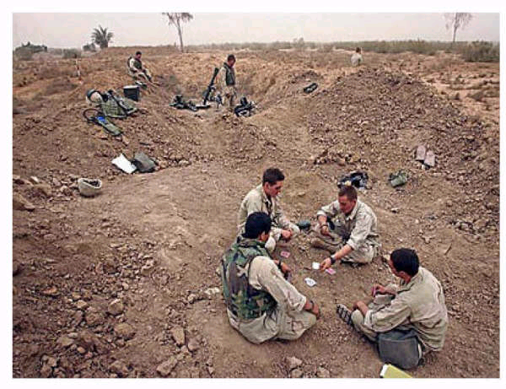
... to listen to his son whine about being bored.⁵

Slide 6
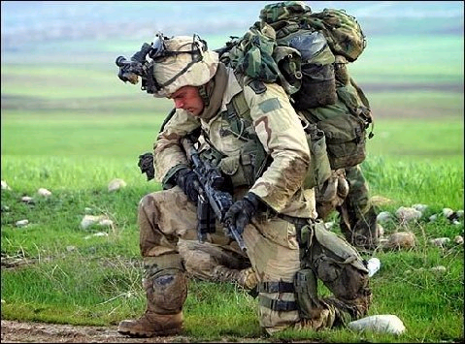
... to keep from ridiculing someone who complains about hot weather. ⁵

Slide 7
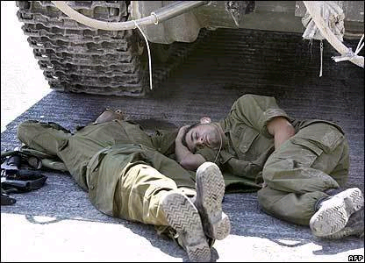
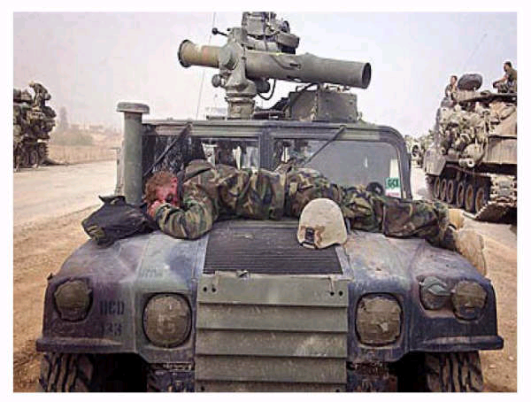
... to be understanding when a co-worker or class mate complains about a bad night's sleep. ⁵

Slide 8
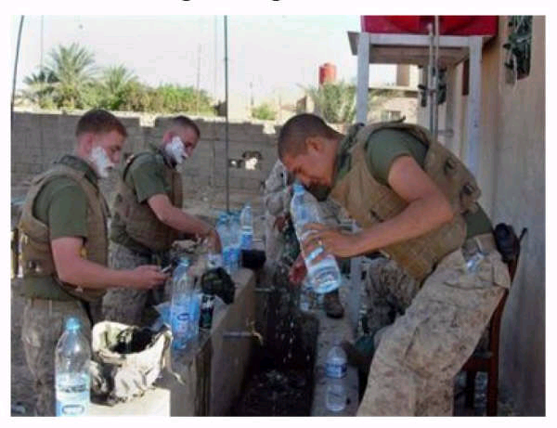
... to be tolerant of people who complain about the hassle of getting ready for work. ⁵

Slide 9
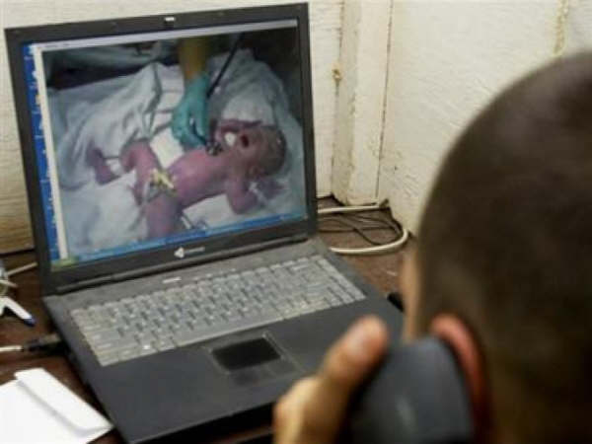
... to be sympathetic when someone says how hard it is to have a new baby in the house. ⁵

Slide 10
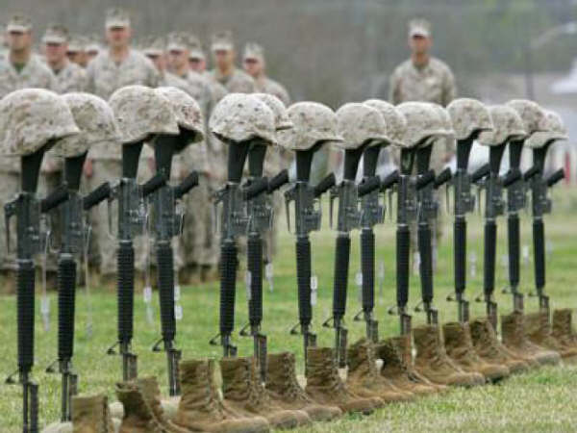
… to control her emotions when she hears someone say that the war is about oil. ⁵

Slide 11
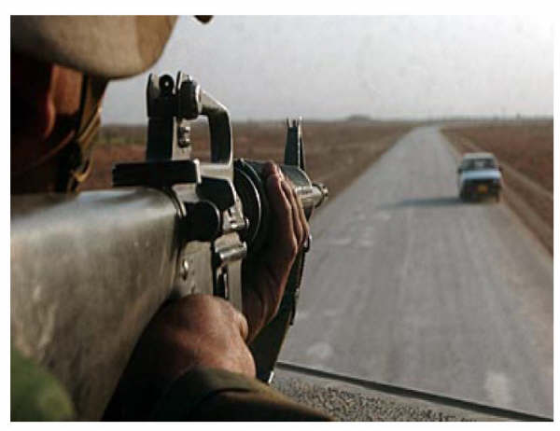
... to control his panic when his wife tells him he needs to drive slower. ⁵

Slide 12
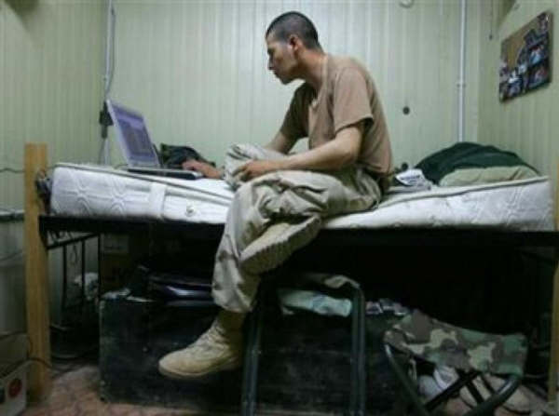
... to be happy for a friend's new hot tub. ⁵

Slide 13
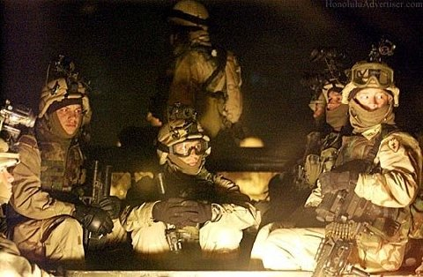
…to sleep through the night.⁵

Slide 14
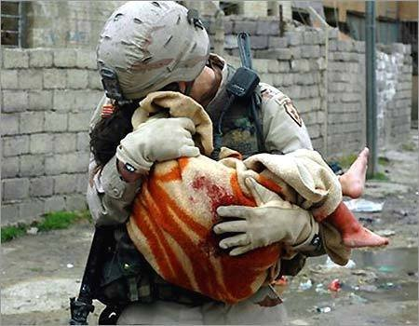
… to forget the things he has seen and done. ⁵

Slide 15
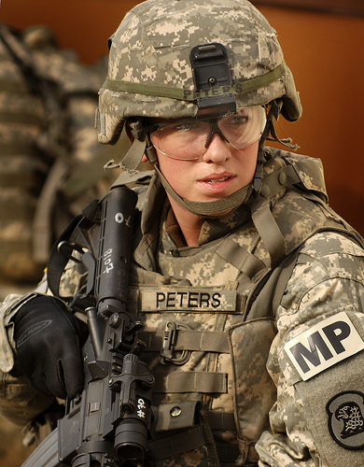
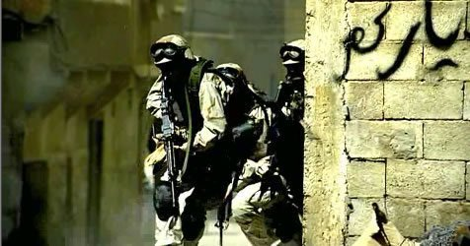
… to feel comfortable with a stranger behind her. ⁵

Slide 16

... to be civil to people who complain about their schoolwork. ⁵

Slide 17
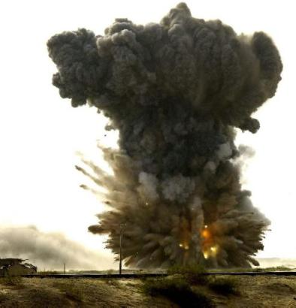
… not to startle to loud noises.⁵

Slide 18
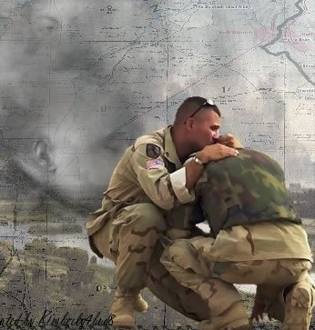
… to make new friends.⁵

Slide 19
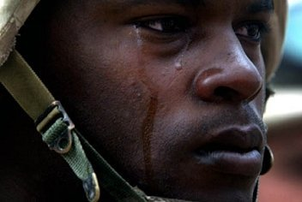
… to remember what it was like to be carefree.⁵

Slide 20
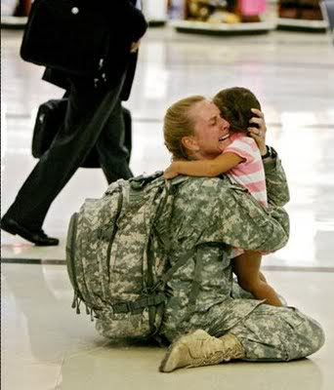
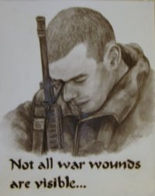
Coming Home: After Effects of a Deployment

Slide 21
Physical Injuries/Conditions
Orthopedic injuries: chronic pain due to joint and muscular-skeletal injuries in back, knees, shoulders, wrists
Hearing problems: hearing loss, ringing in ears
Respiratory illnesses: sand, dust
Skin conditions: rashes, bacterial infections
Major trauma injuries: gunshot wounds, shrapnel etc.

Slide 22
Combat Stress Injuries ⁷⁻⁸
Post-traumatic Stress Disorder (PTSD)
13 to 25%, compared to 3.5 - 7% in general population
NOTE: 75-87% do not have PTSD!
Depression: 5 -13%
Anxiety Disorders: 6%
Mild Traumatic Brain Injury: 15%
Substance Use/Misuse: 5 to 15%
Psychosocial Problems (e.g., family strain, occupational, financial, readjustment): 13%

Slide 23
Typical War Zone Stress reactions ⁹
Hypervigilance / exaggerated startle response
Sleep disturbance
Problems concentrating, easily distracted
Diminished interest in activities
Difficulty relating to others
Some nightmares and intrusive thoughts/memories
Increased irritability and anger outbursts
Avoidance: driving, crowds, news, talk of war
For most veterans, these symptoms decrease over time, with or without treatment.

Slide 24
Typical Readjustment Challenges
Occupational
Job dissatisfaction
Lack of purpose (miss meaning/honor commitment to unit inherent in job as soldiers)
Unemployment / underemployment
Family
Adjustment to different roles and expectations
Interpersonal –
May feel “different” from others and believe that others may not understand
Social isolation
May feel estranged from family/friends, unable to relate to classmates/peers
Irritability/angry outbursts
Can instill fear in others, causing conflict at home and at work

Slide 25
What You May See in Your Classroom or Office
Student may be uncomfortable around unfamiliar people and in unfamiliar surroundings
Student may sit away from windows and in back of class and be reluctant to speak up in class
Student may be sensitive to war references and may withdraw or become confrontational when the topic is brought up.
Student may have difficulty concentrating during class and be easily distracted; which may interfere with the student’s ability to learn
Student may need increased encouragement and guidance
Veterans are used to receiving direct orders and specific instructions
Student may lack organizational skills
Chronic pain – difficult to sit for long periods of time
Reluctance to ask for assistance

Slide 26
Suggestions for faculty and staff…
Include information on class syllabi for student veterans, such as:
“Veterans and active duty military personnel with special circumstances are welcome and encouraged to communicate these, in advance if possible, to the instructor.”
Understand veterans may miss class due to VA appointments which, if missed, can take 1 to 4 months to be rescheduled
Be aware that military spouses and families with loved ones deployed have challenges of their own
Ask veterans what they want. Do they want to be anonymous? How should war references be handled?
Be aware of referral sources on and off campus
Recognize signs of mental or physical stress

Slide 27
Suggestions for faculty and staff…
Remember
Veterans are a heterogeneous group with a wide-range of capabilities, temperaments and experience
Some individuals endure extreme conditions with relatively few negative effects, while others are more sensitive to traumatic events
Regardless of your opinion regarding a specific military campaign, veterans deserve recognition and appreciation
Almost all will be happy to hear that you appreciate their service

Slide 28
Keep this in mind…
In the spirit of fairness, all students, including veterans, have the same responsibilities to complete course work and other university requirements
A faculty/staff member’s goal should be to recognize and, if appropriate, accommodate any special circumstances (while not compromising student responsibility and university policy)

Slide 29
Resources at NDSU
Bill Burns
Director, NDSU Counseling Center
Veterans Reintegration Committee Chair
231-7671, William.Burns@ndsu.edu
Kaarin Remmich
VA Certifying Official
231-7985, Kaarin.Remmich@ndsu.edu
Process VA benefits, verify eligibility of benefits
Services for Veterans web page
http://www.ndsu.nodak.edu/registrar/veterans/
Bruce Steele
Veteran’s Upward Bound
231-8543, Bruce.Steele@ndsu.edu
Prepare veteran’s for postsecondary education

Slide 30
Resources at NDSU
Bunnie Johnson-Messelt
Director Disability Services
231-7198, Bunnie.Johnson-Messelt@ndsu.edu
Justin Grams
Assistant Director of Admission
Advisor, Armed Forces Association
231-8698, Justin.Grams@ndsu.edu
Doug Monroe
Faculty Member
231-8498, Douglas.Monroe@ndsu.edu

Slide 31

Armed Forces Association
Provide a support structure for veterans adjusting to the university
Help ease the transition to college campus
Raise awareness of veterans’ issues
Work with University administration to meet the needs of student veterans

Slide 32
References
³ "GI Blues" http://chronicle.com/free/v51/i36/36a03101.htm
⁴ Department of Defense Deployments, as of Oct. 31, 2007
Reference: http://www1.va.gov/opa/fact/statesum/riss.asp
⁵ Majority of photos and captions come from chain emails
⁶ VA Certifying Officials at each college
⁷ Seal, K.H., Bertenthal, D., Miner, C.R., Saunak, S., & Marmar, C. (2007). Bringing the War Back Home, Archives of Internal Medicine, 167, 476-482.
⁸ Milliken, C.S., Auchterlonie, J.L., & Hoge, C.W.(November 14, 2007). Longitudinal Assessment of Mental Health Problems among Active and Reserve Component Solders Returning from the Iraq War. JAMA, 298 (18), 2141-2148.
⁹ Whealin, J.M. (2004). Warzone-related stress reactions: What veterans need to know. A National Center for PTSD Fact Sheet. Iraq War Clinician Guide. Department of Veteran’s Affairs, National Center for PTSD.
¹⁰ Suggestions adapted from: www.utexas.edu/student/cmhc/booklets/veterans/soldtostudbro.htm
¹¹ Supportive Education for the Returning Veteran (SERV) Cleveland State University http://www.csuohio.edu/serv/

