Slide 1
Chap 4. Growth and Metabolism
Terminology
1. Growth – Irreversible increase in size
2. Development:
Morphogenesis - Morphological and anatomical development
Differentiation - Physiological and biochemical specialization of plant tissues
3. Metabolism: Synthesis and degradation of organic compounds
Anabolism - synthesis
Catabolism – degradation (breakdown)

Slide 2
Major Chemical Processes of Plants
1. Photosynthesis
Chlorophyll
12 H₂O + 6 CO₂ + Light --------------► C₆H₁₂O₆ + 6 O₂ + 6 H₂O
(Water) (Carbon dioxide) (Energy) Chloroplast (Carbohydrate) (Oxygen) (Water)
2. Metabolism
(Enzyme)
C₆H₁₂O₆ + Mineral --------------► Various Organic Compounds
(Carbohydrate) (Fertilizer) (Cytoplasm) (Protein, fats, starch, hormones, etc.)
3. Respiration
(Enzyme)
Organic Compds + O₂ ----------------► CO₂ + H₂O + Energy + Mineral
(Substrates, (Oxygen) (Mitochondria) (ATP) (Inorganic)
Energy source)
The energy released from respiration is used for growth and development of plants

Slide 3
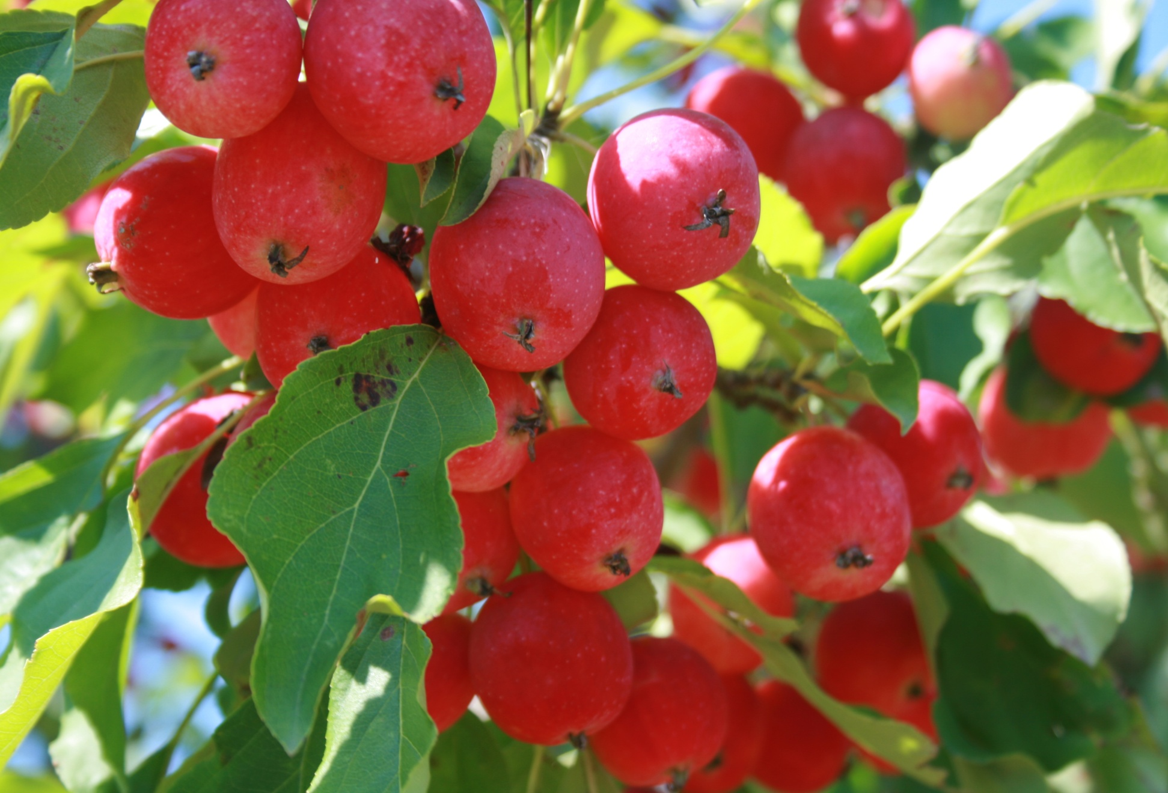
How Do Plants Manufacture Their Own Food?

Slide 4
III. Photosynthesis
1. Light phase of photosynthesis
Photolysis – Cleavage of water into hydrogen and oxygen by light enery
O₂
H₂O
H⁺
e⁻
NADP
NADPH₂
(Hill Reaction)
Photophosphorylation
Conversion of ADP to ATP by light energy
e⁻
ADP
ATP
Sum: Conversion of light energy to chemical energy
ADP
NADP
ATP
NADPH₂
H⁺
(Reducing power)
Energy
used in many energy transfer process of the cell

Slide 5
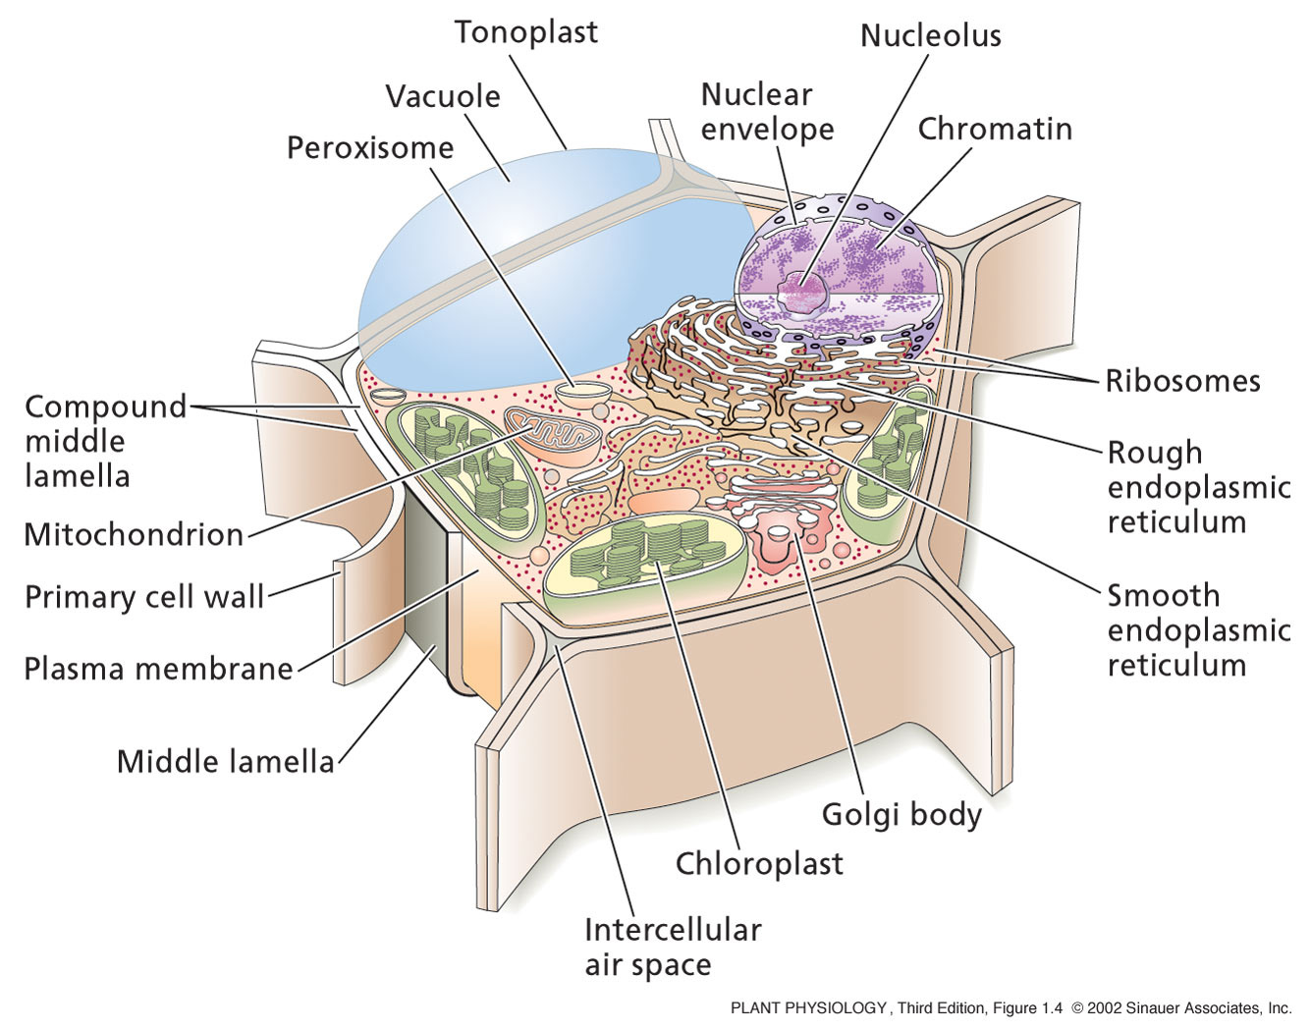

Slide 6
2. Dark Phase of Photosynthesis
Calvin Cycle
A series of enzymatically mediated reactions in which CO₂ reduced to
3-phosphoglyceraldehyde(3PGA) and the CO₂ receptor (Ribulosebiphosphate:RUBP) is generated
12 ATP
¹² 3PGA
12 ADP + 12 Pi
6 CO₂
C₃
¹² Diphosphoglyceride C₃
6 RuBP
C₅
Calvin Cycle
12 NADPH₂
12 NADP
¹² Glyceraldehyde–3P C₃
6Pi+6ADP
2 3PGA
C₃
6 ATP
Glyceraldehyde3-P
Fructose
C₆
C₃
Glucose
C₆
Sucrose
starch
C₁₂
(C₆)_{n}
Net Gain
6 CO₂ (6C) + 12 H₂O + light
C₆H₁₂O₆ (C₆) + 6 O₂ + 6 H₂O

Slide 7
3. Two Different CO₂ Pathways
C₃ Pathway
C₃ Plants (many dicots: soybean, tomato, apple, etc.)
The 1st product of CO₂ fixation is C₃ acids
Only the Calvin Cycle operates
Photorespiration exists
RuBP
CO₂ + RuBP (C5)
C₃ Acids (3PGA)
Carboxylase
Calvin cycle
Fructose
Glucose Starch

Slide 8
C₄ Pathway
C₄ Plants (Tropical grass, corn, sugarcane, some dicots like amaranth, Atriplex)
First product of CO₂ fixation is C₄ acids
Both C₄ pathway and Calvin cycle operate
Lacks photorespiration
C₄ plants grow faster than C₃ plants, due to efficient use of CO₂
PEP
CO₂ + PEP (C₃)
Carboxylase
C₄ acids (Oxaloacetate C₄)
Aspartate
(C₄)
Pyruvate
C₄ Pathway
MesophyII
cells
C₃
Malate
(C₄)
Pyruvate
Malate
C₄
C₃
Bundle
Sheath
Cell
CO₂
RuBP
Carboxylase
3 PGA
RuBP
Calvin Cycle
Fructose
Glucose,Sucrose, Starch

Slide 9
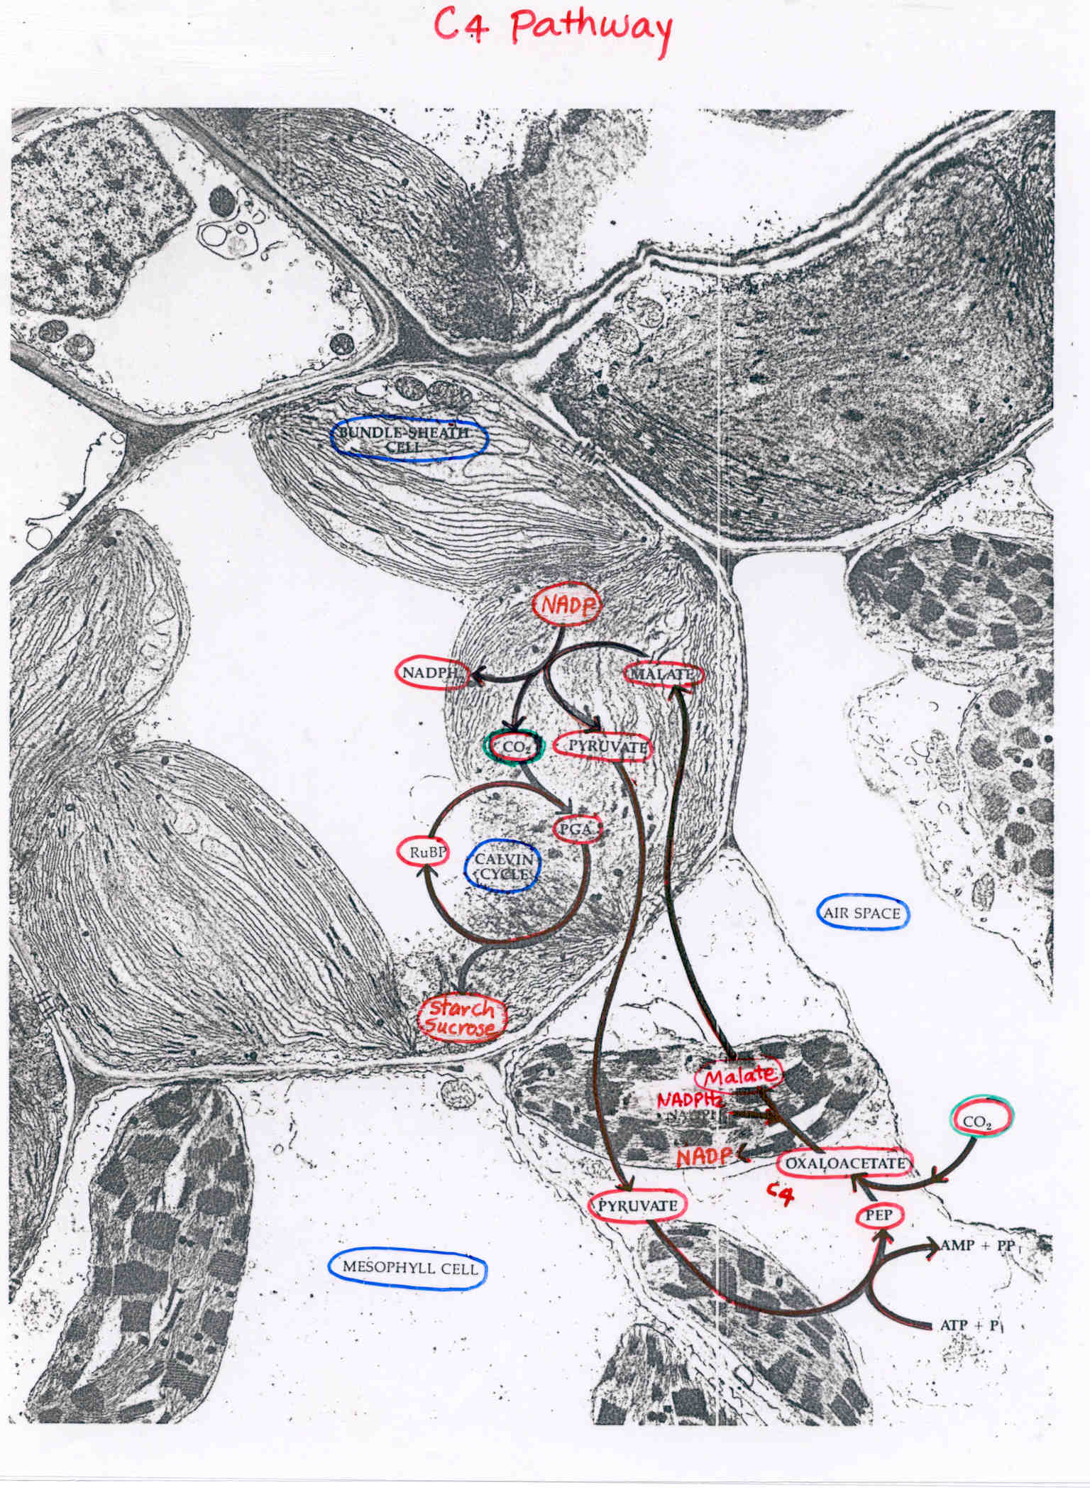

Slide 11
4. Photorespiration
The process of respiration that consumes oxygen and releases CO₂
in the presence of light
Does not produce ATP
Consumes the reducing power for reducing O₂ to CO₂
Reduces photosynthetic efficiency
Occurs in C₃ plants
(High CO_{2,} low O₂)
CO₂, H₂O
PGA C₃
Sugars
Calvin Cycle
RuBP (C5)
Photorespiration
{
PGA C₃
+
Peroxisomes
Phosphoglycolic Acid C₂
CO₂ release
O₂
(High O₂, low CO₂ atmosphere)

Slide 12
5. Carbon Dioxide Compensation Point
A steady state of CO₂ concentration in the air at which CO₂ taken up by plants via photosynthesis is the same as the CO₂ given off via respiration
At CO₂ compensation point, no growth occurs
Below compensation point, plants will degrade
C₃ plants have higher CO₂ compensation points than the C₄ plants
CO₂ Compensation Points:
Soybean (C₃ plant) - - - - - 50 ppm at 25 ºC
Corn (C₄ plant) - - - - - - - - 10 ppm at 25 ºC
Ambient CO2 concentration: 300 ppm (0.03 %)
Same principles apply to Light Compensation Points
Net Photosynthesis = Gross Photosynthesis-Respiration

Slide 13
IV. Nutrient Absorption and Translocation
Plant Nutrients
  16 elements
  Macronutrients: Nitrogen (N), Phosphorus (P), Potassium (K)
        Calcium (Ca), Magnesium (Mg), Sulfur (S)
  Micronutrients: Boron (B), Chloride (Cl), Copper (Cu), Iron (Fe),
        Manganese (Mn), Molybdenum (Mo), Zinc (Zn)
Ability to Manufacture Food
  Most green plants are autotrophic
  Autotrophic – Capable of manufacturing its own food from minerals
  Heterotrophic – Incapable of manufacturing its own food
  Depends on other sources for organic matter
  (Immature embryo, dodder, human)

Slide 14
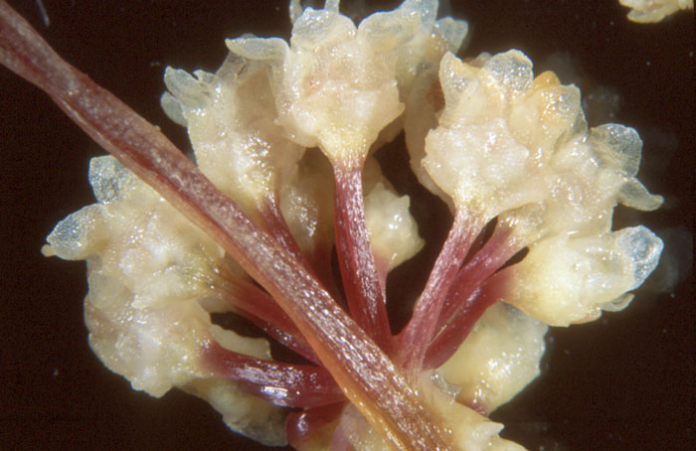
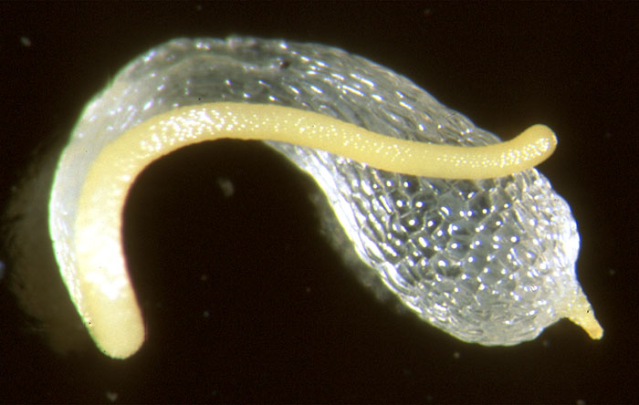
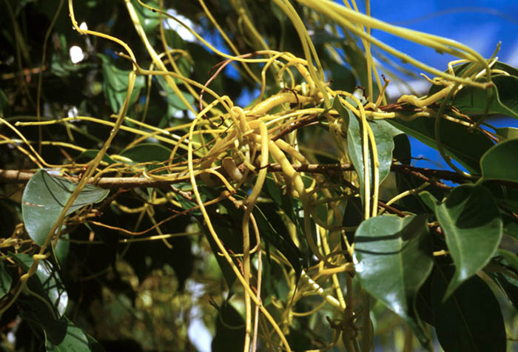
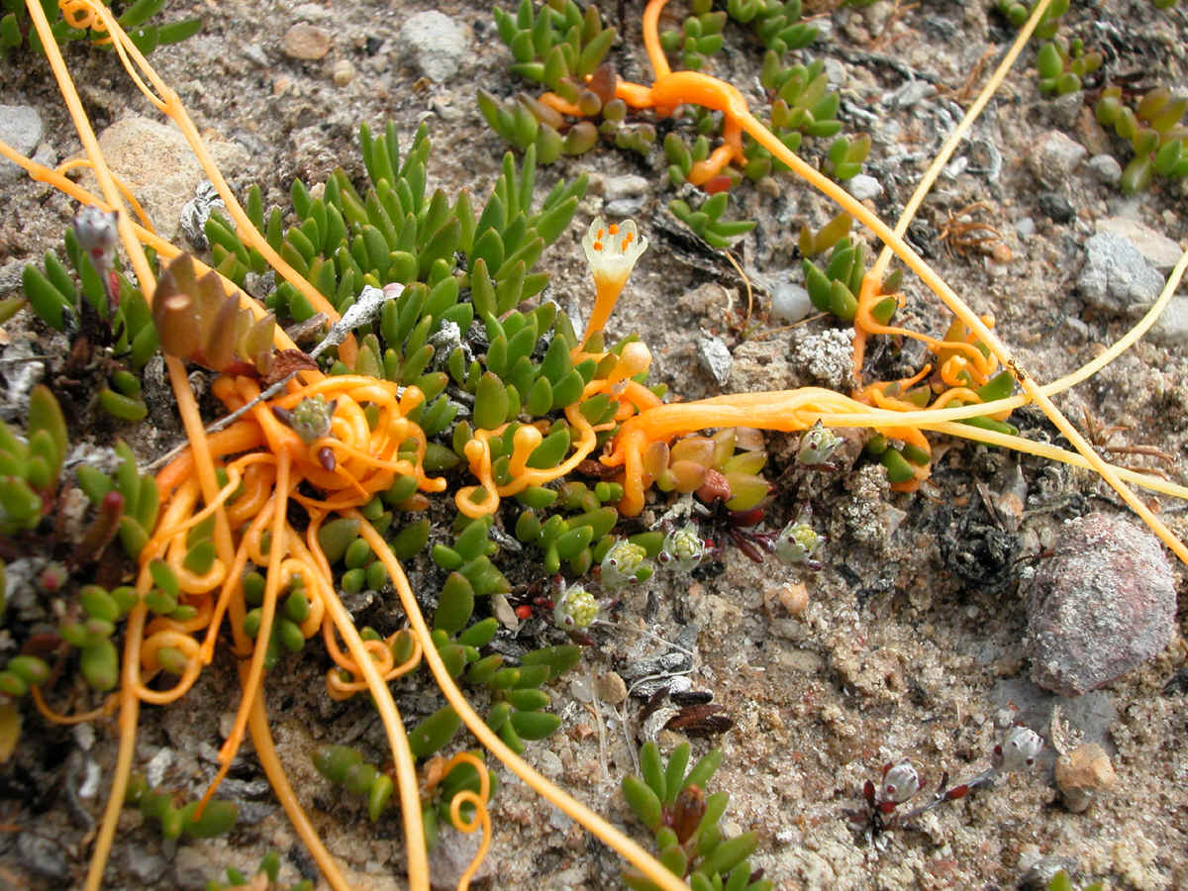
Heterotrophic (Parasitic) Plants
Cuscuta species (Dodders)
Seed
Flower
Parasitic growth of plant
Parasitic growth of plant

Slide 15
3. Nutrient and Water Movement
Diffusion – Movement of molecules (a substance) from a region of high concentration to the region of low concentration
Osmosis – Diffusion of water through differentially permeable membrane
  Reverse osmosis (RO) water- purified water low in salt content
Translocation – Movement of inorganic and organic solutes from one part to another part of the plant
  Water conduction and mineral movement via xylem
  Carbohydrate translocation through phloem
Transpiration – Loss of water vapor from the leaf via stomata
Evaporation – Loss of water by vaporization
Evapo-transpiration – Loss of water by evaporation and transpiration

Slide 16
V. Plant Respiration
Reverse of Photosynthesis
The process of releasing energy, CO₂ and water from organic materials by oxidation
C₆H₁₂O₆ + 6 O₂ -----------► 6 H₂O + 6 CO₂ + Energy
2. Chemical Process
Glycolysis – Conversion of C₆ sugars to CO₂ and pyruvic acid
Citric Acid Cycle (Kreb Cycle) – Oxydation of pyruvic acid to H^{+,} e⁻ and CO₂ (occurs in mitochondria)
3. The Q₁₀
- The rate of respiration doubles when temperature rises 10 ºC (18 ºF)
- Respiration can be reduced by lowering O₂ and increasing CO₂ concentrations
Application: a) CO₂ storage of apples and pears
b) Hypobaric storage of flowers and fruits
(Low atmospheric pressure)

Slide 17
VII. Plant Constituents
Carbohydrates
  Monosaccharides - simple carbohydrates (pentose C₅, hexose C₆)
  Disaccharides – maltose (glu-glu), sucrose (glu-fru) C₁₂
  Olygosaccharides -1-10 monosacchrides lined together
  Polysaccharides – starch (poly glu), cellulose, hemicellulose, insulin, etc.
Lipids (fats, phospholipids, waxes)
Proteins (structural, soluble)
Aromatic Compounds (Vanillin, flavonoids)
Terpenoids and Steroids
Non-Protein Nitrogen Compounds (DNA, RNA, Bases)
Vitamins (Vitamin C, Thiamin B₁)

