Slide 1


North Dakota
A Look Into the Tasty, Cultural Crossroads That Shape Our State
PowerPoint developed by Stacy Halvorson, R.D., Extension Associate
and Julie Garden-Robinson, Ph.D., L.R.D., Food and Nutrition Specialist
Notes:
Introduce yourself and welcome the participants. Have participants introduce themselves.
This presentation will give you a glimpse into the many cultures that are here in North Dakota and how they shape our state.
Let’s begin with an activity.
Potato Activity:
Provide a potato for each class participant. Ask each participant to describe his or her potato , focusing on what makes the potato unique.
Relate how the potato is like each one of us. Everyone is unique and different.
For an extra challenge, put all of the potatoes in a bag and have participants try to find their potato.

Slide 2
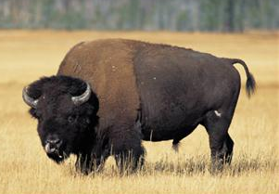
North Dakota
Today the world as we know it is an ever-changing place, and North Dakota is no exception.
The diverse population, with its many customs, religions and traditions, is as different as the crayons in a crayon box.
The one thing that plays a central role in the cultural crossroads of our state is food.
Notes:
Have class participants share their cultural background.

Slide 3

We all have a favorite food, whether it be a special holiday dish or an old family recipe. The foods we eat all originated somewhere.
Can you figure out where these American favorites got their start?
Notes:
Engage the class participants in conversation about some of their favorite foods related to their culture.
Family recipe?
Origin?

Slide 4
All-American Favorites
Watermelon
Africa
South America
Asia
India
Ice cream
U.S.
Norway
China
Russia
Notes:
The next few slides will test your knowledge of the origin of all-American favorites.
1. Watermelon?
a. Africa
b. Asia
c. India
d. South America
2. Ice Cream?
a. U.S.
b. China
c. Russia
d. Norway

Slide 5
All-American Favorites
Hamburger
Mexico
India
U.S.
Germany
Hot dog
Turkey
Peru
Greece
Indonesia
Notes:
3. Hamburger?
a. Mexico
b. U.S.
c. Germany
d. India
4. Hot Dog?
a. Turkey
b. Greece
c. Indonesia
d. Peru

Slide 6
North Dakota:
A State of Many Cultures
Native American
Scandinavian
Germans from Russia
Hispanic
Bosnian
Kurdish
Liberian
Somali
Sudanese
Vietnamese
Notes:
North Dakota’s food culture can be described best as a melting pot full of life and spice.
North Dakota is home to many people from around the world.
Cultures include:
Native American
Scandinavian
Germans from Russia
Hispanic
Bosnian
Kurdish
Liberian
Somali
Sudanese
Vietnamese
Note to class that not all cultures are listed.

Slide 7
Ancestry in North Dakota: 2000
Source: U.S. Census Bureau, census 2000, SF3 Table PCT16.
“The Growing Diversity of North Dakota.” Richard Rathge. NDSU, Oct. 29, 2008
Notes:
Ask class participants where they fit on this pie chart.
Now we will explore a few of the cultures of North Dakota by looking at food in daily life, at special occasions and some traditional foods.

Slide 8
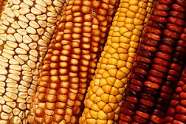
A Glance Into the Food Culture of
Native Americans
Food in Daily Life
Food practices vary from tribe to tribe but meat generally is predominant.
Long ago, the diet consisted of buffalo, rabbits, deer, nuts, berries, corn and other crops.
Today they eat much of the same modern
food we do.
Food at Special Occasions
Most celebrations are centered
around crops and their harvest.
Notes:
(If using the optional globe or world map, begin by pointing out the relative location of where you are referring to, the Midwest. Point out North Dakota.)

Slide 9
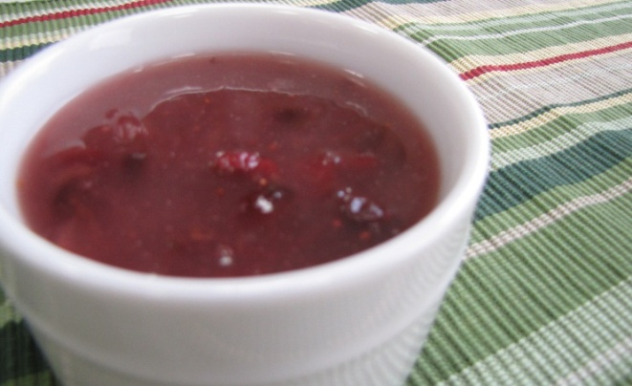
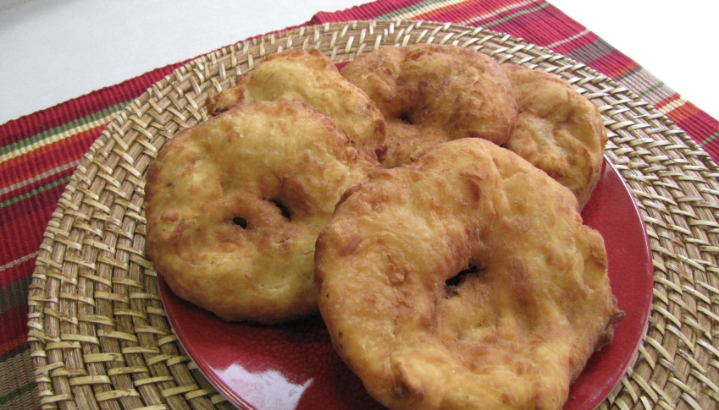
A Glance Into the Food Culture of Native Americans
Traditional Food
Corn cakes
Wojapi
Fry bread
Notes:
Traditional Foods:
Corn cakes: made with dried corn or corn meal mixed with water and shaped in small, round cakes
Wojapi (woh-zjah-pee or ‘woh-zhä-pē): pudding usually made with fresh berries such as blueberries or raspberries
Fry bread: thin round of dough puffed like a doughnut and fried in oil

Slide 10

A Glance Into the Food Culture of Native Americans
North Dakota’s Tribes
Spirit Lake Sioux
Standing Rock Sioux
Three Affiliated Tribes
(Hidatsa, Mandan, Arikara)
Turtle Mountain Chippewa
Notes:
The map shows the relative location of North Dakota’s American Indian tribes.

Slide 11

A Glance Into the Food Culture of Scandinavia
(Denmark, Finland, Iceland, Norway and Sweden)
Food in Daily Life
Mutton, cheese, cabbage, apples, onions, berries and nuts are
common in everyday life.
Seafood is plentiful.
Food preparations are shaped by traditions dating back to the Vikings.
Notes:
(If using the optional globe or world map, begin by pointing out the relative location of where you are referring to: Iceland, Denmark, Norway, Sweden and Finland.)
Salmon, trout, herring, cod, shrimp and lobster are just some of the types of seafood available in Scandinavian countries.
Vikings smoked, cured and salted meats to preserve them for the dead of winter.

Slide 12
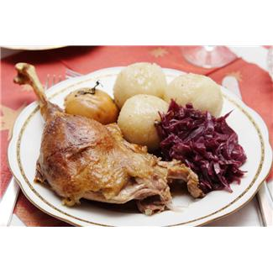
A Glance Into the Food Culture of Scandinavia
(Denmark, Finland, Iceland, Norway and Sweden)
Food at Special Occasions
Midsummer’s Day Celebration:
Traditional meal: Herring and cured salmon served with boiled potatoes
Jul or Yule “The Feast of Feasts”:
Celebrated with a large dinner
Christmas:
Dinners usually feature ham or pork
Notes:
Most holidays are celebrated with a large family meal.

Slide 13
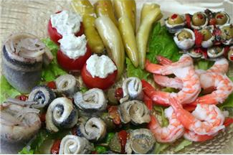
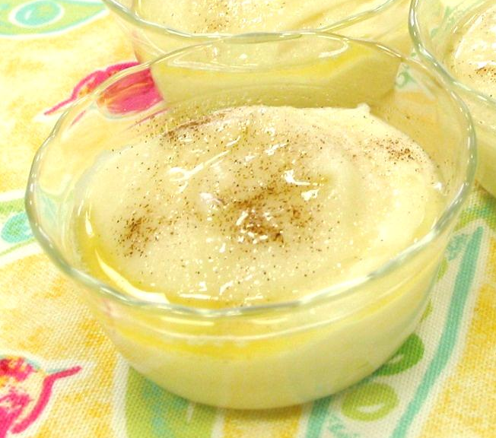
A Glance Into The Food Culture of Scandinavia
(Denmark, Finland, Iceland, Norway, and Sweden)
A Glance Into the Food Culture of Scandinavia
(Denmark, Finland, Iceland, Norway and Sweden)
Traditional Foods
Lutefisk
Rǿmmegrǿt
Lefse
Krumkake
Notes:
Traditional Foods:
Lutefisk (lute•fisk or lüt-,fisk): dried whitefish, usually cod soaked in lye
Lefse (lef•se or lĕf-śe): traditional soft Norwegian flatbread made with potatoes, milk and cream
Rommegrǿt (rom•me•grǿt or ruh-méh-grūht): sweet cream porridge, a traditional Norwegian dessert
Krumkake (krum•kake or krŭm'kāk’): light and crisp cookie in the shape of a cone

Slide 14
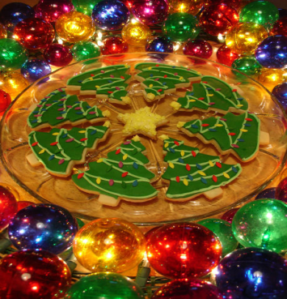
A Glance Into the Food Culture of Germans from Russia
Food in Daily Life
Meat is a major part of the diet and
is in most dishes
Known for sweet dough breads and desserts
Typical meal consists of some sort of meat, potatoes and vegetable
Food at Special Occasions
Christmas is celebrated with a large family meal and extravagant desserts, pastries and cookies.
Notes:
(If using the optional globe or world map, begin by pointing out the relative location of where you are referring to: Germany and Russia.)

Slide 15
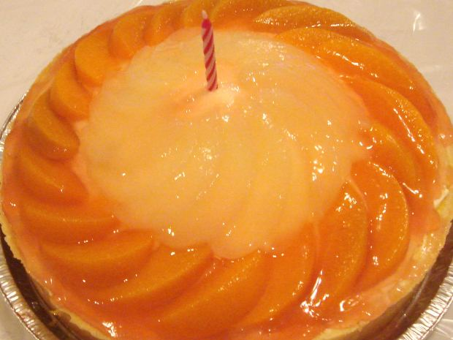
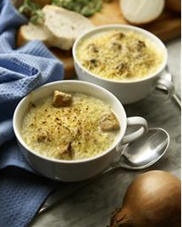
A Glance Into The Food Culture of Germans from Russia
A Glance Into the Food Culture of Germans from Russia
Traditional Foods
Kuchen
Pfefferneusse
Kneophla soup
Fleischkuekle
Notes:
Traditional Foods:
Kuchen (ku•chen or ’kü-kən): dessert with a dough crust and a custard filling; may have some sort of fruit or cheese mixed into it
Pfeffernusse (pfef•fer•nuss or fe-fe (r)- nüs): “pepper-nuts;” traditional German cookie at Christmas made with nuts, such as walnuts, almonds or hazelnuts, and spices, such as cinnamon, ginger, pepper, anise seed, cloves and garlic. The cookie usually is rolled in powdered sugar.
Kneophla soup (kneoph•la soup or ‘néf-la soup): thick soup made with chicken, potatoes and kneophla (dumplings). Vegetables such as carrots and celery also are in the soup.
Fleischkuekle (fleisch•kue•kle or flié-‘sh-kū-kle’): sweet pastry stuffed with meat

Slide 16
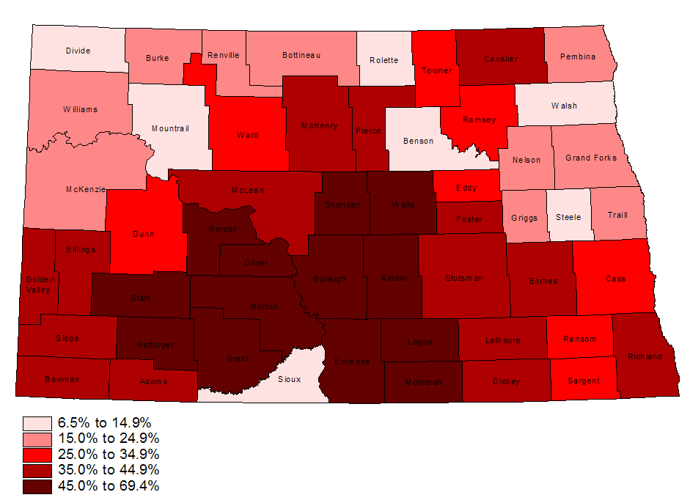
Germans as a Percent of the Total Population of North Dakota by County: 2000
Source: U.S. Census Bureau, census 2000, SF3 Table PCT16.
“The Growing Diversity of North Dakota.” Richard Rathge. NDSU, Oct. 29, 2008
Notes:
Point out that most of the settlement is in south-central North Dakota.

Slide 17
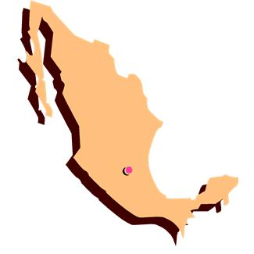
A Glance Into the Food Culture of Mexico
Food in Daily Life
Mexican cuisine often is described as hot and spicy, but this is not true for all dishes.
Corn is the most popular ingredient and is used in some form in most recipes.
Other traditional ingredients include chili peppers, beans, chocolate, squash and tomatoes.
Mealtime is a leisurely family experience and commonly lasts for several hours.
Notes:
(If using the optional globe or world map, begin by pointing out: Mexico.)
The origin of chocolate is credited to Mexico.
The Spanish conquest in the 1500s brought many other influential ingredients, such as rice, wheat, wine and cinnamon. They also raised cattle, which led to beef, butter and cheese.

Slide 18


A Glance Into the Food Culture of Mexico
Food on Special Occasions
Cinco de Mayo:
Tamales traditionally are made for festivals and parades.
Dia de los meurtos: “Day of the Dead”
Celebrated with candy and other foods shaped to look like skulls.
Pan de meurto, “bread of the dead” is made especially for the holiday.
Notes:
Tamales are so labor intensive they usually are made only for special occasions. The women get together the day before and make several large batches.
Pan de muerto is placed on the altar to offer nourishment for the departed spirits.

Slide 19
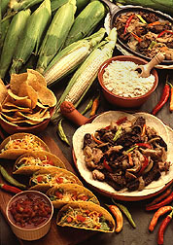
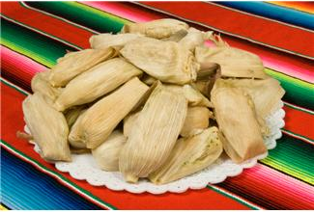
A Glance Into the Food Culture of Mexico
Traditional Foods
Tamales
Enchiladas
Tortillas
Notes:
Traditional Foods:
Tamale (ta•ma•le or tə-mä-lē): steamed meat- and masa-filled corn husk
Enchilada (en•chi•la•da or en-chə-’lä-də): meat filling rolled in a wheat or corn tortilla topped with a chili sauce or salsa
Tortilla (tor•ti•lla or tȯr-tē-yə): thin unleavened pancake made from cornmeal or wheat flour

Slide 20
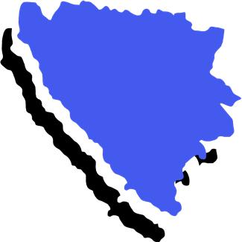

A Glance Into the Food Culture of Bosnia
Food in Daily Life
Influenced by both Turkish and Eastern European cuisine
Grilled meat- and cabbage-based dishes most popular
Little alcohol is consumed since the emergence of the Muslim population
Notes:
(If using the optional globe or world map, begin by pointing out the relative location of: Bosnia-Herzgovinia.)

Slide 21
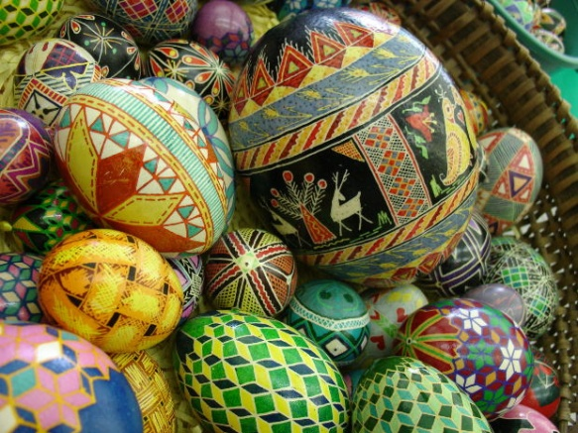
A Glance Into the Food Culture of Bosnia
Food at Special Occasions
Bosnian Muslims:
Celebrate Ramadan with a large meal and Turkish-style meats and sweets
Bosnian Catholics and Orthodox Jews:
Celebrate Easter with special breads and elaborately decorated eggs
Bosnian Christians:
Celebrate Christmas with a large
family gathering

Slide 22
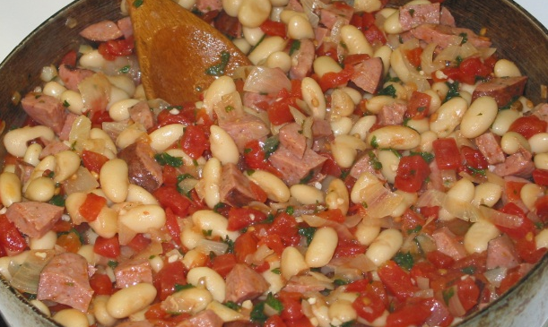
A Glance Into the Food Culture of Bosnia
Traditional Food
Grah
Notes:
Traditional Foods:
Grah (grah or gräh): mixture of sausage, beans and other vegetables

Slide 23
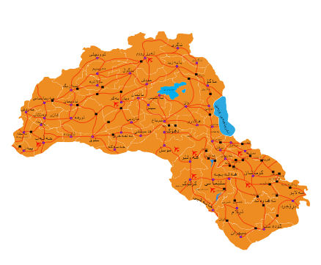
A Glance Into the Food Culture of the Kurdish
Food in Daily Life
Lamb very popular but meat not served often
Meat and vegetable pies prominent
Bulgur wheat was
predominant staple but is
being replaced by rice
Fresh or dried fruit often
used in stews
Notes:
(If using the optional globe or world map, begin by pointing out the relative location of: Kurdistan, which spans portions of Syria, Iraq, Iran, Armenia and Turkey.)

Slide 24
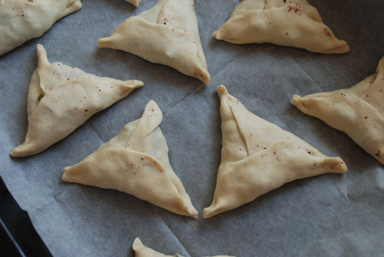
A Glance Into the Food Culture of the Kurdish
Food at Special Occasions
Nowrûz (New Year):
Celebration marking the arrival of spring, usually with a large festival
Traditional Foods
Pokhin
Tapsi
Notes:
Traditional Foods:
Pohkin (poh•kin or pō-kin): a sweet pastry made for the Kurdish New Year; marked with a hoof print to signify the passing of winter and the arrival of spring
Tapsi (tap•si or täp-sē): aubergines (eggplants), peppers, courgettes (zucchini) and potatoes in a spicy tomato sauce

Slide 25
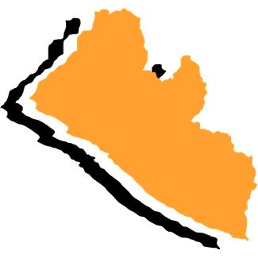
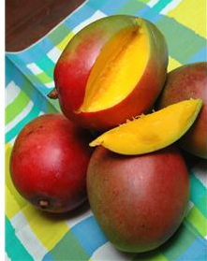
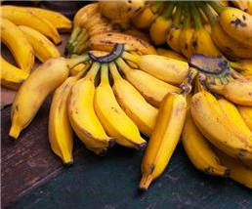
A Glance Into the Food Culture of Liberia
Food in Daily Life
Rice plays role of primary
food staple and is the basis
for most dishes
Mangos, bananas, coconuts, citrus fruits, plantains and cassava also predominant in
the diet
Notes:
(If using the optional globe or world map, begin by pointing out the relative location of : Liberia, Africa.)

Slide 26

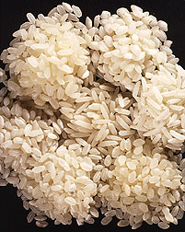
A Glance Into the Food Culture of Liberia
Food at Special Occasions
Rice used ceremonially when making offerings to ancestors or
the recently deceased
Traditional Foods
Jollof Rice
Notes:
Traditional Foods:
Jollof Rice (joll• off rice or jöll-öff - ‘rīs): made with meats such as chicken, bacon, shrimp or smoked pork in a spicy tomato sauce atop white rice

Slide 27

A Glance Into the Food Culture of Somalia
Food in Daily Life
Country Living:
Milk from camels, goats and cows a major staple in the diet
Liver from goats and sheep also popular, but meat only served a few times a month
Durra, honey, dates, rice and tea also mainstays of the diet
People usually eat food with their hands
Notes:
(If using the optional globe or world map, begin by pointing out the relative location of: Somalia, Africa.)

Slide 28

A Glance Into the Food Culture of Somalia
Food in Daily Life
Cities:
Restaurants are popular, offering Arabic, Chinese, European and American cuisine
At home, custom is for men to eat first and women to eat later with the children
Most use silverware to eat
Food at Special Occasions
Customary to make special breads for guests and to slaughter an animal
Notes:
As you can see, modernization is a major difference between country and city life.
At weddings, the bride and groom traditionally cut slices of raw meat and hand them to guests.

Slide 29
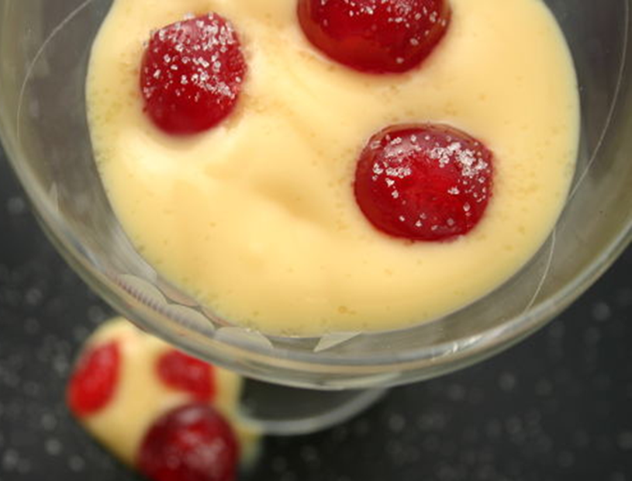
A Glance Into the Food Culture of Somalia
Traditional Foods
Fool
Notes:
Traditional Foods:
Fool (fool or ’fül): sweet custard dessert served with fruit

Slide 30
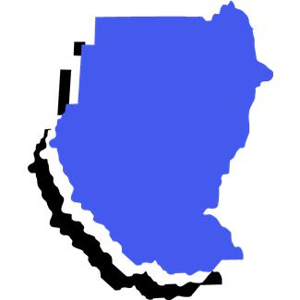
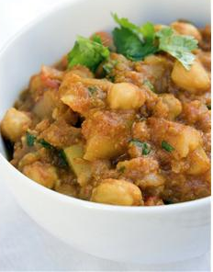
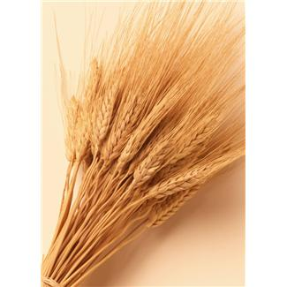
A Glance Into the Food Culture of
Sudan
Food in Daily Life
The day usually begins with tea
Millet is the staple grain
Meat is expensive and
not often used
Vegetables prominent, usually
used in stews and soups
Notes:
(If using the optional globe or world map, begin by pointing out the relative location of: Sudan, Africa.)

Slide 31

A Glance Into the Food Culture of
Sudan
Food at Special Occasions
Eid al-Adha – “Feast of Great Sacrifice”: a sheep is sacrificed and given to the poor
Eid al-Fitr- “Breaking of the Ramadan Fast”: family is invited over for a large meal

Slide 32
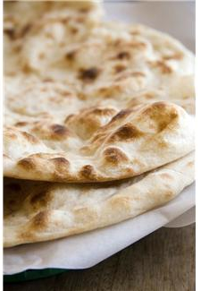
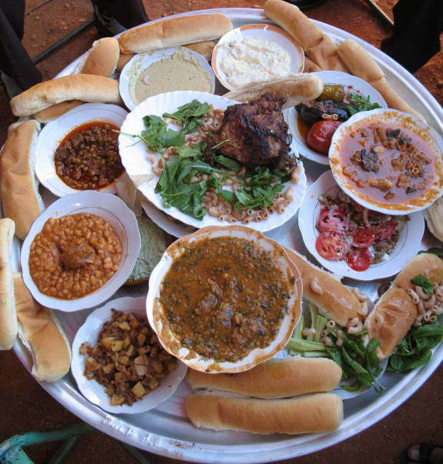
A Glance Into the Food Culture of
Sudan
Traditional Food
Kisra
Notes:
Traditional Foods”
Kisra (kis•ra or kis-‘rä): flat bread made from sorghum flour

Slide 33
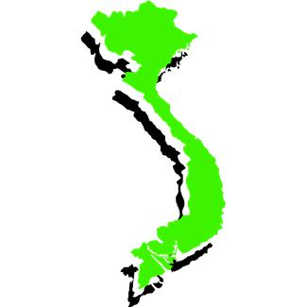
A Glance Into the Food Culture of Vietnam
Food in Daily Life
Vegetables used in most dishes
Diet is rice-based
Noodles and noodle soups also
prominent in daily life
Soy and fish sauce most commonly
used condiments
Food is eaten with chopsticks
Notes:
(If using the optional globe or world map, begin by pointing out the relative location of: Vietnam, South Pacific.)
The Vietnamese are best known for their Pho noodles, which are made from rice.

Slide 34
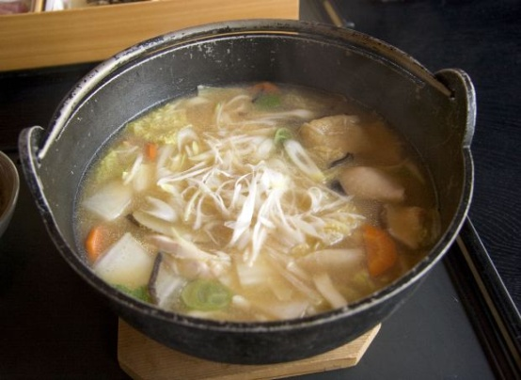
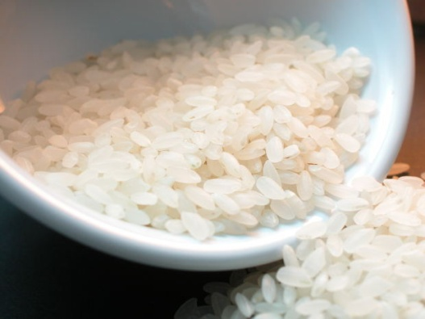
A Glance Into the Food Culture of Vietnam
Food at Special Occasions
Tet Nguyan Dan: New Year
Celebration of the arrival of spring held during several days, generally when family reunions are held
Traditional Foods
Spring rolls
Notes:
Some dishes served during Tet are vegetarian. Eating vegetarian on Tet is considered good luck for the coming year.
Traditional Foods:
Spring rolls: made of meat, rice, noodles and vegetables rolled in a seaweed or rice wrapper

Slide 35

Questions?

Slide 36
Want to Learn More?
Germans From Russia Heritage Collection
  http://library.ndsu.edu/grhc
North Dakota State Data Center
  www.ndsu.nodak.edu/sdc/data.htm
Food in Every Country
  www.foodbycountry.com
Global Gourmet
  www.globalgourmet.com
Notes:
Germans From Russia Heritage Collection
A collection of articles, pictures, recipes and historical information about Germans from Russia
http://library.ndsu.edu/grhc
North Dakota State Data Center
Data information on North Dakota’s demographics, including population, race, ethnicity and health
www.ndsu.nodak.edu/sdc/data.htm
Food in Every Country
Provides links to articles about food and culture from countries across the globe
www.foodbycountry.com
Global Gourmet
Provides food and culture information for various countries around the world
www.globalgourmet.com

Slide 37
References

