Slide 1
How To Submit A Sample
NDSU Plant Diagnostic Lab

Slide 2
Selecting the Sample
Pick both affected and unaffected tissue
Preferably, get the margin between the two
If plants are small, get some healthy, some declining, and some severely affected
  It helps to see what the plant is supposed to look like
  Send entire plant(s) whenever feasible

Slide 3
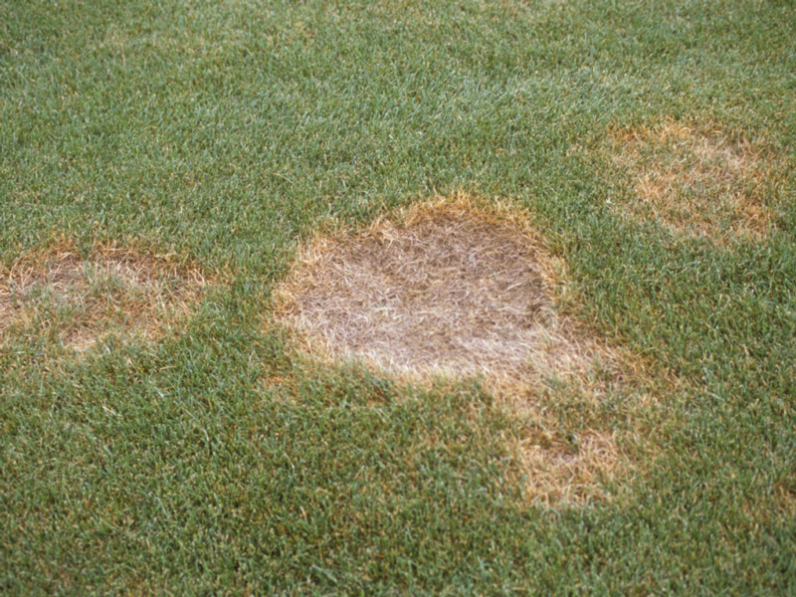
Selecting the Sample

Slide 4
Packing the Sample
Wrap foliage in DRY paper towels
Wrap the roots in wet paper towels
  Removing soil from roots can save you money on shipping and may improve sample quality
Put in sealed plastic bag

Slide 5
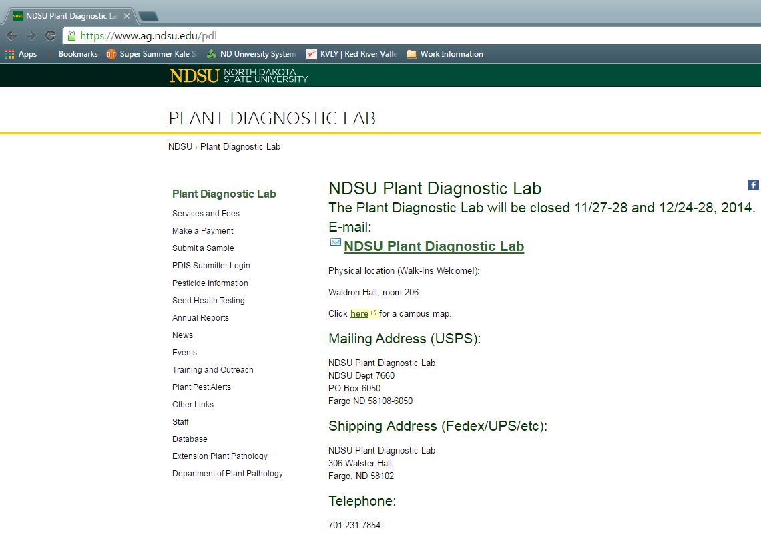
Paperwork
Sample submission forms are available online
  1. Visit our webpage to find link

Slide 6
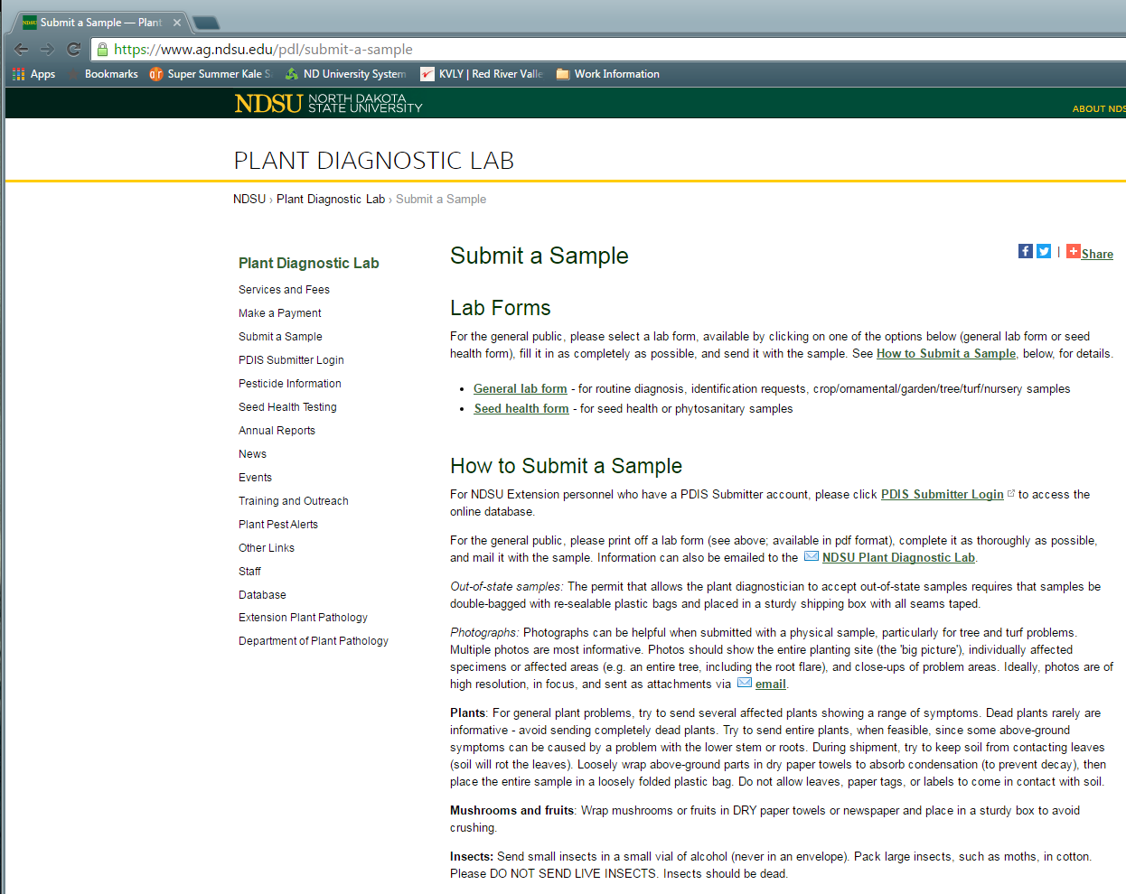
Sample Submission Form

Slide 7
Submission Form
Sample submission forms are available online
  Visit our webpage to find link
  Fill out basic information (the form is a fillable PDF but handwriting is accepted!)

Slide 8
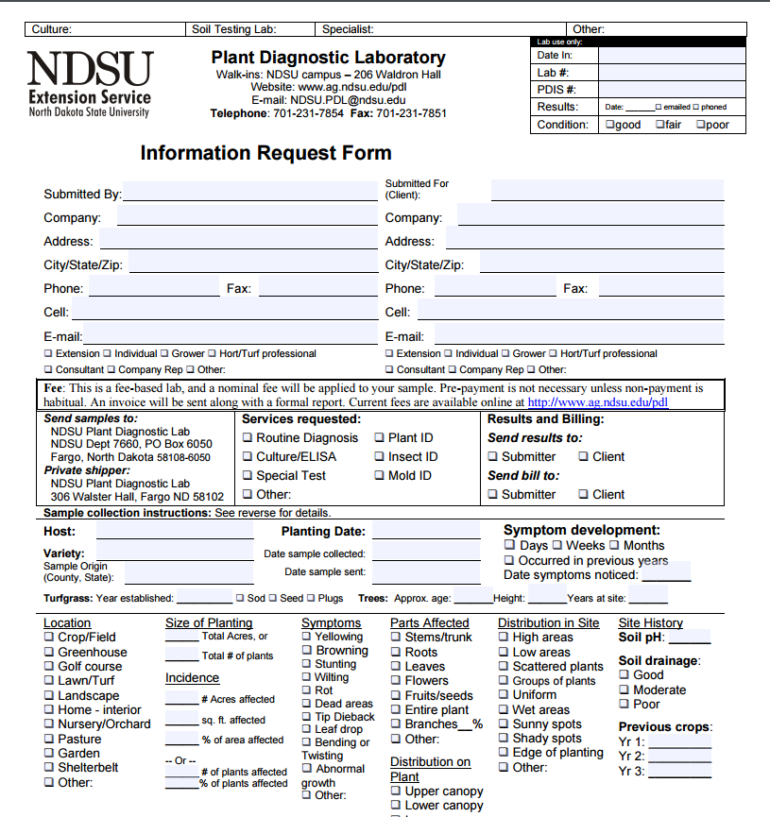
Submission Form
Sample submission forms are available online
  Visit our webpage to find link
  Fill out basic information (the form is a fillable PDF but handwriting is accepted!)

Slide 9
Submission Form
Sample submission forms are available online
  Visit our webpage to find link
  Fill out basic information (the form is a fillable PDF but handwriting is accepted!)
  Write story or explain concerns on reverse side
  Don’t worry about filling out every section of the form
  DO. NOT. PUT. FORM. IN. BAG. WITH. SAMPLE. ☺ Thank you

Slide 10
Shipping the sample
The NDSU PDL has three addresses!
  A walk-in location (206 Waldron Hall, NDSU Campus)
  A USPS address that delivers to campus distribution
  A shipping address that delivers to the Plant Pathology Departmental Office

Slide 11
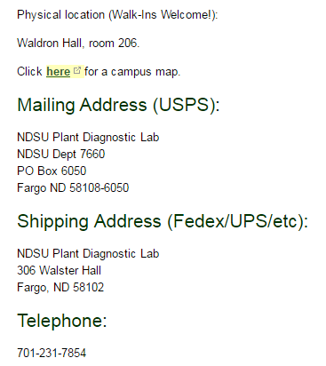

Slide 12
What to expect
Unbiased, professional results
Formal report
Final diagnoses entered into national database (NPDN National Repository)
Turn around varies
  Easy/common samples during slow periods will be > 1 week, or even same day!
  Difficult samples during peak times may take up to 2 weeks; turnaround greatly increased by:
    Culturing slow growing organisms
    Abiotic disorders which resemble disease – it takes time to eliminate the likelihood of a disease
    Unusual samples; we will try to schedule a consultation with specialists who are in and out of the field/office throughout the summer
  Never hesitate to contact us for a status update

Slide 13
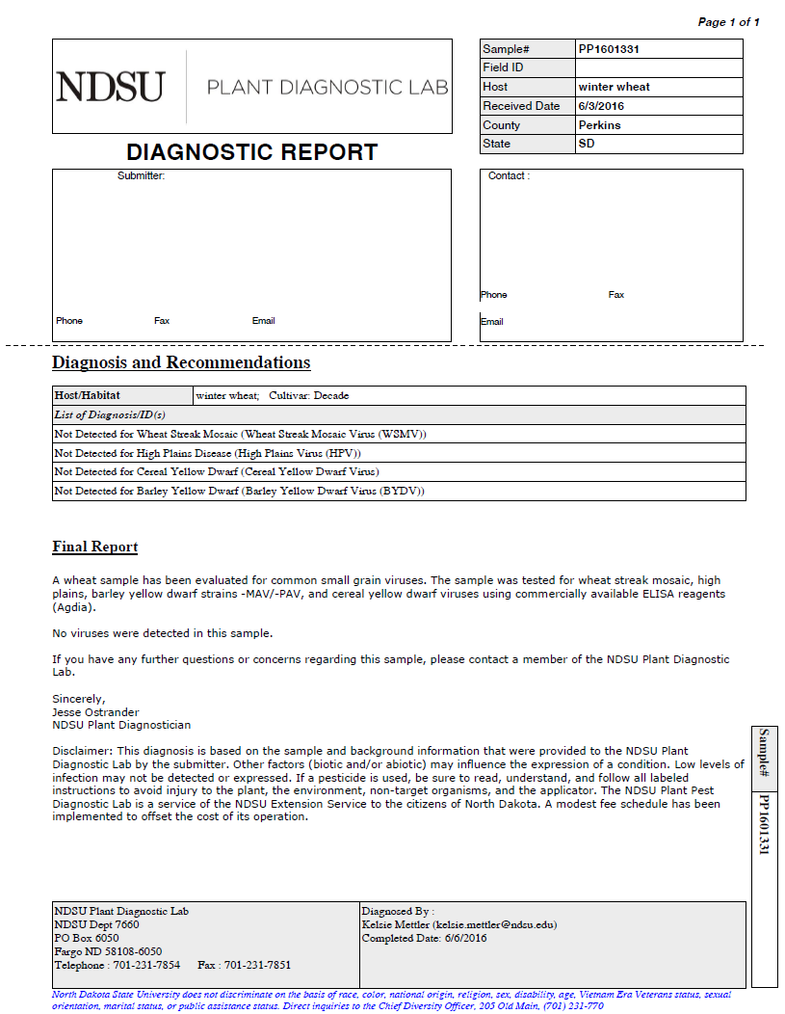

Slide 14
Final Words
Our main goal is to help you!
  Following these guidelines will result in a higher quality sample which increases likelihood of us helping you
We aren't picky though – send us samples
More in-depth sample selection and shipping information on reverse of submission form and on our webpage under the “Submit a Sample” link (see slide 5)

