Slide 1
Industrial Engineering & Management
Manufacturing Engineering
North Dakota State University

Slide 2
At NDSU
Nine academic units
1,500+ staff & 950+ faculty
235 undergraduate and graduate majors
Athletically and academically, NDSU competes successfully at the NCAA Division I level
For more information about NDSU visit
  http://www.ndsu.nodak.edu/ndsu/about/#about

Slide 3
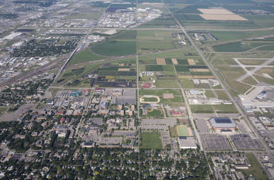
NDSU Campus Overview

Slide 4
Industrial & Manufacturing Engineering Department
Two B.S. degrees offered:
B.S. in Industrial Engineering & Management
B.S. in Manufacturing Engineering
Engineering programs with the traditional content of mathematics, sciences, engineering analysis and synthesis as part of the curriculum.

Slide 5

Industrial & Manufacturing Engineering

Slide 6
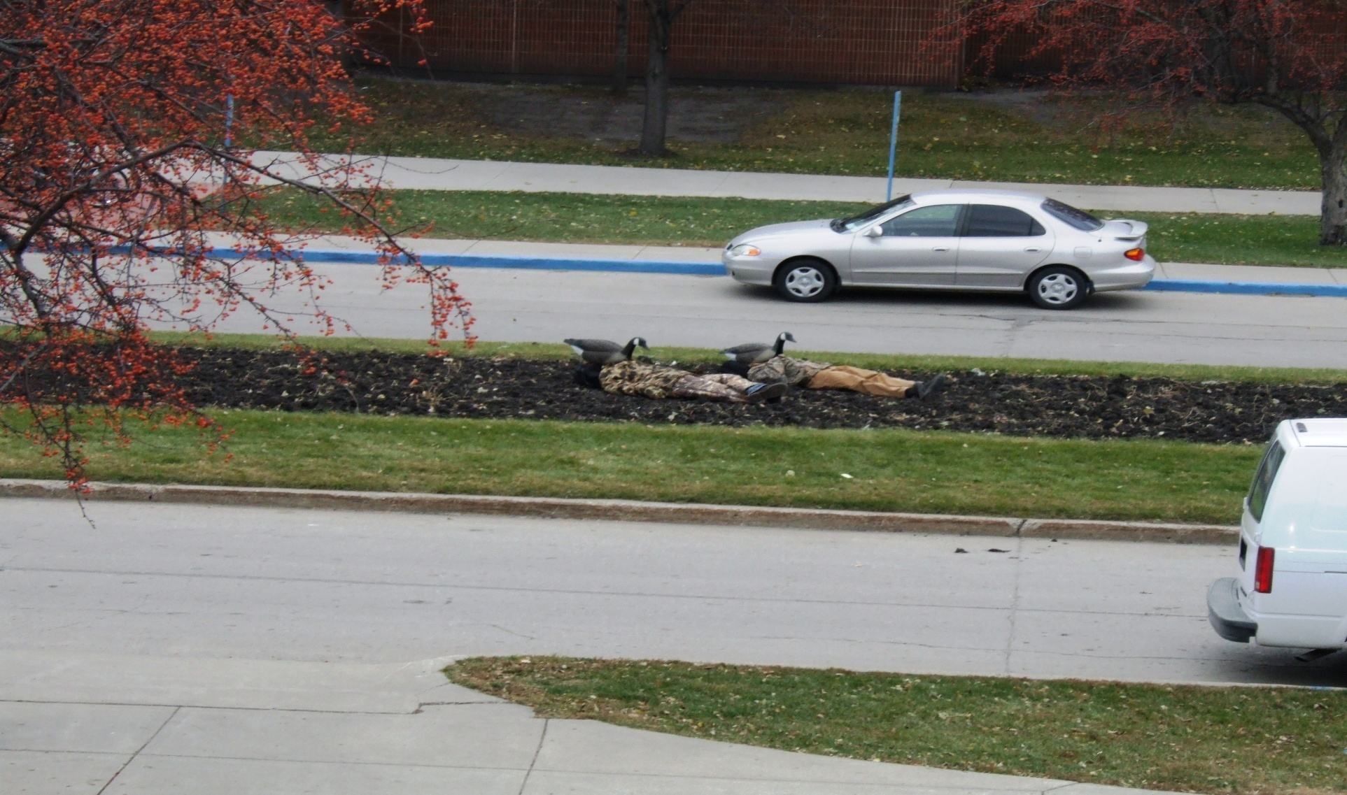

Slide 7


      “Engineering is the application of math and science to create something of value from our natural resources.”
      Industrial Engineering as a science integrates mathematics, sciences, and engineering to design, develop, test, improve, optimize, and solve problems.

Slide 8
Industrial Engineering & Management Program
As engineers design and build more complex systems, the need to oversee and ensure adequate performance of the system becomes more pronounced. IE’s as managers and engineers will have a significant role in understanding performance requirements and improving efficiency of these systems.
Industrial engineers work in every type of enterprise – manufacturers of every sort of industrial and consumer product; healthcare, financial, transportation, distribution and other types of service industries; government units and agencies.
Most branches of engineering are concerned with designing products, while industrial engineers concentrate on designing, installing, and improving procedures, systems, and processes for effective and efficient operation of any enterprise.

Slide 9
Areas of emphasis include:
      Healthcare management engineering
      Production operations and management
      Process and production engineering
      Reliability and quality management
      Specialized manufacturing processes
          Electronics
          Aircraft
          Plastics
          Composites

Slide 10
Industrial Engineers make significant contributions to their employers by saving money while, at the same time, striving for a more pleasant workplace for fellow workers.
Preparation for an IME major:
    Two years of high school math
    Two years of physics and chemistry
    Admission requirements:
    2.5 cumulative GPA
    21 ACT or 970 SAT score
    College preparatory courses (core classes)
      4 years of English
      3 years of Math (algebra I or higher)
      3 years of lab science
      3 years of social science

Slide 11
Manufacturing Engineering Program
Is all about the production of goods – from automobiles, tractors, and airplanes, to electronic and recreational products, sports equipment, toys, to foodstuffs.
NDSU is one of only nineteen universities offering this degree
MfgE major special interests:
  Electronics manufacturing
  Process engineering
  Production & manufacturing systems engineering

Slide 12
Project Management/Capstone
Project Management/Capstone provides students with unique senior design experiences and may include students from various engineering programs, business, and facilities management.
The course is designed to draw on the skills and knowledge obtained
throughout the students’ college careers.
Capstone project teams study real-world client problems, develop alternative solutions, and propose implementation strategies.
The selected project activities start during the second week of Spring semester.
The course concludes with the Capstone presentations and banquet during the last Thursday in April.

Slide 13
Helping businesses with projects is intended to be a multidisciplinary course for senior-focused students designed to draw on their college careers.
The IME Department has a proven success record in working with regional businesses to study their industrial or manufacturing engineering problems, developing alternative solutions, and proposing implementation strategies.
Our research help organizations in:
    Manufacturing
    Retail
    Healthcare
    Distribution & Supply chain
    Packaging equipment
    Food processing
    Service

Slide 14
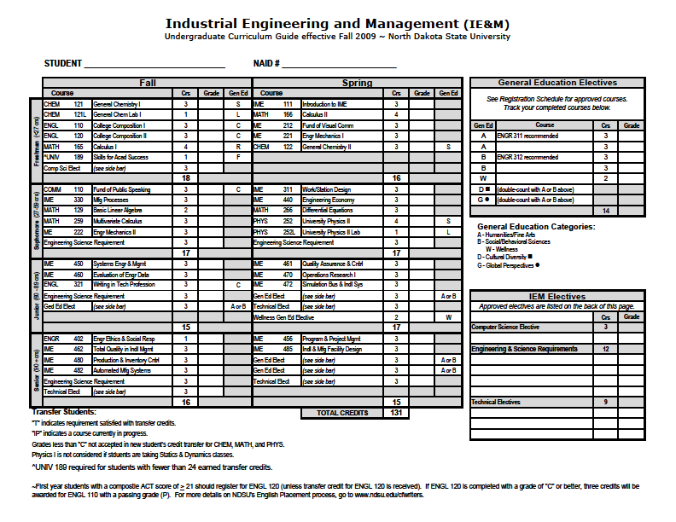

Slide 15
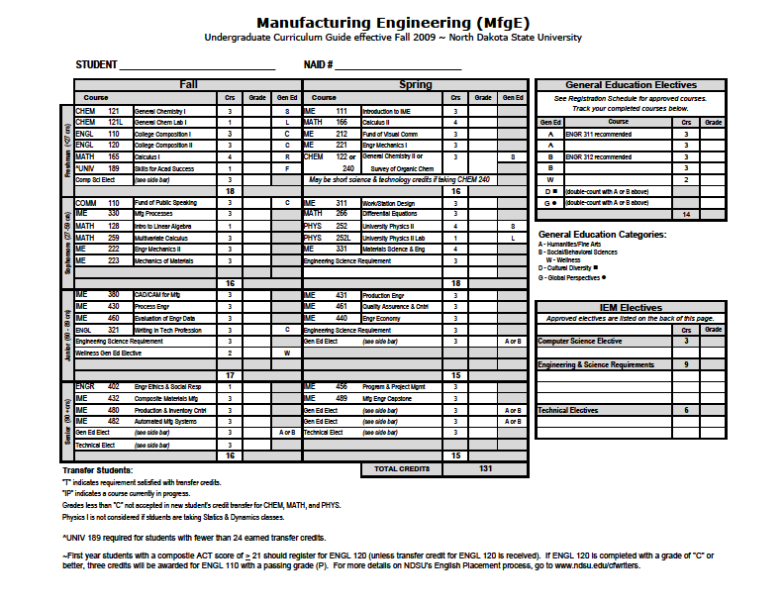

Slide 16
IME Laboratories
Manufacturing Lab
Human Factors Lab
Simulation Lab
CNC Machining Lab
Welding Lab
Automation Lab
Precision Manufacturing Lab
Electronics Manufacturing Lab
Rapid Prototyping Lab

Slide 17
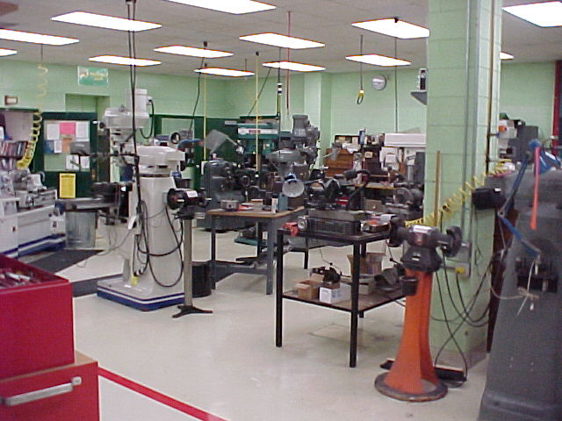
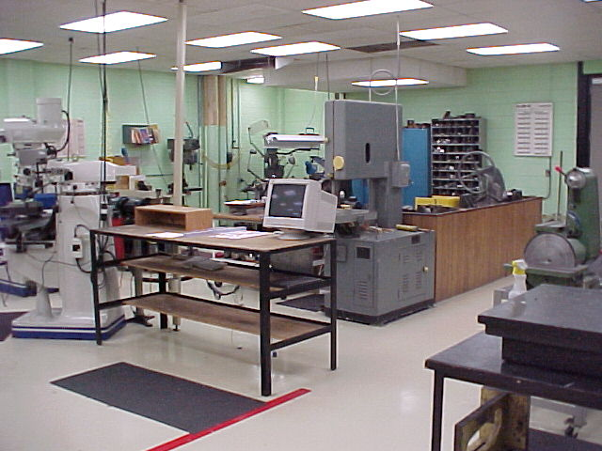
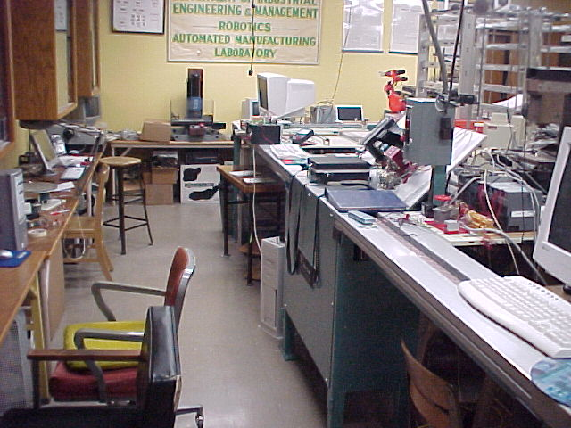
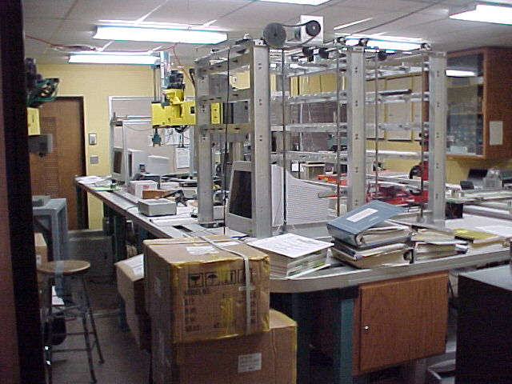

Slide 18
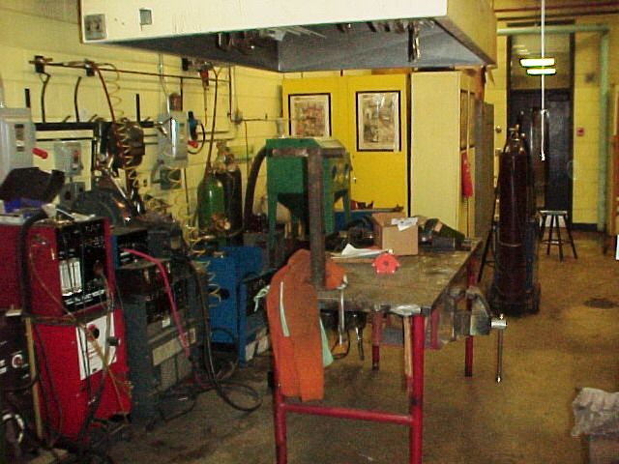
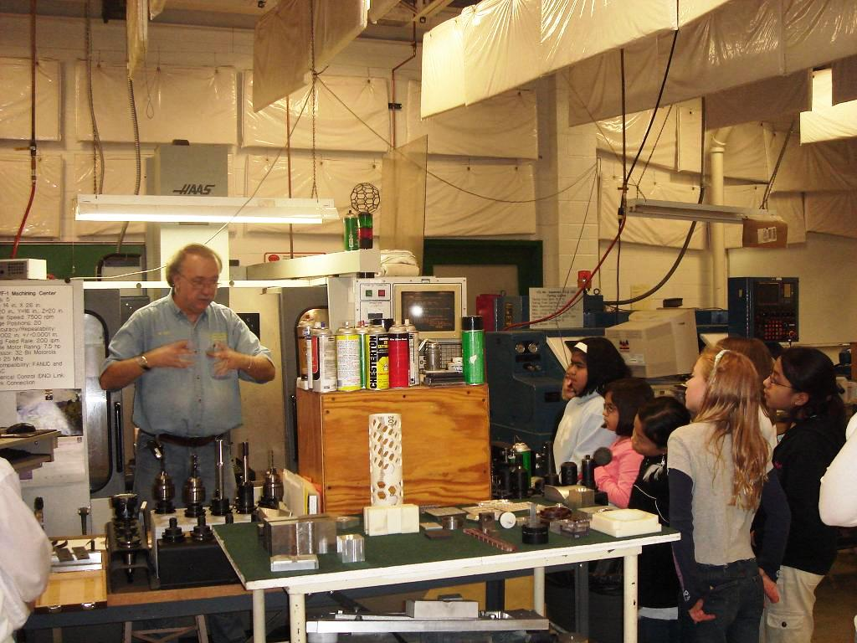
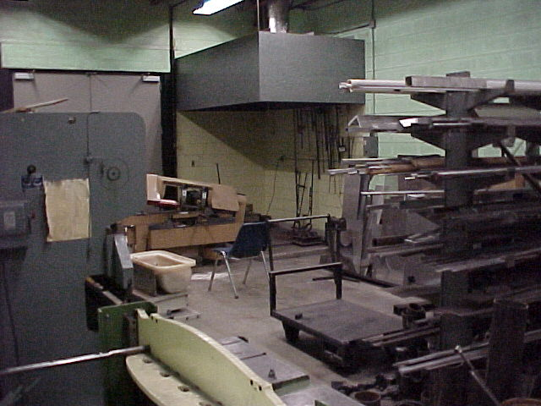
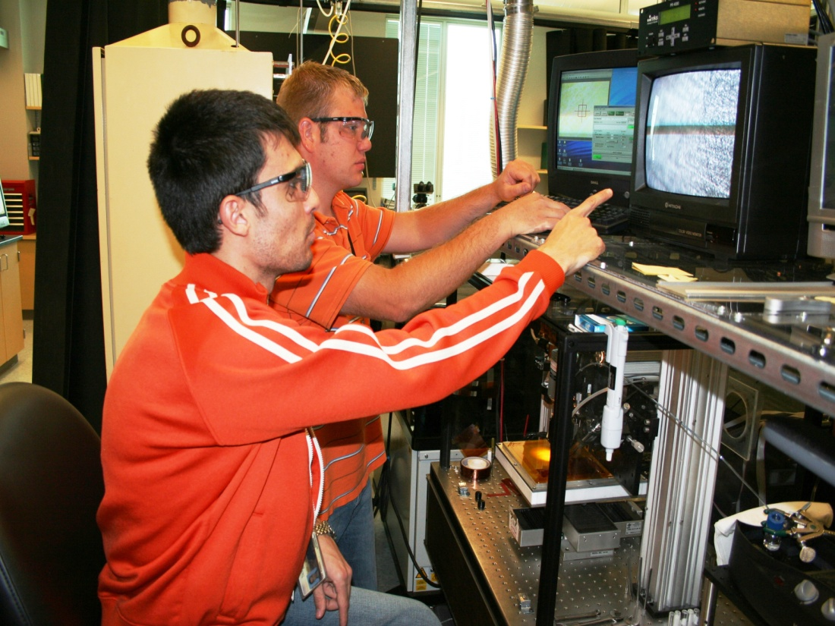

Slide 19
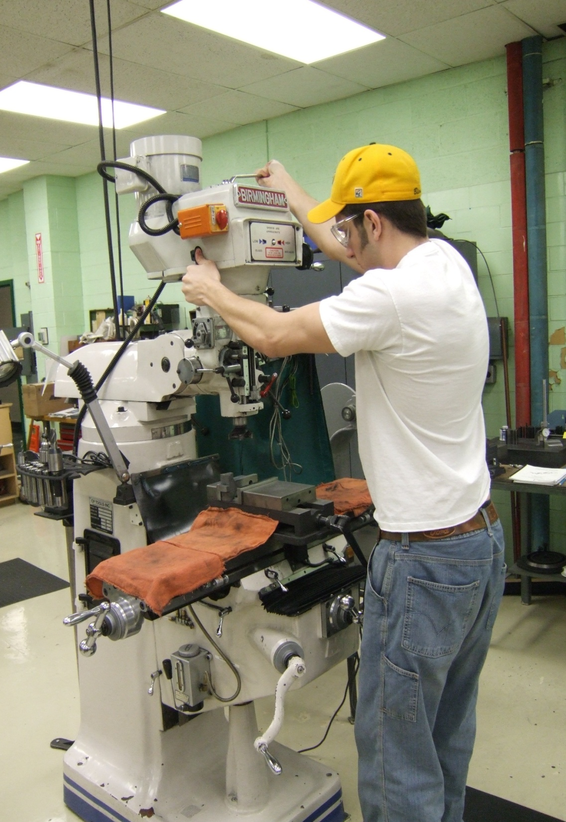
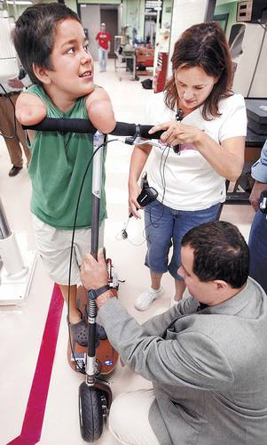

Slide 20
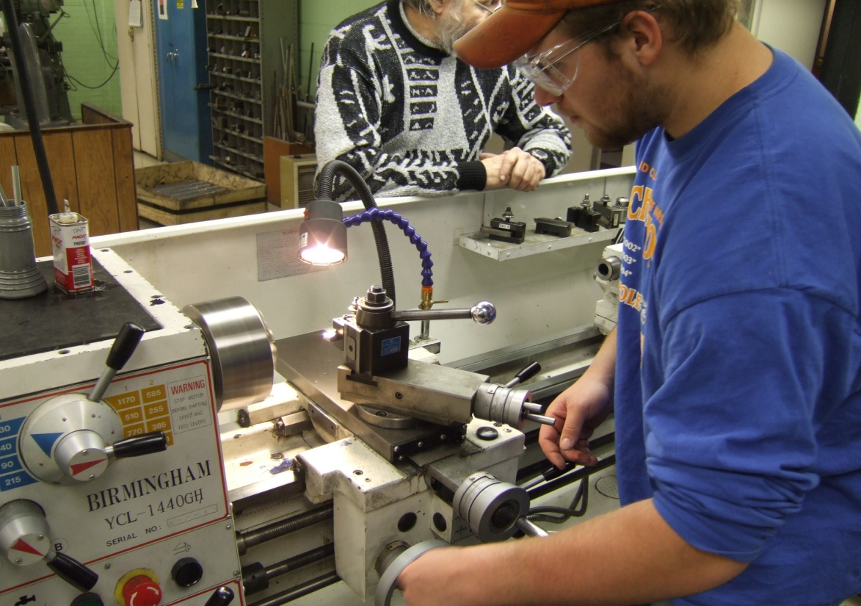

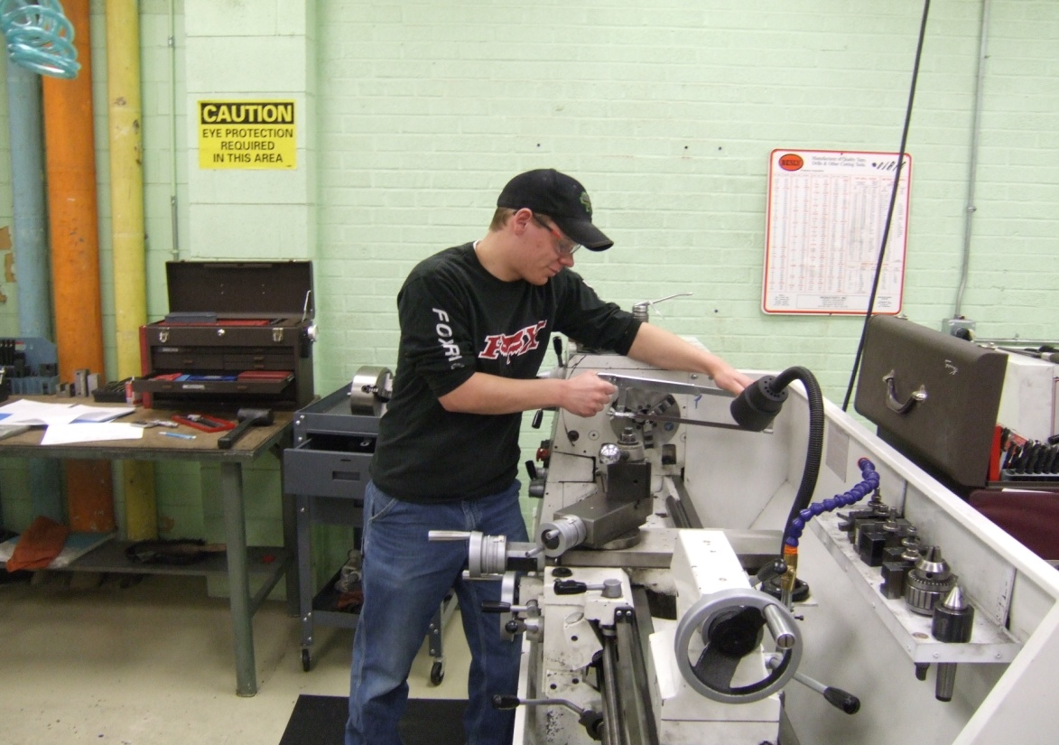
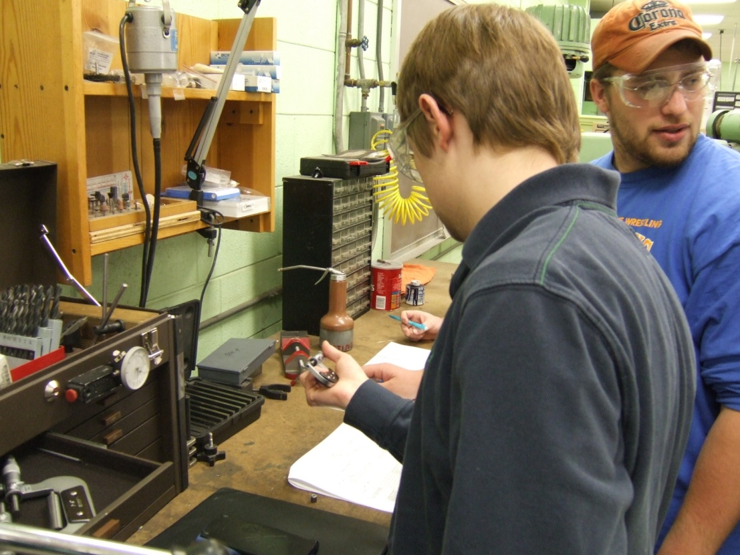

Slide 21
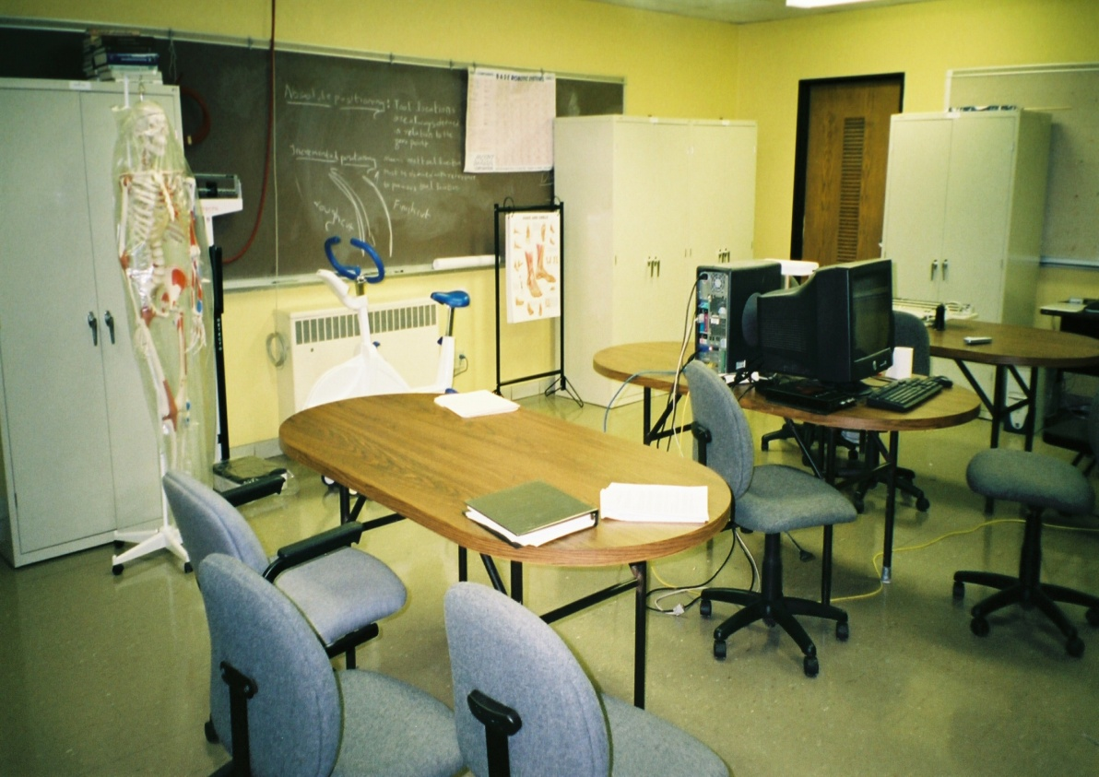
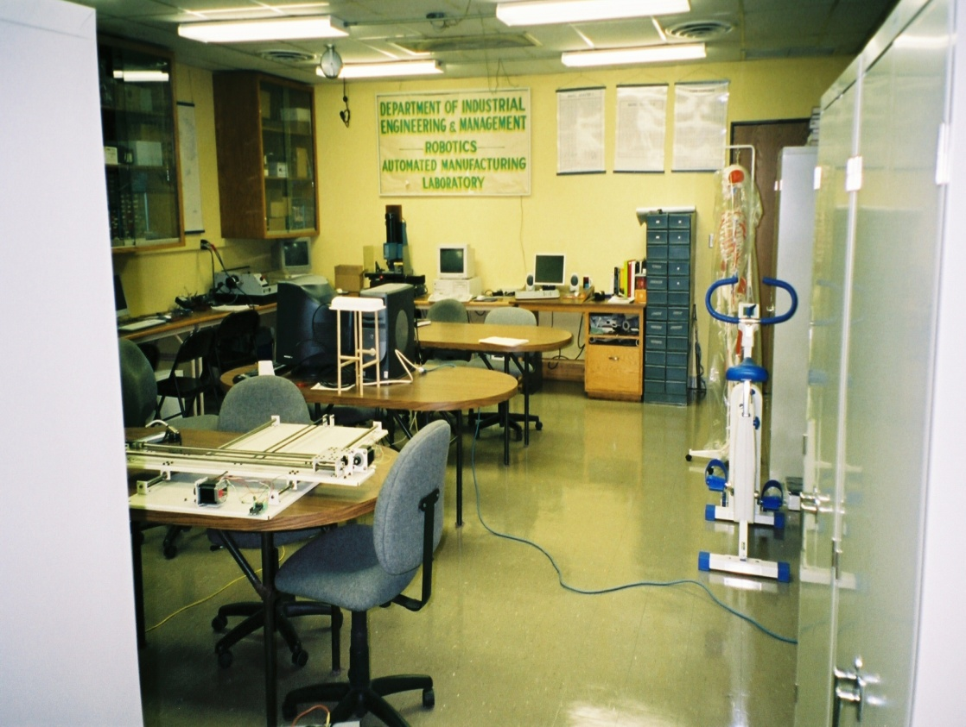
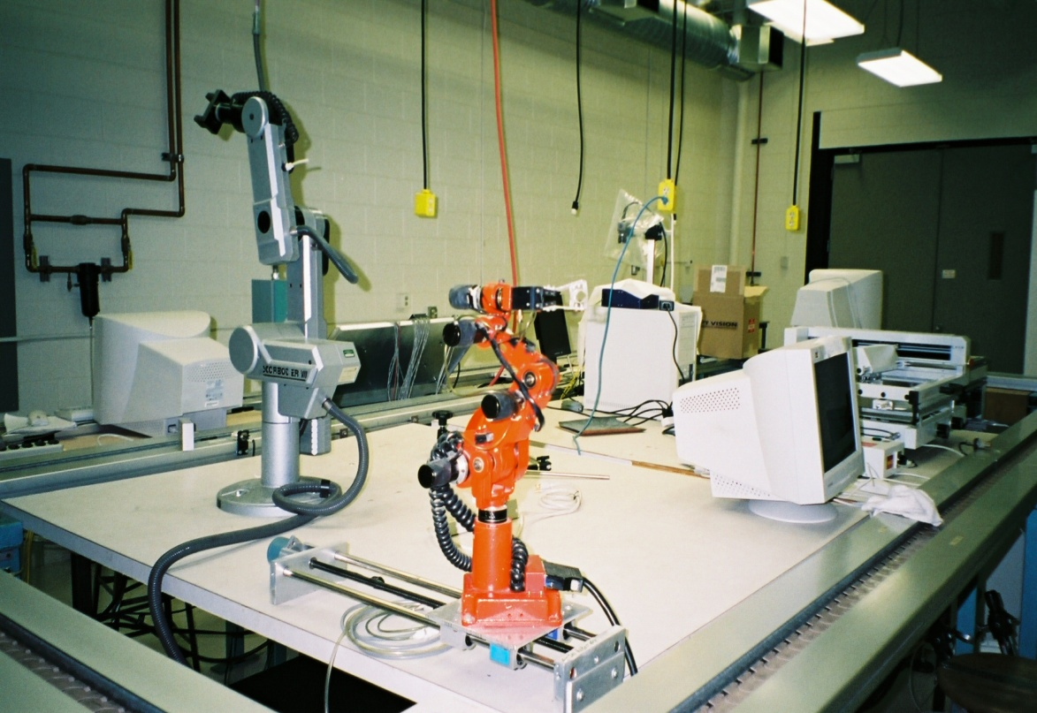
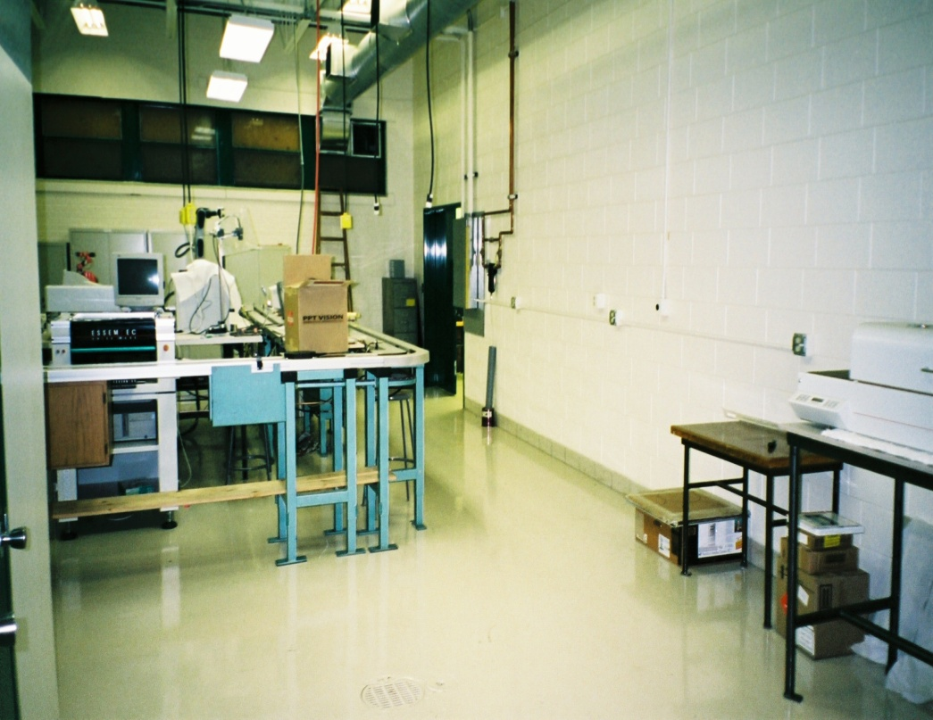

Slide 22
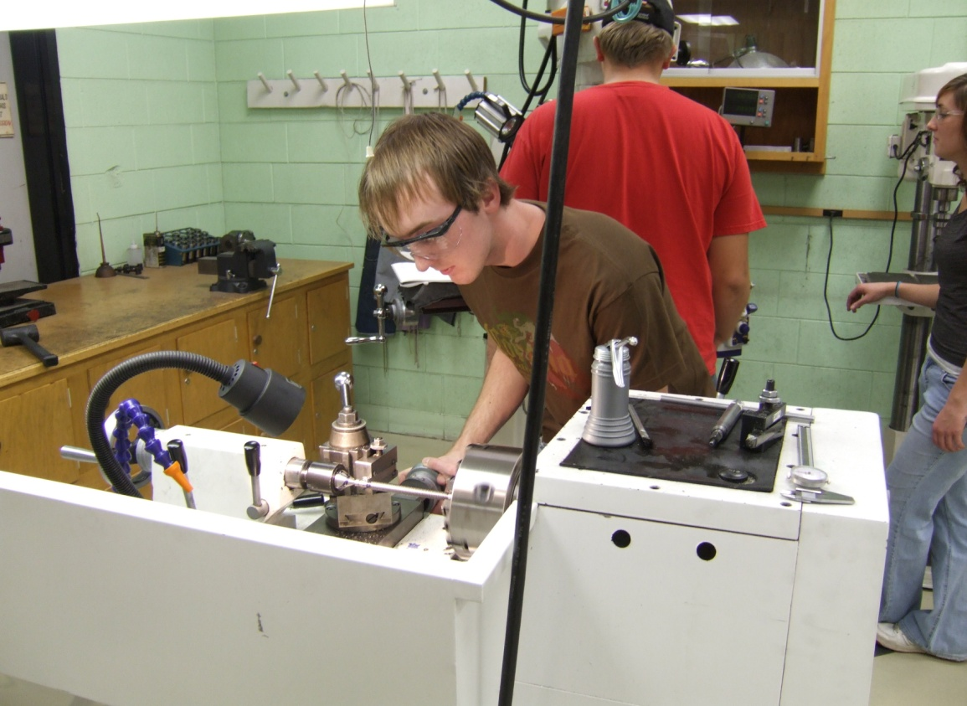
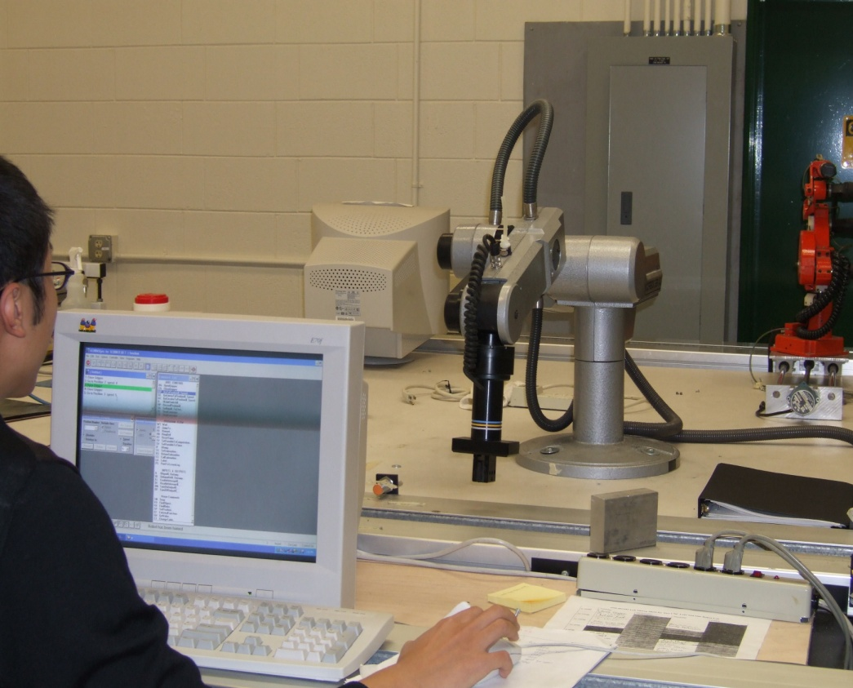
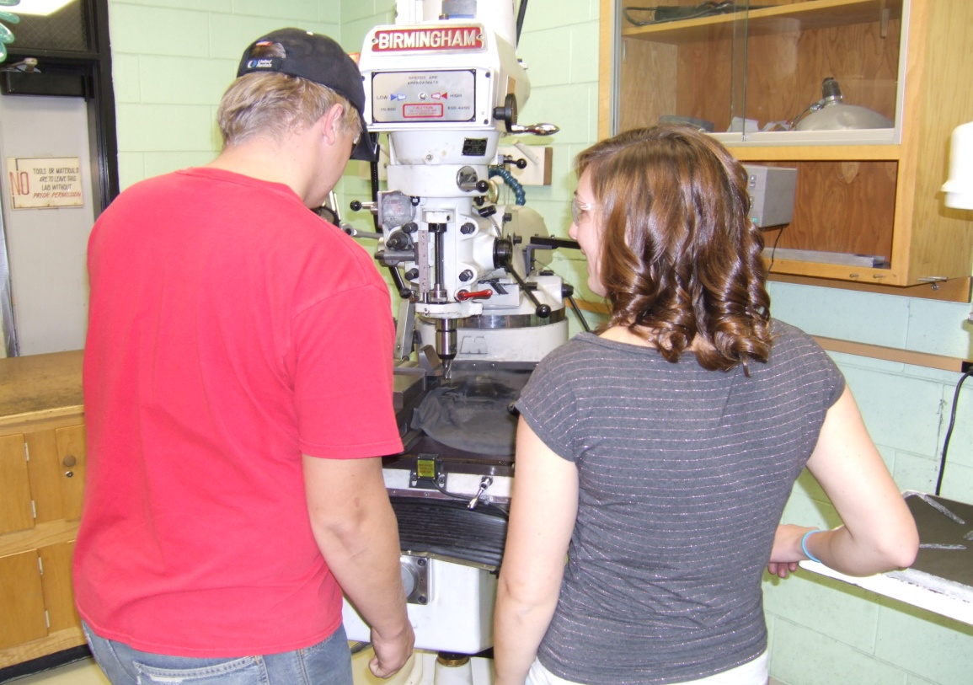
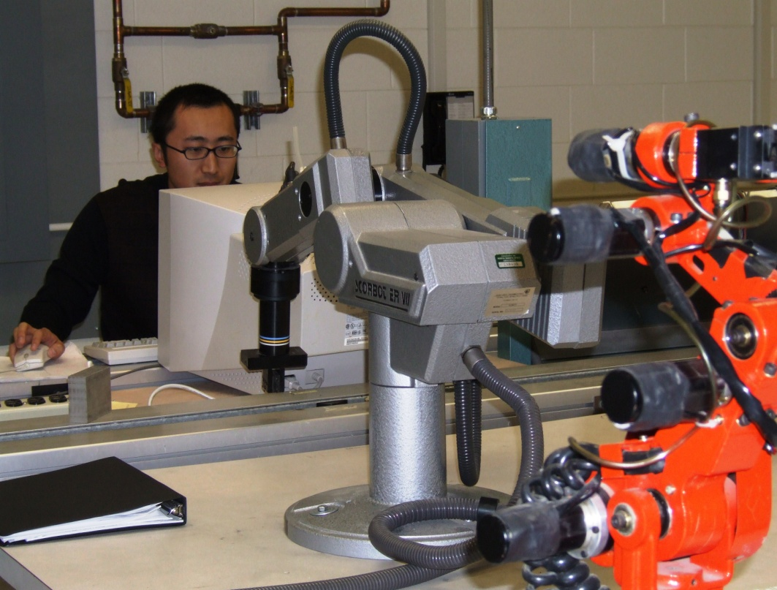

Slide 23
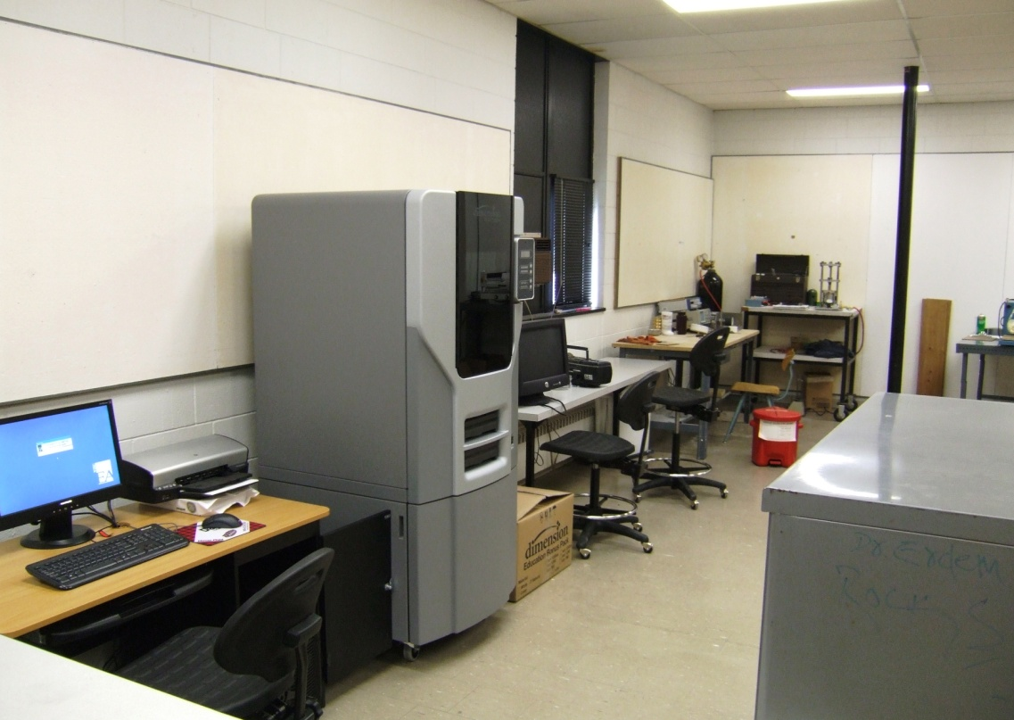
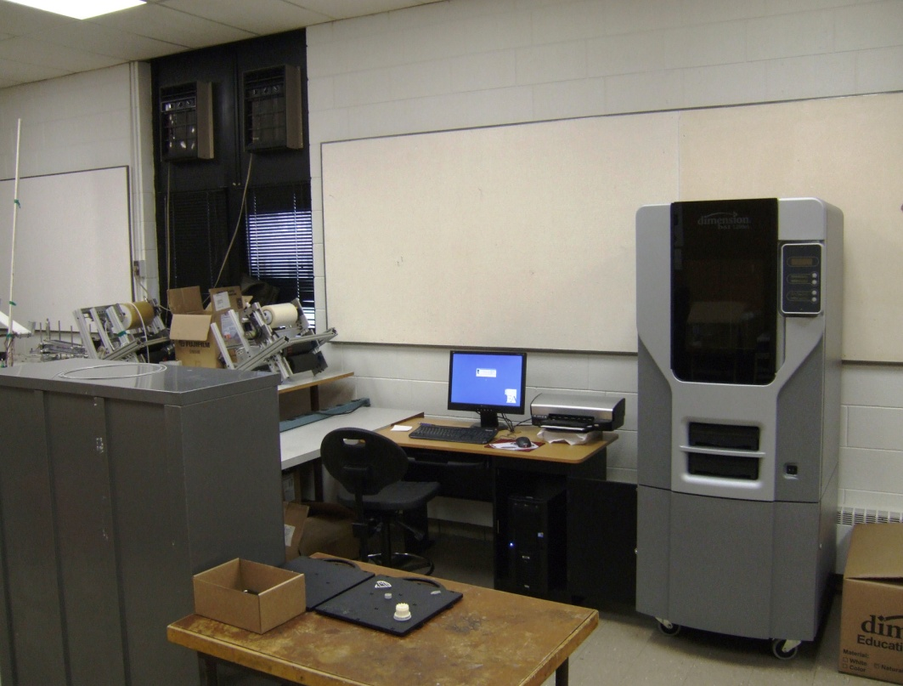
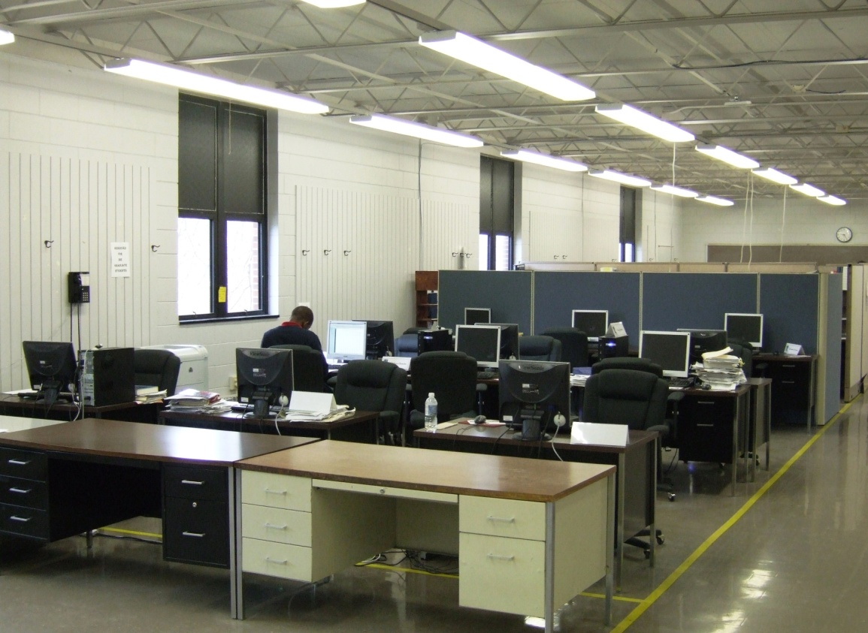
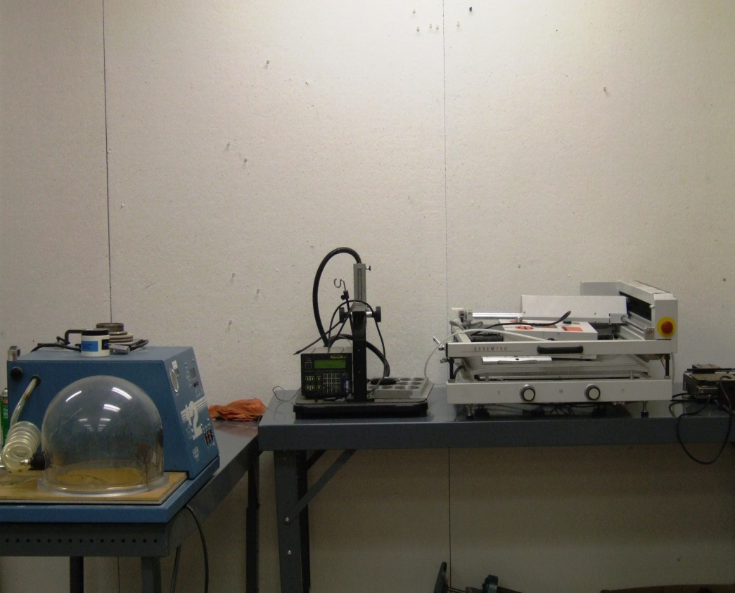

Slide 24
SCHOLARSHIPS
Industrial & Manufacturing Engineering Department
Name of Scholarship | Amount
Gordon Heller | $1,060
The Heller Family Charitable Trust Notebooks and IPods Scholarship | $4000
Dean Joseph Stanislao | $560
Frank Biltonen | $460
Caterpillar Global Paving Sch | $500
Caterpillar Global Paving Sch | $500
Caterpillar Global Paving Sch | $500
Caterpillar Global Paving Sch | $500
Caterpillar Global Paving Sch | $500
Caterpillar Global Paving Sch | $500
Frank Mirgain | $140
Tau Beta Pi | $2,000

Slide 25
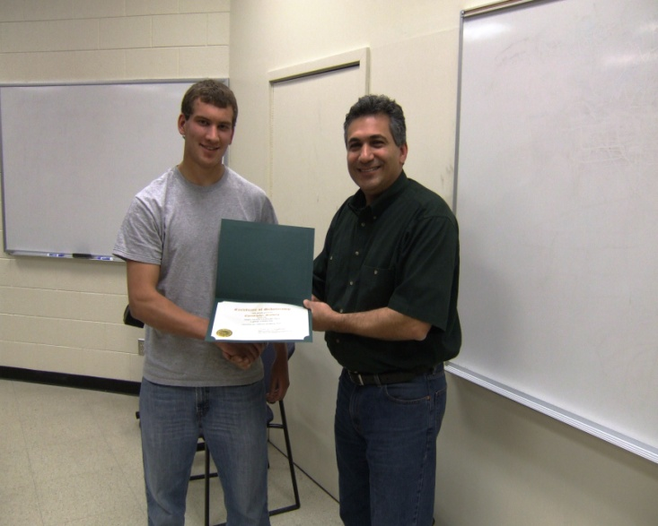

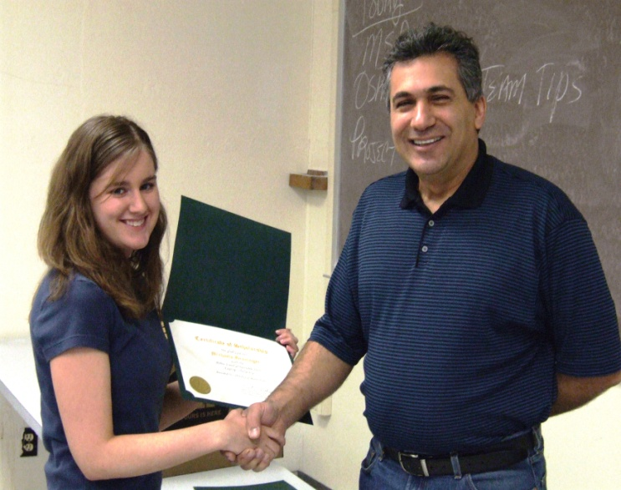
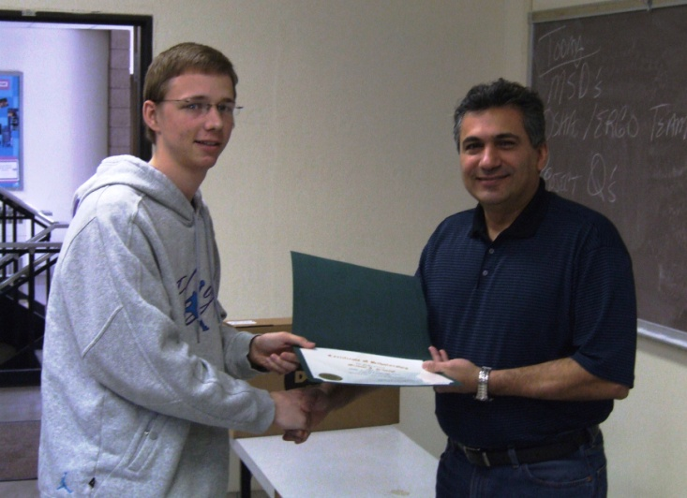
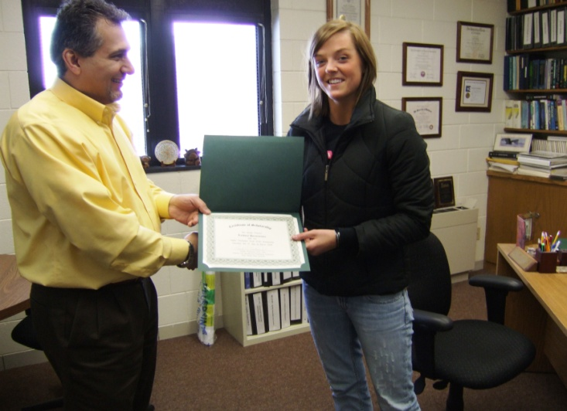
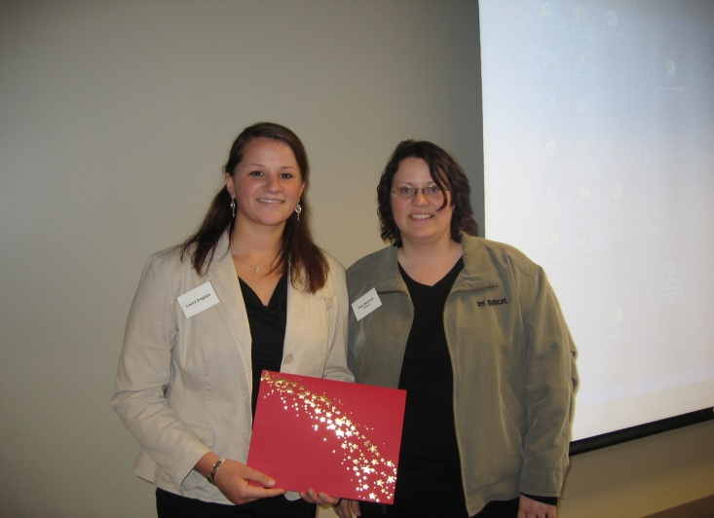
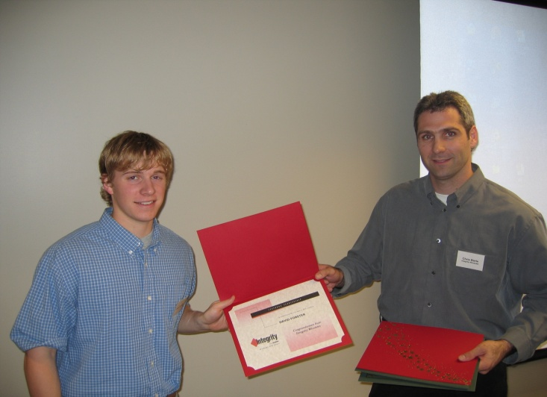

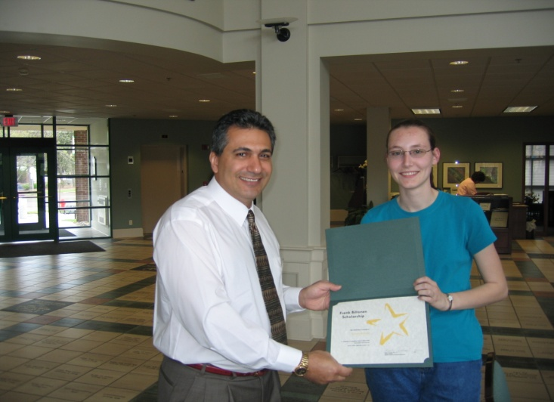

Slide 26
Annual Employment Report
Industrial Engineering & Management Graduates
Year | Graduates | Male | Female | Minority | Unable to Survey | Post Baccalaureate & Professional | Entering Job Market | Employed Related to Major/Minor | Employed Unrelated to Major/Minor | Active in Job Search | Percent Employed | Salary Range ($1,000k) Average-High
2009 | 21 | 16 | 51 | 0 | 2 | 1 | 18 | 10 | 2 | 6 | 67% | 51-80
2008 | 16 | 15 | 1 | 0 | 2 | 0 | 14 | 13 | 0 | 1 | 93% | 52-59
2007 | 15 | 9 | 6 | 0 | 5 | 1 | 9 | 9 | 0 | 0 | 100% | 49-56
2006 | 18 | 17 | 1 | 2 | 3 | 1 | 14 | 14 | 0 | 0 | 100% | 40-48-58
2005 | 18 | 12 | 6 | 1 | 0 | 0 | 18 | 14 | 2 | 2 | 89% | 31-46-59
2004 | 14 | 11 | 3 | 1 | 0 | 2 | 12 | 12 | 0 | 0 | 100% | 43-48-55

Slide 27
Annual Employment Report
Manufacturing Engineering Graduates
Year | Graduates | Male | Female | Minority | Unable to Survey | Post Baccalaureate & Professional | Entering Job Market | Employed Related to Major/Minor | Employed Unrelated to Major/Minor | Active in Job Search | Percent Employed | Salary Range ($1,000k) Average-High
2009 | 3 | 3 | 0 | 0 | 0 | 0 | 3 | 1 | 0 | 2 | 33% | n/a
2008 | 6 | 5 | 1 | 0 | 1 | 0 | 5 | 5 | 0 | 0 | 100% | 48-53
2007 | 5 | 4 | 1 | 0 | 0 | 0 | 5 | 4 | 0 | 1 | 99% | 51-60
2006 | 7 | 7 | 0 | 0 | 1 | 0 | 6 | 6 | 0 | 0 | 100% | 40-48-58
2005 | 6 | 6 | 0 | 1 | 2 | 0 | 4 | 4 | 0 | 0 | 100% | 21-26-33
2004 | 6 | 5 | 1 | 1 | 0 | 0 | 6 | 6 | 0 | 0 | 100% | 33-47-55

Slide 28
Companies Hiring our Students
Allete/Minnesota Power
Allied Machine & Engineering Corporation
AMEC
American Cast Iron Pipe Company (ACIPCO)
American Crystal Sugar Company
Applied Engineering, Inc.
BAE Systems
Baker Hughes
BNSF Railway Company
Bobcat Company
Boston Scientific
Burns & McDonnell
Caterpillar Inc
Central Boiler, Inc.
Cirrus Design Corporation
CNH
D.H. Blattner & Sons, Inc.
Halliburton
John Deere
Karges-Faulconbridge, Inc.
M.A. Mortenson Company
Marvin Windows and Doors
Oregon Department of Transportation
Oshkosh Truck Corporation
Puget Sound Naval Shipyard
Rockwell Collins
Saint-Gobain Abrasives
Schlumberger
Securian Financial Group
Steffes Corporation
The Interstates Companies
U.S. Customs & Border Protection
U.S. Water Services
UPS
Utility Engineering
Valley Engineering, Inc.
Vermeer
Walmart

Slide 29























List of regional companies we interact with

Slide 30















List of regional companies we interact with
fac

Slide 31
















List of regional companies we interact with

Slide 32





Slide 33
Professional Student Chapters
Society of Manufacturing Engineers (SME)
Institute of Industrial Engineers (IIE)
Surface Mount Technology Association (SMTA)
Society of Women Engineers (SWE)
Alpha Pi Mu

Slide 34
Beyond the Academics
IME department sponsors activities such as:
  Engineering Week
  Engineering & Technology Expo
  Engineering & Architecture Ambassadors
  TechGYRLS
  Bison Best
  Sports
  NDSU student clubs

Slide 35
2008 Department Events
HIMSS Conference - February 21-24, 2008
2008 IIE North-Central Regional Conference Chicago Illinois - February 28-March 2, 2008
SMTA Summit - April 15, 2008
IIE Picnic – September 9th, 2008

Slide 36
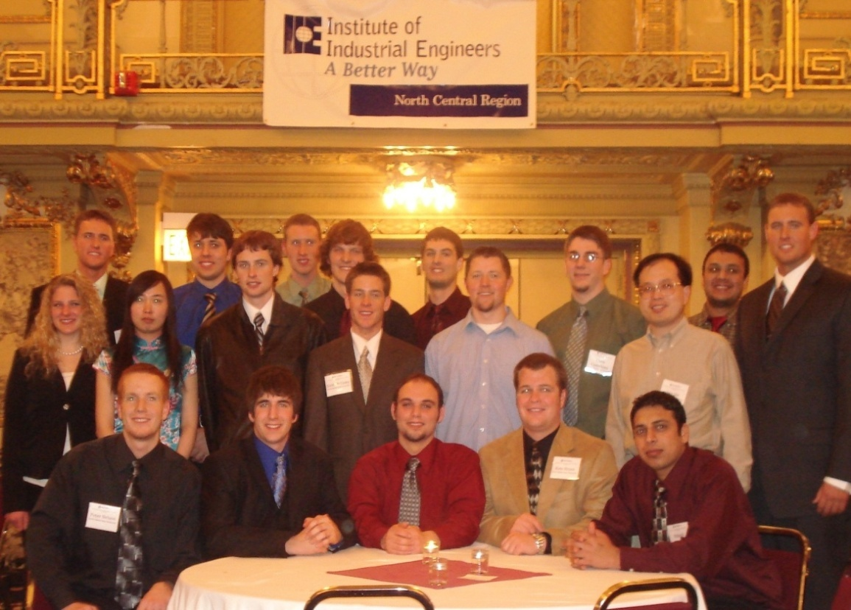
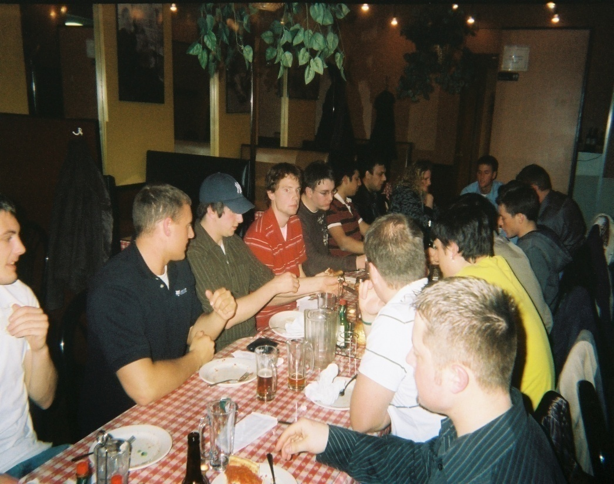



Slide 37
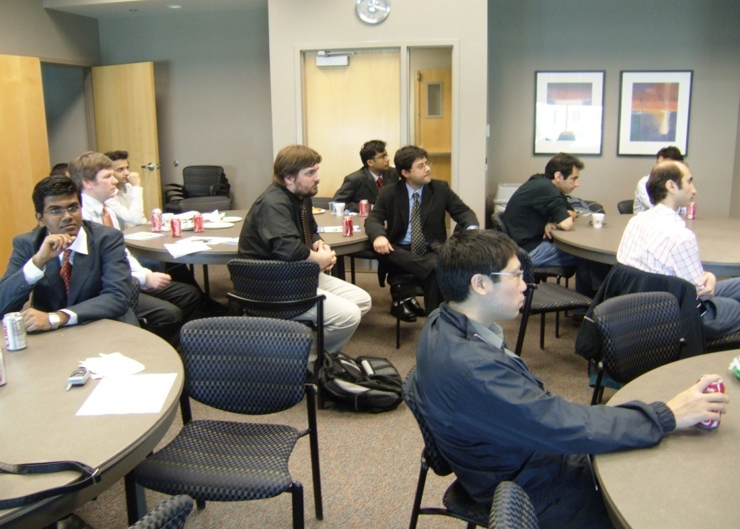
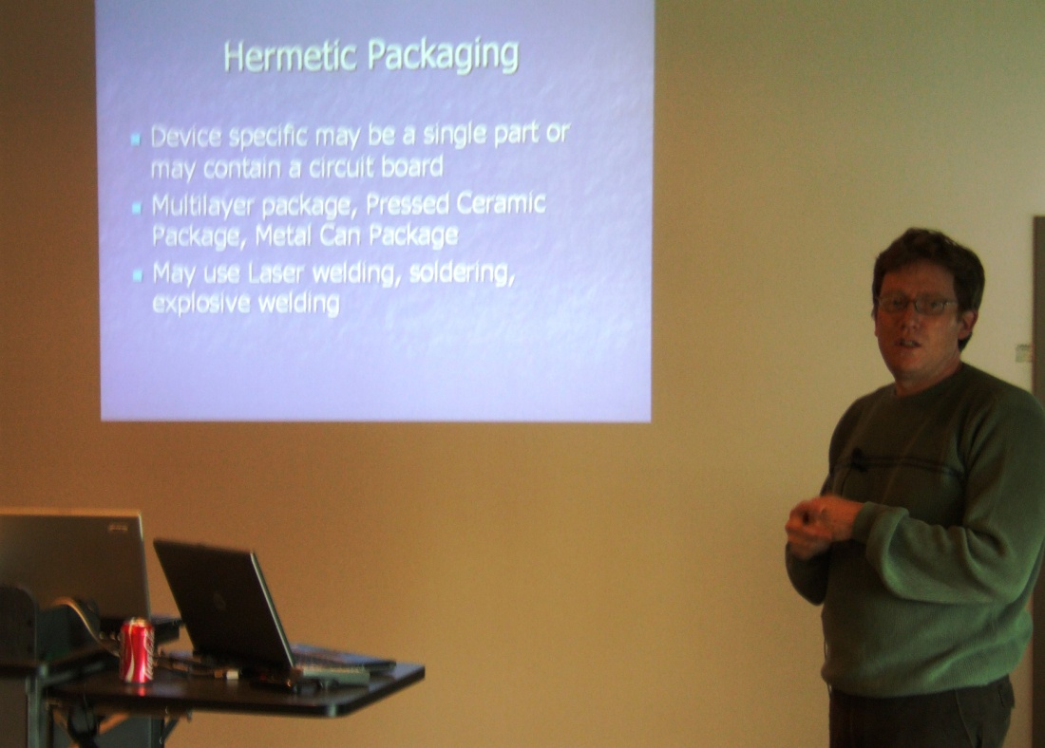

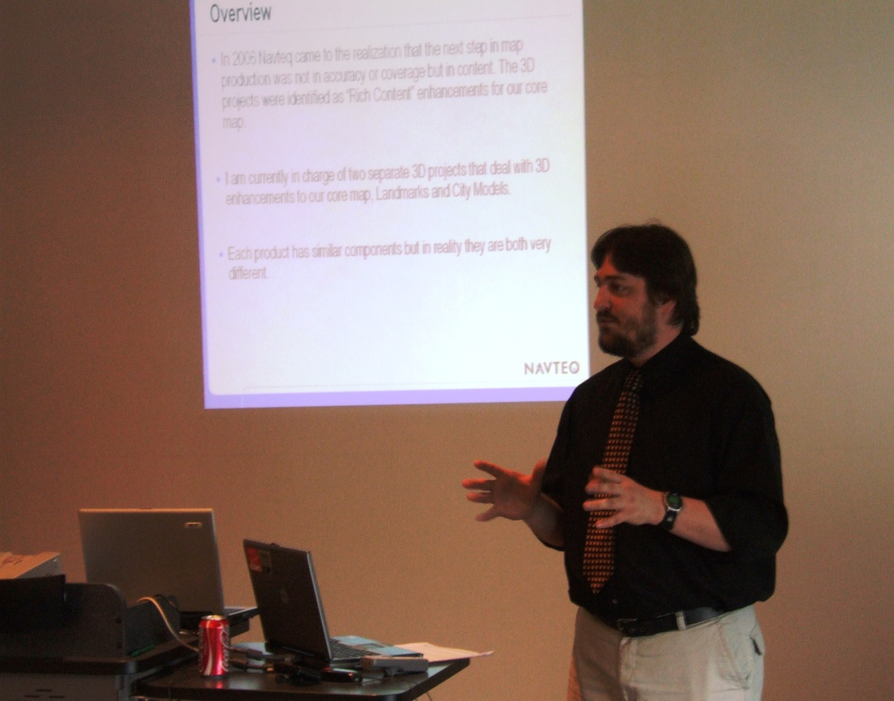

Slide 38
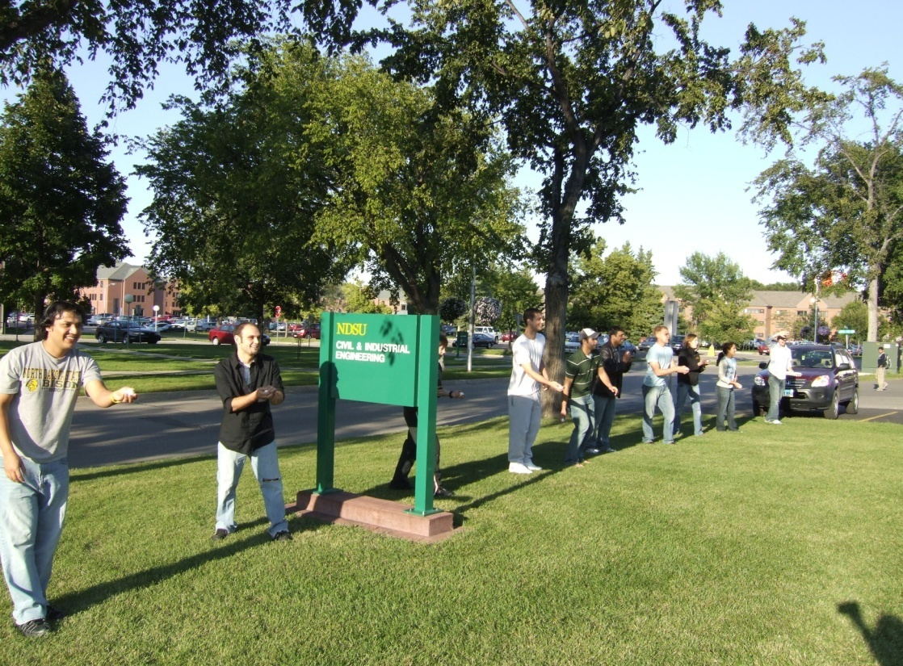
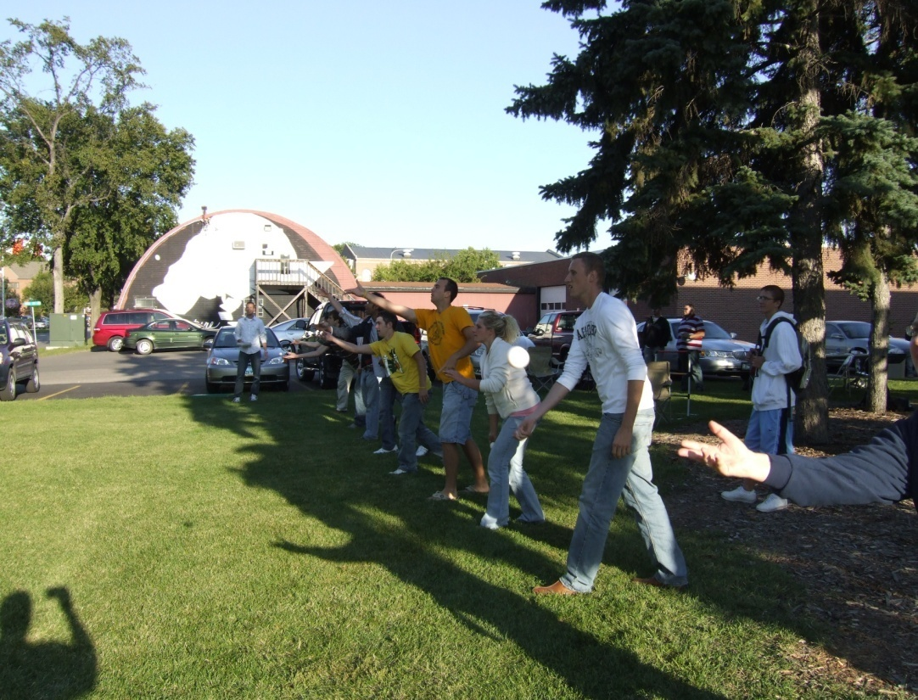
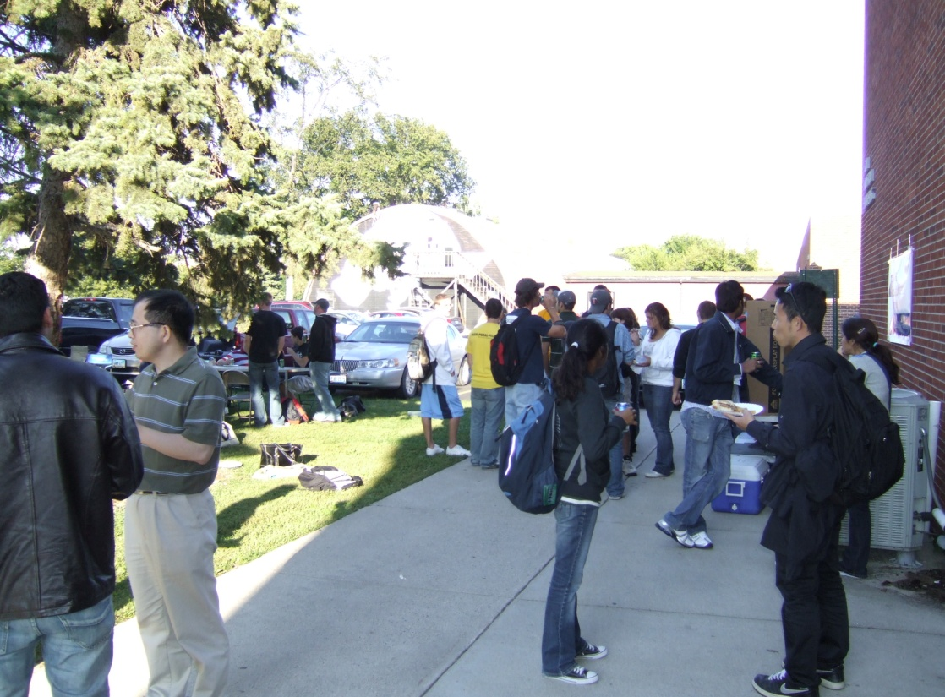
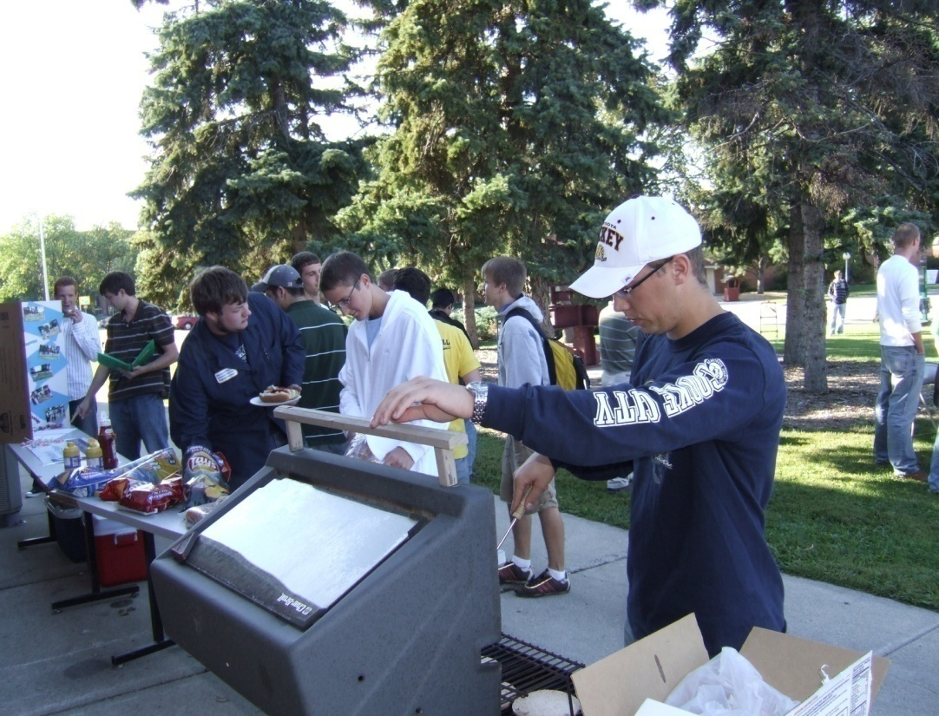

Slide 39
2009 Department Events
2010 IIE North-Central Regional Conference Madison, WI - February Feb. 18 – 21, 2010
2010 SHS/ASQ Conference/Expo
Atlanta, GA - February 25-28, 2010
2010 HIMSS Conference, Atlanta, GA
March 1 – 4, 2010

Slide 40


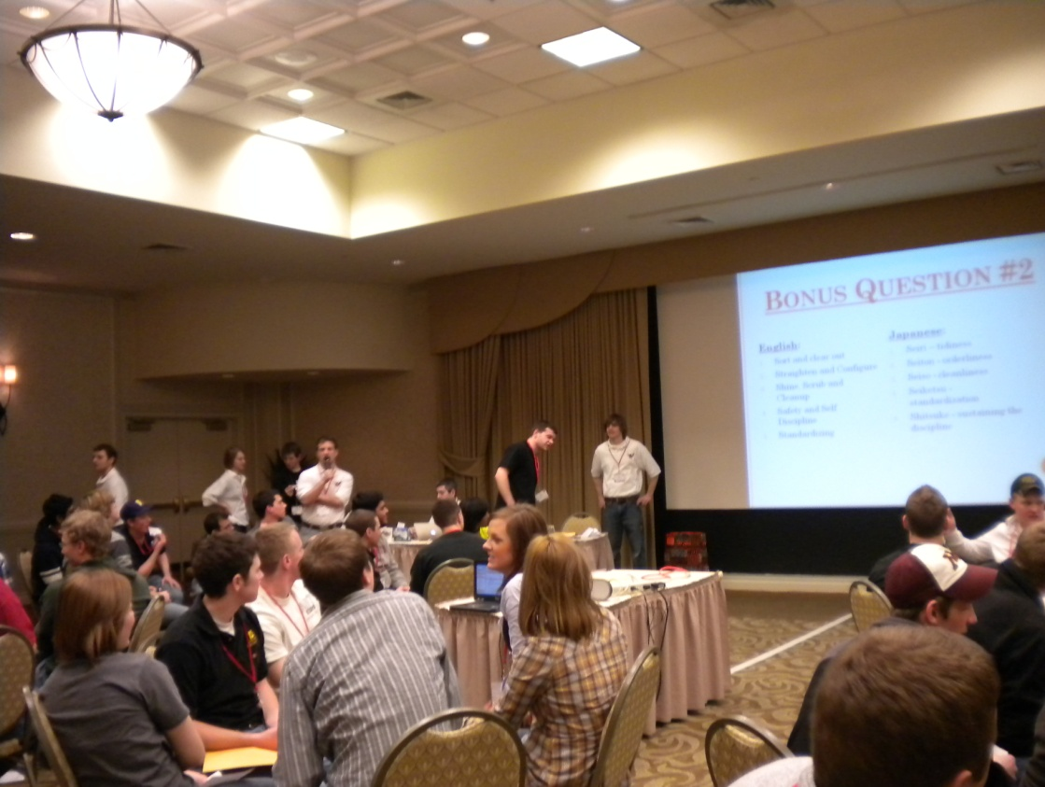
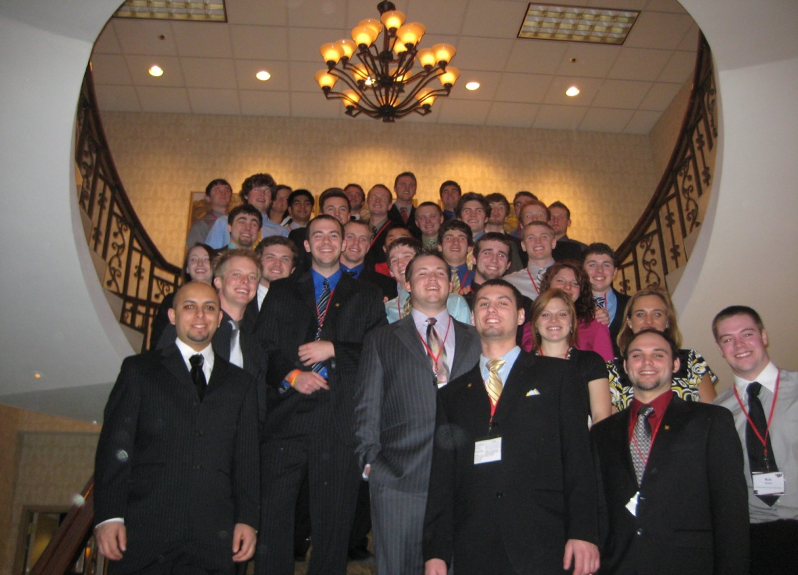

Slide 41
BISON BEST Competition
2008 Theme – “Just Plane Crazy!”
2009 Theme – “High Octane!”
2010 Theme – “Total Recall!”

Slide 42
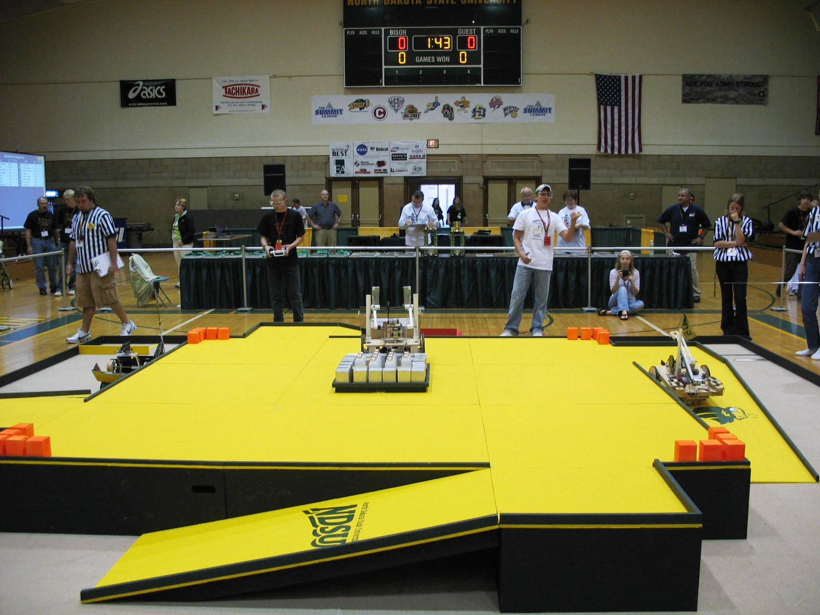
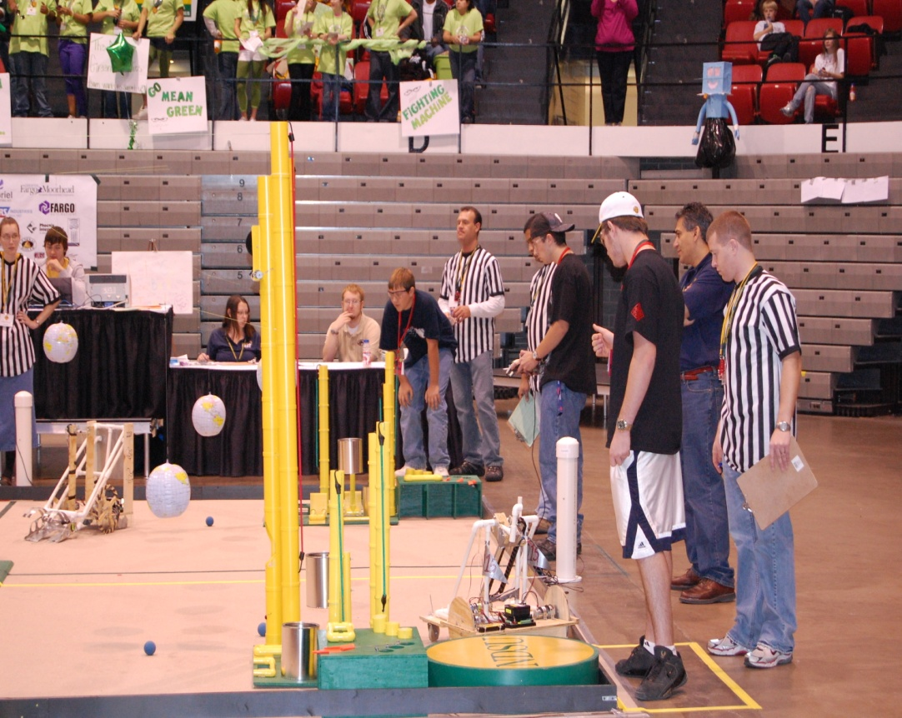
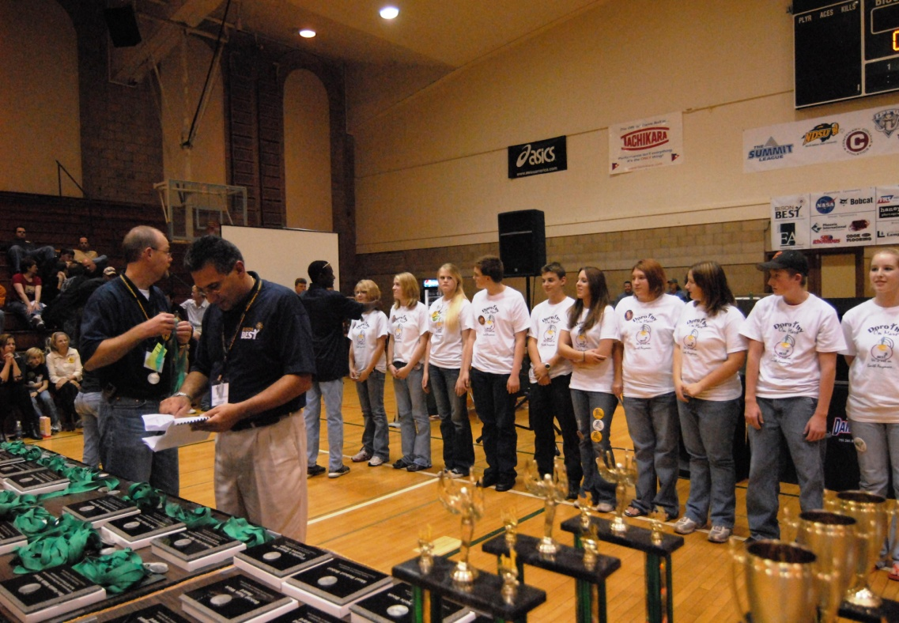


Slide 43
Industrial & Manufacturing Engineering
Department Web Link
  http://www.ndsu.edu/ime/
Video Link
  Part 1
  http://www.youtube.com/watch?v=7TtWRmmsHVE&feature=channel&fmt=8
  Part 2
  http://www.youtube.com/watch?v=faKxg9-osd8&fmt=8

Slide 44
Industrial & Manufacturing Engineering
Department of Industrial and Manufacturing Engineering
North Dakota State University, Fargo, North Dakota 58105
Phone: (701) 231-7287, Fax: (701) 231-7195
Web Site: http://www.ndsu.edu/ndsu/ime/

