Slide 1


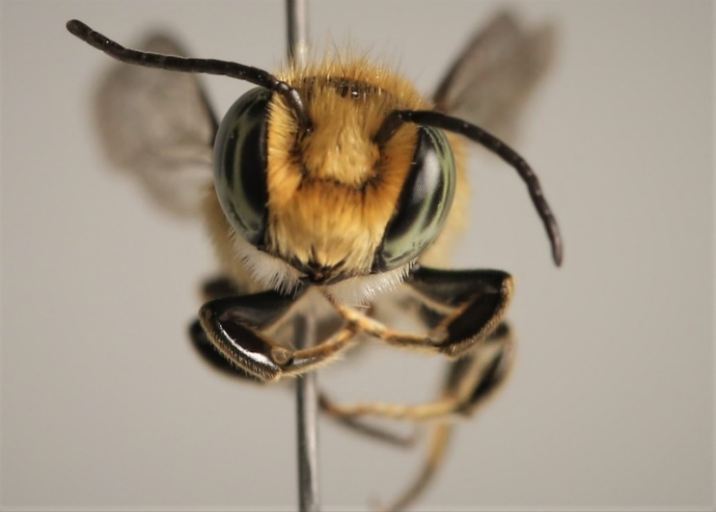

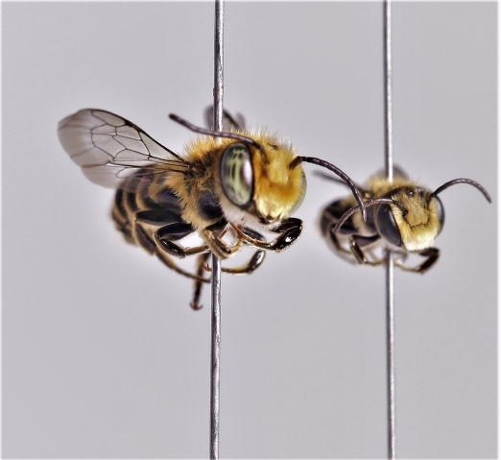
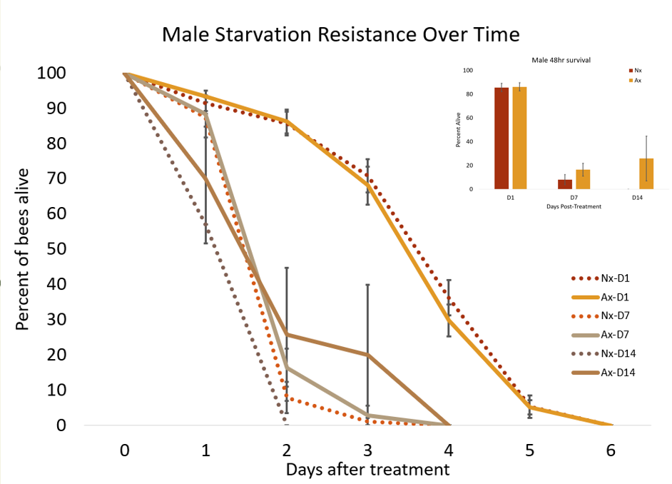
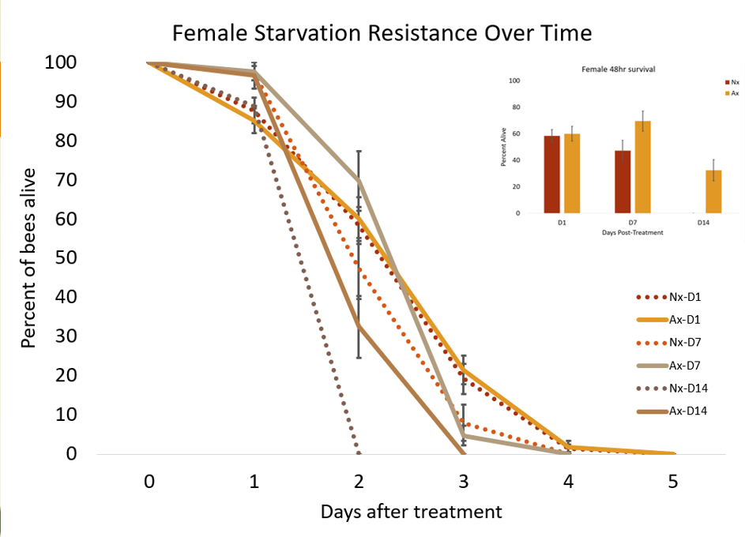
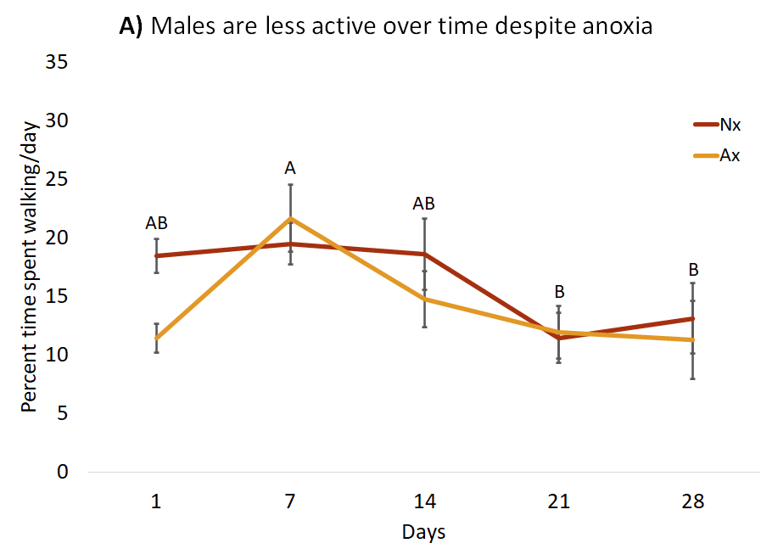
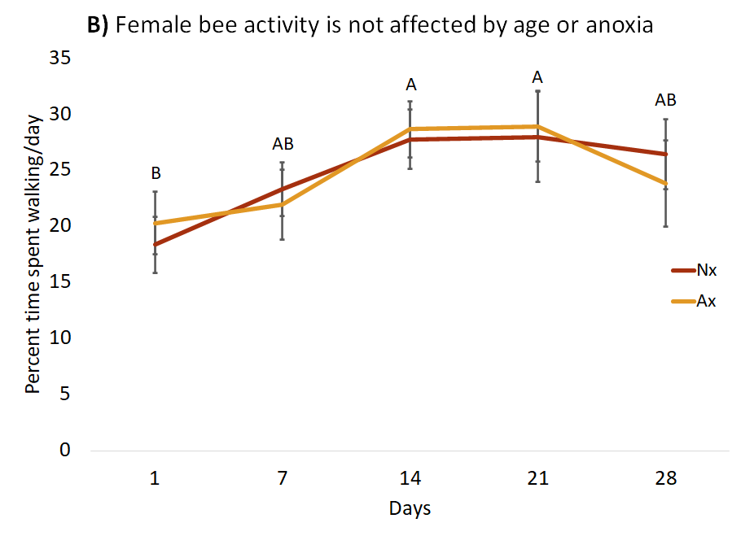
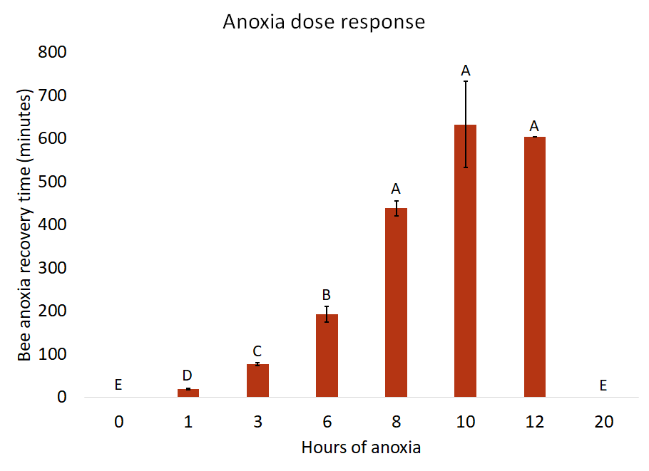
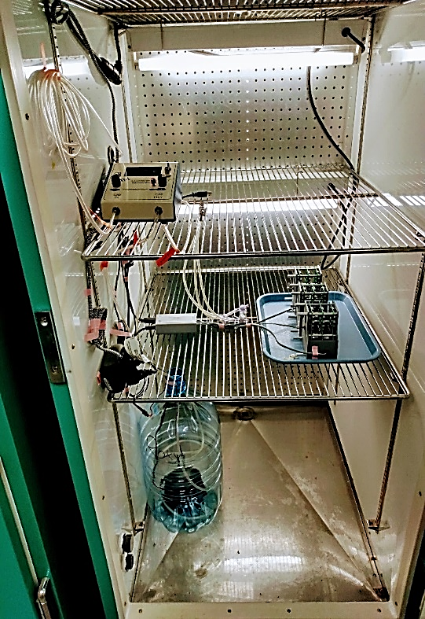
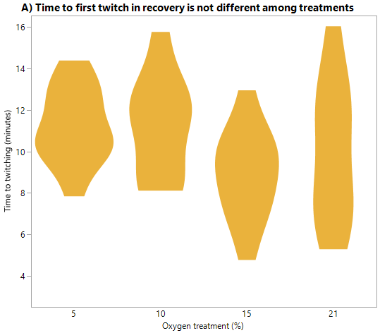
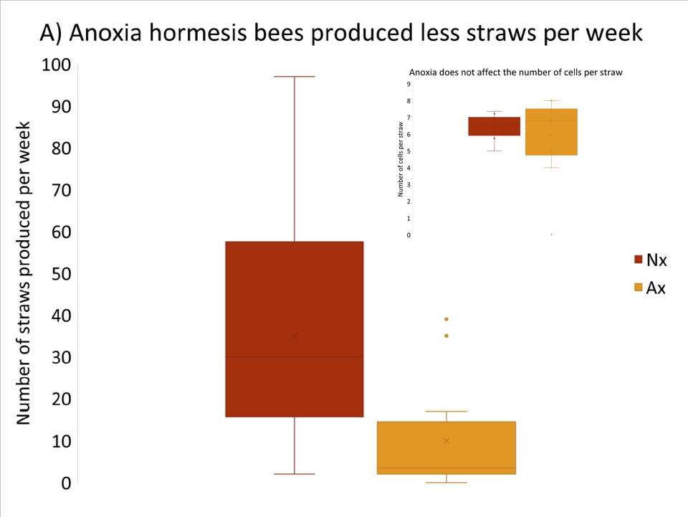
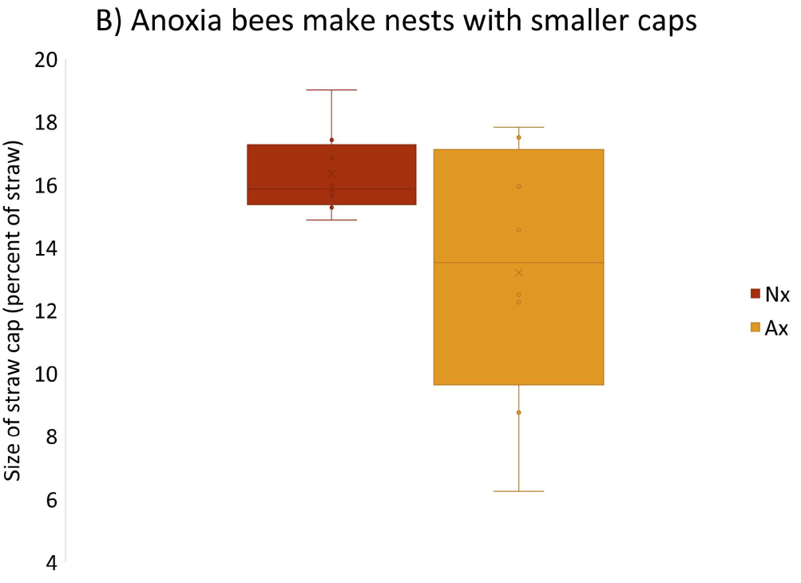
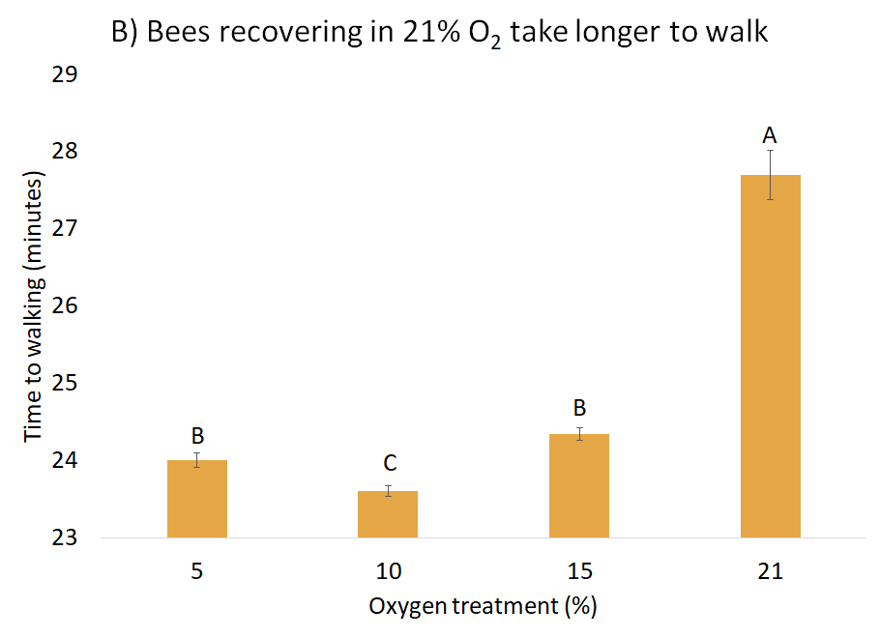
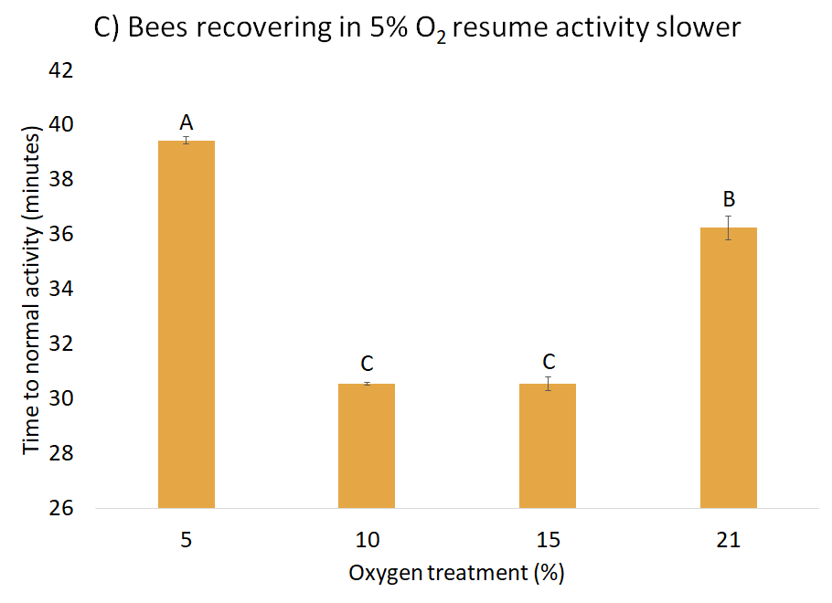
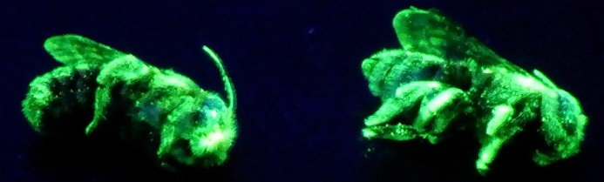
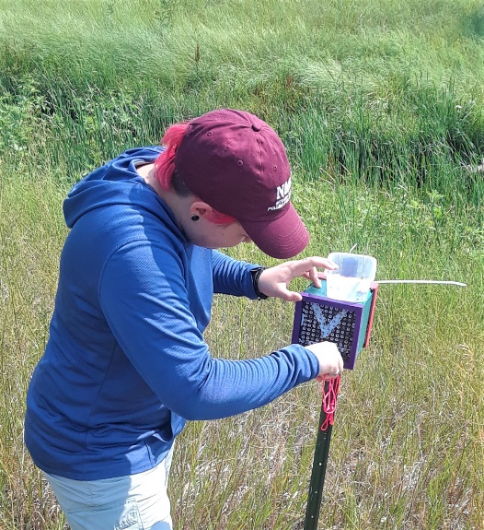
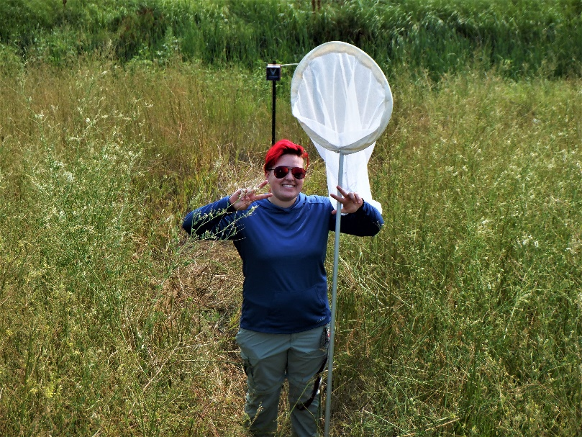
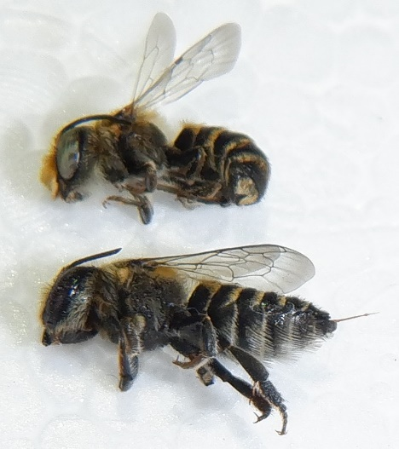
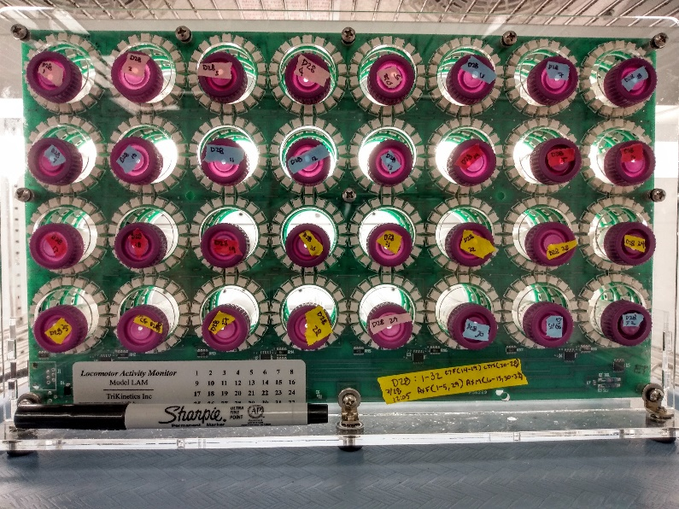
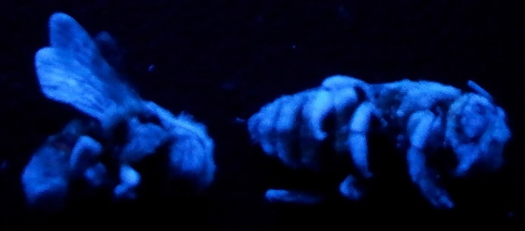
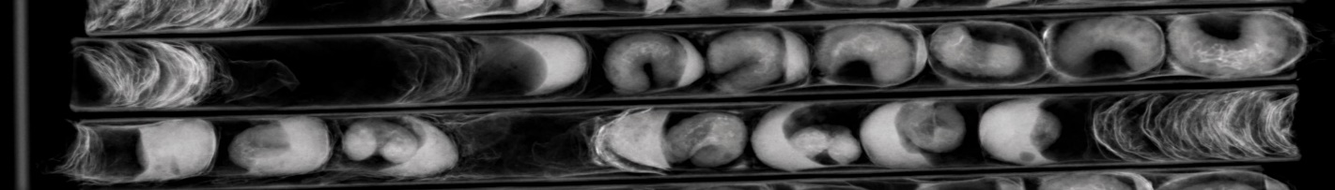

A Tale of Two –oxias: When Living Longer Comes with Better Performance Michaelyne Jo Wilkinson¹ and Giancarlo López-Martínez² ¹New Mexico State University^{, 2}North Dakota State University
Introduction
Results
Conclusion
Anoxia, oxygen-free environment, is known to elicit hormetic responses, which are low dose responses that improve performance. Previously shown in the Alfalfa leafcutter bee, anoxia hormesis improves short-term activity, starvation resistance, and longevity. This improvement is related to a decrease in free radical production in the mitochondria, which leads to lower oxidative damage in tissues. Here we explored the long-term effects of anoxia hormesis.
A)
B)
Anoxia hormesis improves starvation resistance in bees as they age.
Anoxia doesn’t negatively affect activity as bees age.
The cost of anoxia hormesis rests on reproductive output.
Anoxia recovery in normoxia (21%) takes the longest.
Figures 3 A,B: Bees treated with anoxia were not negatively affected in starvation resistance early in life (A) p =0.4204 ; (B) p=0.743. Bees later in life were positively affected by the treatment (male p<0.0001top left; female p=0.0231 top right)
Further Research
Examine the effects of recovery in different oxygen concentrations: 5, 10, 15, and 21% to determine the extend of oxidative damage. Test where recovery conditions affects hormesis potential.
Figure 1: dose response to anoxia measured by the time it took for the bees to recover
Methods
Figure 4: A) Male walking activity declines with age (p = 0.0034) and anoxia does not prevent that (p = 0.1571). B) Female activity remains constant throughout life (p = 0.1326) and anoxia treatment has no effect (p = 0.9827).
Adult bees emerging within 24 hours were captured, placed in syringes, flushed with nitrogen gas, and sealed in a bag.
Bees were under anoxia for 1, 3, 6, 8, 10, 12, 20, or 24 hrs.
One hour was determined to be the hormetic dose.
Bees were then used in:
Anoxia recovery
Activity throughout life
Starvation resistance
Reproduction
Figure 9: Gas mixing(ROXY) and activity monitoring (DAM) setup.
Figure 10: A) During anoxia recovery, the oxygen concen-tration does not impact time to first twitch (p = 0.1299). B) Bees recovering in 10% O₂ start walking sooner (p < 0.0001). C) But 10 and 15% O₂ treated bees resume average activity first
(p < 0.001).
Figure 5: A) Anoxia hormesis bees experienced a 71% reduction in total reproductive output (p = 0.0029), even though the total number of nest straws changed, the total number of offspring/straw did not (p = 0.7261). B) Nest caps are smaller in anoxia treated bees (p = 0.401).
Figure 7(left): straws being collected
Figure 8(right): ecosystem around nest boxes.
Figure 2: A) Drosophila Activity Monitor (DAM) and B) fluorescent powdered bees for field release.
Figure 6: Unidirectional brood cell (top) V.S. a bidirectional brood cell (bottom)
Thanks to: Joseph P. Rinehart, USDA ARS, and the ICE. Network. Funded by: NSF OIA RII Track-2 #1826834 and USDA NACA #58-3060-9-025.

