Slide 1


Social Drivers of Health
Jorden Laducer, Special Populations Coordinator

Slide 2

Learning Objectives
At the completion of this activity, the learner will be able to:
1. Define health equity and its significance.
2. Identify social determinants of health, their categories, and their interconnectedness.
3. Analyze the connection among social determinants of health, health disparities, and health equity.
4. Differentiate health-related social needs from social determinants of health.
5. Describe population-specific social drivers of health.
6. Apply established frameworks and models to address social determinants of health.

Slide 3
Course Outline
Community Engagement Unit
What is Health Equity and why does it matter?
Define the Social Drivers of Health, the types and the ecosystem.
Understand the relationship between the Social Drivers of Health, Health Disparities and Health Inequities.
Define Health-Related Social Needs and understand the difference between Health-Related Social Needs and the Social Drivers of Health.
Describe population-specific Social Drivers of Health.
Understand and apply the existing framework and models to address the Social Drivers of Health.

Slide 4

Community Engagement (CE) Unit
The mission of the Community Engagement (CE) Unit is to understand and reduce health disparities among all North Dakotans. The primary goal is to work alongside North Dakota communities in addressing health-related needs to reduce disease rates by providing opportunities for interventions and improving access to health
care. This will ensure that all North Dakotans have the ability to reach their optimal health.

Slide 5
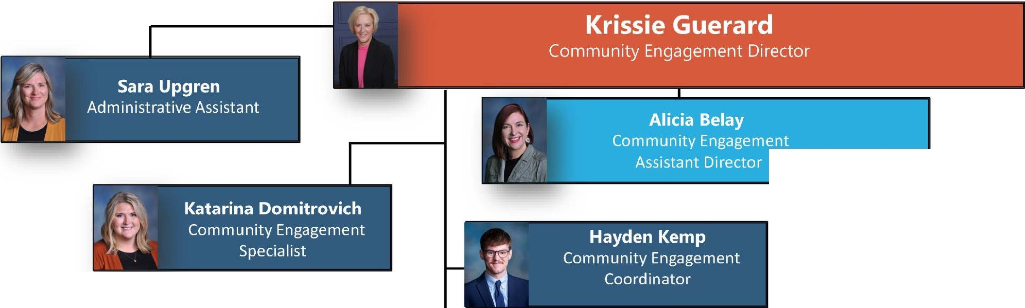
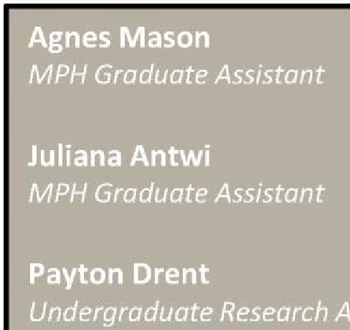
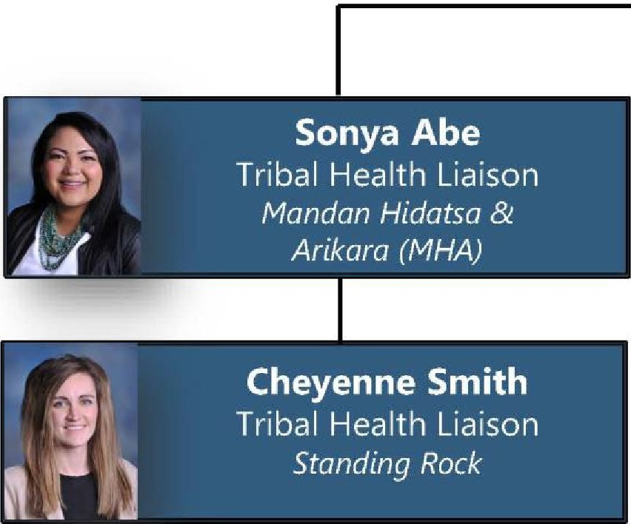
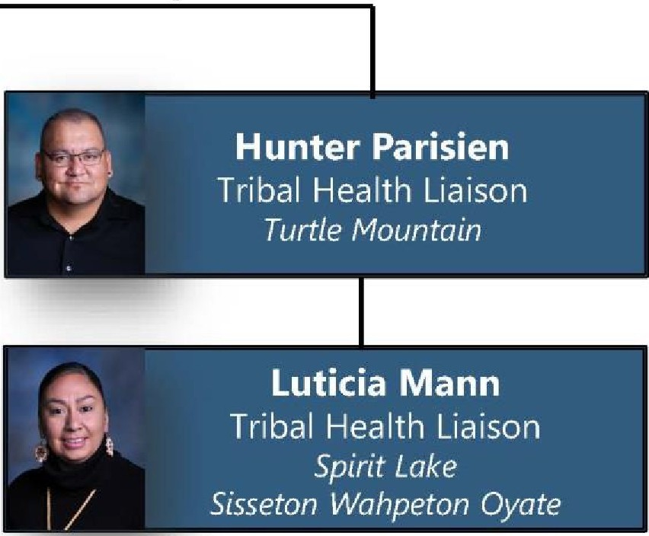


NORTH
Organization Chart January 2024
Dakota I H ealth & Human Services
Bo legenda ry.
Healthy and Safe Communities (HSC) Section
' A
_
Kim Mertz
Community Engagement Unit
,_
HSC
Section Director
,
tf!J
Jorden Laducer
7^{k}8•!
Special Populations
Coordintator
;-
1
r-
Nada Soliman
i1'J z --
Community Liaison
- - - - -
I
Ruth Nwatu
Community Engagement
-
Coordinator

Slide 6
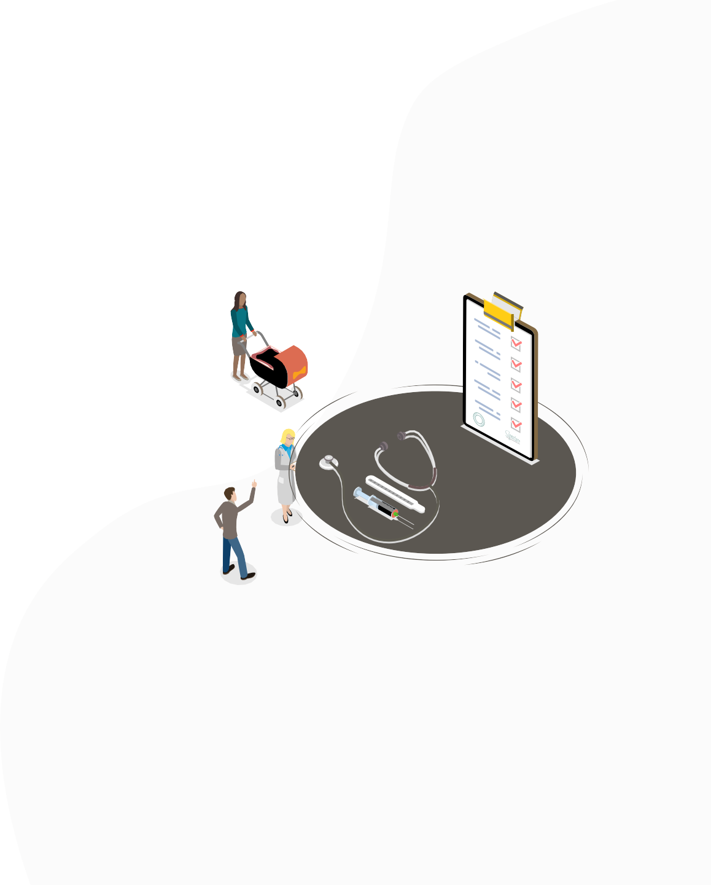


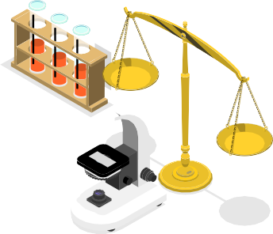







Why Health Equity Matters
Health Equity:
Giving everyone the same opportunity to the highest level of health care that meets their needs.
Health influences all areas of life
Health equity strives to improve the quality of life
Achieving health equity improves all areas of our physical, mental, and emotional well-being

Slide 7
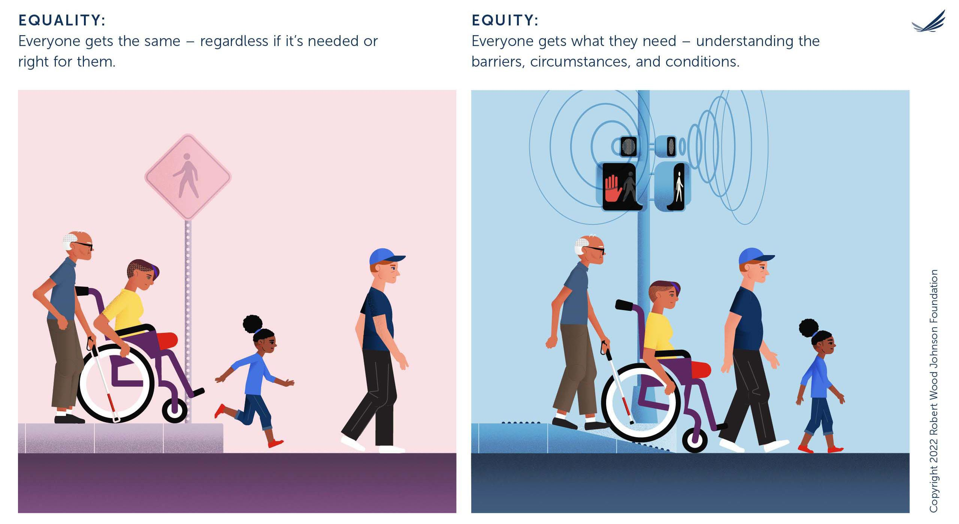

Slide 8


Drivers Instead of Determinants
Reframing the conversation about health, social factors drive our health; they don’t have to determine them.

Slide 9


Understanding the Rationale Behind Social Drivers of Health
Our homes, schools, workplaces, distant and immediate neighborhoods and communities serve as the starting point of our health.

Slide 10
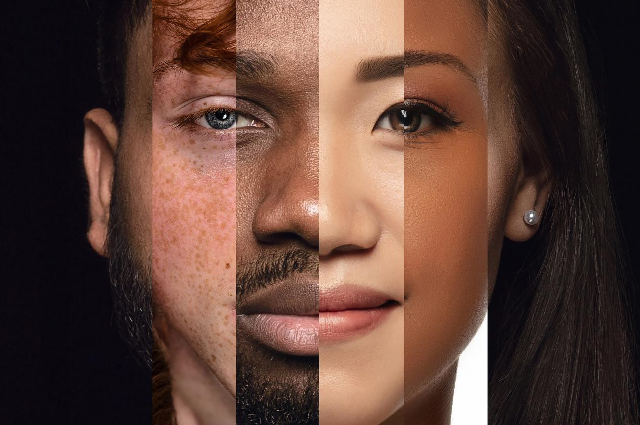
Social Drivers of Health
The conditions in the environments where people are born, live, learn, work, play, worship, and age that affect a wide range of health, functioning, and quality-of- life outcomes and risks.

Slide 11


Importance and Impact of Social Drivers of Health
Social Drivers touch people’s lives and impact their wellness and longevity as they form the fundamental social and structural factors necessary for livelihood.

Slide 12
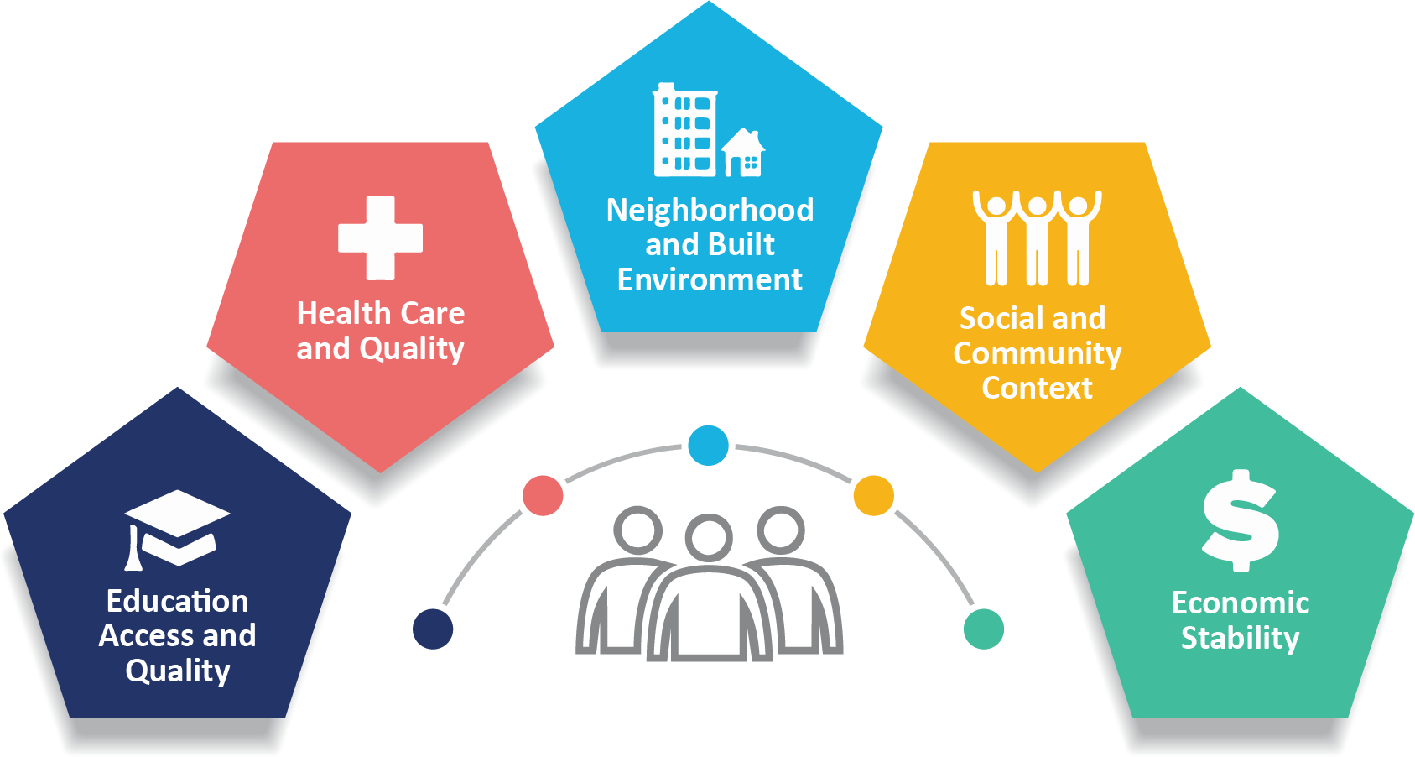
Graphic: CDC. (2020, October 23).

Slide 13

Social Drivers of Health - Education Access and Quality
Early and continued quality education of a child has been associated with positive long-term impacts.

Slide 14

Social Drivers of Health - Health & Health Care Access
“Health, Health Access and Quality is defined as the extent to which people have equitable, affordable and available access to needed healthcare services.”
–Healthy People 2030

Slide 15

Social Drivers of Health - Health Access
Health care access is the timely use of personal health services to achieve the best possible health outcomes.

Slide 16

Social Drivers of Health - Access to Primary Care
Primary care is the provision of integrated, accessible health care services by clinicians who are accountable for addressing a large majority of personal health care needs.

Slide 17
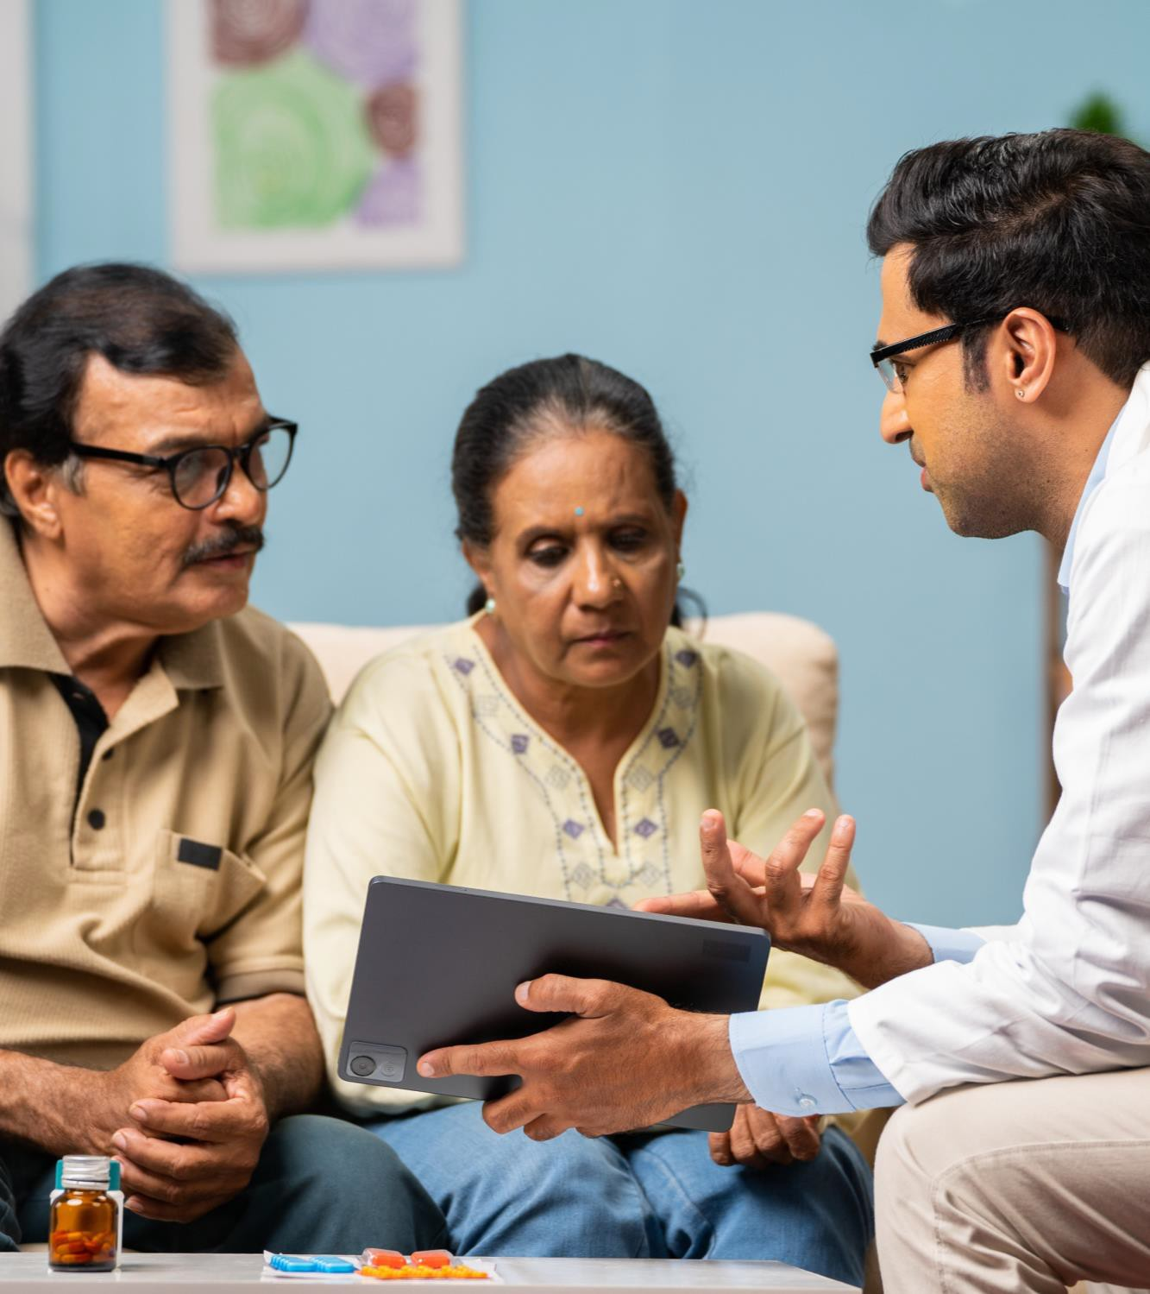
Social Drivers of Health - Health Literacy
Health literacy has been declared as a foundational principle and overarching goal by Healthy People 2030.

Slide 18

Social Drivers of Health - Personal Health Literacy
Personal health literacy is the degree to which individuals can find, understand and use information and services to inform health-related decisions.

Slide 19


Social Drivers of Health - Organizational Health Literacy
Organizational health literacy is the degree to which organizations equitably enable individuals to find, understand and use information and services to inform health-related decisions.

Slide 20
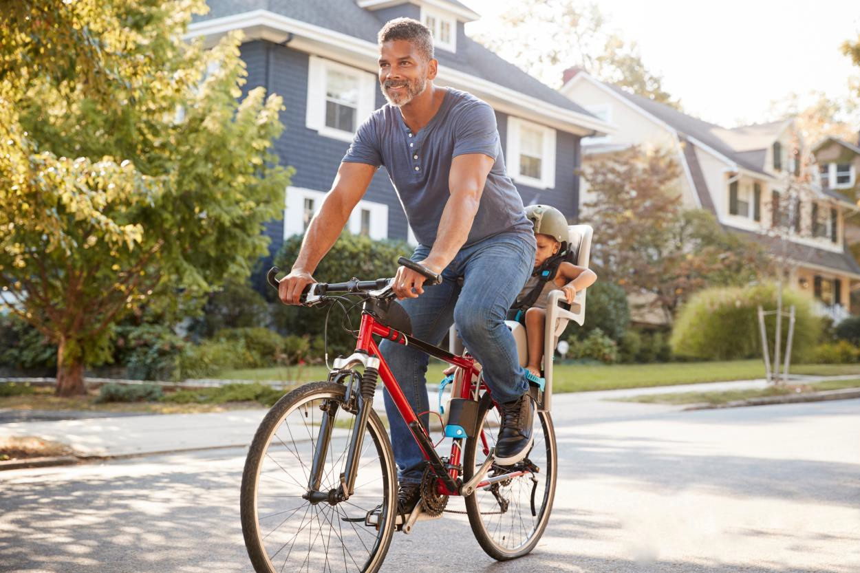
Social Drivers of Health - Neighborhood and Built Environment
Neighborhood and built environment includes key issues such as quality of housing, access to transportation and neighborhood crime and violence.

Slide 21
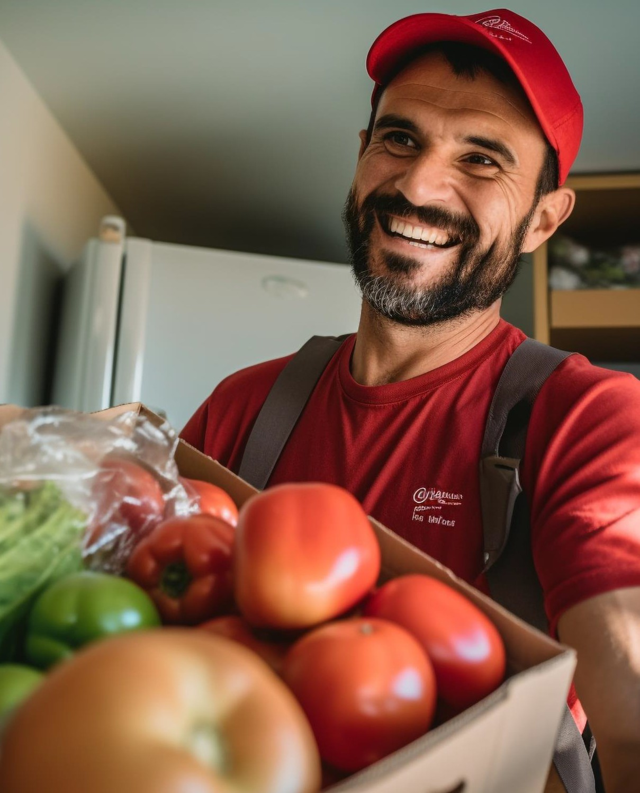

Social Drivers of Health - Access to Healthy Food
Access to foods that support healthy dietary patterns supports health across the lifespan and potentially for future generations.

Slide 22

Social Drivers of Health - Crime and Violence
Every individual and/or population can potentially be affected either directly or indirectly by crime and violence.

Slide 23

Social Drivers of Health - Environmental Conditions
The environment in which we live has a very significant impact on our lives.

Slide 24


Social Drivers of Health - Quality of Housing
Quality of Housing is considered in terms of affordability, stability, quality and safety and surrounding neighborhoods.

Slide 25
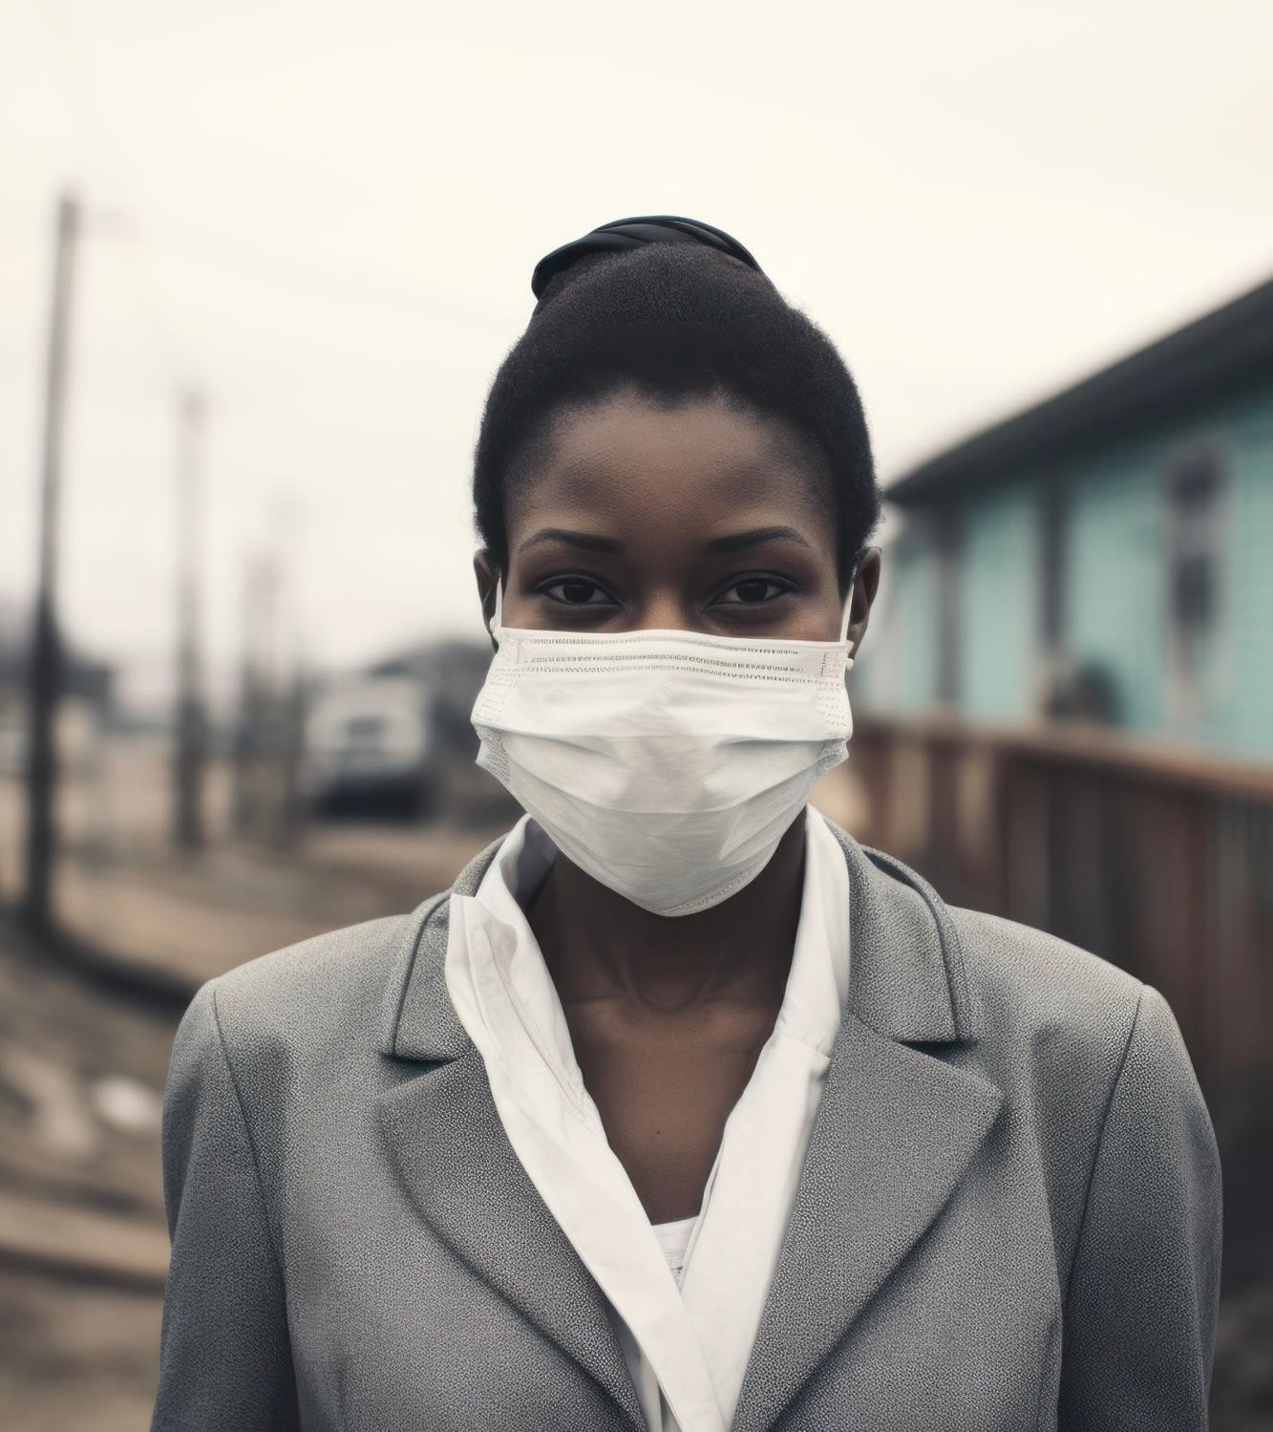
Social Drivers of Health - Ecosystem
Upstream factors are the root causes stemming from social and economic conditions that result in the differences in Social Drivers which establishes downstream effects.

Slide 26

Social Drivers of Health - Social and Community Context
Social and community context encompasses civic participation, discrimination, incarceration and social cohesion.

Slide 27

Social Drivers of Health - Economic Stability
The federal poverty level is a standard measure used to decide whether individuals or families have low incomes making them unable to meet basic economic needs. It may be used to decide who qualifies for benefits and programs.

Slide 28

Health-Related Social Needs
Health-related social needs refers to the social and economic needs that individuals experience that affect their ability to maintain their health and well-being.

Slide 29

Health-Related Social Needs vs. Social Drivers of Health
Social drivers are broader social conditions, whereas health-related social needs are more immediate individual, or family needs impacted by those conditions.

Slide 30
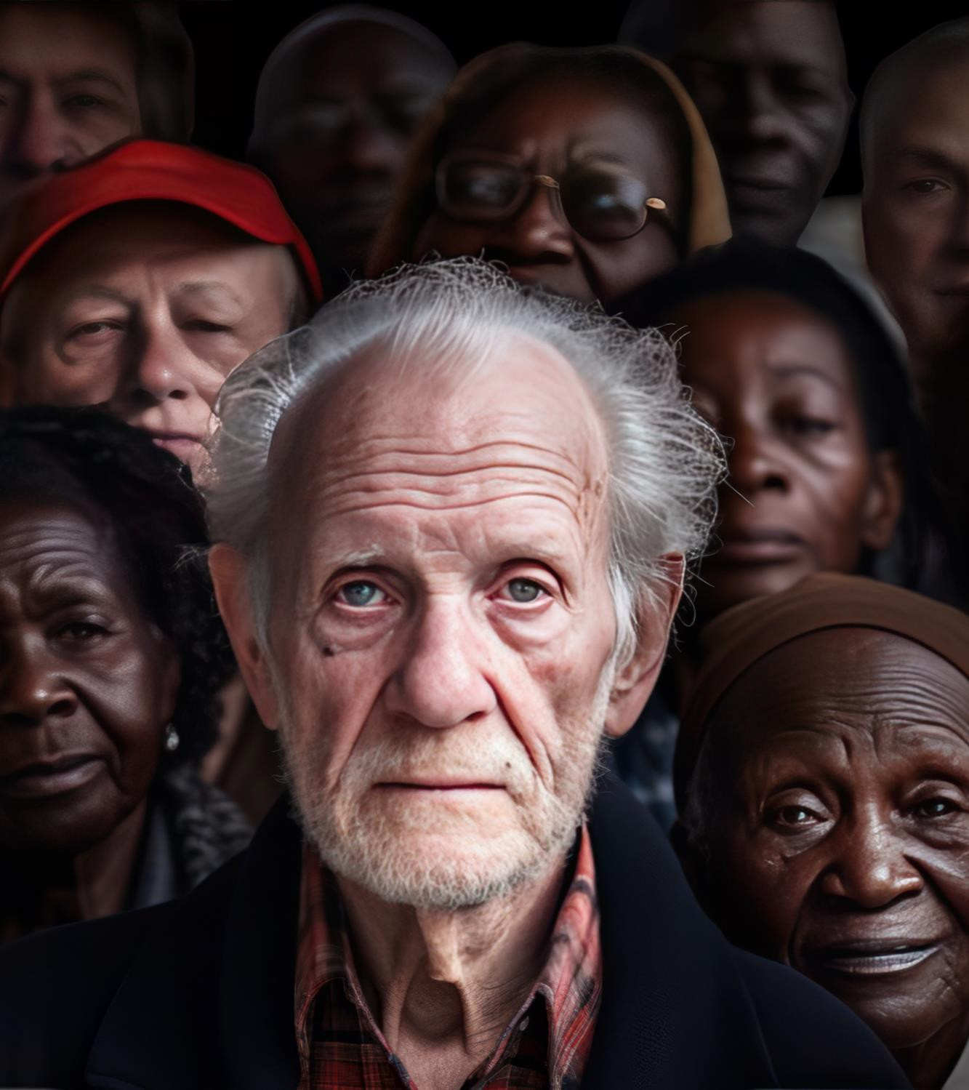

Population Specific Social Drivers of Health
Health equity recognizes that not everyone has the same opportunity to attain the best health outcomes.

Slide 31
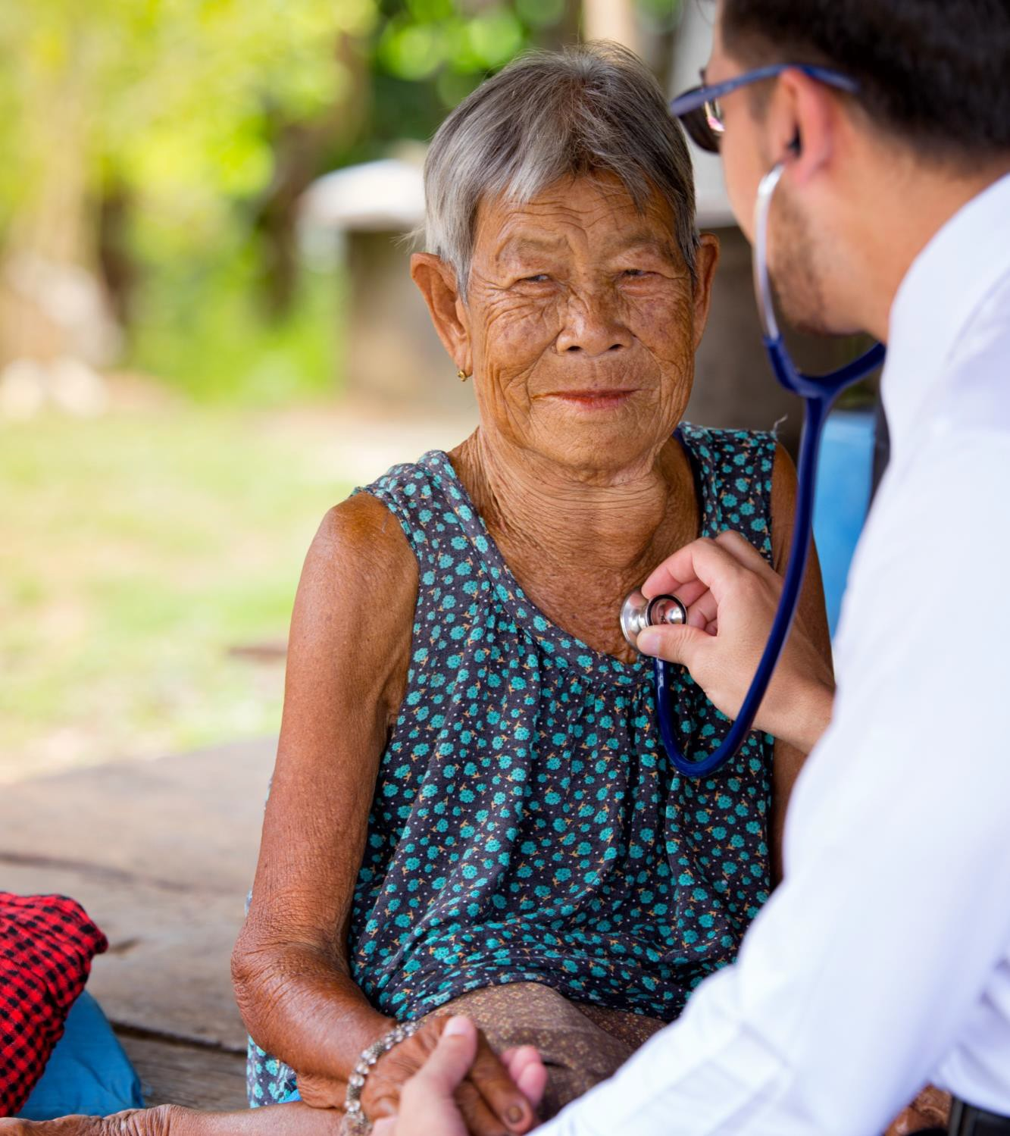
Population Specific: Rural Health
Even while working and living in rural areas has numerous benefits, rural communities still face significant health disparities.

Slide 32
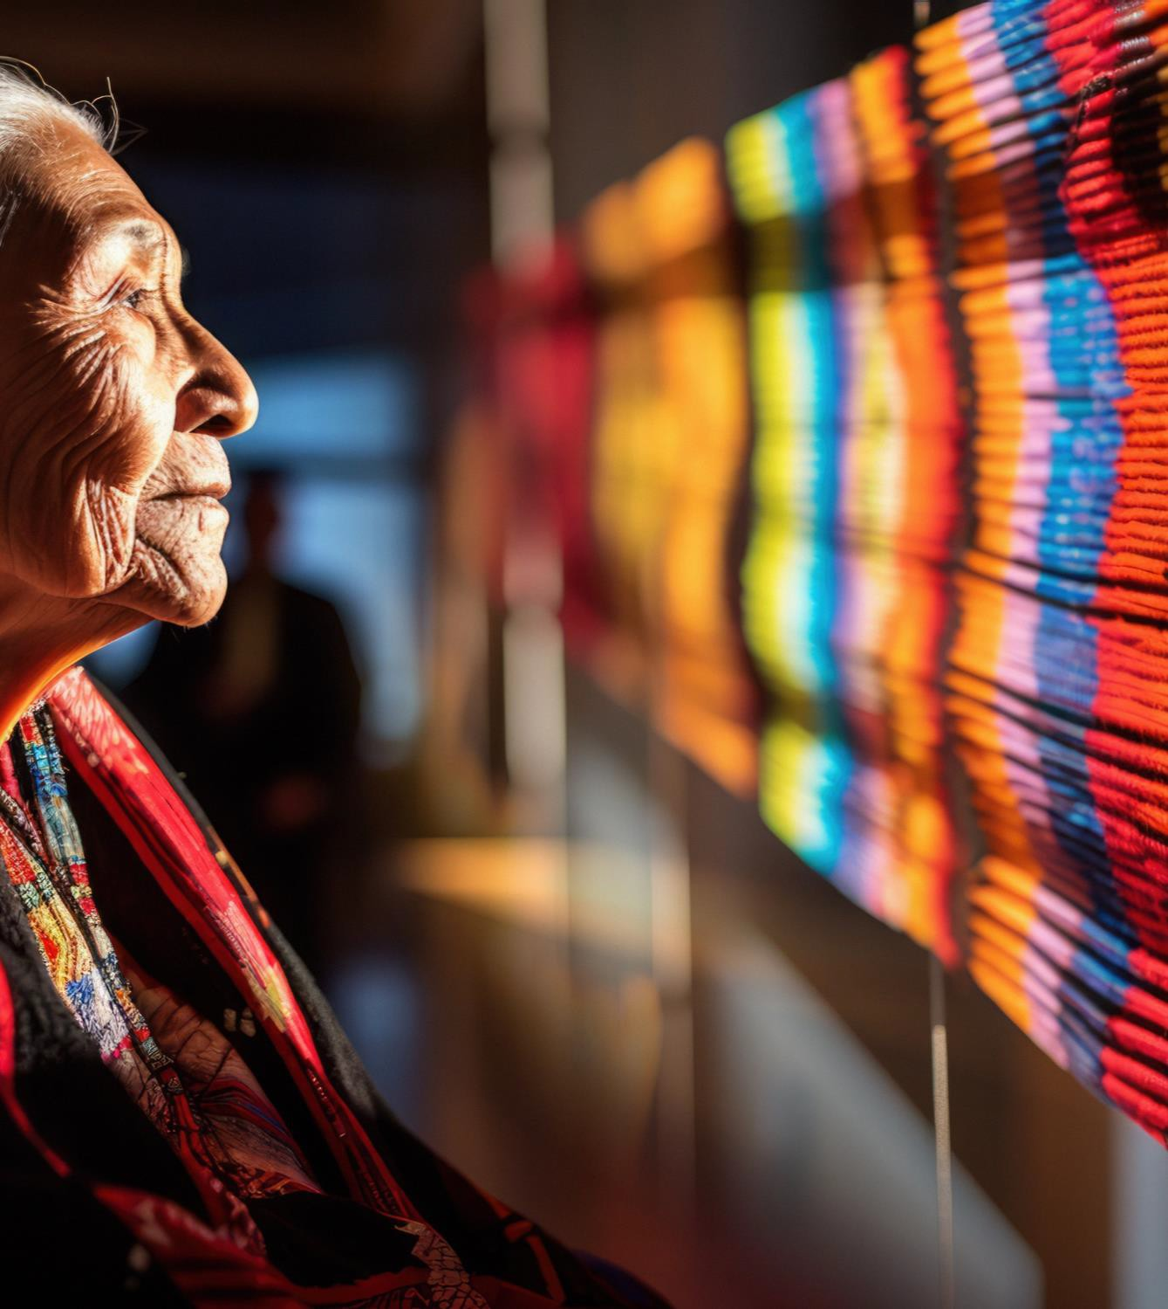

Population Specific: American Indian/Alaska Natives
American Indian/Alaska Natives are diverse in terms of history, culture, disease and nutritional health.

Slide 33

Population Specific: Other Minority Populations
Racial and ethnic minorities’ Social Drivers are significantly impacted by both structural and individual discrimination, according to Healthy People 2030.

Slide 34

Population Specific: Limited English Proficiency Populations
Communication between a patient and a medical professional is critical for managing health concerns, particularly for patients with chronic conditions.

Slide 35

Existing Framework to Address Social Drivers of Health
Social Drivers framework have been established to assist communities, health professionals and others in addressing various health- related problems.

Slide 36
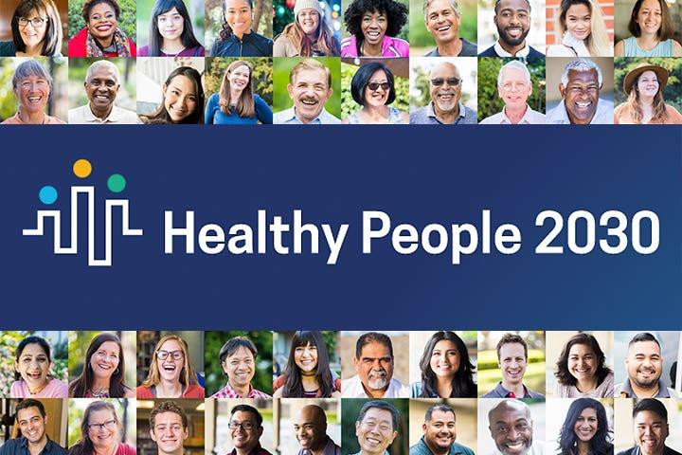
Healthy People 2030 Framework
Healthy People 2030 Framework Pillars:
Economic Stability
Education Access and Quality
Health Care Access and Quality
Neighborhood and Built Environment
Social and Community Context
Graphic: (Healthy People 2030: HHS Prioritizes Socioeconomic Disparities, Overall Well-Being, 2020)

Slide 37

Center of Disease Control (CDC) Framework
CDC Framework Pillars:
Data and Surveillance
Evaluation and Evidence Building
Partnerships and Collaboration
Community Engagement
Infrastructure and Capacity
Policy and Law
Graphic: (CDC, 2023)

Slide 38

World Health Organization (WHO) Framework
WHO Framework Pillars:
Improve Living Conditions
Address Inequities of Power, Money and Resources
Measure and Understand Impact of Action
Graphic: (WHO, 2023)

Slide 39
Summary
You should now be able to:
Define the Social Drivers of Health, the types and the ecosystem of Social Drivers of Health.
Understand the relationship between the Social Drivers of Health, Health Disparities and Health Inequities.
Define Health-Related Social Needs and understand the difference between Health-
Related Social Needs and the Social Drivers of Health.
Describe Population-Specific Social Drivers of Health.
Understand and apply the existing framework and models to address the Social Drivers of Health.

Slide 40
Revisiting Social Drivers of Health
Social Drivers are often (not always) the reason inequities exist.
Many Social Drivers have been shaped by ‘upstream’ issues.
Systems that don’t focus on Social Drivers will tend to
intensify inequities.

Slide 41
Thank You
Community Engagement | hhs-engagement@nd.gov

Slide 42



Click each image for additional training opportunities!

Slide 43
References
Bosch, R. (2021, April 16). The Key to SDOH: Health literacy. MedCity News. https://medcitynews.com/2021/04/the-key-to-sdoh-health-literacy/
Bureau, U. C. (2020, December 10). American Community Survey 2015-2019 5-Year Data Release. The United States Census Bureau. https://www.census.gov/newsroom/press-
kits/2020/acs-5-year.html
Castrucci, B. (2019, January 16). Health Affairs: Meeting Individual Social Needs Falls Short Of Addressing Social Determinants Of Health. De Beaumont Foundation. https://debeaumont.org/news/2019/meeting-individual-social-needs-falls-short-of-addressing-social-determinants-of-health/
CDC. (2020, October 23). CDC - Social Determinants of Health - STLT Gateway. Www.cdc.gov. https://www.cdc.gov/publichealthgateway/sdoh/index.html CDC. (2022, December 8). Social Determinants of Health. Centers for Disease Control and Prevention.
https://www.cdc.gov/about/sdoh/index.html#:~:text=Healthy%20People%202030%20sets%20data
CDC. (2023). Centers for Disease Control and Prevention. Centers for Disease Control and Prevention. https://www.cdc.gov/index.htm
Civic Participation - Healthy People 2030 | health.gov. (2020). Health.gov. https://health.gov/healthypeople/priority-areas/social-determinants-health/literature-summaries/civic- participation
Committee on Educating Health Professionals to Address the Social Determinants of Health, Board on Global Health, Institute of Medicine, & National Academies of Sciences,
Engineering, and Medicine. (2016, October 14). Frameworks for Addressing the Social Determinants of Health. Nih.gov; National Academies Press (US).
https://www.ncbi.nlm.nih.gov/books/NBK395979/

Slide 44
References
Creamer, J. (2020, September 15). Poverty Rates for Blacks and Hispanics Reached Historic Lows in 2019. The United States Census Bureau.
https://www.census.gov/library/stories/2020/09/poverty-rates-for-blacks-and-hispanics-reached-historic-lows-in-2019.html
Discrimination - Healthy People 2030 | health.gov. (2022). Health.gov. https://health.gov/healthypeople/priority-areas/social-determinants-health/literature- summaries/discrimination
Discrimination in America: Experiences and Views. (2019, October 24). RWJF. https://www.rwjf.org/en/insights/our-research/2017/10/discrimination-in-america--experiences-and- views.html
Economic Stability and SDOH SOCIAL DETERMINANTS OF HEALTH. (2020). Centene Corporation CWLA. https://www.cwla.org/wp-content/uploads/2021/06/SDOH-One-Pager- EconomicStability.pdf
Education Access and Quality | Prepare Your Health | CDC. (2023, March 27). Www.cdc.gov; Center of Disease Control and Prevention.
https://www.cdc.gov/prepyourhealth/discussionguides/education.htm#:~:text=Education%20Access%20%26%20Quality&text=Social%20determinants%20of%20health%2 0(SDOH
Gerteis, J., & Booker, C. (2021, July 16). Primary Care: On the Front Lines of Social Determinants of Health | Abt Associates. Www.abtassociates.com.
https://www.abtassociates.com/insights/perspectives-blog/primary-care-on-the-front-lines-of-social-determinants-of-
health#:~:text=Increasingly%2C%20primary%20care%20providers%20understand

Slide 45
References
Hacker, K., & Houry, D. (2022). Social Needs and Social Determinants: The Role of the Centers for Disease Control and Prevention and Public Health. Public Health Reports, 137(6),
003335492211202. https://doi.org/10.1177/00333549221120244
Health Literacy - Healthy People 2030 | health.gov. (2020). Health.gov. https://health.gov/healthypeople/priority-areas/social-determinants-health/literature-summaries/health- literacy
Healthy People 2030. (2020). Access to Foods That Support Healthy Dietary Patterns - Healthy People 2030 | health.gov. Health.gov. https://health.gov/healthypeople/priority- areas/social-determinants-health/literature-summaries/access-foods-support-healthy-dietary-patterns
Healthy People 2030: HHS Prioritizes Socioeconomic Disparities, Overall Well-Being. (2020, August 20). Www.medpagetoday.com. https://www.medpagetoday.com/publichealthpolicy/publichealth/88191
Heath, S. (2023, April 12). Understanding Crime, Violence as a Social Determinant of Health. Patient Engagement ; TechTarget.
https://patientengagementhit.com/features/understanding-crime-violence-as-a-social-determinant-of-health
Hinton, E. (2023, February 22). A Look at Recent Medicaid Guidance to Address Social Determinants of Health and Health-Related Social Needs. KFF. https://www.kff.org/policy- watch/a-look-at-recent-medicaid-guidance-to-address-social-determinants-of-health-and-health-related-social-needs/

Slide 46
References
Immigrants in North Dakota. (2020, August 6). American Immigration Council. https://www.americanimmigrationcouncil.org/research/immigrants-in-north-dakota
Indian Health Service. (2019, October). Disparities | Fact Sheets. Indian Health Service. https://www.ihs.gov/newsroom/factsheets/disparities/
Kleinman, D. V., Pronk, N., Gómez, C. A., Wrenn Gordon, G. L., Ochiai, E., Blakey, C., Johnson, A., & Brewer, K. H. (2021). Addressing health equity and social determinants of health through healthy people 2030. Journal of Public Health Management and Practice, 27(6). https://doi.org/10.1097/phh.0000000000001297
North Dakota - 2020 - III.B. Overview of the State. (2020). Mchb.tvisdata.hrsa.gov. https://mchb.tvisdata.hrsa.gov/Narratives/Overview/074d9a67-d145-4681-9742-7c490a227d9d Office of Disease Prevention and Health Promotion. (2020). Education access and quality. Health.gov. https://health.gov/healthypeople/objectives-and-data/browse-
objectives/education-access-and-quality
Perez, D. (2021, February 21). WHO’s “Conceptual Framework for Action on the Social Determinants of Health” – A Synopsis – Deanna Perez.
https://blogs.oregonstate.edu/deanna/2021/02/21/whos-social-determinants-of-health-synopsis/
Probst, J., & Ajmal, F. (2019, July). Publication Details: Social Determinants of Health Among Rural American Indian and Alaska Native Populations - Rural Health Research Gateway.
Www.ruralhealthresearch.org. https://www.ruralhealthresearch.org/publications/1270
Rural Health Information Hub. (2021). Telehealth Use in Rural Healthcare Introduction - Rural Health Information Hub. Ruralhealthinfo.org.
https://www.ruralhealthinfo.org/topics/telehealth

Slide 47
References
Shivanand Yaresheemi, Raj, A., Jangam, K. V., Padmavathy Doraiswamy, Manoj Kumar Sharma, & Chandra, P. S. (2023). Outcome of capacity building in mental health for well-
being volunteers. Frontiers in Psychiatry, 14. https://doi.org/10.3389/fpsyt.2023.1205344
U.S. Department of Health and Human Services. (2023). Healthy people 2030. Healthy People 2030; Office of Disease Prevention and Health Promotion. https://health.gov/healthypeople
United States Department of Agriculture. (2020). Dietary Guidelines for Americans 2020 -2025 . https://www.dietaryguidelines.gov/sites/default/files/2020- 12/Dietary_Guidelines_for_Americans_2020-2025.pdf
US Census Bureau. (2022, December 6). Nearly 68 Million People Spoke a Language Other Than English at Home in 2019. Census.gov; United States Census Bureau. https://www.census.gov/library/stories/2022/12/languages-we-speak-in-united-states.html
Vital Records. (2020). Health and Human Services North Dakota. https://www.hhs.nd.gov/vital
What is Health Literacy. (2023). Www.healthliteracysolutions.org; Health Literacy Solutions Center. https://www.healthliteracysolutions.org/learning-lab/introduction-to-health- literacy
Whitman, A., De Lew, N., Chappel, A., Aysola, V., Zuckerman, R., & Sommers, B. (2022). Addressing Social Determinants of Health: Examples of Successful Evidence-Based Strategies
and Current Federal Efforts. https://aspe.hhs.gov/sites/default/files/documents/e2b650cd64cf84aae8ff0fae7474af82/SDOH-Evidence-Review.pdf
WHO. (2023). World Health Organization. Who.int; World Health Organization. https://www.who.int/

Slide 48

CPE Instructions for:
Social Drivers of Health
1
2
2
3
Redeem your credit online at
CEimpact.com
*If this is the first time you have utilized the CEimpact Learning Management System (LMS) you will need to create an account.
From the CEimpact.com Homepage – enter the code provided in the ‘Enter Code’ box and click SUBMIT.
Complete the Exam & Evaluation as prompted; click SUBMIT to send your information to CPE Monitor. Follow instructions to access your CPE Statement of Credit on
CPE Monitor or access your Certificate of Completion in MyCourses.
Pharmacist Code: T4kJNG
Technician Code: 64X4QW

