Slide 1
Math for the Aftermath: Budgets, Breaches, and Back Again
Barbara Filkins
Senior SANS Analyst

Slide 2
Breaches, Breaches Everywhere…..
2015 has been called the “year of the breach”:
Even the best [security] firms are at risk (Kaspersky)
Fantasy or fact (Ashley Madison)
Watch your password manager! (LastPass)
Remember who checks your credit (Experian/T-Mobile)
4.5M records, no encryption (UCLA Health)
80M records and patient portal still is 8 character password…. (Anthem)
$50M in fraudulent claims (but it wasn’t that ‘big’) (IRS)
22.1 million affected (and counting) (OPM)

Slide 3
But Now Here Comes 2016….
January
FACC loses €50 million (~ $54.5M) to hackers
February
University of Central Florida breach affects 63,000
US DOJ hacked, information on 10,000 DHS and 20,000 FBI employees released
UC Berkley breach of financial data affects 80,000
March
Snapchart employees phished → names, SSN, payroll
Premier Healthcare breach affects 200,000 patients (stolen, unencrypted laptop)
Hollywood Presbyterians suffers ransomware attack

Slide 4
The Problem Statement
Keep information safe = implement security
Implement security = ∑ Resources
Resources (staff)
Process (policies and procedures)
Technology (tools)
Project Management + Plans
∑ Resources = Investment
Investment =
Spending Money!

Slide 5
So – Today’s Topic…..
First, explore key questions around security budgets and spending:
Who is involved in budgeting and spending for security?
What amounts are actually being budgeted and spent?
Why is the money being allocated and/or spent?
Where are the dollars going?
How are budgets and spending being justified, tracked and controlled?
Then, look at post breach considerations
And wrap up with some actionable takeaways
Sources: SANS 2015 Spending Survey, SANS 2015Post-Breach Surveys
Notes:
The key questions, not necessarily in this order.

Slide 6
The Who……
169 qualified respondents with budgetary control or insight into their IT and security budgets, mostly (72%) based in the United States
56% executive-level staff in both security and IT as well as business unit managers

Slide 7
The Why….

Slide 8
The Why….
The top two business drivers reflect the nature of the top 5 industries.

Slide 9
The What…..
Security budgets as a percentage of the IT budget have increased since 2014
Lowest range (0% to 3%) shrinking
Higher ranges (4–6%, 10–12%) growing
The overall median IT budget and percentage allocated to security by year shows this trend also heading into FY2016
Increase

Slide 10
The What…..
Size matters….

Slide 11
The What…..
As does industry….

Slide 12
The Where…..
Operational areas accounting for security spending:
Protection and prevention 72.4%
Detection and response 62.8%
Compliance and audit (including legal) 58.6%
Risk reduction 49.7%
End-user training and awareness 45.5%
Governance/Policies 43.4%
Staff training and certification 39.3%
Security program or project management 38.6%
Design/Development 34.5%
Discovery and forensics 31.7%

Slide 13
The Where…..
Major categories in a budget→
Skilled staff (salaries and benefits, consultants)
Tools and technology (hardware and software purchases, licenses, maintenance)
In-house operational expenses (data center)
Contracted services (telecommunications, hosting, managed and/or cloud services)
Other direct costs such as travel, conferences and training

Slide 14
The Where—Staff and Skills
Invest in people before tools.
– Survey Respondent

Slide 15
The Where—Staff and Skills
Invest in people before tools.
– Survey Respondent
Percentage of IT Budget Spent on Security Staff

Slide 16
The Where—Technology and Tools

Slide 17
The Gap—Unfilled Requisitions
Operational Area | Tools | Staff | Services
Compliance and audit (including legal) | 18.3% | 23.1% (2) | 12.5% (3)
Design/Development | 12.5% | 16.3% | 4.8%
Detection and response | 27.9% (1) | 26.0% (1) | 6.7%
Discovery and forensics | 21.2% (3) | 14.4% | 7.7%
End-user training and awareness | 16.3% | 22.1% (3) | 16.3% (1)
Governance/Policies | 9.6% | 18.3% | 7.7%
Protection and prevention | 25.0% (2) | 17.3% | 7.7%
Risk reduction | 19.2% | 18.3% | 6.7%
Security program or project management | 12.5% | 21.2% | 10.6%
Staff training and certification | 14.4% | 20.2% | 15.4% (2)

Slide 18
Now Let’s Discuss the Post-Breach Era…
Breach: “any impermissible acquisition, access of or disclosure of sensitive information.”
Most focus here
Pre Breach Era (All Incidents) | Breach Era (Incident as Breach to Near Term Remediation Complete) | Post-Breach Era (Near term remediation to ?)
Incident Handling Steps: Preparation Identification Containment Eradication Recovery Lessons learned | Determination of Incident as a Breach Root Cause Determination Forensics Near-term Remediation Data Recovery | Long-term Recovery Legal Additional Controls Customer/Client Support Reputation/Brand Protection and Recovery
SANS survey focused here

Slide 19
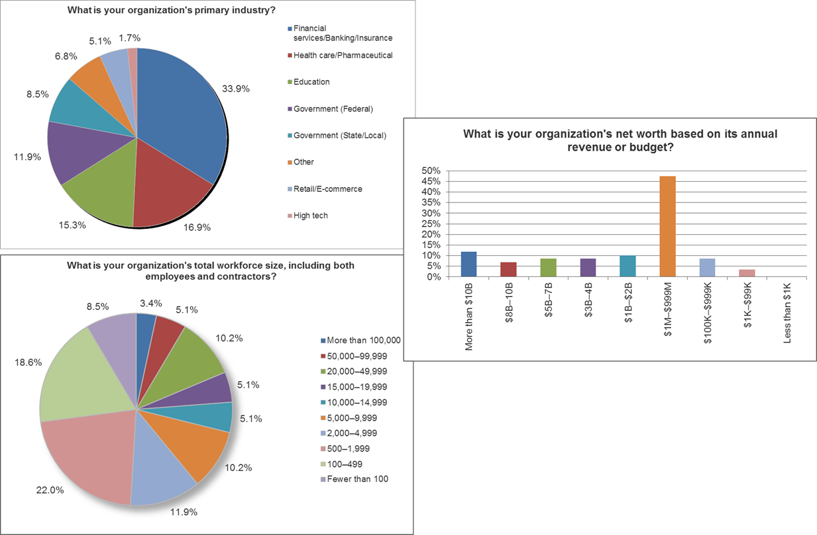
First: Post Breach Survey Background
Limited to industries of interest
Interviews and online survey
De-identified information → “buckets of costs”

Slide 20
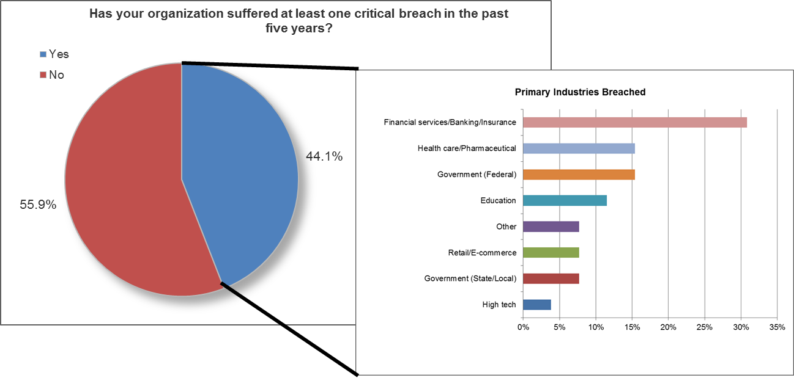
Next: About the Breaches!

Slide 21
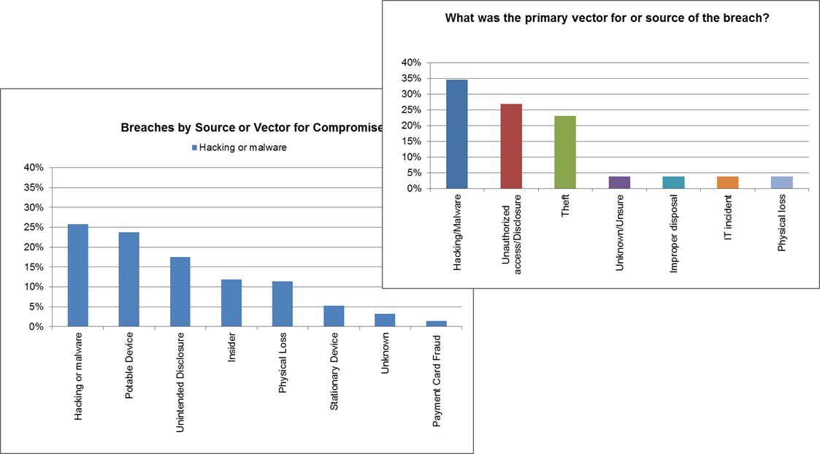
About the Breaches (Source)
SANS Survey
compared to data from PrivacyRights.org

Slide 22
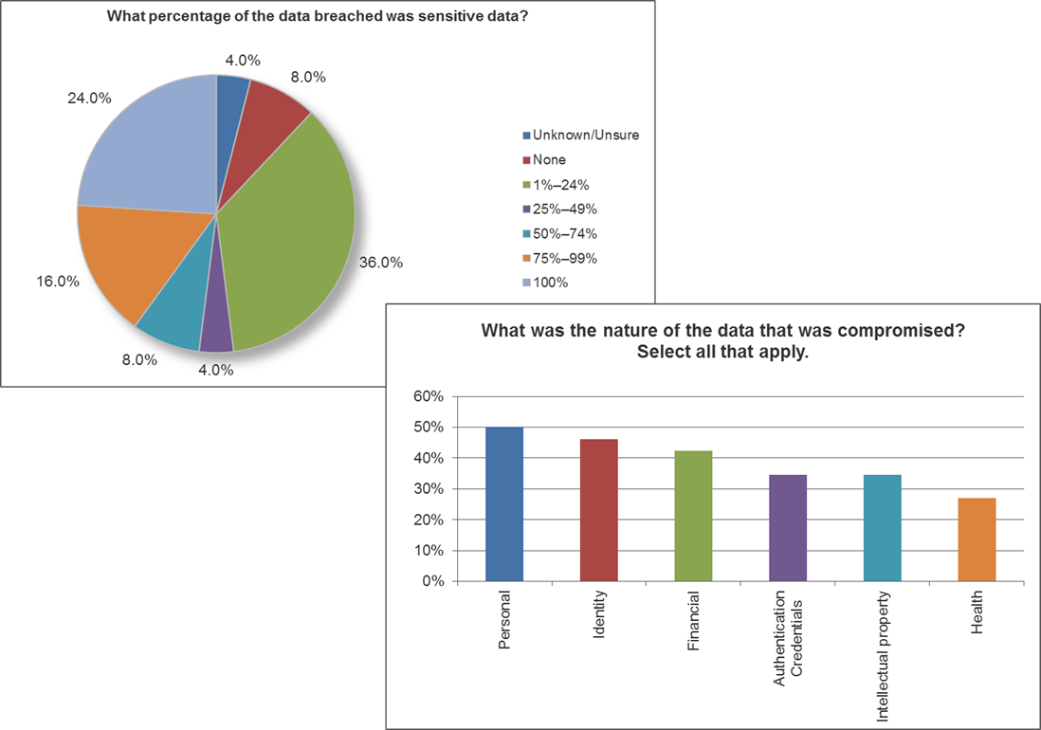
About the Breaches (Data)
81% of respondents had data classification program/policy
Number of Data Types Breached Per Breach | Percentage of Breaches
1 | 42.3%
2 | 23.1%
3 | 23.1%
4 | 11.5%

Slide 23
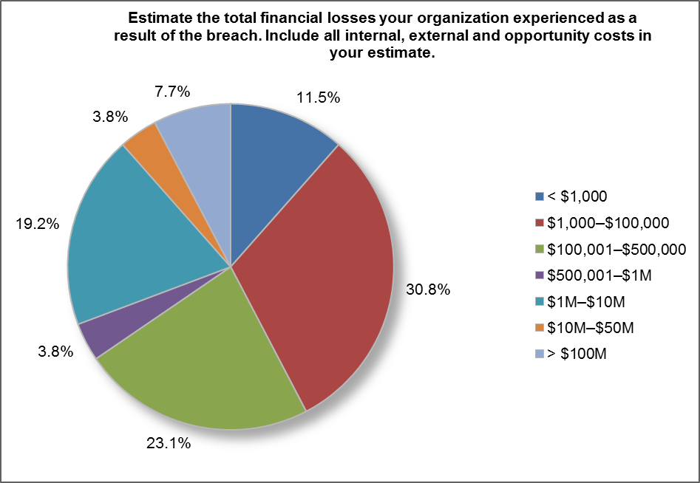
About the Breaches! (Size)
Factors Used to Gauge Breach Impact
# systems or applications impacted
# records breached
# individuals impacted (actual or potential)
# third parties impacted
 | Low | Median | High
Total Financial Loss | < $1,000 | $100K to $500K | > $100M
Systems Impacted | None (7.7%) | 2 to 5 | 11 to 100 (19.2%)
Records Breached | None (7.7%) | <1,000 | > 100M (3.8%)
Individual Impacted | None (3.8%) | <1,000 | >100M (3.8%)
Third Parties Impacted | None (38.5%) | 1 to 5 | >10,000 (11.5%)

Slide 24
About the Breaches (Time)
Looked at three time periods:
Detection of breach to remediation
Period of greatest financial impact
Period after remediation continued to feel effects
Shorter detection to remediation times =
Shorter period of greatest financial impact
Improved chance of no lingering effects

Slide 25
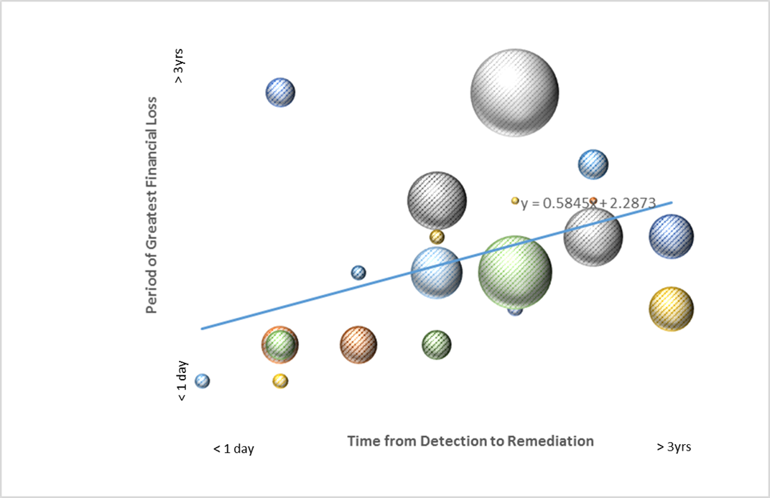
About the Breaches (Time)

Slide 26
Breach Costs vs. Sensitive Data

Slide 27
Post-Breach Factors Considered
Associated Costs:
Data recovery & forensics services and tools
Legal counsel
Insurance
Investment:
Administrative
Technical
Physical
Managed services
Staffing

Slide 28
Post-Breach Factors Considered (Cont.)
Customer Services:
Notification
Credit monitoring
Information hotlines
Credit card reissuance
Brand & Reputation:
Drop in stock value
Drop in revenue
Drop in sales
Customer churn
Loss of brand
Public relations

Slide 29
Post-Breach: Associated Costs
Data recovery/forensics external consulting
In-house resources only: 50%
Augmented in-house: 46%
Note: 58% acquired new tools
Legal costs
73% relied on internal counsel
92% had no legal or regulatory impact
Being proactive pays!

Slide 30
Post-Breach: Associated Costs
About two-thirds of post-breach losses typically end up not covered by insurance.

Slide 31
Post Breach: Investment

Slide 32
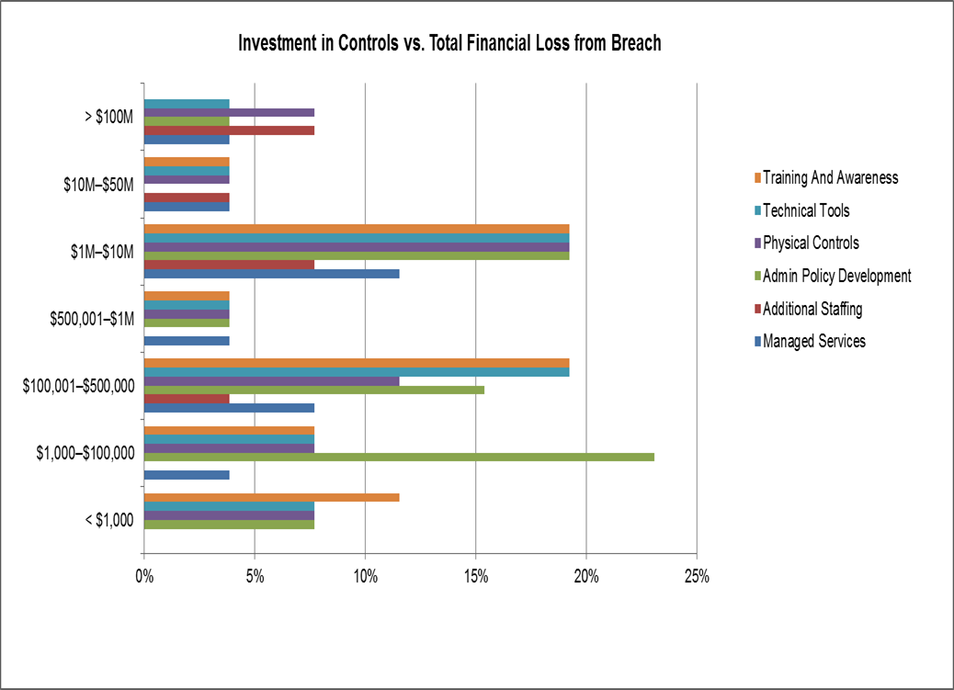
Post-Breach: Investment
Cost Ranges
 |  | Low | Median | High
Controls Acquired | Admin Policy Developed | None (19.2%) | <$25,000 | $500K to $10M (3.8%)
 | Training and Awareness | None (7.7%) | <$25,000 | $500K to $10M (7.7%)
 | Additional Staffing | None (15.4%) | $100K to $500K | $500K to $10M (11.5%)
 | Managed Services | None (11.5%) | $25K to $100K | >$50M (3.8%)
 | Technical Tools | <$25K (15.4%) | $25K to $100K | $500K to $10M (11.5%)
 | Physical Controls | None (3.8%) | $25K to $100K | $500K to $10M (3.8%)

Slide 33
Post-Breach: Customer Support
Customer-Related Costs
Cost Category | Respondent Percentage
Customer notification | 62%
Credit monitoring subscriptions | 27%
Information hotlines for customer support | 23%
Credit card reissuance fees | 19%
Cost Ranges
 |  | Low | Median | High
Customer Service | Credit Card Total | <$5,000 (3.8%) | $500K | $1M to $10M (7.7%)
 | Credit Card Per User | None (7.7%) | $11 to $29 | >$30 (11.5%)
 | Information Hotline Total | <$5,000 (3.8%) | $25K to $100K | $10M to $50M (3.8%)
 | Information Hotline Per User | None (3.8%) | $11 to $29 | >$30 (3.8%)
 | Credit Monitoring Total | <$5,000 (7.7%) | $25K to $100K | $1M to $10M (3.8%)
 | Credit Monitoring Per User | $11 to $29 (15.4%) | $11 to $29 | >$30 (11.5%)
 | Customer Notification Total | <$5,000 (26.9%) | $5K to $25K | $10M to $50M (7.7%)
 | Customer Notification Per User | None (7.7%) | <$10 | >$30 (11.5%)

Slide 34
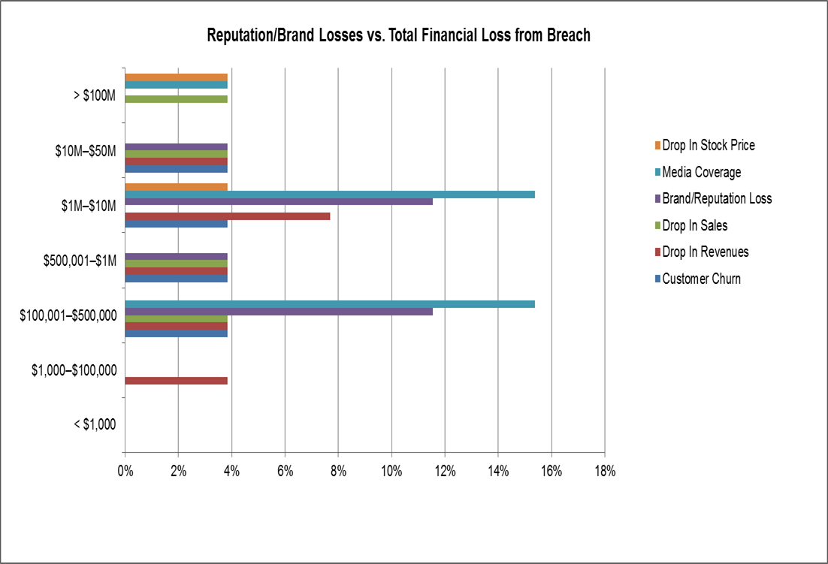
Post-Breach: Brand Reputation Damage
Three Key Factors
Amount of information compromised
Complexity of that information
Media involvement (or the lack thereof)
Cost Ranges
 |  | Low | Median | High
Loss of Brand | Drop in stock | $100K to $500K (7.7%) | $100K to $500K | $500K o $1M (3.8%)
 | Drop in revenue | $5K to $25K (3.8%) | $100K | >$50M (3.8%)
 | Drop in sales | $25K to $100K (7.7%) | $100K to $500K | >$50M (3.8%)
 | Customer churn | $100K to $500K (7.7%) | $500K to $1M | $10M to $50M (3.8%)
 | PR | <$5,000 (11.5%) | $25,000 | $1M to $10M (3.8%)
 | Loss of Brand | <$5,000 (3.8%) | $500,000 | $10M to $50M (3.8%)

Slide 35
Information Governance
Establish information classification policies
Assess risk
Classify your data and information
Implement protections accordingly! Establish information governance
81% had a program in place – possible reason for success?
Act information smart / shrink your information footprint
Watch what you extract from your secure business systems and place in Office files
Prevent employees from copying sensitive data from one spreadsheet to another, not realizing they included Social Security Numbers.
Don’t store 600 copies of the same data in multiple locations creating a larger footprint and a bigger target.
Reduce your cardholder data environment or at least the number of people who have access to it.
Consider getting cyber-insured
Be ready to act!

Slide 36
Post-Breach Action Plan Checklist
Catalog your organization’s major business processes.
Identify which processes handle critical or sensitive data.
Create an access control system.
Identify what assets hold or carry that data.
Determine what data threat actors would want to steal.
Determine what would be disrupted or cease to occur if those important or sensitive assets were compromised.
Develop realistic scenarios:
Identify obvious elements that can lead to financial loss.
Identify possible chain reactions that can lead to even greater loss.
Calculate the potential loss of the systems or breach of data using these scenarios.
Now develop your post-breach plan!

Slide 37
Looking Ahead (2016…)

Slide 38
The How—Getting the Budget You Need
Justification Methods:
Comply with regulatory requirements 79.8%
Align with business objectives, reflect security as “enabler” 78.1%
Reduce events, incidents, and breaches 72.8%
Improve risk profile 64.0%
Correlate with actual threats encountered on the network 64.0%
Measure/track improvements (response, attack surface) 56.1%
Reduce staffing costs through IT spending 39.5%
Maintain risk profile for optimal cyber insurance rates 36.8%
“Have proper, strategic, forward-thinking plans.”
“Think out long-term solutions never [just] short-term ones.”
—Survey responses

Slide 39
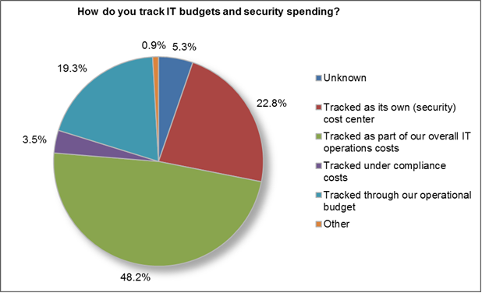
The How—Impediments
Over 54% develop budget/spending profile centrally

Slide 40
The How—Impediments
This leads to issues such as:
Lack of visibility into security $$
Not clearly tied to business objectives
Unclear reporting and approval structure
Lack of benchmarks and metrics
It’s hard to leverage the differences in “what is important” when you’re sitting in the IT meeting space, versus the executive board room and operations offices.
—Survey Respondent

Slide 41
So, Here’s the Challenge….
Know the budgeting and cost tracking processes in your organization from long-range strategic planning to short-range operational needs.
Know your organization’s business cycles.
Be able to prove the relationship between dollars spent and benefits achieved.
Establish methods and metrics to visibly answer those key questions of who, what, why, where and how security spending supports your business objectives.
With the goal of creating an actionable plan….

Slide 42
Schematic for Actionable Plan
Step One; Strategize
Step Two Plan
Step Three: Implement/Operate
Management Updates On Program/Project Spending And Variances
Step Four: Evaluate and Feedback
Strategic Security Budget
Operational Budget
Year-End Spending Report
Updated Budget
Long Term Roadmap (1-3 yr)
Tactical Plan (<1 yr)

Slide 43
Step One: Strategize
Events:
Establish long term security goals/objectives
Communicate value proposition to stakeholders (management)
Identify barriers and enablers
Establish security touchpoints (IT, compliance, business)
Identify key areas of risks and potential threats, cost tracking metrics
Outcomes: Long Term Roadmap, Strategic Security Budget

Slide 44
Advice: Strategize
Have proper, strategic, forward-thinking plans.
Think out long term solutions never [just] short term ones.
Use technology to fulfill business security requirement, rather letting security technology drive business requirements.
Make sure to size your security technology to fit your company. Do not overspend for tools that you do not have the personnel nor the expertise to use. Make sure that the tools are even necessary before throwing money at the problem.
Understand your company's mission/purpose and then tie your security purchases into supporting that securely. If you are successful in that, it is easier to get budget approved.

Slide 45
Step Two: Plan
Events:
Assess current operational status, risks, and threats
Determine gaps and needs
Identify alternatives
Perform cost/benefit analysis (risk/threats vs. implementation approaches & costs)
Develop program/project plans that address budget & cost management
Outcomes: Tactical Plan, Operational Budget

Slide 46
Advice: Plan
Work to align purchasing [procurement] with established security goals and priorities.
First: determine your risks. Second: prioritize your risks. Third: Use this list to guide your spending plans.
Start with initiatives that benefit both Security and Operations to ensure that both buy into these and nurture these initiatives together.
Always calculate the operations and capital expense, don’t just focus on capital.
Spent towards your present threats

Slide 47
Step Three: Implement/Operate
Events:
Conduct procurements/ development (if required)
Work with established management processes; change and configuration management control
Provide maintenance and support services
Track costs against operational budget
Outcomes: Management Updates
Program/Project Actual Spending
Variances

Slide 48
Advice: Implement/Operate
Develop process/policy and then select a tool to suit the business that you can support in maintenance mode. Too many failures are related to no one to take over internally after the consultant leaves resulting in what is effectively shelf ware.
Consider ongoing costs not just purchase price, remembering to factor into the equation staff time or what it would take to hire someone to manage.
Each environment is unique and requires research and education on what product will work for your environment, don't just buy brand name assume you are covered.
Make a decision on what works best for your organization.

Slide 49
Step Four: Evaluate and Feedback
Events:
Weigh actual expenditures against metrics
Technical effectiveness
Cost variance
Return on investment, total cost of ownership
Revise
Security roadmap and tactical plan
Strategic and operational budgets
Outcome: Spending Report, Budget Updates

Slide 50
Advice: Evaluate and Feedback
Share the success of current security controls, then request according to [your] organization’s strategic plan, not just based on your risk index.
Prioritize [new] efforts based on need and return/results
[Align] with strategic objectives, risk reduction and tangible return on investments.
[Perform] continuous assessment of your spending and objectives
We currently invest a minimal amount and it is closely scrutinized, which means that it must be effective or the expenditure would be reallocated to something that is effective.

Slide 51
Questions?
References:
IT Security Spending Trends, February 2016, slides 6 – 17 and 37 - 41
Post-Breach Impact: A Cost Compendium, November 2015, slides 18 - 36
Contact: Barbara Filkins
bfilkins@sans.org
805-524-4282 (office)
805-795-0322 (cell)
Notes:
Reference 1: Webcast -- https://www.sans.org/webcasts/2016-security-spending-strategies-survey-100997
White Paper -- https://www.sans.org/reading-room/whitepapers/analyst/security-spending-trends-36697
Reference 2: Webcast -- https://www.sans.org/webcasts/post-breach-impact-cost-compendium-100757?utm_medium=Referral&utm_source=PR+Log&utm_content=Webcast+Analyst+PostBreach+PR+11+2015&utm_campaign=SANS+Webcast+Analyst
White Paper -- https://www.sans.org/reading-room/whitepapers/analyst/cleaning-breach-post-breach-impact-cost-compendium-36517

