Slide 1
Google Hacking
19 September 2013
Updated August 2015

Slide 2
#s
Google's cache is over 95 Petabytes
Google crawls 300 cached entries per host by default
(If the site's SEO ranking is higher, then Google crawls deeper)

Slide 3
Getting Google To Scan For You
If a site isn't being crawled for some reason, (like it doesn't have a DNS entry) you can solve this problem by:
Adding a DNS entry for the site publicly
Creating a Custom Search under a Google user account
If you create a custom search and add the IP, the site will be indexed within 7 days

Slide 4

#s
Numbers From Sept 2013 .com sites: 25,270,000,000 .org sites: 2,510,000,000 .jp sites: 15,550,000,000 .cn sites: 1,610,000,000 .ru sites: 1,560,000,000 .uk sites: 982,000,000 .ca sites: 400,000,000 | .gov sites: 207,000,000 .us sites: 178,000,000 .mil sites: 5,600,000 .ny.us: 4,870,000 .mn.us: 3,430,000 .ca.us: 3,070,000 .nd.us: 711,000
Numbers From Aug 2015 .com sites: 25,270,000,000 .org sites: 6,560,000,000 .jp sites: 633,000,000 .cn sites: 336,000,000 .ru sites: 1,070,000,000 .uk sites: 2,130,000,000 .ca sites: 1,070,000,000 | .gov sites: 814,000,000 .us sites: 178,000,000 .mil sites: 42,300,000 .ny.us: 8,610,000 .mn.us: 15,100,000 .ca.us: 28,200,000 .nd.us: 306,000

Slide 5
Common Functions
site:
intitle:
inurl:
filetype:

Slide 6
Examples from 2013
site:gov filetype:log 205,000 site:gov filetype:ini 40,200 site:gov filetype:conf 11,400 site:gov filetype:xls 3,740,000 site:gov filetype:xlsx 137,000 site:gov filetype:doc 12,200,000 site:gov filetype:docx 818,000 filetype:rdp username 774 filetype:xls visa "12/13" filetype:xls SSN DOB 1965 | site:gov filetype:mdb 274 site:gov filetype:sql 7,880 site:mil filetype:sql 1 site:mil filetype:mdb 4 (1 in cache) site:mil filetype:ini 9 site:mil filetype:txt 696,000 site:mil noforn 95,800 inurl:allstathomehealth.com/Users filetype:rdp password
inurl:https://mail.piginc.net/bidforms/LF18/115 Bldg. LF-18 NETWARCOM/Badging/
site:s3.amazonaws.com filetype:xls yourcompanyname

Slide 7

A Word of Caution
Hackers love pulling practical jokes on each other. What constitutes a practical joke is a personal decision that can range from a funny message, a 'like a sir' image, or deleting your computer.
You should always hack on a
machine that's useless and
and on a separate network than
Machines containing sensitive
Data.

Slide 8
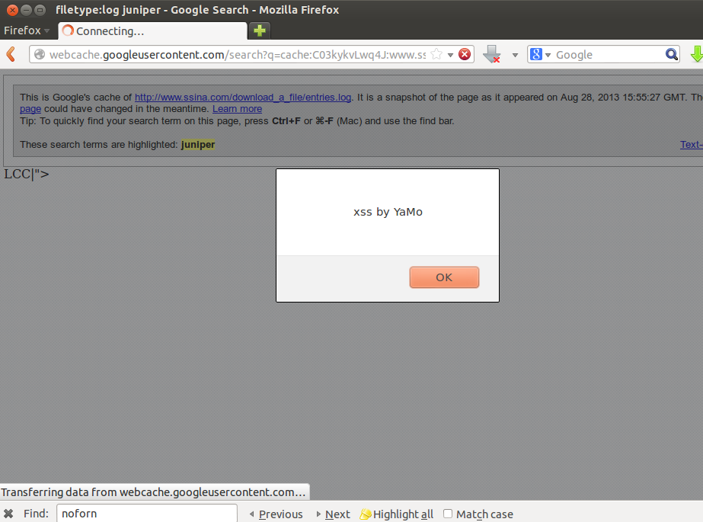
A Word of Caution

Slide 9
Rigging a Sweepstakes
Lotteries are fun and all... but they're considerably more fun when you win. Let's see if we can increase our odds!

Slide 10
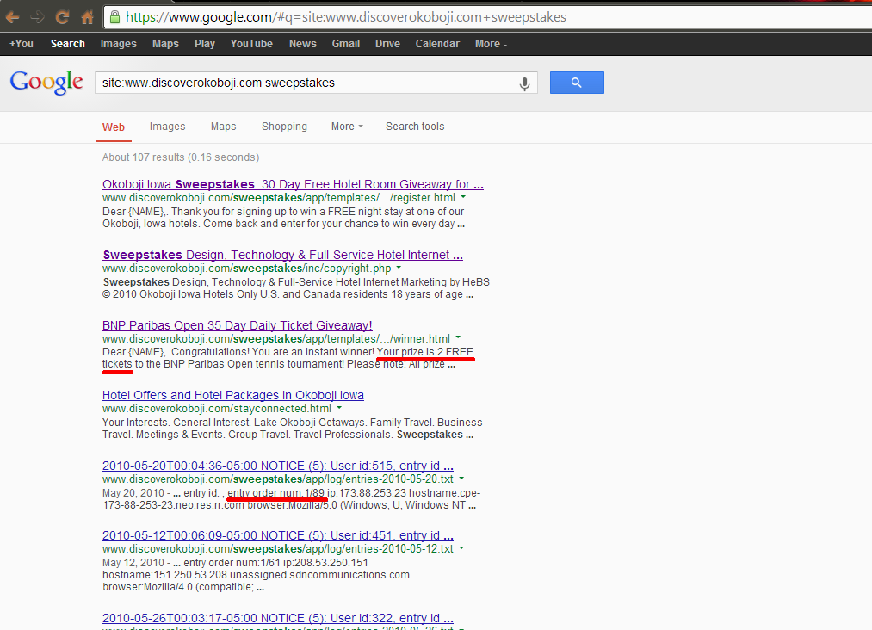
Rigging a Sweepstakes

Slide 11
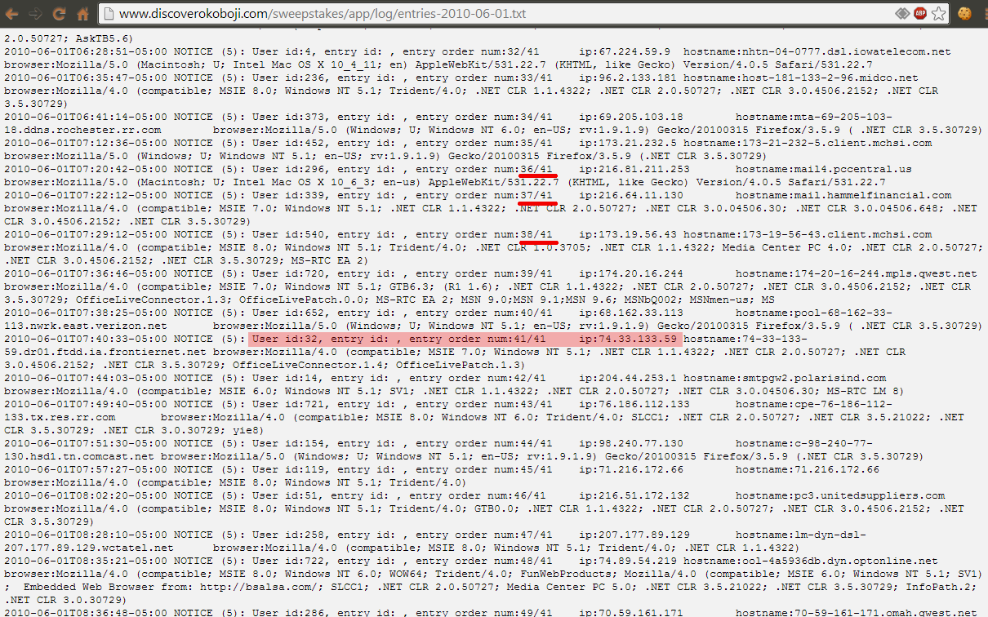
Rigging a Sweepstakes

Slide 12
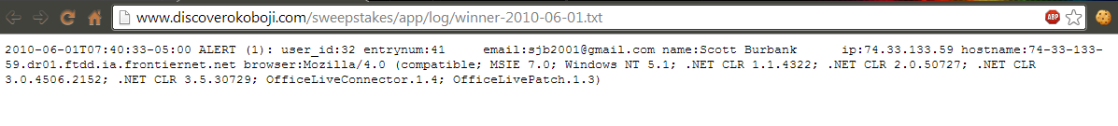
Rigging a Sweepstakes
So those numbers count up with each entry, eh? I wonder what happens when they hit “41/41” ...
Winner!!!
Now tomorrow, we can just watch the entries txt file, wait until it gets close, and enter when we know we'll win!

Slide 13
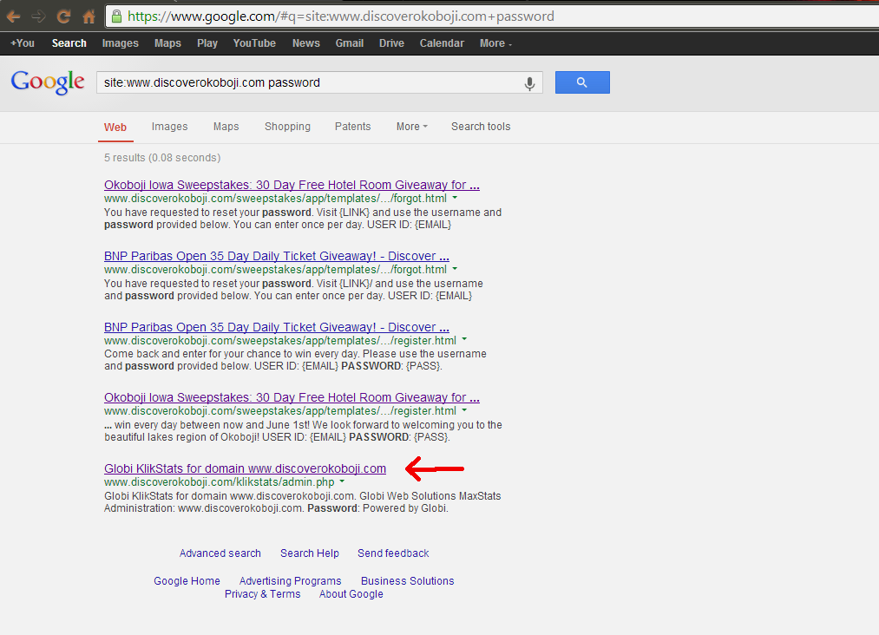
Something Sinister
While searching the same site, I stumbled upon this:

Slide 14
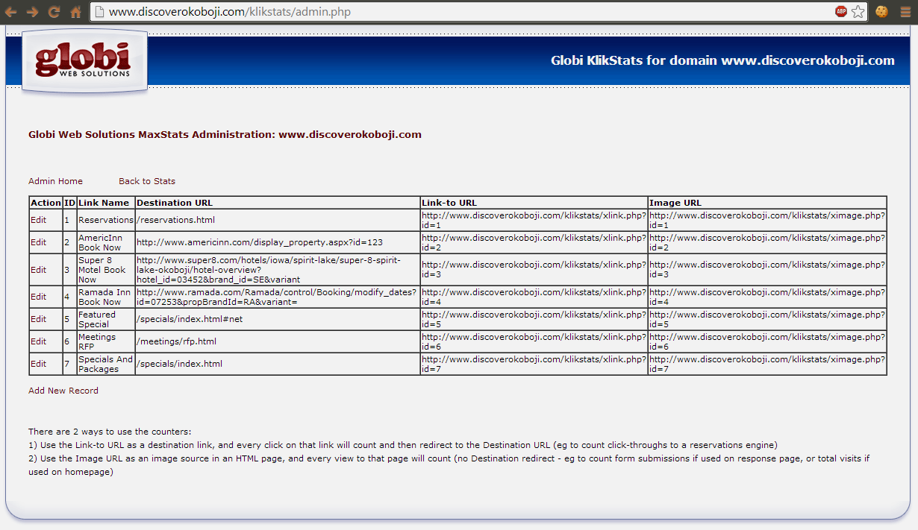
Something Sinister

Slide 15
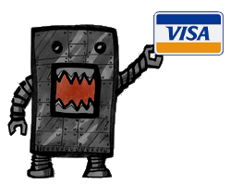
Something Sinister
That is an admin for a link manager. They have links across their site that point to the ID numbers. This software tracks the clicks, then forwards the client on to the destination.
So if we edit the destinations to our phishing sites, visitors would book a hotel through our phony site!
Thanks for the CC#s!

Slide 16
Amazon Wispernet
Kindles, Cloud Storage, etc

Slide 17
Kindle
Steps to add file to Kindle:
1. Email file to kindleid@free.kindle.com
2. Wait for file to show up on your Kindle
3. File is automatically stored on Amazon S3

Slide 18
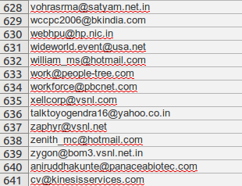
Amazon Wisper
List of consultants in a company

Slide 19
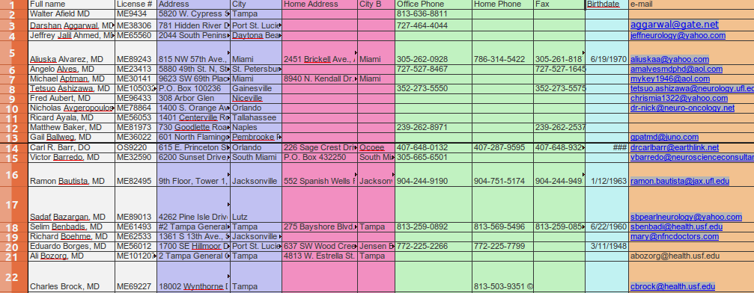
Amazon Wispernet
Doctor Roster

Slide 20
Amazon is a treasure trove of company users, emails, and social engineering info.
Try it yourself:
site:s3.amazonaws.com filetype:xls

Slide 21
S/NOFORN
Government

Slide 22
Disclaimer
Mining for classified, restricted, or interesting military and government data without written authorization is likely to lead to incarceration.

Slide 23
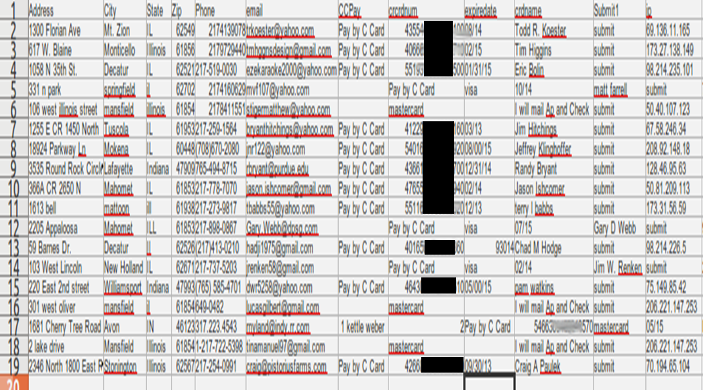
City Govt – Rib Cookoff

Slide 24

City Gov – Employee Census

Slide 25
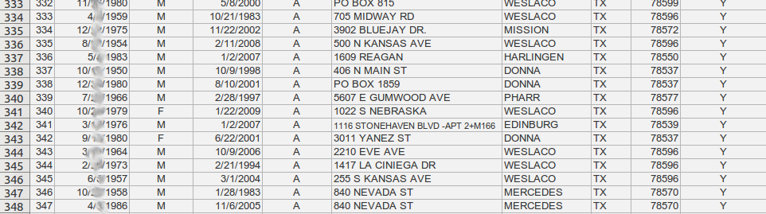
The Census

Slide 26
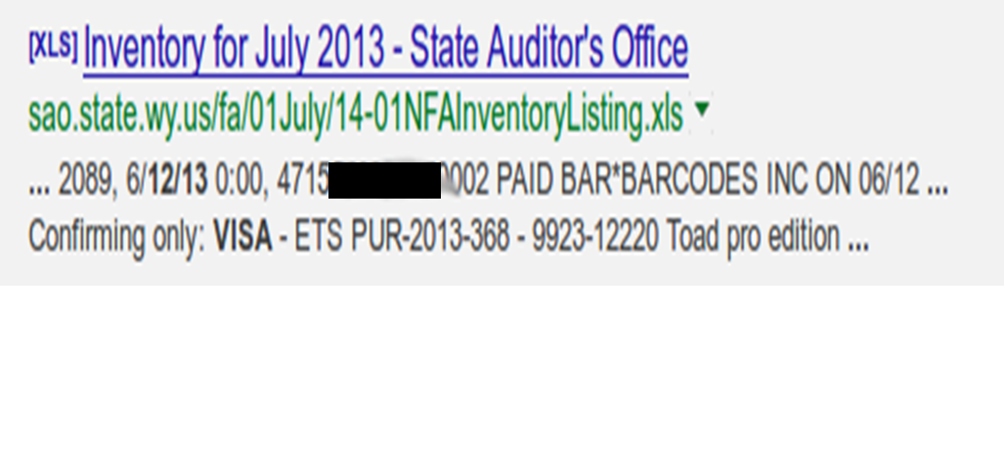
State Auditors – CC#
Document unfortunately taken down

Slide 27

State Gov't – HIPAA Viloation

Slide 28
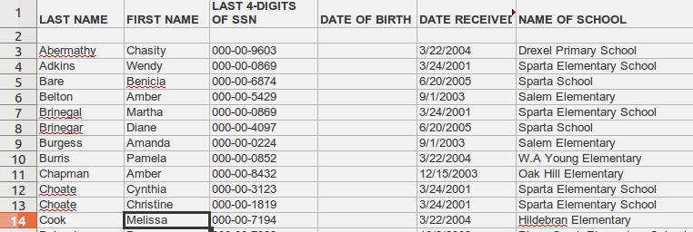
Think of the Children...
Over 1000 Children...

Slide 29
The above slides were unrelated
The 2nd was from Texas
http://socialsecuritynumerology.com Will help you identify the social security number's prefix if you know the state and year that the person was born.

Slide 30
Research Labs
Government Research labs have some of the worst security worldwide.

Slide 31
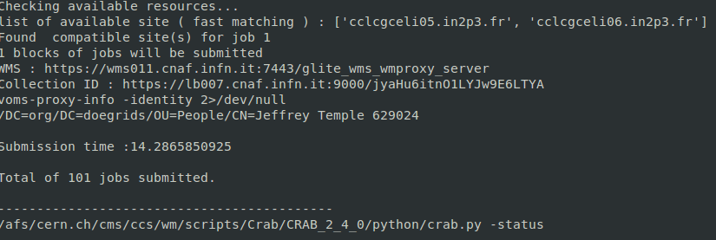
CERN

Slide 32
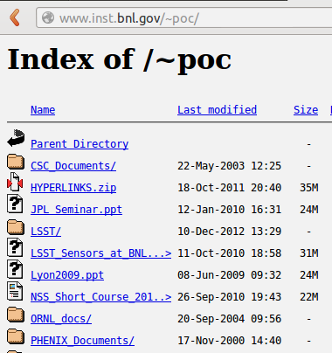
Nat'l Lab Directory Traversal

Slide 33
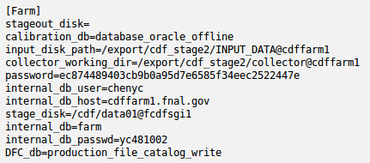
FNAL Fail

Slide 34
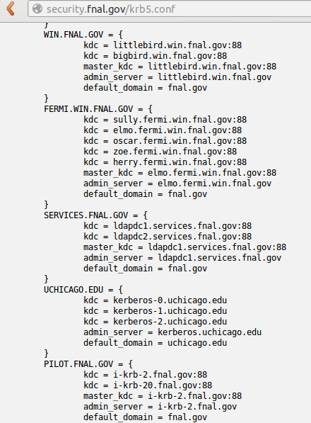

Slide 35

Linux Logs

Slide 36
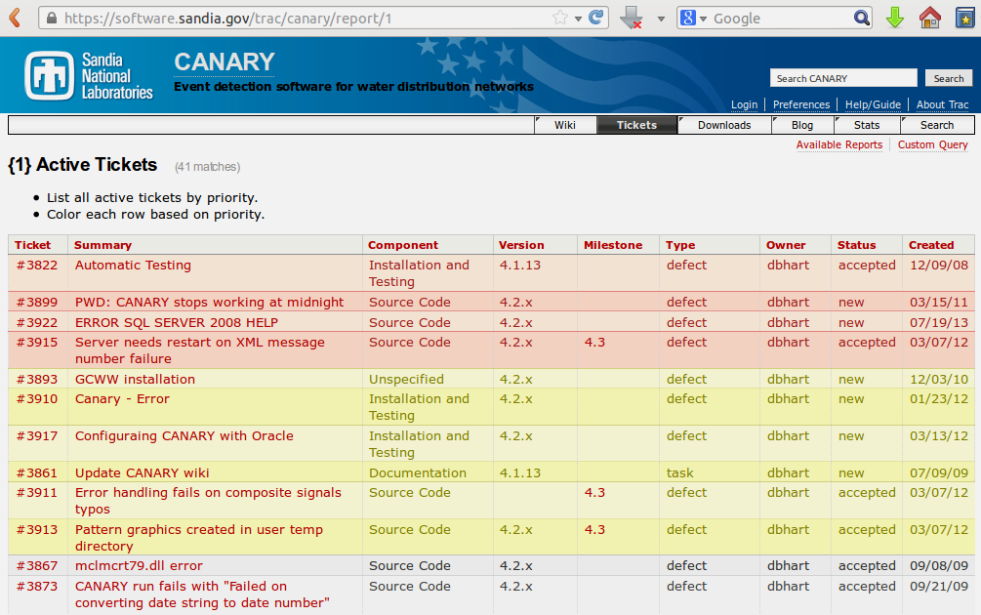
I said the worst right?

Slide 37

The Military

Slide 38
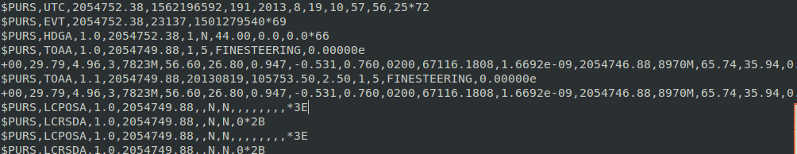
GPS From an Carrier

Slide 39

DARPA Conference

Slide 40
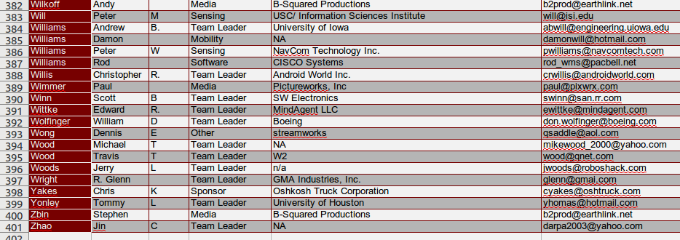
DARPA Conference
Detail

Slide 41
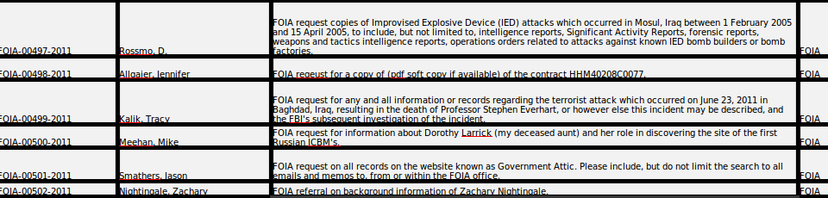
FOIA Request List

Slide 42
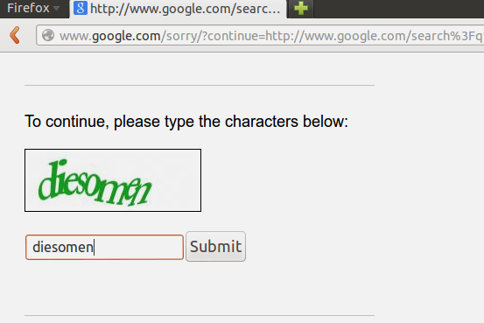
Are you Human?
This is when Google starts asking if I'm actually human:

Slide 43
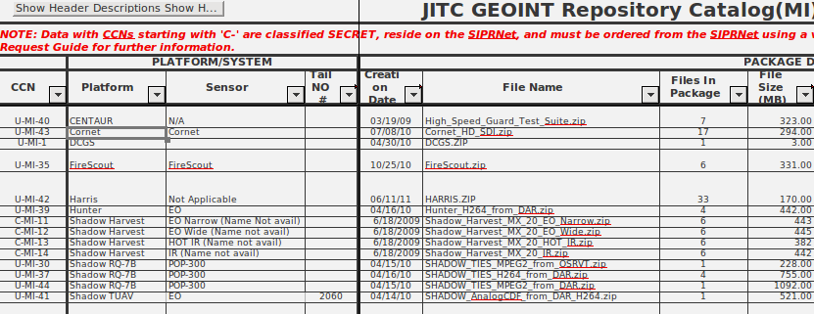
Fly me to the moon...

Slide 44
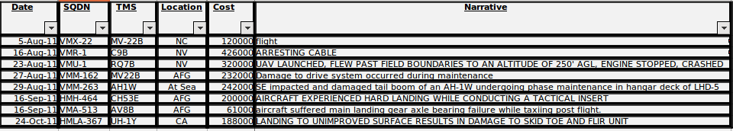
Military Plane Crashes
Including UAV

Slide 45
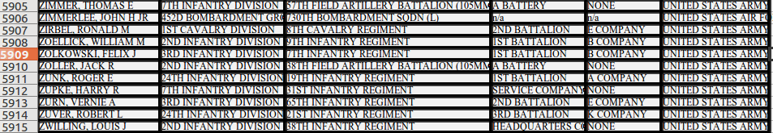
We lost your picture...
Document of over 100,000 service members, their contact numbers, location in the world, and the branch. Because their ID pictures were lost and need to be re-taken. Now I have a list of who doesn’t have a picture, and I know where they are…

Slide 46
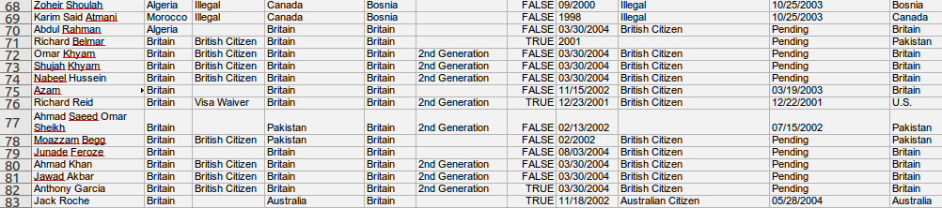
Known Terrorist DB

Slide 47
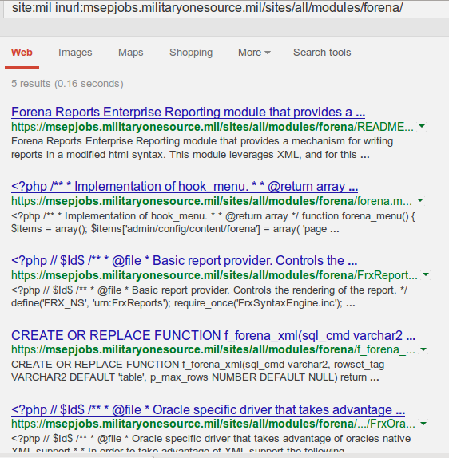
Military Jobsite internal Code

Slide 48
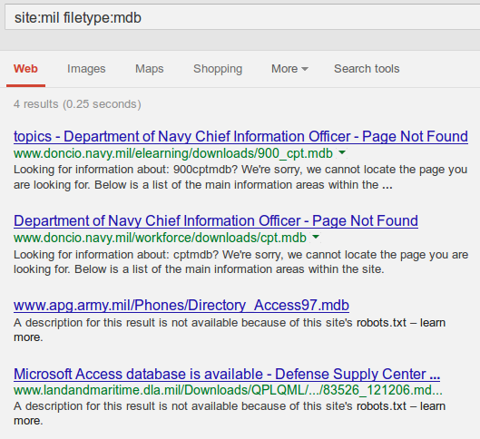
Databases in Google

Slide 49
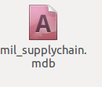

Slide 50
Taliban Suspect List anyone?
Came with a Secret/NOFORN clearance
On an Australian Military Site...

Slide 51
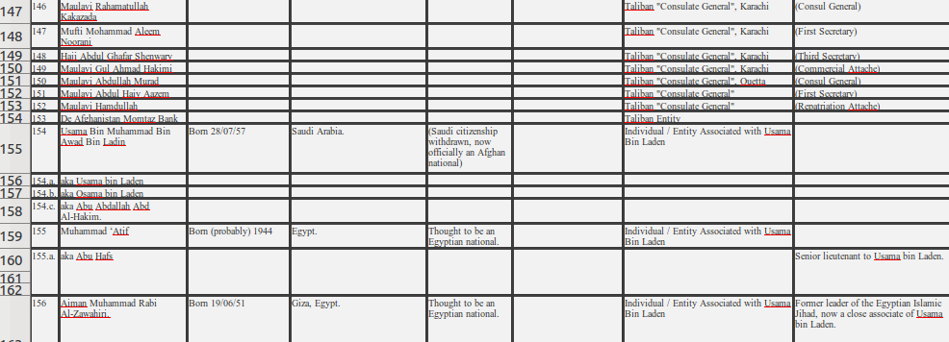

Slide 52
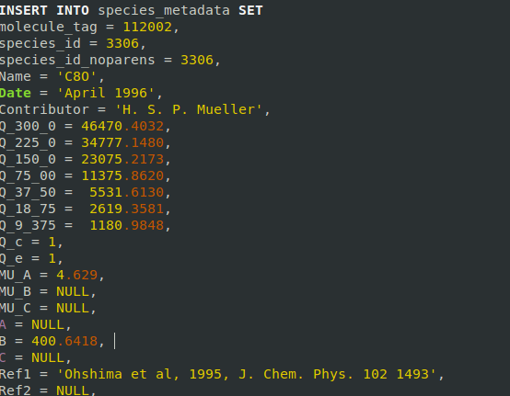
NASA SQL Files

Slide 53
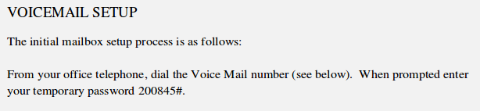
Voicemail

Slide 54
You know what'd be convenient? A list of recent recruits who maybe haven't set up their voicemail yet...

Slide 55
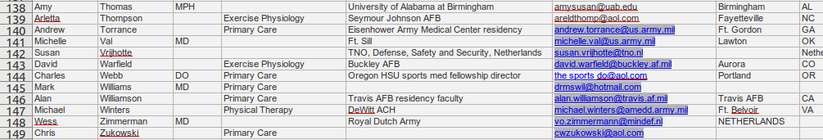

Slide 56


Slide 57
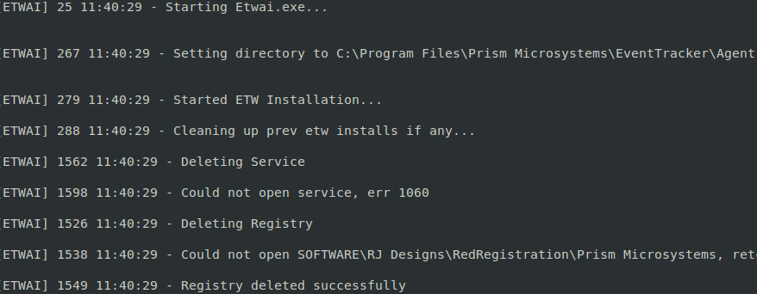
Snoop onto them...
As they snoop onto us!

Slide 58
Obviously these are security problems. Someone should tell DISA so they can assist in remediation...

Slide 59
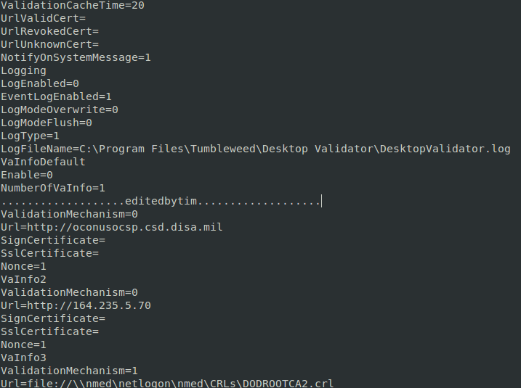

Slide 60
Other stupid things that shouldn't be in Google.

Slide 61
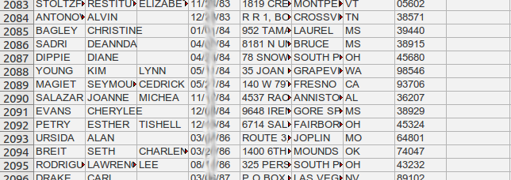
2100 Employee Records

Slide 62
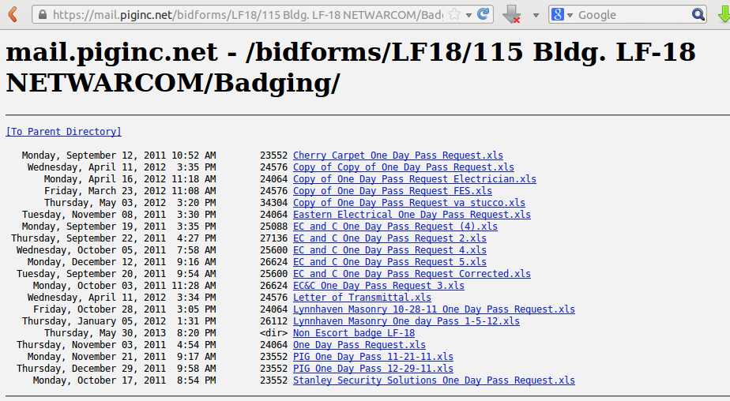
Physical Security Data

Slide 63
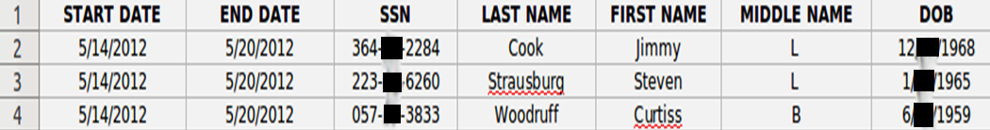
Contractor Door Card Pass

Slide 64
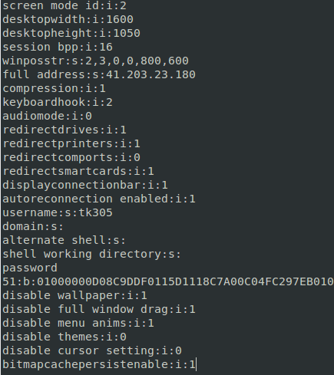
RDP File to directly login
To a BANK

Slide 65

Canadian Finance Group Trash Files

Slide 66
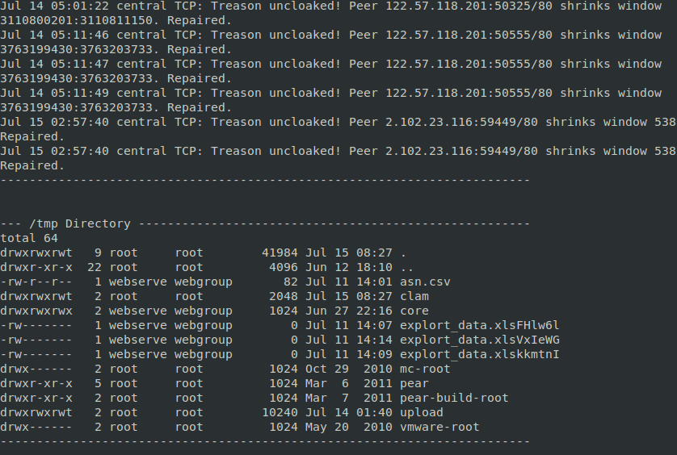
Canadian Finance Group's Logs

Slide 67

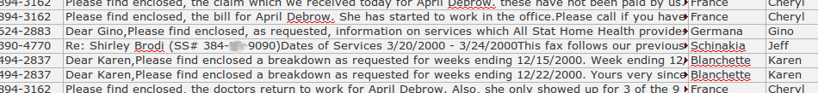
HIPAA Who?

Slide 68
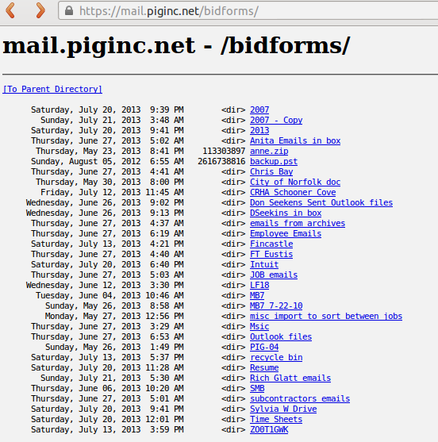

Slide 69

Nursing Home

Slide 70
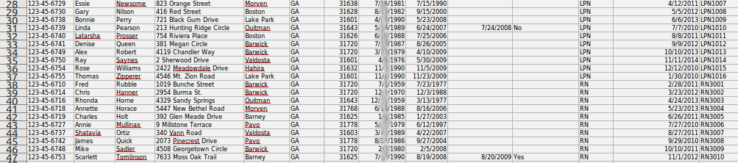
Nursing 2

Slide 71
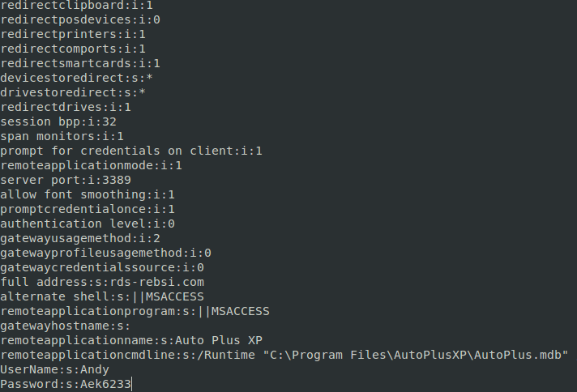
More RDP

Slide 72
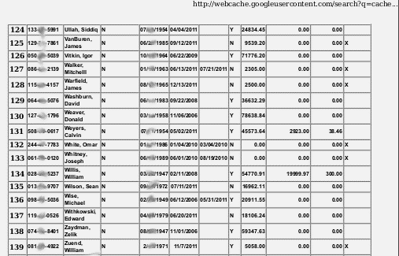
HR Database

Slide 73
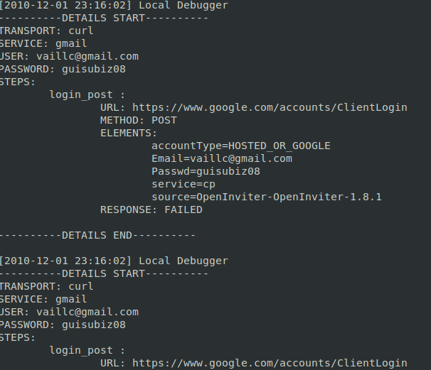
Wordpress - OpenInviter

Slide 74
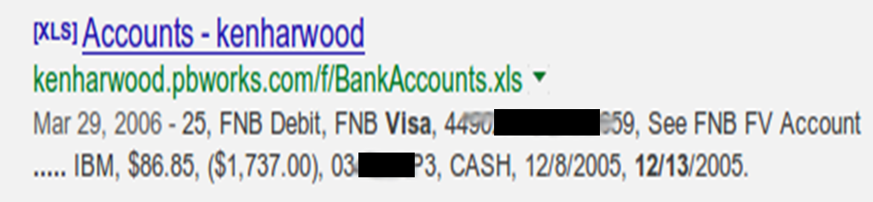
Stupidest....

Slide 75
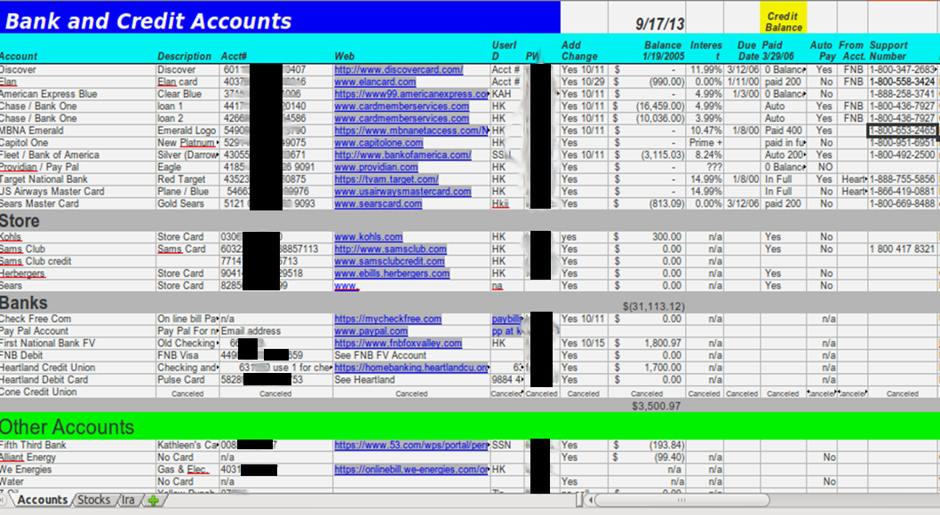

Slide 76
2015 Updated Content

Slide 77

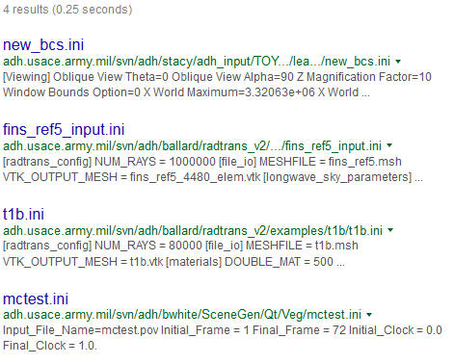

Slide 78
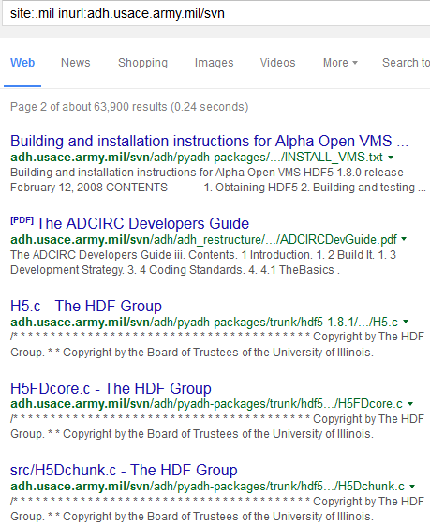
Access to Source Code allows attackers to create exploits much faster. Subversion (SVN) repositories may also leak passwords and other sensitive information by mistake.

Slide 79



SolarWinds Database Logs

Slide 80




Slide 81

This data is on a Military University website. The log is showing not only internal directory information, but that data is being linked externally. The medpix.50megs.com site no longer exists. I can register it myself and replace these images with ones containing exploit code. When the images are pulled up by users they may get infected.

Slide 82
Switching to Gov’t sites since .mil doesn’t have nearly as much as it used to. That likely means its being monitored more as well and I don’t want to get arrested…

Slide 83


Slide 84


Slide 85



Htacess files are used in Linux and Unix systems to control directory permissions on web servers. These can contain passwords, usernames, or as seen below, internal IP addresses allowed to access the folder. If we know what this scientist is working on, we now know which internal machine is his and the IP’s of co-workers working on the same project. Excellent targeting information to gather before breaking into the network. Its good that he has this set, because his entire profile and saved documents is publically available on the internet....

Slide 86


The previous slide showed an example of Directory Traversal. This is when a directory on a webserver is not locked down, and an unauthorized user can browse files. Desired behavior would be to show a “you are not authorized” error message. Being able to traverse directories allows us to find files we really shouldn’t have access to. To reliably locate directory traversal attack points, use the following search.

Slide 87

Directory traversal is specifically disallowed on any DISA STIG/SRG compliance webserver. Locating any server with this allowed is showing us a list of unhardened targets

Slide 88

This is very not good.

Slide 89

This is the log file found in the previous slide. Note that the username, failed password, and IP address is logged. The IP shows that this system is accessible over the internet. Users often fat-finger passwords, and as such if I download this file and pull all passwords for the user, I will likely see the common misspells and be able to guess the real password reliably before the account is locked out.
If the user logs in from home I can also target his home network, which will have significantly less security than the military networks. I hope.

Slide 90


To break into a system we often need a username and a password. Usernames are sometimes more difficult to locate than passwords, since we have password lists that can guess. Its useless and time consuming to guess usernames as well as passwords. So if we can find a list of known users of a system, then half of the authentication challenge has been solved.

Slide 91


The following is an interesting security vulnerability in Microsoft Sharepoint which has never officially been disclosed. This would be considered a feature except that it can have devisating effect. Sharepoint has users, and is often tied to Microsoft Active Directory. To setup users in Sharepoint, an admin goes to a page called aclinv.aspx. Unfortunately any authenticated user can view this page, they just can’t setup users. This can disclose a lot of internal user information such as name, email, phone number, title, internal usrid, etc. For the entire organization. The big problem is that many organizations allow external visitors to create an account to login and make them have “guest” or low-level access. Sharepoint doesn’t recognize the custom permissions, which allows someone from the internet to login and interrogate your Active Directory. This is a good example of using inurl to locate known vulnerable websites.
aclinv.aspx
aclinv.aspx

Slide 92


Slide 93


Below is a German site which allows user creation and then guest access

Slide 94


Slide 95



Slide 96


Slide 97


Slide 98


Slide 99


Slide 100


Slide 101


Slide 102


Slide 103


Slide 104


Slide 105


Slide 106


Slide 107


Slide 108


Slide 109


Slide 110


Slide 111


Slide 112


Slide 113


Slide 114


