Slide 1
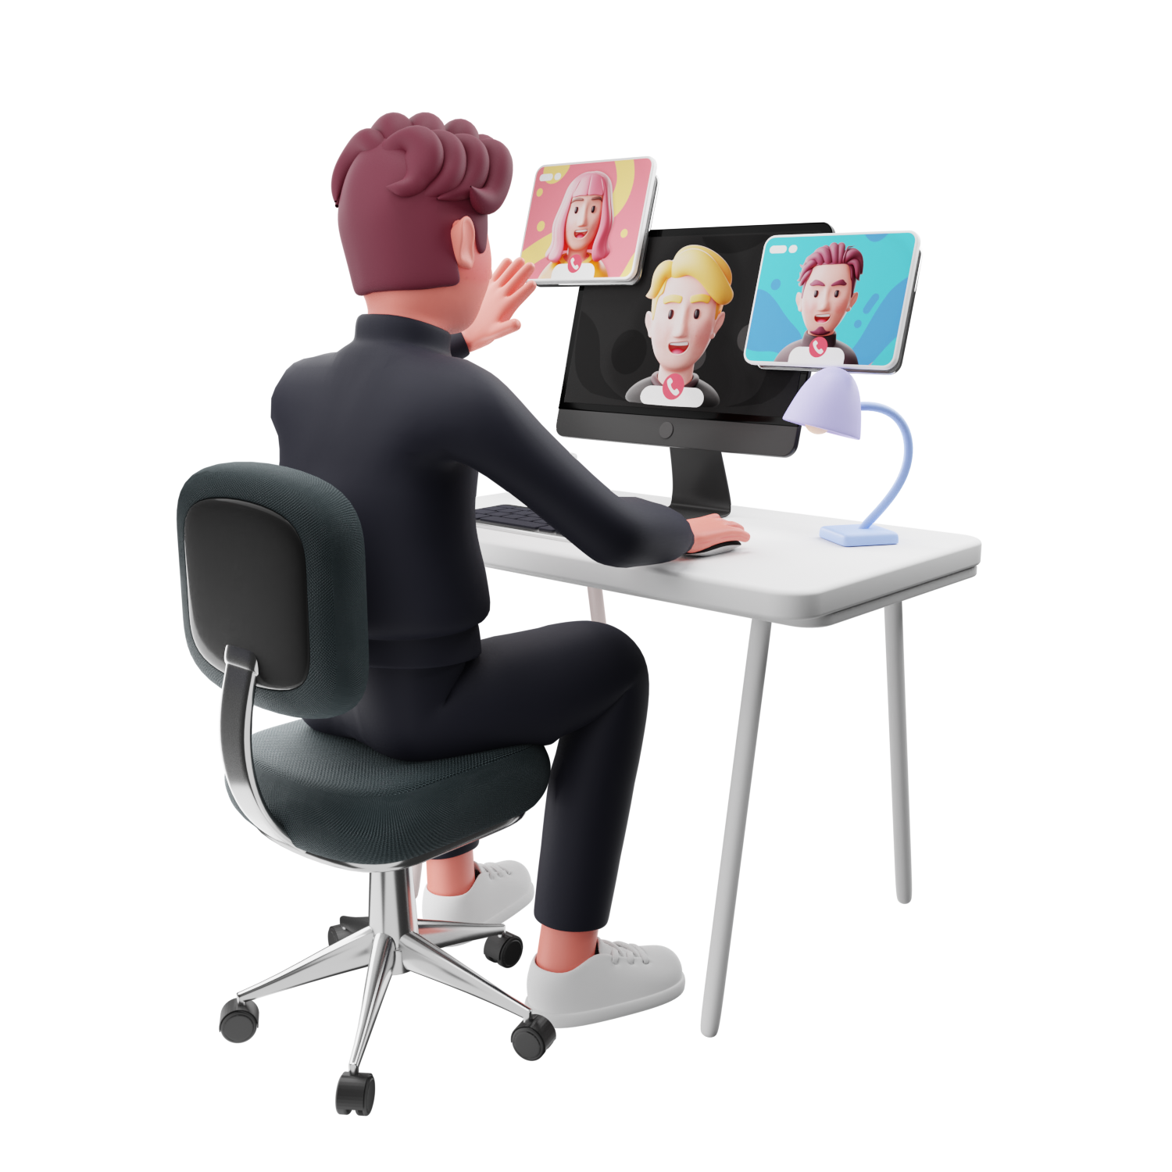
Online Course Development

Slide 2
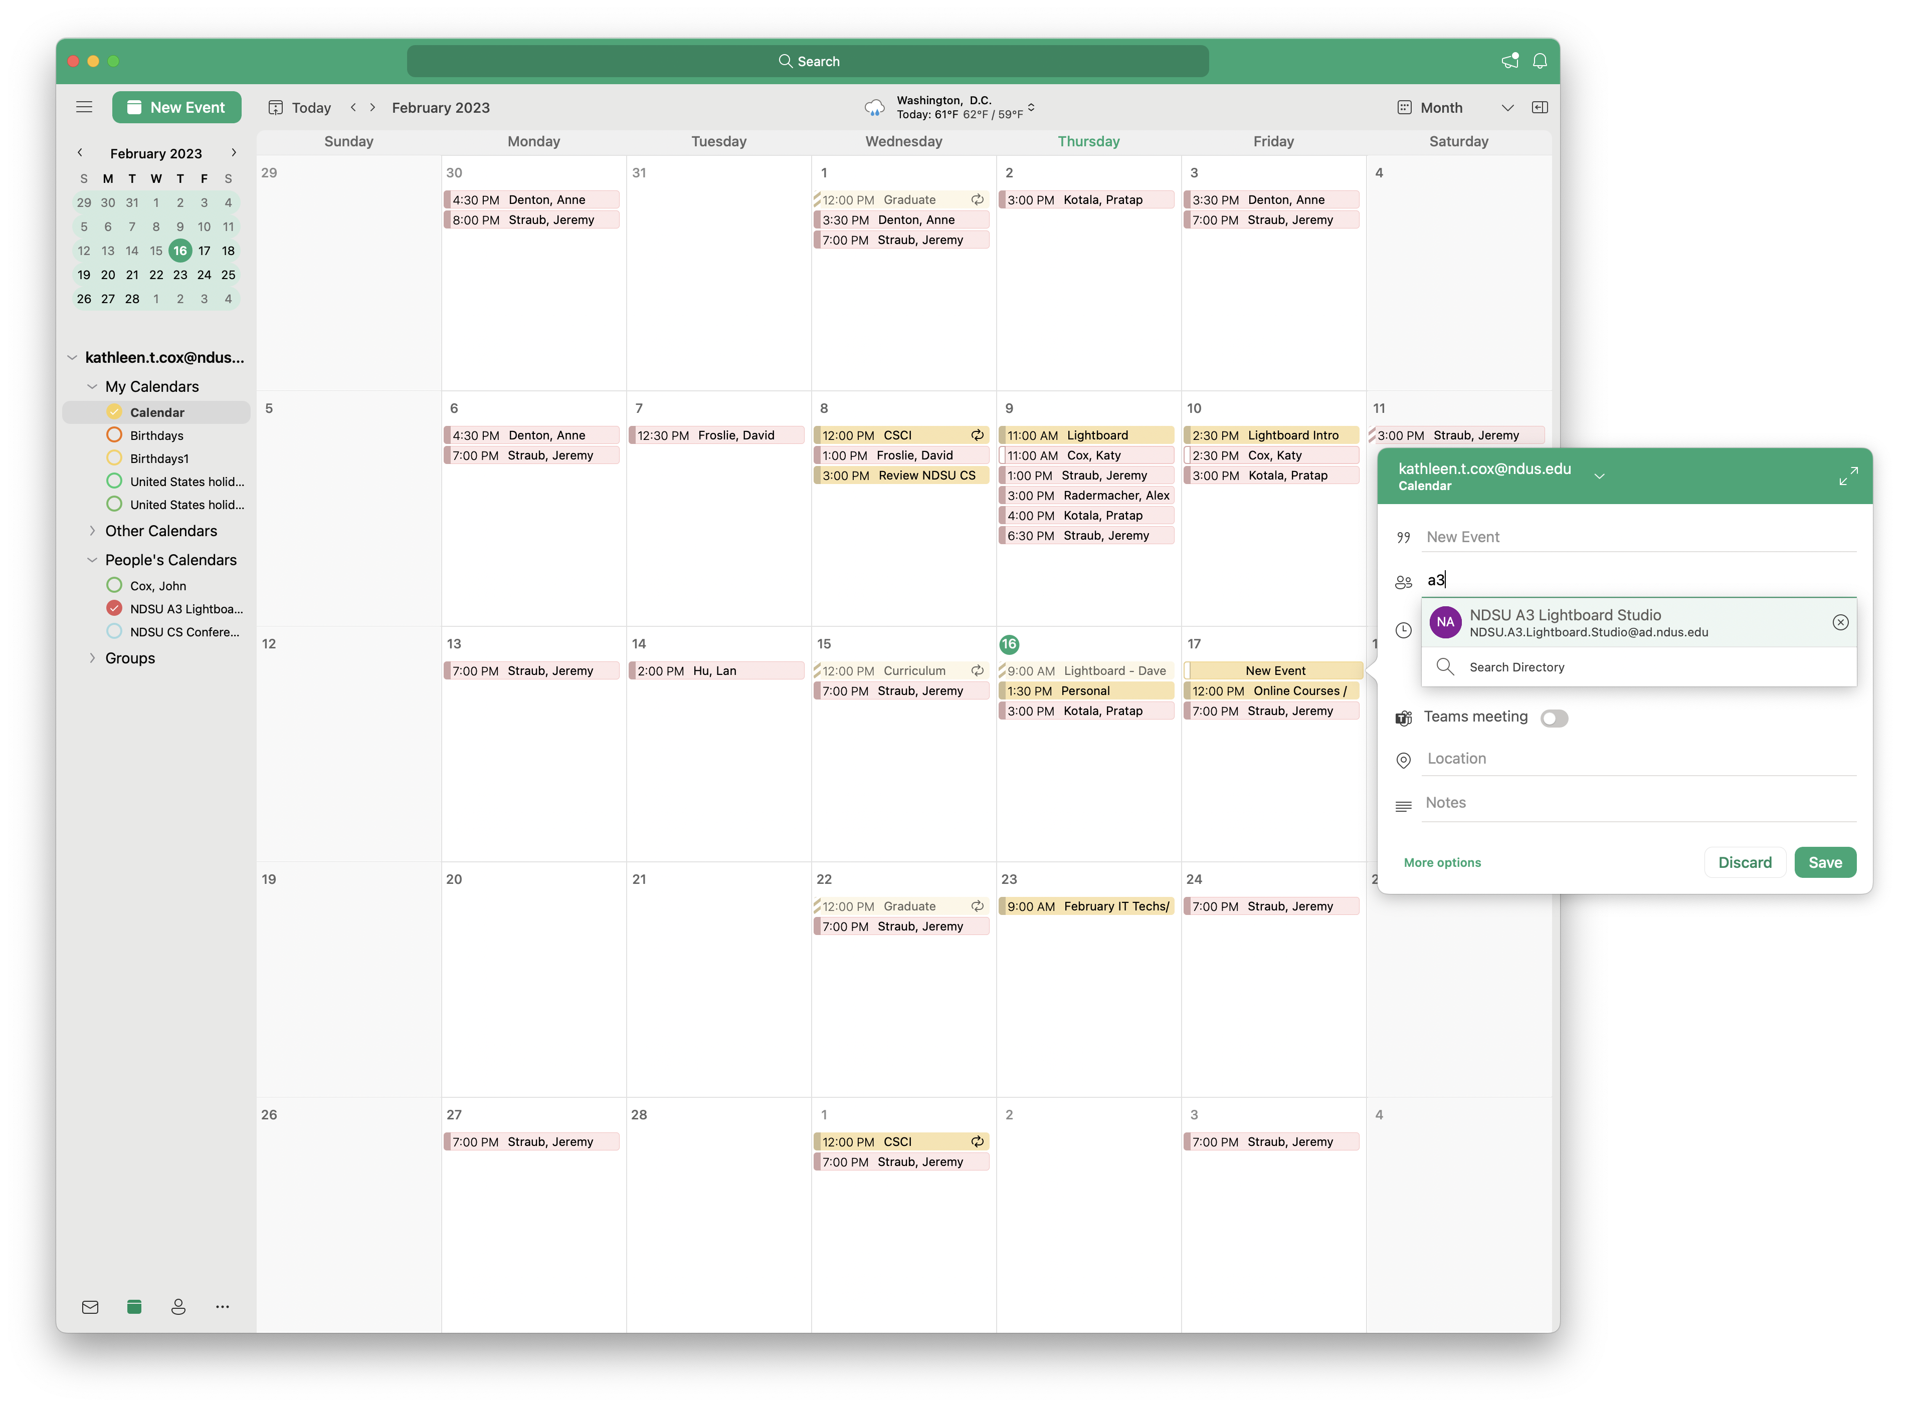
Reserving the Lightboard Studio
Add the NDSU A3
Lightboard Studio as an
invitee when reserving

Slide 3
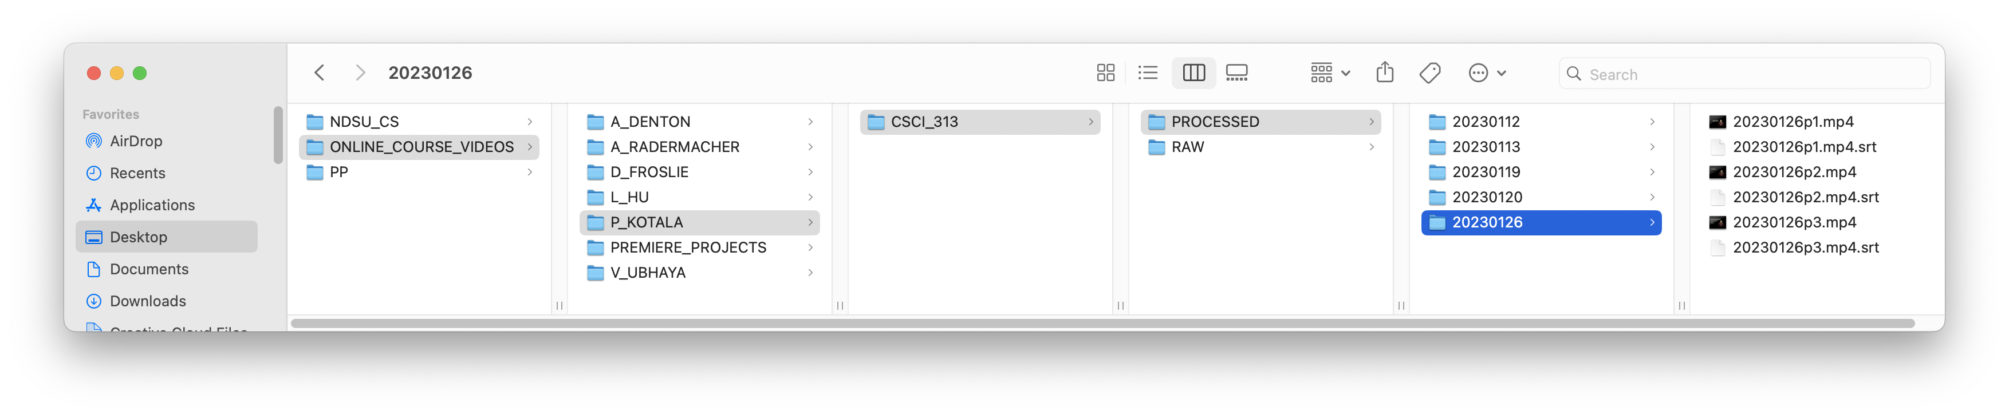
Server Space and Accessing Videos
Server Update
within the month
password protected
backup not host
Current Folder Structure

Slide 4
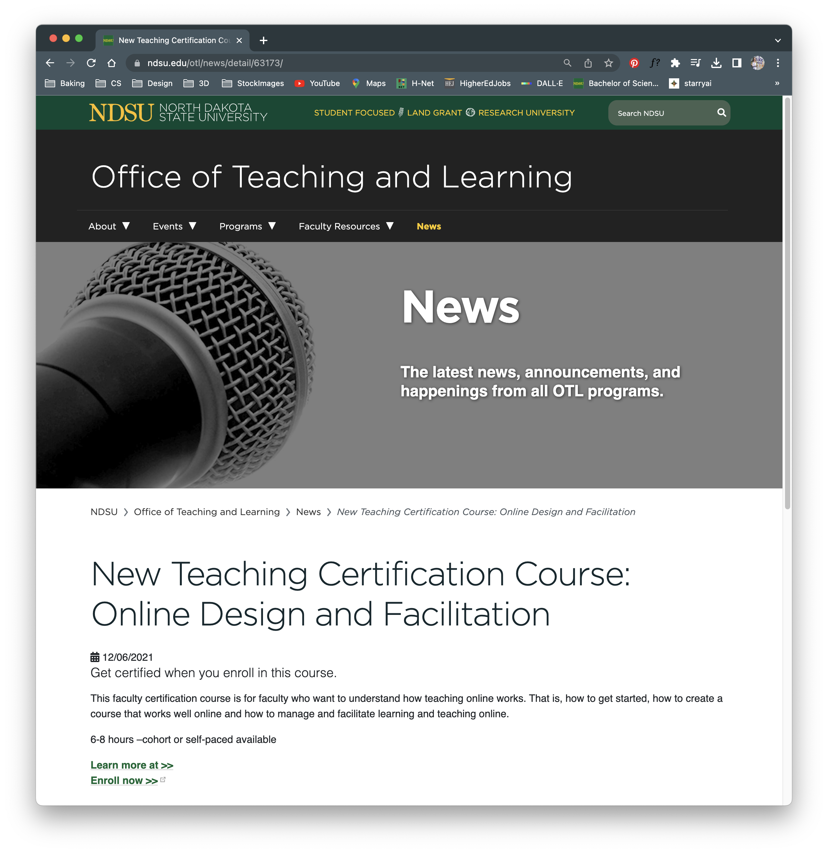
NDSU Resources
OTL & LAIC’s Online Design and Facilitation course (6-8 hour commitment)
Additional Hyflex and Facilitation and Universal Design for Learning and Digital Accessibilty courses
ndsu.edu/cs/a3_studio

Slide 5
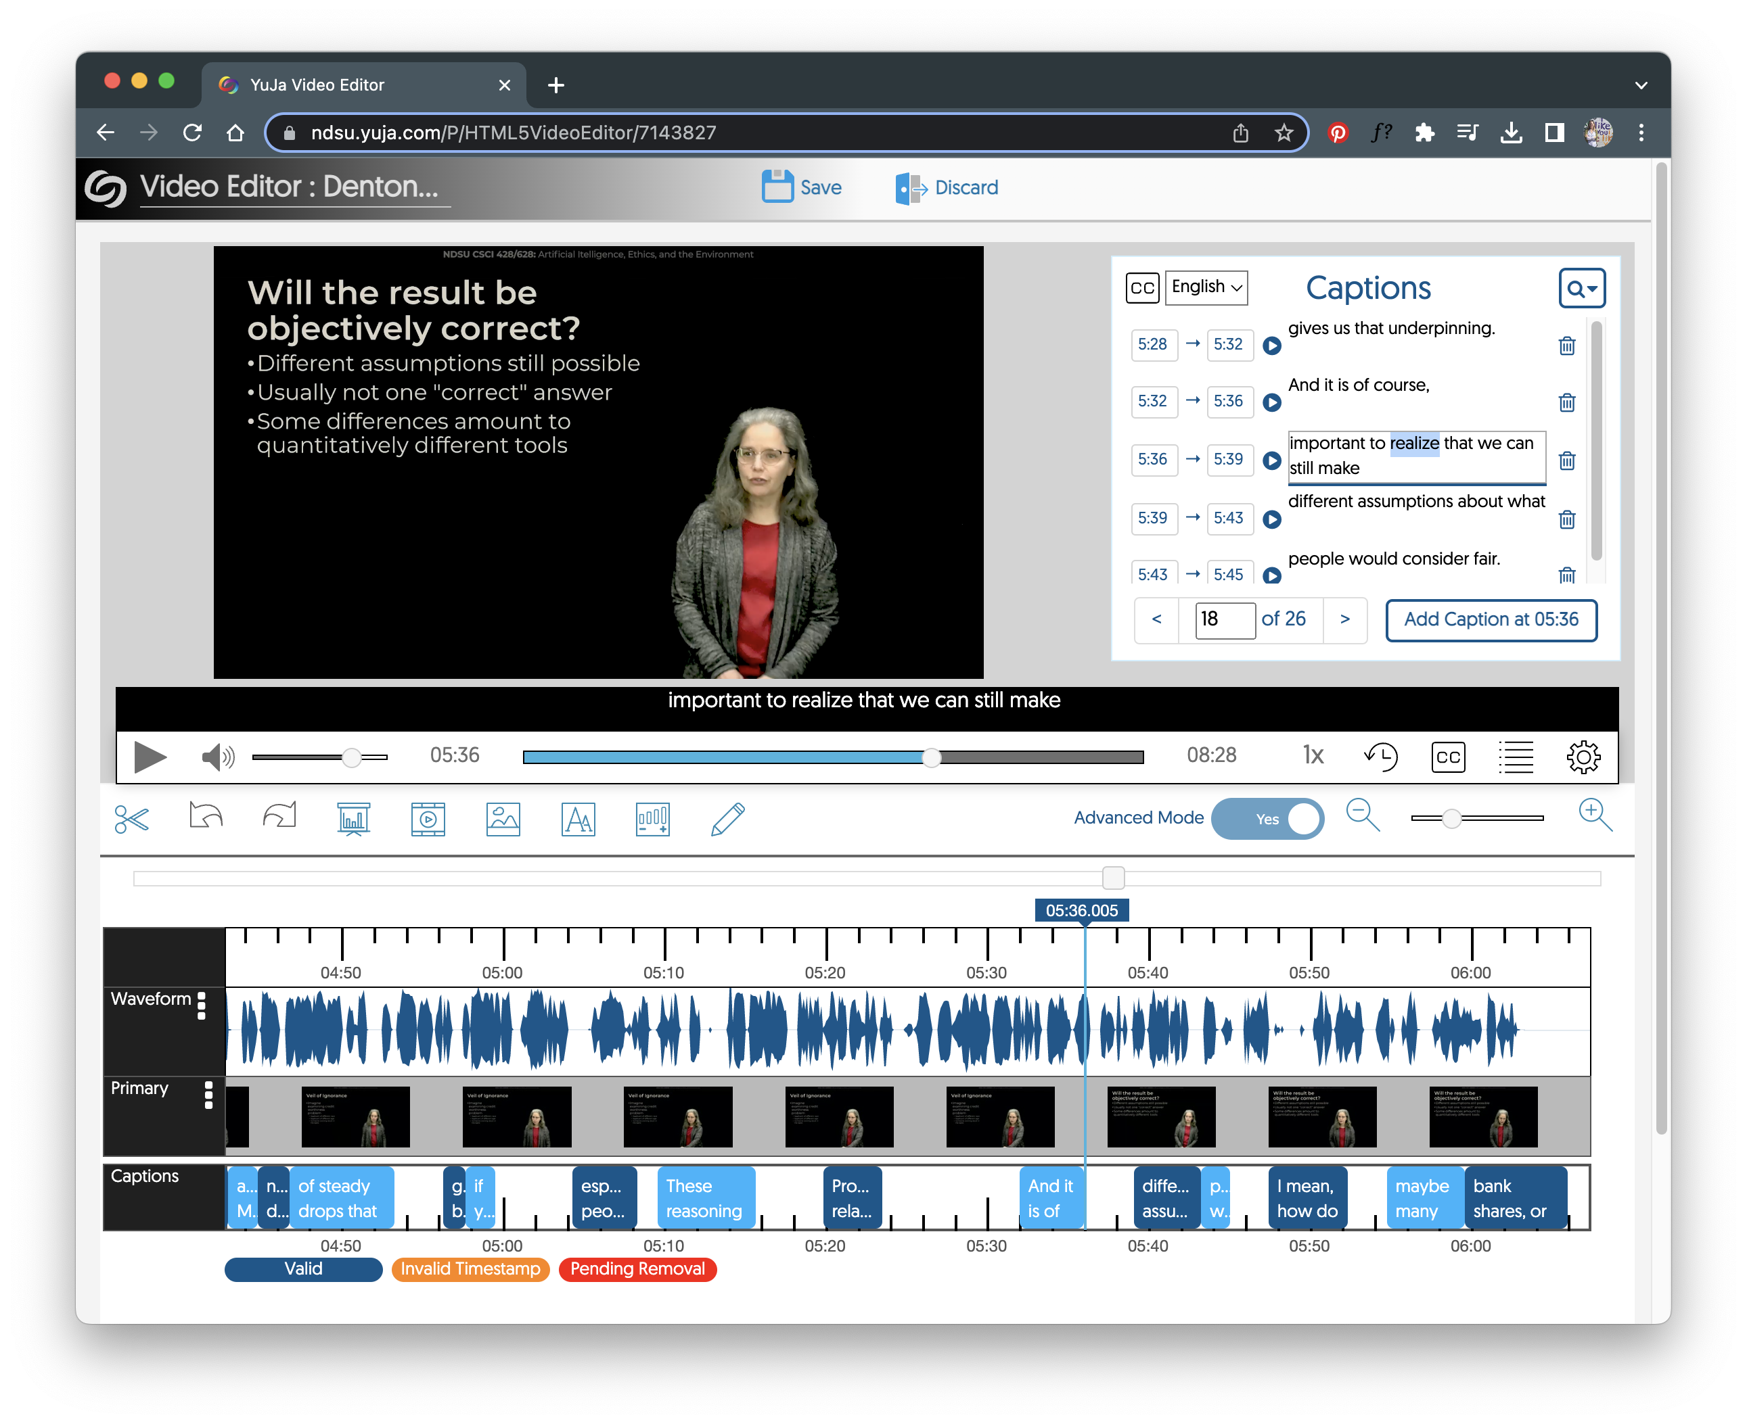
Closed Captioning
UDL: Universal Design for Learning
“Closed captioning provides a critical link to information for individuals who are deaf or hard-of-hearing. For individuals whose native language is not English, English language captions improve comprehension and fluency.”
Sidecar Subtitles (.srt) and the YuJa Editor
Importance of reviewing auto-generated captions

Slide 6
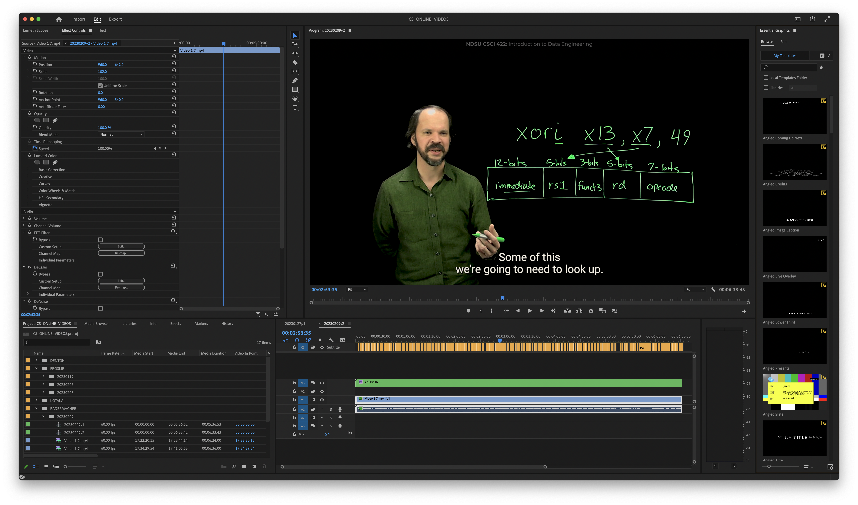
Video Production Steps
In Adobe Premiere Pro
Add Course Identifier at top
Position/Resize video
Audio filter
Color correction
Masking
Closed captioning
Basic editing
Exporting with web appropriate compression
Free video software: Davinci Resolve (desktop), YuJa (online)

Slide 7
Before and After
https://youtu.be/Iybdxq-CcSQ

Slide 8
Example Lightboard Videos
https://www.youtube.com/watch?v=MDUnKfOhggo

Slide 9
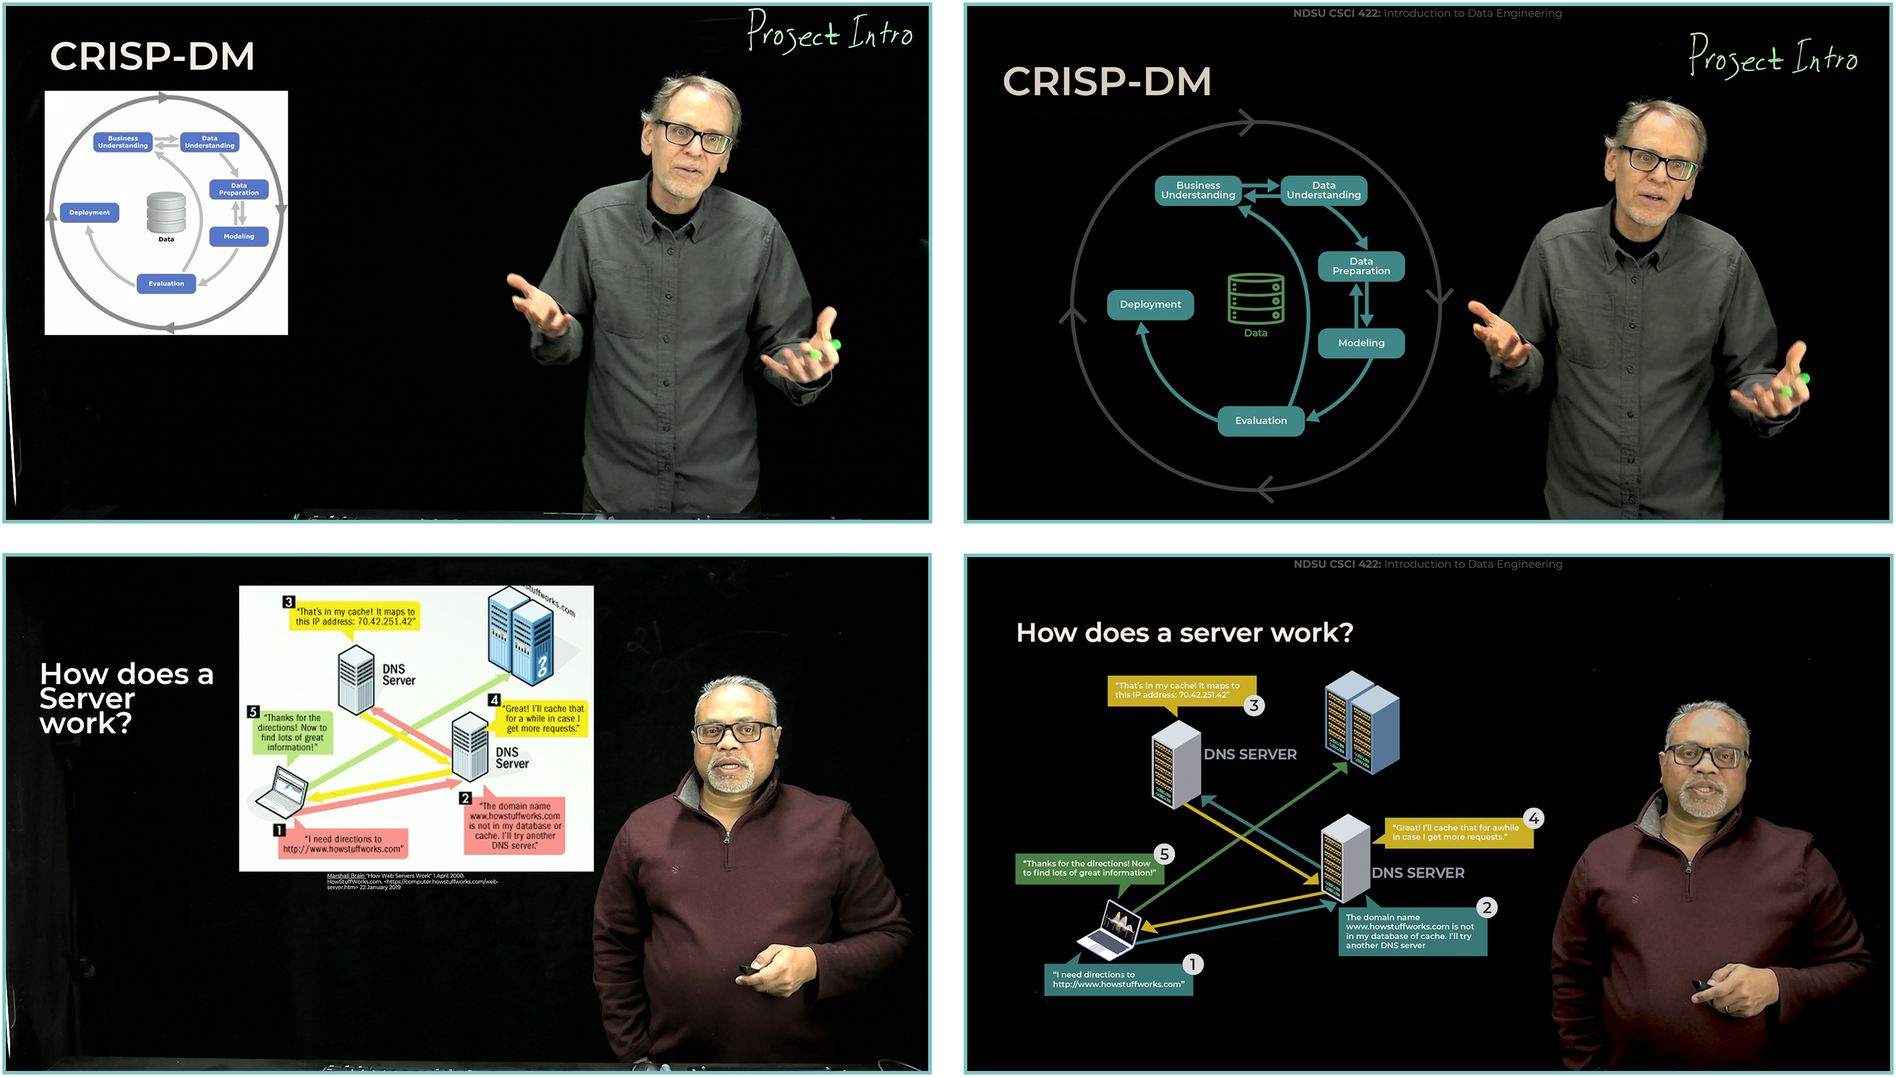
Custom Graphics

Slide 10
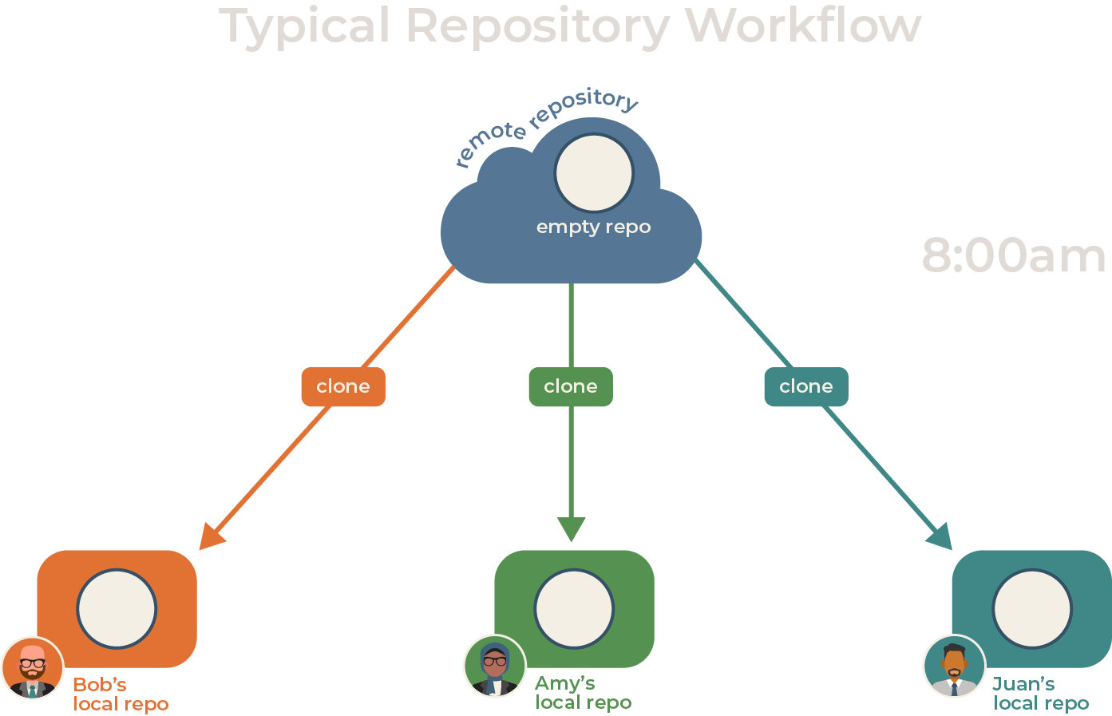
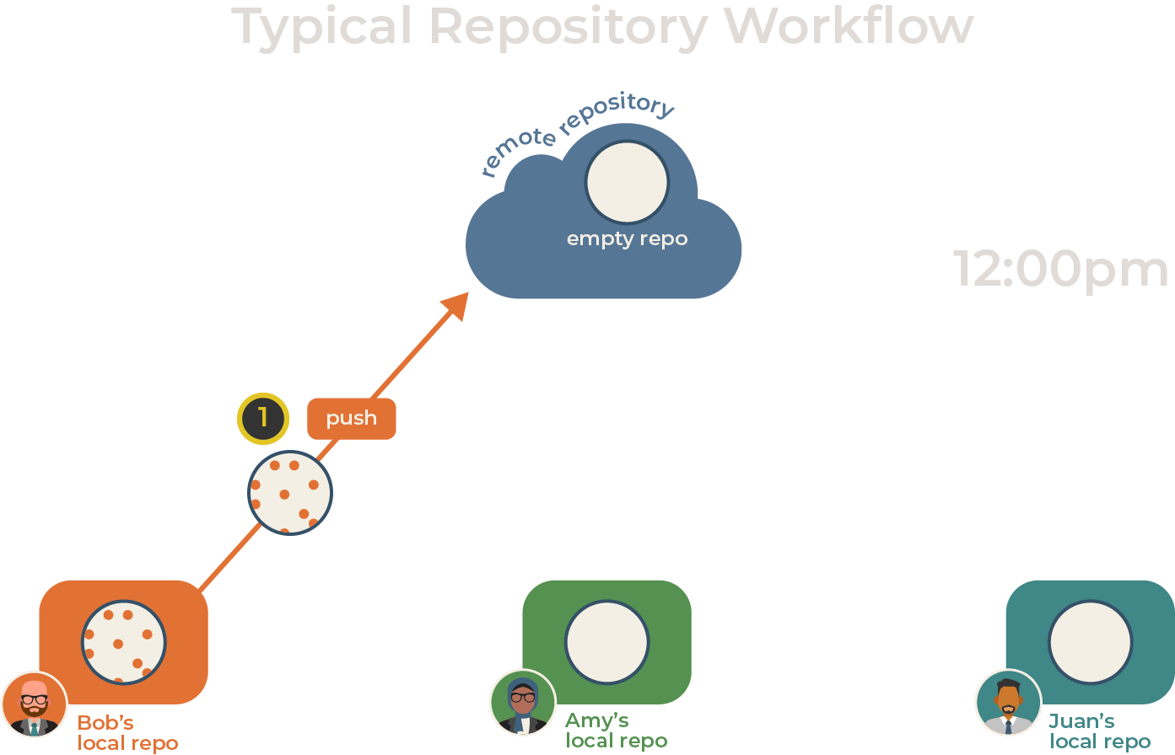
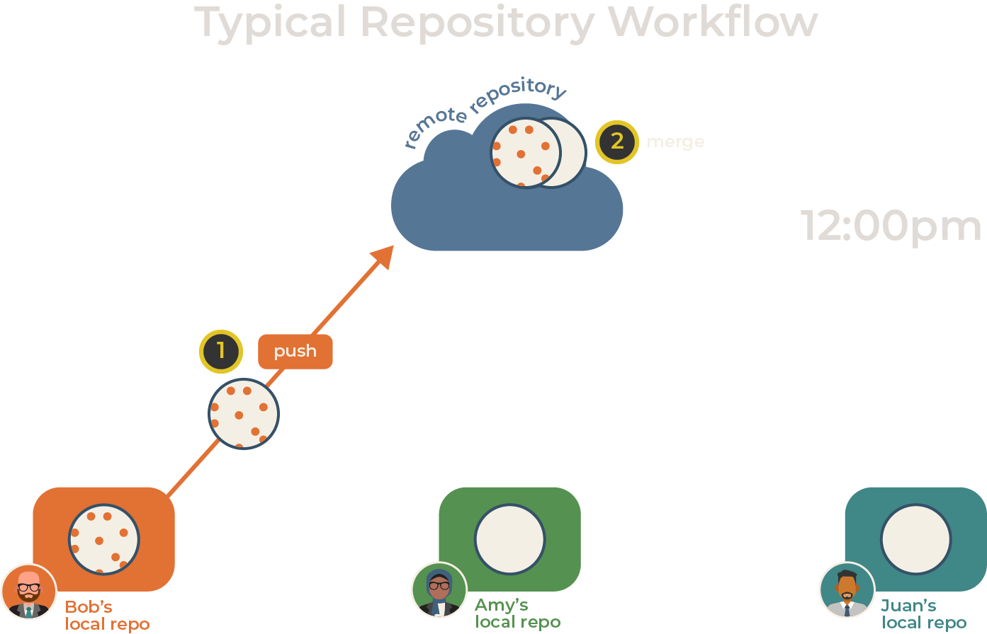
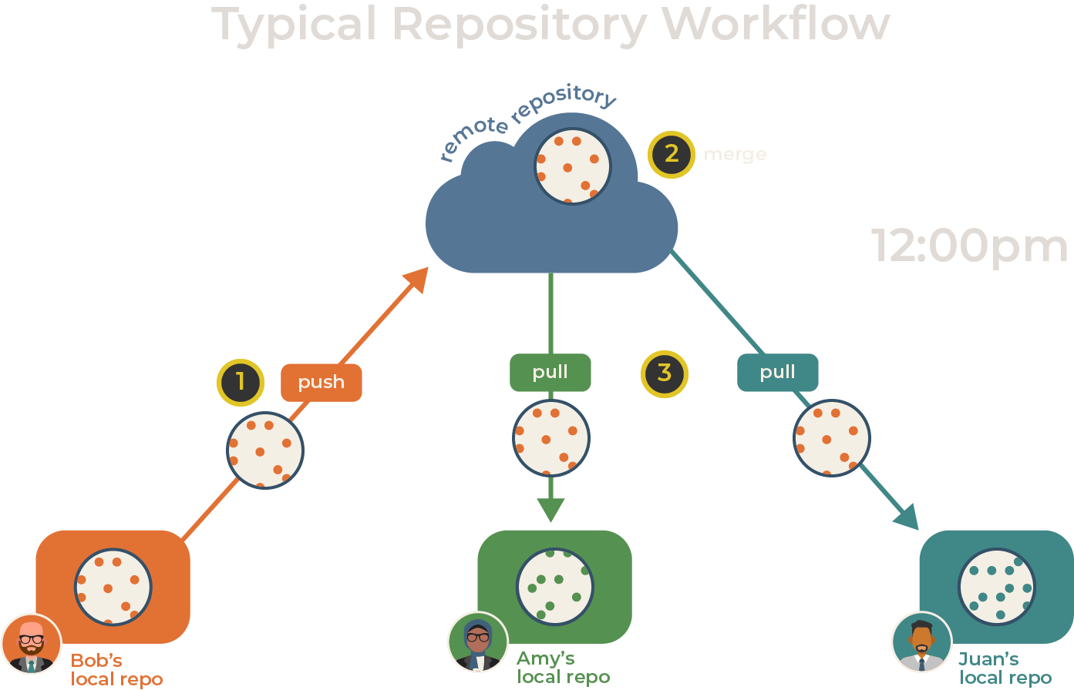
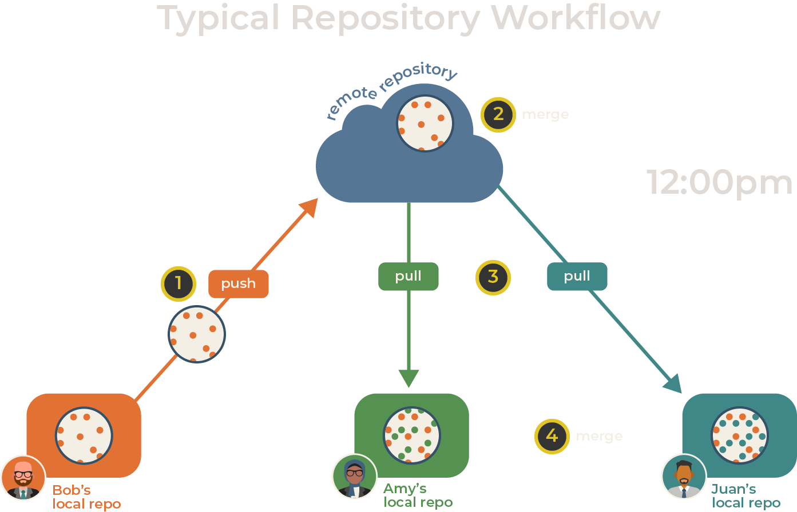
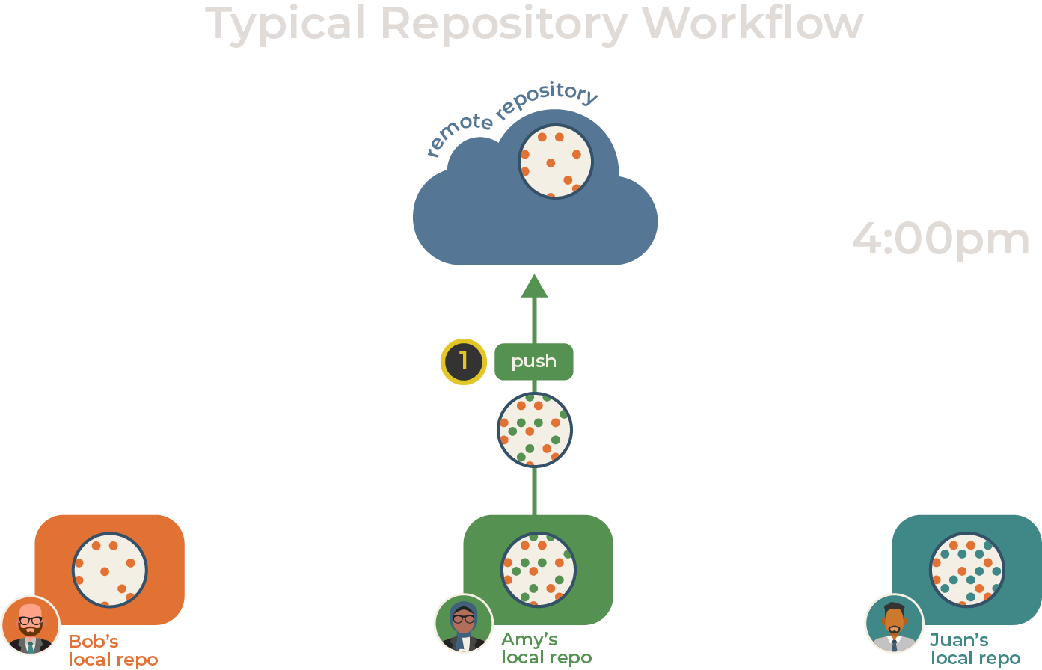
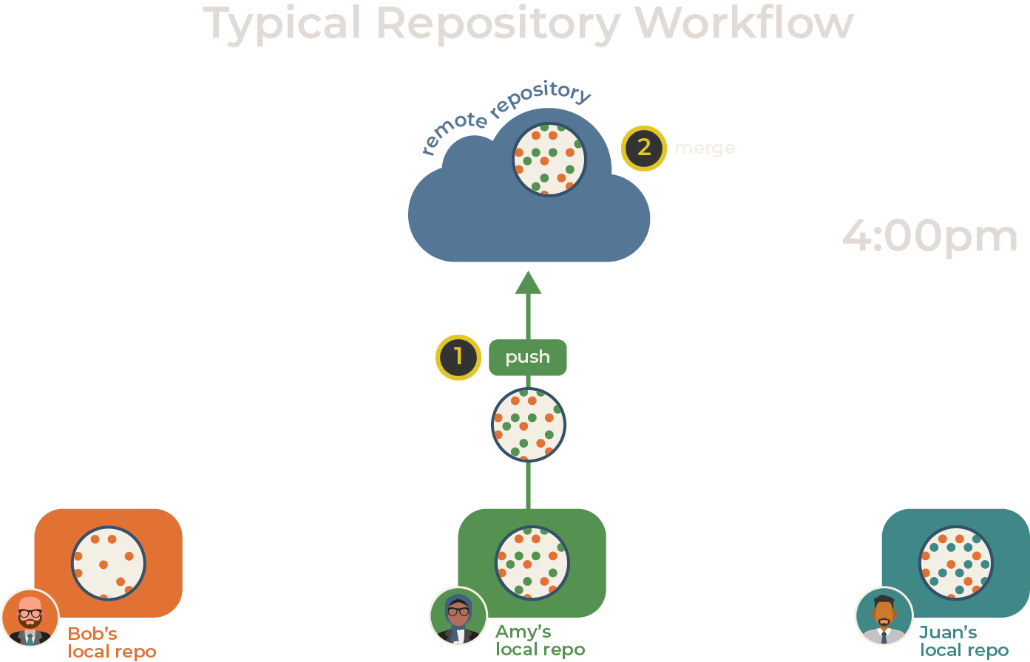
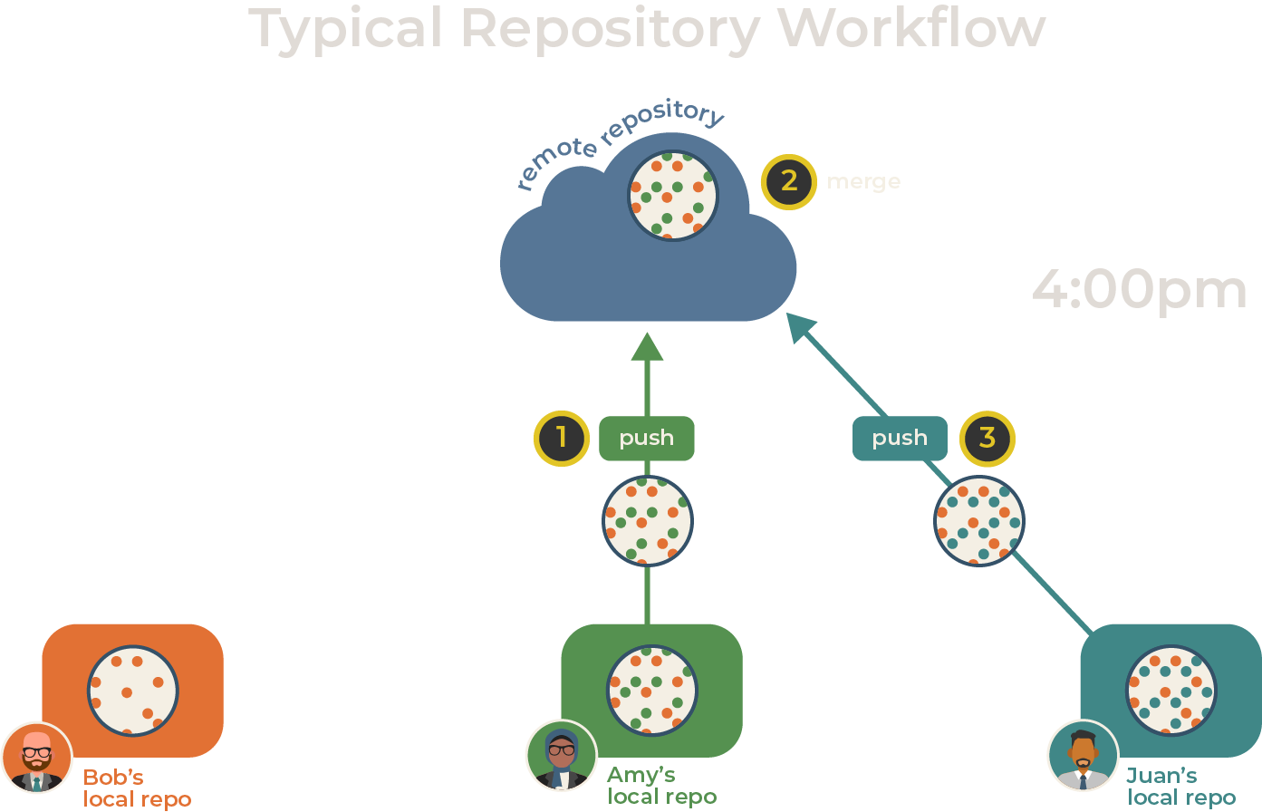
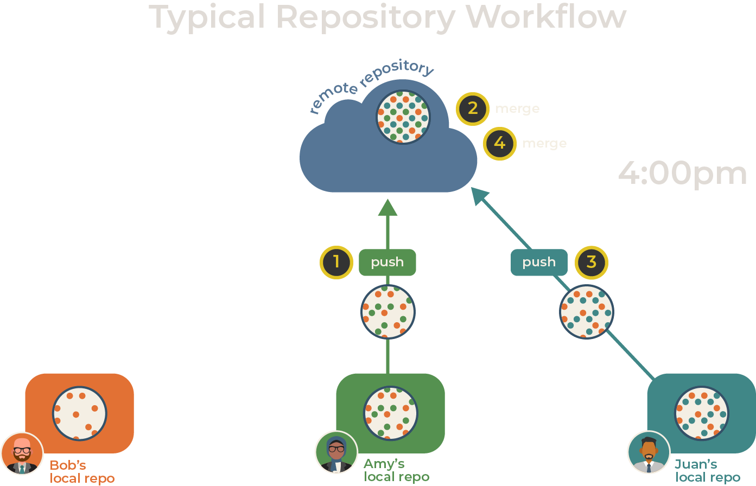

Slide 11
Questions and Feedback

