Slide 1
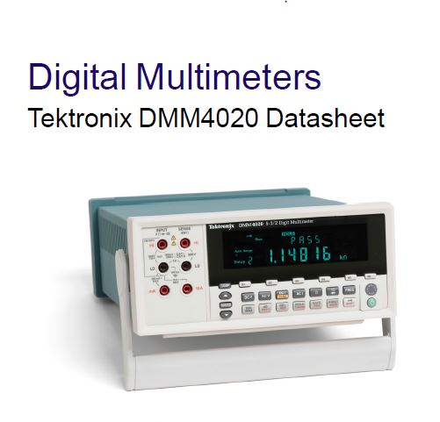
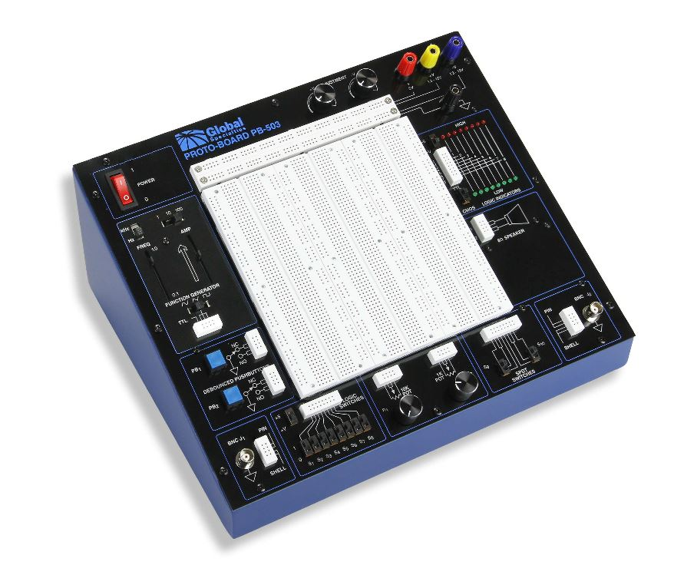
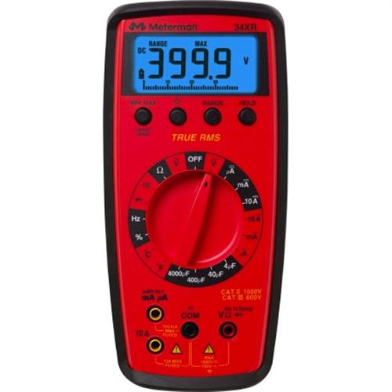
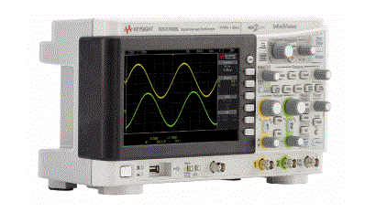
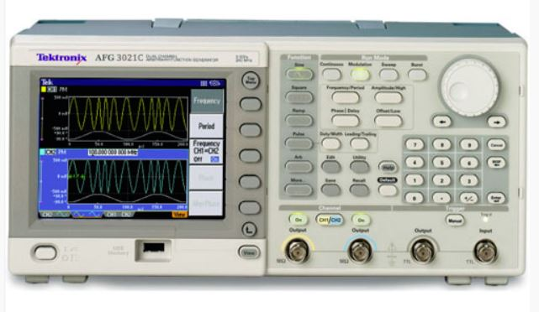
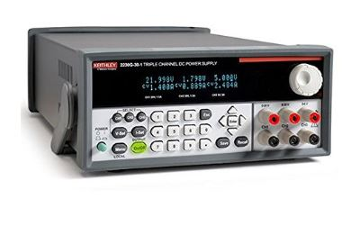
NDSU ECE Laboratory
DMM’s
Cadet
Equipment Operation
DC Power Supply
Oscilloscope
Signal Generator

Slide 2
LAB EQUIPMENT
Electrical Engineering requires extensive use of different types of Electronic equipment for understanding the concept of electronics.
Typically the ECE Labs have five pieces of test equipment students will see in all laboratories, therefore we will discuss these five pieces of equipment and watch a short Oscilloscope tutorial.
Five types of equipment are : DMM or Digital Multimeter
: Oscilloscope
: Signal Generator
: Cadet Board
: DC Power Supply

Slide 3
DIGITAL MULTIMETER (DMM)
As you cannot see electricity, test equipment is required to help understand the various aspects of ohms law. An Engineer needs to measure Resistance, Voltage, Current and Frequency, to understand the concepts.
All Engineers must be proficient in the use of this equipment and one of the most useful of all electronic test equipment is the DMM (Digital Multimeter)
DMM’s may be Portable (Hand Held) or Bench Top. The equipment that we typically use is all bench top.
Handheld DMM

Slide 4
Different Makes and Models
There is a large variety of DMM’s from very inexpensive to expensive, ($20-$2000)
The Bench Top Digital Multimeter on your lab bench is a model # DMM4020 and is made by Tektronix, and was purchased for $ 565.00
Some of the many companies that make electronic test equipment are
Rigol, Keithley (HP),Fluke, Tektronix, B&K etc.

Slide 5
Digital Multimeter (DMM) basics tutorial
- the digital multimeter, DMM is one of the most useful items of test equipment. Basic instruments can measure current, voltage and resistance, but most DMM’s include the capability to measure many other values.
Very useful tutorial on DMM’s
http://www.radio-electronics.com/info/t_and_m/digital-multimeter/dmm-basics-tutorial.php

Slide 6
DMM facilities
While the facilities that a digital multi-meter can offer are much greater than their analogue predecessors, the cost of DMMs is relatively low. DMMs are able to offer as standard the basic measurements that would typically include:
•Current (DC)
•Current (AC)
•Voltage (DC)
•Voltage (AC)
•Resistance
However, using integrated circuit technology, most DMMs are able to offer additional test capabilities. These may include some of the following:
•Capacitance
•Temperature
•Frequency
•Transistor test - hfe, etc
•Continuity (buzzer)

Slide 7
In addition to the additional measurement capabilities, DMMs also offer flexibility in the way measurements are made. Again this is achieved because of the additional capabilities provided by the digital electronics circuitry contained within the digital multimeter. Many instruments will offer two additional capabilities:
•Auto-range: This facility enables the correct range of the digital multimeter to be selected so that the most significant digits are shown, i.e. a four-digit DMM would automatically select an appropriate range to display 1.234 mV instead of 0.012 V. Additionally it also prevent overloading, by ensuring that a volts range is selected instead of a millivolts range. Digital multimeters that incorporate an auto-range facility usually include a facility to 'freeze' the meter to a particular range. This prevents a measurement that might be on the border between two ranges causing the meter to frequently change its range which can be very distracting.
•Auto-polarity: This is a very convenient facility that comes into action for direct current and voltage readings. It shows if the voltage of current being measured is positive (i.e. it is in the same sense as the meter connections) or negative (i.e. opposite polarity to meter connections). Analogue meters did not have this facility and the meter would deflect backwards and the meter leads would have to be reversed to correctly take the reading

Slide 8
Voltage Measurements using a DMM

Slide 9
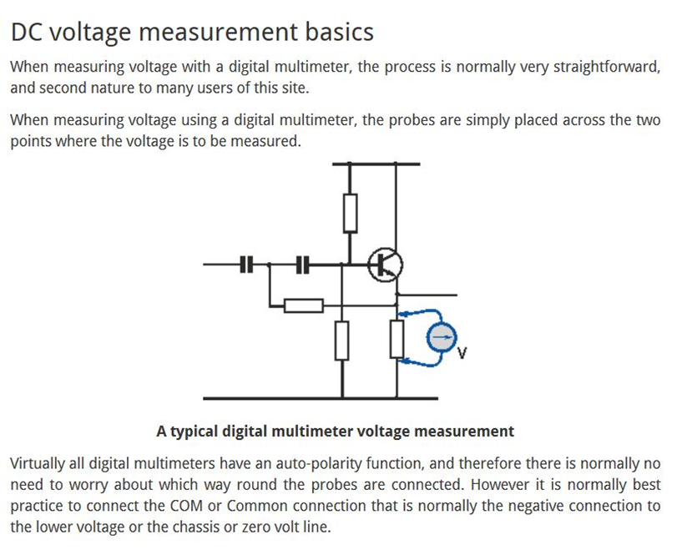

Slide 10
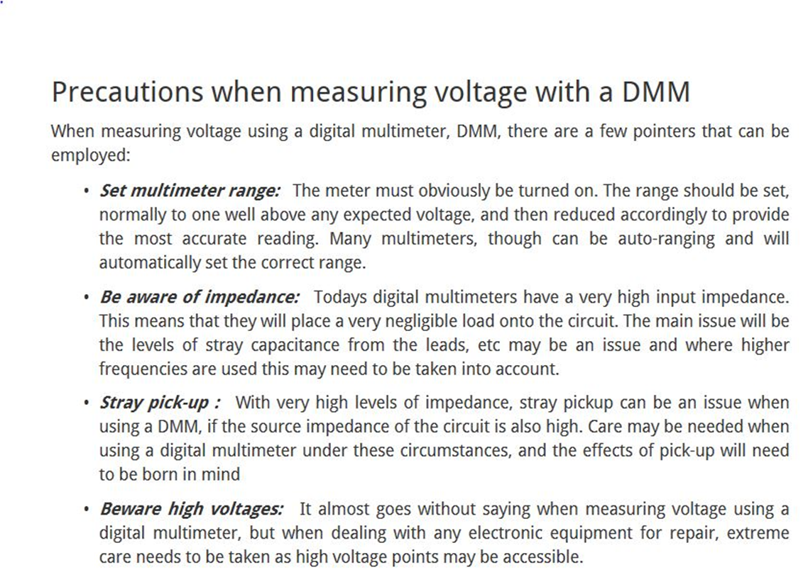

Slide 11
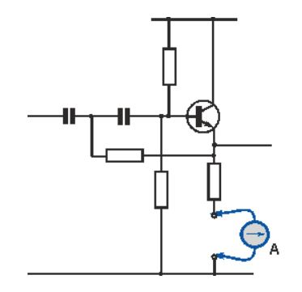
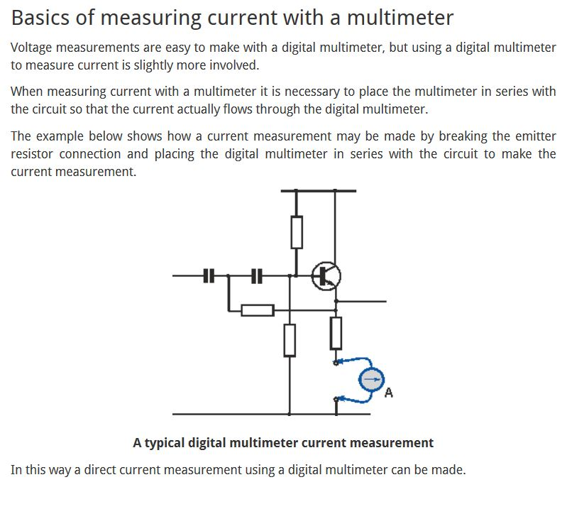
Measuring Current with a Digital Multimeter

Slide 12
Precautions on measuring Current with a DMM
Precautions for measuring current with a multimeter
When measuring current with a multimeter, there are a few precautions that can be observed to ensure that the readings are as accurate as possible.
•Ensure test leads are secure: When measuring current with a multimeter it is necessary to ensure that the connections will remain in place for a while. It may not be appropriate to use ordinary test probes, because these will only remain in place while they are held. It may be more appropriate to have connections using crocodile / alligator clips or some other method that will keep the connections in place while the circuit is switched on for the test.
•Meter resistance: The leads and meter will introduce additional resistance. In most cases this will be very low and can be ignored, bit on some occasions it may be important.
•Lead length: The leads used for the multimeter may cause issues with some circuits, especially if they are long. If the circuit is carrying signals above 100kHz or is capable of operating at frequencies above this, the leads may introduce stray capacitance and inductance which can cause the circuit to malfunction. Also radiation of the signal may cause problems.
Some voltage regulator chips are known to oscillate if the lead length to the smoothing capacitor is too long. Local decoupling may therefore be required on some occasions.

Slide 13
Measuring Resistance with a DMM
- measuring resistance with a digital multimeter is straightforward, but there are a few essential hints and tips to make sure the readings are accurate.
Resistance measurements are one of the common measurements that need to be made in an electronics laboratory or workshop.
Knowing how to measure resistance with a digital multimeter is quite straightforward, although there are a number of precautions and hints and tips that can make the measurements more reliable and accurate.

Slide 14
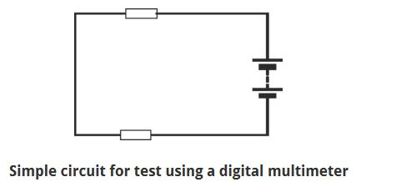
Digital multimeter resistance tests
Basic resistance measurements
For accurate measurements of resistance, the item to be tested should not be affected by other components within the circuit.
In the very basic circuit shown below, other components will affect any readings made.
When making a resistance measurement, the digital multimeter supplies current to the item under test and measures the response. The more current the device is able to draw, the lower the resistance.
Often the digital multimeter will possess several ranges. Typically it is best to opt for the lowest range that does not overflow the display.

Slide 15
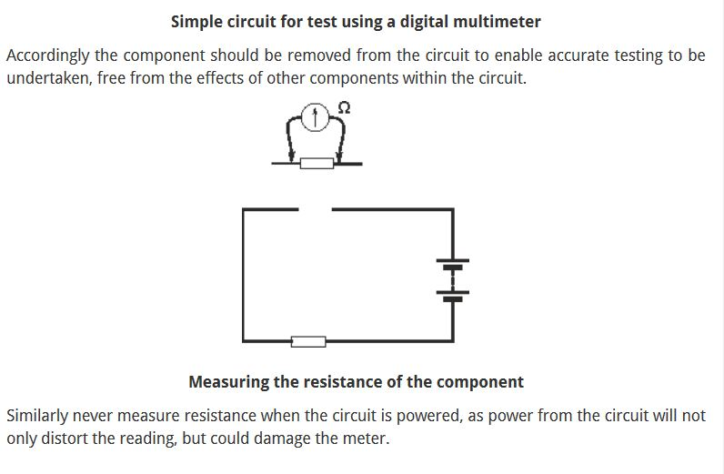
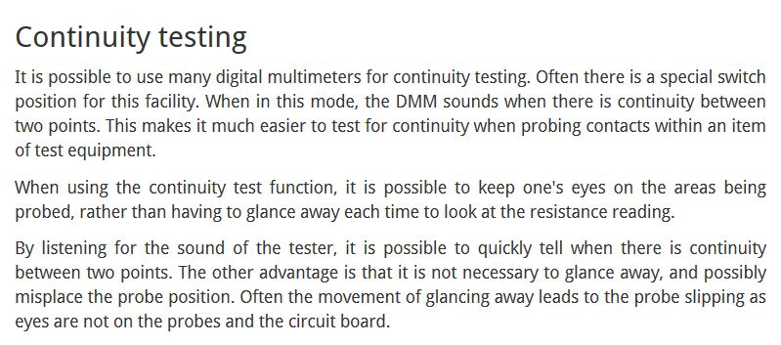
Resistance Testing with a DMM

Slide 16
Resistance Meter Check
ALWAYS SHORT YOUR LEADS TOGETHER TO VERIFY LEADS ARE OK

Slide 17
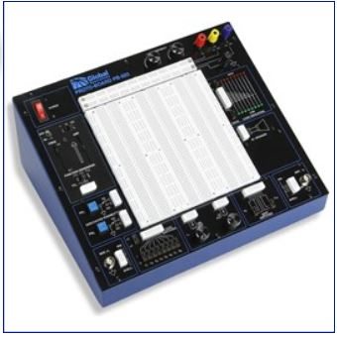
DIGITAL TRAINER- Prototyping

Slide 18
Digital Trainer
Used for all levels of electronics instruction and prototyping
FEATURES of the PB-503 Trainer
PB-503: Desktop Analog & Digital Design Trainer Product Features
◾Ideal for analog, digital, and microprocessor circuits
◾Eight high & low buffered logic indicators
◾Eight selectable logic switches
◾Function generator with continuously variable sine, square, and triangle waveforms and TTL pulses
◾Triple-output power supply offers fixed 5 VDC supply plus two variable outputs: ±1.3 to ±15 VDC
◾Two digital pulsers
◾Audio experimentation speaker
◾Removable breadboard plate with additional plates available

Slide 19
DIGITAL TRAINER points
Advantage
Disadvantage
Easy to use
Has all functions required for electronic prototyping
Built in function generators
Fused @ 650mA for a reason. Protects the internal circuitry
Potentiometers are on board- use them
Breadboard has 2520 tie points
Limited Power available 0.5A
This runs most circuitry but will not drive a stepper motor
Removable Prototyping board- do not remove as they are expensive and get misplaced
They blow fuses but easily replace-
able with a 650mA GMA Fuse
“Note” Cadets DO NOT SUPPLY ENOUGH CURRENT TO RUN STEPPER MOTORS

Slide 20
DC Triple Power Supply
Electrical Components require voltage to run them. This could be AC (alternating current) or DC (Direct Current)
This Power supply supplies DC (Direct Current) and is programmable.
It has three individual power supplies inside.
+/- 5 Volt DC @ 3A output
Two 0-30V @ 3A DC output
Set the outputs with 0.06% basic accuracy and 0.2% current output accuracy
Connect the two power supplies in series or parallel
Can control the Power supply from a PC (Programmable timers etc)
Practice usage by using a DMM and monitor 5 volt supply, 0-30 volt supply and how to program a voltage in series or parallel.
Where is the fuse?

Slide 21
DC Power supply Testing using a DMM for product hookup and configuration
Practice usage by using a Digital voltmeter and monitor 5 volt supply, 0-30 volt supply and how to program a voltage in series or parallel.
Where is the fuse?
What is the amperage of the fuse?

Slide 22

OSCILLOSCOPE

Slide 23
Oscilloscopes are incredibly useful so the ECE engineer is required to be proficient in its usage.
Basically they draw a graph of a waveform showing amplitude over a period of time and display it on an LCD screen.
We cannot see electricity although we all know it’s there. To SEE the signals, whether it is DC, AC sine wave/ trapezoidal, square waveform, audio or pulsed we use the oscilloscope.
The advantages of a digital storage scope is that you can look at a waveform and freeze it for further examination.
An Oscilloscope has three sections to it. An Vertical axis for measuring amplitude of a waveform, a horizontal axis for measuring time/frequency and is displayed in divisions on the LCD screen and another is the trigger which synchronizes the horizontal sweep of the oscilloscope to the proper point of the signal.
By repeatedly displaying similar portion of the input signal, the trigger makes the repetitive waveform look static.
Oscilloscopes CANNOT Measure Current or Resistance, They are designed to Measure a Change in Voltage

Slide 24
Digital Oscilloscopes-
Many manufacturers of Oscilloscopes
Keysight scopes-Model # 1000X
Purchase price--$750.00
100MHz Bandwidth
2 Analog Channels plus external trigger
USB Waveform storage
Built in Generator
Student Tutorial -Cut and Paste to Watch
www.bing.com/videos/search?q=rigol+ds1102ca+digital+oscilloscope+tutorial&qpvt=rigol+ds1102ca+digital+oscilloscope+tutorial&view=detail&mid=AEBF732B648C99A9DE0CAEBF732B648C99A9DE0C&FORM=VRDGAR

Slide 25
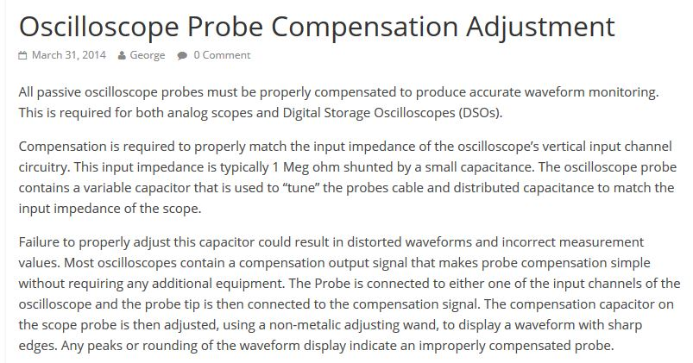

Slide 26
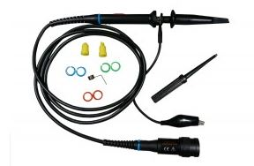
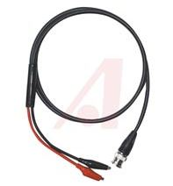

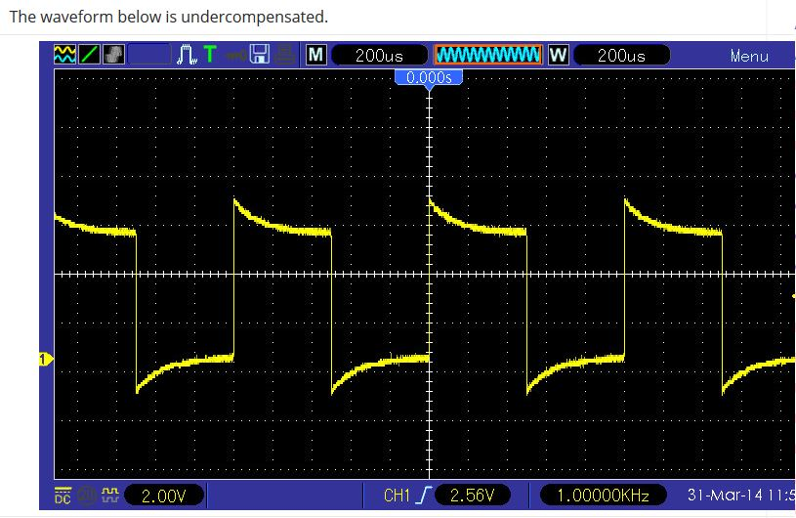
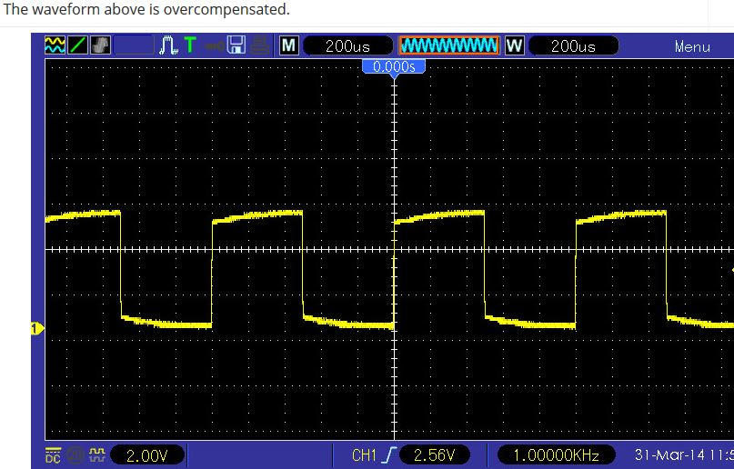
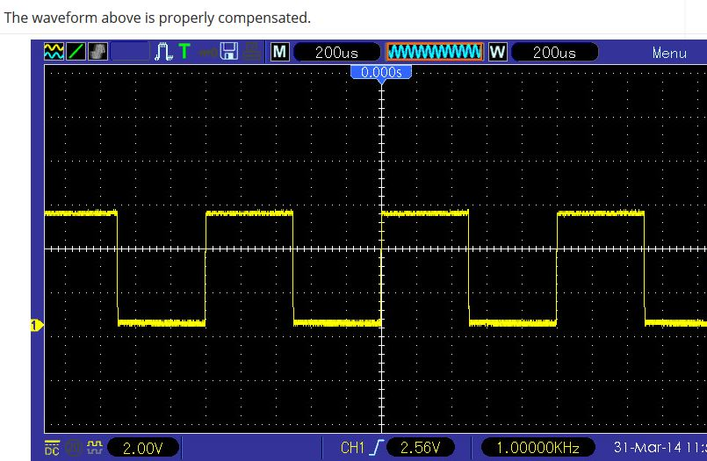
Oscilloscope Probes
An Oscilloscope Probe is a Test Cable! It is not a signal cable!
Oscilloscope Compensation

Slide 27
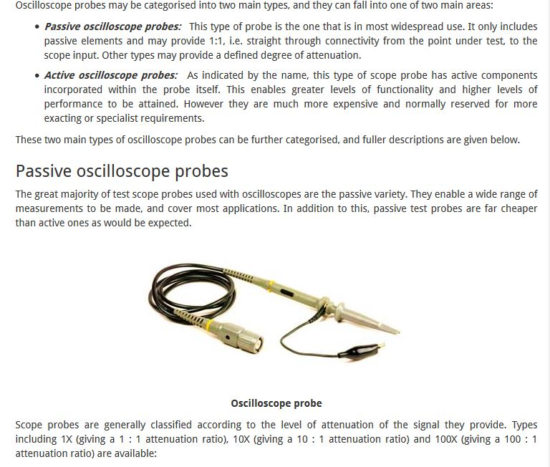
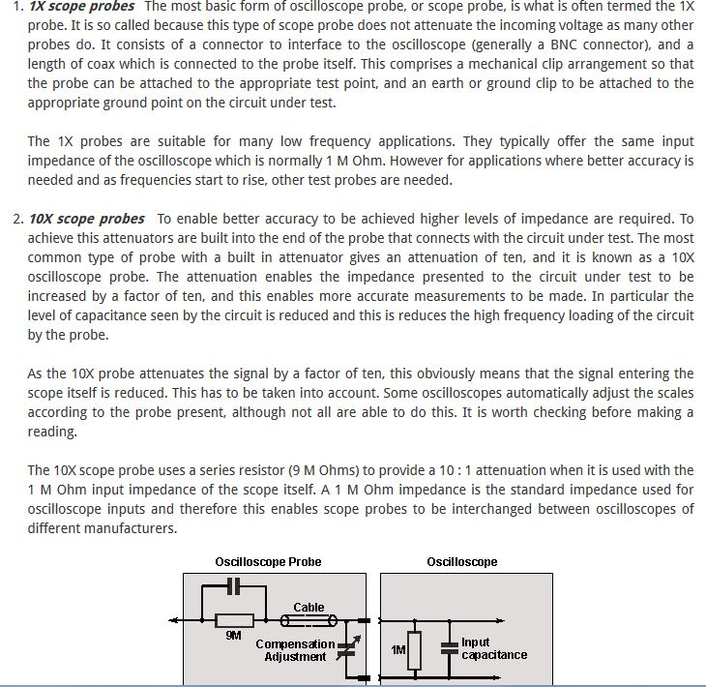

Slide 28
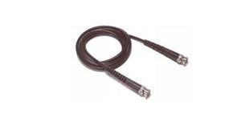
Practice using the oscilloscope, showing waveforms from the AWG(use a BNC to BNC cable

Slide 29
Switch on the function generator and adjust the output level to produce a visible signal on the oscilloscope screen. Adjust TIME/DIV and VOLTS/DIV to obtain a clear display and investigate the effects of pressing the waveform shape buttons.
The rotating FREQUENCY control and the RANGE switch are used together to determine the frequency of the output signal. With the settings shown in the diagram above, the output frequency will be 1 kHz. How would you change these setting to obtain an output frequency of 50 Hz? This is done by moving the RANGE switch to '100' and the FREQUENCY control to '.5':
changing the frequency
Experiment with these controls to produce other frequencies of output signal, such as 10 Hz, or 15 kHz. Whatever frequency and amplitude of signal you select, you should be able to change the oscilloscope settings to give a clear V/t graph of the signal on the oscilloscope screen.
The remaining features of the function generator are less often used. For example, it is possible to change the output frequency by connecting suitable signals to the 'Sweep in' input. The DC Offset switch and the Offset control allow you to add a DC voltage component to the output signal producing a complex waveform as described in Chapter 4.
The output level switch is normally set to 0 dB:
This gives an output signal with a peak amplitude which can be easily adjusted up to several volts. In the -40 dB position, the amplitude of the output signal is reduced to a few millivolts. Such small signals are used for testing amplifier circuits.
The TTL output produces pulses between 0 V and 5 V at the selected frequency and is used for testing logic circuits.

Slide 30
Oscilloscope Probes and Safety
https://www.youtube.com/watch?annotation_id=annotation_1102280035&feature=iv&src_vid=Iq4QlfH-oqk&v=OiAmER1OJh4
How Not to Blow up your oscilloscope
https://www.youtube.com/watch?annotation_id=annotation_3049017447&feature=iv&src_vid=Iq4QlfH-oqk&v=xaELqAo4kkQ

Slide 31
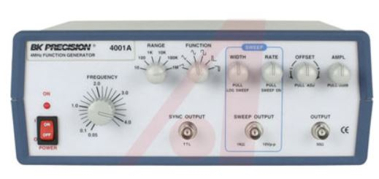
Arbitrary Waveform Generator
SIGNAL GENERATOR VS ARBRITRAY WAVEFORM GENERATOR
DIFFERENCES
SIGNAL ARBRITRARY
Generates Sine, Triangle, & Square waveforms from
0.5 Hz to 4 MHz
Arbitrary Waveform Generator
Arbitrary Waveform Generators allow you to generate a user-defined waveform of any size, unlike an Arbitrary Function Generator which can only generate a custom periodic waveform. AWGs operating in Arbitrary Waveform mode only generate each sample of the waveform that is stored in memory in order
Tutorial
http://www.tek.com/signal-generator/afg3000-function-generator

Slide 32
High Impedance Vs. Low Impedance setting on Generator.
“Note” Sometimes upon monitoring a circuit, you will notice that the output of the Generator is double what it should be as read on the display of an oscilloscope.

Slide 33
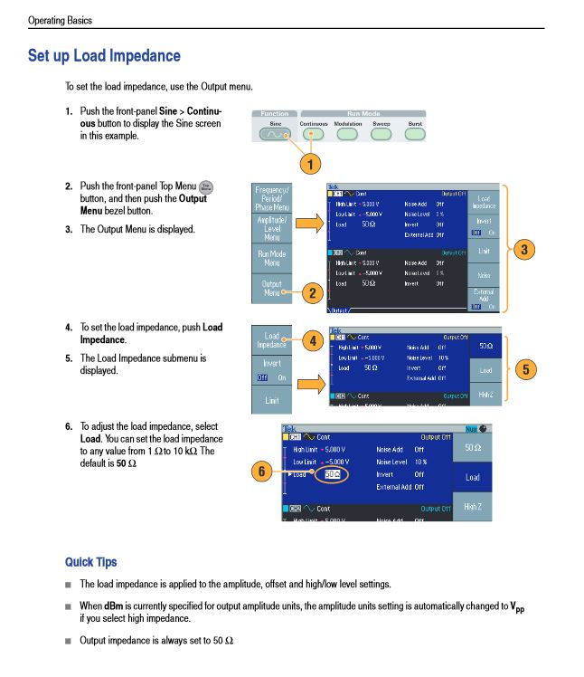

Slide 34
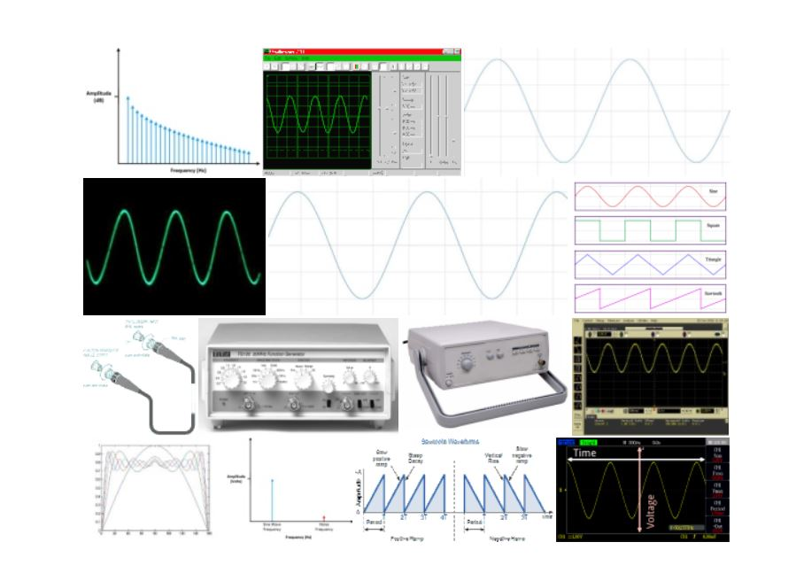
Three Equipment exercises recommended to be completed .
Using Oscilloscope and AWG create
A sine wave, square wave and trapezoidal wave and show it on the oscilloscope
1Khz, 25Khz, 150Khz and 1.1MHz
Vary PP voltage 1V, 5V and 9V
Using DMM, Monitor the DC Power Supply, create +11VDC and +16VDC,
Show it on DMM and on the Digital Oscilloscope
Using DMM Monitor look at all three power supplies on the cadet board, and also monitor all three waveforms of the cadet board using the Digital Oscilloscope Sine/Square/Trapezoid

