Slide 2
December 2, 2010
Operation Crosshair:
NDSU Memorial Union Active Shooter Table Top

Slide 3
Introduction
Facilitator
Dustin Jensen
Ready Campus
Project Director
701-231-8598
dustin.jensen@ndsu.edu
Facilitator
Alex Cole-Corde
Ready Campus
EM Specialist
701-231-5081
aleczandre.colecorde@ndsu.edu

Slide 4
Exercise Objective
This Table-Top scenario is intended to stimulate discussion in regards to an Active Shooter in the Memorial Union

Slide 5
Ground Rules
The exercise is open dialogue. All ideas and input are welcome.
Be respectful of all opinions.
Think critically: How do outside factors influence your actions? i.e. time, weather, location…

Slide 6
Terminology
Active Shooter: An individual actively engaged in killing or attempting to kill people in a confined and populated area; in most cases, active shooters use firearms(s) and there is no pattern or method to their selection of victims.

Slide 7
Terminology
Situational Awareness:(SA) involves being aware of what is happening around you to understand how information, events, and your own actions will impact your goals and objectives, both now and in the near future.

Slide 8
Video Presentation
Shots Fired: Guidance for Surviving an Active Shooter Situation

Slide 9

Questions?

Slide 10
Scenario Overview
Date: Thursday, December 2, 2010
Time: 11:02 AM CST
Location: NDSU Memorial Union
Weather : 16° F Mostly Sunny
All University Departments are in Normal Operations

Slide 11
Scenario Interject 1
Time: 11:02 AM CST
Two students rush into your office and report an individual is standing outside the Brostrom Lounge brandishing two semi automatic handguns. Students in the area are fleeing while some are trying to take cover.
Individual Description:
  Height: 5’ 6”- 5’ 8”
  Weight: 150 -170 lbs.
  Ethnicity: Caucasian
  Hair: Black/shoulder length
  Clothing: Blue business suit and black bag

Slide 12
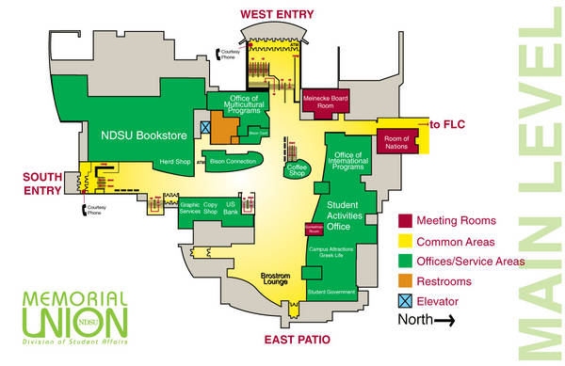

Slide 13
Scenario Interject 1 (cont)
What do you know?
What do you do?

Slide 14
Scenario Interject 2
Time: 11:05 AM CST
Shots Fired!!
Shots Fired!!
Shots Fired!!
Shots Fired!!
Shots Fired!!
Shots Fired!!

Slide 15
Scenario Interject 2 (cont)
What do you do?
Where do you go?
What do you do when you get there?

Slide 16
Debrief

Slide 17
Recommendations
Review/Discuss Active Shooter Procedures (DHS)
Develop Methods for Internal Warning Systems/Communications
Create Memorial Union Phone Tree
Participate in training
Review/Discuss Evacuation Plans
Review/Discuss Shelter-in-Place Procedures

Slide 18
Questions?

Slide 19
Thank You!

