Slide 1


Development, implementation, and assessment of activity-based instruction
HIGHLIGHTS FROM PLENARY PRESENTATION
SCALE-UP: Student-Centered Active Learning Environment with Upside-down Pedagogies
Maria Oliver-Hoyo
August 17, 2016

Slide 2
Reasons for Change
Lab
Different teaching styles
Little measurable affect on achievement
Disconnect between lab and lecture material^{1,2,3}
Influences student attitudes consistently in a positive way
Lecture
Students lose interest after 20 minutes
Cooperative groups improve learning
Fails to sustain student interest in the sciences
Tends to decrease sense of accountability
References:
1.Hart, et al.
JRST, 2000
2. Russell & Weaver, ijSOTL, 2008
3. Hoifstein & lunetta, Sci.Educ., 2004
Notes:
The rationale for this effort is well documented. Here are some of the reasons that I have personally being baffled about. Particularly the disconnect between lab and lecture. Our hopes are that by combining the formats, it will help in blending the differences in the way students apply concepts tried in lab to topics discussed in lecture.
Explicit connections at the secondary level:
Hart, C.; Mulhall, P.; Berry, A.; Loughran, J.; Gunstone, R. What is the Purpose of this Experiment? OR Can Students Learn Something from Doing Experiments? J. Res. Sci. Teach. 2000, 37, 655-675.
“Teachers need to make the pedagogical purpose of lab work explicit for students. In doing so, it might better help them to make the links between the tasks in such a way as to build a more holistic view of their science learning experiences.”
Explicit connections at the undergraduate level
Russell, C.B.; Weaver, G.C. International Journal for the Scholarship of Teaching and Learning, 2008, 2, 1-14.
“Student Perceptions of the Purpose and Function of the Laboratory in Science: A Grounded Theory Study”
Laboratory aspects:
Hifstein, A. & Lunetta, V.N. (2004). The laboratory in science education: Foundations for the 21st century. Science Education, 88(1), 28-54

Slide 3
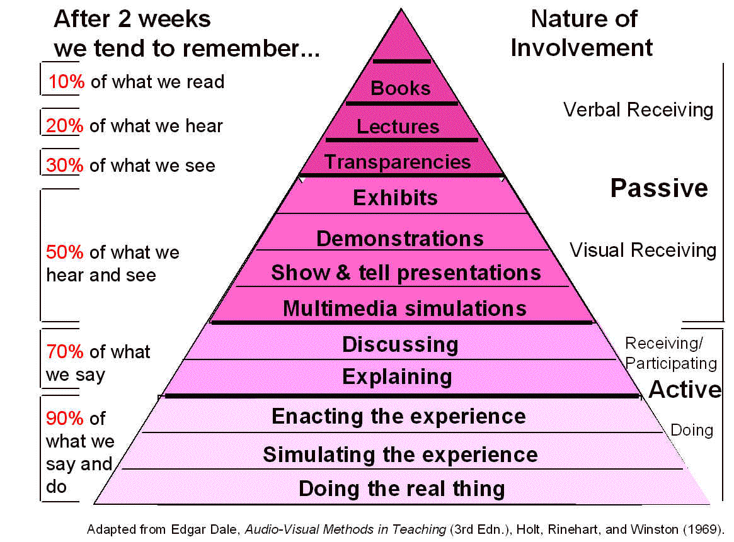
“Revisiting the Cone of Learning”, Thomas Lord, J. of College Science Teaching, 6, 2007, 14-17

Slide 4
Activity-based instruction
Basic Approach
Readings
Active
Learning
Inquiry-Guided
Short
Lecture
“hands-on, minds-on”
Group
Work
Notes:
Active learning vs group work → individual accountability
Inquiry-guided
Answering questions with provoking questions
Hands-on , minds-on
Physical materials AND mental thoughts required to find meaning and pursue understanding

Slide 5
Types of activities
List
Resources
Requisite for choosing a specific type of activity:
reflection on the learning goal pursued
Requisite for keeping a type of activity:
some evidence that it works and fits the need/goal = assessment or evaluation
Notes:
DEPENDS ON THE DISCIPLINE
English composition class vs a philosophy course (writing versus debate skills).
Debate teams consisting of students that have opposite pre-conceived notions – force students to look at things from a different perspective.
Identify incorrect grammar and write it appropriately.
Argumentation – scientific argumentation (validation of the known) is very different from argumentation as studied in logic (forms of arguments)
RESOURCES: original journals workshops discussions among peers (ad hoc groups) conferences websites
REQUISITES: instructors tend to adopt resources without thinking oi their prupose. For example: demonstrations – just for promoting a sense of awe about science?, for understanding a concept?, for demonstrating a phenomena vs discovering an aspect of that phenomena?,

Slide 6
Classroom Management Techniques
Capitalizing on students’ learning
Individual accountability
Roll of dice -Room organization
Preparation for class
Positive interdependence
Remuneration of group effort
Interpersonal skills
Nametags -Cooperative groups
Self-assessment of group functioning
Evaluations

Slide 7
Results
Inferential statistical analysis
positive effect on student performance
"Effects of an Active Environment: Teaching Innovations at a Research Institution",
M. Oliver-Hoyo* and DeeDee Allen, J.l of Chemical Education, 2004, 81(3), 441-448.
Quantification of Qualitative data
positive RGS in attitude comparisons
"Attitudinal Effects of a Student-Centered Active Learning Environment",
M. Oliver-Hoyo* and DeeDee Allen, J. of Chemical Education, 2005, 82 (6), 944-949.
Qualitative analysis
positive attitudes toward teaching strategies
positive effect on graphing skills performance
"The Use of Triangulation Methods to Validate Results of Qualitative Educational Research",
M. Oliver-Hoyo* and DeeDee Allen, J. College Science Teaching, 2006, Jan/Feb, 42-47.
From a TA: “cAcL₂ not only creates an “active” classroom,
but develops an “interactive” student.”

Slide 8
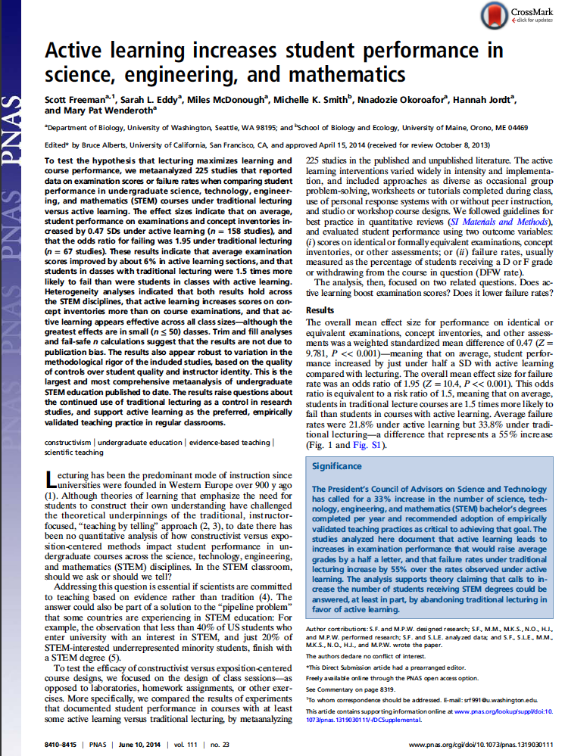
Proceedings of the
National Academy of Sciences
2014, 111 (23); 8410-8415
Notes:
Carl Weiman’s commentary - Impact is large and consistent across a) different STEM disciplines, b) course levels, and c) experimental methodologies. Measured on failure rate in courses and performance on tests.
Comparative results between lecture and active learning were the same for one instructor using the two different methods or independent instructors using different methods. Thus, there was no indication that the relative effectiveness of the different teaching methods is instructor dependent.
research should compare different active learning methods, because there is such overwhelming evidence that the lecture is substantially less effective

Slide 9
Take-home messages Activity-based instruction
Learning responsibility shifts to learners
Instructor facilitates learning
What teachers do versus how teachers may assist
Promotes engagement at different levels
Inquiry – answering questions with questions
Students influence pace of learning
Students’ preparation is a determining factor
Transforming curricular materials; resources available
Self-reflection and evaluation are an integral part of the teaching enterprise
Hands-on, minds-on
Physical materials AND mental thoughts required to find
meaning and pursue understanding
Appropriate assessments
Notes:
--Student-centered approach = Shift from teacher as the provider of information to facilitator of learning
– provides opportunities to learn independently and from one another and coaches them in the skills
– Increase active involvement of students in class

