Slide 1
Look Who’s Coming to Your Classroom: NDSU Student Profile, Useful Resources and Strategies for Student Success
Laura Oster-Aaland, Enrollment Management
Emily Berg, Institutional Research and Analysis
Casey Peterson, Student Success Programs
Notes:
Laura

Slide 2
Profile of New Students
Notes:
Laura

Slide 3
Profile of Incoming Students Fall 2016
Gender
State of Residency
Male 54%
Female 46%
North Dakota 34%
Minnesota 57%
Other U.S. 8%
International 1%
Ethnicity
Asian 1.68%
Black/African American 2.92%
Nat.Hawaiian/Pac. Islander 0.08%
Hispanic 3.32%
Am. Indian/Alaska Native 0.28%
White 87.18%
Two or More 3.84%
Not Specified 0.72%
Age
Under 20 yrs. 98.84%
20-21 years 0.68%
22 and above .48%
Notes:
Laura

Slide 4
Profile of Incoming Students Fall 2016
Academic College
Ag, Food Sys, Nat Res 9%
Arts, Hum, Soc Sci 11%
Business 11%
Engineering 20%
Health Professions 14%
Human Dev & Educ 10%
Science & Math 16%
Undeclared 9%
Top 5 Majors
Undeclared 9%
Pre-Nursing 7%
Pre-Mechanical Eng 6%
Pre-Business Admin 5%
BS-Computer Sci 4%
Notes:
Laura

Slide 5
Profile of Incoming Students Fall 2016
Academic Qualities
Average ACT 23.89
Average HS GPA 3.43
1st in Class 109
National Merit 7
Presidential 261
(ACT > 29)
Admission Guidelines
ACT 22
HS GPA 2.75
15 Core Courses
Notes:
Laura

Slide 6
NDSU Retention Context
First Year Retention and Academic Standing
Notes:
Laura
Assumption is that the students who leave NDSU were not academically prepared. Yet, we can see that most who leave are well above the admission guidelines.

Slide 7
NDSU Retention Context
Notes:
Laura
Assumption is that the students who leave NDSU were not academically prepared. Yet, we can see that most who leave are well above the admission guidelines.

Slide 8
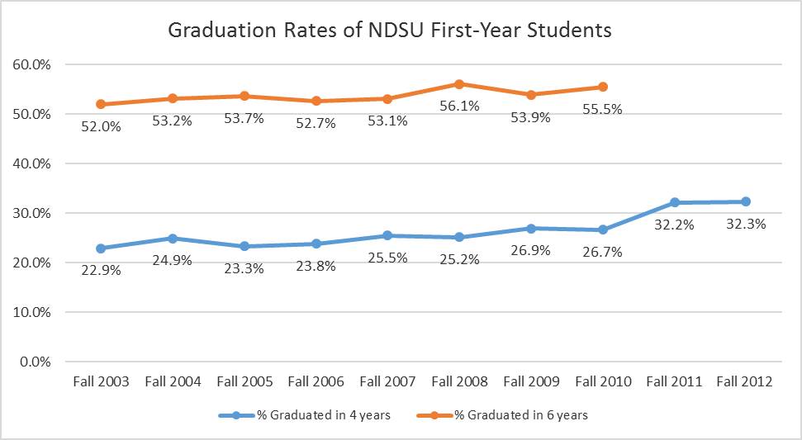
NDSU Graduation Rates
Notes:
Ave. of Similarly Selective IPEDS PEERS*
4 Year: 28.8%
Six Year: 57.0%

Slide 9
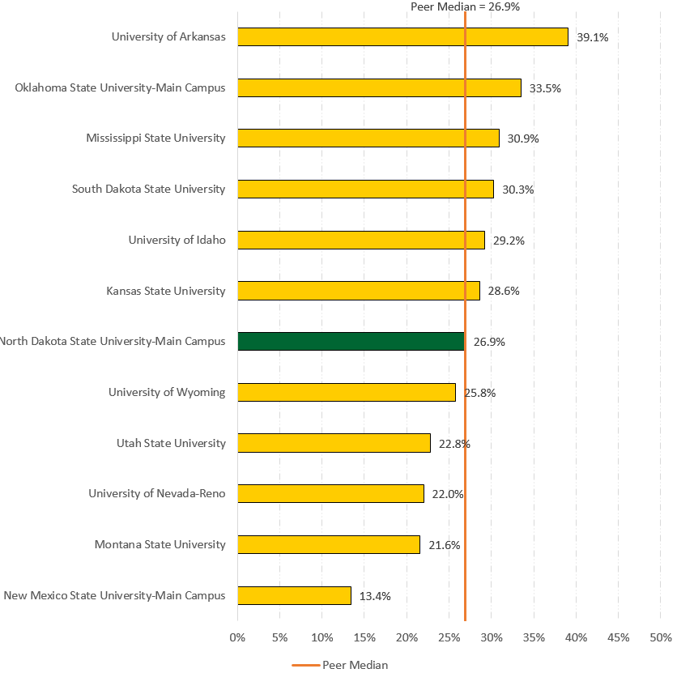
NDSU 4-year Graduation Rate
Notes:
Ave. of Similarly Selective IPEDS PEERS*
4 Year: 28.8%
Six Year: 57.0%

Slide 10
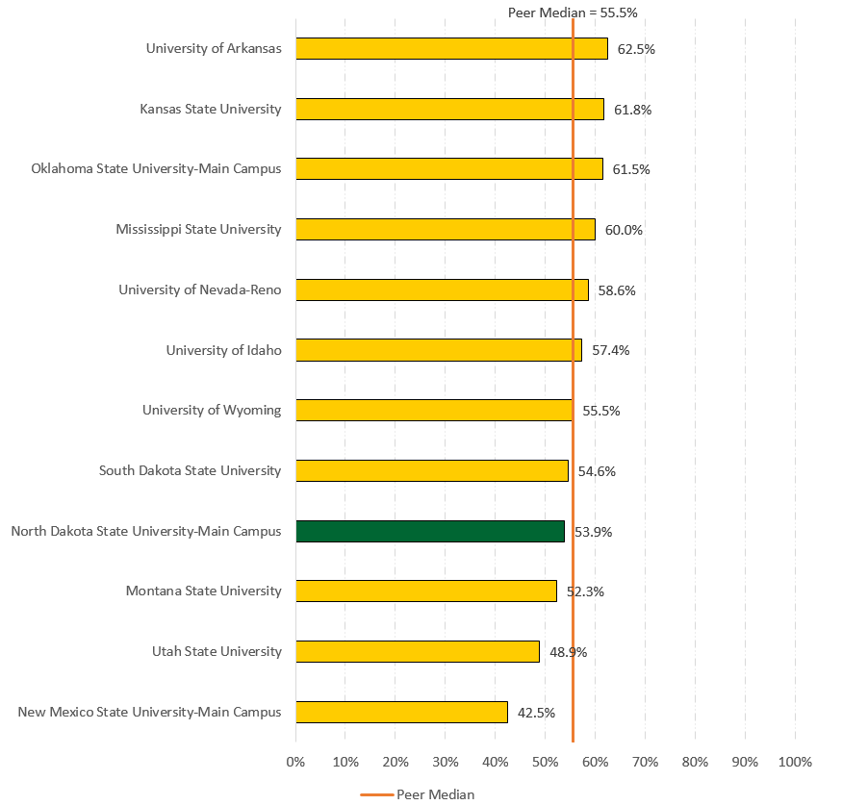
NDSU 6-year Graduation Rate
Notes:
Ave. of Similarly Selective IPEDS PEERS*
4 Year: 28.8%
Six Year: 57.0%

Slide 11
Success Factors
Student Characteristics
ACT/SAT
HS GPA
Socio-Economic Status
Parental Education
Ethnicity
Mental Health Concerns
Motivation
Tinto, 1987; Berger, 2000; Paulsen & St. John, 2002
Institutional Characteristics
Involvement with Peers
Interaction with Faculty
Engaged Learning
Astin, 1993; Tinto, 1987; Pascarella & Terenzini, 2005
Notes:
Casey – These are some of the common factors that predict risk level for students. They overlap and intersect in a variety of degrees for each individual. You’ll hear groups discussed as first gen, low-income, conditionally admitted, etc.

Slide 12
Transition Questions
How does this place work?
Where are my classes?
Will I fit in?
Who will talk to me?
Am I smart enough?
Can I manage the workload?
Will others think I’m smart enough?
Notes:
Casey – Did a qualitative analysis of new student writing samples on what advice they’d give to next year’s freshmen. Interesting that all comments about being smart had nothing to do with intelligence level, all about managing the load.

Slide 13
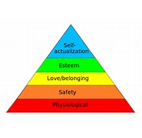
Transition Needs
The basics
Housing, food, heat, safety
Sense of belonging
Not feeling alone
Feeling of mattering
Would be missed
Contributions noticed
Maslow,1943
Notes:
The basics = residence life, dining, facilities management, safety office, campus police: living facilities and food will take priority in the first days (tell Pati’s story)
Belonging = peers, RA’s, staff, instructors: determination about belonging was made after visit, now they’re testing it
Mattering = YOU, leadership roles, mentors, friends (this one develops over time): this happens over two weeks, two semesters, or two years

Slide 14
Mattering & Identity
Marginality and Mattering
Attention
Importance
Ego-Extension
Dependence
Appreciation
Schlossberg, 1989
Identity Development
Foreclosure
Identity Diffusion
Moratorium
Identity Achievement
Marcia, 1980
Notes:
Casey – Students need to know they matter in the classroom as well. They need to develop a sense of belonging in an academic community. Service professionals are working to help them transition socially, but they need to hear it from instructors as well.
Students are trying to figure out who they are. The transition to college moves them into Identity Diffusion and Moratorium at many levels. Race, intelligence, career path, etc. What YOU say and do matters the most (academic identity in particular). Everyone’s goal is to move them toward the Appreciation stage in one and the Identity Achievement stage in the other.

Slide 15
What role can faculty play in student success?
Notes:
Casey – You are critical.

Slide 16
Engagement, Mattering, Validation at NDSU
NDSU Students…
Want meaningful personal interaction during advising
Want to feel engaged in the classroom and with faculty
Don’t want to feel like a number
Notes:
Casey – What students tell us confirms the slides we’ve just covered.

Slide 17
Engagement, Mattering, Validation In Practice
Learn student names.
Set high expectations and be explicit.
Approach failures from a mindset of “not yet”.
Reflect diverse student backgrounds in content.
Show concern for struggle, celebrate success.
Provide opportunities for peer interaction and reinforcement.
Recognize students elsewhere on campus.
Encourage involvement in your area.
Refer for other services.
Believe in student ability.
Notes:
Casey - Biggest takeaway I can give you is that every student is at a different stage. Don’t give in to talk and stereotypes that involve ALL students. “A lot of students just don’t care (are lazy).” Data shows us that’s just not true.

Slide 18
NDSU Resources for Success
Notes:
Casey

Slide 19
Resources for Students
Student Success Programs
ACE Tutoring
TRIO Student Support Services (SSS)
TRIO McNair Scholars Program
Center for Writers
Technology Learning and Media Center
Disability Services
Counseling Center
Notes:
Casey –
ACE: Talk about common complaints, drop-in tutoring, small group tutoring, referrals for hiring, collaborations
SSS: Talk about ways to qualify and how the program helps
MSP: Help us identify students with the drive and potential to earn a PhD

Slide 20
Additional Resources for Students and Faculty
NDSU One Stop
Registration and Records Liaisons
Advising Resource Center
Student Activities Office
Career Center
On-campus employment website
Career preparation
Student Financial Services
Notes:
Casey

Slide 21
Campus Wide Initiatives
STEPS to Success
Posters, hand outs and digital displays available for faculty
Mindset Project
Welcome Week Enhancements
Gateways-ND
Learner-focused STEM Instructional Cohorts
Notes:
Casey –
Connecting with resources
Dweck, 2006

Slide 22
References
•Astin, A.W. (1993). What matters most in college: Four critical years revisited. San Francisco, CA: Jossey-Bass.
•Berger, J. B. (2000). Optimizing capital, social reproduction, and undergraduate persistence: A sociological perspective. In J. M. Braxton (Ed.), Reworking the student departure puzzle (pp. 95-126). Nashville, TN: Vanderbilt University Press
•Dweck, C.S. (2006). Mindset: The new psychology of success. Random House: New York.
•Kuh, G. D. (2009). What student affairs professionals need to know about student engagement. Journal of College Student Development. 50(6), pp. 683-706.
•Kuh, G. D., Schuh, J. H., Whitt, E. J., et al (1991). Involving Colleges: Successful approaches to fostering student learning and development outside the classroom. SanFrancisco, CA: Jossey-Bass Publishers
•Marcia, J. E. (1980). Identity in adolescence. Handbook of adolescent psychology, 9(11), 159-187.
•Maslow, A. H. (1943). A theory of human motivation. Psychological Review, 50(4), 370-96.
•National Survey of Student Engagement. http://nsse.indiana.edu/
•Noel Levitz (2013). Higher Ed Benchmarks: Noel-Levits Report on Undergraduate Trends in Enrollment Management. www.noellevitz.com/documents/shared/Papers_and_Research/2013/2013_Retention_Indicators.pdf
•Pascarella, E. & Terenzini, P. (2005). How college affects students (Vol 2). San Francisco, CA: Josey-Bass.
•Paulsen, M.B., & St. John, E.P. (2002). Social class and college costs. The Journal of Higher Education, 73(2), 189-236.
•Rendon Linares, L. I. & Munoz, S. M. (2011). Revisiting validation theory: Foundations, applications, and extensions. Enrollment Management Journal, Summer 2011, 12 – 26.
•Schlossberg, N. K. (1989). Marginality and Mattering: Key issues in building community. New Directions for Student Services, No. 48.
•Tinto, V. (1987). Leaving College: Rethinking the causes and cures of student attrition. Chicago Il: University of Chicago Press.
•Tough, P. (2014) Who gets to graduate. New York Times available at www.nytimes.com/2014/05/18/magazine/who-gets-to-graduate.html?_r=2

Slide 23
Questions/Comments
Laura Oster-Aaland, Vice Provost for Student Affairs & Enrollment Management
Laura.Oster-Aaland@ndsu.edu
231-7052
Emily Berg, Director of Office of Institutional Research and Analysis
Emily.A.Berg@ndsu.edu
231-8263
Casey Peterson, Director of Student Success Programs
Casey.Peterson@ndsu.edu
231-7750

