Slide 1
Working Toward Gender and Racial Equity in Higher Education
Mark Chesler*
Emeritus Professor of Sociology, University of Michigan
& Executive Director, Community Resources Ltd.
*With the collaboration of Abigail Stewart, Diana Kardia and University of Michigan STRIDE

Slide 2
Working Toward Gender and Racial Equity in Higher Education
Changing academic organizations: A general approach
The history and approach of STRIDE (UMichigan)
A STRIDE workshop design

Slide 3
Changing Academic Organizations
Five elements to consider in thinking about academic organizations – departments and schools
Core activities, Influence patterns, Culture/norms, Climate/relationships, Boundaries.
Resources
Goal clarity, Information, Support/allies, A change team, Oneself
Strategies for making change

Slide 4
Elements of Academic Organizations
Core activities (teaching, scholarship, service/maintenance)
How is curriculum determined?
Is teaching highly valued?
How are members of subfields valued?
Are some kinds/styles of scholarship valued more highly than others?
Is there agreement on the value of different kinds of service?

Slide 5
Elements of Academic Organizations
Power and Influence
Who has the power?
Past chairs/deans? Gender/race/rank
How is it exercised?
Formally/informally, Overtly/covertly
How does opposition get expressed?
Productively/unproductively
What is power based on?
Position? Likeability? Trust? Reputation? Funding? Loudness? Being in the “Older White Boy” network?

Slide 6
Elements of Academic Organizations
Culture and Norms
What are expectations for appropriate behavior?
Contentious? Aggressive? Assertive? Civil? Caring?
What are informal rules of the game?
What is “sacred” – not to be questioned?
What does it take to get respect? Rewards?
How much do department members collaborate?

Slide 7
Elements of Academic Organizations
Climate and Social Relations
Who talks to whom and where? And about what?
Who’s in/out?
How do people interact?
Stiff? Relaxed?
What is department morale? Is this a good place to work?
Can colleagues criticize/disagree? How?
Are there known “difficult personalities”?
How are they dealt with?

Slide 8
Elements of Academic Organizations
Boundaries and Connections
What are relations like with dean’s office?
What are relations like with other departments/schools?
What are relations like with central administrative offices?
To what extent is interdepartmental work really valued?
Are alumni, parents and/or the local community heard from?

Slide 9
Resources for Making Changes
Goal Clarity – what is this about
What will change
Attitudes, Behaviors, Rewards, Procedures, Structures
Who is impacted by this change? Who benefits?
Differentiate problems’ symptoms and causes
Read symptoms but change causes
Don’t take on all goals - everything
Not nothing
Maybe not the hardest thing first

Slide 10
Resources for Making Changes
Information/Assessments
Formal or informal “data” (audits?)
Used to calibrate next steps
Evaluations ( Pre, Pre-Post or Post)
From which stakeholders/constituencies?
How transparent will reporting be?

Slide 11
Resources for Making Changes
Support/Allies (no one does this alone)
With commitment to the change effort
With influence/legitimacy in the unit/department
Senior faculty/administrator involvement
And external legitimators? (e.g. ADVANCE)
Able to work together
With access to broader allies and coalitions

Slide 12
Resources for Making Changes
A Change Team
Membership
Diverse, Linked to power/influence, Skilled
Development
Leadership, Process, Norms, Confidentiality
Stand as a Model

Slide 13
Resources for Making Changes
Oneself and Self-development
Awareness/Knowledge
Commitment/Passion
Skills – Technical and Relational
Reflection on self and Feedback from others
Risk-taking Ability/Willingness

Slide 14
Strategic Planning for Change
Clarity about goals - what will change
Assessment of Problems, Resources/Supports and Barriers
Personal
Organizational
Tactical Approach: How ?
High profile or Low profile (under the radar, small ripples)
Big bites or small wins
Education, Persuasion, Incentives, Pressure
Anticipating and dealing with resistance (who/where, why, how)

Slide 15
An Example of Institutional Change Efforts
Diversifying the Faculty: The Experience of the Michigan ADVANCE Project & STRIDE Workshops for STEM Disciplines
[Strategies and Tactics for Recruiting to Improve Diversity and Excellence]

Slide 16
ADVANCE Goal: Institutional Change in STEM (at first gender now race also) (at first recruitment now retention and climate change also)
Identify problematic and beneficial practices
Networks and resources to support white women faculty and URM faculty
Training for chairs, search committees and new full professors (STRIDE)
Institutionalize beneficial practices
Policy changes
Departmental climate change (grants and workshops)
Institutionalize ADVANCE (from NSF to UM)
Notes:
16

Slide 17
Strategies for Changing the Climate: Multiple Points of Entry
Individuals
Create collective identity for women and URM scientists and engineers
Level the playing field by supplying resources
Provide leadership opportunities for women and URM
Departmental “microclimates”—hardest to make happen
Present analysis and history of current situation (information)
Place theory in the background
Provide opportunities and incentives for self-motivated change
Institution-wide leadership
Publicize and monitor data – “consciousness raising”
Provide resources
Help drive reviews and changes in policies

Slide 18
Strategies for Changing the Climate
Evidence/Data-based approach to change
Climate survey demonstrated there was a problem
Climate survey identified problematic practices
Readministration monitors progress
Combine cognitive and affective tactics (CRLT players)
Linked to other change programs/strategies/tactics
Educational approach - STRIDE
Increase awareness through discussion of data/findings and research literature (studies)

Slide 19
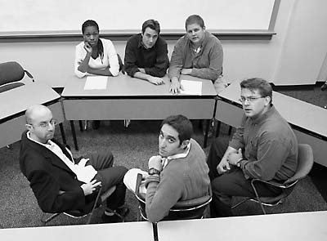
CRLT Players and Climate Change
Head (cognitive) and heart (affective)
Used local interviews and social science findings on departmental gender/race/rank dynamics
Created and performed interactive (and emotionally powerful) sketches on departmental dynamics
Faculty meetings
Faculty advising faculty (mentoring)
Tenure committee meeting
“Faculty Meeting” Sketch

Slide 20
Composition of STRIDE – The Change Team
8-10 senior faculty in science and engineering (and 1-2 ss)
Recruited by P.I. of ADVANCE and nominated by Deans of STEM Colleges (LS&A, Medical School, College of Engineering)
Belief that faculty would be most receptive to learning about diversity from colleagues they already respected as researchers
To demonstrate that this agenda matters to men as well as women, five of the original eight committee members were men
Took advantages of differing perspectives – first by gender and discipline, and now also by race/ethnicity
Sought allies – FASTER (Friends and Allies of STRIDE Toward Equity in Recruiting)
Notes:
How I was recruited, why I joined, what I do as part of STRIDE

Slide 21
How did STRIDE develop expertise?
Self-education/self-development
Valian lecture and book and other primary research studies
Developed presentation for faculty on recruitment…now also climate
In the first 8 months, 26 presentations were made
Developed handbook
Continuing education
Work-family issues
Gender plus Race and underrepresented minorities
Intimate and confidential discussions
Politics/strategies of change

Slide 22
STRIDE Workshop on Faculty Recruitment for Diversity and Excellence
[Who, How and How long]

Slide 23
What is the problem?
By any reasonable definition, there are too few women and minorities on the faculty at major research institutions (and especially in STEM disciplines)
The higher the rank, and access to power, the fewer women and minorities.
Focus on - pool, applications, interviews, selections, performance, and retention/advance
Notes:
23

Slide 24
Diversity Matters
Gives us access to talent currently not represented
More perspectives are taken into account in devising solutions to problems
Fewer things are taken for granted, more things are questioned
Professors’ race and gender matter to students
Ely & Thomas (2001) Administrative Quarterly. 48(2) 229-273.
S. Page (2007) The Difference: How the Power of Diversity Creates Better Groups, Firms, Schools and Bodies..
Correll, Page & Wiest. 2000. Sex and science: How professor gender perpetuates the gender gap
Notes:
24

Slide 25
What causes the problem?
Is it the available pool of candidates? Is the pool too homogeneous, with too few women and minorities?
Partly yes, but it does not fully account for outcomes for either gender or race/ethnicity.
The situation differs across fields and departments.
The impact of a reduced pool of candidates is greater for race/ethnicity than for gender.
Under-representation cannot be assessed for sexual orientation or (dis)ability.
So maybe discrimination also is at work?
Notes:
25

Slide 26
Does “Discrimination” Play a Role?
Maybe overt “discrimination” is only practiced by a small set of people, but…
Research shows that we all – regardless of gender or race – perceive and treat people based on their race/gender/social group, etc.
Often unconsciously, implicitly, unintentionally
Valian (1998) Why So Slow? The Advancement of Women.
Notes:
26

Slide 27
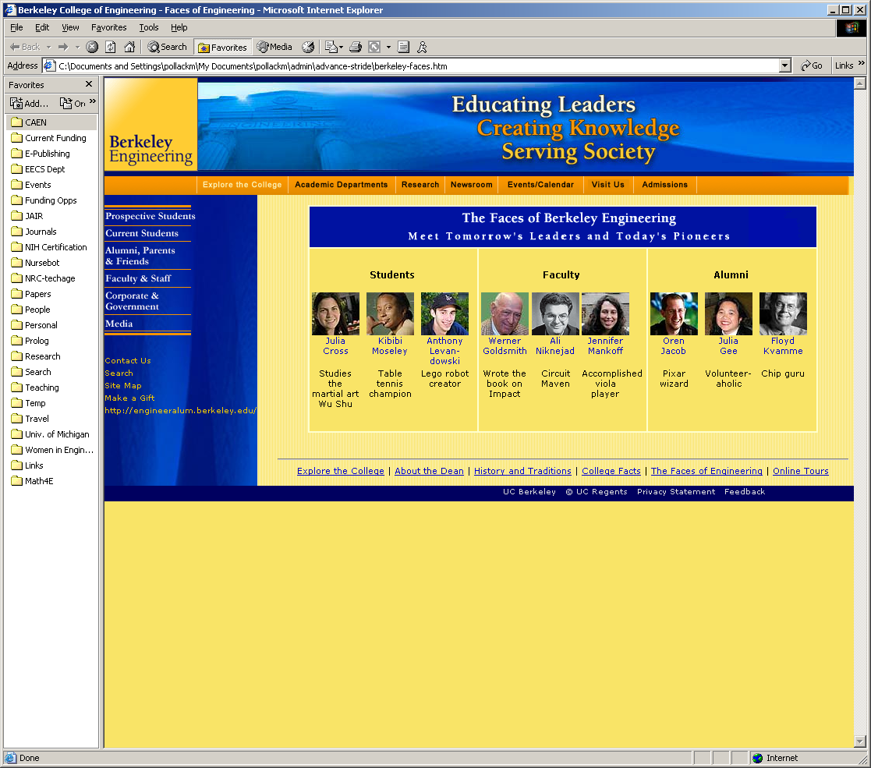
Notes:
27

Slide 28
Notes:
28

Slide 29
Obstacles to Achieving Diversity (a review of a series of studies)
Schemas
Gender, Race/ethnicity, Sexual orientation, Age, ability, other
Differ in content but similar in process
Biased evaluations and judgments
Solo status and Lack of critical mass
Accumulation of disadvantages

Slide 30
Why has it been so difficult to overcome the obstacles? (a review of a series of studies)
Schemas and lack of critical mass make differential outcomes seem “natural” or expected:
Who applies for jobs, is invited to interviews, and is selected for jobs
Who performs well (or is expected/seen to perform well)
Who receives awards and is promoted to leadership positions
Together schemas, solo status, and lack of critical mass provide unconscious justification for the status quo (which lessens our likelihood of questioning it)
And disadvantages accumulate – pile on top of one another

Slide 31
Schemas and Policies Produce a Self-Reinforcing Cycle
Tendency to value people who fit into traditional/cultural definitions of the discipline and of good work.
Late and reactive implementation of family friendly policies.
Narrow or homogeneous social and professional networks.
Concentration of white men at the top: often overlooking women and minorities for executive leadership positions.
Students' awkward, confused, or challenging reactions to faculty who are women, racial/ethnic minorities, or sexual minorities.

Slide 32
Lowered success rate
Self-reinforcing Cycle
Accumulation of disadvantage
Performance is underestimated
Evaluation bias
Gender / race schemas
Lack of critical mass
Notes:
32

Slide 33
Lowered success rate
Self-reinforcing Cycle
Routine Practice Will Reproduce the Same Institution
Accumulation of disadvantage
Institutional Inertia
Performance is underestimated
Solo status/Lack of critical mass
Evaluation bias
Schemas

Slide 34
What Can We Do? Strategies for Breaking the Cycle

Slide 35
Recruiting Strategies
Recruit for diversity and excellence
Search committee composition
Job definition
Advertisements
Active recruiting
Interviewing processes
Promote awareness of the issues
We're STRIDE, not STRID!

Slide 36
Search Committee Composition
Include people who are committed to diversity and excellence.
Include women and minorities.
Remember to take account of their added service load in other assignments
Remember the additional impact and load on women of color and people belonging to multiple minority groups

Slide 37
Active Recruiting
Widen the range of institutions from which you recruit.
Widen the range of venues in which openings are advertised or communicated.
Consider women and minorities who may currently be under-placed: those thriving at less well-ranked or resourced institutions.
Disadvantaged by early career/personal decisions
Experienced past discrimination
Explicitly ask colleagues for names of female and minority candidates.

Slide 38
Focus on Multiple Specific Criteria during Evaluation
Weigh colleagues’ judgments that reflect examination of all materials and meetings with the candidate.
Avoid “global” reactions: Specify evaluations of scholarly productivity, research funding, teaching ability, ability to be a conscientious departmental/university member, fit with the department’s priorities.
Forms exist that can be modified to fit your situation.

Slide 39
Evaluation of Candidates: Promote Awareness of Bias
Awareness of potential evaluation bias is a critical first step: Remember the lessons of research studies on:
CVs and resumes
Letters of recommendation
Spread awareness to others on the search committee
Evaluation bias can be counteracted
Bauer & Baltes (2002). Sex Roles. 9-10, 465.

Slide 40
Interviewing Tips
Bringing in more than one female or minority candidate can increase the likelihood that a woman or minority member will be hired.
Treat female and minority applicants as scholars and educators, not as valuable because they are female or minority scholars and educators.
Ensure that all candidates meet at least some people who share important personal and social characteristics.
Do not ask about matters not relevant to the position (unless asked)
Heilman (1980) Organizational Behavior & Human Performance. 26, 386-395.
Hewstone, et al. (2006) Group Processes & Intergroup Relations. 9(4), 509-532.
Huffcut & Roth (1998) Journal of Applied Psychology. 83(2), 79-189.
Van Ommeren et al. (2005) Psychological Reports. 96, 349-360.

Slide 41
Positive Approaches to the Role of Personal Life for Faculty Candidates
Many faculty have two-career households.
Female faculty are more likely not to be partnered or to have a partner who is employed fulltime.
UM climate study (2001)
Family friendly policies provide resources to help both male and female faculty manage households
Distribute family friendly policy information to all candidates before or during first visit.
Expeditiously address family issues raised by the candidate.

Slide 42
Top Mistakes in Recruitment
Search committee itself is not diverse
Search committee does not generate a diverse pool
Committee discusses information about the candidate that is inappropriate/illegal and ultimately counter-productive.
Telling a woman or underrepresented minority candidate that , “we want you because we need diversity.”
Candidate does not meet others like themselves during a visit.
Search committee or faculty makes summary judgments about candidates without using specific and multiple criteria.

Slide 43
Recruitment is Just the Beginning!
Provide help with negotiating contract, networking, lab startup and access to resources.
Show an interest in aspects of adjustment to local life.
Introduce new faculty directly to colleagues.
Check that new faculty are being treated (and feel they are being treated) equitably.
Include women and minorities in departmental proposals and the academic, political and social life of the department.
ATTEND TO NEEDED IMPROVEMENTS IN THE 0VERALL CLIMATE AND CULTURE OF THE DEPARTMENT (go wider and deeper).

