Slide 1
North Dakota State University Federal Work-Study Program
U.S Department of Education
Employer Information & Updates 2018-2019

Slide 2
Agenda
Value and Purpose of Student Employment
Requirements and Limitations
Student Responsibilities
Employer Responsibilities (On & Off-Campus Employers)
CAREERLink! New Job Board for 2018-19
Interviewing and Hiring
HR/Payroll Requirements (Updates and Procedures)
Managing Student Employees
Tracking Balances / Requesting Award Increases
Managing Performance
Requesting Students Back

Slide 3
The Value of Student Employment
Student jobs help students:
Learn useful skills that can apply to future employment
Earn money while pursuing a degree
Develop leadership and professional skills
Become involved in the campus and the community
Student employment promotes a foundation of retention and persistence toward graduation

Slide 4
Purpose of Work-Study
Eligible students have the opportunity to work and earn money while attending college.
Convenient - students work around their class schedules.
FWS Funding helps stretch your departmental dollars to help pay wages!
FWS pays a percentage of the students’ hourly wages:
75% paid from Work-Study funds
25% paid from Employer funds
The exception to this is the America Reads Program which pays 100% of the student wages.
Students employed by America Reads Program employers may work as reading and math tutors for children, or students may work in family literacy projects performing family literacy activities for approved employers.

Slide 5
Work-Study Requirements
To be eligible to participate in FWS, students must:
Complete the Free Application for Federal Student aid (FAFSA)
Have demonstrated financial need as determined by the FAFSA
Be a U.S. citizen, U.S. permanent resident, or eligible non-citizen
Be awarded and accept Work-Study funds offered
Be enrolled in a minimum of 6 credits per semester
Meet Standards for Satisfactory Academic Progress (SAP) each semester
Complete Verification (if selected)
Complete FWS Authorization form and the hiring process with the employer before beginning work
NOTE: FWS jobs cannot displace employees (including those on strike) or impair existing service contracts

Slide 6
Work-Study Limitations
Work schedule and class schedule cannot overlap
Students cannot skip class to go to a FWS job
Students can work up to a maximum of 20 hours per week - employers should consider student’s academic progress and adjust work schedule if needed
During semester breaks/vacations, students may work up to 40 hours per week if work schedules have been approved by the supervisor
Students may work only one FWS job at a time
Students may not use more than their FWS award
Rate of pay – cannot work for less than minimum wage
Students may work during the fall and spring semesters only – Not available in summer (First day of classes through last day of finals if meets all HR/Payroll and FWS requirements)

Slide 7
Work-Study Student Responsibilities
Review and adhere to all rules and policies established by the employer
Review and adhere to all rules as stated in the FWS Authorization form
Review and adhere to all rules and policies established by NDSU’s HR/Payroll Office
Complete all required paperwork (e.g. I-9, W4, Direct Deposit, etc.)
Comply with NDSU Payroll time entry processes and maintain accurate recording of time worked. This may include use of TLAB or other approved methods (e.g. timesheet).
Complete all required trainings (e.g. Baseline Safety, Title IX, etc.)
Perform job duties satisfactorily

Slide 8
On Campus Employer Responsibilities
Billing:
Employers are charged 25% of student earnings and FWS program pays 75%. Setting up payroll documents correctly is very important so payroll is charged accurately
On Campus employers should monitor both student charges and award balances carefully to ensure accuracy
Supervision:
Supervisors are responsible to make sure students report to work as scheduled and work on appropriate projects while in the work place. Students are not paid to study during work time as the title implies.
Documentation of Work Performed - Choose a Method (Online or Manual Timesheet):
Online system is referred to as Time and Labor (or TLAB). *Requires computer access.
Manual timesheets are also available if you do not have computer access for students to log in to TLAB
If using a manual timesheet, the supervisor is responsible to entering all hours worked by the student employee
All hours worked must be verified and approved by the supervisor
On Campus employers using the TLAB system maintain the same 75/25 split. It is recommended that you set up a position which includes this split to ensure more efficient and accurate time entry.

Slide 9
Off-Campus Employer Responsibilities
Annual Responsibility:
Complete a FWS Agency agreement and provide proof of Non-Profit status (e.g. provide a tax exempt form or letter from IRS).
Billing:
Responsible to pay 25% of student gross earnings. Off-Campus employers are billed on a monthly basis for 25% of the gross wages paid.
The exception to this is America Reads. America Reads funding pays 100% of the student earnings.
To avoid late fees - pay the balances due on a timely basis. Unpaid balances are subject to late fees as determined by Customer Account Services.
Setting up payroll documents correctly and on time is very important. Work with the FWS Coordinator to coordinate the set up of student employment documentation.
Important to monitor both student charges and award balances carefully to ensure accuracy.
Supervision:
Supervisors are responsible to make sure students report to work as scheduled and work on appropriate projects while in the work place. Students are not paid to study during work time as the title implies.
Documentation of Work Performed - Choose a Method (Online or Manual Timesheet):
Online system is referred to as Time and Labor (or TLAB). *Requires computer access.
Manual timesheets are also available if you do not have computer access for students to log in to TLAB
If using a manual timesheet, the supervisor is responsible to entering all hours worked by the student employee
All hours worked must be verified and approved by the supervisor

Slide 10
NDSU Student Employment
NEW
NDSU Career Center
CAREERLink Advertise and promote your employment opportunities at
https://ndsu.12twenty.com/hire
The Job Board is a central place where students (both work-study and non-work study) can look for employment opportunities.
This service is offered by a partnership between NDSU Career Services and Financial Aid and Scholarships.

Slide 11
CAREER CENTER—306 CERES HALL

Slide 12
EMPLOY
OUR BUSINESS
We prepare students for maximum employability–beginning when they arrive, continuing early and often through graduation.

Slide 13
SYSTEMS – BEFORE AND NOW
Before…
Symplicity – CAREERlink
LogicStew – Part-time Job Board and Work Study
Volunteer Services
Formsite
Now…
One integrated system!
12Twenty – CAREERlink

Slide 14
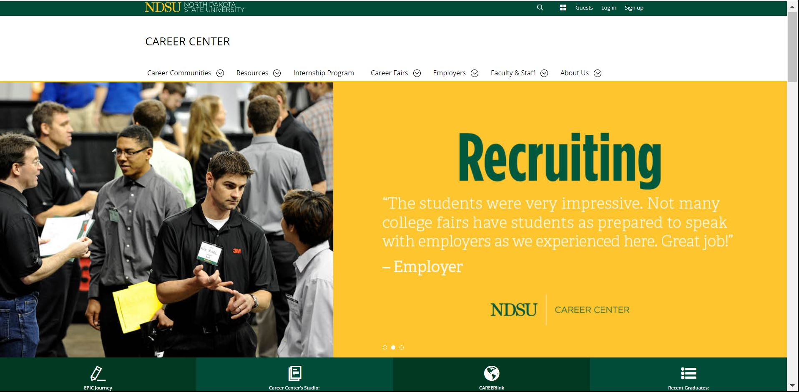

Slide 15
The first time you Sign up

Slide 16
The next time you Log in

Slide 17
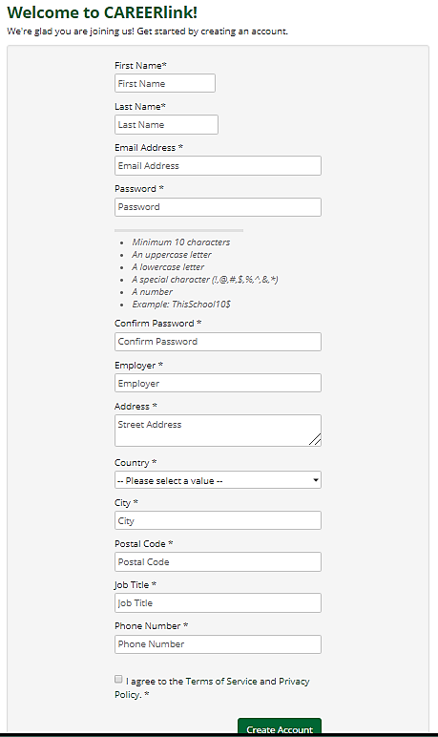
Sign up page
NDSU departments,
please use:
“NDSU [department name]”
Ex. NDSU Bookstore

Slide 18
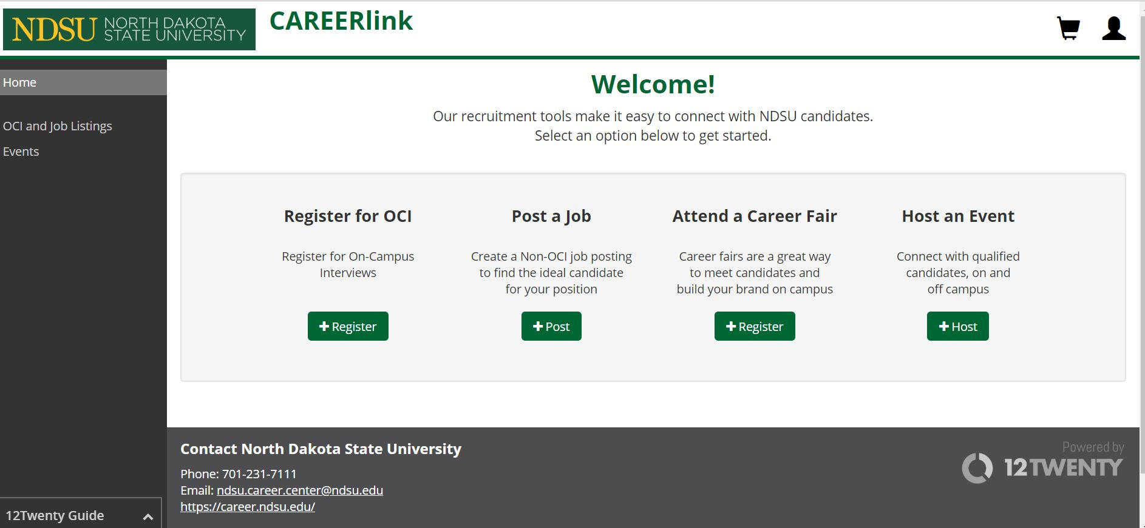

Slide 19
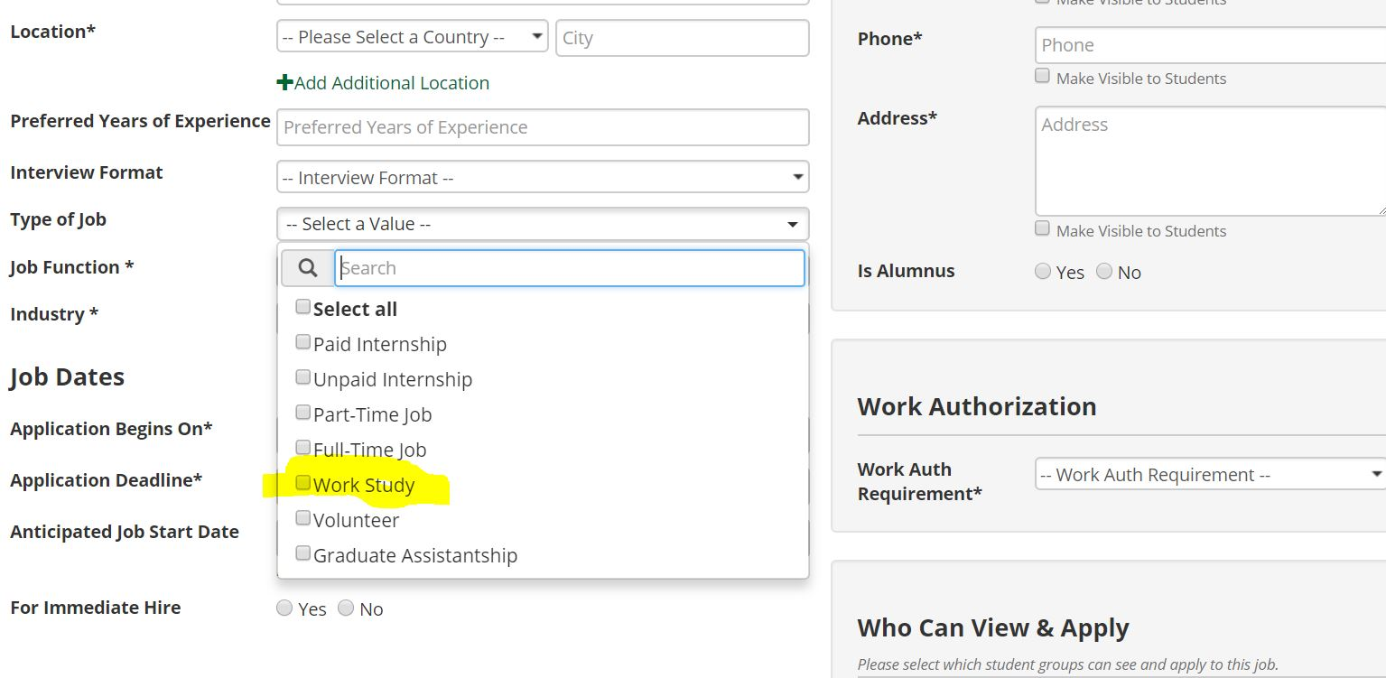
Type of Job
You
You can pick multiple values; for e.g.: Work Study and Part-Time Job

Slide 20
OTHER RESOURCES
- 12Twenty Guide
- https://12twenty.freshdesk.com/support/solutions/articles/9000043583-posting-a-job

Slide 21
KEY CONTACTS—NDSU CAREER CENTER
1st point of contact for job postings, presentations, tabling, on-campus interviews
2
Internship oversight
1
Pat Breen
Employer Partnership Manager
Alli Goossens
Assistant Director, Internship Program
5
Connectivity
3
Internship details
4
Career fairs/expos
Smita Garg
Assistant Director, Employer Engagement
Emmanuel Jinor
Internship Program Specialist
Erika Bartunek
Events Manager

Slide 22
QUESTIONS?
Contact:
NDSU Career Center
306 Ceres Hall 701-231-7111
ndsu.career.center@ndsu.edu
https://career.ndsu.edu
THANK YOU!

Slide 23
You Have a Potential Employee
A student contacted you and wants to work for you. That’s GREAT!
Set up an interview/meeting and ask the student to bring along a copy of their Financial Aid award. If they don’t bring one, they can access the document through their Campus Connection account.
SELF SERVICE > FINANCIAL AID > ACCEPT/DECLINE AWARDS > 2018
If the student has a work-study award, you will need to request the FWS Authorization form.

Slide 24
Interviewing & Hiring a Work-Study Student
Completing and Returning the Work-Study Authorization Form
Request a FWS Authorization form for your student employee online The FWS Authorization form will be sent to you via email if the student:
has been awarded and accepted FWS funds
is registered for a minimum of 6 credits, and
does not have any Financial Aid holds in effect. If the student has any holds, you will be notified and sent the authorization form once the holds are no longer in effect.
The student cannot begin working using FWS funds if they have any holds in place.
Review the document with the student, sign where requested, make a copy of the FWS Authorization form for your files, and return the original to the FWS Coordinator

Slide 25
Students earning wages using FWS funds are “employees of the University” and must adhere to University, State, and Federal regulations
HR/Payroll

Slide 26
Manager Self Service Process
What is the Manager Self Service Process?
Hiring process used for non-benefited hires
Utilizes electronic workflow of employee hire and termination information
Provides tracking mechanism for documentation
Process encourages initiating hires EARLY, well before the actual first day of work!

Slide 27
Manager’s Self Service Onboarding Overview
New Hire Overview – Non Benefited
Department has employee fill out Employment Information Form and retains for use during Step 4
Department sends employee to HR/Payroll with ID’s for I-9. Employee completes I-9 Section 1 and 2 at the Payroll office.
Employee returns to department with Approval Sheet, stating employee is able to be hired as of that date (or later)
Department initiates Hire in Manager Self Service and uploads Employment Information Form and Approval Sheet
Employee gets email with Temp ID and Temp Password to enter basic Bio-Demo info
Hire continues through MSS workflow to HR/P. If employee has entered basic Bio-Demo info, hire is finalized by HR/P
Employee gets second email with permanent Empl ID, link to claim NDUS Account, and link to complete online Activity Guide
Training / Reference Manual https://www.ndsu.edu/fileadmin/hr/Online_Onboarding/MSS-Onboarding_Manual-Campus_Manual-I-9.pdf

Slide 28
Essential Payroll Processes
Employment Information Form completed for each hire/rehire! (On and Off Campus hires)
Students must complete I-9 form in person at HR/Payroll Office prior to start date. REQUIRED! [Stop & Go Center, 1919 University Drive. N. #102]
Students provide 2 (original) forms of identification Acceptable forms of ID are listed on the following website: https://www.ndsu.edu/forms/#human9
On Campus Employers work directly with HR/Payroll
Off Campus Employers work with FWS Program Coordinator to administer Manager Self Service Process
Use the Manager’s Self-Service Onboarding Manual to learn more about the MSS process: https://www.ndsu.edu/fileadmin/hr/Online_Onboarding/MSS-Onboarding_Manual-Campus_Manual-I-9.pdf
All required forms must be completed and on file according to HR/Payroll deadlines.
The employee cannot start working until ALL required forms are complete.

Slide 29
Human Resources Management System HRMS
Positions and Default Funding
Work with HR/Payroll to set up the positions using FWS funds to include default combination codes! This will save you time!

Slide 30
Want to learn more?
Attend Training Sessions Offered by HR/Payroll
https://www.ndsu.edu/hr/news/detail/34073/
Queries and Reports: Thursday, August 2, 2018 9:30-11:30 a.m. Quentin Burdick Bldg. 114

Slide 31
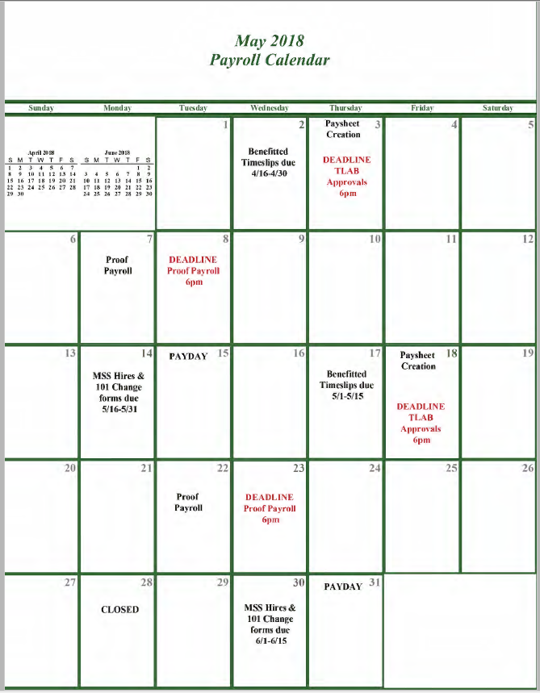
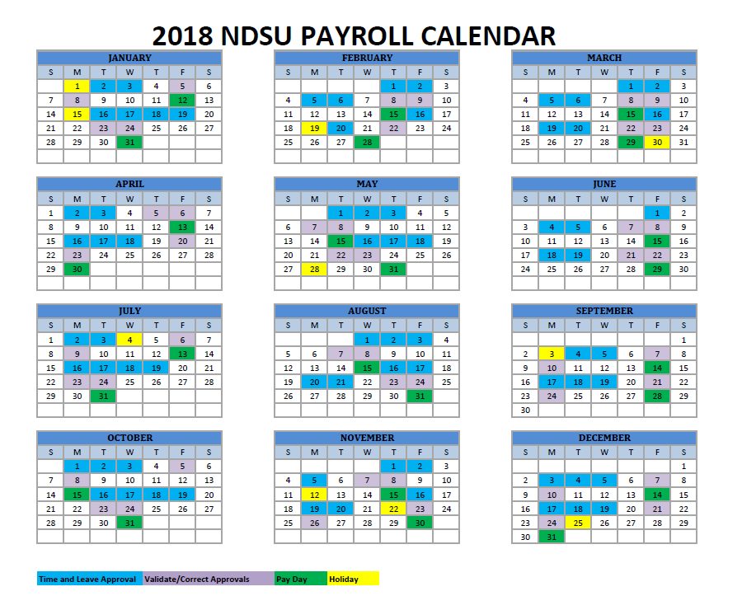
HR/Payroll Calendars Monthly/Yearly https://www.ndsu.edu/hr/admintoolbox/
Monthly Payroll Calendar Annual Payroll Calendar

Slide 32
HR/Payroll Contacts
Julie Giffey - Payroll Records Technician
Phone: (701) 231-8958 Julie.Giffey@ndsu.edu
Sheila Tindall – Senior Payroll Records Technician
Phone: (701) 231-5657 Sheila.Tindall@ndsu.edu
Kari Schmitz-Eilertson – Payroll Coordinator
Phone: (701) 231-6251 Kari.Schmitzeilertso@ndsu.edu
Tricia Johnson – Associate Director for Payroll
Phone: (701) 231-8990 Tricia.R.Johnson@ndsu.edu

Slide 33
Tracking Work-Study Balances
Once you have hired your student employee(s), you must keep a running balance of their FWS award.
Tracking of FWS award balances is based on 100% of their total earnings. The balance is not just the employer’s percentage.
All dollars earned beyond the FWS award are to be charged 100% to the department.
Balance award notifications will be sent to you on a monthly basis. It is important to monitor balances regularly so as not to go over the available amount awarded!
Once student has reached a balance of $500 or under, you will receive an additional email notification.
Data reflected in the “$500 and under” report has a lag time. It is best to track the hours the students worked on an on-going basis to maintain an up-to-date balance

Slide 34
What if the student is running out of Work-Study Funds?
Submit a request for an increase online to see if the student qualifies for an increase: https://www.ndsu.edu/onestop/finaid/employment/employer/
Increases are awarded only if:
Funds are available, and, the student IS eligible for an increase
You will be contacted by the FWS Coordinator via email with the updated information.
If the student IS NOT eligible for an increase:
She/he must stop working at the time FWS funds have been used up; or the student may continue to work for you if the department is willing to pay 100% of the student’s hourly wages.

Slide 35
Managing Your Student Employees Work-Study is a real job!
FWS jobs provide a great place to start (or continue) developing skills and good performance habits.
Students should treat the job as an opportunity to learn and grow professionally.
Students not performing up to required job standards should be treated like any other staff person and subject to performance evaluation.
If you have provided adequate counseling and guidance to a student and he/she continues to display poor or inappropriate work performance, and, does not meet the basic requirements of the job, you do have the right to dismiss the student from the position.
Contact the FWS Coordinator if you decide to terminate a student who is using FWS funds.

Slide 36
Requesting Your Students Back
You can request to have specific students considered for FWS funding for the next academic year
Returning FWS students still must meet eligibility requirements
Returning FWS students, if eligible, would receive funding during first round of awarding along with first-year students
Returning students still go through the standard hiring process annually
Request the FWS Authorization form
Complete hiring documentation (required by HR/Payroll)
Must complete all required trainings (e.g. Baseline Safety, Title IX, etc.)

Slide 37
Employer Information https://www.ndsu.edu/onestop/finaid/employment/employer/
Employer Resources for 2018-2019 available online from the Financial Aid and Scholarships web page. Items available include:
NDSU CAREERLink (Job Board)
Important Links for Employers
Request FWS Authorization form (online)
Request Increase to existing FWS award (online)
Work-Study Resources for All Employers
FWS Employer Resource and Training Manual
Employer Information Session PowerPoint
Salary Tracking sheet and Fund Number / Combo Code Reference
HR/Payroll Resources (training manuals, forms, etc.)
Notes:
Review web site information

Slide 38
Questions?

Slide 39
Thank You for Attending Today’s Session!
For further information, contact:
Tammie Reger NDSU Financial Aid and Scholarships Financial Aid Administrator and Work-Study Coordinator Tammie.Reger@ndsu.edu 701-231-7535

