Slide 2
Shared Services Working Group
Peggy Cossette
Mark Genkinger
Kay Hopkins
Pamela Jo Johnson
John McEvoy
Hallie Pritchett
Kimberly Wallin

Slide 3
Committee Charge
To identify efficiencies that can be realized by implementing shared services between colleges, including accounting and academic support services
To make recommendations on potential structure, functions and other ideas in a shared services model for NDSU

Slide 5
What is Shared Services?
It is a business model that enables resources to be leveraged across the university resulting in lower costs with agreed upon customer-service levels
Built upon gaining efficiencies with people, processes, and the use of technology through continuous improvement methodology
Focused on service and accountability for their customers

Slide 6
University Shared Service Models in 2016
(not an exhaustive list)

Slide 7
Most Common Areas for Shared Service Models
Finance and Accounting
Human Resources
Information Technology

Slide 8
Success Keys for Shared Services
Leadership support
Clear attainable goals and objectives
Firm boundaries & flexible implementation
Transition support
Communications & change management

Slide 9
What Did We Do?
Surveyed staff working in academic support areas
Looked for possible areas for future exploration
Reviewed current structure of staff assigned to these tasks
Focused on efficiencies, waste reduction, processes, communication, training opportunities, and retention efforts

Slide 10
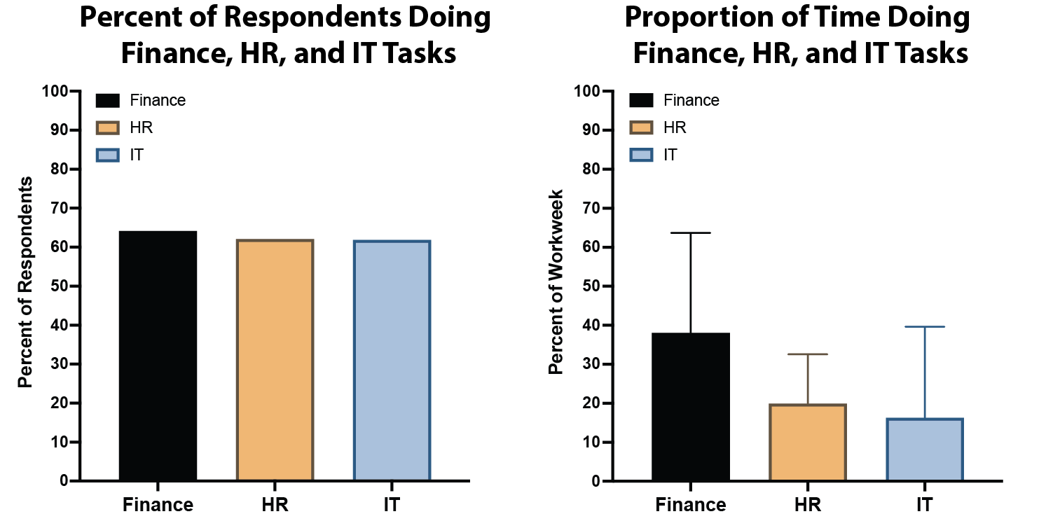

Slide 11
Takeaways from the Survey
Any changes are going to take buy-in, TIME, and money
Shared services would need input from ALL of campus vs. solely academic areas
This work really can’t be completed without other committee work being done first
There seem to be MANY opportunities for improvement without adopting a shared services model

Slide 12
Themes from the Survey
HR
HRMS/hiring process is cumbersome
Performance reviews
DocuSign
Has improved efficiencies, but...
Not being able to edit or send back is limiting and creates duplication of effort
Novelution
Has dramatically improved grant and IRB processes
Systems working together
Perceptive Content, DocuSign, etc.
Records Retention
and Perceptive Content
Intranet
TYP03 - content management for website
maybe more resources needed
Track Training System
including grad students and PTAs

Slide 13
Recommendations for Consideration
Regardless of model, this is not a quick fix
Need to identify goals and objectives for implementing shared services
Recommend starting with one area
Chance to learn, pilot and then move to other areas
Leadership needs to pick area(s) of focus

Slide 14
Conclusions and Next Steps
Shared service models do not have to incur layoffs
Personnel cost savings can be had with natural attrition over time
Not one size/type model fits all institutions
Different models depending on system needs
Unique implementations depending on system needs
Many universities have moved to a shared service model
Variety of different models with successes and challenges to each
Evaluate other universities with shared services models

Slide 15
Questions, Thoughts, Feedback?

