Slide 1
ImageNow User’s Group
December 7, 2010
Notes:
The 3rd meeting of the NDSU ImageNow User’s Group was held on Tuesday, December 7, 2010 at 3:30 pm in the Hidatsa Room of the Memorial Union.

Slide 2
User’s Group Goals
Communicate & Share Ideas with Others
Discuss What Works / Best Practices
Discuss Common Problems & Issues
Coordinate Efforts between Offices
Share Knowledge & Coordinate Training
Promote use of ImageNow across campus
Notes:
The goal of the user group is to get everyone in the same room and discuss what works, what doesn’t work, to combine efforts, and to inform current ImageNow users about the product so they can serve as advocates to other offices on campus.

Slide 3
Today’s Agenda
Introductions & Office Updates
Participating Office Review
Scanner Maintenance Tips
Key Field Clean-up
Workflow Routing Rules
eForms Add-on Module
Questions

Slide 4
Introductions & Office Updates
*** Please sign the attendance sheet ***

Slide 5
Participating Offices
Office | # of Licenses | User Avg. | # of Users
Admission | 10 | 7 | 21
Enrollment Mgt. | -- | -- | 1
Grad School | 7 | 6 | 14
HR/Payroll | 3 | 1 | 17
Int’l Programs | 5 | 2 | 15
ITS | 2 | 1 | 4
Reg. & Records | 15 | 14 | 32
Residence Life | 2 | 2 | 26
TOTALS | 44 | 33 | 130
Notes:
Listing of offices currently using ImageNow, the number of licenses, users, and logged-in user average per office.
[Animation 1:] International Programs is the most recent addition
A total of 10 licenses and a net gain of 26 users have been added since the last meeting (February 2010).

Slide 6
News & Notes
New Offices Starting 2011
Bison Connection
Student Financial Services
Client Upgrade to version 6.6
Windows 7 (64-bit) compliant
Day-to-day users should not be affected
Notes:
Viet Doan, of Enrollment Management Technical Services, mentioned that he knows a work-around for anyone having trouble using the ImageNow printer on a Windows 7 computer. (This solution may make an upgrade to the 6.6 version not as urgent as previously thought.)

Slide 7
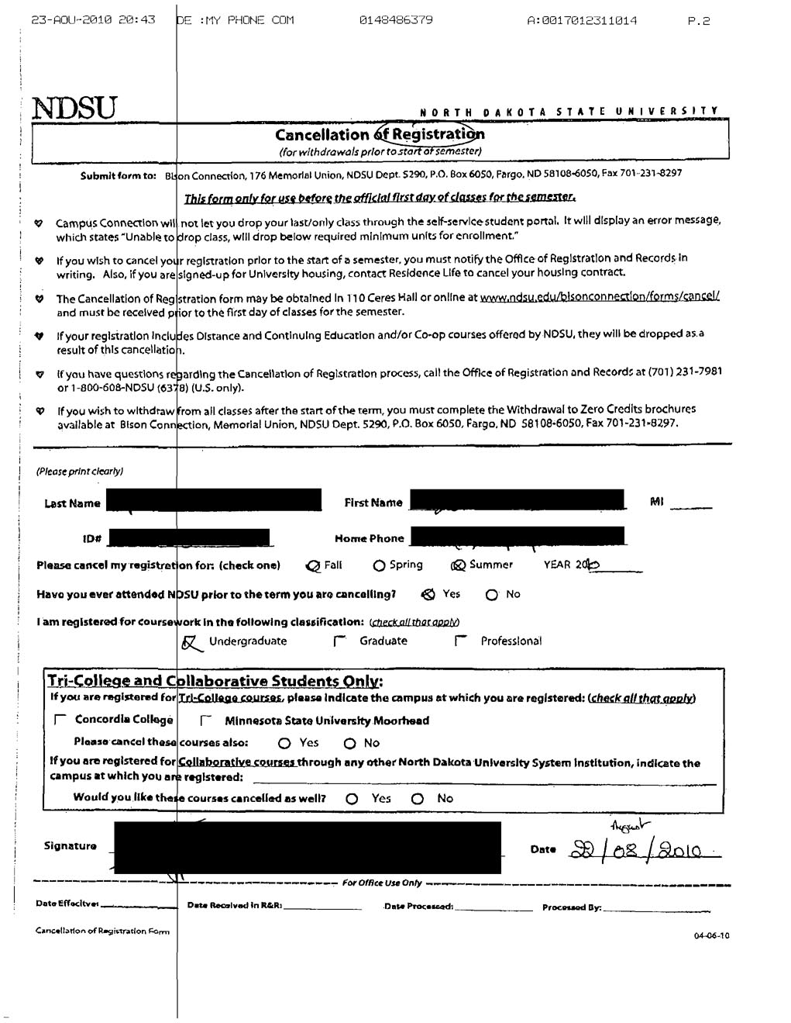
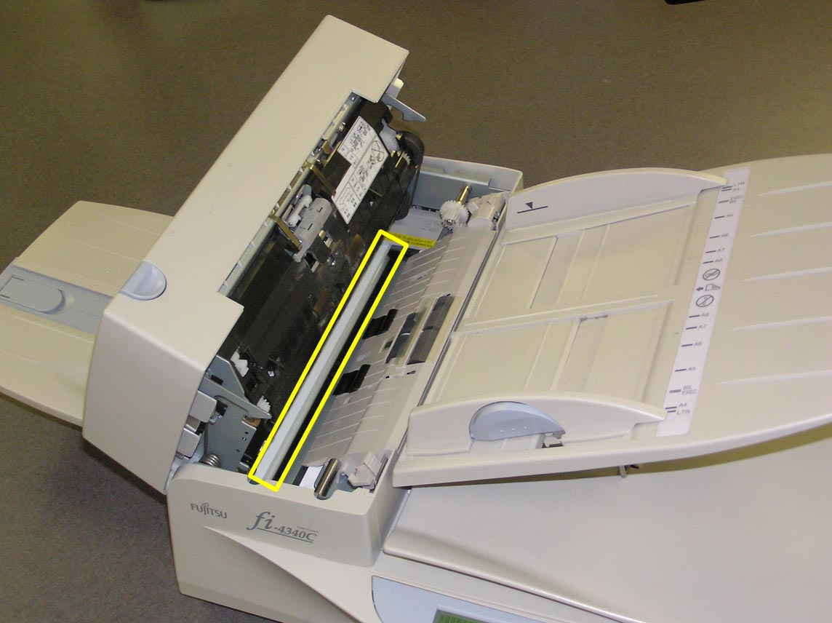
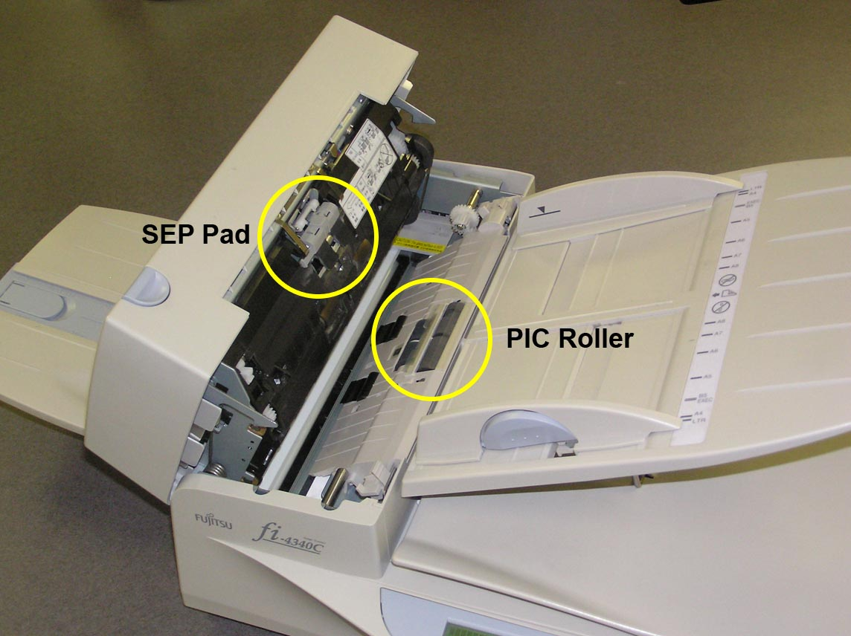
Scanner Maintenance
Rollers
Symptom: feeder grabs more than 1 sheet at a time
“PIC Roller”
“SEP Pad”
Glass
Symptom: line appears on scanned documents
Open Document Feeder
Clean glass with soft cloth
Notes:
One thing to watch for scanner maintenance are the rubber rollers on the Automatic Document Feeder. The usual sign that the rollers are wearing out is that the feeder will start to grab more than one sheet of paper into the feeder at a time.
[Animation 1:] The two pieces of hardware that need to be watched are the “PIC Roller” and the “SEP Pad” (as shown on the slide)
For R&R, these pieces typically last about 9 months before wearing out (we’re working on getting a document count instead of measuring the wear in months). Sometimes the feeder will start grabbing extra pages earlier than that, but usually the rollers can be cleaned by simply rubbing them with your hands to remove any dirt, dust, or residue left by thousands of pages of paper passing through the feeder. **Please note that using a cleaning solution that contains alcohol will dry out the rubber on the rollers which will make them hard and slippery.
Another issue for scanner maintenance is keeping the glass surfaces of the scanner clean.
[Animation 2:] Many times a scanned document will have a pin-stripe line on the entire length of the page. (as shown in slide)
This is usually caused by a speck of dirt or maybe some leftover residue from a sticky note that gets stuck to the glass surface of the scanner.
[Animation 3:] The easiest remedy for this is to open the Document Feeder and use a soft cloth (or micro-fiber cloth) to clean both the top and bottom glass surfaces (it has two surfaces because it scans both top and bottom sides of the page)

Slide 8
Scanner Maintenance
Contact Information:
Bill Cody PRINTER SOLUTIONS 701-298-6594
Notes:
The Registration & Records’ contact for scanner replacement parts (rollers & pad) is Bill Cody with Printer Solutions in Fargo.
We used to have Bill come to the office and replace the parts for us, but doing so meant paying a $70 service charge for the on-site visit in addition to the cost of the parts. Now, we just place an order for the parts and A.J. replaces the rollers when needed.
Feel free to contact the other participating offices if you have questions about your scanner.

Slide 9
Key Field Housekeeping
Filling in the blanks for any missing key fields:
Student ID
Name
D.O.B.
Term/Year
Can create/save filters to look-up missing fields
Notes:
Just wanted to mention here that we are finding instances where certain key index fields are appearing blank in the system. For some of the historical documents that have been scanned into archive, the student doesn’t exist in Peoplesoft, so the student information cannot be linked to the document and some fields need to either be left blank or filled in manually.
Please do occasional checks of your documents to make sure the key index fields are populated as much as possible. **Please note that the “Term/Year” field is especially important because it is the main field we will have to search for when we start the process of purging documents.
A search filter can be created to find documents with blank key fields. (demonstrated one of the R&R search filters for finding missing D.O.B.)

Slide 10
Demonstration
“SHOW US YOUR WORKFLOW”
How Registration & Records uses Routing Rules to automatically sort documents into workflow queues by Document Type
Notes:
I’d like to introduce a new “segment” to these meetings called “Show Us Your Workflow” in order to demonstrate how different offices are using Workflow and to highlight different features within workflow.
For this meeting, we will look at how Registration & Records uses custom-built routing rules to sort scanned documents into their assigned workflow queues based on the scanned document’s Document Type.
When we started workflow, we knew that certain document types had to be routed to designated workflow queues (Transcripts needed to go to the “Transfer Evaluation” queue, Major Change Forms had to go to the “Major Change” queue). We initially setup individual capture profiles for each document type that needed to go to a different queue. But it got to the point where there were too many scanner profiles to manage, so we created a queue called “Incoming Documents”, created one capture profile that dumped all scans into the “Incoming Documents” queue, and then a routing rule was created that sorted the documents by document type and routed those document types to the assigned workflow queue.
The automatic routing of the documents is on a cycle of approximately 15 minutes, so sometimes the documents route quickly, and sometimes they sit in the “Incoming Documents” queue until the server triggers the routing rule again. **Please note that there are times when the auto-routing process gets stuck and the documents do not route automatically. For those cases, there is a server process that needs to be restarted. Contact Jon Bronken in ITS/ECI to restart that service.

Slide 11
Discussion
eFORMS
Eliminates paper/PDF forms
Forms available via web address
Entry Validation
Creates ImageNow document automatically
Secure electronic submission (?)
One instance on server = shared cost
Notes:
The last topic for discussion is the “eForms” feature. Every office is kind of in the same budget situation right now to where purchasing this add-on module may not be in anyone’s immediate future, but I’d like to at least present it as a possibility and make the group aware of some of the potential benefits the “eForms” could provide to many of the offices using ImageNow.
“eForms” is an add-on module that allows you to create web-based forms that can be placed on a web server and accessed by clicking on a link on a web page. Right now, most offices have forms that are available in either paper or PDF format. An “eForm” exists as its own ImageNow document and can go directly into workflow after being submitted. This eliminates any need for paper in any part of the process. No more scanning and no more chance of a paper form “getting lost”.
One case where “eForms” may not meet an office’s needs would be if the office needs to collect a physical signature on a form. One possible solution for this would be having ITS develop some kind of secure login screen that appears before the online form is displayed. That way the secure login could act as the student’s signature in lieu of having them sign a paper form. (this solution may not work for all forms, some offices like HR may have certain forms that require a physical signature)

Slide 12
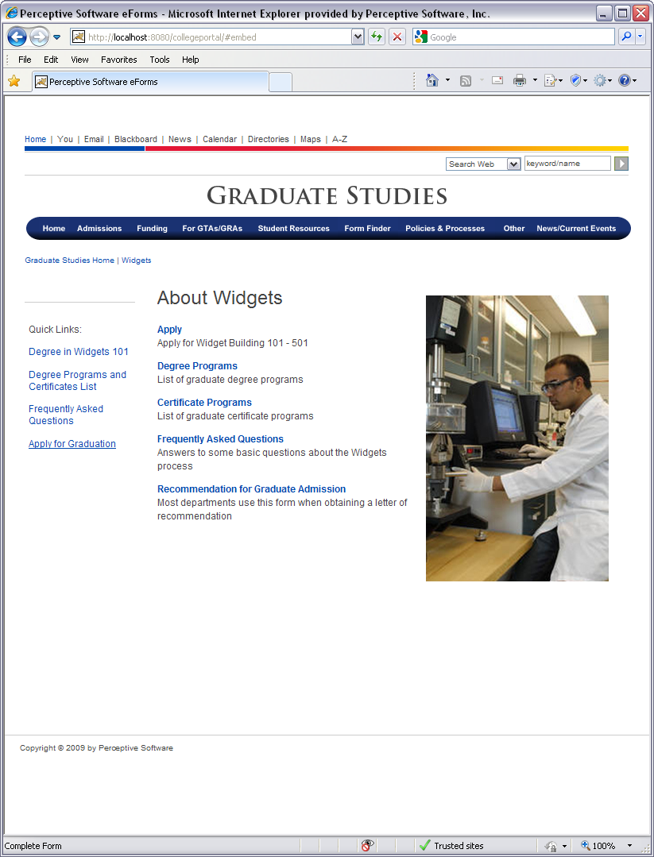
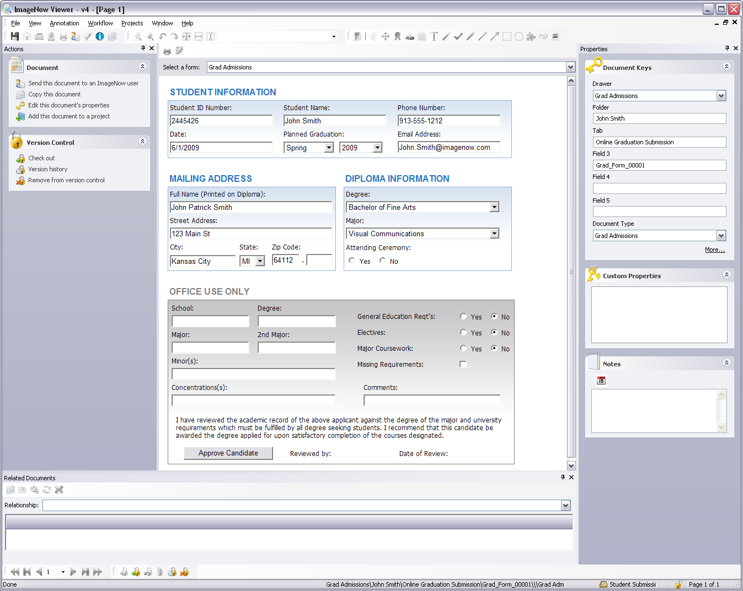
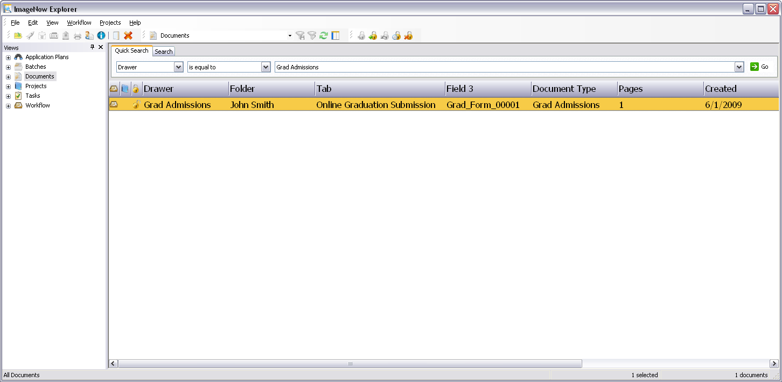
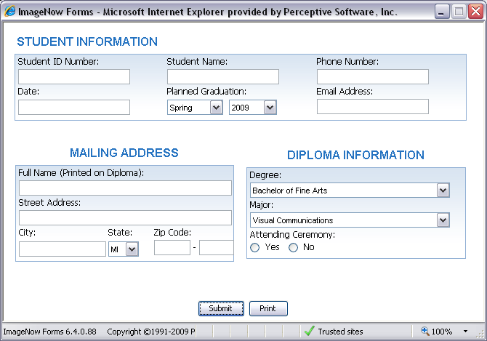
eForms in action
4
5
1
6
2
3
Notes:
[This slide courtesy of Perceptive Software, taken form materials presented to the Twin Cities Regional User Group]
Explanation of steps:
A student enters the graduate studies website and presses the “Apply for Graduation” link.
The application for graduation form displays, available for data entry.
The student completes data entry and submits the form for review. (The form is submitted to the ImageNow repository, indexed and placed in a defined Workflow queue.)
The assistant registrar locates the form by searching within the document viewer. (Notice, the form is indexed just like a document. Index values can be defined as static or dynamic.)
The assistant registrar opens the form for review.
A new section of the form is now displayed – for Office use – which had been hidden when the student filled out the form.

Slide 13
Discussion
eFORMS
Eliminates paper/PDF forms
Forms available via web address
Entry Validation
Creates ImageNow document automatically
Secure electronic submission (?)
One instance on server = shared cost
Notes:
Like all of the “good” features in ImageNow, the “eForms” module is an add-on that needs to purchased separately. The latest cost of the eForms module that I received from our sales rep is $17,500. The good thing about the eForms module is that it is a software pack that can be loaded onto the ImageNow server and used by anyone using ImageNow. That means that we can split the cost by the number of participating offices. And with Bison Connection and Financial Aid coming on board in the next year, that puts our number of participating offices at 9, which means that the per-office cost for the eFroms module is just under $2000 (plus a yearly maintenance fee which would be divided proportionally based on the number of client licenses each office has).
Again, this is something that may have to wait until everyone feels better about their budget situation, but I just wanted to put it on everyone’s radar as a possible purchase in the future. If you would like more information about eForms, please see the brochure I have posted on the web site, and additional information can be found on the ImageNow Customer Support portal as well.

Slide 14
Questions???
Notes:
Merideth Sherlin, from Admission, asked about participating in some of the online “refresher” courses that Perceptive offers. The online courses are offered by topic and it might be worthwhile to purchase one instance of the training session, set it up in one of the conference rooms with a SmartBoard, and then invite anyone interested to sit-in on the session and share the cost.
A.J. mentioned that one option that Perceptive is exploring is holding training sessions either before or after the Regional User Group meetings. An email went out about month ago to individuals asking for suggested training topics. That method could be another way to receive some training at a lower cost than sending someone to Kansas City of on-site classroom training.

Slide 15
Until We Meet Again…
Next Meeting
Spring semester
R&R Web site
www.ndsu.edu/registrar/imaging
User Group Listserv
NDSU-IMAGENOW-USERS-GROUP@listserv.nodak.edu
*** Please sign the attendance sheet before leaving***
THANKS FOR COMING!
Notes:
We’ll look to meet again at some point in the Spring semester. I’ll be asking for a volunteer from one of the offices to contribute to the “Show Us Your Workflow” segment.
The power-point and other information from this meeting will be posted on the User Group page of the “Document Imaging” web page on the Registration and Records web site at <www.ndsu.edu/registrar/imaging/>. Be sure to check out the other pages of the site for links to ImageNow resources, scanner information, license & user counts for participating offices.
The user group Listserv has also been created for the purposes of communicating meeting times, but it can also be used to send a general question or message to the entire group. See the link on the web page to sign-up or send a message.
Thanks for coming and please let me know if you have any suggestions for future topics.

