Slide 1
ImageNow User’s Group
April 26, 2011
Notes:
The 2011 Spring meeting of the NDSU ImageNow User’s Group was held on Tuesday, April 26, 2011 at 3:00 pm in the Peace Garden Room of the Memorial Union.

Slide 2
User’s Group Goals
Communicate & Share Ideas with Others
Discuss What Works / Best Practices
Discuss Common Problems & Issues
Coordinate Efforts between Offices
Share Knowledge & Coordinate Training
Promote use of ImageNow across campus
Notes:
The goal of the user group is to get everyone in the same room and discuss what works, what doesn’t work, to combine efforts, and to inform current ImageNow users about the product so they can serve as advocates to other offices on campus.

Slide 3
Today’s Agenda
Introductions & Office Updates
Participating Office Review
News & Notes
Demonstration
Discussion Topic (eForms)
Questions
Notes:
Today’s Agenda includes…

Slide 4
Introductions & Office Updates
*** Please sign the attendance sheet ***

Slide 5
Participating Offices
Office | # of Users | # of Licenses | # of Scanners
Admission | 20 | 10 | 2
Bison Connection | 11 | 3 | 1
Enrollment Management | 1 | -- | --
Graduate School | 13 | 7 | 1
HR/Payroll | 16 | 3 | 1
International Programs | 15 | 5 | 1
IT Services | 4 | 2 | 1
Registration & Records | 33 | 15 | 3
Residence Life | 25 | 2 | 1
Student Financial Services | 17 | 4 | 1
TOTALS | 155 | 51 | 12
Notes:
Listing of offices currently using ImageNow, the number of users, licenses, and scanners per office.
[Animation 1:] Bison Connection & Student Financial Services are the most recent additions
A total of 7 licenses and a net gain of 25 users have been added since the last meeting (December 2010).

Slide 6
News & Notes
Welcome New Offices Starting 2011
Bison Connection
Student Financial Services
Client Upgrade to version 6.6
Windows 7 (64-bit) compliant
Added eForms components/features
Day-to-day users should not be affected

Slide 7
News & Notes
INspire 2011 Conference Report
April 10-13, Las Vegas, NV
Attended by Viet Doan
Twin Cities Regional User Group Meeting
Wednesday, May 18th (10:00 – 2:00)
University of Minnesota-Rochester
Email Alerts on Workflow Queues are Active!

Slide 8
Demonstration
Customizing Your Toolbar & Viewer
Adding the Message Center to Toolbar
Adding Queues to the Message Center
Setting Defaults
Grid Display Options in Viewer

Slide 9
Discussion
eFORMS
Student Government Capital Project Grant
Implementation Timeline
Online Training Opportunity

Slide 10
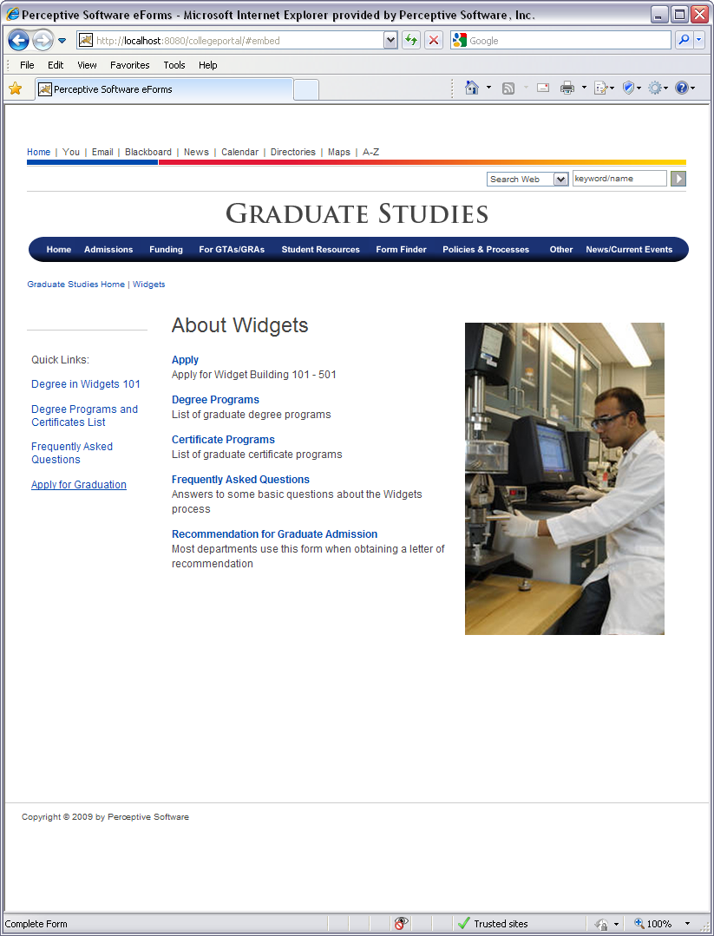
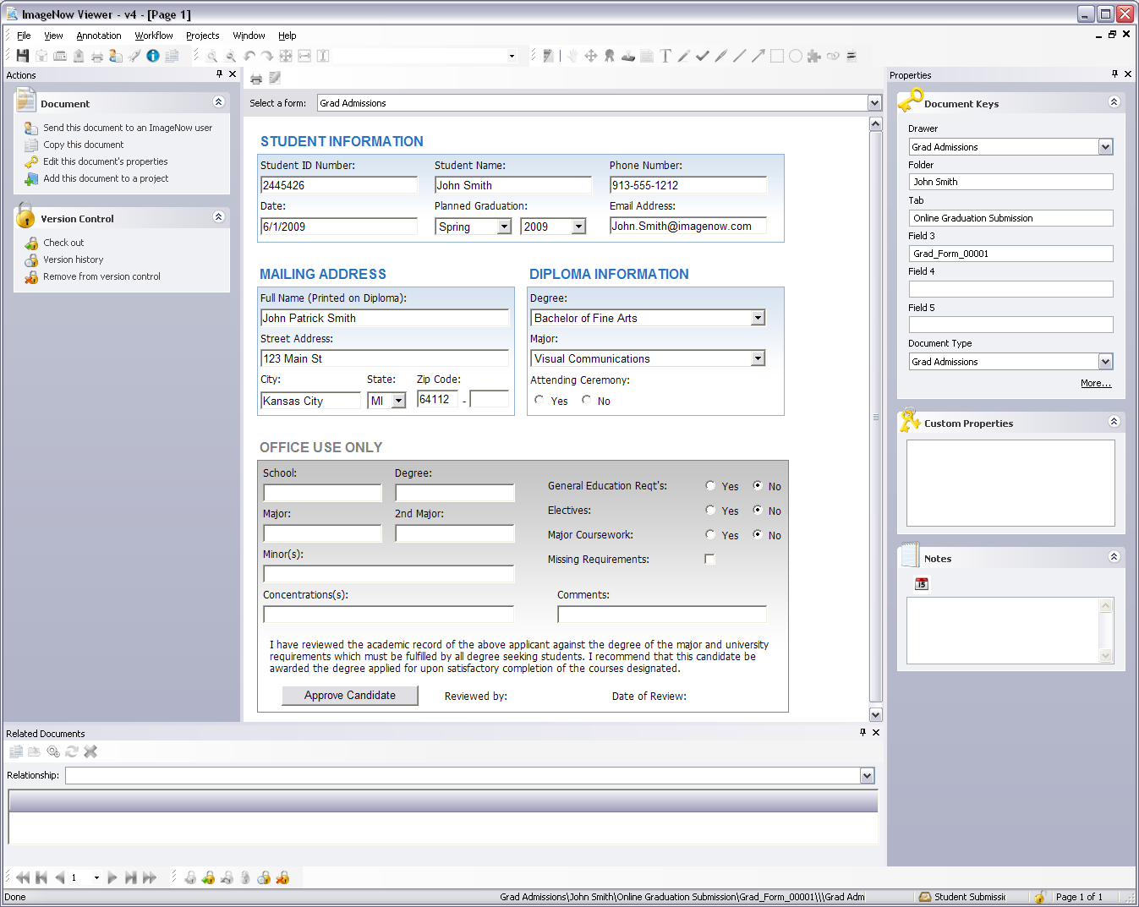
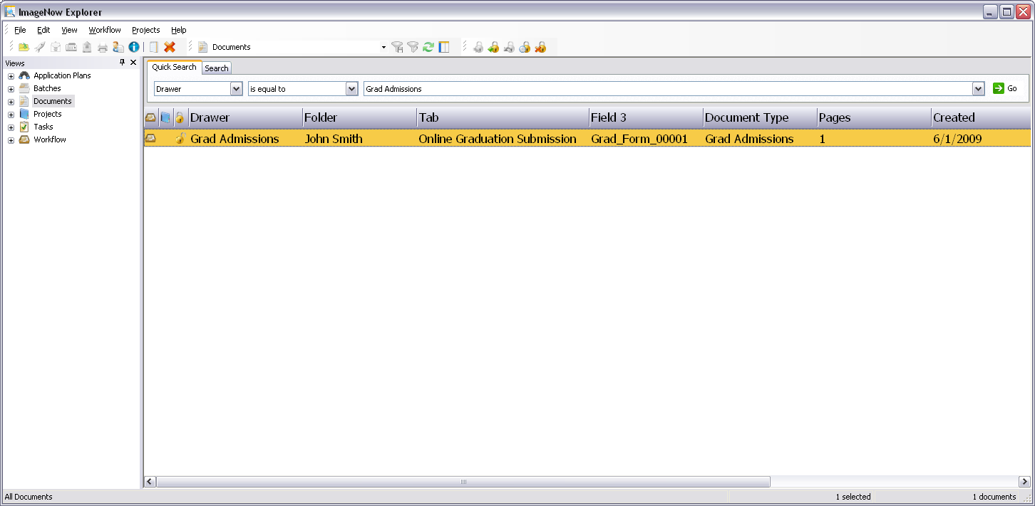
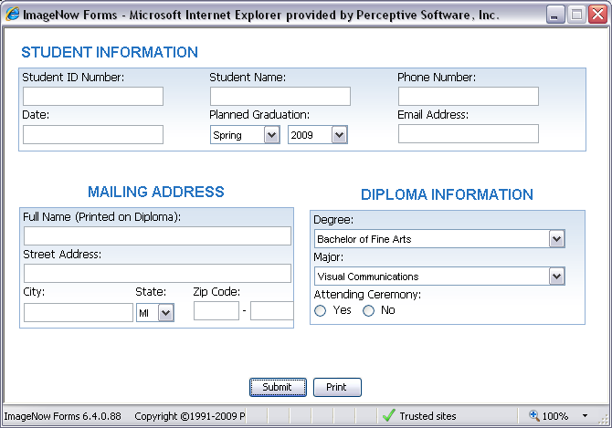
eForms in action
4
5
1
6
2
3
Notes:
[This slide courtesy of Perceptive Software, taken form materials presented to the Twin Cities Regional User Group]
Explanation of steps:
A student enters the graduate studies website and presses the “Apply for Graduation” link.
The application for graduation form displays, available for data entry.
The student completes data entry and submits the form for review. (The form is submitted to the ImageNow repository, indexed and placed in a defined Workflow queue.)
The assistant registrar locates the form by searching within the document viewer. (Notice, the form is indexed just like a document. Index values can be defined as static or dynamic.)
The assistant registrar opens the form for review.
A new section of the form is now displayed – for Office use – which had been hidden when the student filled out the form.

Slide 11
Discussion
eFORMS
Student Government Capital Project Grant
Implementation Timeline
Online Training Opportunity

Slide 12
Discussion
eFORMS ONLINE TRAINING OPPORTUNITY
Available online via e-Learning course
3-4 hours
Can set up in Conference Room w/Projector
Interested individuals contact A.J.

Slide 13
Questions???

Slide 14
Until We Meet Again…
Next Meeting
Summer/Fall
R&R Web site
www.ndsu.edu/registrar/imaging
User Group Listserv
NDSU-IMAGENOW-USERS-GROUP@listserv.nodak.edu
*** Please sign the attendance sheet before leaving***
THANKS FOR COMING!

