Slide 1
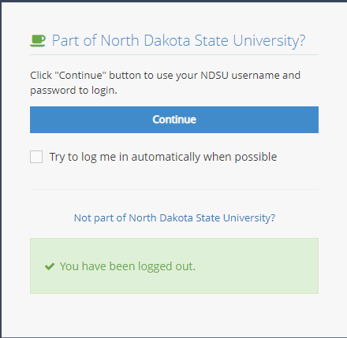
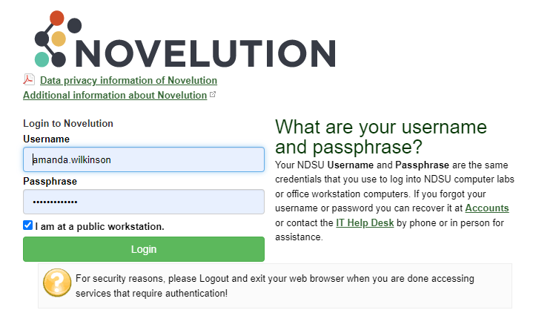
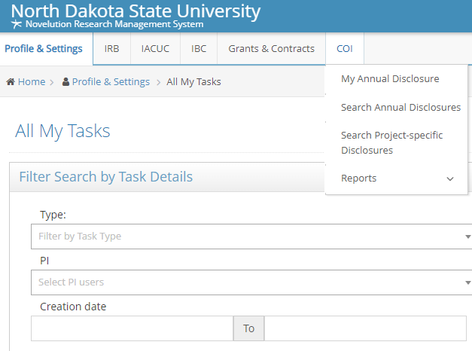
My Annual Disclosure in Novelution
My Annual Disclosure in Novelution
Log in to Novelution:
https://erac.ndsu.edu/

Slide 2
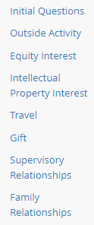
Once the page is open you will see the panel on the left
with the module titles
All * questions are required for submission

Slide 3
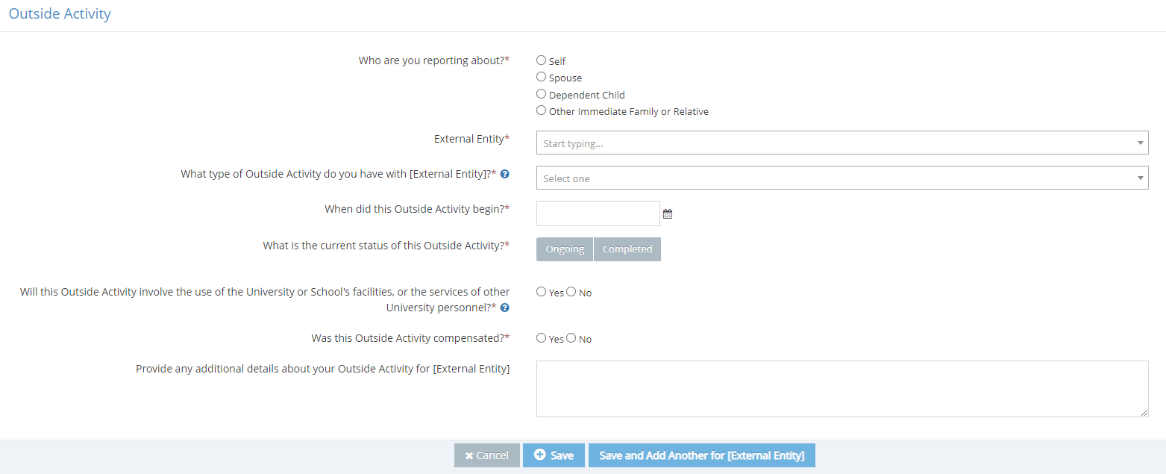
If yes is selected in the module – a blue box will appear that will require
information to be entered. This box can be used multiple times if you
have multiple conflicts to report. It will show as a table once saved.
Opens the modal below
This is the table that will appear after entering information in the modal
Always answer the questions in order, more questions will populate
based on the answers provided
Click on the Blue question mark for help text

Slide 4
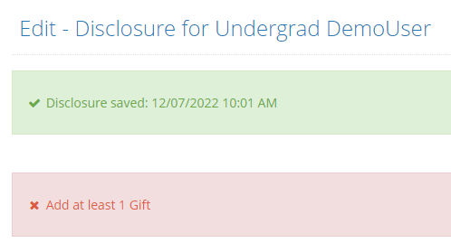
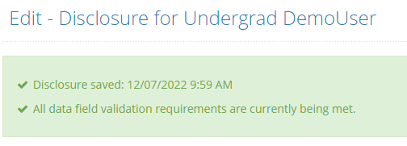
Once all modules are filled in, click check validations at the
bottom of the screen. This will show if all required questions have been
answered (*). Save can be selected if you need to finish filling out the
form at a later time.
If you see this red box, it lists the section(s) that is missing
information. Once completed, check validations again.
If you see this green box, it is ready to submit for approval.

Slide 5
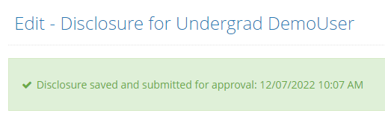
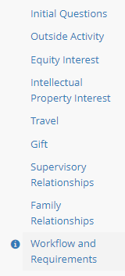
Click the blue button at the bottom of the screen. Once submitted you will see this green box.
You can see the status of the disclosure review at any time in the Workflow and requirements panel

