Slide 2
Electronic Research Administration and Compliance (ERAC)
Sponsored Programs Administration
Research Integrity and Compliance
Grant and Contract Accounting
Business Development
February 15, 2018

Slide 3
ERAC Software Modules
Sponsored Research
IRB
IACUC
IBC
COI
Effort Reporting

Slide 4
Novelution Corp.
Yaniv Eyny, CEO
Evan Sable, CTO

Slide 5
NDSU Core Team SR Module
Val Kettner Associate Vice President, SPA
Amy Scott Assistant Director, SPA
Joycelyn Lucke Love Assistant Director, Bus Dev
Ann Young Director, GCA
Laura Lutkemeier Grant and Contract Officer, GCA
Jill Mackenzie Award and Program Officer and Interim NDSU ERAC Project Manager, SPA

Slide 6
NDUS Project Structure

Slide 7
ERAC Timeline – SR Module
June 2015 RFP ERAC Proposals
July 2016 Contract signed – Project Initiation
Sept – Dec 2016 Discovery Phase SR Module
Jan 2017 – Feb 2018 SR 4 Implementation Stages with 4-5 iterative sprints in each stage.
Future work Complete Stage 4 iterative testing, PS integration, Full process testing, Campus training
October 2018 Anticipated SR Launch to Campus

Slide 8
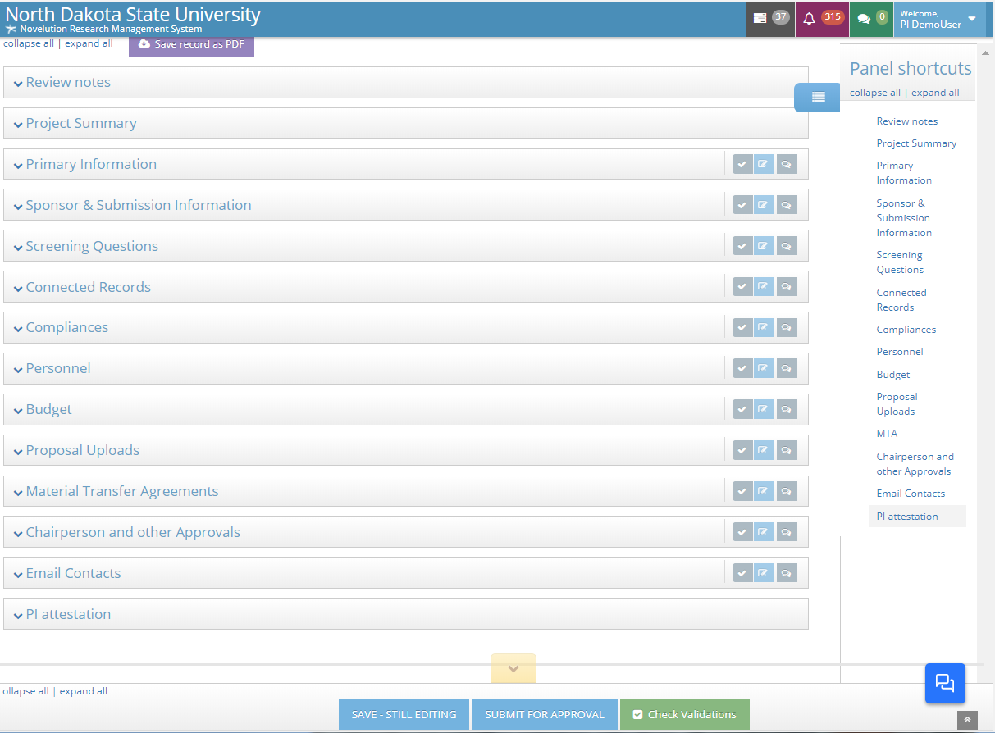
Novelution Test Site Demonstration

Slide 9
Budget Samples

Slide 13
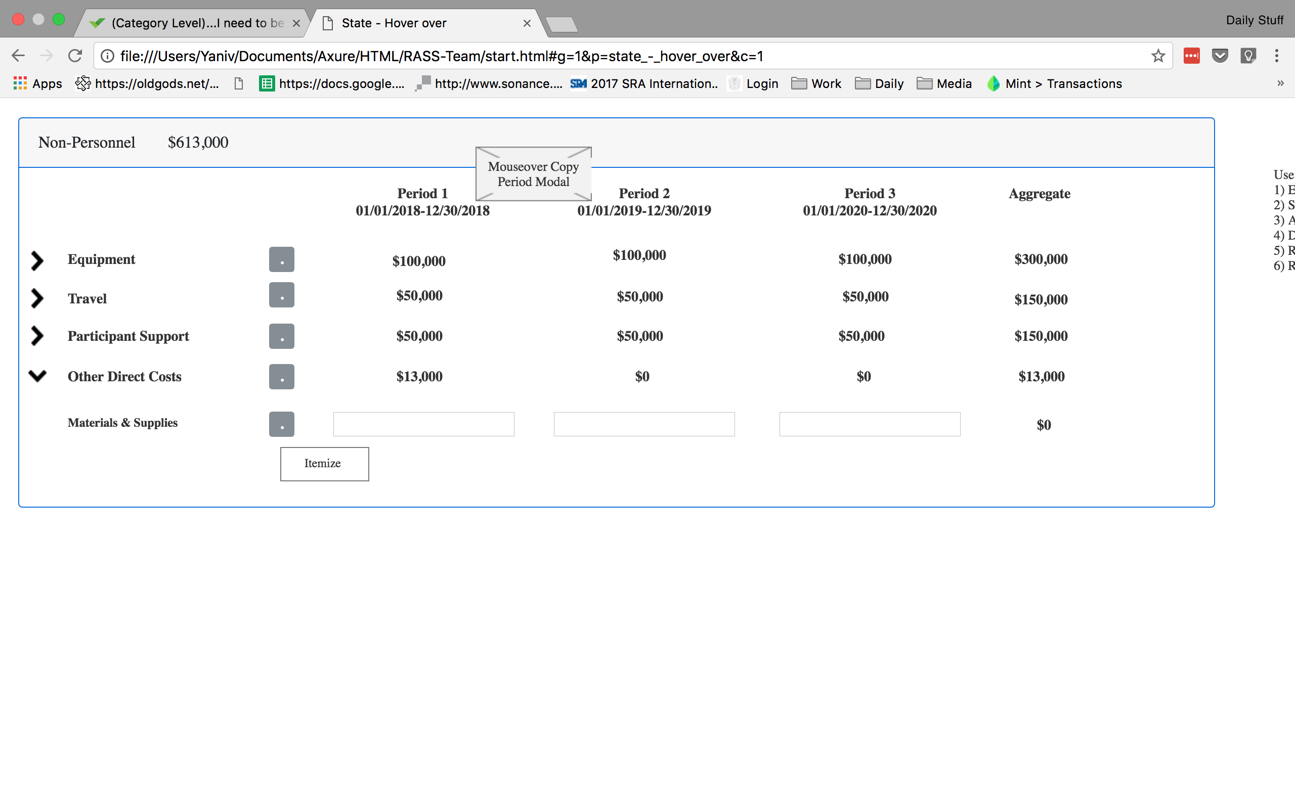

Slide 14
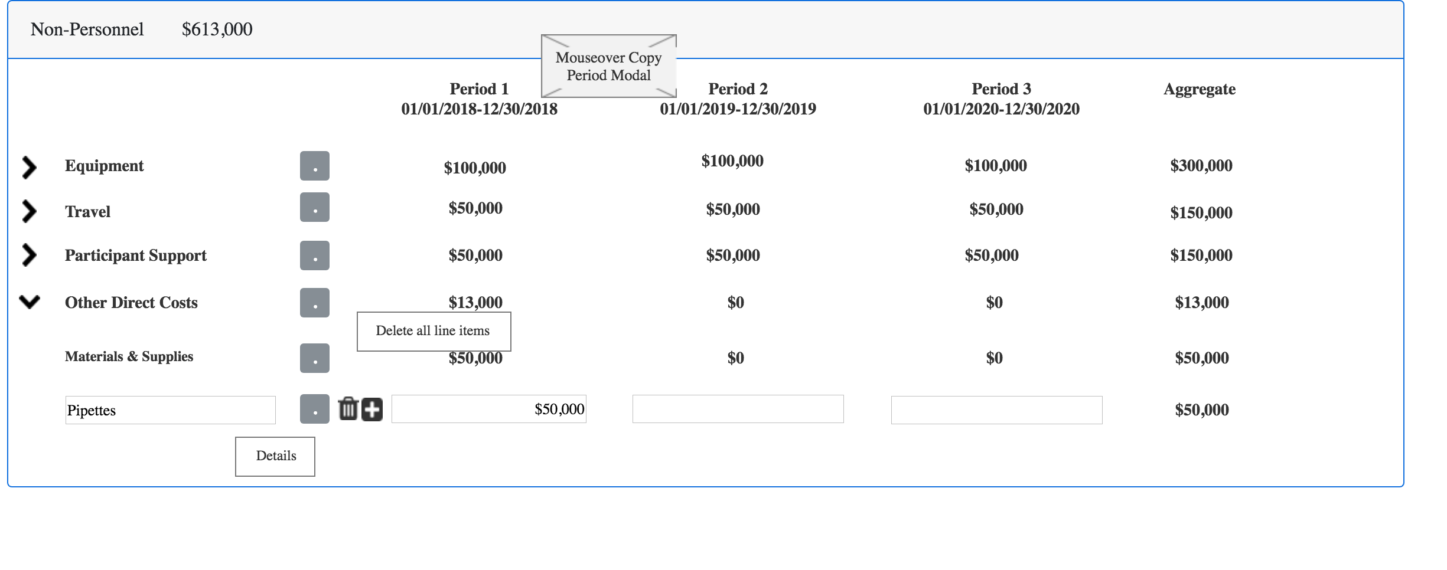

Slide 15
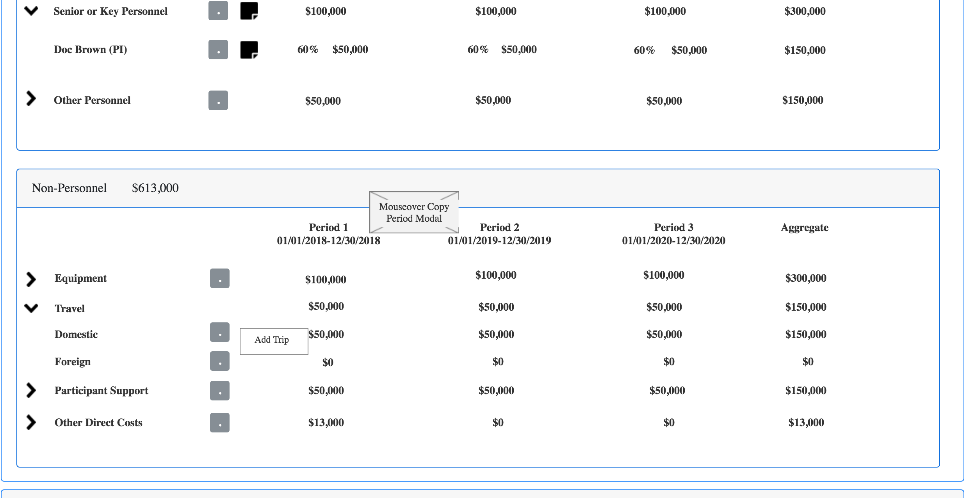

Slide 16
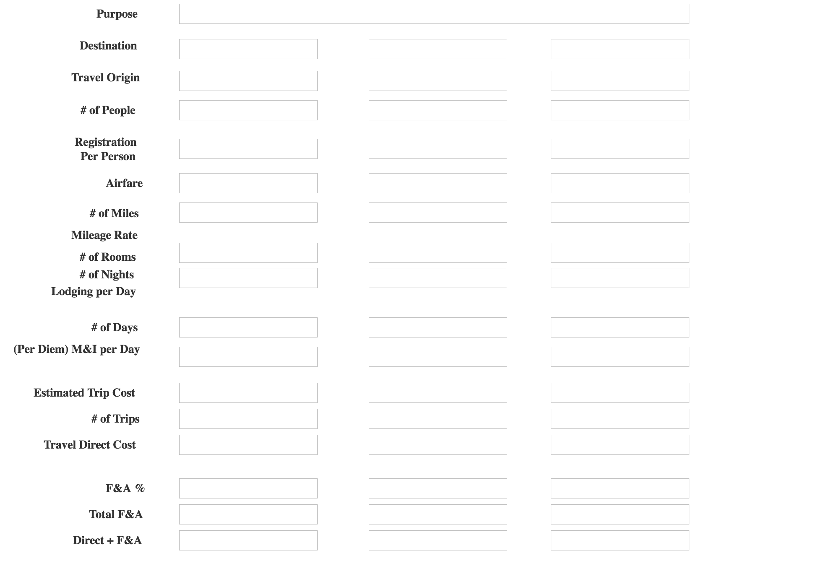

Slide 17
No More PTF’s

