Slide 1
Congress of Student Organizations (CSO)
Fall of 2016
Large Group Meeting

Slide 2
CSO Information
Resource for all organizations on campus
Commission Time: 7:30pm on Wednesdays
Contact email: ndsu.sg.cso@ndsu.edu

Slide 3
Travel Policy
Each time your organization travels…
1) Trip Leader must fill out the Student Travel Notification
On Blackboard (it is under the tab “Travel Authorization”)
Once it is submitted, the Student Activities Office receives it
2) Each student traveling must fill out: “Student Field Trip Informed Consent, Assumption of Risk and Release Form”
On the CSO Blackboard portal directly above the Travel Notification Form
ONLY USE THIS ONLINE FORM

Slide 4
Facility Use Agreement/alcohol Risk Management and Assement
Reserving Space in Union- staff will help your organization through the process
Reserving any other spaces (including outdoors) – organizations need to fill out a Facilities Use Agreement on BB (under the tab “Forms”)
When planning an event off campus with Alcohol, please complete the Alcohol Risk Management and Assessment (ARMA) Form (under the tab “Forms”)
These forms require Adviser signatures. Please contact the Student Activities Staff for more information or assistance.

Slide 5
Listserv & Digital Signage
New Listserv format
Emails will be converted into pdf format
If sending an infographic or image – please include it in the body of the email.
Most attachments have been working, however some have not.
Traditional email format will still work.
Send requests to: ndsusg.techcomm@gmailcom
Tier II & III CSO status:
5 = 5 emails per semester
4 = 4 emails per semester
3 = 3 emails per semester
2, 1, 0 = 1 email per semester for recruitment purposes only
Tier 1 organizations: emails will be sent separately
Guidelines will be updated soon and placed on the website (ndsu.edu/sg)

Slide 6
Listserv & Digital Signage
Digital Signage
Send any signage requests to: ndsu.signage@gmail.com
Guidelines will be updated soon and placed on the website (ndsu.edu/sg)
Seth Bisbee, Executive Commissioner of Technology
seth.bisbee@ndsu.edu
Please contact me with any questions!

Slide 7
Requirements (how to remain in good standing with CSO)
Enrollment on BlackBoard
President, Vice-President, Treasurer, and Adviser
Constitution must be updated every three years
One Large Group per semester (Fall and Spring)
Check mailbox often

Slide 8
Officer Eligibility
Undergraduate students must be enrolled in 9 credits and have successfully completed 9 credits the previous semester
Graduate Students must be full time according to their program
Must have a minimum 2.0 CUM GPA
Be in good conduct standing with the University

Slide 9
Benefits CSO gives Full status Orgs
Ability to reserve Memorial Union Space (rooms, contact tables, cages) Limited to SIX hours per week and one Special Event per semester
Ability to reserve space in Wallman Wellness Center and any other academic building on campus
Student Organization Checking Account
Usage of Student ANNOUNCEment Listserv
Dining Service Grant

Slide 10
Memorial Union Reservations
Temporary Organizations:
1 Hour meeting Reservations
3 Flyers
Full Status Organizations (3+)
6 Hours of Meeting Reservation
1 Major Event per Semester
3 Flyers
Only officers allowed to make reservation
Probationary Status (Status 1-2)
Restricted from any facility on campus
Set up a one-on-one meeting with CSO Commission
Any planned on or off campus events will be canceled

Slide 11
Dining Service Grant
Catering Grant
Apply Early/Take advantage
Needs at least 10 days to process with Union Dining Services
Grant is only available M-F 8am-8pm
Your MU reservation must be complete before applying for the grant (reservation number needed to apply)
$6,000 per year
$150 per organization until funds are out

Slide 12
What to do next?
Things you need to do:
Update Officers on Blackboard
Add all new members of the organization to your Blackboard
Update Constitution (make it available on Blackboard)
*Failure to do this will result in at least one Status Reduction
*Due date: October 1st

Slide 14
What does the Volunteer Network do?
The Volunteer Network is a resource that connects NDSU students to volunteer opportunities in the community.
We put on various events throughout the year.
We log and track Bison Service Challenge hours.

Slide 15
Our website
https://www.ndsu.edu/

Slide 16
Intake Forms
Paper form and online.
Unsure of what opportunities are out there, we can narrow it down for you
Tailor your interests towards opportunities that will work for you
Fill it out, hand it in, wait for email.
Email arrives, see volunteer opportunities, engage on opportunities.

Slide 17
Serve with the Herd
Occurs once a month. Our first one is happening on Wednesday September 21th, 12:00 p.m. – 2:00 p.m.
Volunteer with: The Red River Zoo, Dakota Boys and Girls Thrift, and Rosewood on Broadway

Slide 18
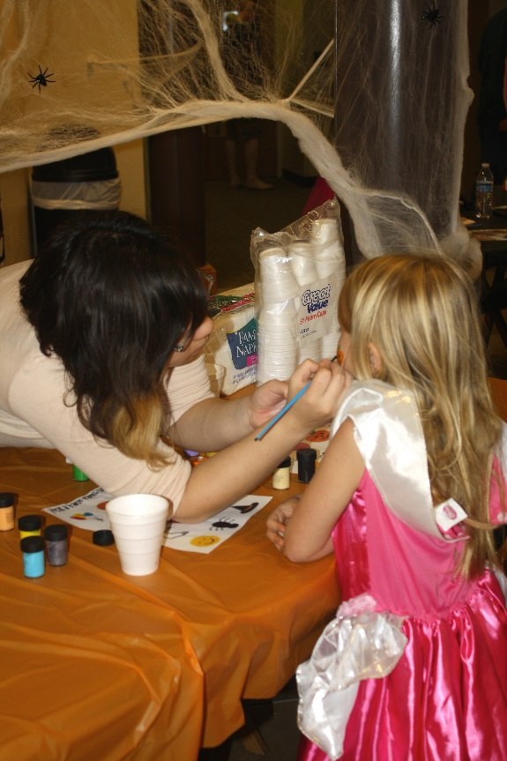
Boo! at NDSU
October 27th
Mathew LLC East & West
This event is to let kids trick or treat early in a safe and friendly environment.
Student organizations volunteer to run various booths with fun Halloween themed games, crafts, and activities.
Email the Volunteer Network if your organization would like a booth.

Slide 19
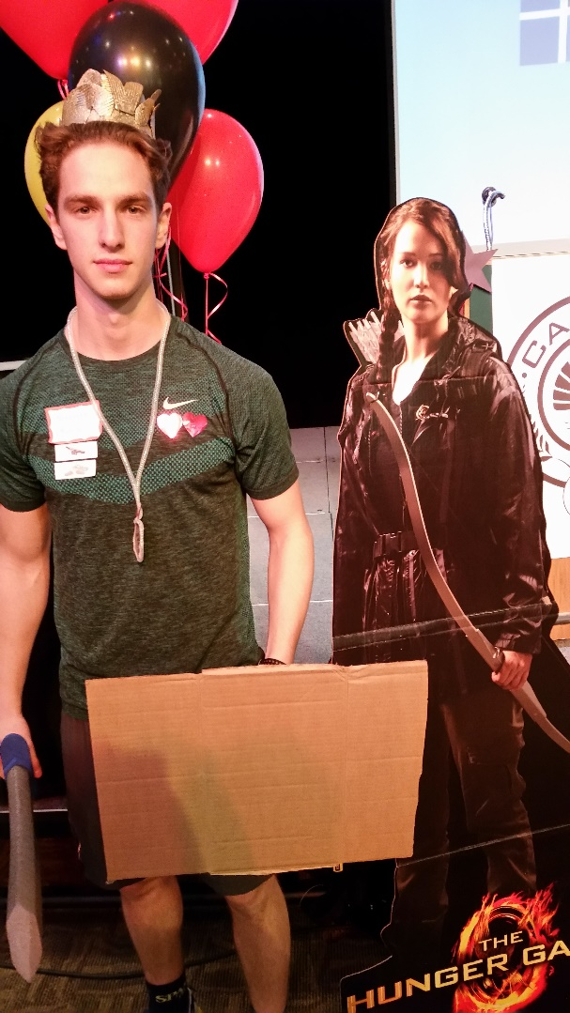
Hungry Games
November 20th
Organizations volunteer “tributes” who compete against each other to become the “victor”
Collect the non-perishable food items to benefit tribute
Food donated to Fill the Dome

Slide 20
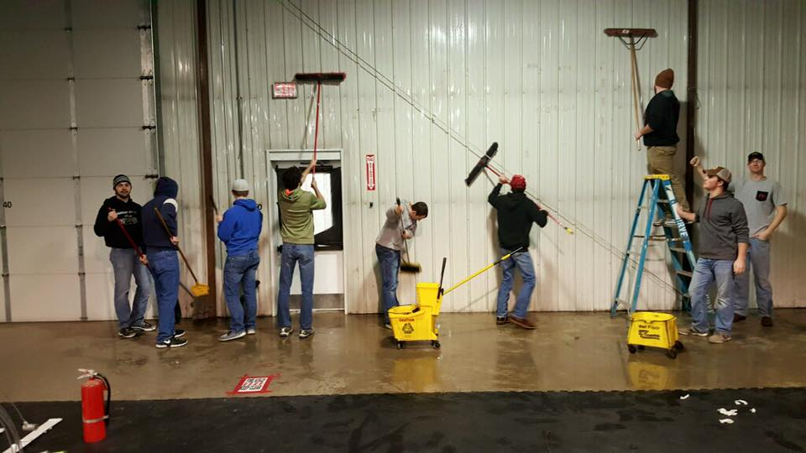
Martin Luther King Jr. Day of Service
When: MLK Day January 16
Students sign up ahead of time then on the day of they are sent out to different nonprofits in the community.
Smaller scale of the Big Event

Slide 21
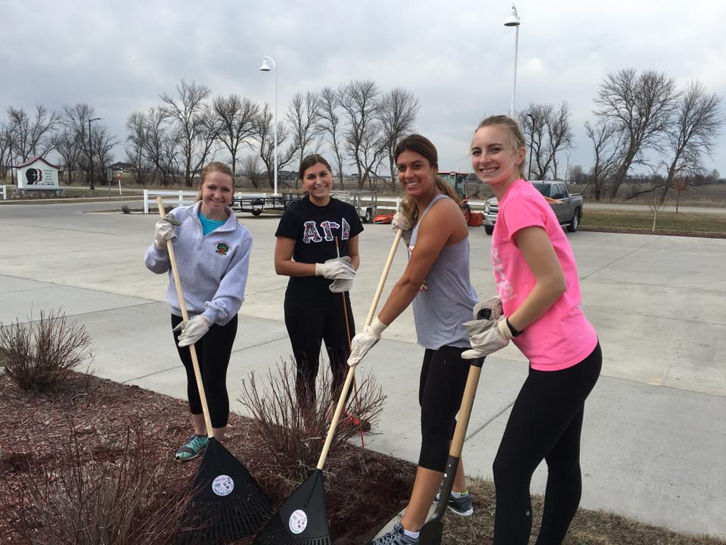
The Big Event
The largest event the Volunteer Network organizes.
When: Thursday April 20th
Students sign up ahead of time then on the day of they are sent out to different nonprofits in the community.

Slide 22
Bison Service Challenge
End of academic year, category winners will receive recognition.
Student organizations will be again split into service organizations and nonservice organizations.

Slide 23
Listserv Email
Each week on Wednesday an email is sent out with volunteer opportunities.
Some are single day events, others are new ongoing things.

Slide 24
Facebook
Make sure to like us on Facebook!
A good source of information of various events and opportunities that are going on.

Slide 25
Student Government Finance
Mason Wenzel – Landon Holmquist

Slide 26
Tier II and III Organizations
Tier II
Must be recognized by CSO
Must allow any student to be involved
Must be in good CSO standing to receive a budget
SAF dollars allocated based on recommendations from the Finance Commission
Budgets can be found on Blackboard
Tier III
Must be recognized by CSO
Have restrictions on who may be involved
E.g. Greek Life, honor societies
Only eligible for SP’s & RR’s

Slide 27
Non-Competitive Org Budget
Standard operating expenses
One non-competitive conference for six people
Travel
Lodging
Registration
Additional requests

Slide 28
Competitive Budget
Standard operating expenses
Equipment
Funding for the five least expensive away games and five home games
Travel for away games
Lodging for away games
Registration for both home and away
Funding for a team and a half
One level of dues
Practices

Slide 29
Getting Funding
Fill out the Contigency Request form found on the Finance webpage (www.ndsu.edu/sg/finance)
Fill out all of the relevant information and then email it to the Finance Email (ndsu.sg.finance@ndsu.edu)
Landon will set up a meeting for you to meet with the Finance Commission and it will then be sent to Senate to be approved.

Slide 30
MEP Fund
New Fund that has replaced Special Projects.
Must be submitted a minimum of 3 weeks prior to the event.
You will now need to discuss the following areas to receive parts of your funding.
1. If it is free and affordable to all NDSU students.
2. How it is being effectively marketed to the student body.
3. How it is conveniently located to students
4. How it is an educational experience for students attending.

Slide 31
Printing Cards
#1. Make sure you have submitted a budget
#2. Fill out the Printing Card form
on CSO page of SG website
#3. You will receive an email notifying you that your card is ready to be picked up from Student Government office.
Notes:
alice

Slide 32
Items not funded
Food or drink
Equipment that will not remain with group
Prizes, t-shirts, and other giveaways.
Others can be found in Finance Code

Slide 33
Reimbursement Request
Be sure to attach all receipts!
Be sure to sign the reimbursement form
Our official means of communication is E-MAIL
ndsu.sg.finance@ndsu.edu

Slide 34
Direct Deposit
All organizations are required to have direct deposit set up if they are to receive funding from Finance.
If you already have direct deposit set up, you have nothing to worry about.
If you do not have direct deposit set up….
Fill out the form found on the Finance page of the SG website.
Submit the form to Finance to be finalized.

Slide 35
List of the Club Sports
Bison Dance Team
Club Baseball
Club Tennis Team
Cricket Club
Cycling Club
Hockey Club (Men’s and Women’s)
Horseman’s Club (Equine Club)
Intercollegiate Bowling Team
Lacrosse Club (Men’s and Women’s)
Marksmanship Club
NDSU Fencing Club
NDSU Men’s Nordic Skiing Club
NDSU Swim Club
NDSU Women’s Nordic Skiing Club
Paintball Club
Racquetball Club
Rock Climbing Club
Rodeo Club
Rugby Club (Men’s and Women’s)
Soccer Club
Softball Club
Ultimate Frisbee
Volleyball Club (Men’s and Women’s
Freestyle Ski and Snowboard Club

