Slide 1
Building a Collaborative Network: Developing a Community of Practice for Veteran & Military Services
Monteigne S. Long

Slide 2
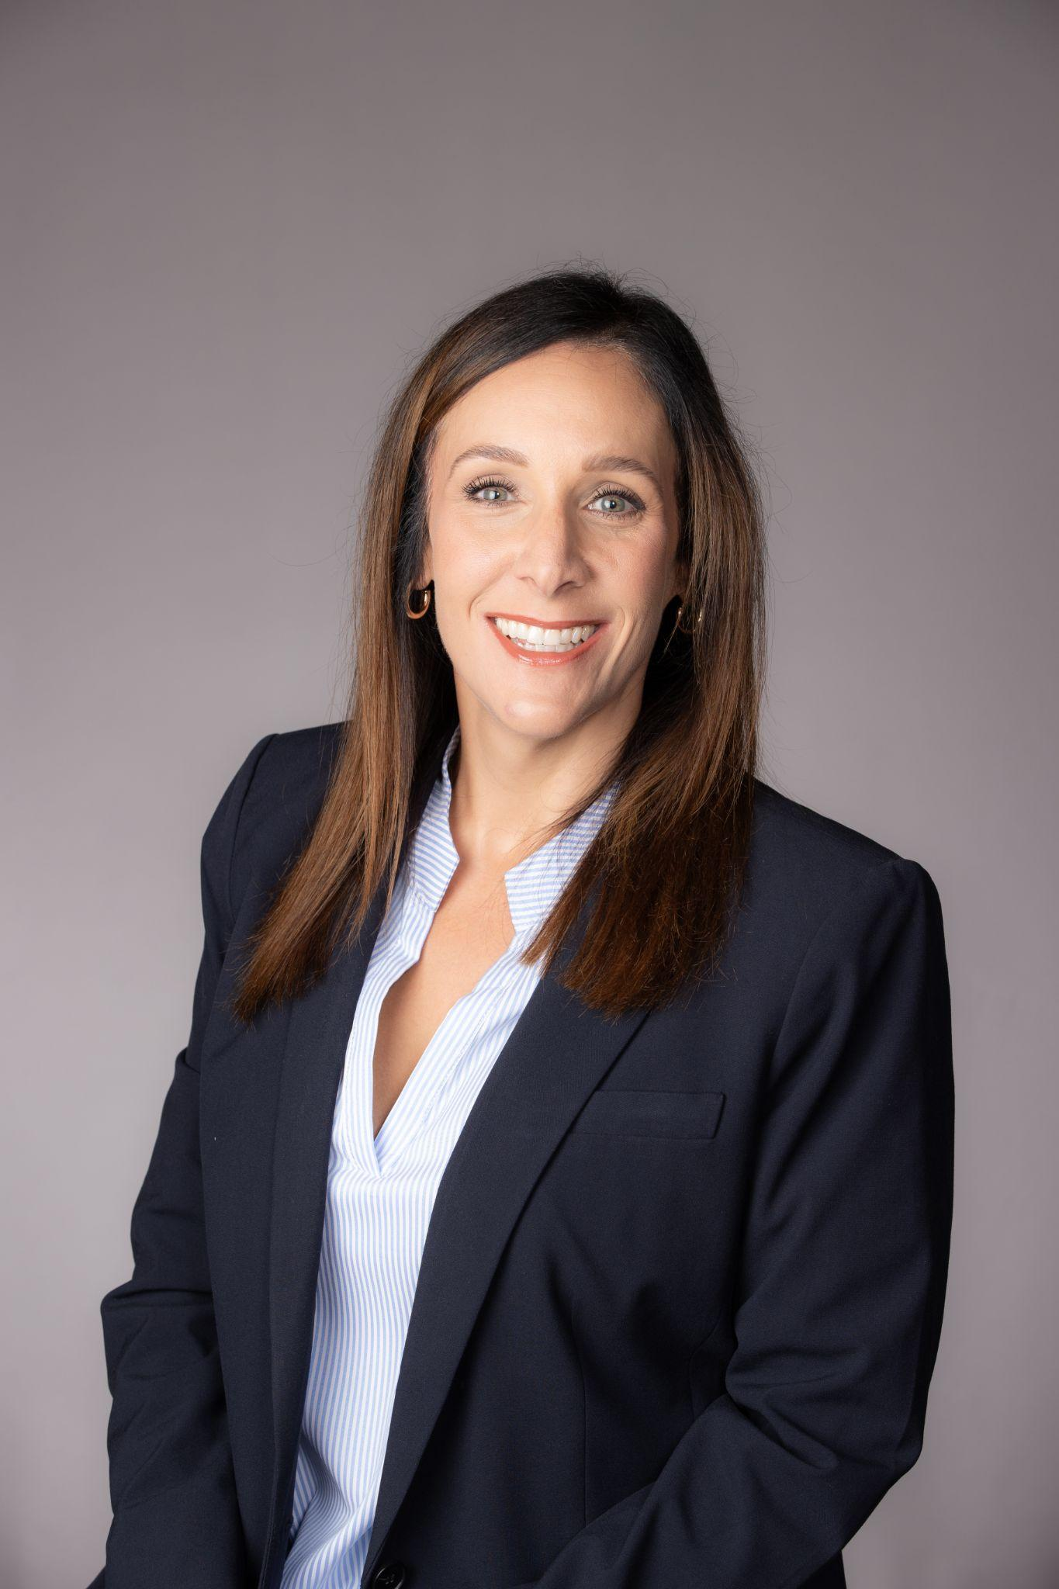
Monteigne Long
Director, Veteran & Military Services, The Texas A&M University System
Higher education/Student affairs professional for 14+ years
Doctoral candidate in Higher Education Administration

Slide 3
Agenda
Introduction
Conceptual Framework
Case Study
Steps to Establish a CoP
Sustaining a Thriving CoP
Tools and Takeaways
Q&A

Slide 4
Goals & Objectives
Learn key steps, structure, and strategies for success.
Discover how CoPs foster ongoing growth, collaboration, and support.
Explore their benefits for veteran services and improved resource-sharing.
Gain practical insights on stakeholder recruitment, goal-setting, and sustainability.
Learn methods to keep members active, share resources, and adapt to evolving needs.

Slide 5
Why Communities of Practice (CoPs)?
Groups of people who share a concern or passion for something they do and learn how to do it better as they interact regularly (Wenger, 2011).
Key Components:
  Domain - Identity defined by a shared domain of interest
  Community - Joint activities and discussions, sharing information
  Practice - Developing a shared repertoire of resources
Wenger, E. (2011). Communities of practice: A brief introduction.

Slide 6
Why Communities of Practice (CoPs)?
Relevance to veteran services
  Shared identity of serving military-connected students.
  Activities and discussions where we learn from one another.
  We are practitioners! We share resources to address best practices.
Benefits
  Collaboration
  Resource-sharing
  Innovation
  Problem solving

Slide 7
The Theory Behind CoPs
Social learning systems
  Learning is an interplay between social competence and personal experience.
CoPs are the basic building blocks of social learning systems.
  Joint enterprise - what it is about
  Mutual engagement - how it functions
  Shared repertoire - what it has produced
Wenger, E. (1999). Communities of practice: Learning, meaning, and identity. Cambridge University Press.

Slide 8
Case Study: A Statewide Network of Veteran Services Directors

Slide 9
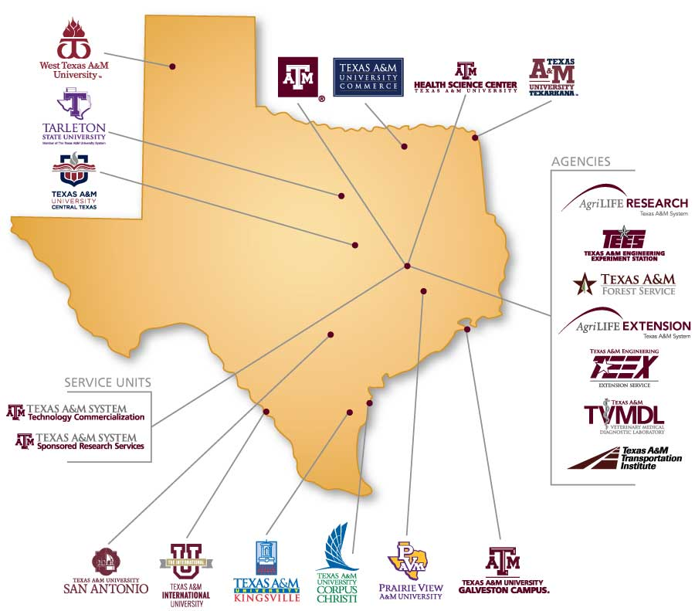

Slide 10
Building the TAMUS CoP
2018 - Started as virtual meetings
  Met bi-annually for “housekeeping” and touch-base meetings
2021 - Started meeting a few more times per year
  Meetings centered around pertinent topics:
    Education benefits
    Enrollment management
    Best practices
    Fundraising and Development
    Career readiness
2023 - Formalized the Veteran & Military Services Working Group
2024 - Transitioned to a Community of Practice
Notes:
Key outcomes
Success stories?
Challenges faced/strategies to overcome them
Best practices to foster collaboration and innovation

Slide 11
Key Outcomes of TAMUS CoP
Enhancing communication
Promoting collaboration
Identifying shared challenges
Sharing best practices
Expanding professional development
Building a strong network
Driving innovation
Creating a community of support
Notes:
Success stories?
Challenges faced/strategies to overcome them
Best practices to foster collaboration and innovation

Slide 12
Success Stories
Career Readiness
Institutional Effectiveness
Notes:
Challenges faced/strategies to overcome them
Best practices to foster collaboration and innovation

Slide 13
Challenges
Maintaining regular engagement- meeting cadence
Scheduling across multiple campuses
Keeping topics relevant
Sustaining member interest
Balancing workloads
Ensuring equitable participation
Managing diverse needs
Notes:
Best practices to foster collaboration and innovation

Slide 14
Best Practices
Encourage cross-campus representation
Establish clear goals
Focus on actionable outcomes
Promote resource sharing
Foster networking opportunities
Continuously seek feedback

Slide 15
A Step-by-Step Guide
Recruit stakeholders
Define the purpose and shared goals
Determine the structure
  Leadership
  Communication
  Decision-making
Select tools for collaboration
Plan for resource sharing
Evaluate and adapt
Sustain engagement
Communicate impact

Slide 16
Sustainability
Engagement strategies
  Regular meetings, events, and resource-sharing platforms
  Provide ongoing professional development opportunities
Celebrating milestones and recognizing contributions
Highlighting other successful CoPs
  NASPA VKC
  Big 10
  Others in TAMUS
    Enrollment Management
    Academic Advising Leaders
    Recovery of Stopped-Out Students

Slide 17
Key Takeaways
Communities of Practice drive collaboration
Engaging stakeholders is key
Sustainability requires tools and strategies
Continuous improvement ensures relevance

Slide 18
Questions?

Slide 19
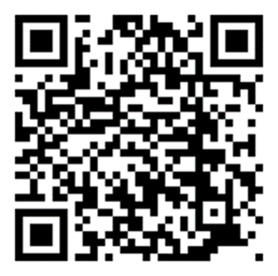
Thank you!
Monteigne Long
mlong@tamus.edu
Connect with me on LinkedIn!

