Slide 1

11.5 Ways to Adapt your Support Services to Better Operate Remotely Bob Mayer, Mount Wachusett Community College
February 24-26, 2021 | Virtual

Slide 2
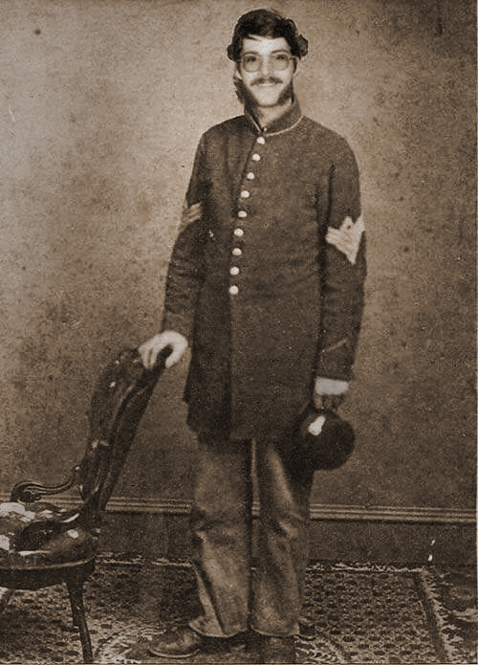
Introduction
Bob Mayer
Director of Veterans Services, MWCC
21 years in higher education
7 years of veterans services oversight, 11 working with student veterans
US Army/Army National Guard Veteran

Slide 3

Learning Objectives
Discover some new ways (and rediscover some old ones) to engage, inform and protect your veteran students.
Change your tactics, not necessarily your methods, when communicating with students, co-workers and outside providers.
Identify common practices that seem to work regardless of institution.
Contribute your ideas on how you engage veteran students in a remote environment.

Slide 4
Be Accessible
Be available by phone, zoom or email during the hours you would normally be available.
I don’t think 24/7 is a good idea. You are sending wrong message.
Treat emails/phone as walk-ins, answer/look at right away. Prioritize immediately.

Slide 5
Organize, Prioritize
Organize. Organize. Organize. (Write it down!)
Have a prioritized to-do list. I use written list. Longer term items I put as appointments on calendar.
Be prepared to re-prioritize. A new email or phone call may change the relative urgency of your tasks.

Slide 6
Continue to Do What You Do
Events, do virtually.
Reach outs. (i.e. Early Warnings)
Include personal e-mail address on reach outs to “missing” students. They’re probably not checking their school email.
Communicate but don’t overwhelm! (when is the latest something can be sent?)

Slide 7
Never Do What You Can Delegate
This is a management guideline that I have used for years. Sometimes it saves you time. Sometimes it does not.
When you let the people who are trained to do a job, do it, it saves you time.
When you teach someone, student or co-worker, to do a job they should be doing, it will likely take you more time. In the long run though, it will be better for everyone.
Especially true when you can delegate that job to the student veteran. (What is your job?)

Slide 8
Efficient may not always be Effective
Military communication is efficient, concise and unemotional. That is not what is needed now.
Be professional but be personal. Share a story. Let the person “see” you.
People in general and veteran students in particular are hungry for kindness.
Never respond when you are upset or angry! (Especially when you have every right to be!)

Slide 9
Listen, Listen, Listen
Take your time. Don’t react. Hear/read everything. Read and re-read. Your goal should be accurate and thorough even at the expense of prompt.
Draft replies. Never type a reply and hit send before re-reading message and your reply. Re-read before sending.
Always take the time to add kindness.
Once you have created something that you know you will use again, save it so you can selectively copy and paste later. Just be sure you don’t mix up the names!

Slide 10
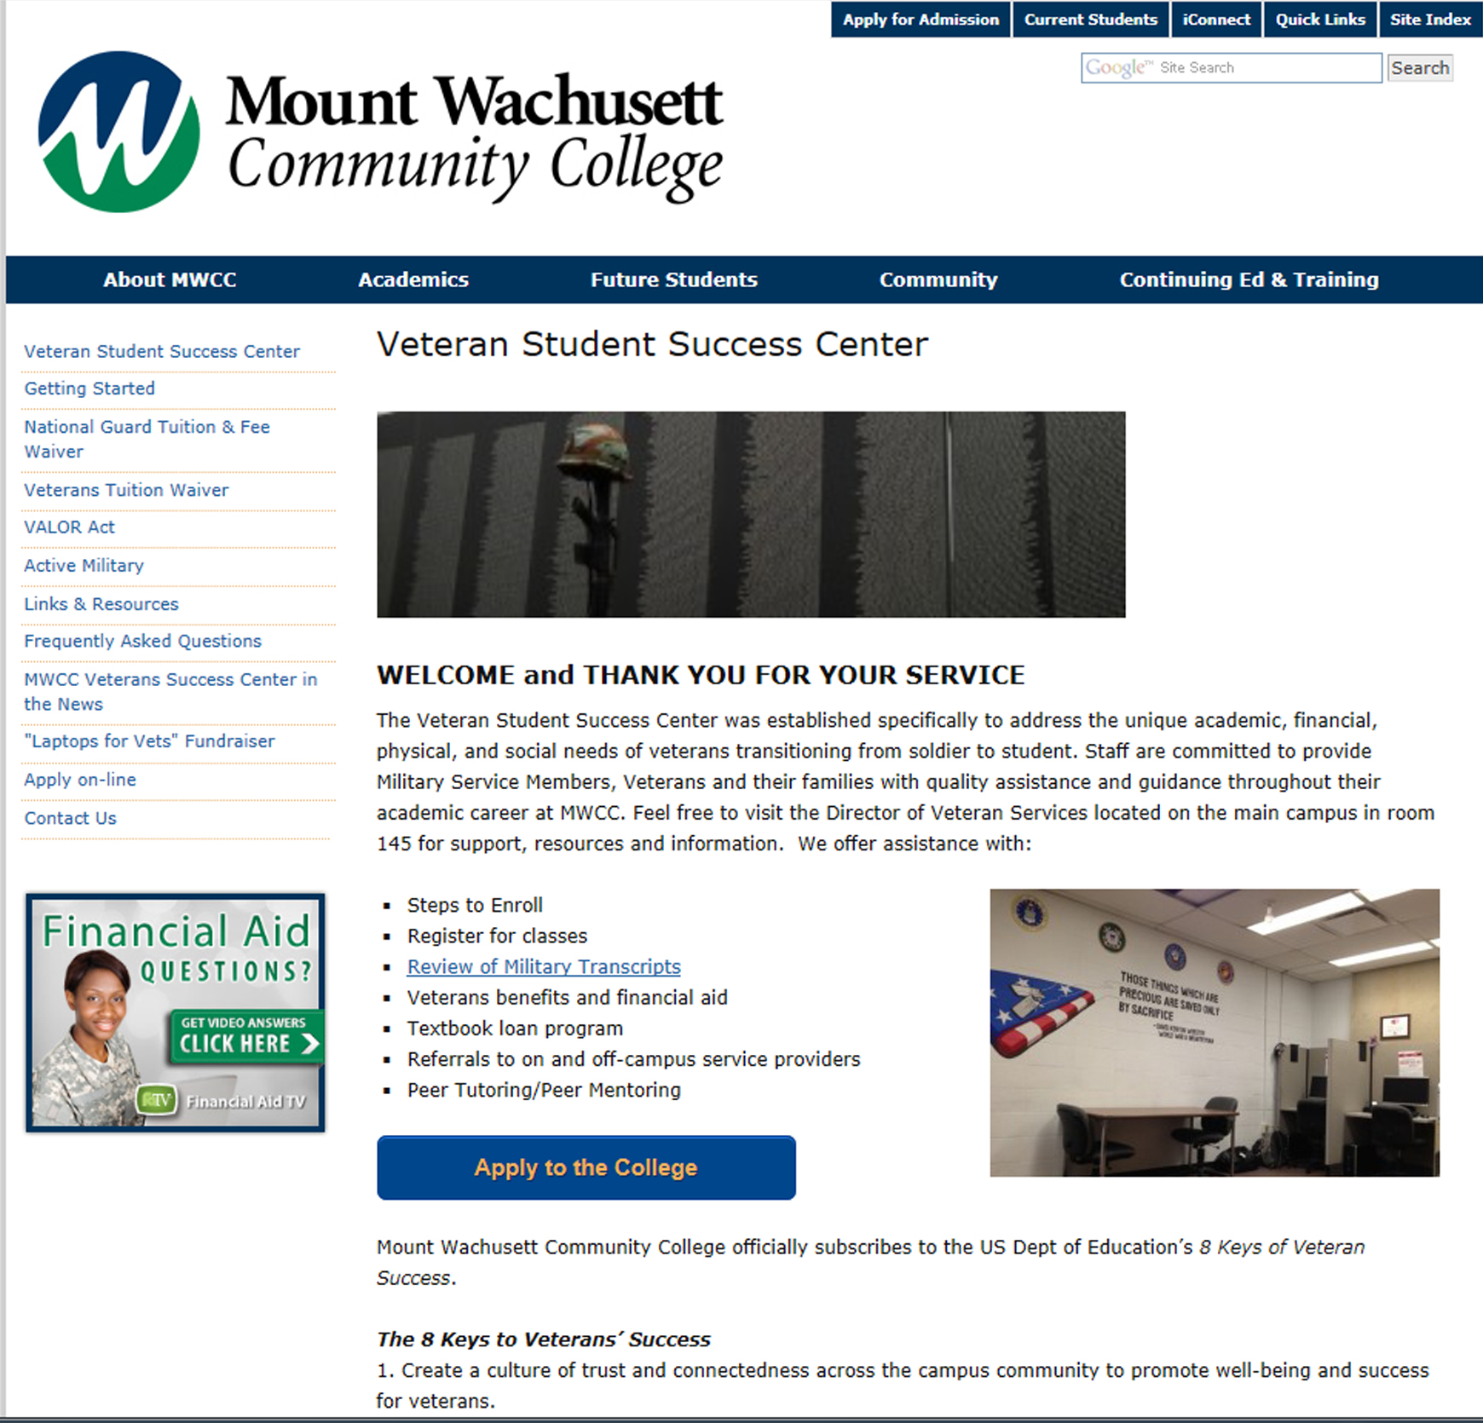
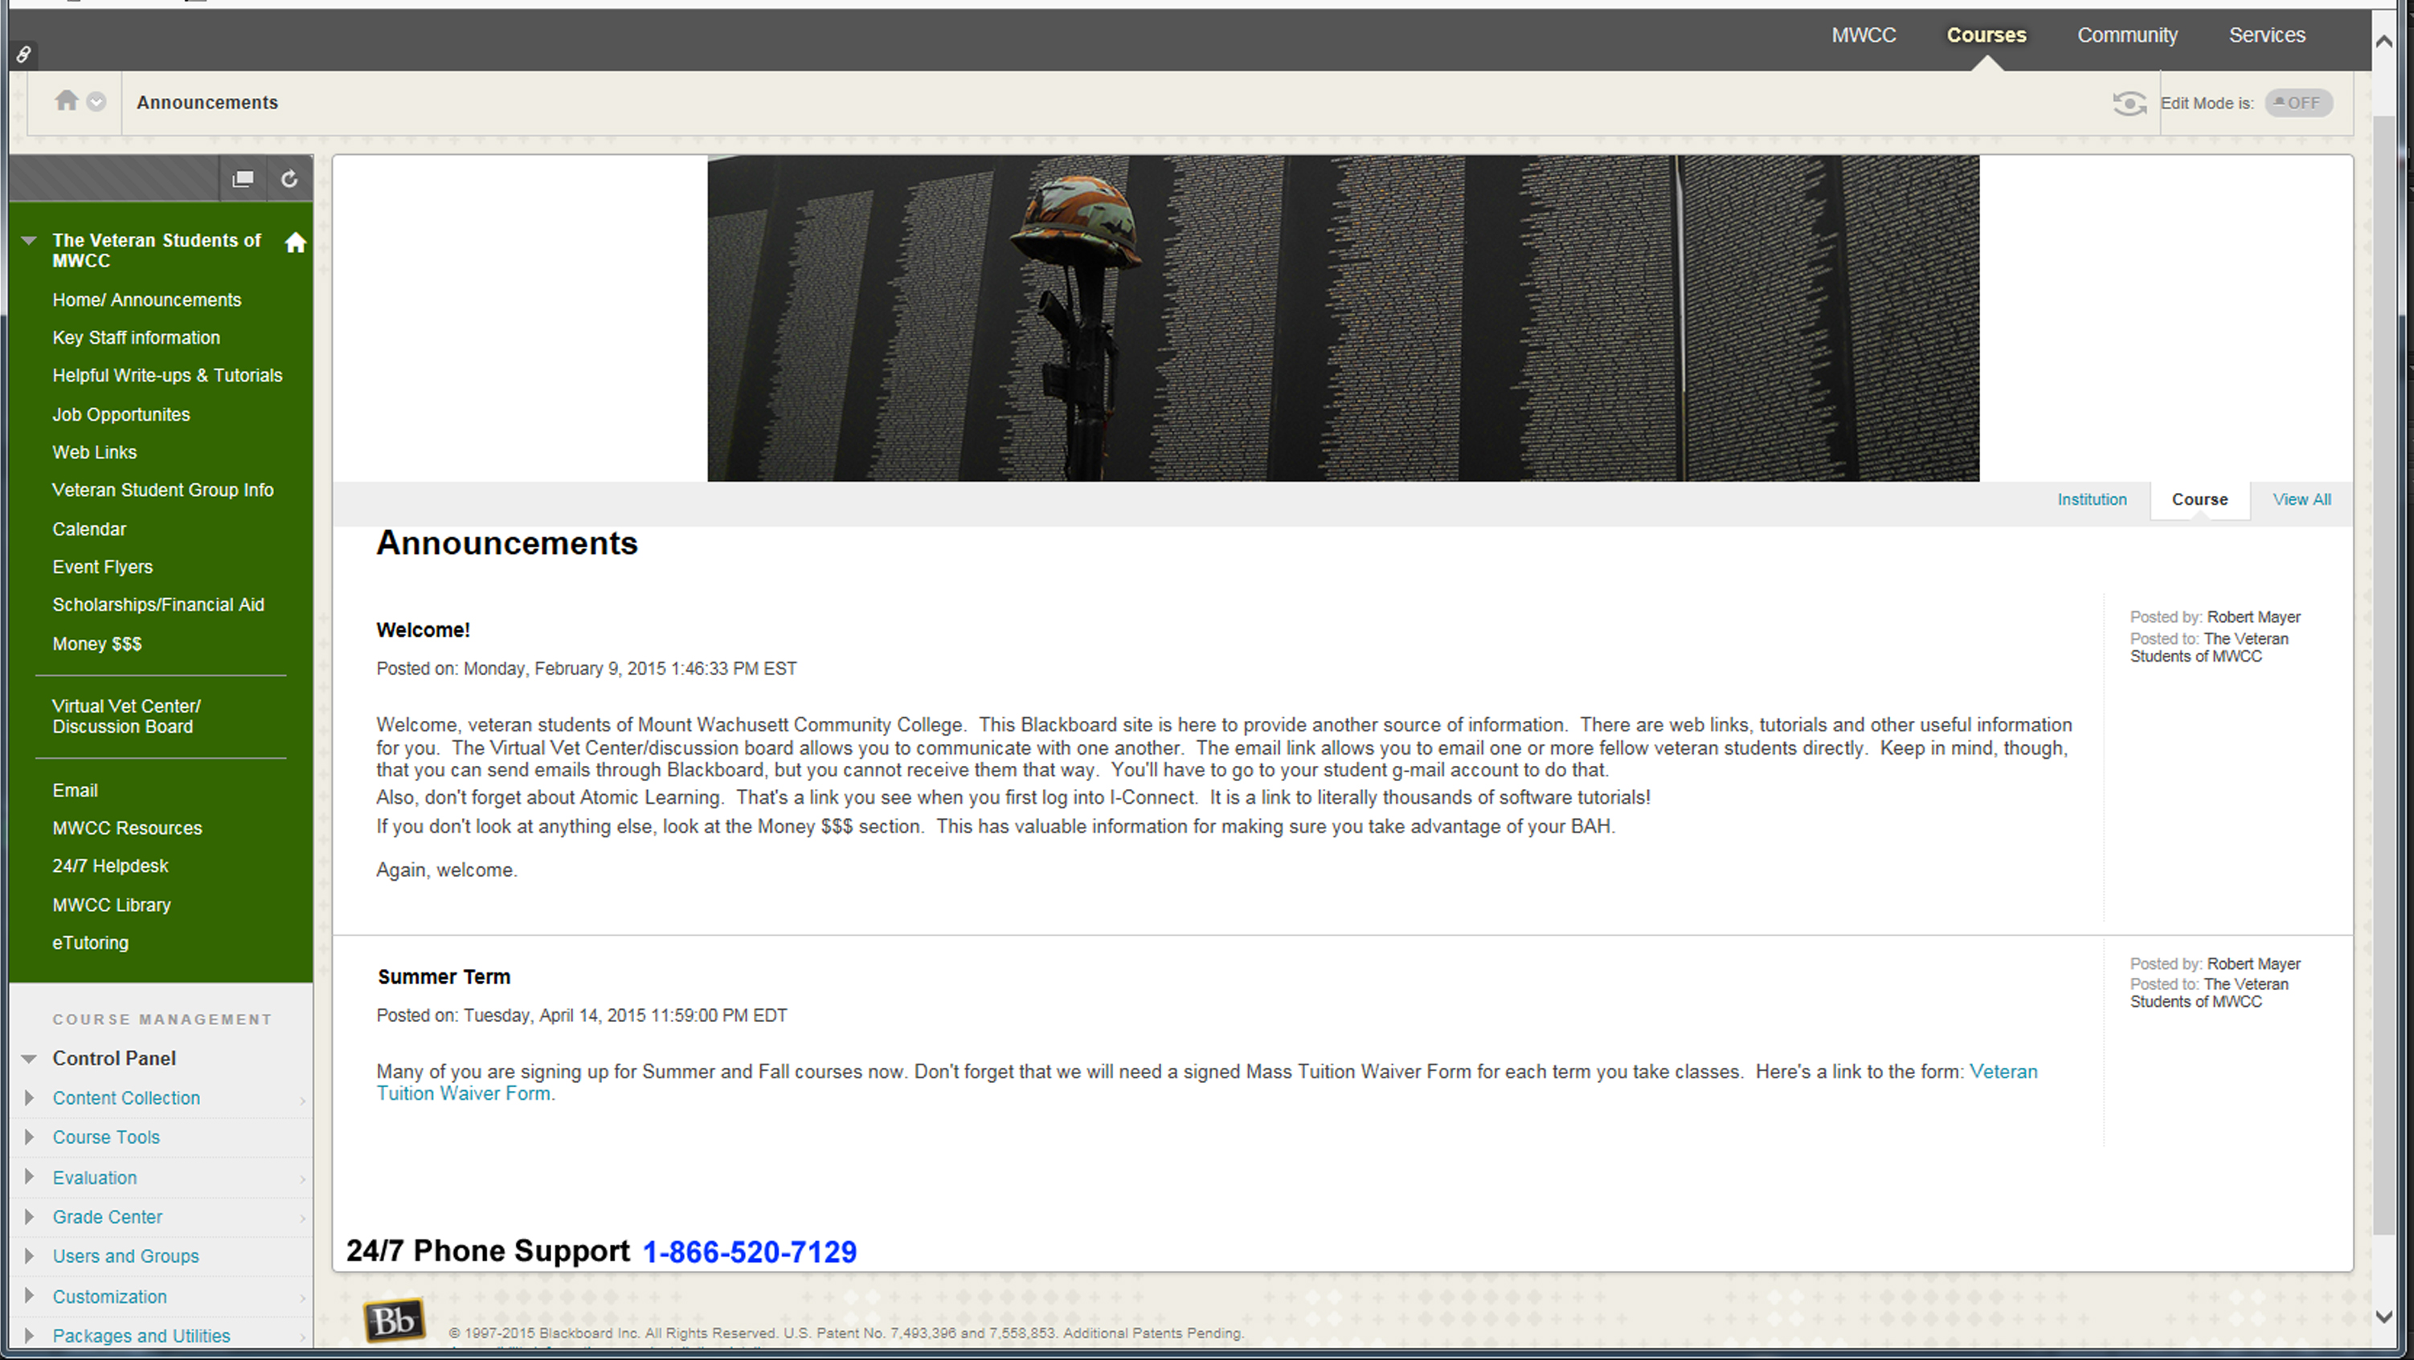
Post Documents That Can be Read
Only computers with Microsoft Office installed can read word or excel documents.
Just about anything can read a PDF.

Slide 11
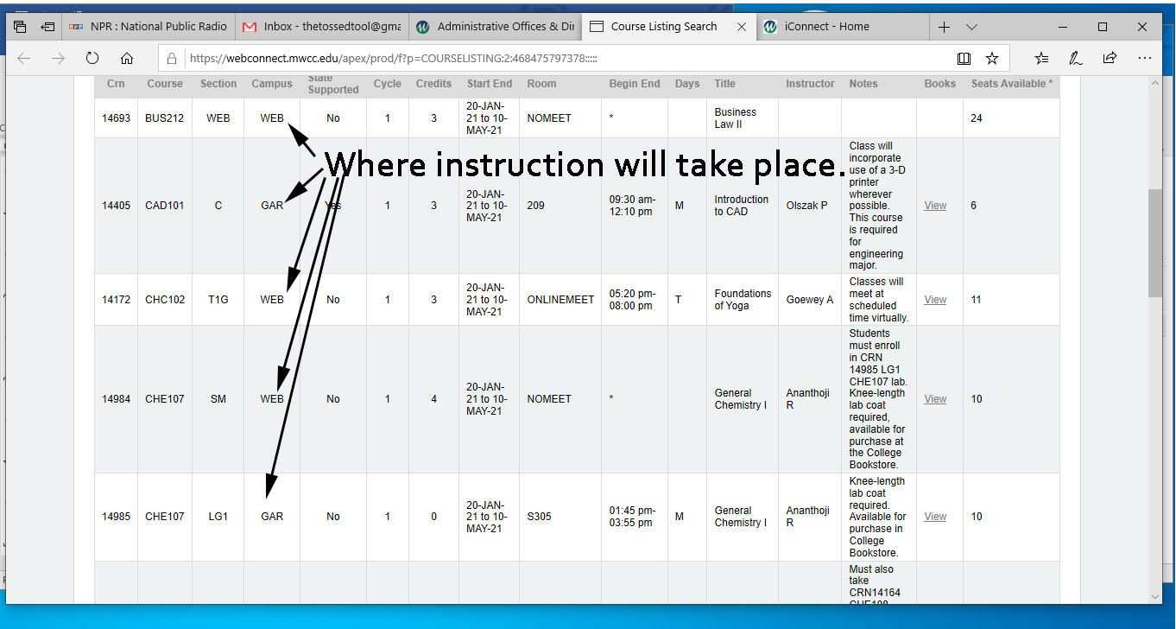
Be Visual! Use Photos/Graphics!
Be visual.
Your instructions should include photos, diagrams.
Any way to make it easier for the student to see what you mean.

Slide 12
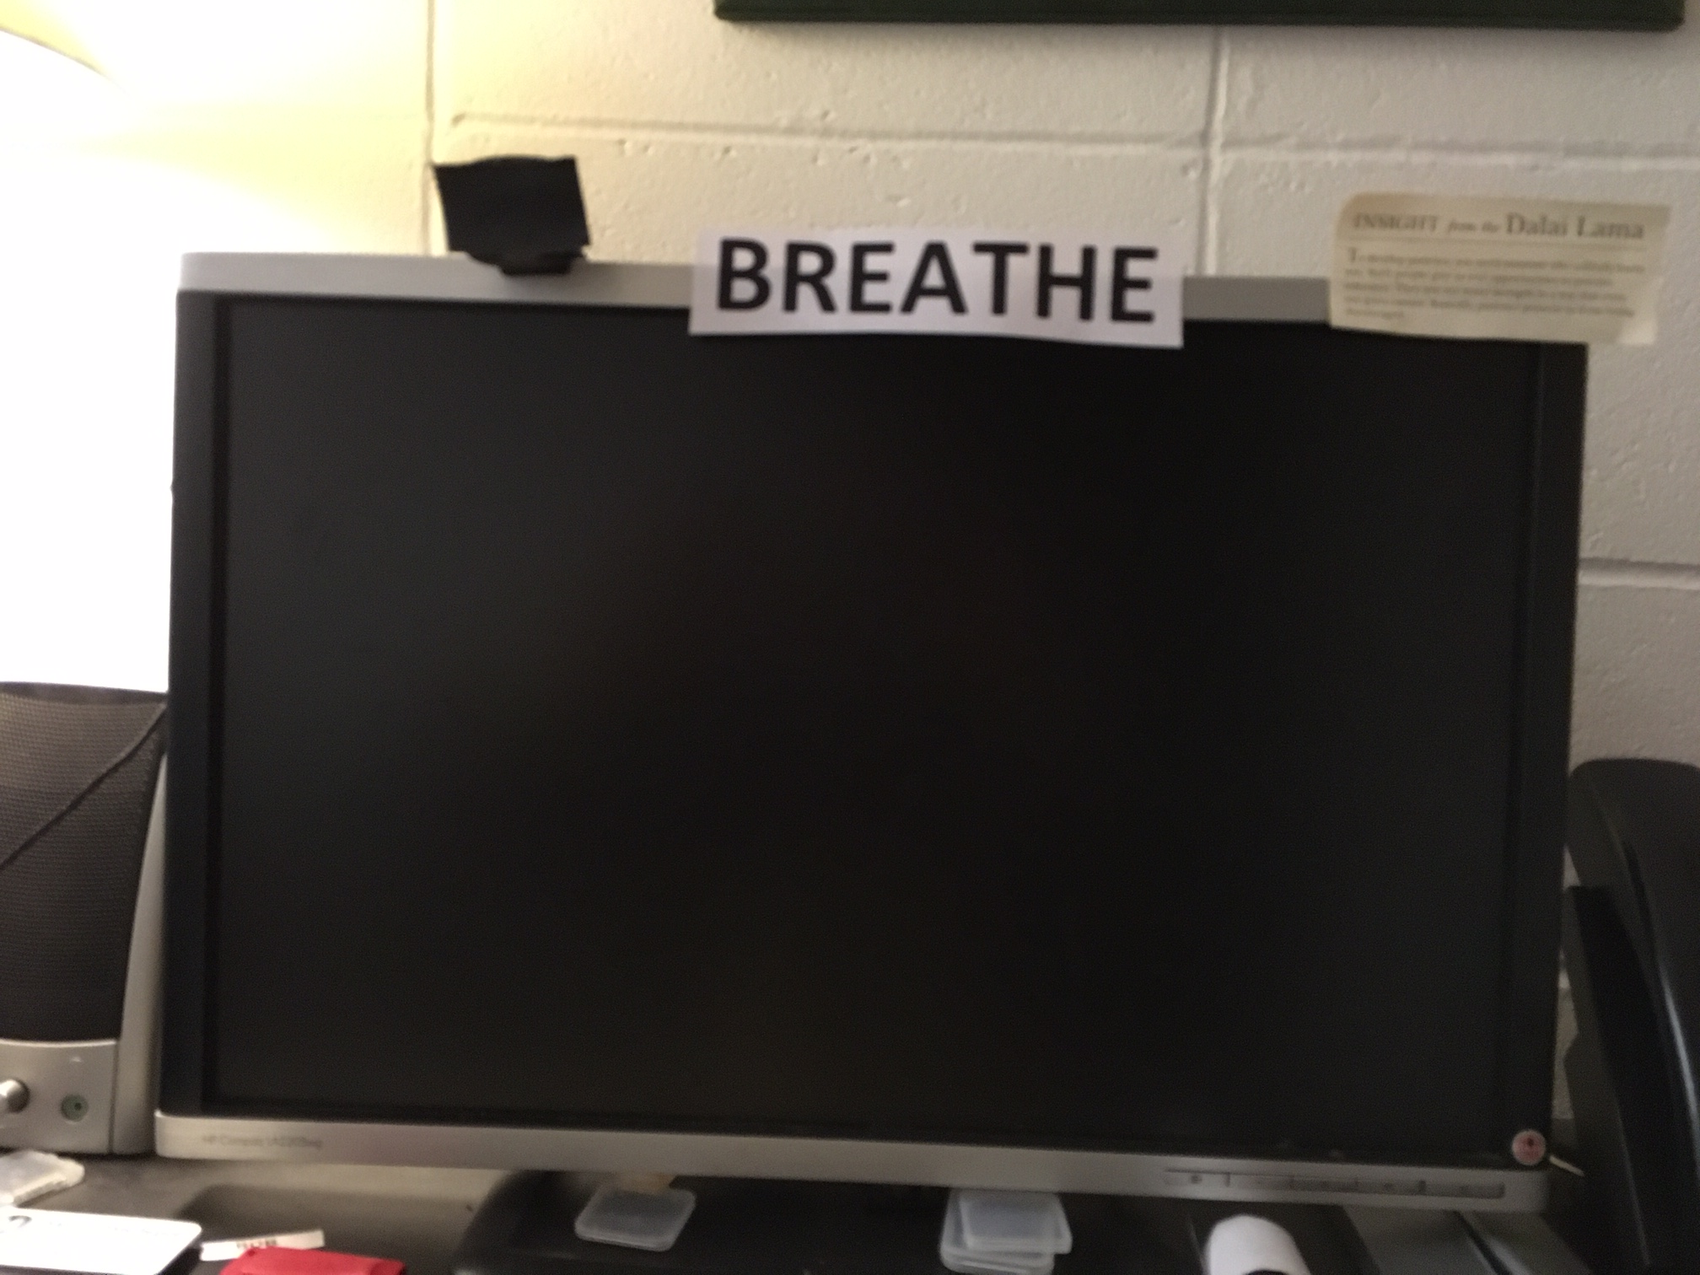
Use available resources to mimic successful programs
Take Care of Yourself
This was a really hard job before COVID. It’s even harder now.
Meditation (VA 5 minute grounding) https://www.youtube.com/watch?v=q4oqk5spCXY
Walks
Sunshine
Rick Hanson, Tara Brach

Slide 13
Use available resources to mimic successful programs
Take Care of Yourself
Your virtual schedule is not necessarily my virtual schedule. I am not and should not be available 24/7. Just because you are in your new place of employment all the time does not mean you that should be working all the time. It is an easy trap to fall into.
Close the laptop and shut it down. Don’t peek at your business emails on the phone!
Okay sometimes we all do, but, if you do, go ahead and take care of whatever quick issues you can. Write the other ones on your to-do list so you don’t forget. Then, forget about them!
You have (and should have) a life outside of work. Live it!
Take care of yourself. You will be of greater value to everyone if you do.

Slide 14
Be Patient
Be patient with your veterans. This is mostly new to them. They came from a culture of being told what to do many, many times.
Be patient with your co-workers. They likely aren’t as good at their jobs as you are at yours. There is no sense in getting angry. Try to be helpful and persuasive in assisting that individual to do what you need them to do. You still need their cooperation.
Be patient with yourself. You are really good at what you do, but you cannot and should not do everything. (See Move On.)

Slide 15
Be OK with Moving On
Sometimes there is nothing you can do to help a student. If you did everything you could, accept that and move on.

Slide 16
Work Together!
Mount Wachusett Community College and Middlesex Community College
NE Higher Ed Collaborative
Community partners
Reach out!
rmayer@mwcc.mass.edu

Slide 17

Discussion
What questions do you have?

