Slide 1
Speaking their Language: Translation and Military Support Services in a Virtual Environment
Heather Turner & Taylor Pratt | University of Louisville
February 24-26, 2021 | Virtual

Slide 2
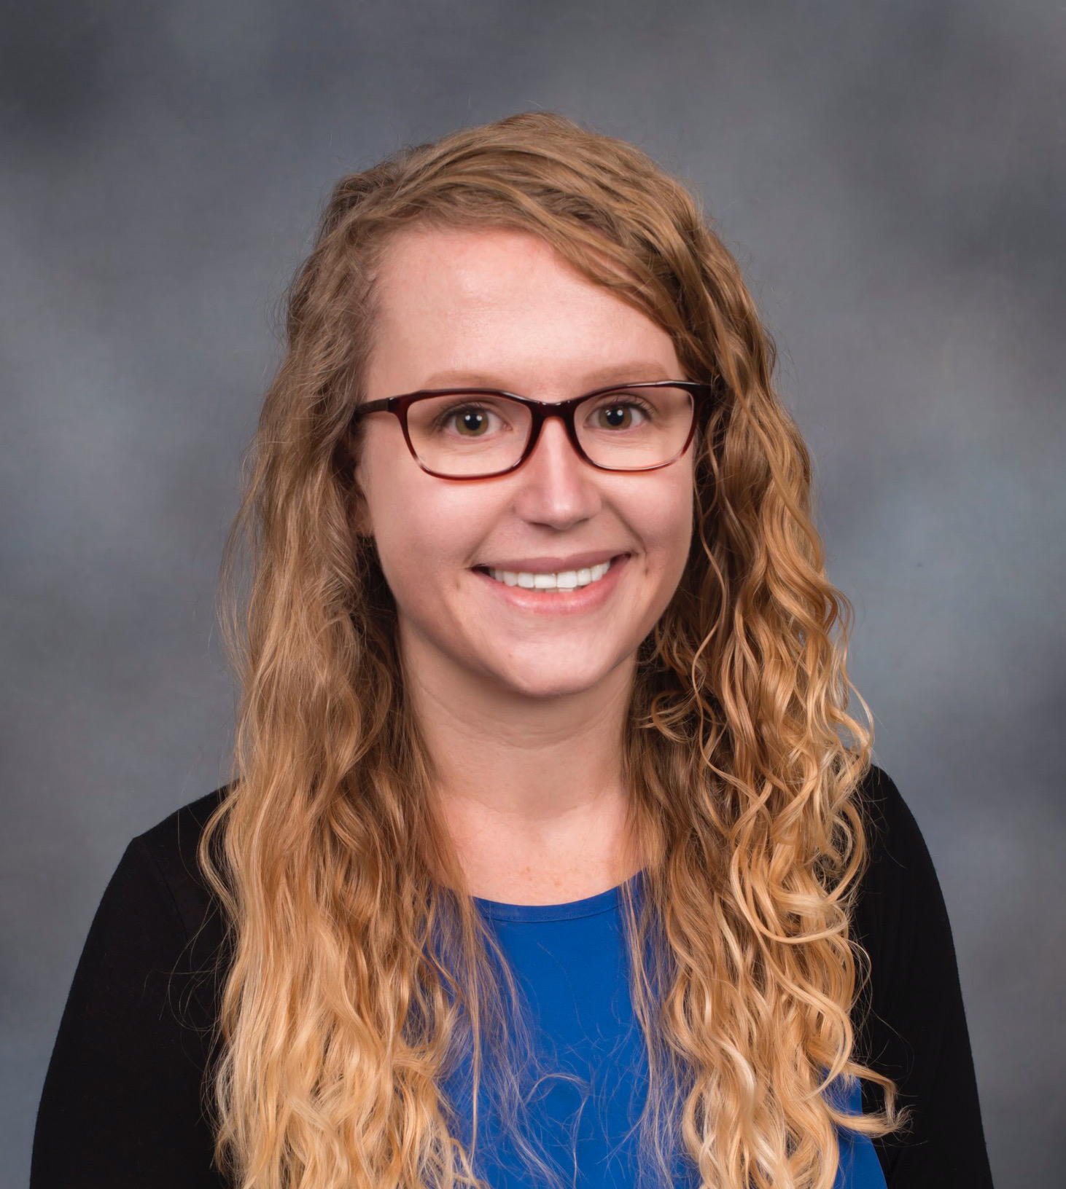
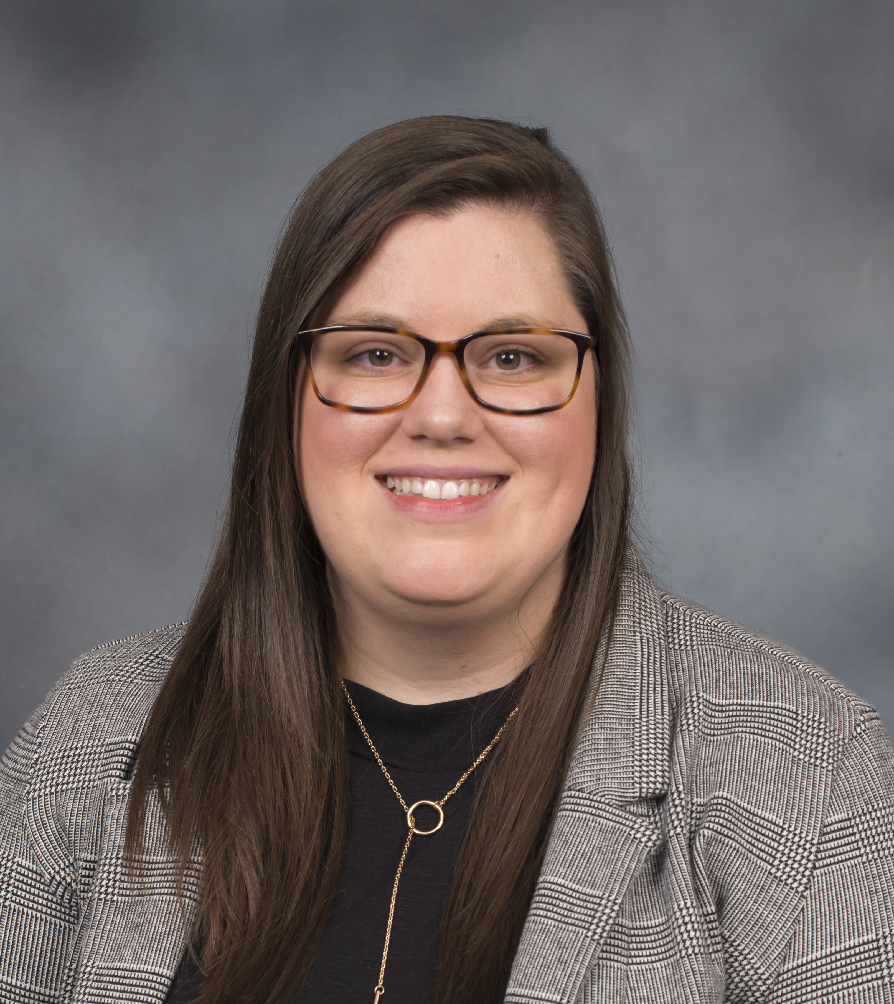
Introductions
Heather Turner, MA
Director of Research and Policy
SKILLS Collaborative
PhD Candidate, Higher Education
University of Louisville
Taylor Pratt, MA
Program Manager
Master Educator Course
PhD Student, Higher Education
University of Louisville

Slide 3
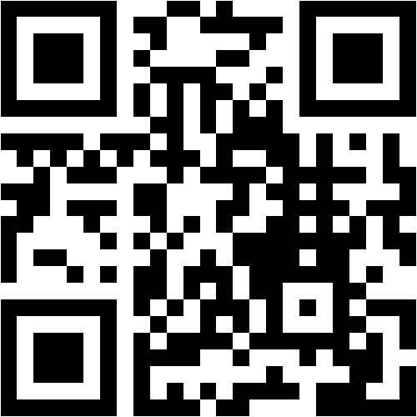
What Are Your Experiences?
Go to https://www.menti.com/1yhitp4x7v
OR
Go to menti.com and enter code: 57 30 81 4
Identify one service that matters most for military students in virtual environments
Explain one higher education concept or process that is often challenging for military students

Slide 4
Master Educator Course
Founded in 2014, the Master Educator Course (MEC) is a collaboration between the University of Louisville's College of Education & Human Development and U.S. Army Cadet Command. MEC delivers accredited courses designed to educate Army ROTC Cadre, as well as other military instructors and trainers, in pedagogy and instructional strategies, learning sciences and facilitation of learning, curriculum development, effects of college on students, and organizational analysis in higher education.

Slide 5
Student Success Center (SSC)
One-on-One Synchronous Writing Appointments
Asynchronous Writing Feedback
In-class Tutoring
Student Affairs Support
Delivered to them and for them in their setting

Slide 6
Student Success Center (SSC)
Student Satisfaction with Academic Support Services
1-5 Scale
5 = Extremely Satisfied
Average SSC Appointments per Student by Most Represented Ranks

Slide 7
Translation and Support Services in a Virtual Environment
Strategy 2: Root Assignments in Practical Applications
Strategy 3: Show Similarities between Genres
Strategy 4: Vary Feedback Formats
Strategy 1: Add Purpose to the Assignments with Scaffolding Language
Strategy 5: Create a “Physical” Space
Strategy 6: Integrate Academics with Student Affairs
Strategy 7: Continuously Assess and Evaluate

Slide 8
Add Purpose to the Assignments with Scaffolding Language
Problem Description and Relevant Background Information
The intent of this paper is to describe a program that addresses a problem you have identified in your ROTC program. Draw from your previous assignments such as your Institutional Profile (Assignment 1), Program Needs Assessment (Assignment 2), and Problem Statement (Assignment 3). Provide readers with relevant background information necessary for understanding the importance, scope, and causes of the problem. Describe the context for the problem including a description of the organization and your assessment of the environment.
Use your understanding and application of your chosen theory (Assignment 4) to frame the issue for your audience with relevant terms and concepts, and to communicate the importance of the problem as well as your proposed solution. Analyze the problem using your chosen theoretical frame, as well as other available information such as your personal knowledge of the problem.
Solution to Problem
This section details the program you are proposing as a solution to the identified problem. It includes short-term and long-term outcomes and indicators, activities, and a timeline and implementation strategy.
The executive summary you prepared (Assignment 5a) and the feedback you received from your presentation (Assignment 5B) will be useful in preparing this section.

Slide 9
Show Similarities (or Dissimilarities) between Genres
Assignment: Program Proposal & Assessment Plan
[additional text omitted for brevity]
Note that an administrative memo is stylistically different from an Army memorandum for record. Be brief and clear in your language, avoid passive voice, and prepare an effective argument.

Slide 10
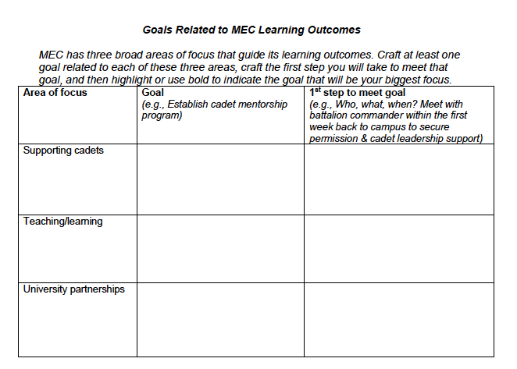
Root Assignments in Practical Applications

Slide 11
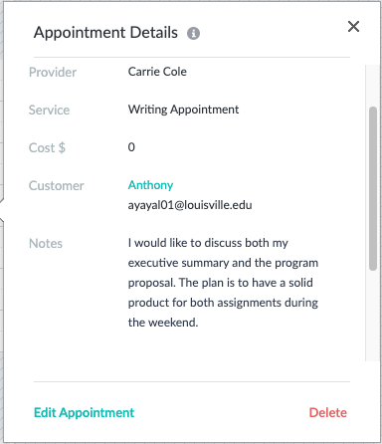
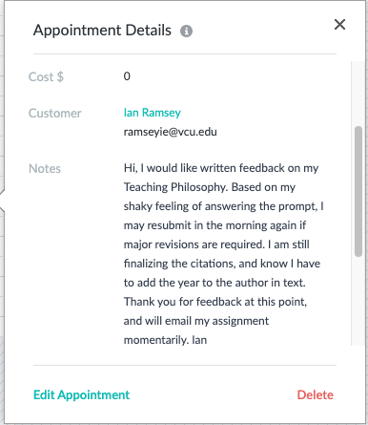
Vary Feedback Formats

Slide 12
Create a “Physical” Space

Slide 13
Integrate Academics with Student Affairs
Facilitated admissions process
Written feedback on personal statement
Access to specially trained and dedicated student success consultants
Dedicated consultant to work with and track the success of students who need additional support
University services brought directly to the students in their environment
Transition support for integration into the general MA program population

Slide 14
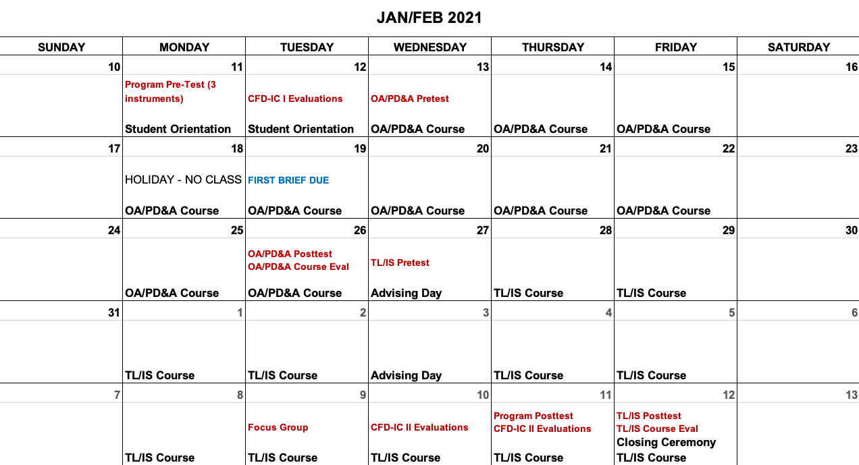
Continuously Assess and Evaluate

Slide 15
Circling Back
Think of the concepts we addressed in the opening activity, and identify one strategy for using military language to help with the challenge
Explain two to three design elements of a successful academic affairs student success center

Slide 16
QUESTIONS AND DISCUSSION

