Slide 1
Veterans Navigating Transition Journeys into Corporate Leadership – Emerging Implications for Higher Education
Will Baas
February 24-26, 2021 | Virtual

Slide 2
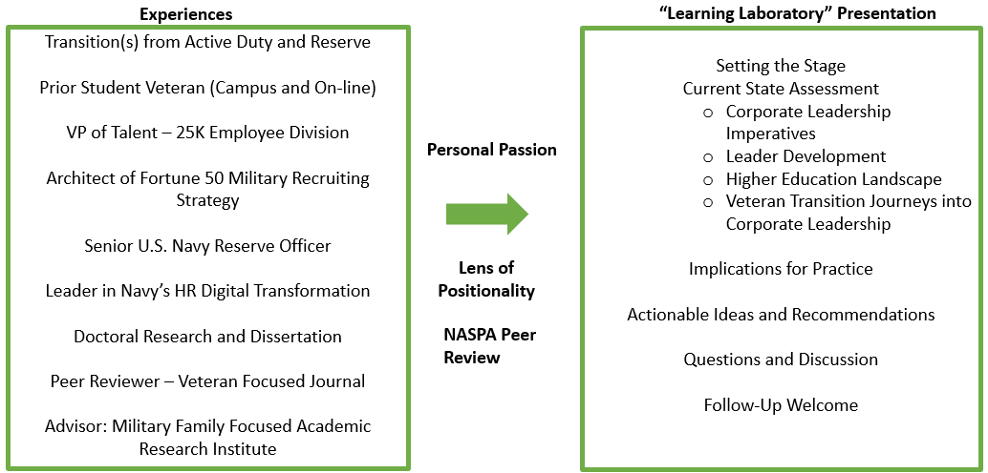
Veterans Navigating Transition Journeys into Corporate Leadership – Emerging Implications for Higher Education

Slide 3
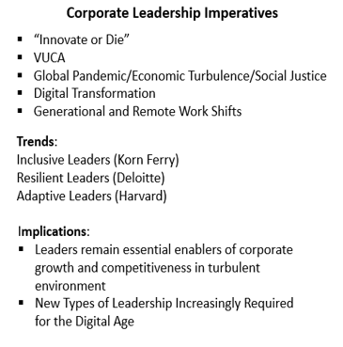
Veterans Navigating Transition Journeys into Corporate Leadership – Emerging Implications for Higher Education

Slide 4
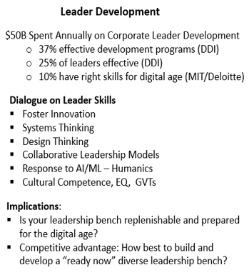
Veterans Navigating Transition Journeys into Corporate Leadership – Emerging Implications for Higher Education

Slide 5
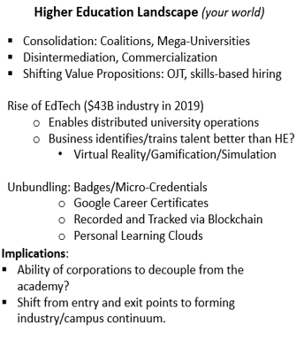
Veterans Navigating Transition Journeys into Corporate Leadership – Emerging Implications for Higher Education

Slide 6
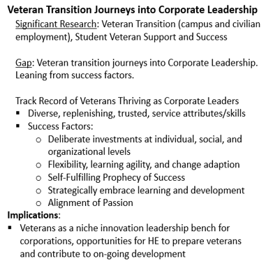
Veterans Navigating Transition Journeys into Corporate Leadership – Emerging Implications for Higher Education

Slide 7
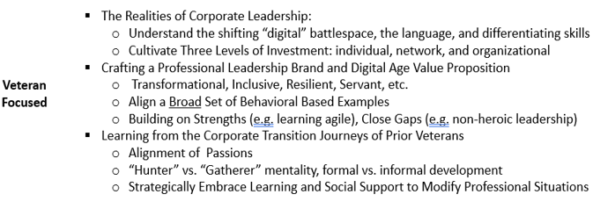
Learning Lab: Actionable Ideas and Tools

Slide 8
Learning Lab: Actionable Ideas and Tools

Slide 9
Questions?
williambaas@comcast.net
www.linkedin.com/in/willbaas

