Slide 1
Implementing the Value-Add Model in Your Veteran Center

Slide 2
Welcome
Introductions & Intentions
CSU Land Acknowledgement
Where we started & Why that is important
Value-Add Model
Cornerstone Values of Community & Engagement
Being a joint space for Student Veterans & Adult Learners
ELEVATE: A program example
Creating Buy-In Across Campus & the Community
Questions & possible Break-out rooms
Notes:
Many ways, what fits your University Culture, land grant institution

Slide 3
CSU Land Acknowledgement
Colorado State University acknowledges, with respect, that the land we are on today is the traditional and ancestral homelands of the Arapaho, Cheyenne, and Ute Nations and peoples. This was also a site of trade, gathering, and healing for numerous other Native tribes. We recognize the Indigenous peoples as original stewards of this land and all the relatives within it. As these words of acknowledgment are spoken and heard, the ties Nations have to their traditional homelands are renewed and reaffirmed.
CSU is founded as a land-grant institution, and we accept that our mission must encompass access to education and inclusion. And, significantly, that our founding came at a dire cost to Native Nations and peoples whose land this University was built upon.
This acknowledgment is the education and inclusion we must practice in recognizing our institutional history, responsibility, and commitment.

Slide 4
Where we started…
Toxic culture
Very few students using our space
Little collaboration
Funding for just scholarships
Where we are…
Military Times Best for Vets 2020-2021, Ranked #2
Our CSU SVA Chapter was picked in January 2020 as Best Chapter of the year
Over 50 students in our office at any time, over 150 students in our office in a day.

Slide 5
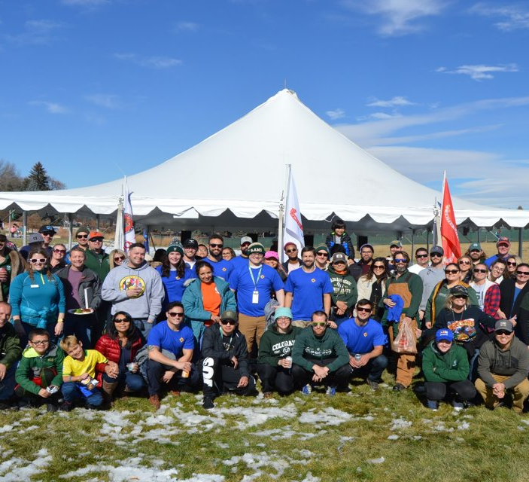
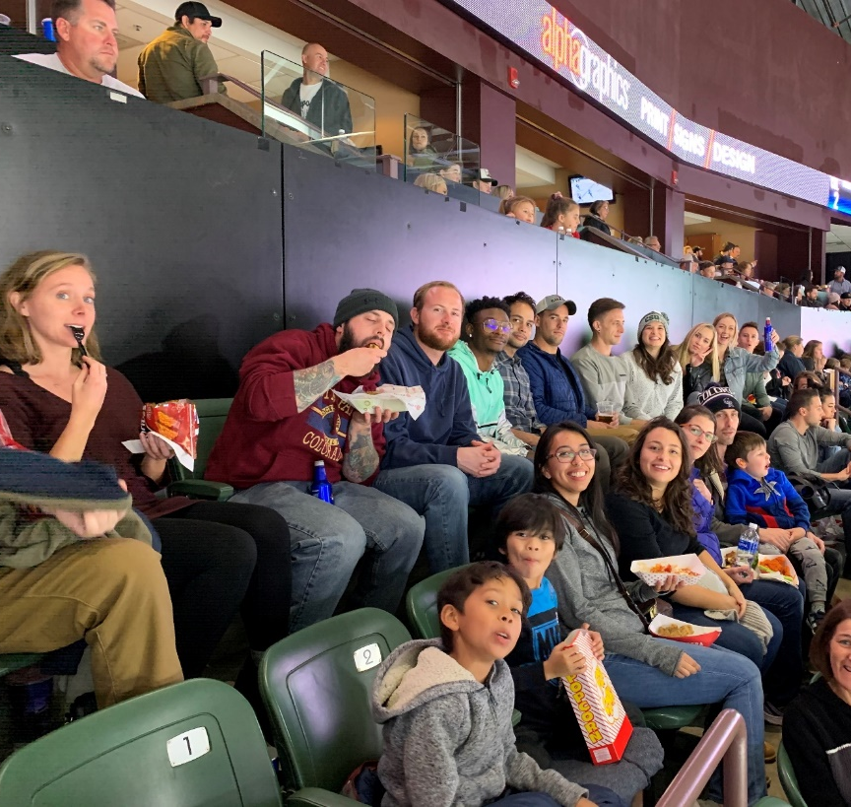
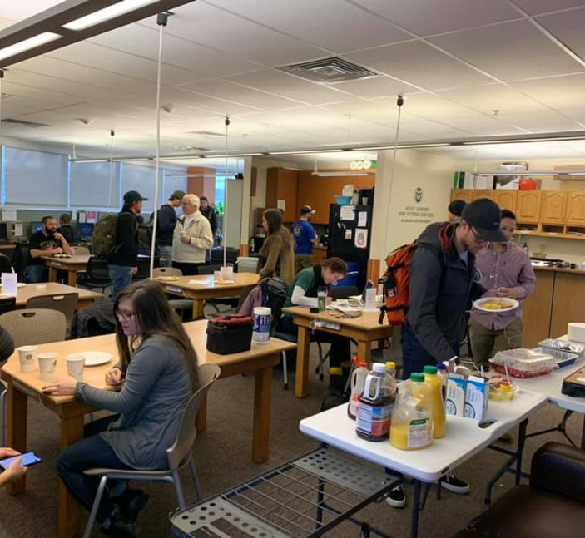
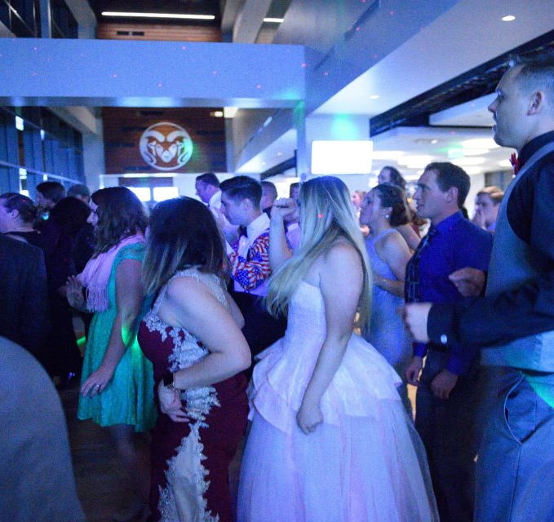
We aim to CREATE community.

Slide 6
Value Add Model
Strengths Driven
articulating to the students the strengths & value they bring to campus & the greater community
articulating to the greater community the value that student veterans bring; especially to jobs/businesses
Opportunity Focused
Internal/Individual focus
What can the Student Veteran change or impact?

Slide 7
Value Add Model
4. Accountability
address the toxic culture: end racist/sexist/homophobic conversations
Principles of Community-inclusion, integrity, social justice, respect, service
5. What is present that we can build on?
What is working for the Student?

Slide 8
Core Values
Community
Create a place of belonging & growth
Connect with peers
Joint space for Student Veterans and Adult Learners
All Student Veterans are Adult Learners
There are no veteran only break rooms in the corporate world
Our Veterans may be in a community w/o veteran-specific services
Our logo explained

Slide 9
Core Values Continued
2. Engagement
Our office functions as an initial hub to get them connected to the greater campus
Strong collaborations: Career Center, RamEvents, Cultural Centers, Counseling Center, VA: VITAL & VA Caseworker
Associated Student Government, Senate Seats
Not only veteran-specific; goal is to aid in transitioning into civilian life
Ask Student Veterans what they want!

Slide 10
ELEVATE
Summer Bridge Program
Academic focus on Math & English/Comp
4 weeks of instruction, 9am-12pm
Social Engagement:
Peer Advisors connect with students each day
Social Activities:
Scavenger hunt on campus into town w/brewery tour; Hike the ‘A’; Utilize the Rec Center; CliftonStrengths (formally known as StrengthsQuest), & Graduation
$1,500 award for completion
Other supports
Parking
Youth Sport Camp

Slide 11
Create Buy-in Across Campus & in the Community
Veteran Success Team
Helps address programs from being siloed
President’s Office/Upper Administration
Come to them with opportunities!
Alumni Office
4. University Advancement
Moving beyond just scholarships
Unrestricted programming funds
Funds specific to creating ‘Community’
Anschutz Grant to Extension Communities

Slide 12
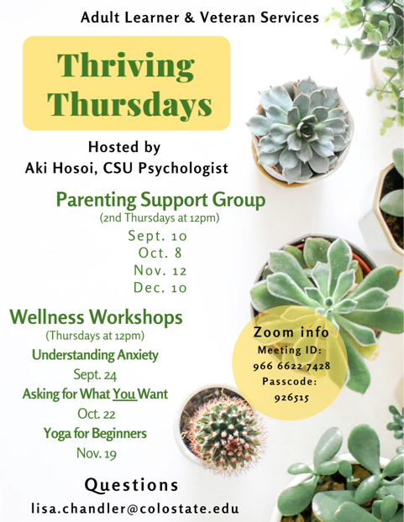
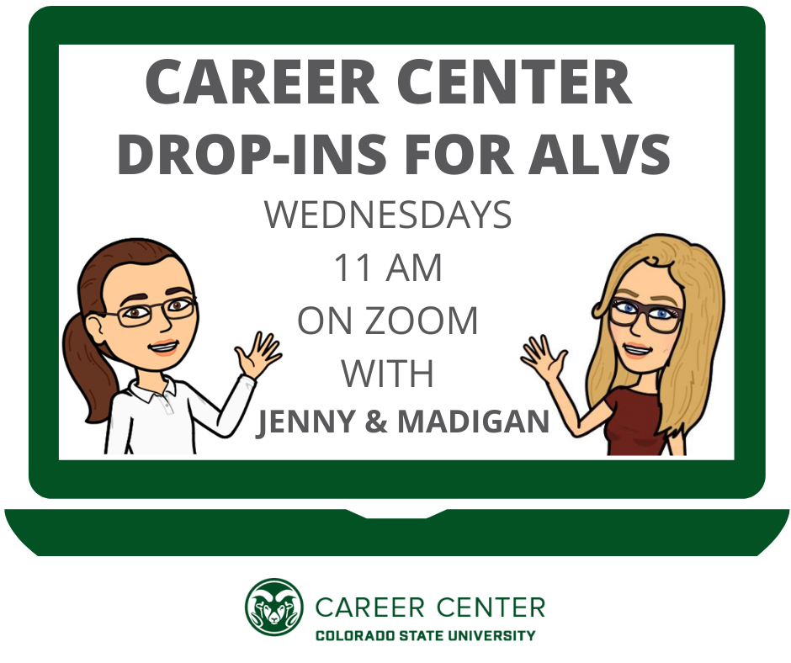
Collaborations
\

Slide 13
Questions? lisa.chandler@colostate.edu
Notes:
What is an example of how you are already implementing the Value-Add model on your campus?
Is there an example of a ‘roadblock’ that you can now change to an opportunity to expand and/or deepen your services for Student Veterans on your campus?
What is something you want to bring back to your campus? Or an action item you want to take going forward?

