Slide 1

Military Student Readiness: Ensuring Military Student Success at a
Midwestern State University
Dr. Seth Kastle
Dr. Brendon Fox
February 24-26, 2021 | Virtual

Slide 2
Objectives
Understand the unique issues impacting the growing population of military-connected students in higher education.
Identify resources needed to support military-connected student performance, retention, and motivation.
Examine existing military support programs in institutions from our collected research to serve as a template for participants

Slide 3

Military Student Demographic
What classifies a military connected learner?
Demographic factors that influence success in higher education
  Older, delayed entry, parents, financially independent (Ford & Vignare, 2015)
  Come from low-income racial/ethnic backgrounds more than traditional college students (Molina & Morse, 2015)

Slide 4
Military Student Demographic
What classifies a military connected learner? (cont.)
  Not devoid of formal education since leaving HS (Nelken, 2009)
  Enter higher ed at different phases of their military careers
  Have operated in and been shaped by environments heavily governed by command control and structure (Naphan & Elliott, 2015)
  First generation college students (Bonura & Lovaald, 2015)

Slide 5
Motivations for Our Study
How to convert what we had to what we needed to support our objectives
Used extant literature to benefit our cohort
How to make our school a military friendly institution
How to ensure the success of our students and Transfer and Military Center (TMC)

Slide 6

AAS Degree
Associate of Applied Science in Technology and Leadership
  Why the AAS?
  Concentration in Leadership Studies
  Certificate in Leadership Studies

Slide 7
AAS Degree Structure
60 Credit Hour Degree Program
  Up to 30 Hours CPL Credit
  15 Hours General Education
  15 Hours Leadership Studies
    Common Core Military Leadership Training
    What, How, and Why of Leadership Studies
    24 Hours of in classroom experience with no prior formal college experience
    15 Hours minimum must be taken from degree granting institution

Slide 8

Trends in the Literature (Institutional Readiness)
Increase in enrollment since the Post 9/11 G.I. Bill (5M transition by 2020)
Universities are unsure how to maximize retention and persistence (Green & Van Dusen, 2012)
Veteran/Military Friendly Environment
  Sense of belonging
  Academic support
  Campus culture
  Successful programs (Hanover Research, 2019)
High Graduation Rate Colleges and Universities

Slide 9

Trends in the Literature (Student Efficacy)
Traditional Adult Learners
  25 or older
  Similarities to military
  Support services
  Prefer a single point of contact
  Part of the larger set of nontraditional students (Daly & Garrity, 2019)

Slide 10
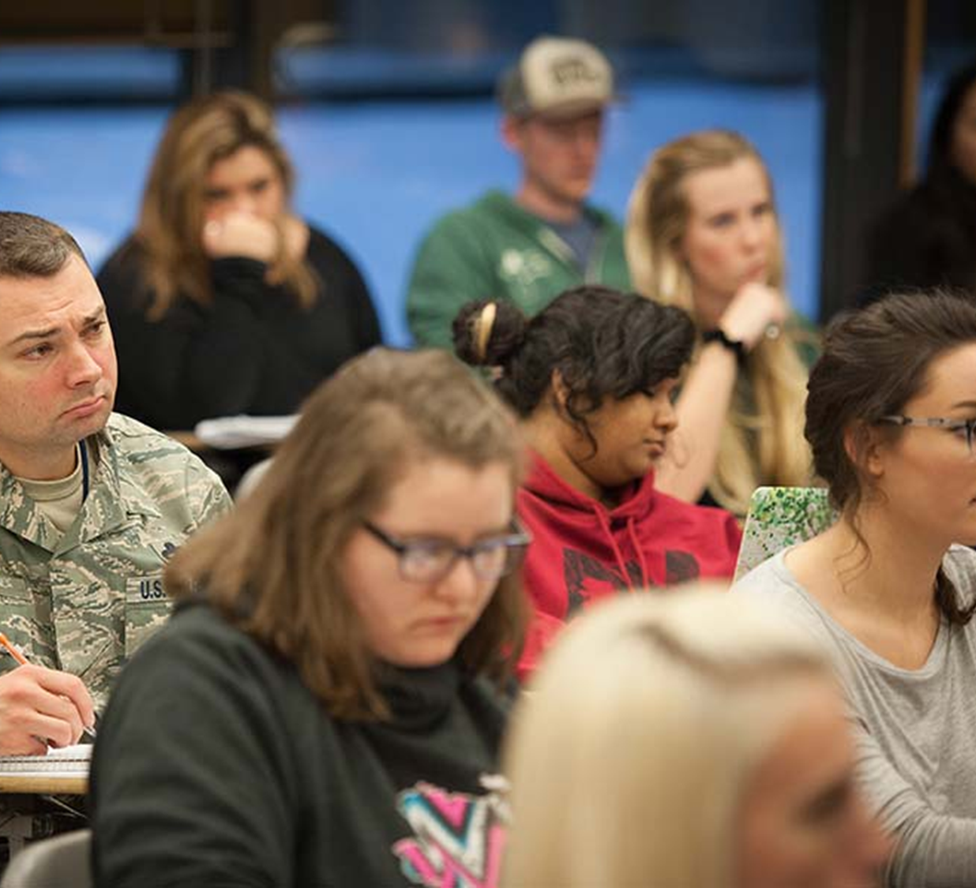
Trends in the Literature (Student Efficacy)
Military Connected Learners
  Earn higher GPAs (3.34 compared to 2.94 for traditional – disputed)
  Enrollment “battle with bureaucracy”
  Have previous structured learning post high school
Readiness/Self Perception
  Are among the most highly motivated
  Feel unprepared for academia
  Are methodical
  Have heightened perceptions of maturity and academic goal commitment (Ford & Vignare, 2014)

Slide 11

Trends in the Literature (Student Efficacy)
Persistence/Retention
  71.6% success rate
  Affected adversely by multiple factors
    Families
    Work obligations
    Military deployments
    Feelings of isolation from the institutions
  Need Campus Resources
    Programs, offices, policies
    High Graduation Rate Universities and Colleges (Bond Hill, Kurzweil, Davidson Pisacreta, & Schwartz, 2019)

Slide 12
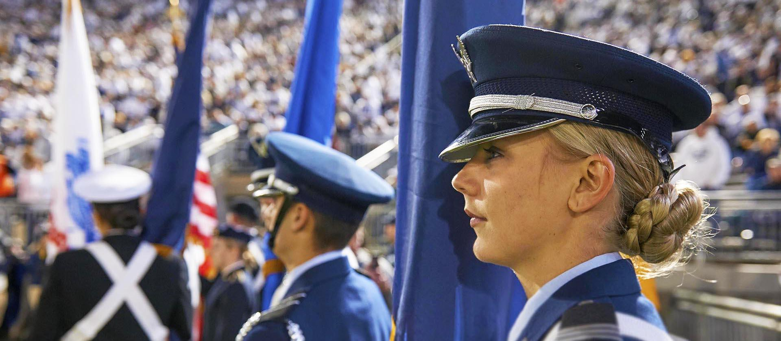
Findings
Ryan, Carlstrom, Hughey, and Harris (2011)
Best Practices to Support Military-Connected Students
  Enrollment – identification, assessment, and single point of contact
  Community-Building
    Relationship-centered support services
    Self advocacy
    Cross stakeholder communication
    Full spectrum (military to career) Navigation
    Capacity, knowledge, and awareness building
  Advising
  Accountability
    “S-Factors” Guidance (strategies factor) and listen to them and interact (support factor) (Ryan, Carlstrom, Hughey, & Harris 2011)

Slide 13

Implications and Recommendations
  Our Study
  Single Point of Contact Upon Enrollment
  Centralized Support Services
  Formal Peer Support Networks
  Continued Assessment
  Additional Evaluation Mechanisms (continuous improvement)
Future Study
  Longitudinal Study at home institutions
  Surveys of graduating or recently graduated veteran students
  Multiple institutional meta data analyses to examine motivation, preparedness, and retention

Slide 14
Breakout Session
What does your institution do to support this unique population of students?
How can understanding this demographic help your institution serve the military connected community?
How can supporting this population help build the future of higher education?
What are the long term societal impacts of supporting the military connected community through their journey in higher education?

Slide 15
Debrief
Spokesperson will share key takeaways that emerged from their group
What were the most salient discoveries of the presentation and breakout session?
What do you plan to take back to your institution?

Slide 16
Questions?
Dr. Seth Kastle
Director of Military Program Innovation
Assistant Professor
Leadership Studies
Fort Hays State University
sdkastle@fhsu.edu
Dr. Brendon Fox
Assistant Professor
Leadership Studies
Fort Hays State University
bcfox@fhsu.edu

Slide 17
References
Bond Hill, C., Kurzweil, M., Davidson Pisacreta, E., & Schwartz, E. (2019). Enrolling more veterans at high-graduation-rate colleges and universities.
Bonura, K. B., & Lovald, N. (2015). Military cultural competency: Understanding how to serve those who serve. Higher Learning Research Communications,5(2), 4.doi:10.18870/hlrc.
v5i2.226
Daly, D. D., & Garrity, B. K. F. (2013). From boots on the ground to seats in the classroom: An assessment of institutional structure and veteran students. American Journal of Business Research, 6(1), 5-17.
Ford, K., & Vignare, K. (2015). The Evolving Military Learner Population: A Review of the Literature. Online Learning, 19(1), 7-30.
Green, L., & Van Dusen, R. (2012, March). Welcome home: Understanding and serving veteran transition and identity development in college. In 2012 American Counseling Association Conference (p. 2012).
Hanover Research (2019). Best practices in supporting and retaining adult and military students.
Molina, D., & Morse, A. (2015). Military-Connected undergraduates: Exploring differences Between National Guard, Reserve, Active Duty, and Veterans in higher education. Washington, DC: American Council on Education and NASPA – Student Affairs Administrators in Higher Education. Retrieved from https://www.acenet.edu/newsroom/Documents/Military-Connected Undergraduates.pdf
Naphan, D. & Elliott, M. (2015). Role exit from the military: Student veterans’ perceptions of transitioning from the U.S. military to higher education. The Qualitative Report, 20(2), 36. Retrieved from http://search.proquest.com.ezproxy.liberty.edu/docview/
1677848280?pq-origsite=summon&accountid=12085
Nelken, M. L. (2009). Negotiating classroom process: Lessons from adult learning. Negotiation Journal 25(2), 181-184.doi:10.1111/j.1571-9979.2009.00219.x
Ryan, S. W., Carlstrom, A. H., Hughey, K. F., & Harris, B. S. (2011). From boots to books: Applying
Schlossberg's model to transitioning American veterans. NACADA Journal, 31(1), 55-63.

