Slide 1

Female Student Service Member’s Higher Education and Military Transitions
Sophie Cieslicki, Graduate Student, Eastern Illinois University
Jon Coleman, Ph.D, Assistant Professor, Eastern Illinois University
February 24-26, 2021 | Virtual
Notes:
Welcome and thank for coming to our virtual presentation

Slide 2
Jon Coleman, Ph.D.
Assistant Professor in College Student Affairs Master’s Program
  Eastern Illinois University
Father was in Navy for 35 years including my first 18 years
Notes:
JC – introduce myself and history
Talk about master’s thesis and brief outline
Explain that I will be monitoring the chat for any questions you have, so please ask when you have them as we want to have a discussion.

Slide 3
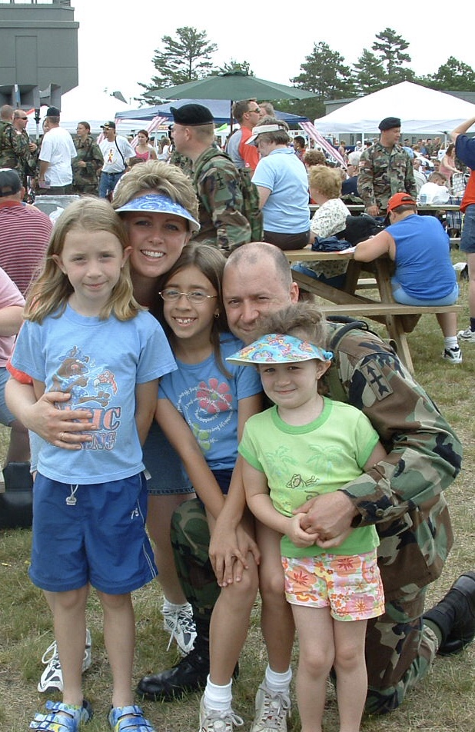
Sophie Cieslicki
Graduate Student
  Eastern Illinois University
Military Dependent
Why Female Student Service Members?
Notes:
SC – Intro of self
Father info
Impact of being military dependent
Concern about minimum of research on women’s veteran’s and dad’s pursuit of higher education while in military

Slide 4
History of Military Benefits
Servicemen’s Readjustment Act of 1944
Increase of Veteran’s On-Campus
Vietnam and Cold War
1985 Montgomery G.I. Bill
Notes:
SRA – GI Bill WWII – reason for the bill and impact on higher education
Increase of veteran’s impacted changes in how higher education treated these students
Vietnam war negatives for this population and decrease in services
1985 Montgomery GI Bill

Slide 5
Current Military Educational Benefits
2008 Post 9/11 G.I. Bill
  Monthly Benefit
  Transferable
Montgomery G.I . Bill Active Duty
  Serve Over Two Years of Active Duty
Montgomery G.I. Bill Selected Reserve
  At least Six Years Selective Reserve
Tuition Assistance Programs
Notes:
Current military benefits include
- Post 9/11 GI Bill
- details and qualifications
Montgomery GI Bill
- details and qualifications
Montgomery GI Bill Selected reserve
- details and qualifications
Tuition Assistance Programs
- details and specifics

Slide 6
Current Military Educational Benefits
(Gonzalez, Miller, Buryk, & Wenger, 2015).
Notes:
Description of the figure presented as visual breakdown of kinds of benefits out there for veterans

Slide 7
Student Service Members
(Holian & Adam, 2020)
Notes:
Here we have the numbers of veterans and national guard and reserves. Though small, Reserves/Guard still needs attention

Slide 8
Student Service Members
(Molina & Morse, 2017)
Notes:
This gives us a breakdown of undergraduate by gender and race

Slide 9
Female Student Service Members
1967 Women’s Armed Services Integration Act
Military Experiences
  Mental Health
  Sexual Trauma and Harassment
Family Experiences
  Female Stereotypes
  Marital Relations
Notes:
Issues specific to women veterans
1967 WAS– limits on women serving and rank. Current numbers and changes
Military experiences
- mental health
- sexual trauma & harassment
Family experiences
- female stereotypes
- marital relations

Slide 10
Theoretical Framework: Retention
Tinto 1975
  Rooted in Durkheim’s Theory of Suicide
  Dropout as a Theoretical Model
  Retention Based on Individual
Tinto 2006
  Environmental Factors to Retention
  Institutional Support Systems
Notes:
For this study, I used two major theoretical frameworks to look at my findings.
Tinto’s Retention theory from 1975 development and history
- history, model, and development, original viewpoint
Tinto 2006 revisions using environmental elements
- environment & institutional support

Slide 11
Theoretical Framework: Transition
Schlossberg 1984
  Rooted in Crisis Theory
  Anticipated, Unanticipated, & Nonevent
Schlossberg 2011
  Situations
  Self
  Support
  Strategies
Notes:
The second theory used was Schlossberg’s transition theory
1984 development and description
Revision in 2011
- four S explanation

Slide 12
Research Study
Narrative Qualitative
Midsized Regional Public Institution
Top 30 Regional Midwest Colleges for Veterans
Semi-Structured Interviews
Three Participants
Notes:
Description of your research study
Narrative – give voice to participants!

Slide 13
Participants
Jane
  White, 28 years old, pursing Masters in Political Science & Public Administration; Master Sergeant in Air Force National Guard, 10 years active duty
Laura
  White, 25 years old, pursuing Bachelors in Music & Psychology; Four Years in Navy Reserve and currently a Petty Officer Third Class and Navy Musician
Rachel
  White, 38 years old, pursuing second Bachelors degree in Digital Media; served four years in Air Force and left as Senior Airman. Not in reserves or guard
Notes:
Introduce three participants

Slide 14
Research Questions
  What Influence do Military responsibilities have on women service member’s:
  Higher Education Experiences
  Motivation for Degree Completion
  Expected Date of Degree Completion
  Use of Student Support Services
Notes:
Introduce research questions

Slide 15
Influence of Military on HE Experiences
Biggest impact was on time for completion
Learn new strategies to manage all responsibilities
Notes:
Big findings

Slide 16
Influence of Military on HE Experiences
Rachel: “I had to go somewhere for three to four days at a time, away from a computer or civilization or anything.”
“I just wanted to get it done as soon as I could, but there’s restrictions because you have service. You can’t just go to school all the time.”
Notes:
Why using quotes – to tell their story!

Slide 17
Motivation for Degree Completion
One anticipated finding was that her military responsibilities would impact women's Motivation for Degree Completion while pursuing a degree in Higher Education
In this study, all three participants actually felt the opposite.

Slide 18
Effect on Motivation
Two participants felt that they were more motivated by their military experiences while one did not feel any effect
All spoke of personal motivations that were supported by military service as well as family
Notes:
Motivation impacts

Slide 19
Effect on Motivation
Jane: “I always knew I wanted to go to college, but [my dad] said he wasn’t going to pay for it. So, the only way to get it paid for was to join the military. I was going to do six [years]. I was going to get in and out.”
Laura: “I always wanted to play music professionally, and that’s basically impossible to do straight out of high school. So, it was from that aspect, just a matter of being able to learn the skills to do that professionally.”

Slide 20
Effect on Date of Completion
Biggest impact was a delay in finishing due to scheduling and other conflicts
However, all of the participants spoke of push by senior officers to not only enroll, but to finish their degrees
Notes:
Impacts on date of completion

Slide 21
Effect on Date of Completion
Laura: “I was Navy reservist for like about four years, and then during that time I went to [Institution 1] for a little bit and then I transferred to [Institution 2]… And now I'm active duty. I took a couple of years off from school so that I could like do the training in the Navy to be a musician… now I'm using tuition assistance to finish my degree”
Rachel: “We weren't allowed to start going to school until we were a year and a half into our service. So, I know I started right away, and I was in for four years so I would say 2 ½ or three years [for my associates].”

Slide 22
Support Services Available
The participants didn’t talk about using any campus-based support services, in fact they didn’t have an understanding of what was available
They did however speak very strongly about being supported by faculty members individually in their efforts
Instead, they focused on family support, peer support, and military support to get the support that they needed

Slide 23
Support Services Available
Jane: “I don’t even know what they offer.”
Laura: “I never really felt like I needed anything from the Student Assistance Center, so I just didn’t reach out.”
Rachel: “I guess I just don’t know if it’s time, or I just don’t know where to go or who to connect with… There’s maybe a missing link as to how to get involved in those services.”

Slide 24
Final Thoughts
Degree completion will typically take longer for students
Family responsibilities, spouse and children, were also a factor for these participants
There appears to be a disconnect between female military members and the services that campus provide to them

Slide 25
Questions?
Thank you for your interest and participation!

Slide 26
Key References
Anney, V. N. (2014). Ensuring the quality of the findings of qualitative research: Looking at trustworthiness criteria. Journal of Emerging Trends in Educational Research and Policy Studies (JETERAPS), 5(2), 272-281.
Barry, A. E., Whiteman, S. D., & Wadsworth, S. M. (2014). Student service members/veterans in higher education: A systematic review. Journal of Student Affairs Research and Practice, 51(1), 30-42.
Bauman, M. (2009). The mobilization and return of undergraduate students serving in the National Guard and Reserves. New Directions for Student Services, 2009(126), 15-23.
Bowman, N. A., & Felix, V. (2017). It’s who I am: Student identity centrality and college student success. Journal of Student Affairs Research and Practice, 54(3), 235-247.
Brown, P. A., & Gross, C. (2011). Serving those who have served—managing veteran and military student best practices. The Journal of Continuing Higher Education, 59(1), 45-49.
Carastathis, A. (2014). The concept of intersectionality in feminist theory. Philosophy Compass, 9(5), 304-314.
Chartrand, M. M., & Siegel, B. (2007). At war in Iraq and Afghanistan: Children in US military families. Ambulatory Pediatrics, 7(1), 1-2.
Cortazzi, M. (1994). Narrative analysis. Language teaching, 27(3), 157-170.
Crossland, R. B. (1984). Twice the citizen: A history of the United States Army Reserve, 1908-1983. Office of the Chief, Army Reserve.
Defense Manpower Data Center. (2019). DoD personnel, worliforce reports & publications [data file]. Retrieved from https://ww.w dmdc.osd.mil/appj/dwp/dwp_reports.jsp
DiRamio, D., Ackerman, R., & Mitchell, R. L. (2008). From combat to campus: Voices of student-veterans. NASPA Journal, 45(1), 73-102.
Doubler, M. D., & Listman, J. W. (2003). The National Guard: An illustrated history of America's citizen-soldiers. Potomac Books, Inc.

