Slide 1
The Strength of the Pack: A Collaborative Approach to Increasing Veteran Enrollment

Slide 2
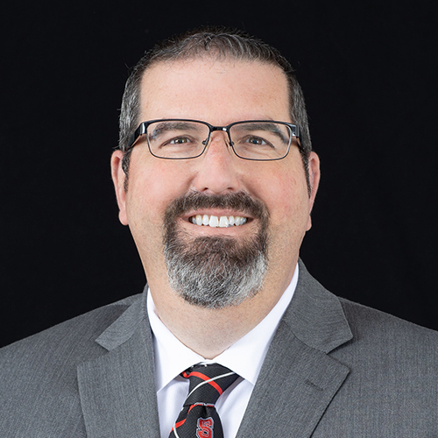
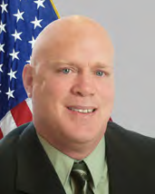
Presenters
Jon Westover, NC State University
Associate Vice Provost and Director of Admissions
Nick Drake, NC State University
Director of Jeffrey Wright Military and Veteran Services
Kyle Snyder, NC State University
Veterans Education School Certifying Official

Slide 3
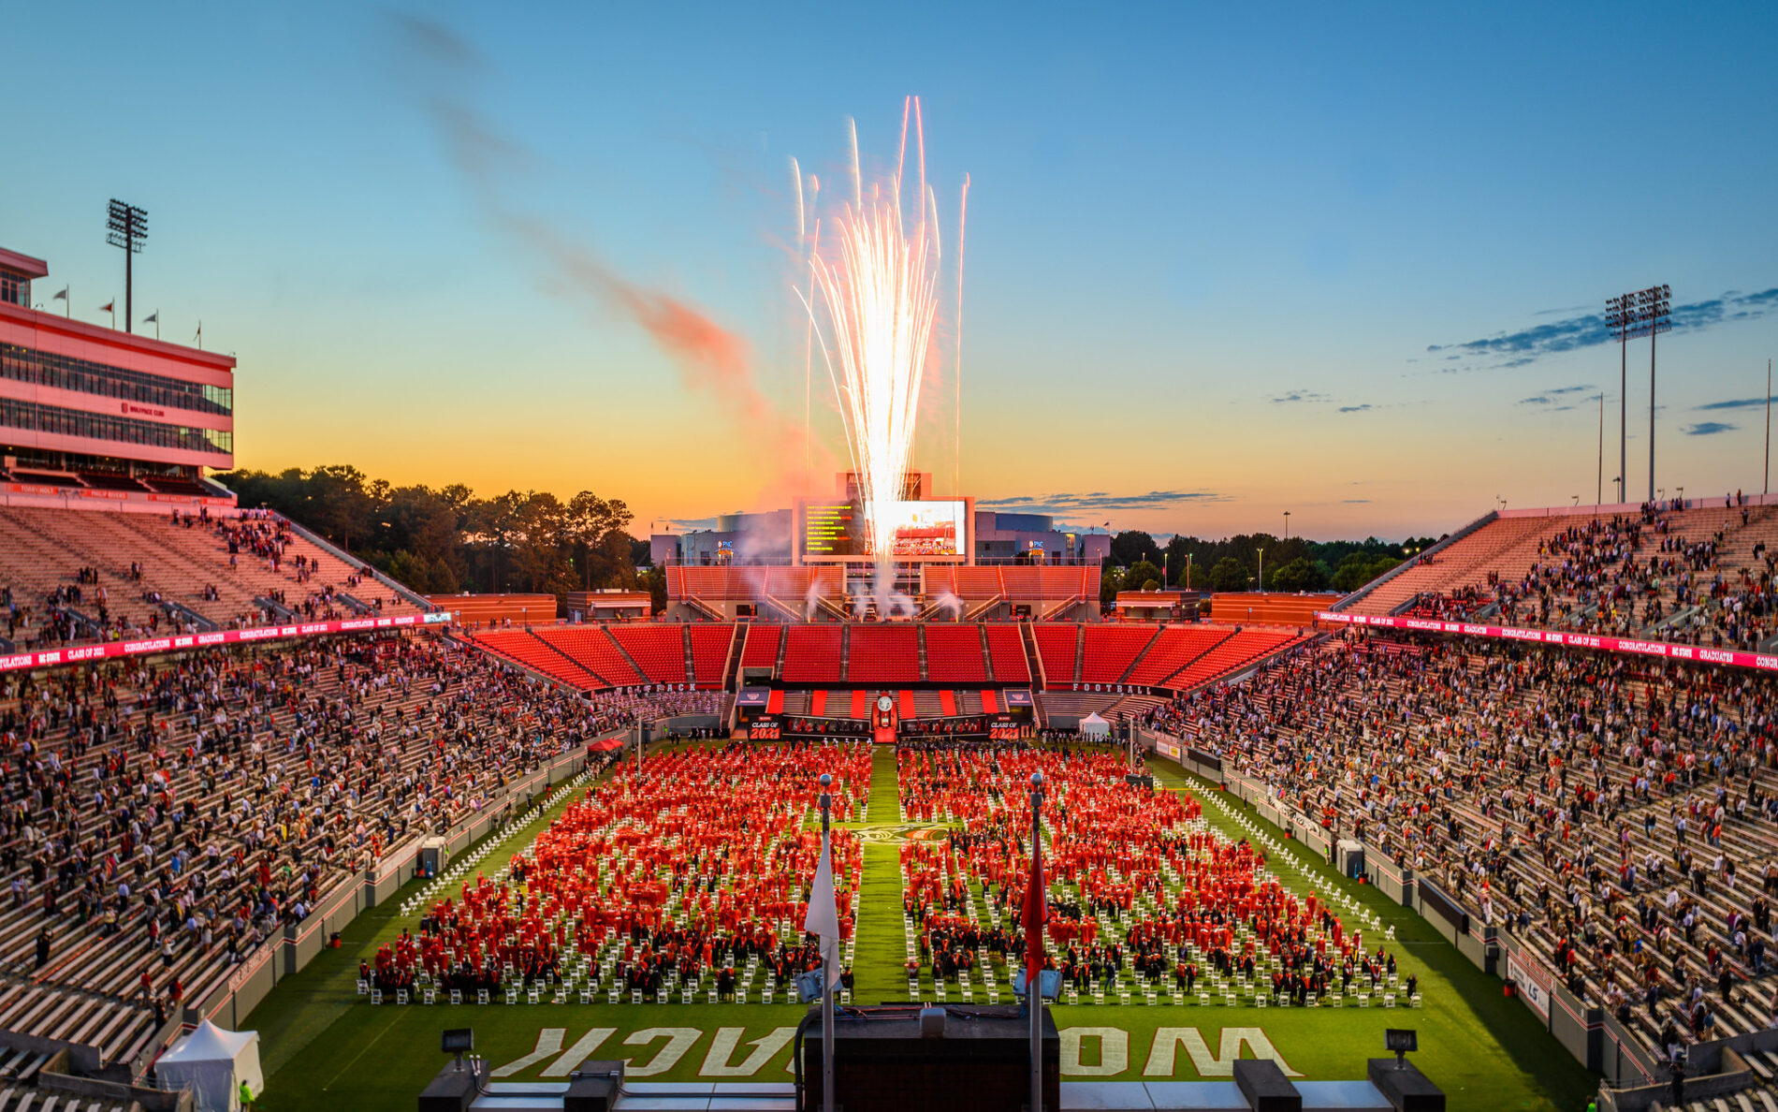
Session Roadmap
Participant Outcomes
Identifying the Need
Introducing the Initiative
Presenting the Partners
Discussing Pathways
Future Direction
Discussion
Notes:
Nick

Slide 4
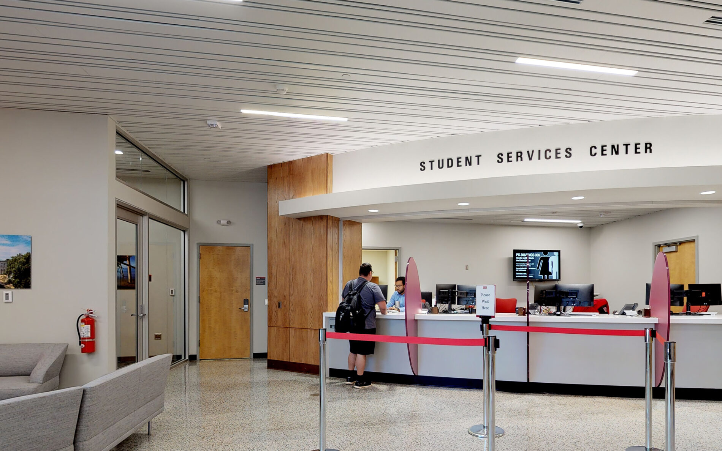
Learning Objectives
Participants will be able:
Identify sources of data at their respective institutions
Identify key campus and community partners
Develop a plan of action appropriate for their institution
Notes:
Nick

Slide 5
Providing Context
NC State University
Large Tier I research campus with 12 colleges
Flagship STEM Institution of the UNC System
37,000 students and 9,000 employees
2,400 military-connected students
MVS & Veterans Education Co-located on campus
Staffing framework
Proximity to military installations
Fort Bragg
USMC Base Camp Lejeune
Seymour Johnson Air Force Base
USMC Cherry Point
USCG Air Station Elizabeth City
Notes:
Nick

Slide 6
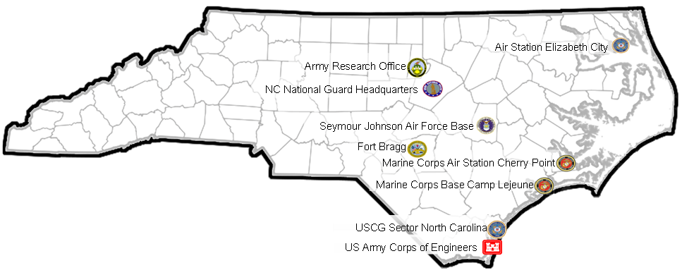
Veteran Presence in North Carolina
659,584 veterans call North Carolina home as of 2020 (7th in the nation)
7.9% of the state’s population served in the military (6.9% nationwide)
59,109 live in Wake County
Source: www.veteransdata.info
Notes:
Nick

Slide 7
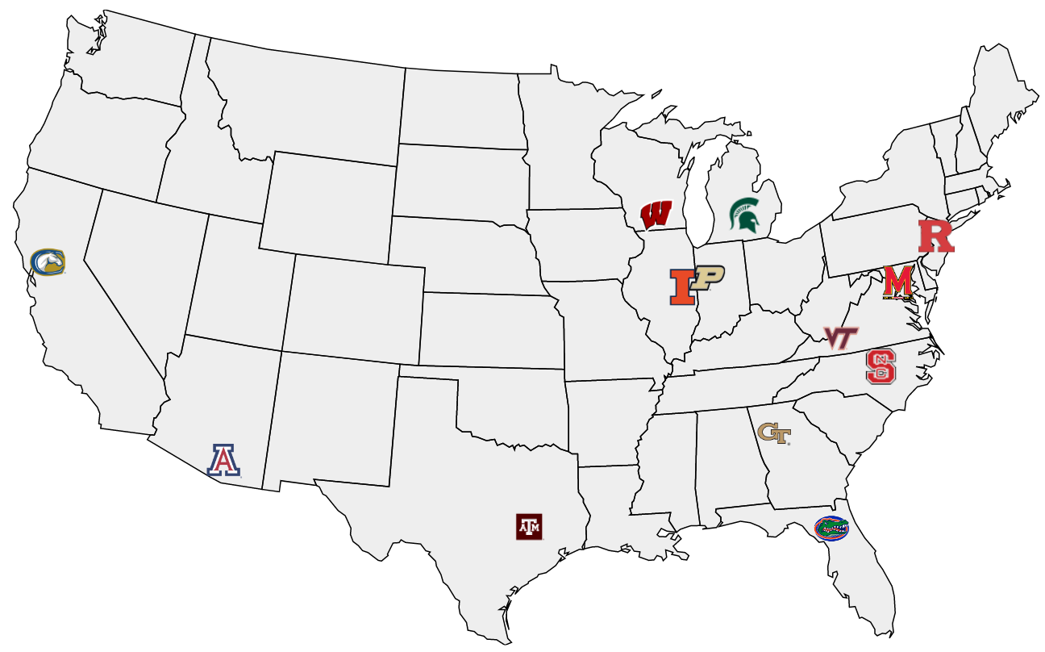
Identifying The Need
Notes:
Nick

Slide 8
Challenges for Prospective Students
Unfamiliar with the admissions process
First year versus transfer
Competitive applicant
Admissions deadlines and expectations
Residency
Application fees
College Credit for military service
Notes:
Nick, Kyle & Jon

Slide 9
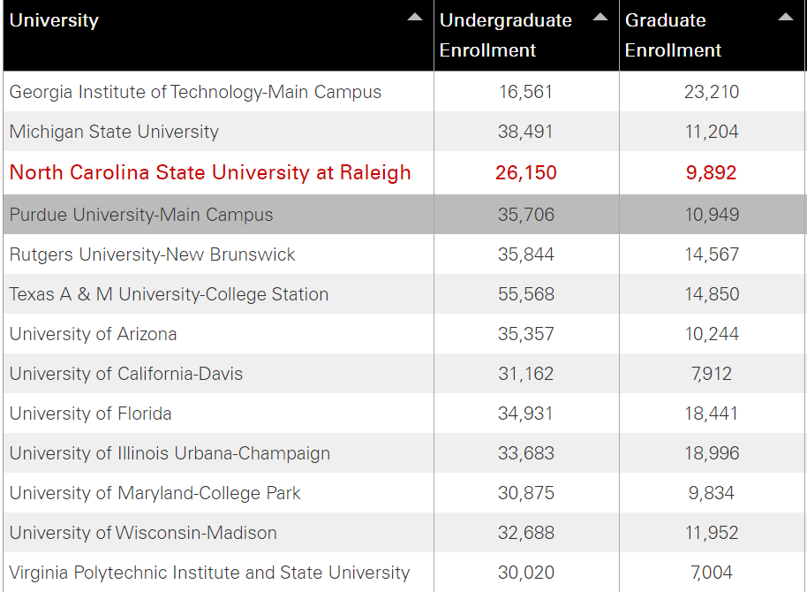
Notes:
Nick

Slide 10
Peer Institution Figures for Comparison
Notes:
Nick

Slide 11
The Plan
Increase student-veteran enrollment
Increase veteran applicants
Increase veteran acceptance rate
Establish touchpoints with prospective student veterans
Conduct transfer admission information sessions
Conduct CC and military installation visits
Regular communication
Develop an effective documenting/tracking process
Notes:
Nick

Slide 12
Military Academic Pathways Program (MAPP)
Ensure prospective applicants are thoroughly informed of the admissions application process
Identify non-competitive applicants early within the application process
Provide detailed plans for non-competitive applicants to reach the competitive status
Connect non-competitive applicants with a local community college to complete prerequisite requirements.
Notes:
Nick

Slide 13
Key Components of MAPP
Track number of prospective military/veteran applicants (initiated and completed applications)
Track prospective students who attend Admissions Information Sessions
Track prospective students who complete the Admissions “Interest Form”
Provide a report of completed applications 30 days prior to the deadline
Provide a report of completed applications post application deadline
Track admitted and denied applicants
Track denied applicants who enrolled in the NC CC System
Notes:
Nick

Slide 14
Military Academic Pathways Program (MAPP)
MAPP is….
a collaborative initiative to increase veteran enrollment at our university
A pathway to higher education for military and veteran students
NC State or another 4 year university or college
MAPP is not….
A guarantee for future acceptance
Notes:
Nick

Slide 15
The Key Players
NC State University Partners
Enrollment Management and Services (EMAS)
Office of Undergraduate Admissions
Registration and Records (Veterans Education Benefits)
Community College Collaboration (C3)
Division of Academic and Student Affairs (DASA)
Jeffrey Wright Military and Veteran Services
External Partners
North Carolina Community College System Office
Various North Carolina Community Colleges
North Carolina Veterans Upward Bound
Notes:
Nick - Share some historical context, how these relationships came about

Slide 16
Undergraduate Admissions Role
Collect info on admissions application for currently serving, veteran and military affiliated.
Admissions emails students about Office of Military & Veteran Services.
Admissions emails students once a decision is sent.
Admitted student - connect them with Military & Veteran Services
Students not admitted - offer assistance from Military & Veteran Services to become competitive future applicant.
Notes:
Jon

Slide 17
Undergraduate Admissions Role
Work through Military & Veteran Services to identify other students of interest in applicant pools - ROTC, STA-21, Green to Gold, MECEP, ASCP, etc.
Application fee waivers for active duty and veteran applicants.
Attend college fairs on military bases with Military & Veteran Services staff members.
Monthly admissions transfer information sessions for veterans and current service members.
Notes:
Jon & Nick

Slide 18
Communication Plan
Students receive the following emails via Undergraduate Admissions
Upon completion of application (self-identified military affiliation)
Upon admission to NC State
Upon denial of admission (Pathway Plan)
Each communication is crafted in partnership with Military and Veteran Services with Nick and Kyle
Notes:
Jon

Slide 19
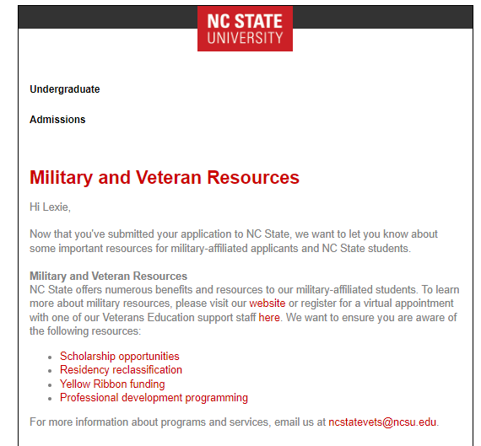
Initial Communication Upon Submitted App
Notes:
Jon

Slide 20
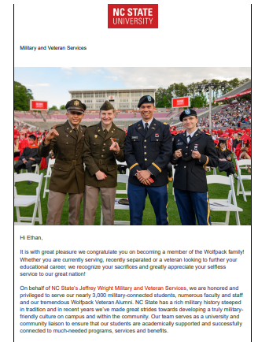
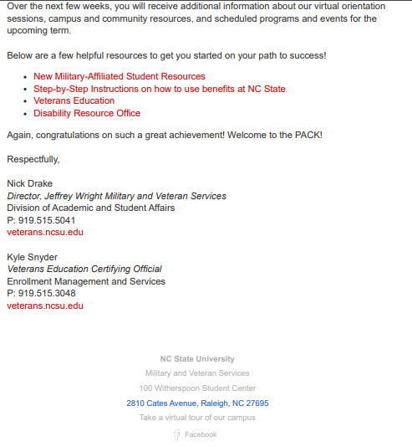
Communication Upon Admission
Notes:
Jon

Slide 21
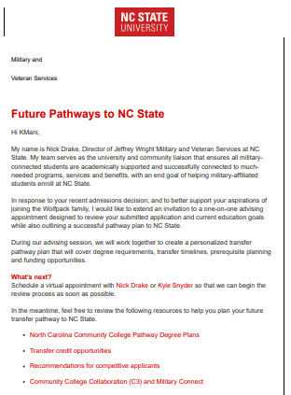
Communication Upon Denial
Notes:
Jon & Nick

Slide 22
Registration and Records Role
Veterans Education benefits advisement
Identifying appropriate chapter
Maximizing benefits
Forecasting time to degree
Conduct Transfer Credit Evaluation and Transfer Credit Summary
Transfer course equivalencies
Non-Degree Studies
Prerequisites
Residency
Notes:
Kyle

Slide 23
Military and Veteran Services Role
Access to Slate
Semester Query/Report
Conduct avising with denied applicants
Calendly link
Coordinate Transfer Admissions sessions
Virtual with Undergraduate Admissions
In-person with local NC community colleges
Host on-campus visits
Prospective students and families
Provide a comprehensive website
Include key elements from partners
Notes:
Nick & Kyle

Slide 24
Pathways to NC State
C3 & C3 Military Connect
Collaborative Pathway
NC Community College System
Pathway Degree Plans
UNC System Schools
Military Marketing Campaign
Complete Prerequisites at Current Institution
Credit Equivalency database
Change of Academic Major
Additional degree options for non-competitive applicants
Notes:
Kyle & Nick

Slide 25
Undergraduate Admissions Data
Undergraduate Applications - Veteran (2021-2022)
Term | Applied | Admitted | Enrolled | Acceptance Rate | Enrollment Rate
Fall 2021 | 416 | 119 | 53 | 28.6% | 44.5%
Spring 2022 | 138 | 32 | 21 | 23.2% | 65.6%
Summer 2022 | 6 | 4 | 4 | 66.7% | 100%
TOTAL | 560 | 155 | 78 | 27.67% | 50.32%
Notes:
Nick & Jon

Slide 26
Veteran Data
Veteran Transfer Admission Sessions
Virtual: 5
In-Person: 2
Pathway Advising
Fall 2022: 31 appointments
15 enrolled in a North Carolina Community College
8 will attend another institution
5 will complete requirements at another institution
3 unknown
Spring 2023: 14 appointments
10 enrolled in a North Carolina Community College
2 will attend another institution
1 will complete requirements at another institution
1 unknown

Slide 27
Early Lessons Learned
You don’t need a 100% solution to get started
“A good plan violently executed now is better than a perfect plan executed next week” - George S.Patton
Consistent and timely communication is key
WIth both partners and prospective student veterans
Partnerships are vital to the success of this initiative
You will find some are stronger than others

Slide 28
Future Considerations
Expand initiative to all military-affiliated students
Spouses and children of veterans
Partnership with Graduate Admissions
Refine current implementations
Create a replicable framework
May have applicability outside of NC State
Incorporate a Peer to Peer Network
Faculty/Staff
SVA

Slide 29
Notes:
Nick

Slide 30
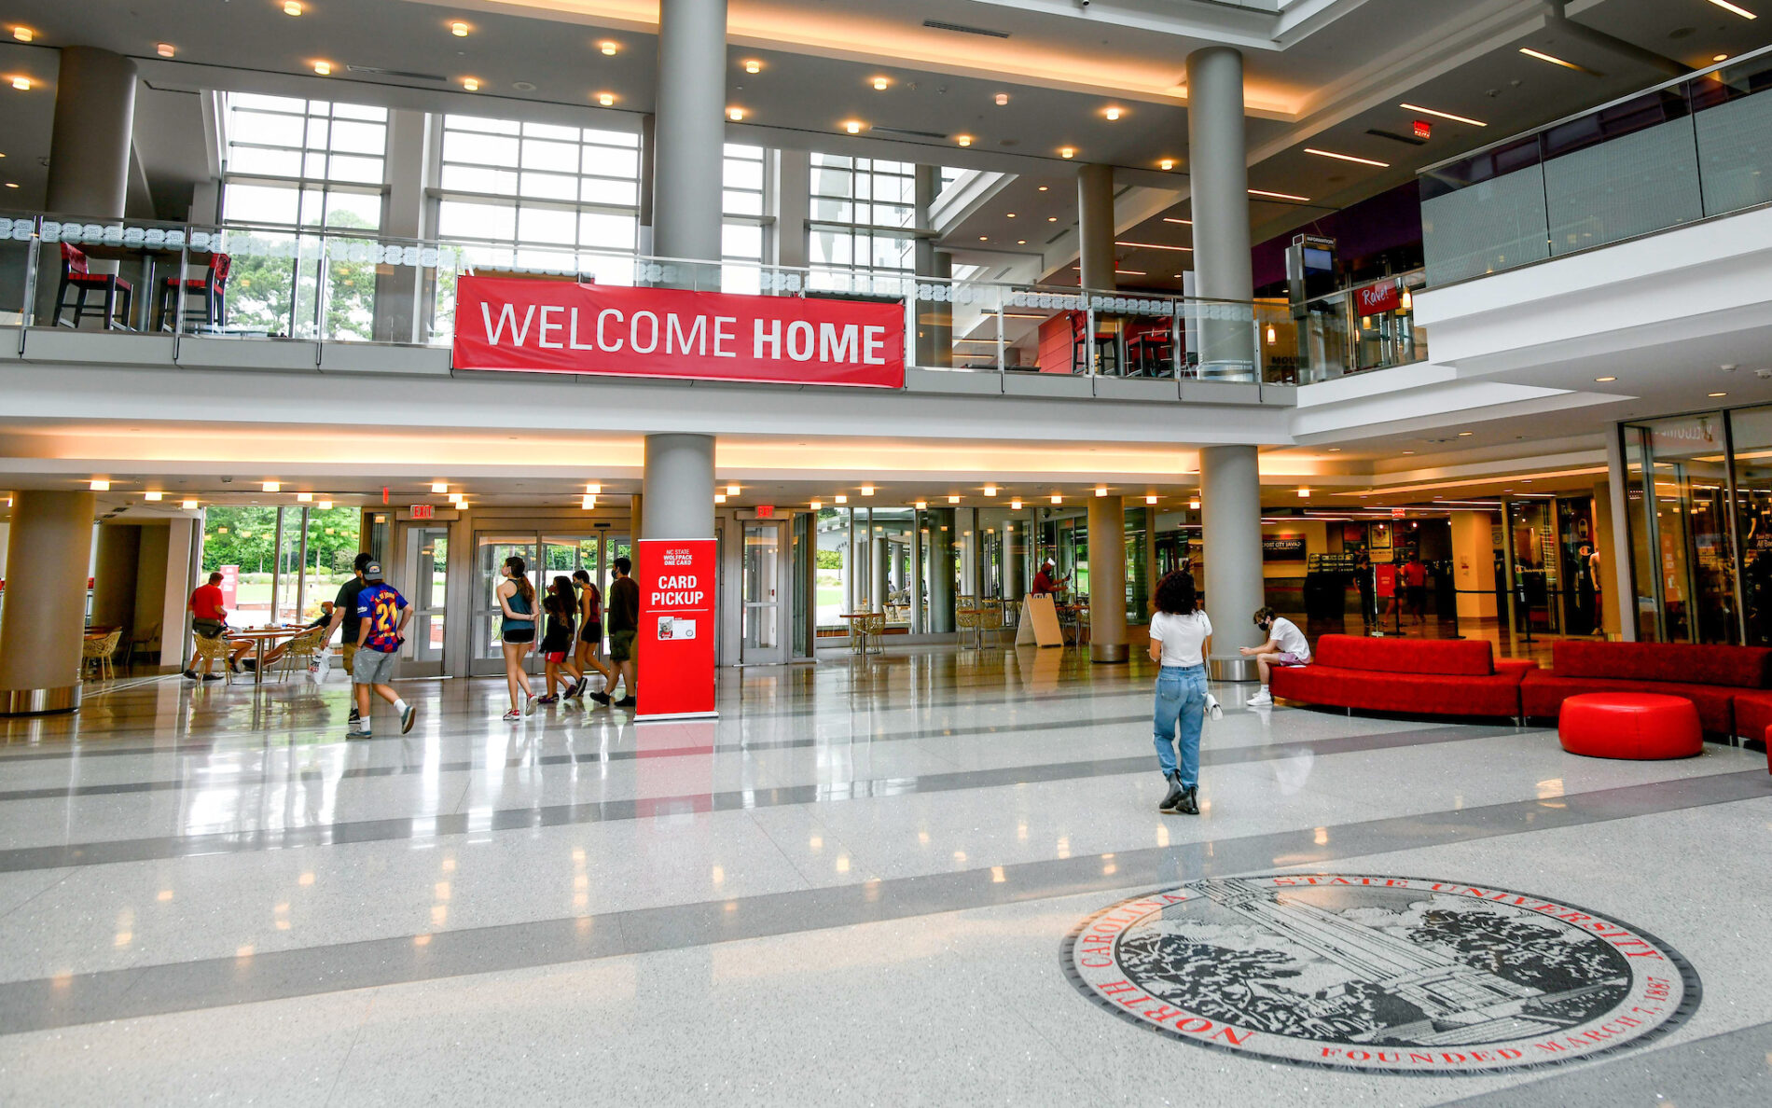
Thank You
Discussion & Questions
Veterans.ncsu.edu
919.515.5041
ncstatevets@ncsu.edu
Notes:
Jon, Kyle and Nick

