Slide 1
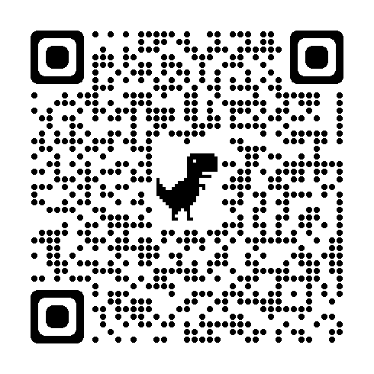
7 Ways to Celebrate
Military Kids On Your Campus
Notes:
Charlie - Welcome. Take Lead on Presenter Introductions.

Slide 2
Agenda
Welcome & Introductions
Grounding Theory
The W&M Context
Celebration Strategies
Open Conversation
Notes:
Lauren. Walk Thru Agenda.

Slide 3
Goals
7 Military Kid Strategies
Network of Colleagues
Notes:
Brandon. Reviews Presentation Goals.

Slide 4
Grounding Theory
Schlossberg’s Transition: Moving In, Thru & Out
Astin’s Involvement: The First Six Weeks
Notes:
Lauren. Review

Slide 5


The W&M Context
Founded 1693
Public Ivy
Liberal Arts & Sciences
~7000 Undergraduates ~2800 Graduate Students
91% 6-Year Graduation Rate
Residential UG Experience
5 (soon to be 6) Academic Schools
Notes:
Charlie. Our Military Affiliated / Dependents.

Slide 6
Our 7 Strategies to Celebrate Military Kids
Notes:
Lauren. Quick Review.

Slide 7
(Self-) Identify Military Kids
Notes:
Lauren. Identify Who …

Slide 8
(Self-) Identify Military Kids
Provide Pre-O Meet-Up Opportunity
Notes:
Charlie. Summer Meet-up.

Slide 9
(Self-) Identify Military Kids
Provide Pre-O Meet-Up Opportunity
Have Military Kid Swag Available
Notes:
Brandon. Swag to Identify Self and Others Easily.

Slide 10
(Self-) Identify Military Kids
Provide Pre-O Meet-Up Opportunity
Have Military Kid Swag Available
Engage in Military Kid Club Convos
Notes:
Charlie. It may happen every year … but keep it up

Slide 11
(Self-) Identify Military Kids
Provide Pre-O Military Kid Meet-Up Opp
Have Military Kid Swag Available
Engage in Military Kid Club Convos
Partner with Parent & Family Programs
Notes:
Lauren.

Slide 12
(Self-) Identify Military Kids
Provide Pre-O Military Kid Meet-Up Opp
Have Military Kid Swag Available
Engage in Military Kid Club Convos
Partner with Parent & Family Programs
Extend Military Appreciation Perks
Notes:
Brandon. Offer military appreciation connections

Slide 13
(Self-) Identify Military Kids
Provide Pre-O Military Kid Meet-Up Opp
Have Military Kid Swag Available
Engage in Military Kid Club Convos
Partner with Parent & Family Programs
Extend Military Initiatives / Perks
Purple Up! Month of the Military Child
Notes:
Lauren. Month of Military Child.

Slide 14
Your Turn …
How Do You Identify Your Military Kids?
What’s Your Support Mechanism?
Collaborative Team v. Point Office/Person?
Who Supports Your Military Dependents?
At the Table? Missing?
Notes:
Charlie. Lead Conversation.

Slide 15
Contact Us
Student Veteran Engagement
Charlie Foster M.Ed. ‘17 (USMC)
Director
ctfoster@wm.edu
Brandon Parker M.Ed. ‘25 (USMC)
Graduate Assistant
bparker01@wm.edu
Student Transition Engagement Programs
Lauren Garrett ‘02
Director
lmgarrett@wm.edu

