Slide 1


February 2-4, 2020 | Seattle, WA
Tami Thacker -
Building Relationships: On and Off Campus Partners

Slide 2
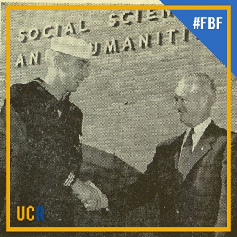
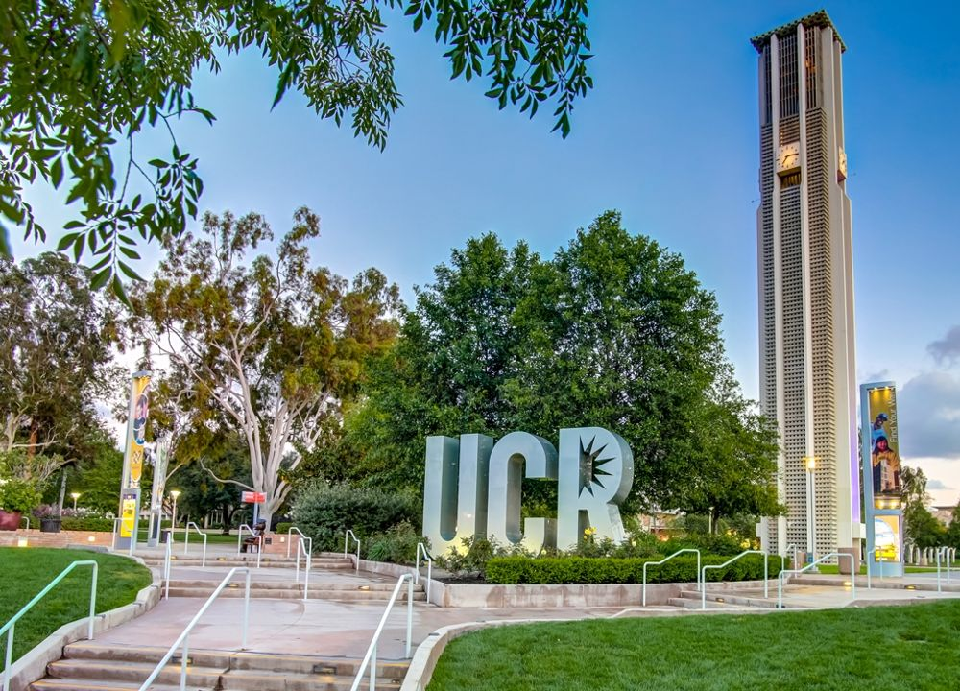
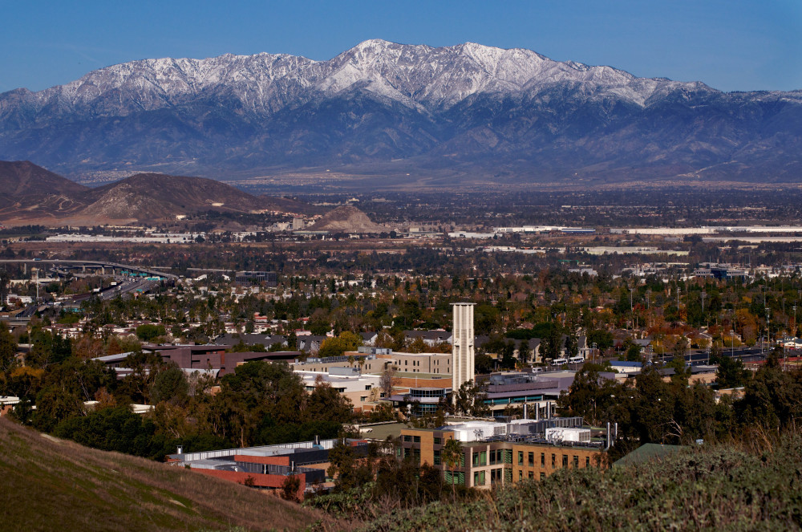
First UCR Student Jim McMillin one day after getting discharged from the US Navy.
Campus Center and Riverside Aerial View

Slide 3
UC Riverside Riverside, CA
Located on nearly 1,200 scenic acres in Inland Southern California (1hr to Los Angeles, the mountains & beaches) and distinguished by 60+ years of high-impact research.
Home to approximately 24,000 students. With a community of 300+ Veterans, Active Duty, Reservists and Military-Connected Students AND ~600 dependents
We offer 101 Bachelor's Degrees, 55 Master's Degrees and 42 Ph.D's
Ranked # 2 in the U.S. for financial aid (Business Insider 2019)
Counted among the Top 35 public universities in the country, UCR is America’s fastest rising ranked university. (U.S. News 2019 rankings)
Faculty Distinctions: 48 Fulbright Scholars, 19 Guggenheim Fellows and 49 National Endowment for the Humanities Fellows
Riverside County is home to 136,466 veterans which is 6% of its total population.
The city is the 61st biggest city in the United States and the 12th biggest city in California.
Home to a whopping 58 parks! Including 2 State Parks.
The March Air Joint Reserve Base is the oldest operating air force base on the west coast and was founded in 1918.
The city of Riverside has a large art scene, inspired by Charles Dickens.

Slide 4
BUILDING RELATIONSHIPS – ON-CAMPUS PARTNERS
Academic Resource Center or Learning Centers
Financial Aid
Advising or Academic Counseling
R’pantry/food pantry
Student Disability Resource Center
Counseling and Psychological Services
Study Abroad
Career Center
Research positions

Slide 5
BUILDING RELATIONSHIPS – ON-CAMPUS PARTNERS
Advising or Academic Counseling
Financial Aid
Help with filling out FAFSA
Financial Wellness Info Sessions at the VRC
Military Affiliated Students have their own Financial Aid Representative/School Certifying Official
Help with making sense of award
Guidance on Certifying Benefits
Office Hours at the VRC
Front of the line privileges
Create an Academic Plan to Follow that will be VA approved
Course Selection
Graduation Requirements
Attend Advisor Quarterly Meeting
Present on unique needs of military affiliated students
Stress how benefits can be affected

Slide 6
BUILDING RELATIONSHIPS – ON-CAMPUS PARTNERS
Student Disability Resource Center
Counseling and Psychological Services
Assisting Disabled Veterans With Completion of Education
FREE
Private
Accommodation examples
Longer test times
Private testing room
Audible devices
Rides to class
Information Sessions at the VRC for Familiarity
Include on scholarship panels
On Campus Mental Health Services
Free
Confidential
Case Management
Crisis Hotline
Information Sessions in Veterans Resource Center (VRC)
Branch Flags in the Window
Sit on hiring panels

Slide 7
BUILDING RELATIONSHIPS – ON-CAMPUS PARTNERS
Career Center - Operation VETS Program
Veteran Specific Programs and/or Appointments
Resume Writing and Critique
MOS- Translate to Today’s Terms
Federal Resume Builder
Mock Interviews
30 Second Pitch
Strength Finders and True Colors
Mentorship
Employer Networking Events
Alumni Networking Events
No Cost Clothing Closet

Slide 8
BUILDING RELATIONSHIPS – OFF-CAMPUS PARTNERS
Congressmembers
Senators
Assemblymembers
Local Government (Mayor)
Veterans Affairs
State Benefits Representatives
State Employment Development Departments

Slide 9

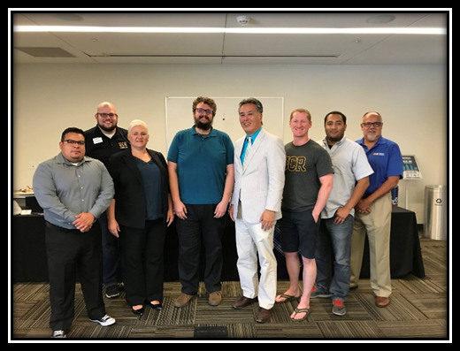
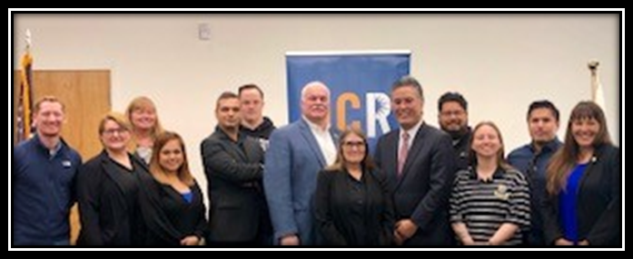
Congressional Committee on Veterans' Affairs
The standing Committee on Veterans' Affairs in the United States House of Representatives oversees agencies, reviews current legislation, and recommends new bills or amendments concerning U.S. military veterans.
Mark Takano – Chairman
Congressman California 41st District
Notes:
Internships

Slide 10

Senate Bills Affecting Veterans
Senate Bill 500
Disabled Veterans Continuing Education Assistance
Senator for California 31st District
Richard D. Roth – Air Force Veteran
The Department of Veterans Affairs shall establish an education assistance program to provide housing and tuition assistance to disabled veterans attending graduate school in the State of California.
Notes:
Meeting for inquiry on SB and introductions

Slide 11
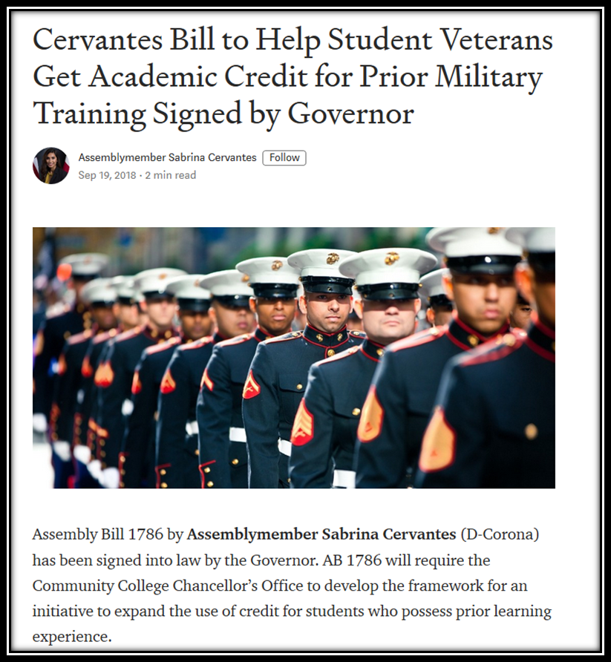

In the News: $2 Million allocation to local veterans initiatives
Assemblymember Sabrina Cervantes
District 60
Assemblymember Jose Medina
(UCR Alum)
District 61

Slide 12

City/County – Veteran Taskforce
Mayor Rusty Bailey – Army Veteran
Veterans Free Pass
“I believe that supporting our military families must be one of our top priorities.”

Slide 13
BUILDING RELATIONSHIPS – OFF-CAMPUS PARTNERS
Veterans Affairs
Info sessions on campus quarterly
Job Fairs
Benefits
Work Study
State Benefit Representatives (CalVet)
Info sessions on campus quarterly
State TAP program
Job Fairs
Veteran community connections
Where they are, so are the community connections
State Employment Development Department
Info sessions on campus quarterly
Veterans Division
Job Fairs and Placement Events

Slide 14
BUILDING RELATIONSHIPS – OFF-CAMPUS PARTNERS
Helpful tips
Establishing these relationships requires persistence and flexibility.
Schedule Appointments. Keep appointments.
Have an ask but be mindful of their main initiatives.
Invite them to campus events.
Invite them to meet with a group of student veterans.

Slide 15
Student Barriers – Partners Can Help With
Cost of going to school and living expenses
VA (GI BILL, Voc Rehab, DEA)
In-house and Veteran Organization Scholarships
Housing (U.S. Department of Housing and Urban Development-VA Supportive Housing (HUD-VASH) Program or campus housing)
Transportation (free bus pass, bus tokens, gas cards)
Deadlines
State Veterans Representative - Proper job/education info given before ETS
Admissions Counselors - Application cycle timeline can be a year out
Lack of Follow Through
Counselors, advisors, coordinators should be following up with student as the processes themselves may be barriers.
Not knowing where the safe spaces and resources are at
Make all veteran friendly offices, brochures, flyers accessible in-house and online
Networking
Career Centers, Alumni Events - One on one introductions, networking events, job fairs

Slide 16
Barriers That May Affect Student Success and Well-Being
Treatment
Older than the average college student but still treated the same
Faculty
Lack of empathy for veteran status
Stereotypes
Mental health issues
Aggressive nature
Money
Many only using educational benefits and have family & mortgage
Communication skills
Used to being in charge and getting things done fast (instant gratification)
May not be the best communicator
Short and concise in speech – used this method in communicating orders
Political Correctness
Many are not

Slide 17
Strategies for on and off campus partners to offset challenges
Campus Support Team – Internal cross campus support
Veterans Community Advisory Council – Community partner support
Meetings with local officials regularly – Create a presence within veteran community
Veteran services coordinator – Early positive contact, open availability
Veteran staff – Identify who on campus is a veteran and reach out
School Certifying Official – Early positive contact, open availability
Faculty – Include syllabi blurb

Slide 18
QUESTIONS?

