Slide 1

Building a Transition Program for Holistically Admitted Student Success
February 2-4, 2020 | Seattle, WA

Slide 2
Introduction
Kimberly Bloodgood
Director, IUPUI’s Office for Veterans and Military Personnel (OVMP)
US Air Force Veteran
Military Education Benefits since 2008
Aaron Jones
Transfer Articulation Specialist
Strategic Operations, Undergraduate Admissions, IUPUI
6 years professional experience within Higher Education

Slide 3
Agenda
What is IUPUI?
Admission standards then and now
What is Military Holistic review?
Cohort information
Warrior Transition Seminar Function
Outcomes
Lessons Learned

Slide 4


What is IUPUI?
Accreditation by the Higher Learning Commission in 1969
Indiana’s premier urban public research university, located in downtown Indianapolis
The best of Indiana University and Purdue University, offering more than 450 academic programs
29,537 students enrolled at IUPUI (4,103 freshmen)
1,634 military-affiliated population
Notes:
Campus enrollment
29,579 students enrolled at IUPUI in fall 2018. Of those:
21,246 were undergraduates
8,333 were graduate or professional students
83% of undergraduate students attended school full time
Freshmen entering in fall 2018
IUPUI welcomed 4,103 freshmen in 2018.
Average SAT score: 1125
Average high school GPA: 3.48/4.00
Average age: 18
Student body demographics
86.5% are Indiana residents, 13.5% are nonresidents
58% are female, 42% are male
27% are minority students
7% are international students
Geographically speaking, students hail from:
92 Indiana counties
50 states
142 countries and territories (including the U.S.)
Research
IUPUI researchers were awarded $435.9 million in external funding in 2017–18
The campus includes about 100 research centers, including 11 Signature Centers
1,999 research grants were awarded in 2017–18
Community engagement
Students spend 1,000,000+ hours each year engaging with community partners through courses
700+ community organizations have engaged with IUPUI through research, service learning, volunteer projects, and experiential learning
IUPUI annually hosts four major days of service and 20+ other service events
Faculty
IUPUI is home to more than 2,800 faculty in 17 degree-granting schools and 2 colleges.
Over 95% of full-time faculty have professional or doctoral degrees
43% of faculty are women
5% of faculty are African American
3% of faculty are Hispanic
26% of faculty are people of color

Slide 5
Admission Standards (pre-holistic review)
PRIOR TO FALL 2019:
26 transferable credit hours needed if applying 1+ year after high school:
  Cumulative GPA of at least 2.0 (4.0 scale), transcripts required from all previous post-secondary institutions. High school transcript is not required.
If fewer than 26 transferable credit hours are completed:
  If applicants have not completed 26 transferable credit hours at another college or university, the admission standards you must meet depend on whether you would have qualified for admission to IUPUI as an incoming freshman. Transcripts from both your previous college and graduating high school are required for admission review.
  2.7 Cumulative high school GPA required (4.0 scale)

Slide 6


Here’s the rub…
IUPUI currently awards 8 - 12 military credits for transfer into the University. Many applicants with prior military experience have not earned 26+ transferrable credits.
Current policy does not consider an appropriate conversion of military “Primary Educational Requirements (PME)” into civilian educational counterparts.
Admission review relies HEAVILY on high school GPA.
Veterans are being denied admission. Recommendations are given to enroll within a community college.

Slide 7
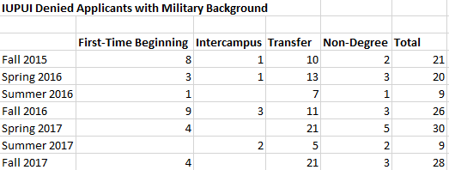
Denied/Deferred – Historic IUPUI Data

Slide 8
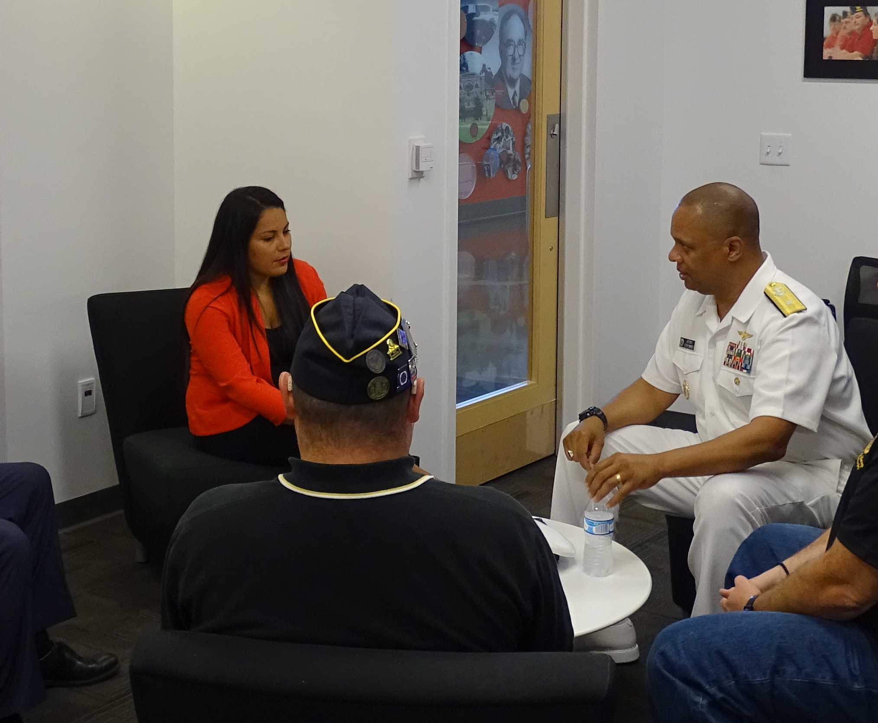
Suggested Policy
Current and former US Service Members who do not meet current admissions standards that have completed initial training and served one year or more of aggregate* active duty service in the US Armed Forces will be admissible into University College, pending holistic committee review.
These students will be admitted into the university with expectations of the following:
              Targeted Military Orientation
              Targeted TLC or 2+ Day Military Transition Workshop
              Attend meeting with a Peer Coach
              Attend regular meetings with a Faculty-Staff Coach
              Enroll in a Math class in their first semester at IUPUI or at a transferrable institution
*Aggregate means having completed the basic and advanced courses and having been under service contract for one year or more.

Slide 9
Re-thinking Admission Review
By evaluating military students through a holistic process that considers military transcripts and experience, less emphasis is placed on grades or test scores received prior to military service.
Additional documents will be required:
DD Form 214
Joint Services or Community College of the Air Force Transcript
Essay (Describe your academic and career plans and any special interests that you are eager to pursue as an undergraduate at IUPUI. If you encountered any unusual circumstances, challenges, or obstacles in completing your education, share those experiences and how you overcame them.)

Slide 10

Committee Review
5 committee members
  2 Admission staff
  2 Faculty
  1 Representative from the OVMP
Review Rubric: 5 areas of interest
  Type of Discharge & Military Standing
  Citations
  Development of Purpose
  Writing Composition
  Academic Standing

Slide 11
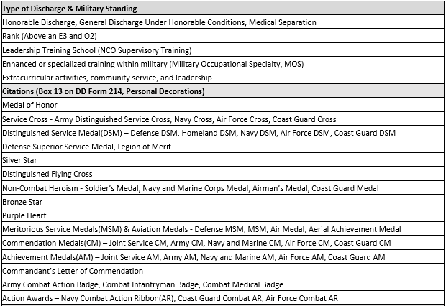
Holistic Scoring Rubric, pt. 1

Slide 12
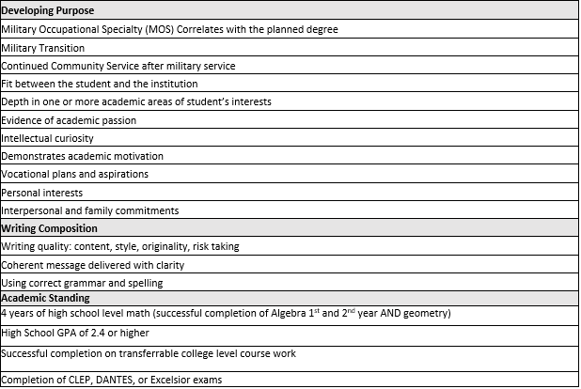
Holistic Scoring Rubric, pt. 2

Slide 13
Holistic Scoring Rubric, pt. 3
Applicants will be able to achieve a maximum score of five. The scoring key below will guide the committee’s final determination on admissibility:
  Score 5 = Student demonstrates the ability to achieve high levels of:
    Student Retention (Persistence)
    Educational Attainment
    Academic Achievement
  Score 3 to 4 = Student demonstrates the ability to achieve moderate levels of:
    Student Retention (Persistence)
    Educational Attainment
    Academic Achievement
  * Score 1 to 2 = Student demonstrates the ability to achieve low levels of:
    Student Retention (Persistence)
    Educational Attainment
    Academic Achievement
*These students will be deferred, with recommendations to begin an undergraduate program at Community College

Slide 14

Our 1st cohort
2 women, 5 men
Average Age: 27.1
Average HS GPA: 2.14 (4.0 scale)
  Highest GPA: 2.67
  Lowest GPA: 1.52
Average military service period: 5.5 years (44.5 years total!)
9 students reviewed, 8 admitted, 7 enrolled for Fall 2019

Slide 15
Steps to Enrollment
Once admitted, students were sent personalized acceptance email & mailed letter
  Letter includes the following suggestions:
    Military Orientation
    Warrior Transition Seminar
    Math Enrollment (1st semester)
    Peer Coaching
  Students were also included in admitted student communication campaign to continue providing further information not provided within personalized letter

Slide 16

Warrior Transition Seminar Function
The OVMP:
  Sends Email communications to these students to say:
    Who
    When
    Where
    What
  Discusses the Warrior Transition Seminar Function at orientation

Slide 17
Warrior Transition Seminar Function
Objectives
Primary
To assist in the success of each student by providing them with a set of skills necessary to be successful at IUPUI.
Secondary
To create a program that provides participants with a foundation of knowledge about the University and it’s resources so that the student can achieve their educational goals.

Slide 18

Warrior Transition Seminar Function
Specifics:
  One week workshop, daily 9am to 3pm
  Participants
    Offered to all incoming military students, but
    priority given to Holistic Review students
    Typically less than 15 credit hours
    transferred into the University
  Canvas course site
  Student success coaching
  Each student received a copy the book
  The Strategic Veteran Student by David Cass
  AND a binder for daily lessons and resources!

Slide 19
Warrior Transition Seminar Function
Format:
  Students received an agenda daily
  Courses set like a regular class schedule
    Ex. Math – Mon/Wed/Friday
  Daily Mash Ups
  Had Lunch with various groups and times
  Resource and skills workshops
  Online Canvas Site
Budget:
Direct Expenses
Binders: $ 35.00
Faculty: $1,600.00
Lunches: $1,227.83
$2,862.83
Indirect Expenses
Staff Salaries

Slide 20
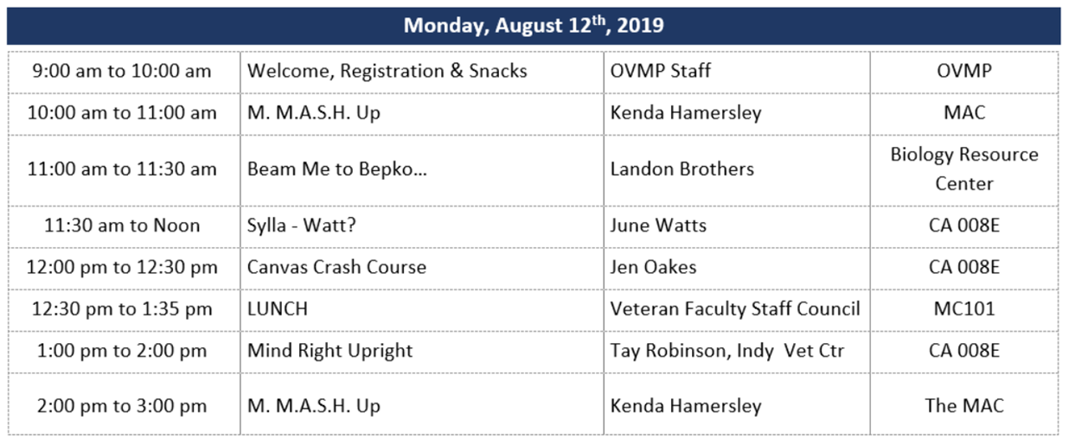
Warrior Transition Seminar Function
Highlights
  First day welcome
  The locations change
  Instructors are experts
  VA Indianapolis Vet Center
  Snappy Names & Bios

Slide 21
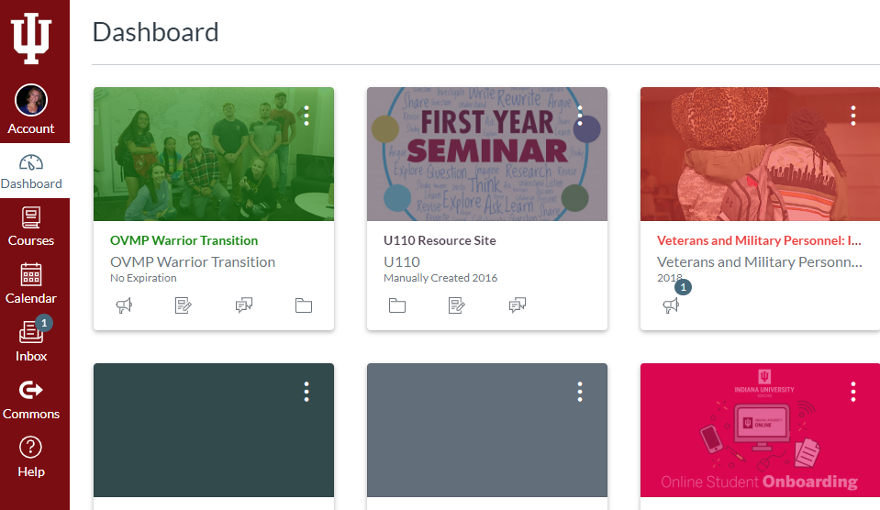
Warrior Transition Seminar Function
Specifics:
  Beam Me to Bepko
    Student Success Resources
  Sylla-Watt
  Canvas Crash Course
    Homework
    Assignments
    Announcements
  Mind Right Upright, Upright Mind Right
    Imposter Syndrome
    Loss of Sense of Purpose
    Stress Management
    Group Work
    High Stress Environment to Low Stress Environment

Slide 22
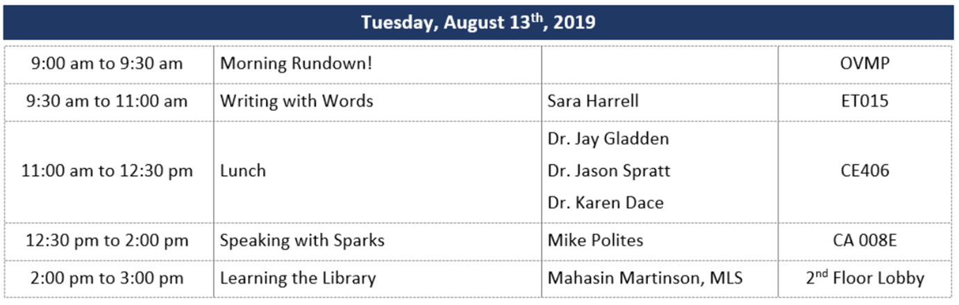
Warrior Transition Seminar Function
Highlights
  Morning Rundown!
  Different courses
  Lunch Group – Higher Admin
  Speech Assignment

Slide 23
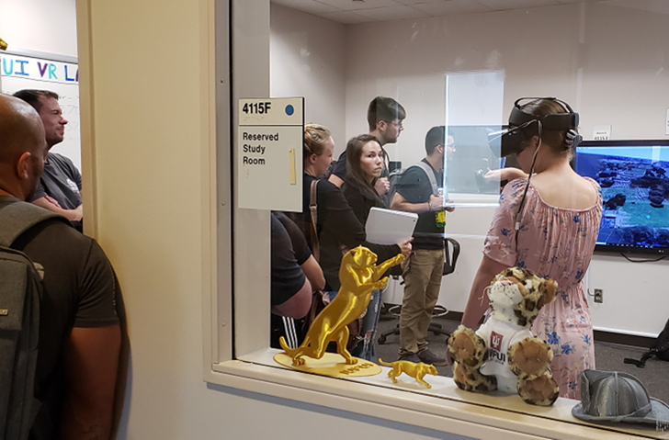
Warrior Transition Seminar Function
Specifics:
  Morning Rundown!
    Tue/Thurs/Fri
    Consisted of
      Time Management
      Classroom Skills
      Study Skills
      Testing Skills
  Higher Administrators
  Speech Homework
  Introduction to Physical Library

Slide 24
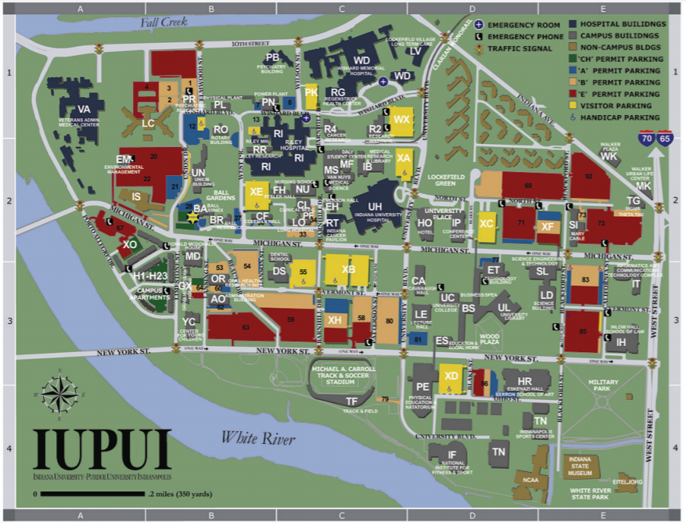
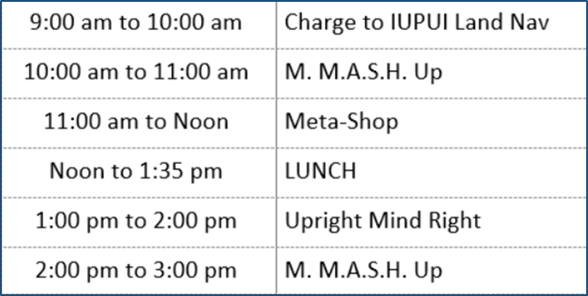
Warrior Transition Seminar Function
Specifics:
  IUPUI Land Nav
    Instructions of project
    Provided an IUPUI Map
    Had to take photos at various locations
  Meta-Shop
    Metacognition Cycle and how to use it as a student
  Student Veteran Organization

Slide 25

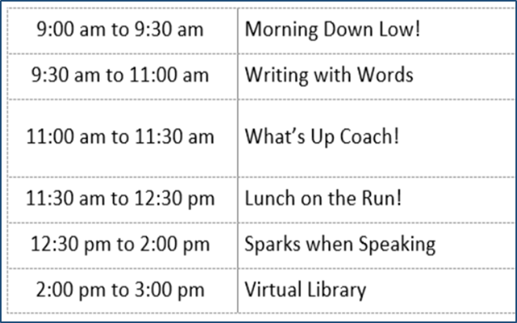
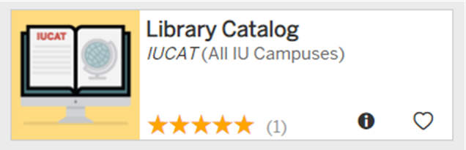


Warrior Transition Seminar Function
Specifics:
  Sparks when Speaking
    2nd Part
    Homework realized
  Lunch on the Run!
  Virtual Library

Slide 26
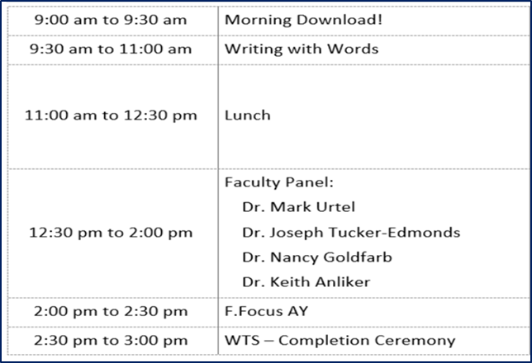
Warrior Transition Seminar Function
Specifics:
  Faculty Panel
    Various Departments
    Present were
      Program Chair
      Adjunct Faculty Member
      Full time faculty
  American Legion University Post 360
  Looking Forward

Slide 27
Warrior Transition Seminar Function
Student Evaluations:
  Out of the 10 who showed up 9 completed the majority of the quizzes.
  Conducted on the WTS Canvas Site as quizzes.
  Questions were given, but the points don’t matter.
  Questions consisted of
    Multiple choice
    True/False
    Fill in the blank
    Agree/Disagree/Neutral/Something else
    Essay

Slide 28
Warrior Transition Seminar Function
Student Feedback
The lengthy writing portion of the underground WTS program was probably beneficial to my overall writing ability, and maybe helped with by brief brevity.
Getting hands on with some actual math problems before the start of classes what a huge help for me! It helped break off a ton of "rust" and as a plus I got a chance to meet my professor!
When asked about obstacles all were positive
This entire class was perfect for my learning method. I feel I'm going to be successful because of it. No obstacles were faced as far as my learning goes.

Slide 29
Warrior Transition Seminar Function
We asked student to give 1 - 3 specific things about the program that they feel made a difference to their education.
  Student One:
    Everything we learned in the MAC! Every bit of the math brush up skills greatly helped me prepare!
    Brushing up on my writing skills. While also being taught the different methods that will be used at the college level.
    Navigation! I feel like I can with fill confidence walk around campus and know where I'm going! In fact, I feel I could probably give someone directions on how to get somewhere!
  Student Two:
    Talking with different faculty members and students.
    Learning about different programs and things available to me at the school like the MAC and Bepko.
    Learning on different skills and different approaches to handle or solve something.

Slide 30
Outcomes
AVG Fall 2019course load: 13.7 credits
AVG Spr 2020 course load: 14.4 credits
Holistically reviewed students
  WTF – 5/7 attended*
  Retention – 100%
AVG 1st semester GPA: 3.03
  High GPA: 3.19
  Low GPA: 1.77*
Regularly admitted students
  WTF – 5/6 attended
  Retention – 83%
AVG 1st semester GPA: 2.3
  High GPA: 3.83
  Low GPA: 0.00*

Slide 31
Warrior Transition Seminar Function
Lessons Learned
Staff-Based
Student-Based
Homework Assignment
Present on a chapter of the Text The Student
Veteran OR choose one of the
handouts (i.e. Study Skills, Test Skills, etc.)
Homework Assignment
The speech portion of the program was great! It gave us a chance to actually stand up in front of a group and see where we are at skill wise. I do feel at times the instructions were a bit confusing and unclear, but we worked out some kinks and made do! Also I feel if the assignment was given on Monday vise Tuesday there would have been more time to prepare and rehearse our speeches.
Land Nav
Post at least two photos on the Canvas Site
Lunch
Have “Lunch on the Run” on 1st day
Get younger vets involved
Canvas Quizzes
Discuss in depth what to expect
Mental Health
Reduce to one day, use Meditation
Land Nav
Tailor the groups together with similar majors and have them look for classes they have or at least in the building they have them in. Keep the resource centers in the land nav to help students know where they can go for assistance.

Slide 32

Holistic Review Pilot
Lessons Learned
Communication is key!
  Contact applicants asap
  Set clear expectations
  Follow up
Committee reviews take time, be prepared
  In person vs. online review
Essays play essential role in review
Mathematical ability is difficult to determine

Slide 33
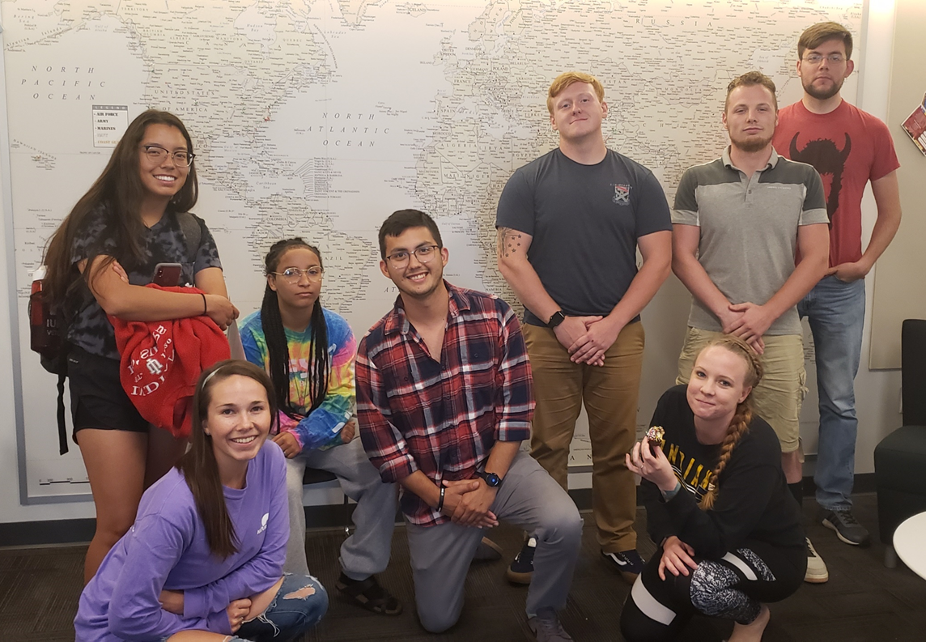
Members of the inaugural WTS Cohort

