Slide 1
Placement of a School Certifying Official and its Impact on Employee Satisfaction and Commitment
Meshell LaBaun, ABD
Military Benefit Specialist
Sullivan University
Notes:
Years working with MCS and KAVECO

Slide 2
Who am I?
Started working in higher education in 2001 (1997 if you count work-study)
Treasurer and founding board member of KAVECO
Currently have approximately 300 military-connected students I assist students using
ArmyIgnitED
VAOnce
WAWF
AI Portal
MyCAA
KY National Guard

Slide 3
Why?
Institutes of Higher Learning (IHL) are provided with a list of requirements of the responsibilities of School Certifying Officials (SCO) but not with the location within the institution
The SCO must collect necessary information from across the institution to report to the federal government and is monitored by the state government, this classifies it as ambidextrous and boundary-spanning
This study’s purpose is to determine how an ambidextrous organizational perspective of a boundary spanning position, such as an SCO, influences the commitment and satisfaction of the SCO and ultimately enable IHLs the insight into how SCO placement impacts employees
Notes:
Discuss Daily & Fox Garritty (2013)
SCO handbook

Slide 4
Research Questions
How does the departmental placement of a School Certifying Official influence their job satisfaction?
How does the departmental placement of a School Certifying Official influence their affective organizational commitment?

Slide 5
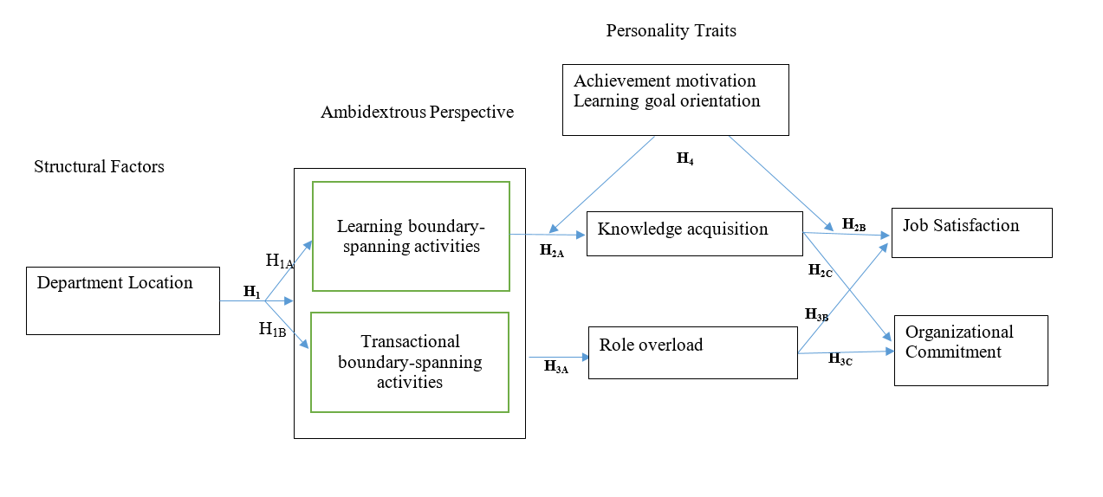
Conceptual Model
Notes:
Show of hands? Is that possible with virtual? Where people are within an organization

Slide 6
Background
An organization which requires innovation and improvement is considered ambidextrous, they look for growth between either path as they refine processes through either innovation or improvement
A position of SCO has been found to be one in which organizations have developed innovative ideas on location and full job duties while leaving the individual to improve processes among changing legislative requirements
SCO position has been found to be located within various departments across industries based upon what has been determined to be the best fit to student service, financial aspects, or course requirements while at the same time either data entry or holistically viewing the student

Slide 7
Background
IHLs fall into a wide variety of business models and organizational structures
Dept. of VA regulations allows for SCO to be housed within any department: faculty, administration, admissions, financial aid, academics, bursar, student services, or military affairs.
Daly & Fox Garrity (2013) reviewed the various positions SCOs held at IHLs and recommended that students were best serviced by a mid-level employee in a department focused on military affairs
The evolution of the GI Bill ® over the past 75 years has demonstrated that an SCO must be ambidextrous to ensure quality service to veterans as they innovate processes around a changing benefit
Notes:
Take the time to discuss each department and how an SCO fits

Slide 8
Background
Learning Boundary-Spanning – involves innovating based upon learning new information from outside of the department
Transactional Boundary-Spanning – involves improving current practices to improve efficiency and/or service
Boundary Spanning assists with job satisfaction as it increases the need to coordinate and can be viewed as a vital task
SCOs may feel commitment toward the organization or toward students
Focus on affective commitment, this is connected with gaining knowledge and role responsibilities

Slide 9
Background
Employees vary in how and if they chose to search out and find information
Must understand how each employee varies in their role, and how it impacts the overall organizational information flow
Achievement motivation: need for achievement, need for power, relationships
Learning goal orientation: personal drive

Slide 10
Research Design
Survey Research methodology
Survey is a partial replication of instrument created by Wang, Liu, & Liu (2019) along with TCM Commitment Model (Meyer & Allen, 2004)
Wang et al survey was adjusted to apply to IHL instead of IT industry
TCM Commitment Model only utilized affective commitment section
Questionnaire was administered electronically via Survey Monkey
Choice selection and Likert-scale rating questions
Notes:
Total number of questions

Slide 11
Survey Instrument
Demographic questions
Statements regarding constructs of
Boundary spanning activities
Role overload
Knowledge acquisition
Achievement motivation
Learning goal orientation
Satisfaction
Affective commitment

Slide 12
Variables
15 total variables
Control: department interactions, veteran population percent, age, gender, veteran status, percent time with military students, and years in higher education
Independent: location, learning boundary-spanning activities, and transactional boundary spanning activities
Mediating: knowledge acquisition, role overload
Moderating: achievement motivation, and learning goal orientation
Dependent: job satisfaction and affective commitment

Slide 13
Population
Must have
2 or 4 year degrees
Regional accreditation
SCOs within IHLs of the USA and DC, 1865 IHL facilities meet criteria with an estimated 5035 SCOs
Notes:
Explain POE and 8 keys – next slide

Slide 14
Sample Size
Samples sizes of 107 using G*Power 3.1.9.7; 220 for χ²; 240 as a simple sample size; 184 using a-priori for CFA
492 responses were received, only 422 responded to answers after demographics
After data clean up N = 371

Slide 15
Data Analysis
Descriptive Statistics:
34.5% work in registrar, 22.9% military services, 21.8% financial aid, 11.9% student services, 1.9% admissions, 1.6% bursar, 0.3% faculty, 5.1% other
43.2% over 50 years of age, 24% 40-49, 25.3% 30-29, 7.5% 18-29
64.2% working in higher ed over 10 years
41.8% working in military higher ed over 10 years
76% are not veterans
67.1% female
39.9% have a school population of 1501-5000
27.2% have a veteran population of 151-500

Slide 16
Correlations

Slide 17
Cronbach’s Alpha

Slide 18
Confirmatory Factor Analysis
Determined the model was a good fit with the reduced variables
CMIN/DF = 1.513
GFI = 0.992
CFI = 0.994
RMSEA = 0.07
Boundary-spanning was the only variable which did not show to have significant AVE or CR

Slide 19
Hypothesis Testing H1, H1A, H1B
Notes:
H1 Structural position of an SCO has an impact on boundary-spanning activities. retained
H1A Structural position of an SCO will have a positive impact on learning boundary spanning activities. retained
H1B Structural position of an SCO will have a positive impact on learning boundary spanning activities. retained

Slide 20
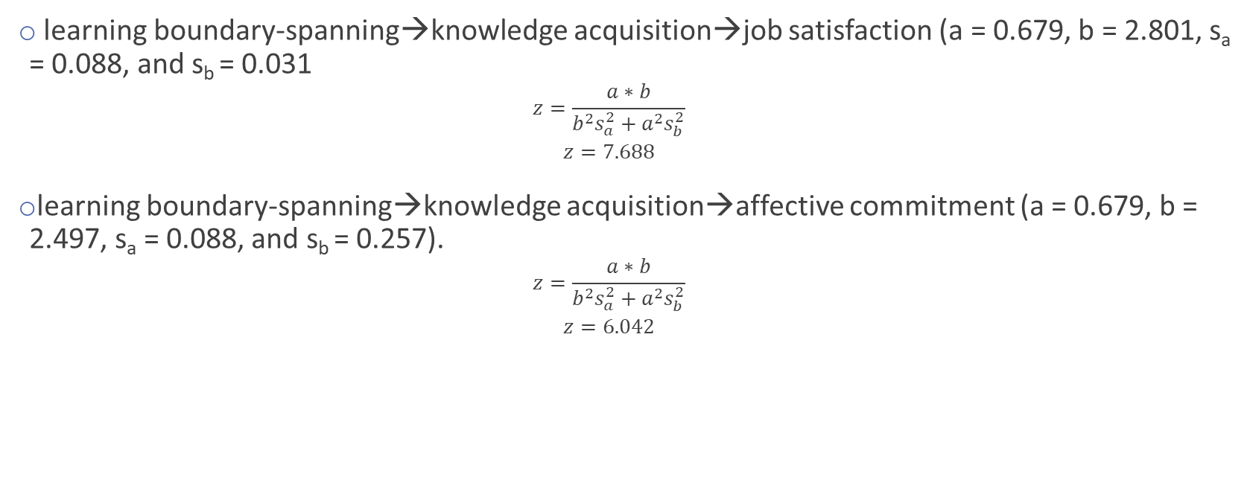
Hypothesis Testing H2
learning boundary-spanning→knowledge acquisition→job satisfaction (a = 0.679, b = 2.801, s_{a} = 0.088, and s_{b} = 0.031
$$z=\frac{a∗b}{b^{2}s_{a}^{2}+a^{2}s_{b}^{2}}$$
$$z=7.688$$
learning boundary-spanning→knowledge acquisition→affective commitment (a = 0.679, b = 2.497, s_{a} = 0.088, and s_{b} = 0.257).
$$z=\frac{a∗b}{b^{2}s_{a}^{2}+a^{2}s_{b}^{2}}$$
$$z=6.042$$
Notes:
H2: knowledge acquisition of an SCO plays a mediating role between LBS activities and employee’s JS and AC. retained
Z is greater than +/- 1.96, larger difference than standard

Slide 21
Hypothesis Testing H2A
Notes:
H2A LBS activates have a positive impact on Knowledge acquisition. retained

Slide 22
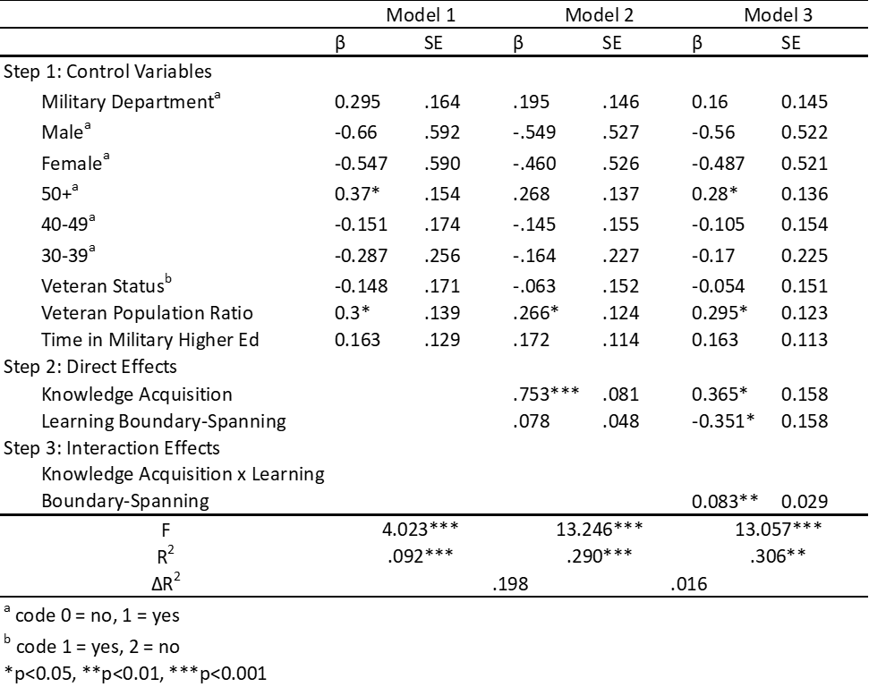
Hypothesis Testing H2B
Notes:
H2B: Knowledge acquisition has a positive impact on job satisfaction. retained

Slide 23
Hypothesis Testing H2C
Notes:
Knowledge acquisition has a positive impact on affective commitment. retained

Slide 24
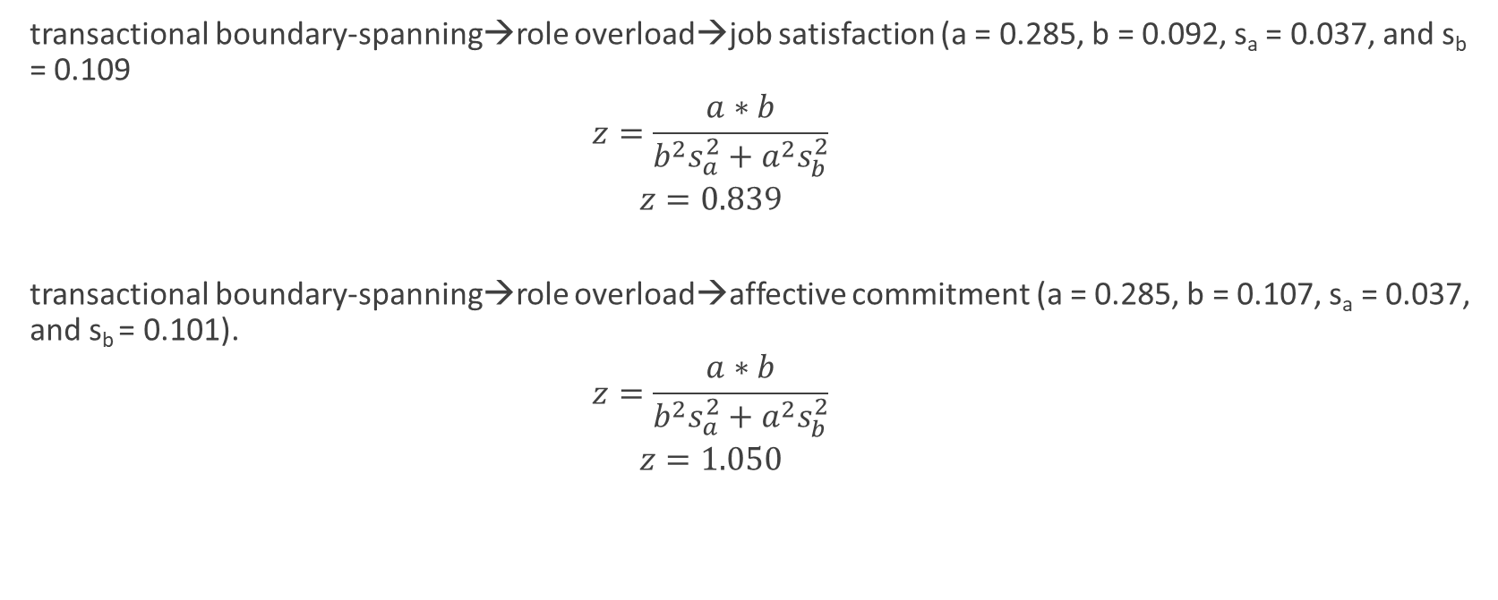
Hypothesis Testing H3
transactional boundary-spanning→role overload→job satisfaction (a = 0.285, b = 0.092, s_{a} = 0.037, and s_{b} = 0.109
$$z=\frac{a∗b}{b^{2}s_{a}^{2}+a^{2}s_{b}^{2}}$$
$$z=0.839$$
transactional boundary-spanning→role overload→affective commitment (a = 0.285, b = 0.107, s_{a} = 0.037, and s_{b} = 0.101).
$$z=\frac{a∗b}{b^{2}s_{a}^{2}+a^{2}s_{b}^{2}}$$
$$z=1.050$$
Notes:
H3 The role overload that an SCO perceives plays a mediating role between transactional boundary-spanning activities and employee’s job satisfaction and affective commitment. rejected

Slide 25
Hypothesis H3A
Notes:
TBS activities have a positive impact on role overload. rejected

Slide 26
Hypothesis H3B
Notes:
Role overload has a negative impact on job satisfaction. retained

Slide 27
Hypothesis H3C
Notes:
Role overload has a negative impact on affective commitment. rejected

Slide 28
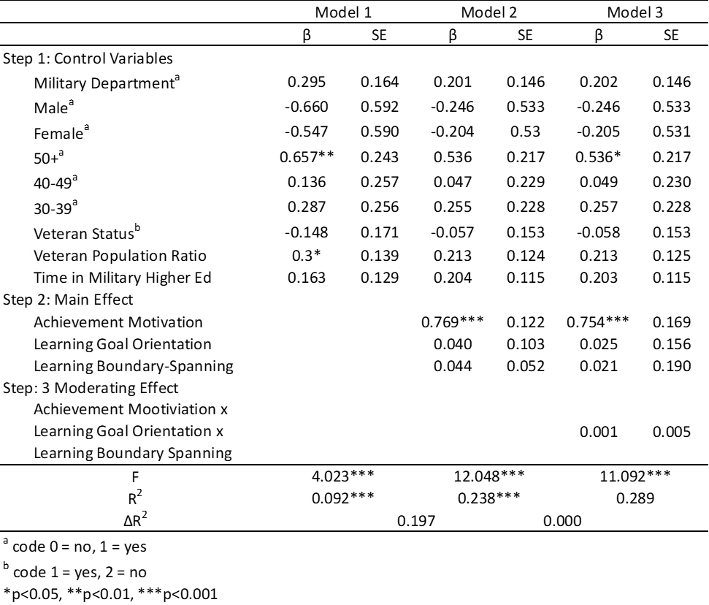
Hypothesis Testing H4
Notes:
High achievement motivation and learning goal orientation moderate the positive effect of learning boundary-spanning activities on JS. rejected

Slide 29
Findings
A relationship between SCO department and SCO’s boundary spanning abilities is found
Learning boundary-spanning does impact job satisfaction and affective commitment and is mediated by knowledge acquisition. Achievement motivation and learning goal orientation do not moderate the relationship
Transactional boundary-spanning activities do not impact affective commitment but there is a relationship with job satisfaction, role overload does not mediate this relationship.

Slide 30
Answering RQ1
How does the departmental placement of a school certifying official influence their job satisfaction?
Departmental placement does influence job satisfaction, it does this through both aspects of boundary-spanning and mediation from knowledge acquisition

Slide 31
Answering RQ2
How does the departmental placement of a school certifying official influence their affective commitment?
There is a relationship in part, mostly driven by learning boundary spanning

Slide 32
Conclusion
Boundary-spanning positions need to be further studied
More research needs to focus on employees primarily, serving students secondarily
Practitioners will hopefully understand their own position more

Slide 33
Discussion
Is there a best department?
How does our own job satisfaction and affective commitment influence our students?

Slide 34
Questions?

Slide 35
My contact information
Meshell LaBaun, ABD
mlabaun@Sullivan.edu
502-515-2547

