Slide 1

Cameron Cox, Intelecom Learning
myVRC: A Customizable Smartphone App for Your Student Veterans
February 4, 2020 | Seattle, WA

Slide 2

About Us
Joint Powers Authority
501(c)3 Non-Profit Corporation
Community College Consortium
Content Development
Educational Technology
Established 1970

Slide 3
Project Background
Project Timeline
Board Directive (2015)
Needs Assessment (2016)
App Developer Selected (2017)
Development Begins (2018)
Soft Launch (2019)
Product Launch (2020)
Advisory Group
VRC Directors
Counselors
Certifying Officials
Student Services
DSPS
Student Veterans

Slide 4
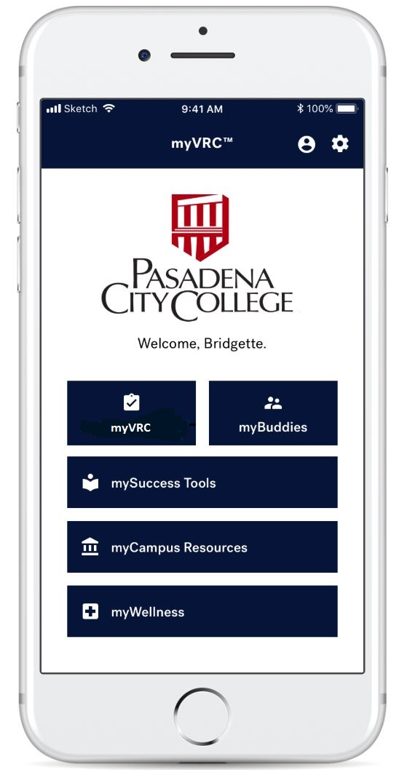
myVRC: Customizable Smartphone App
Improve Equity and Success
Increase Accountability and Completion Rates
Build Community of Learning
Extend VRC Reach and Capacity
Decrease Probation or Dismissal Rates
Address Mental Health and Isolation Issues
Enhance On-Boarding and Transition Process
Customizable by College or University
No IT or SIS Integration Required
WCAG and FERPA Compliant
No Cost to Your Student Veterans

Slide 5
Reach Your Veterans Where They Are
Campus VRC Information
On and Off Campus Resources
Mental Health
and Wellness Resources
Personal Profile
In-App Chat Social
Media Feature
Academic Success Tools and Resources

Slide 6
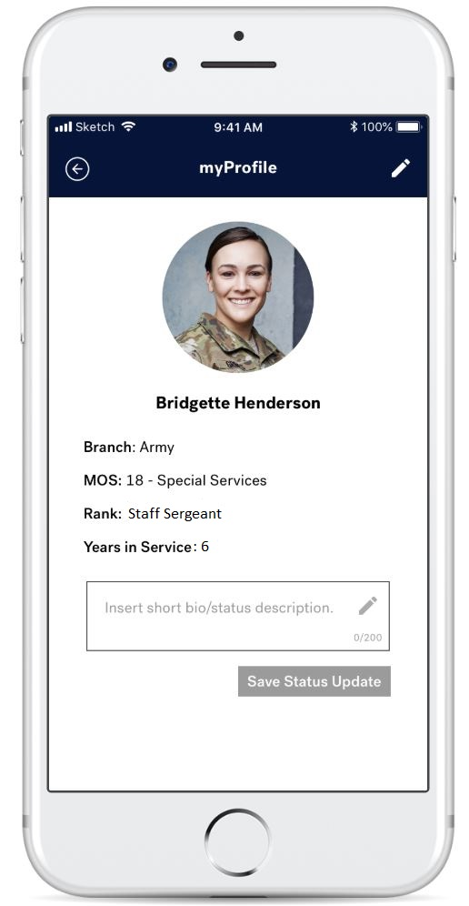
Key Feature: myProfile
User-Level Feature
Profile Picture
Military Branch
Rank
MOS
Years in Service
Current Status
Proposed
Major or Field of Study
Skin Themes (by Branch)

Slide 7
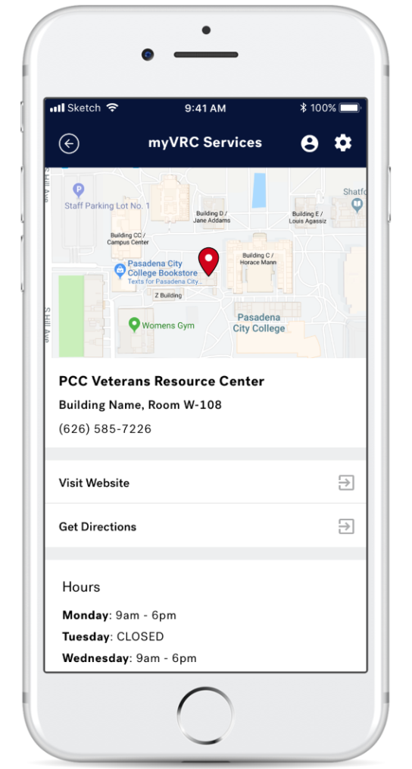
Key Feature: myVRC
Campus Map (Google)
VRC Campus Address and Hours
VRC Phone and Website
VRC Staff Information
Quick Links (e.g., HealtheVet)
Under Consideration
Forms and Documents
Push Notifications
Need Assistance

Slide 8
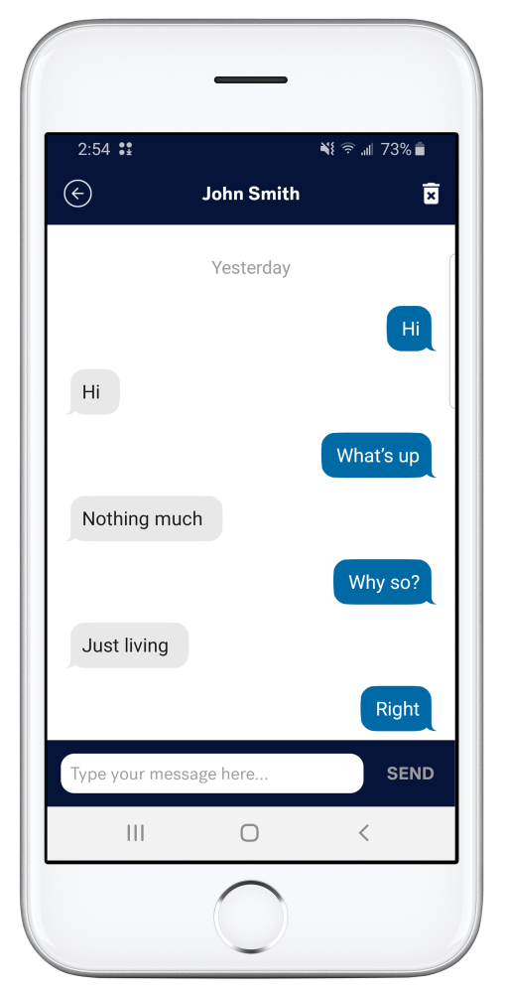
Key Feature: myBuddies
Social Network In-App Chat
Text Only (no Images, Video)
Build Your Own Social Network
Ability to add, delete, block
Administrator Access
Proposed
myCadre (Who’s Got Your Six?)

Slide 9
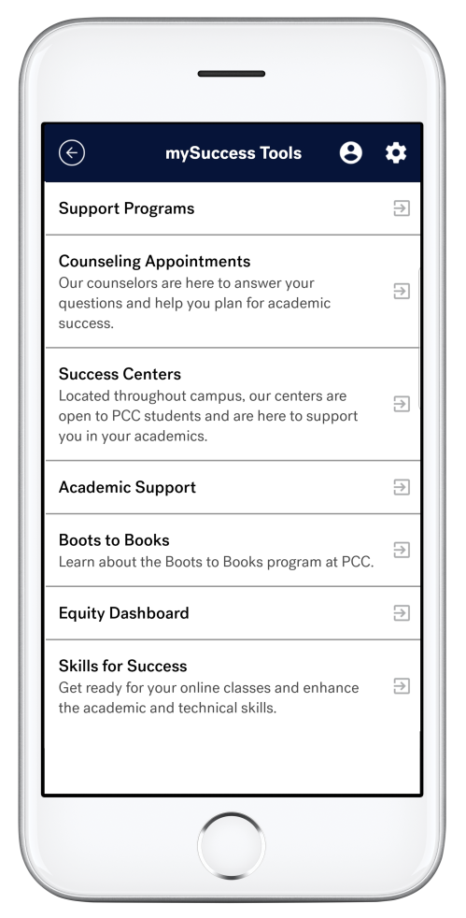
Key Feature: mySuccess Tools
Links to Success Tools
Up to 10 Links
Resource Name, Description, Link
Easily Add, Edit, Delete
Examples
Study Skills
Time Management

Slide 10
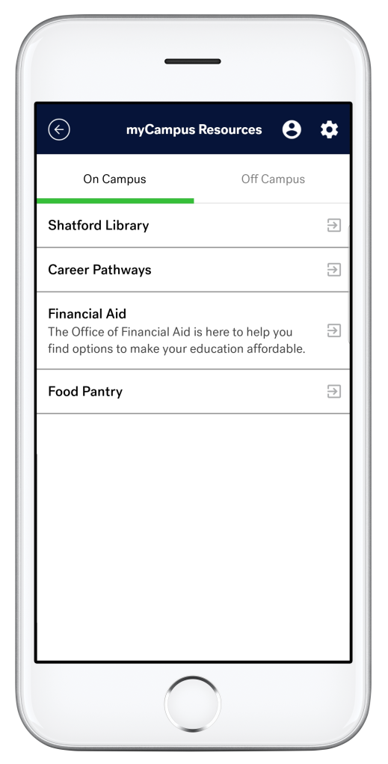
Key Feature: myCampus Resources
Links to Campus Resources
Both On and Off Campus
Resource Name, Description, Link
Up to 12 Each
Easily Add, Edit, Delete
Examples
Student Center
Financial Aid
Area Goodwill, VFW, Food Pantry

Slide 11
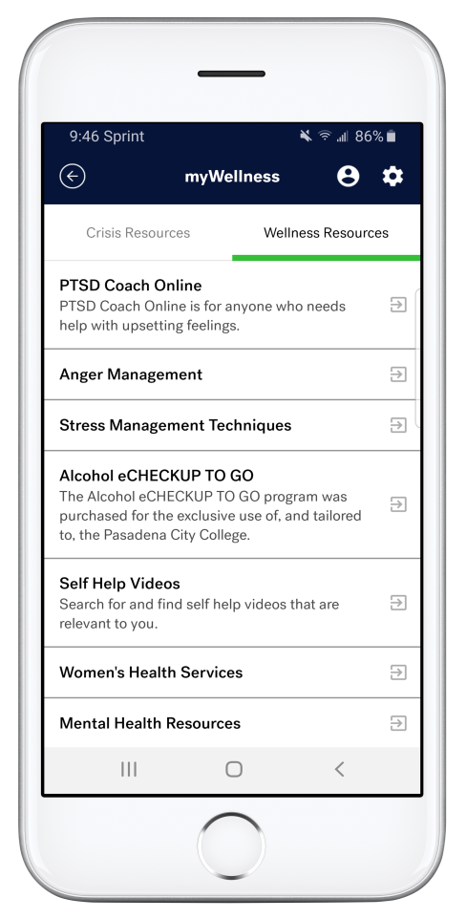
Key Feature: myWellness
Links to Wellness Resources
Both Crisis and Wellness
Resource Name, Description, Link
Up to 12 Each
Easily Add, Edit, Delete
Examples
800 Press 1
Outside the Wire
PTSD Coach

Slide 12
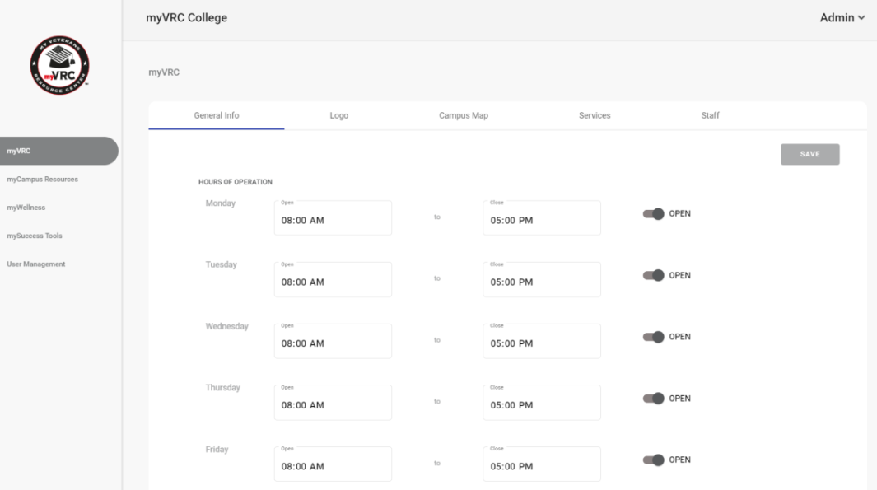
Campus Site Administrator Portal
24/7 Database Access
Password Protected
Add, Edit, Delete Links
Add Campus Map, Logo
Add, Edit, Delete Resources
User Management
Proposed
Discussion Forum
Campus Usage Metrics

Slide 13


WCAG and FERPA Compliance
WCAG Level A, AA Compliance Audit
Manual, Technical Assessments for PII and Data Protection

Slide 14
How to Participate
Available by Subscription
Annual Subscription (Renewable)
Pricing Based on Campus ‘Certified Student Veteran’ Population
Multi-Year Subscriptions Available
Multi-Site (District, Consortium) Discounts
Includes New Features, Support and Maintenance
Demo Version
Download ‘myVRC’ from Apple Store or Google Play
User: joe.student@mycollege.edu, jane.student@mycollege.edu
Password: Asdf@123

Slide 15
Thank You!
For More Information or to
Request an Online Demonstration for Your Campus
www.myvrc.net
Cameron Cox Meg Cundiff
ccox@intelecom.org mcundiff@intelecom.org
323.647.3606 323.647.3605

