Slide 1
II. Vegetative Propagation
Use of Apomictic Seeds
Use of Specialized Vegetative Structures
Adventitious Root Induction (Cuttings)
Layering
Grafting

Slide 2
a. Use of Apomictic Seeds
Apomixis = Development of seeds from maternal tissue inside ovule
Some apomictic seeds are formed from megaspore mother cells
Apomictic seeds produce plants that are genetically identical as maternal plants
Examples: Mango, Kentucky bluegrass, Citrus

Slide 3
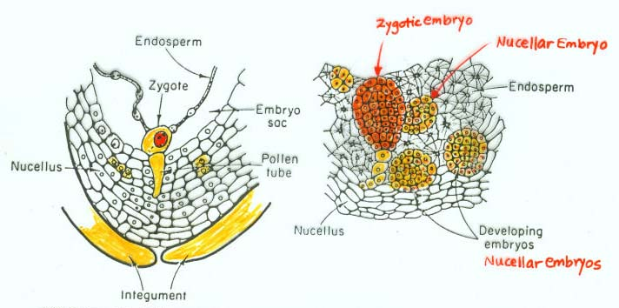
How is Apomictic Seed Formed?
Asexual seed formation from maternal tissues around zygotic embryo inside an ovule
Apomictic seeds can be formed from nucellar tissues, egg mother cell, flower heads (bulbils)
Found in Kentucky bluegrass, dandelion, citrus, Alliums
Nucellar embryos in Citrus

Slide 4
b. Specialized Vegetative Structures
Runners (Stolons)
Bulbs
Corms
Rhizomes
Off-Shoots
Stem Tubers
Tuberous Roots
Root Suckers

Slide 5
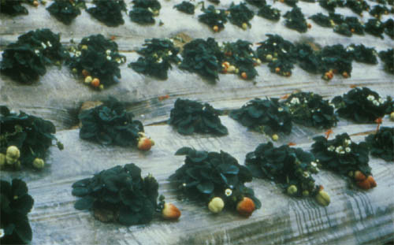
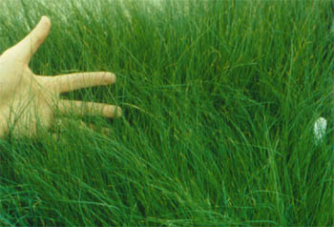
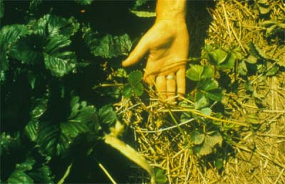
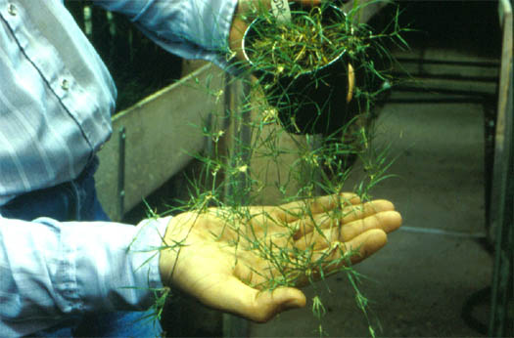
Runners (Stolons)
Above-ground running stems
New plants are formed on each node
Examples: Strawberry, Spider Plant, Buffalograss
Strawberry
Buffalograss

Slide 6
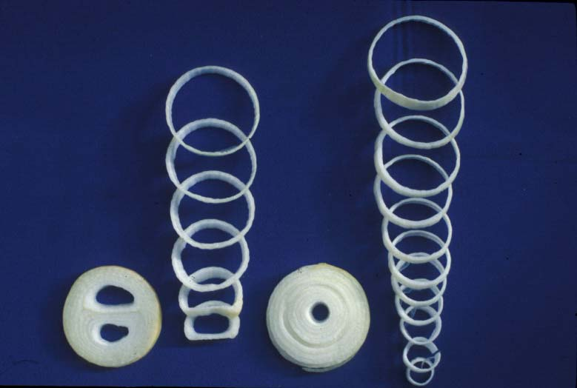
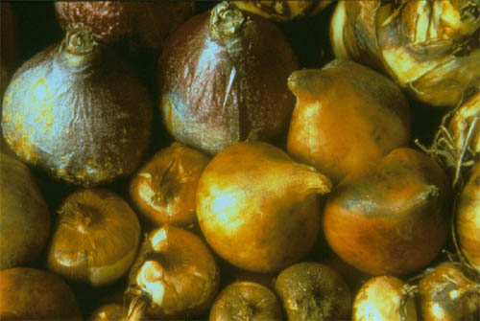
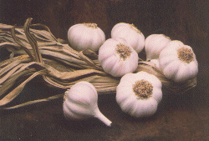
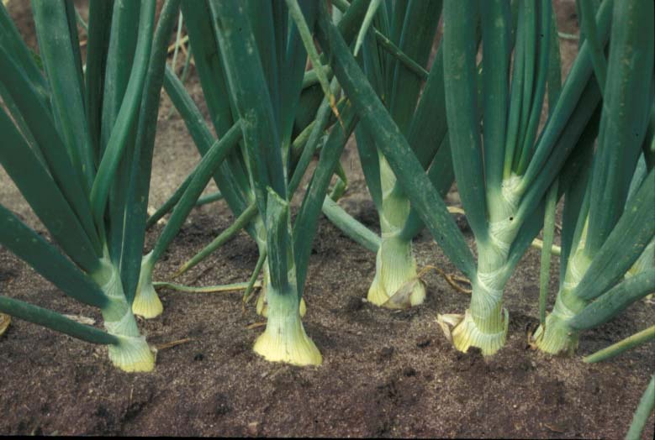
Bulbs
A specialized underground organ consisting of a basal plate, growing points, flower primordia, and fleshy scales
Found in monocots
Tunicate bulbs - Onion, tulip, garlic, hyacinth
Non-tunicate bulbs – Easter lily, Oriental lily
Bulblets, bulbils, stem bulblets

Slide 7
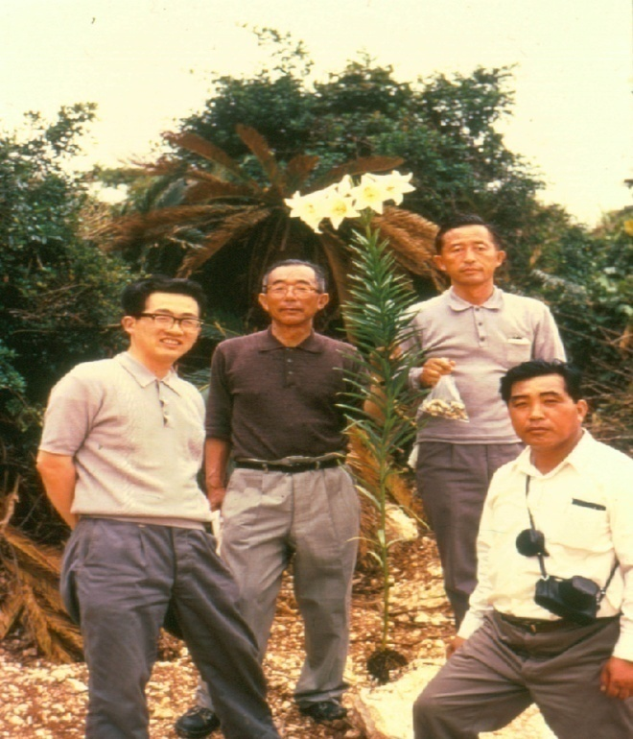
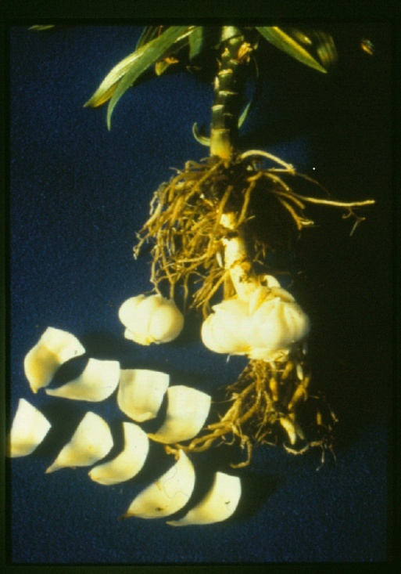
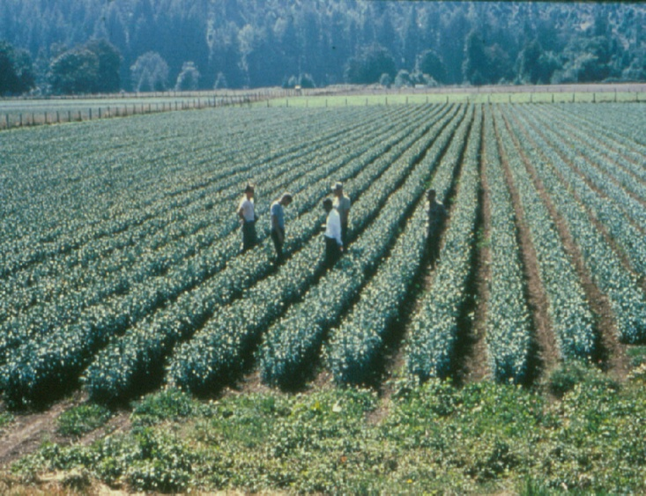
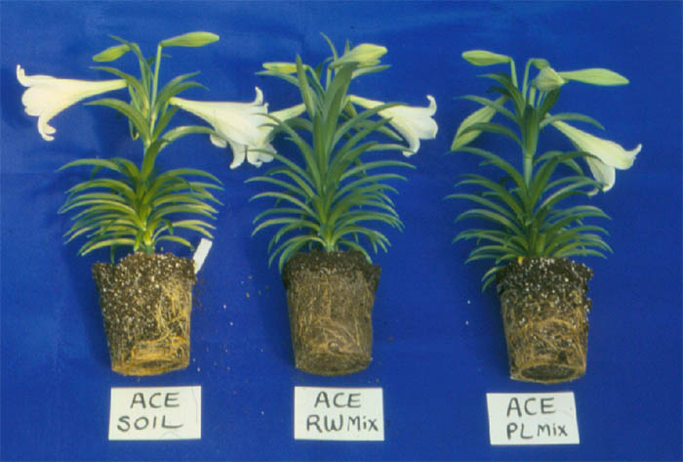
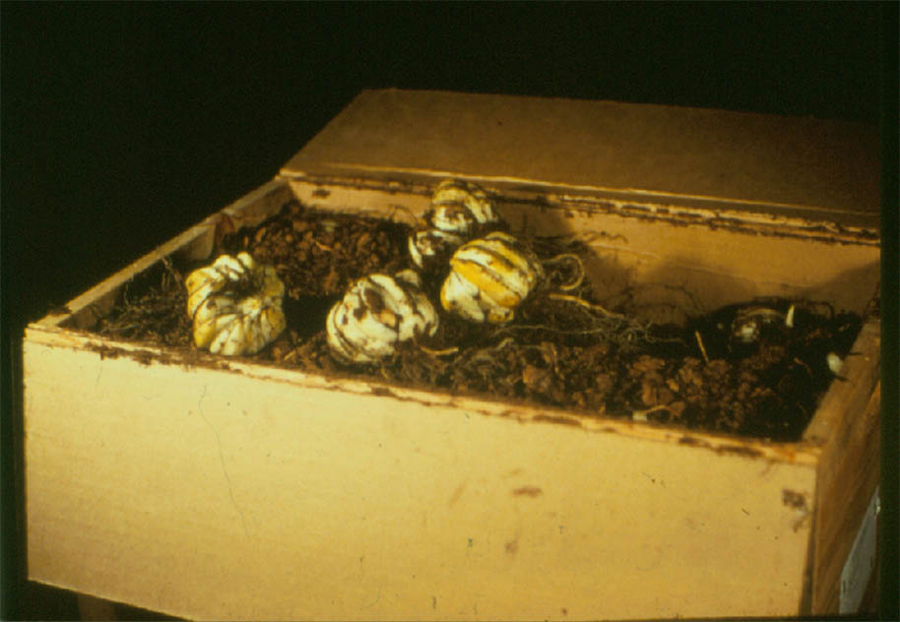
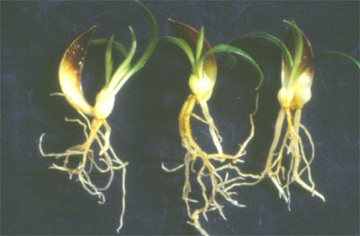
Scaly Bulbs: Easter Lily

Slide 8
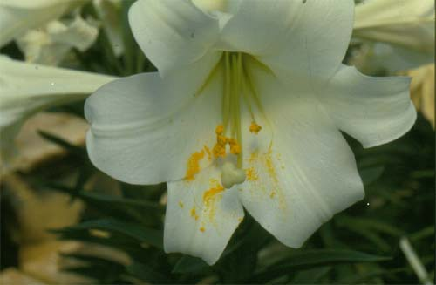
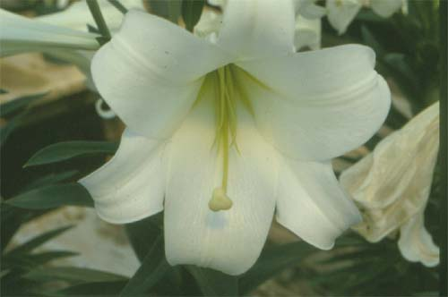
Anther Removal on Easter Lily Flowers
Pollen germination on stigma triggers ethylene release
Yellow color stain makes the flowers unsightly
Anthers intact
Anthers removed

Slide 9
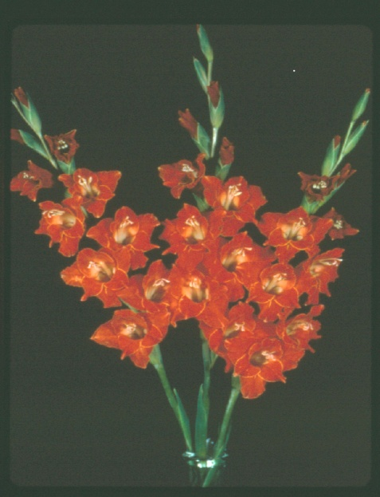
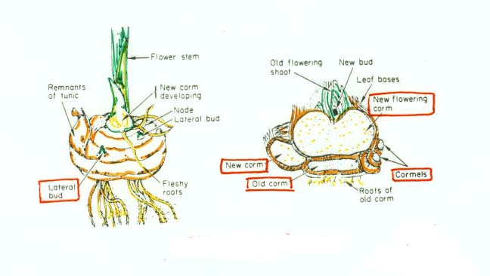
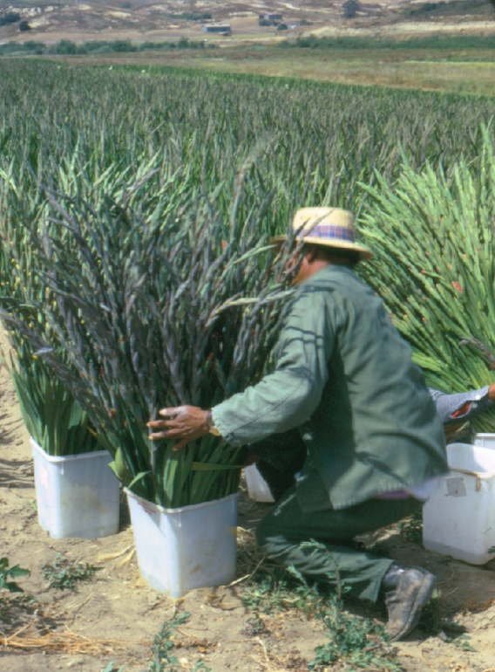
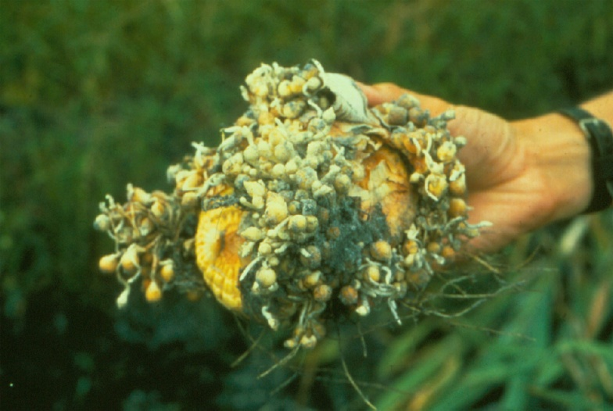
Corms: Gladiolus

Slide 10
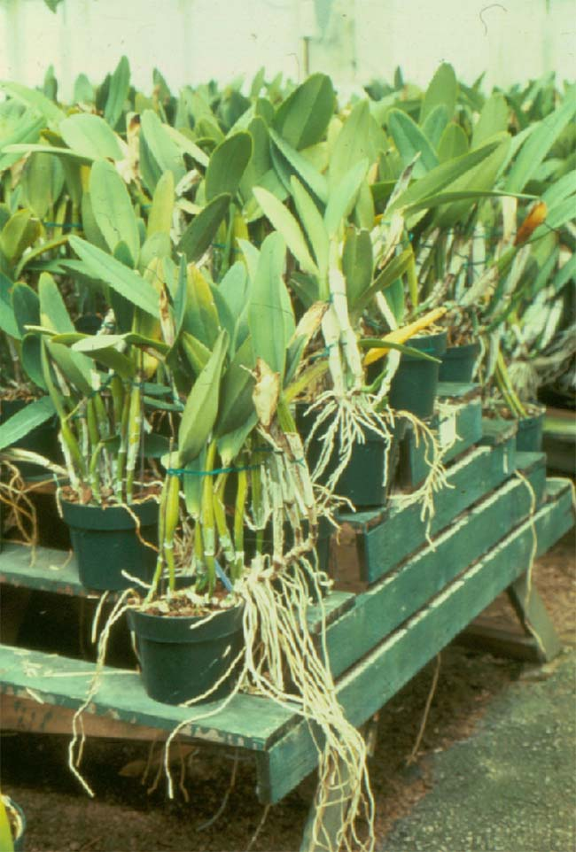
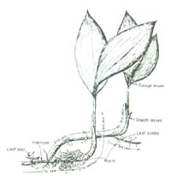
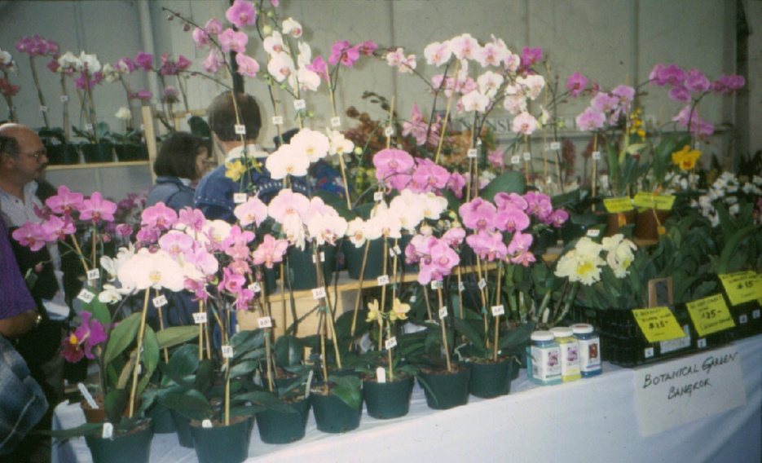

Rhizomes
Laterally grown underground stems
Iris, ginger, lily of the valley, orchid

Slide 11
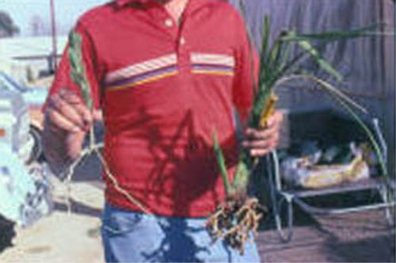
Offshoots
Lateral shoots, often with roots at the base, produced on main stems which can be separated and grown as independent plants
Examples: Pineapple (slip), dendrobium, cymbidium

Slide 12
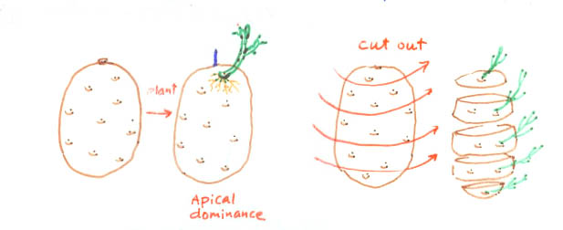
Stem Tuber
Tuber is a swollen, modified stem structure that functions as an underground storage organ
Examples: potato, caladium, Jerusalem artichoke
Use of eyes in potato propagation

Slide 13
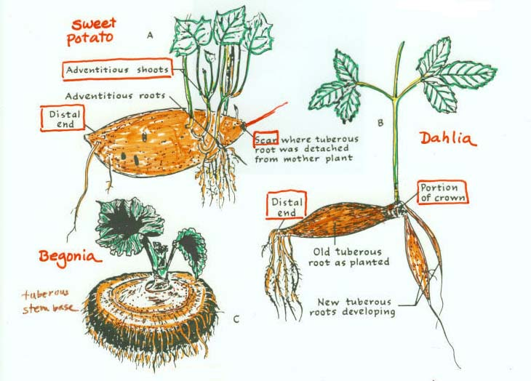
Tuberous Roots

Slide 14
b. Cutting Propagation
Detached stems and roots are used to induce adventitious roots or shoots
Woody Plants
    Hardwood cuttings
    Softwood cuttings
    Semi-hardwood cuttings
    Single-node cuttings
Root Cuttings
    Problem with phenotype conversion in chimeric plants

Slide 15
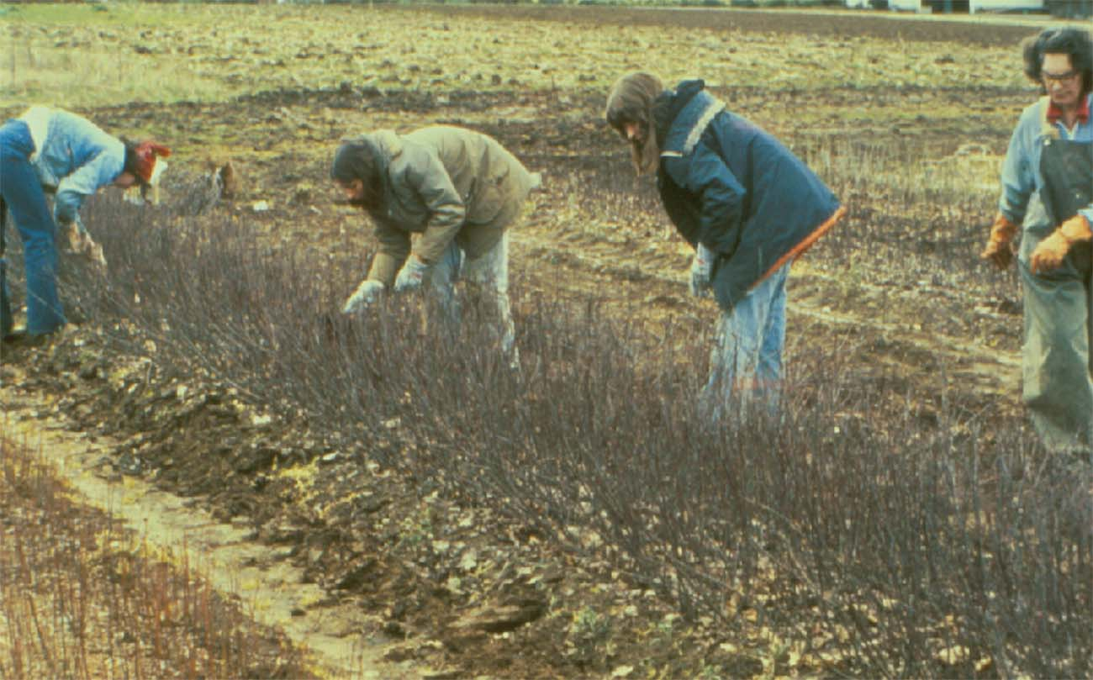
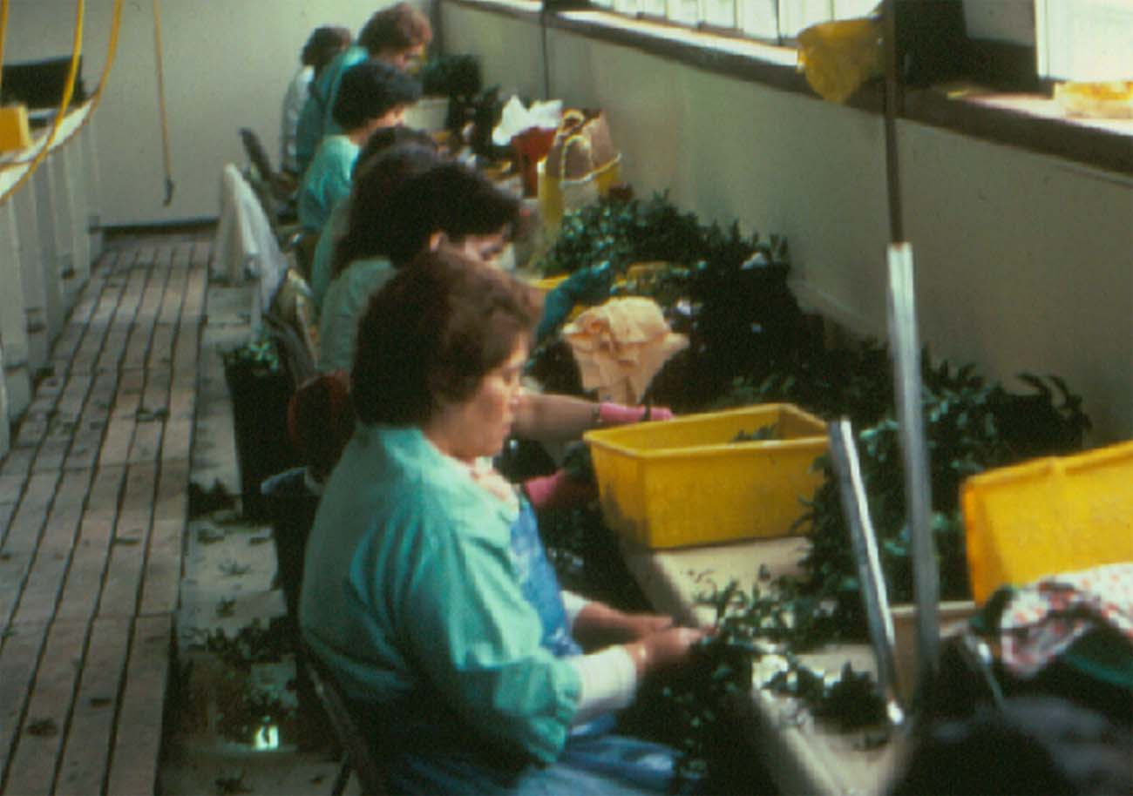
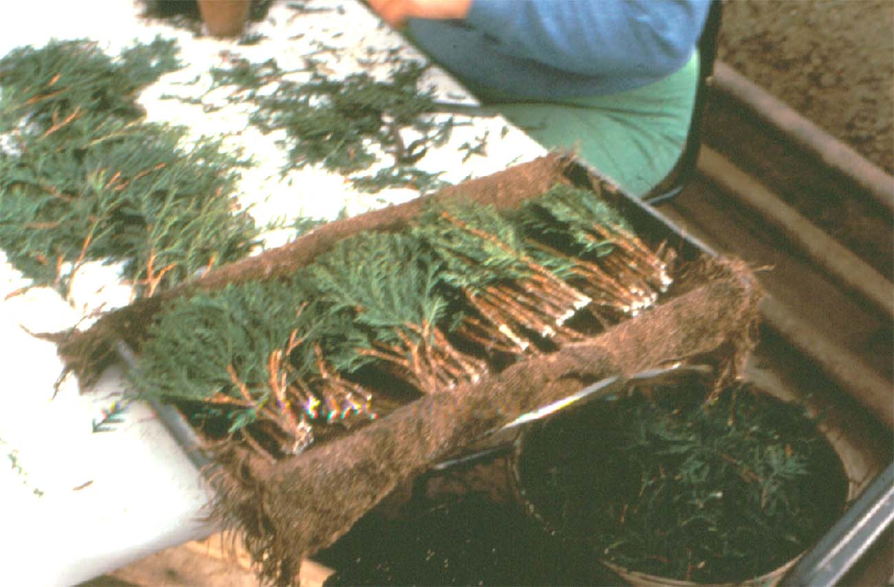
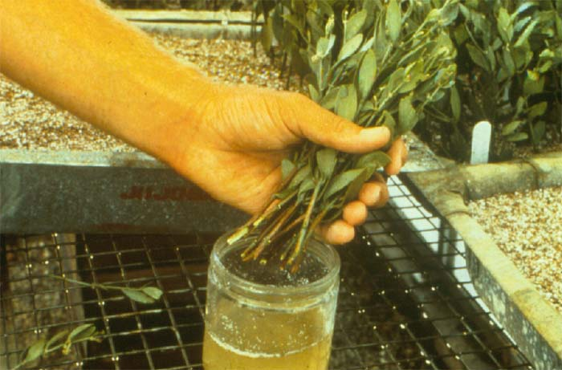
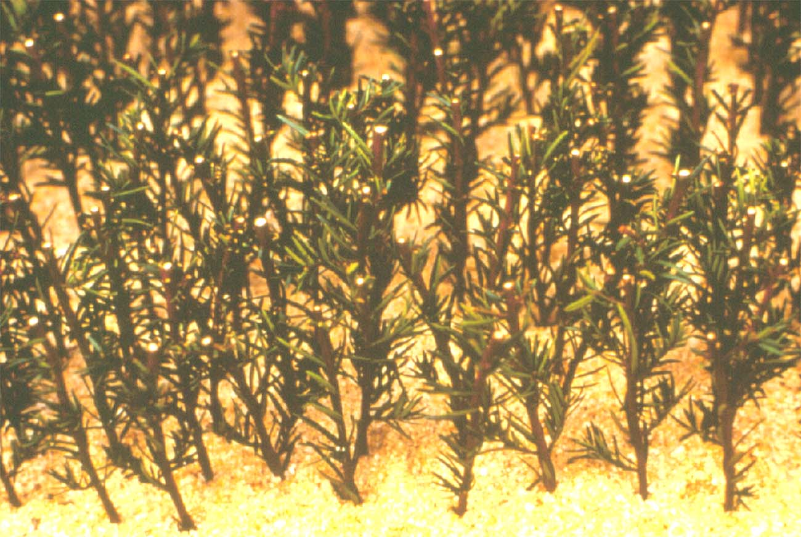
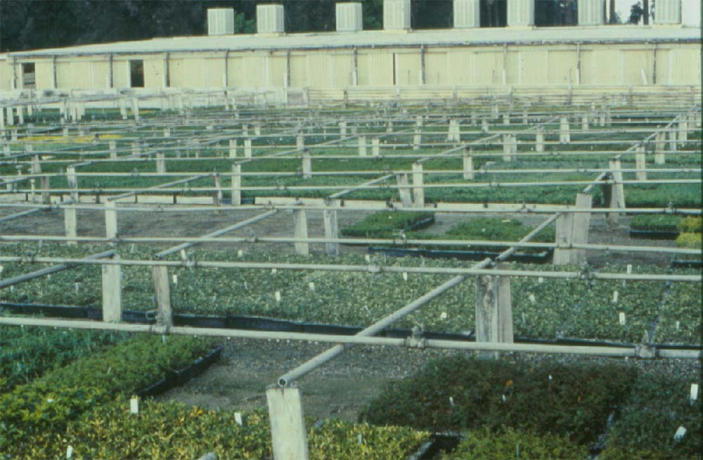
Hardwood and Semi-hardwood Cuttings
1
2
3
4
5
6
1-Stock plant nursery, 2-making cuttings, 3-bundles of cuttings, 4-IBA treatment, 5-rooting in artificial mix, 6-outdoor misting system for rooting

Slide 16
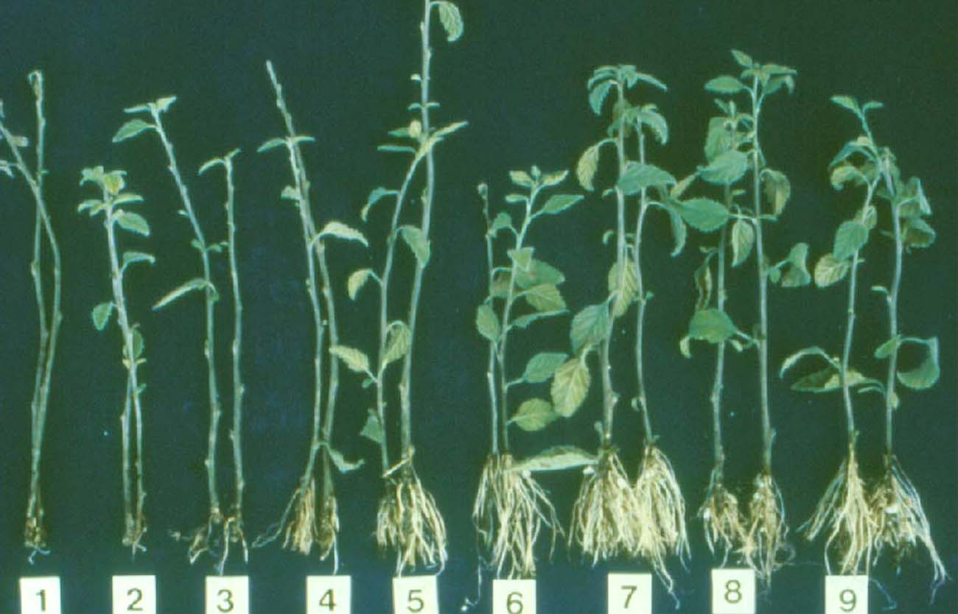
Influence of IBA on Rooting-Cordia parvifolia
1-Control, 2-50% ethanol, 3-100 ppm, 4-1000 ppm, 5-2000 ppm, 6-4000 ppm, 7-6000 ppm, 8-8000 ppm, 9-10000 ppm IBA

Slide 17
Cutting Propagation in Jojoba
Regular Stem Cuttings
  Use 4-5 nodes
  Semi-hardwood cuttings
Single Node Cuttings
  Double-eye single node cuttings
  Single-eye single node cuttings

Slide 18
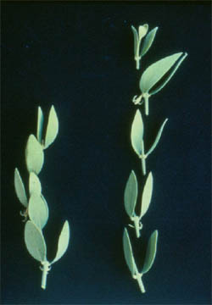
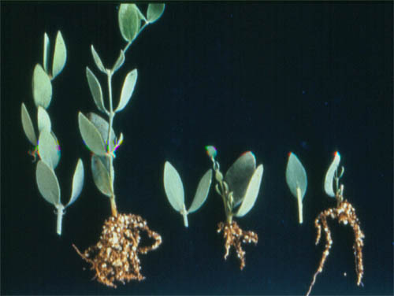
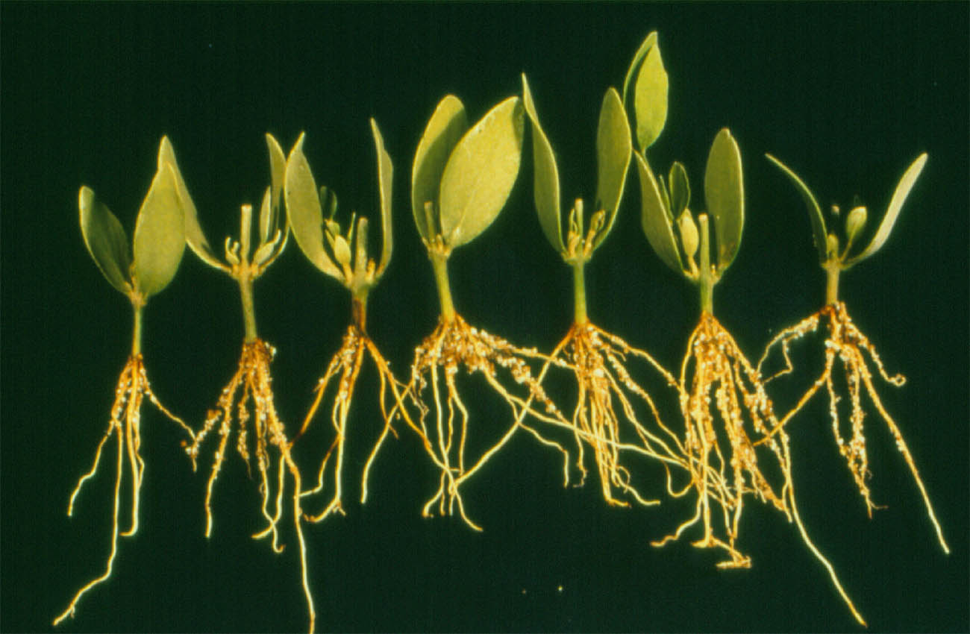
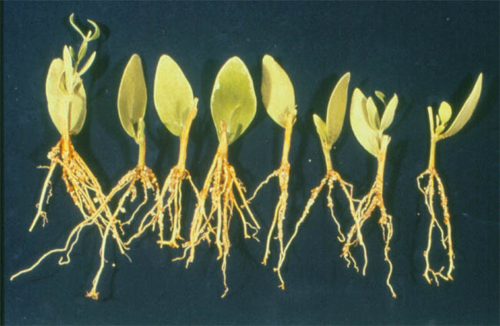
Single Node Cuttings of Jojoba
Single Node Cuttings
DE
SE
5-node
DE
SE

Slide 19
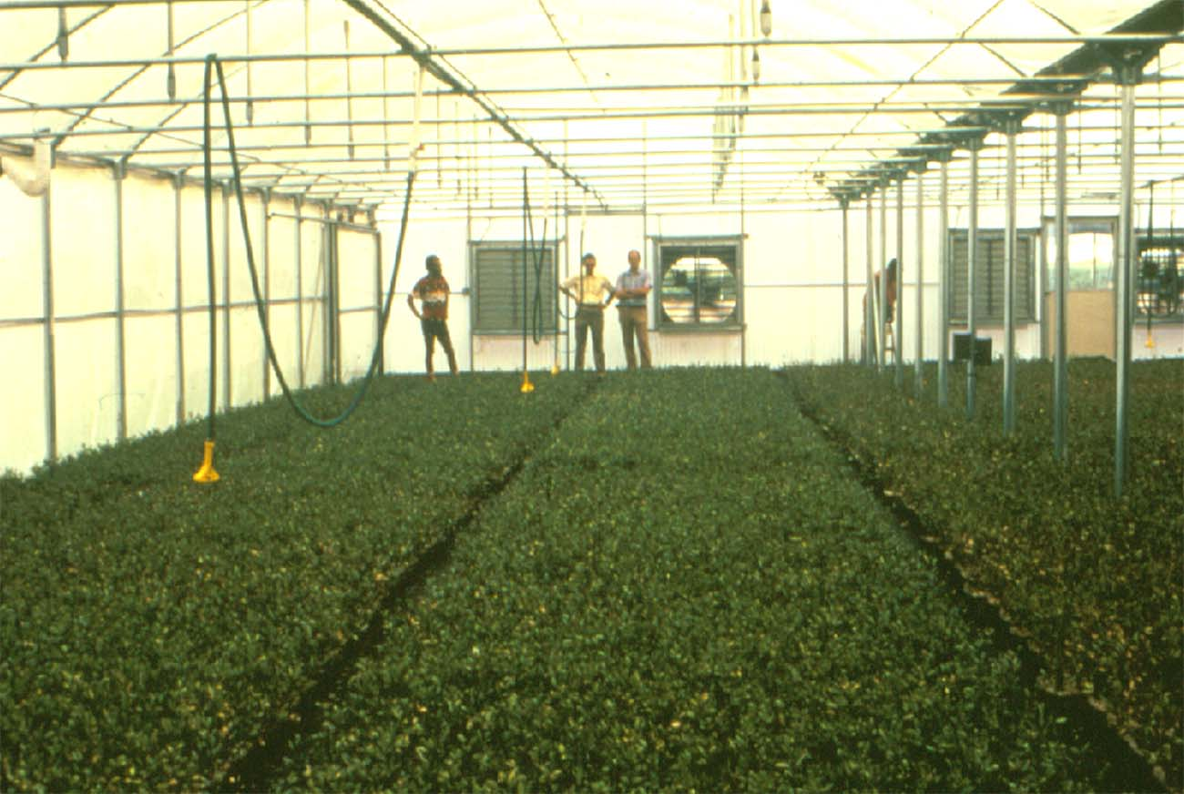
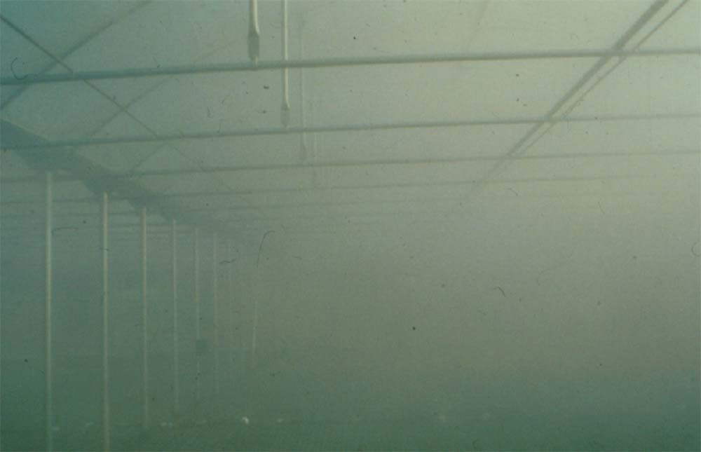
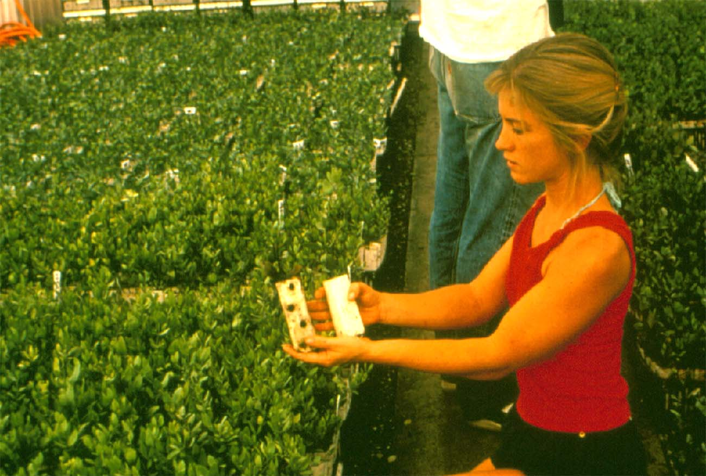
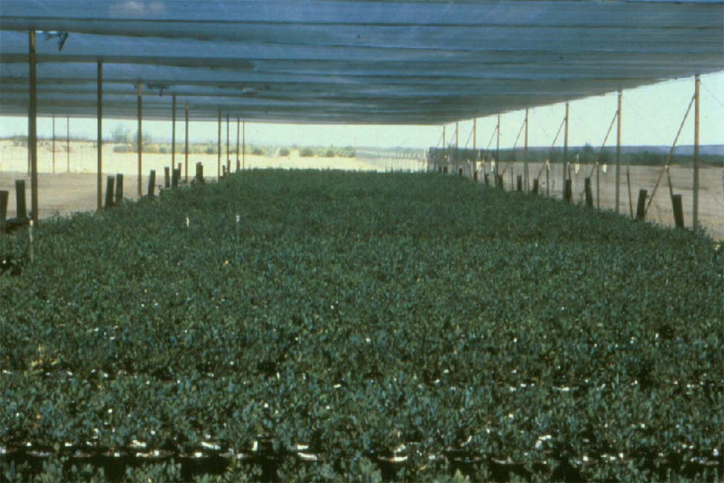
Cutting Propagation in Jojoba

Slide 20
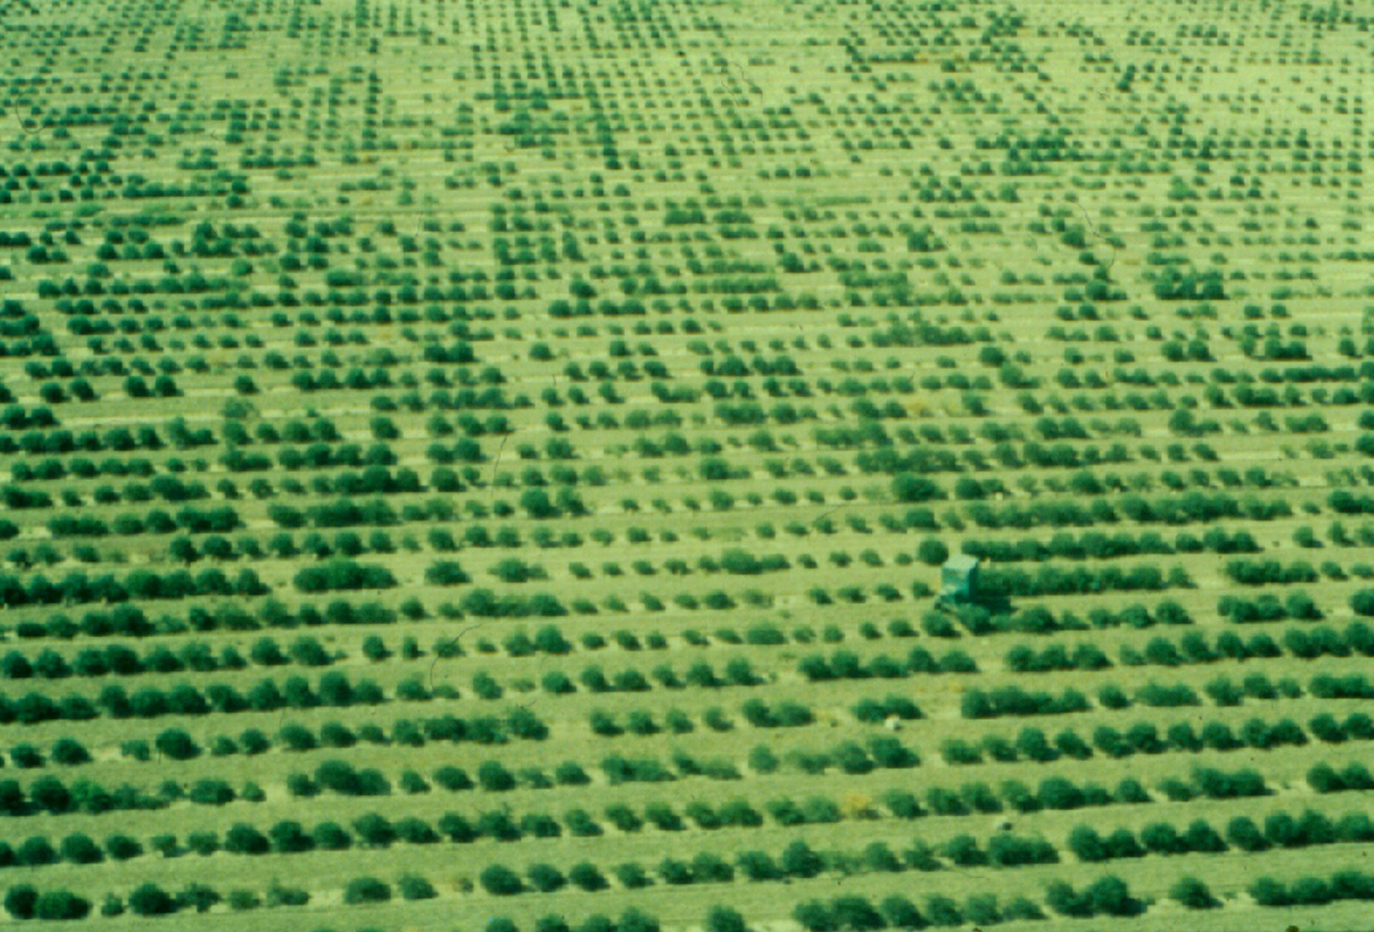
Clonally Propagated Jojoba Field
Bakersfield, CA

Slide 21
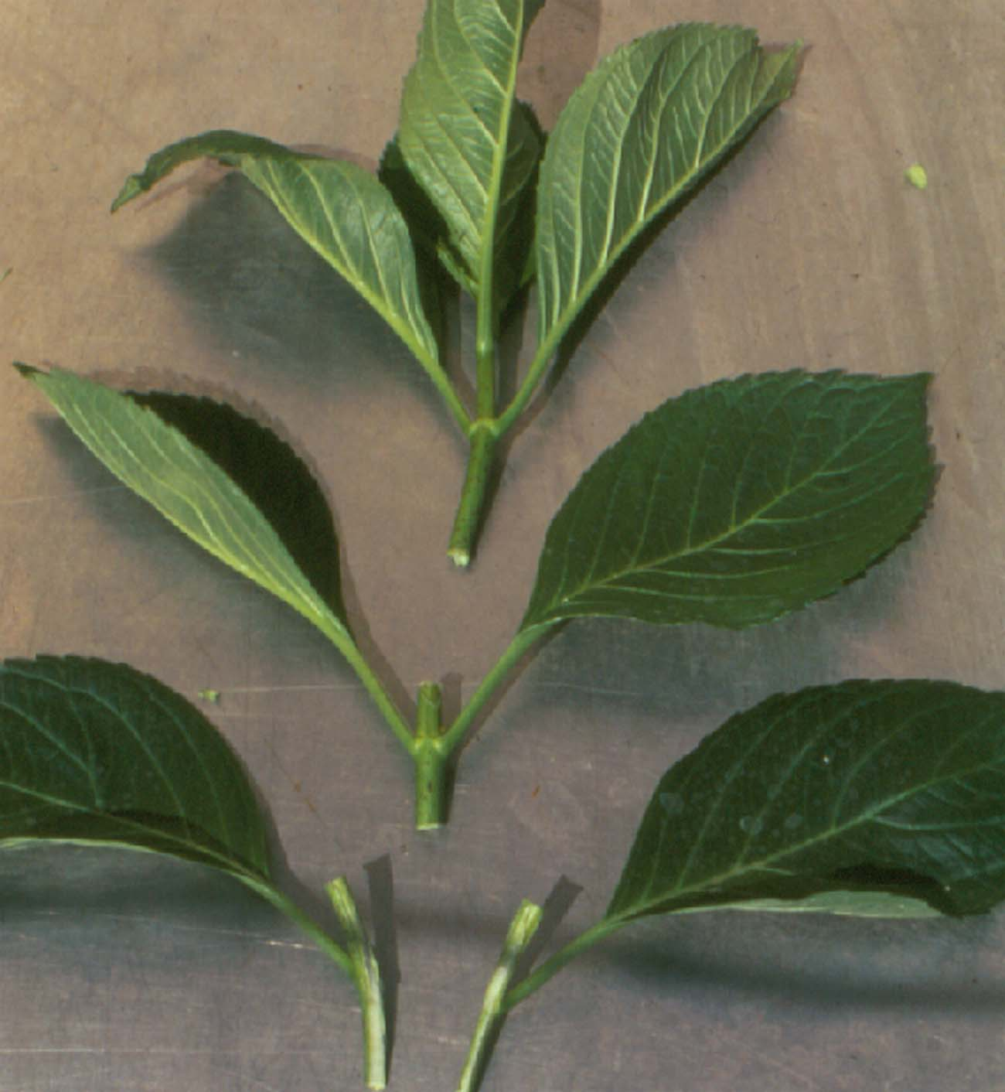
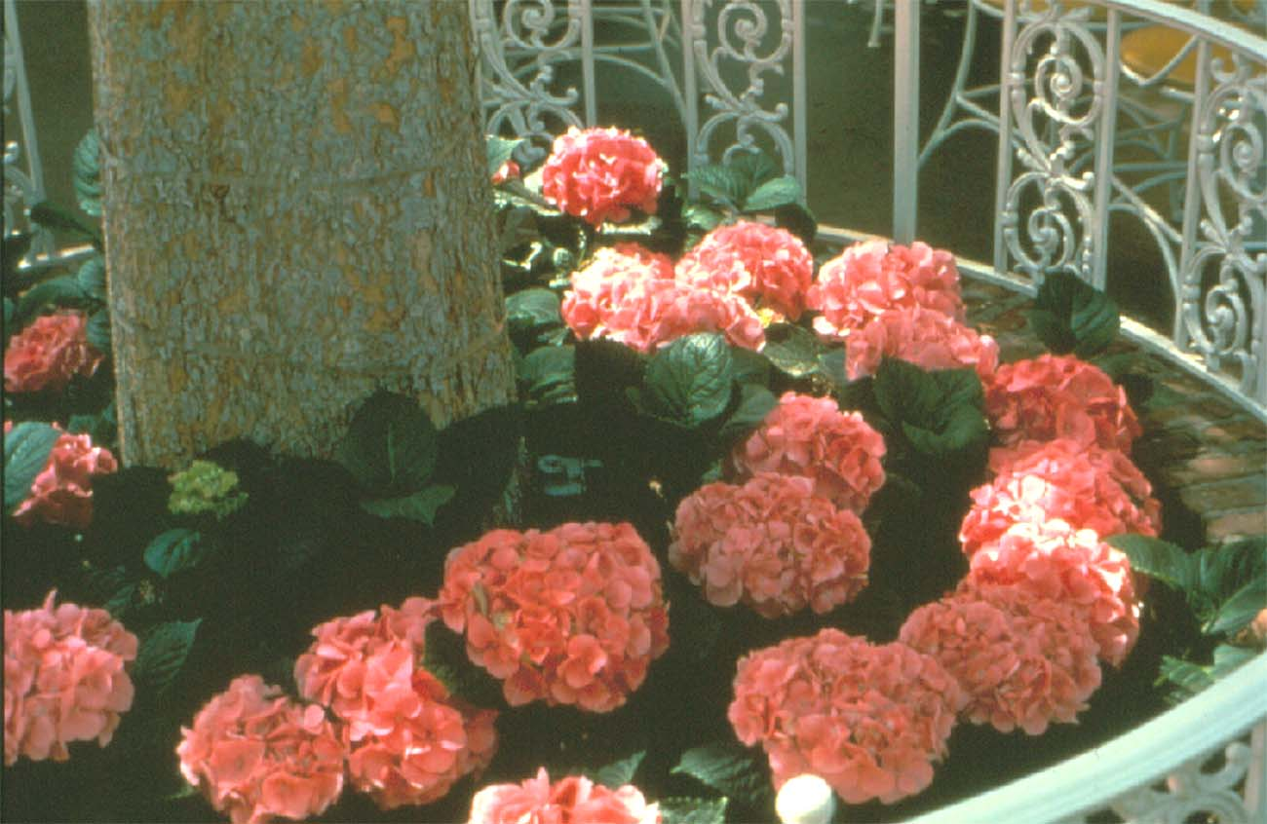
Shoftwood Cuttings - Hydrangea
Use of Butterfly and Single Node Cuttings

Slide 22
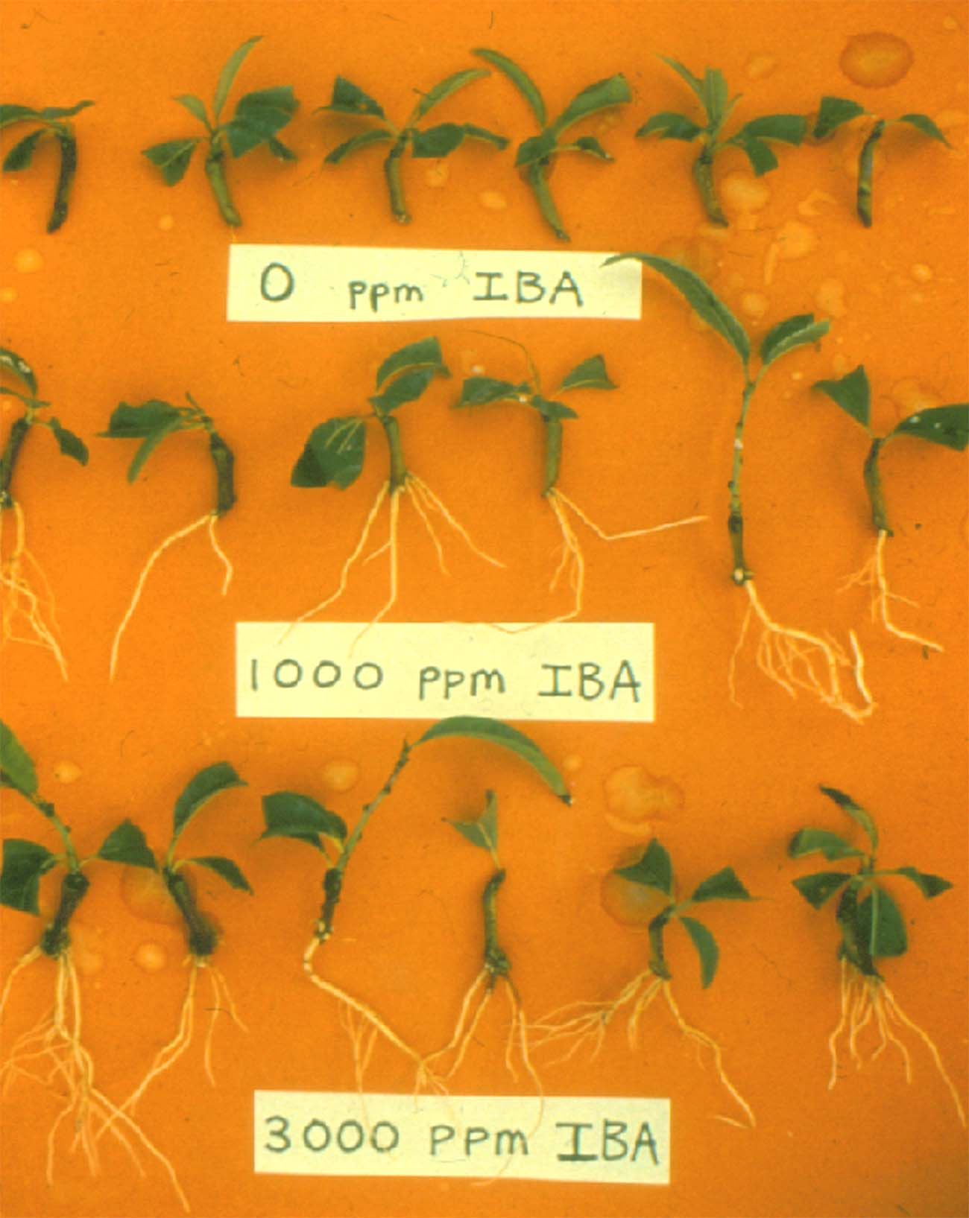
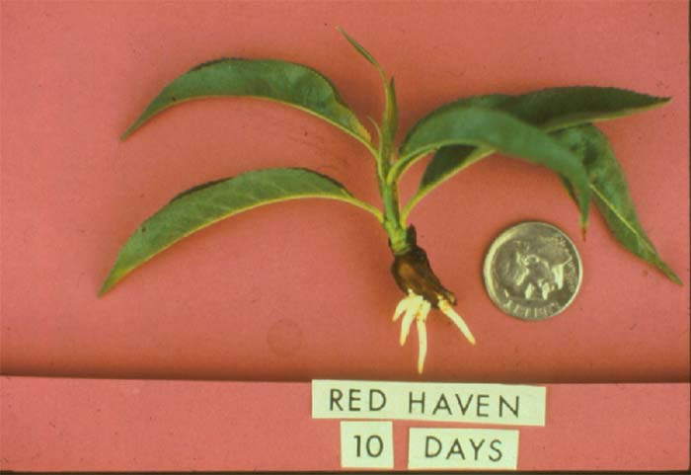
Softwood Cuttings-Peach

Slide 23
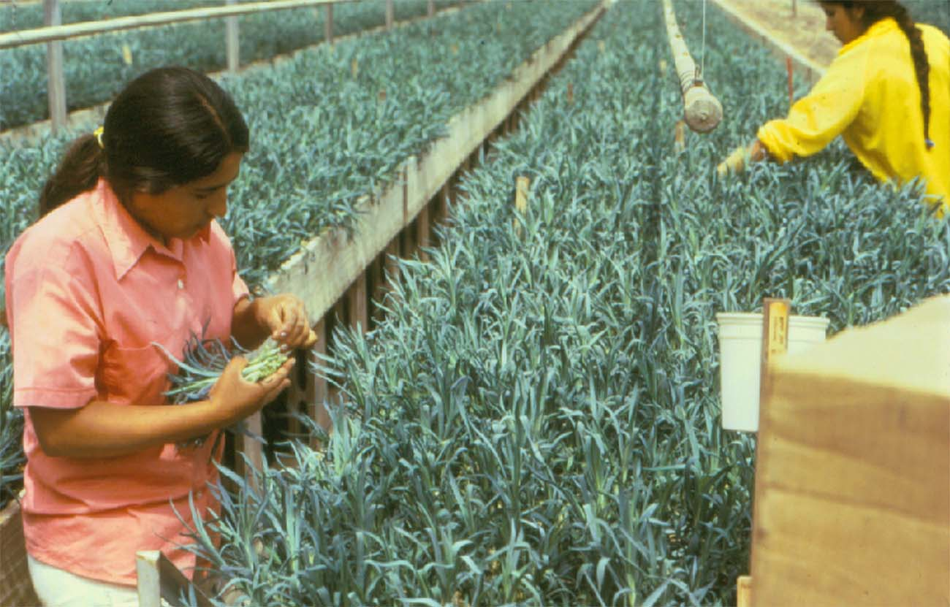
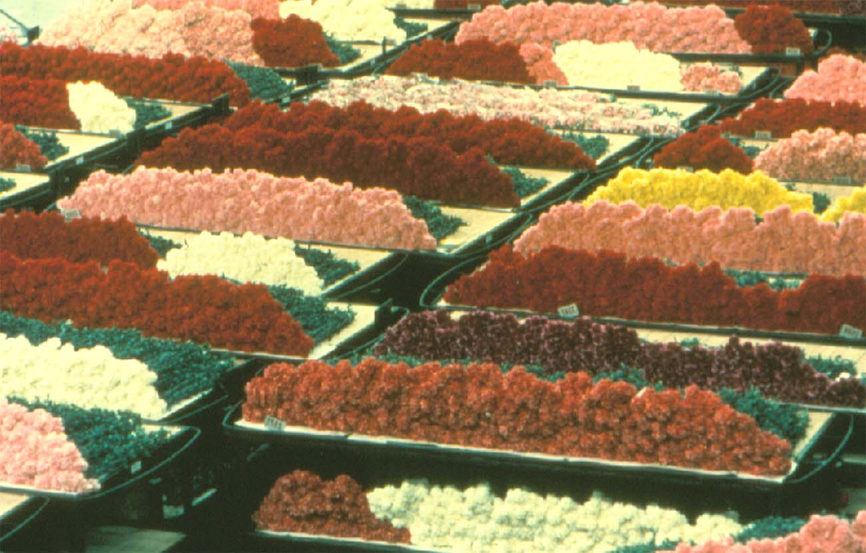
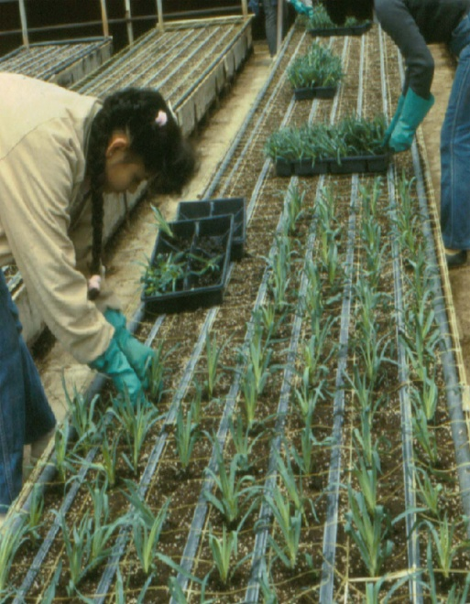
Herbaceous Cuttings - Carnation

Slide 24




Pauk Ecke’s Poinsettia Greenhouse

Slide 25



Leaf Cuttings-African Violet, Piggyback Plant

Slide 26

Chimeras
A plant that is composed of tissues of more than one genotype
Chimera (Greek Word)
  A mythological monster, having a lion’s head, a goat’s body and a serpent’s tail
Chimera
Periclinal Chimera

Slide 27

Three Types of Chimeras

Slide 28


Examples of Chimeric Plants
Chrysanthemum
Rose

Slide 29
Propagation by Grafting
Requirements for Success
  Compatibility between stock and scion
  Alignment of cambium layers
  Prompt handling
Grafting Methods
  Cleft grafts
  Whip-and-Tongue
  Side grafts
  Budding
  Inarching
  Bridge Grafts
  Topworking

Slide 30

Cleft Graft

Slide 31


Whip Graft, Whip-and-Tongue Graft
Whip Graft
Whip-and-Tongue Graft

Slide 32

Side Grafts

Slide 33



Budding

Slide 34



Grafted Plants

Slide 35


Bridge Graft and Inarching
Rejuvenating old fruit trees
Repair damage on the tree trunk
Bridge Graft
Inarching

Slide 36




Topworking
Scions are grafted on branches of mature trees
Used to change cultivars on old fruit trees

Slide 37
Use of Herbaceous Grafting
Virus Indexing
Synthetic Plants
Construction of Genetic Chimeras
Improved Crop Performance
Research in Plant Physiology
Enhancement of Esthetic Value

Slide 38
Cucurbits (watermelons, melons, cucumbers, squashes, etc.)
Various grafting methods in vegetables with or without rootstock root systems
Solanaceous crops (tomatoes, peppers, eggplants, paprika, etc.)

Slide 39




Grafted Cactus Production

Slide 40


Position of grafting
Tomatoes, grafted onto tomato rootstock (left) or on potato (right)

Slide 41




Cabbage/Radish
Chinese cabbage/Radish
Tomato/eggplant
Eggplant/potato

Slide 42

Herbaceous Grafts

Slide 43
Cultivation of Grafted Vegetables in Korea and Japan.
J a p a n K o r e a
Field+Tunnel Greenhouse Field+Tunnel Greenhouse
Crop Total Grafted Total Grafted Total Grafted Total Grafted
(ha) (%) (ha) (%) (ha) (%) (ha) (%)
Watermelon 14,017 92 3,683 98 13,200 90 21,299 98
Cucumber 10,160 55 5,440 96 1,728 42 5,964 95
Melons 6,142 0 8,258 42 1,047 83 9,365 95
Tomato 6,549 8 7,141 48 258* 0 4,752 15
Eggplant 11,815 43 1,785 94 650* 0 413 10
Pepper* 2,684 – 1,468 5 75,574 0 5,085 25

Slide 44

Robotic Grafting Machine

Slide 45

Seedling Grafting on Vegetable Plugs

Slide 46

Herbaceous Grafts

Slide 47
Vascular bundle
Cut
Diameter of scion: 10 mm.
※ After placing the scion on the top of rootstock to match the vascular bundle, thread or clips are used to hold the position.
* Standard rootstock length : 9 cm long
* Diameter of rootstock: 30~ 35 mm
Hylocereus trigonus, the most popular rootstock for cactus grafting

Slide 48
















F
G
H

Slide 49

Care of grafted watermelon seedlings in a commercial greenhouse

Slide 50

Commercial Cactus Greenhouse in Korea

