Slide 1
Chap 3. Plant Structure
The cell and its components
Tissues and their systems
Anatomical regions
Morphological structures
  Roots
  Shoots
  Leaves
  Flowers
  Seeds

Slide 2
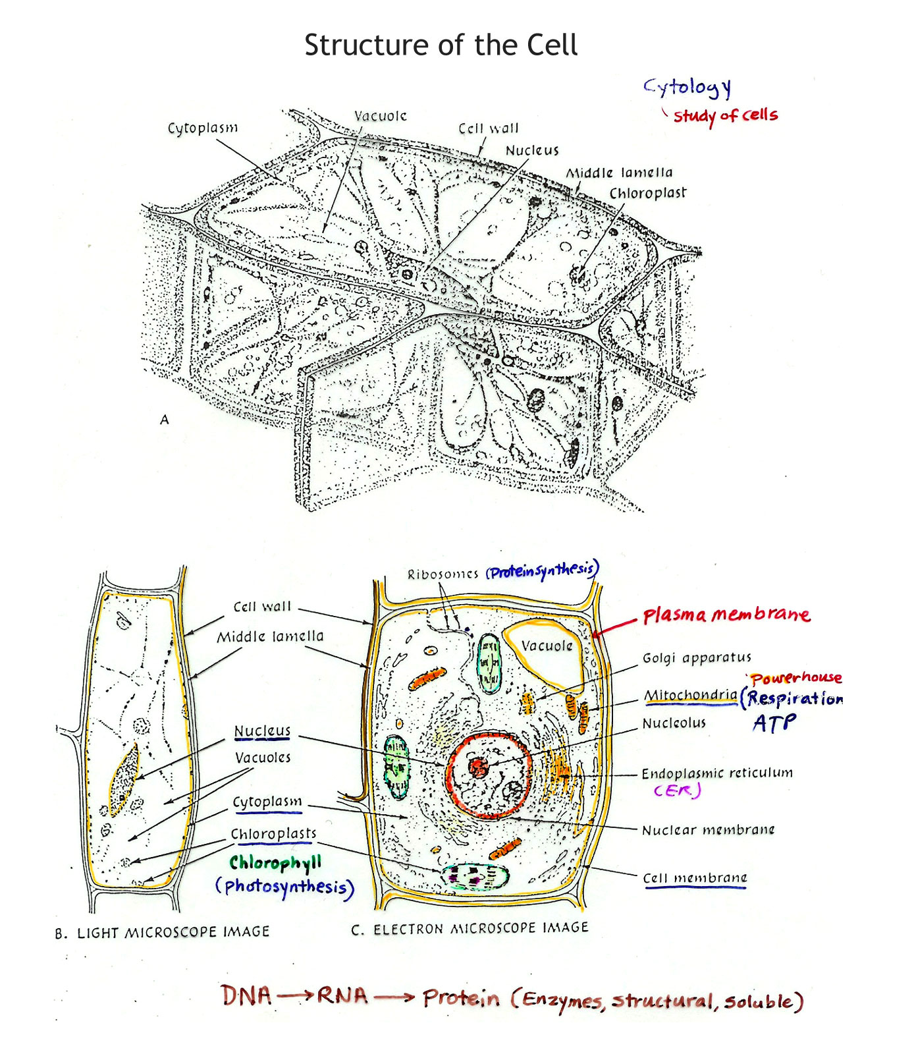

Slide 3
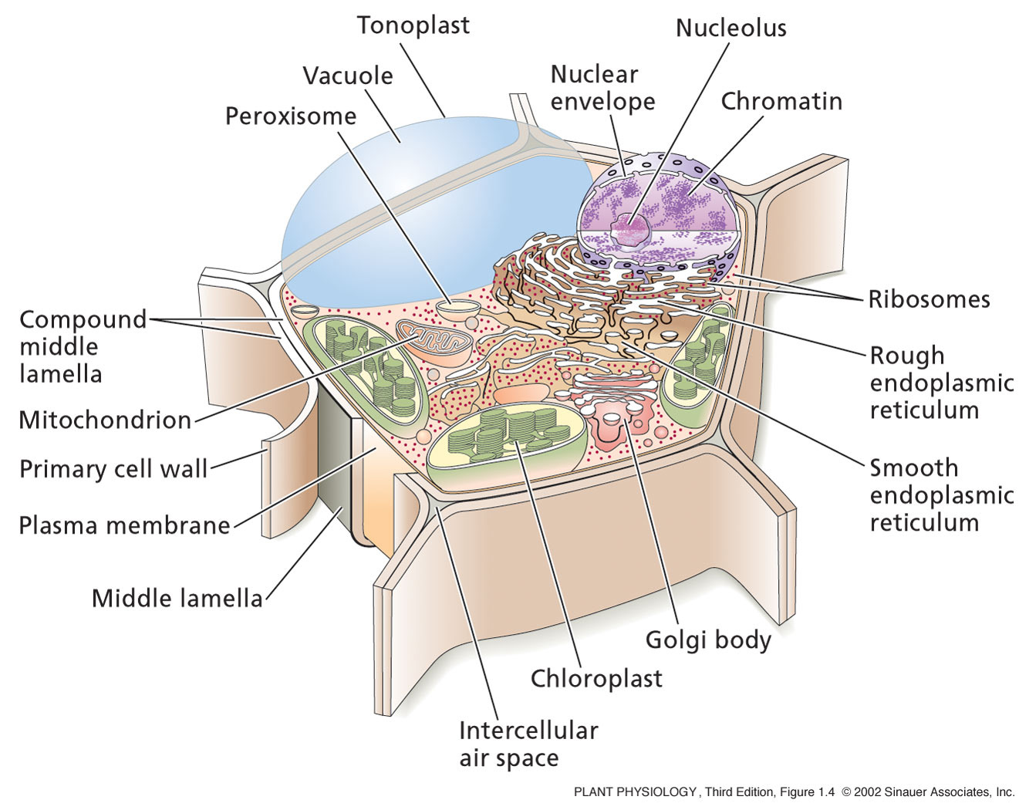
Components of the Cell

Slide 4
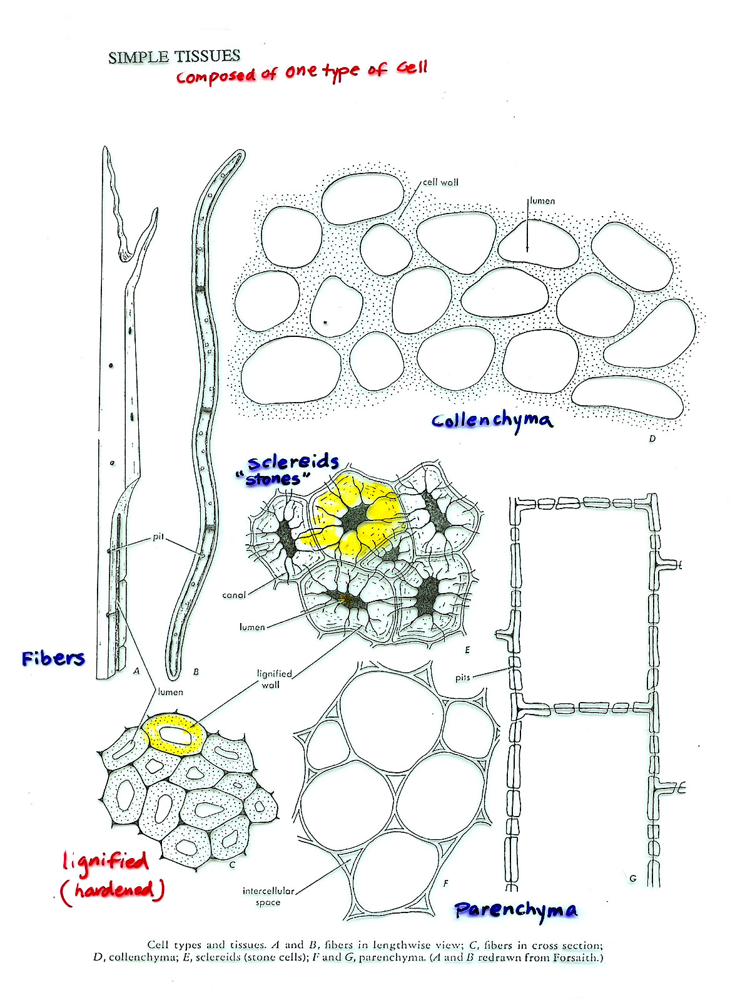

Slide 5
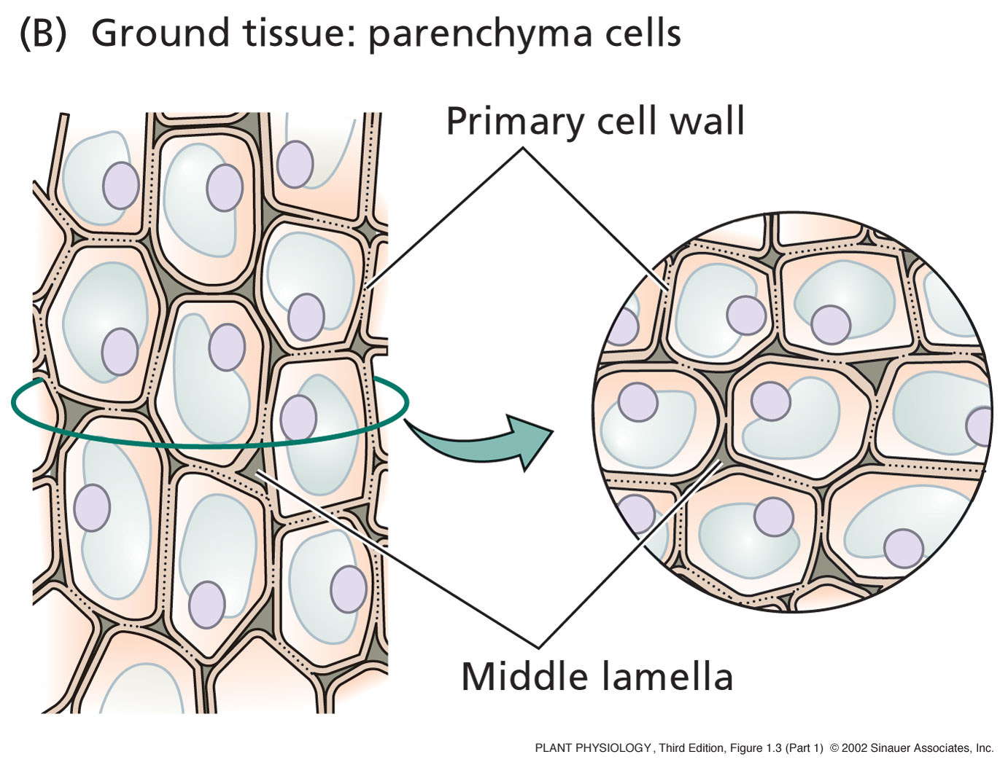
Notes:
PP01031.jpg

Slide 6
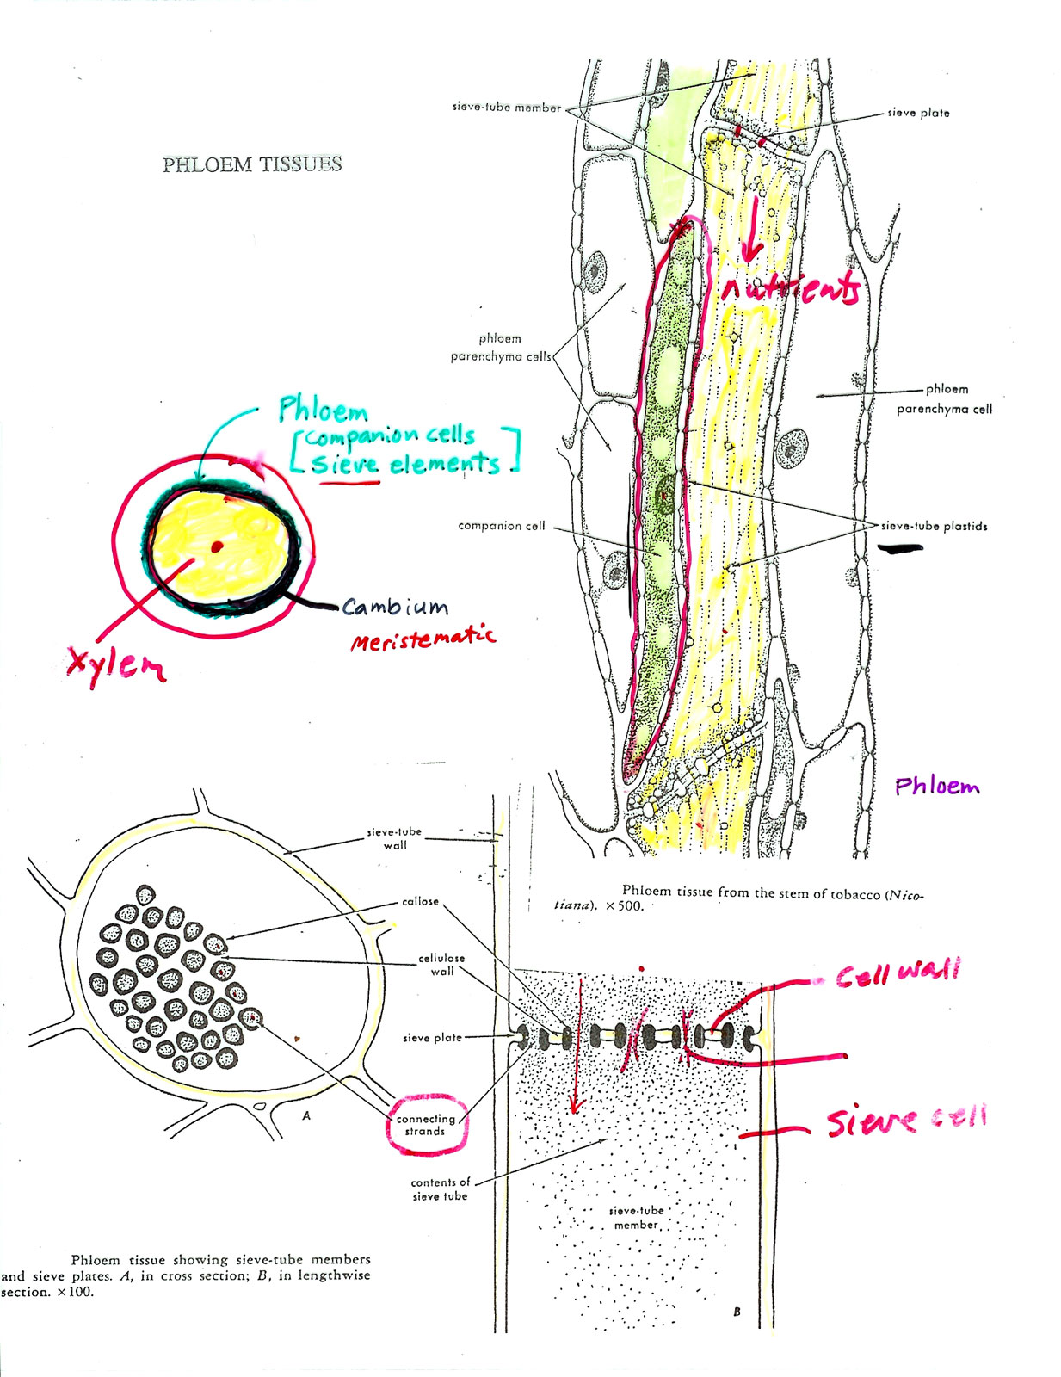

Slide 7
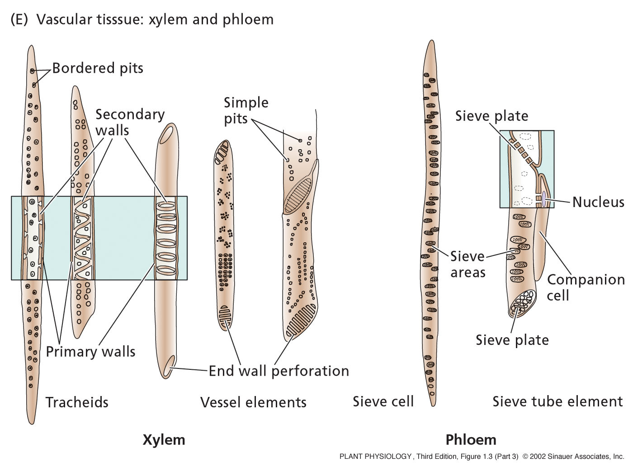
Notes:
PP01033.jpg

Slide 8
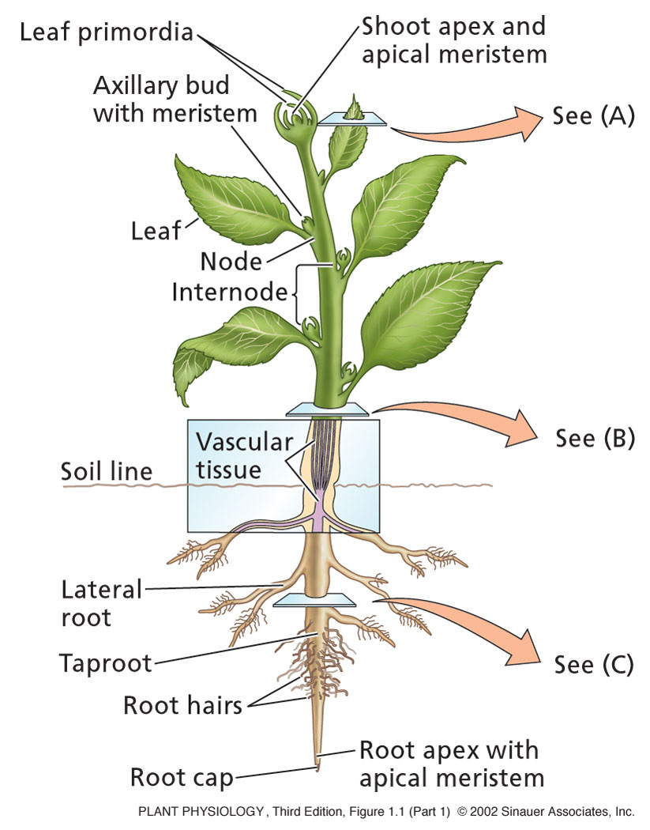
Notes:
PP01011.jpg

Slide 9
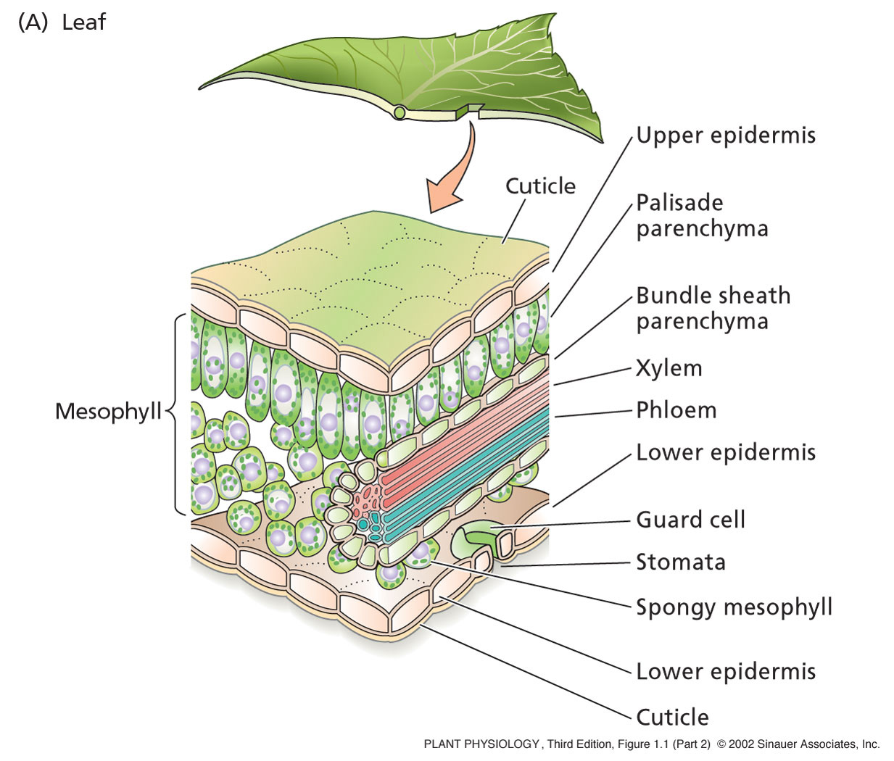
Leaf Tissues
Notes:
PP01012.jpg

Slide 10
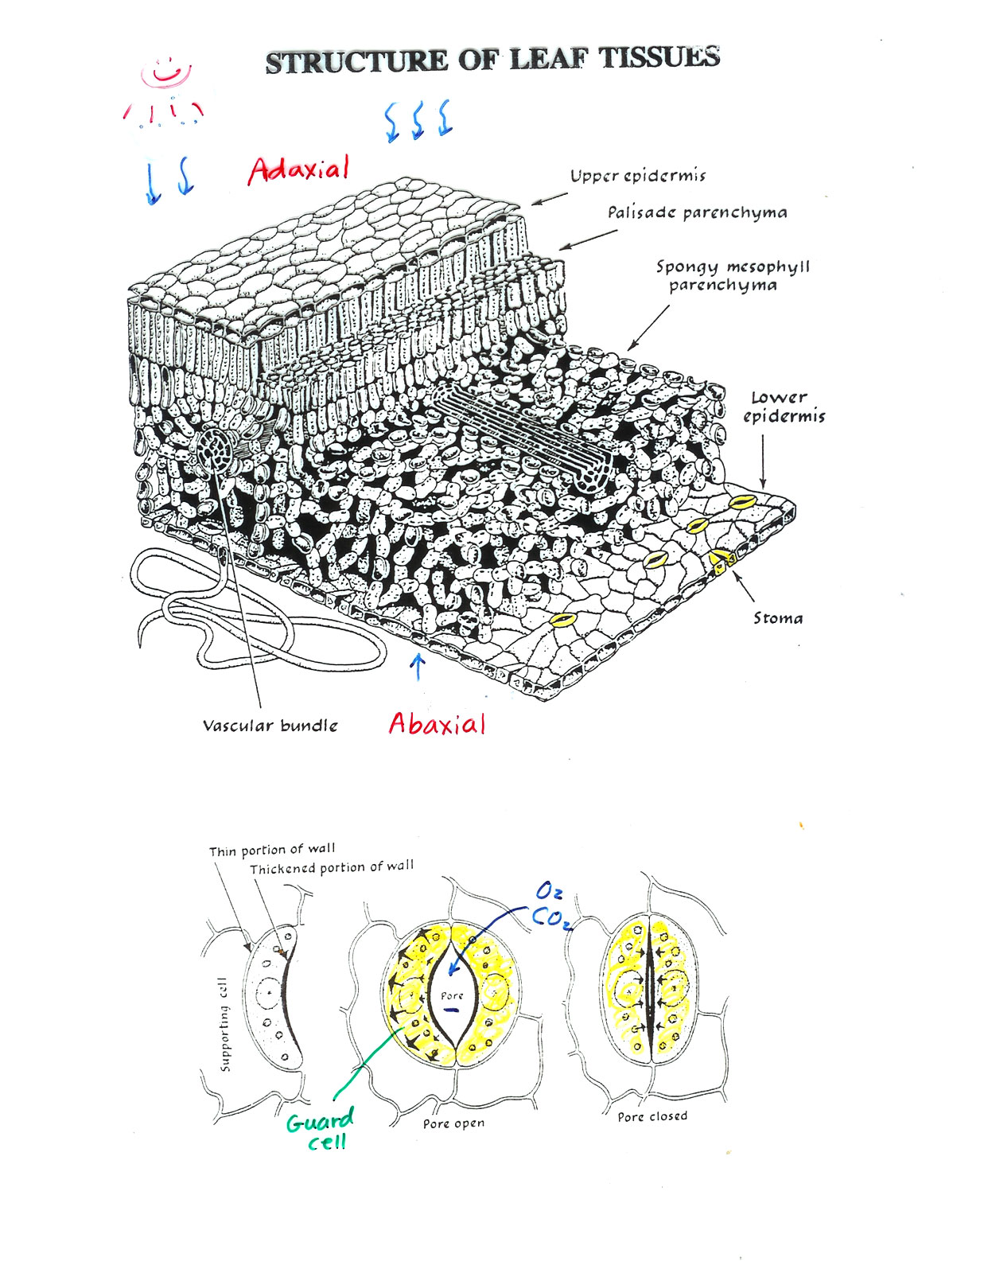

Slide 11
Cross Section of a Stem
Notes:
PP01013.jpg

Slide 12
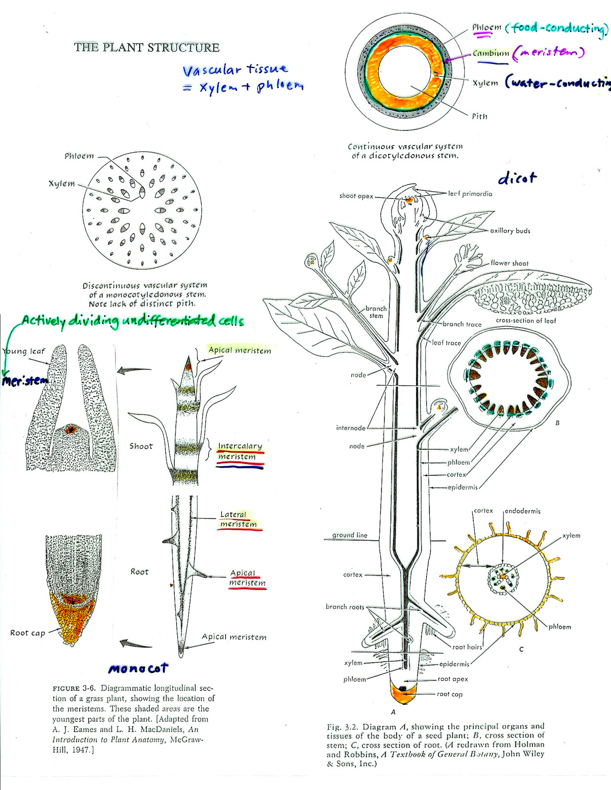

Slide 13
Cross Section of the Root
Notes:
PP01014.jpg

Slide 14
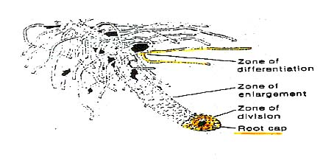
Root Tip and Root Hairs

Slide 15
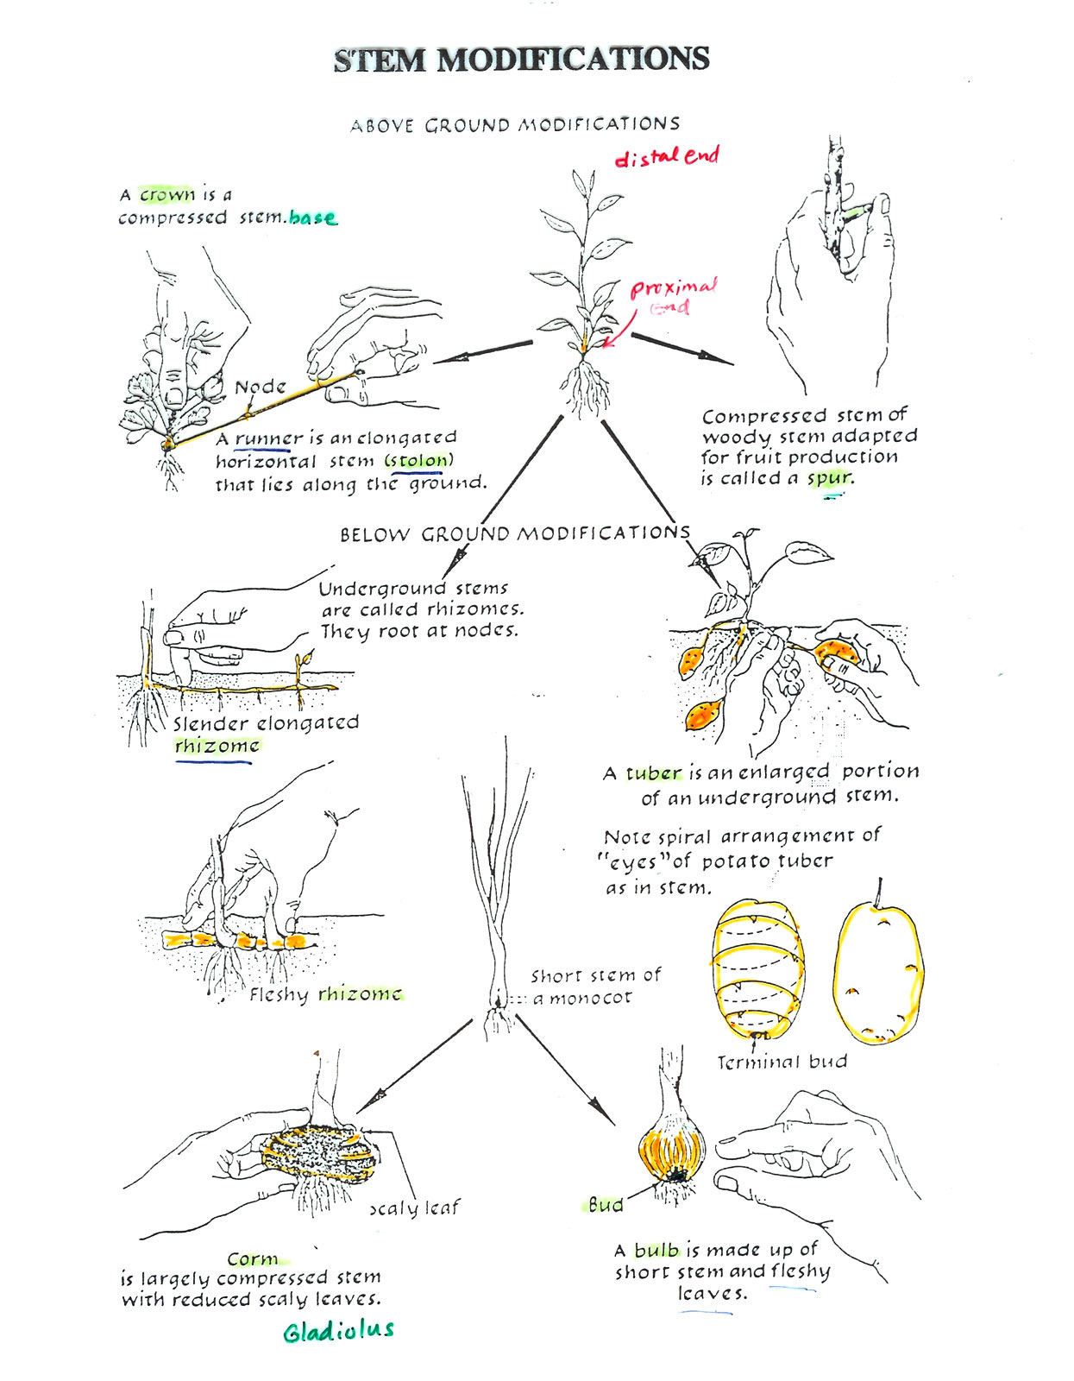

Slide 16
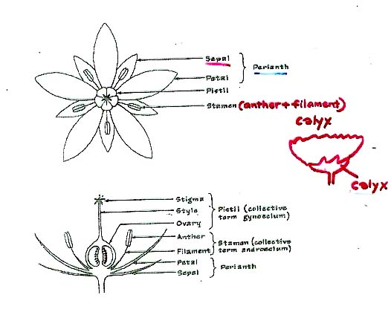
Structure of the Flower

Slide 17
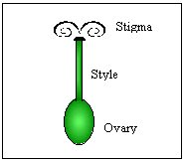
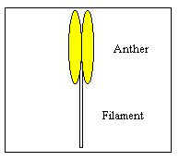
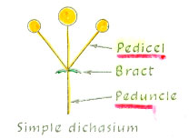
Flower Structure

Slide 18
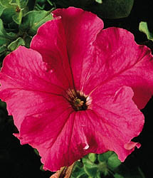
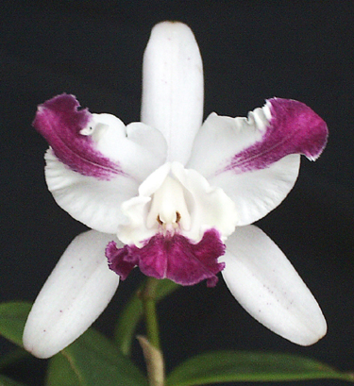
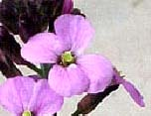
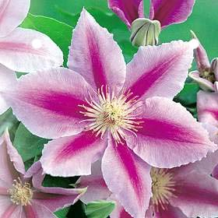
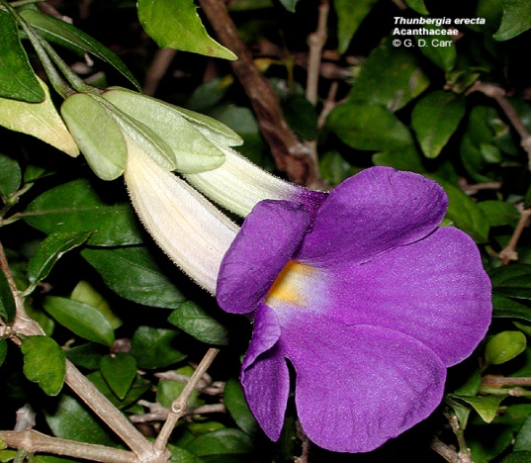
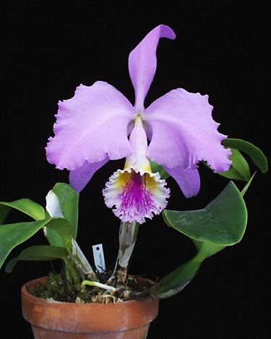
Classification by Number of Petals
Dicots: 4-merous, 5-merous
Monocots: 3-merous
Dicot flowers
Monocot Flowers

Slide 19
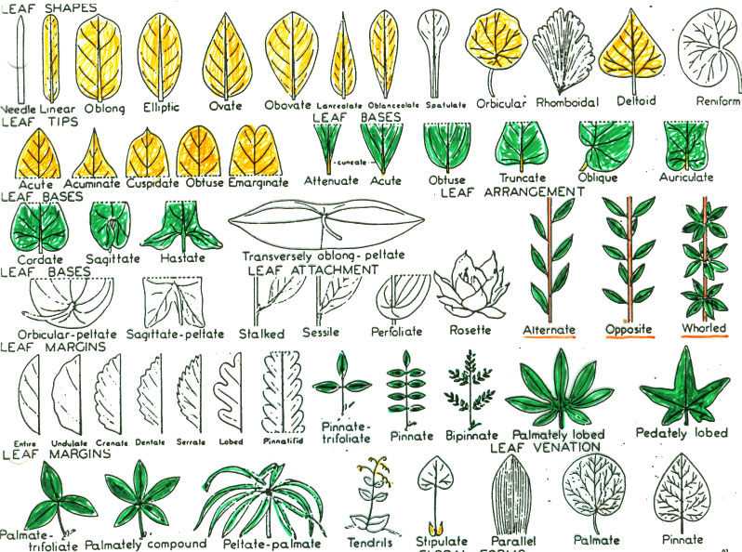
Leaf Morphology

Slide 20
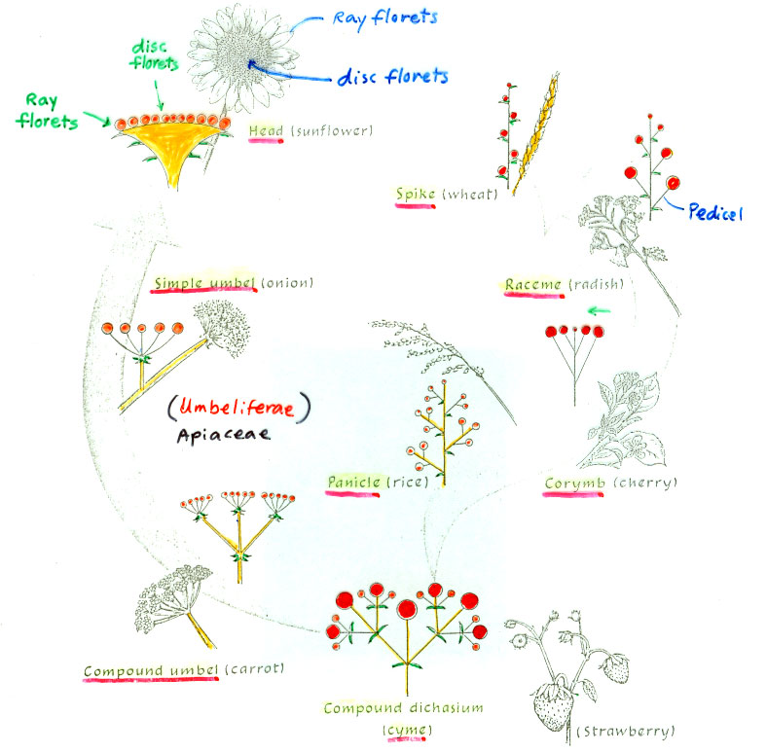
Types of Inflorescence

Slide 21
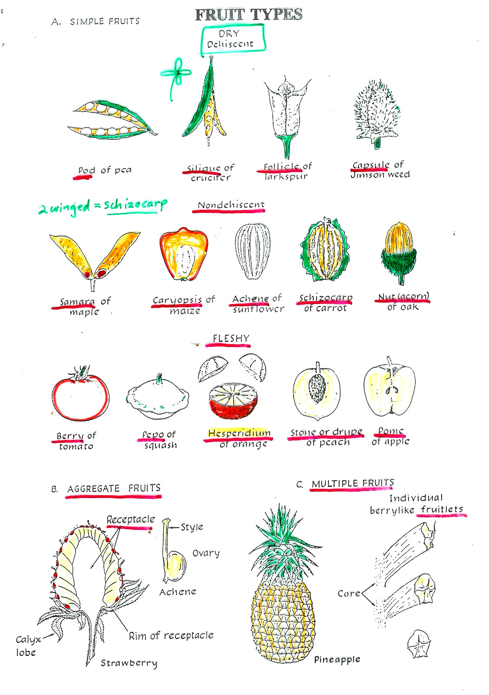

Slide 22
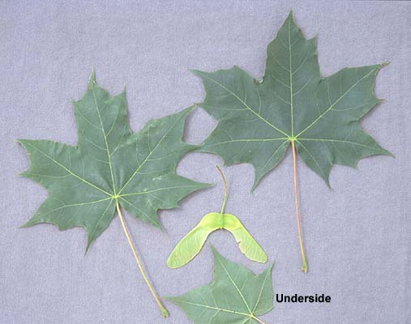
Samara - Schizocarp

Slide 23
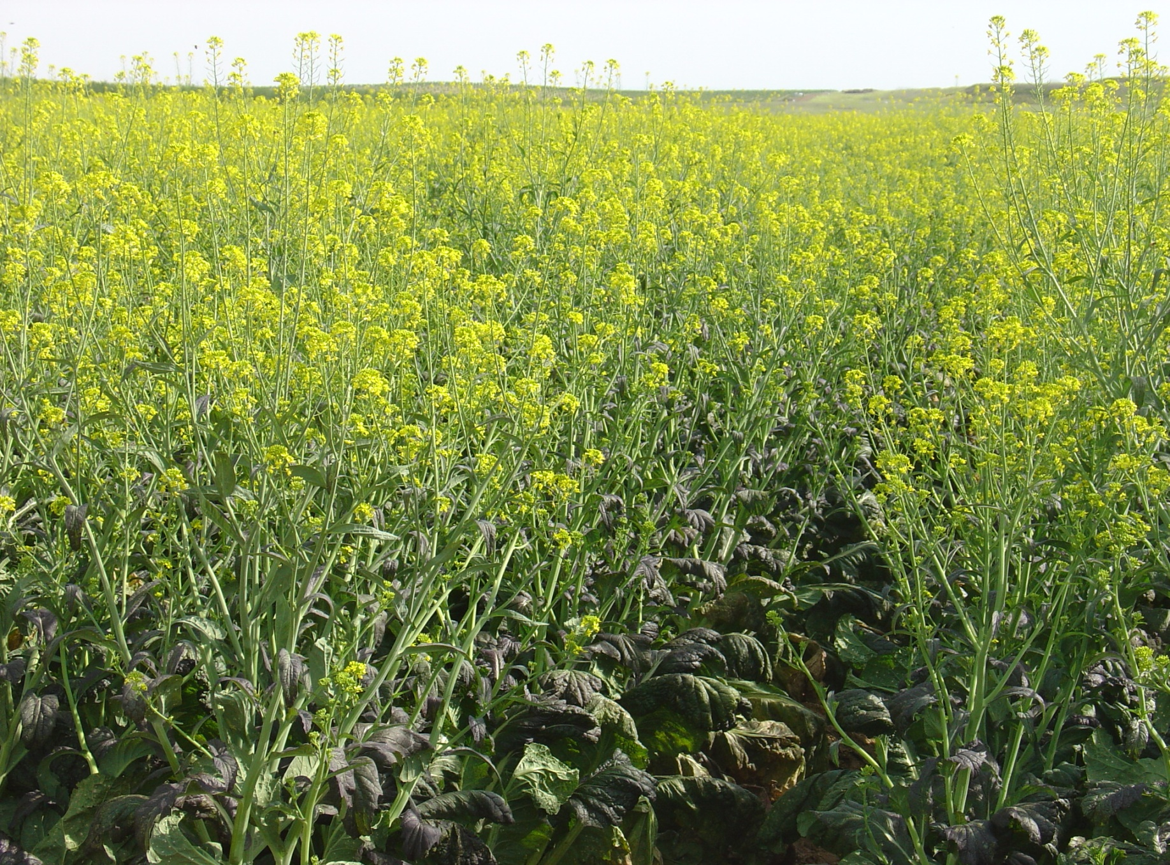
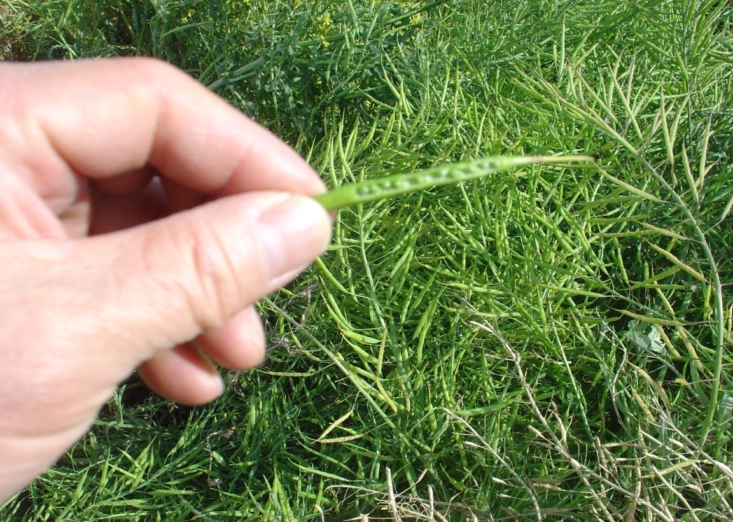
Silique in Crucifers

Slide 24
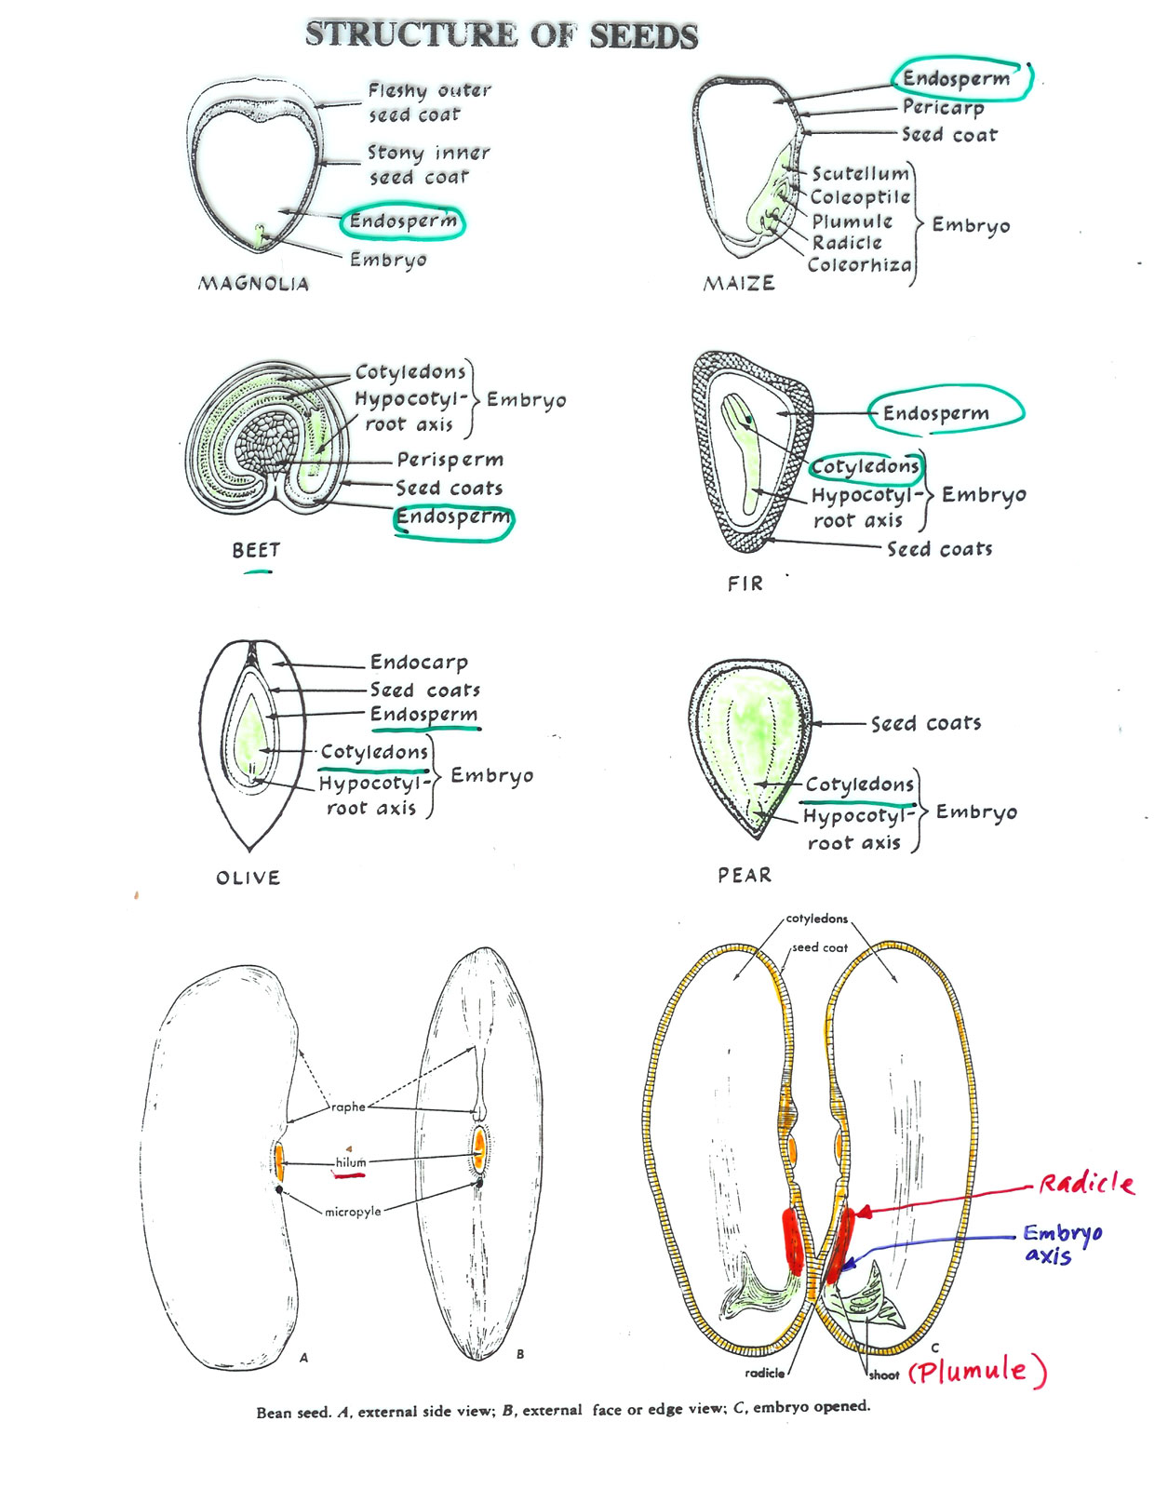

Slide 25
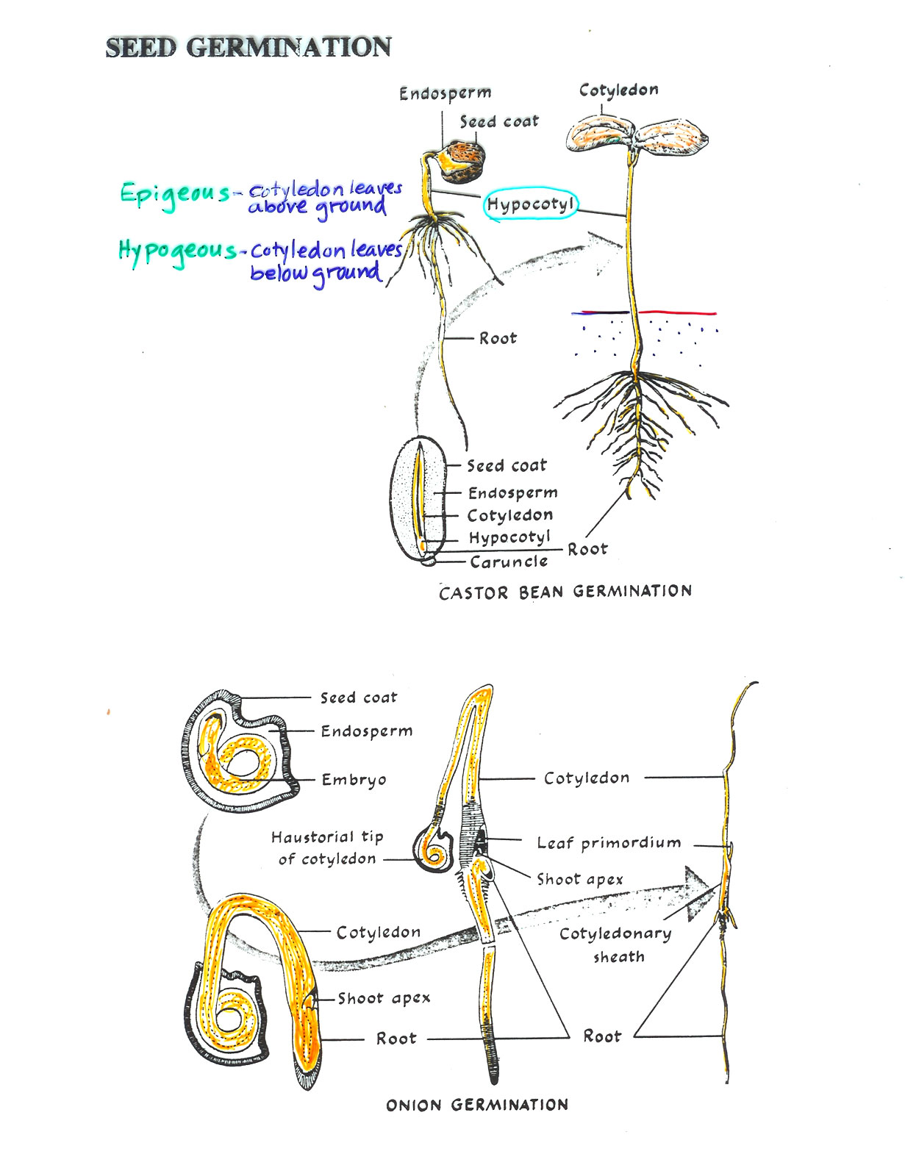

Slide 26
Flower Sex Expression
Flower Types
Staminate Flower – Male Flower
Pistillate Flower – Female Flower
Hermaphroditic Flower (Perfect flower)
  Male and female parts together in a single flower

Slide 27
Flower Sex Expression
Plant Types
Monoecious - Plants carrying both male and female flowers
the same plant (cucumber, corn)
Dioecious - Species in which separate male (staminate) and
female (pistillate) plants exist
        (Date palm, papaya, spinach, hemp, ginkgo)
Andromonoecious - Plants carrying both male and perfect flowers the same plant (muskmelon)
Gynomoecious - Plants carrying both female and hermaphroditic
flowers on the same plant (some cucurbits)
Trimonoecious - Plants carrying make, female, and hermaphroditic flowers on the same plant (some cucurbits)

Slide 28
