Slide 1
Chap 5. Differentiation and Development
General Information
Plant Growth Hormones
Vegetative Physiology
Reproductive Physiology

Slide 2
1. Process of Differentiation
Differential growth in cell and tissues:
Orderly and systematic in mitotic cell division
Genetically controlled development
  by gene activation and deactivation
  Also influenced by external environment
Tissue and organ differentiation controlled by plant growth hormones that are produced indifferent parts of plants

Slide 3
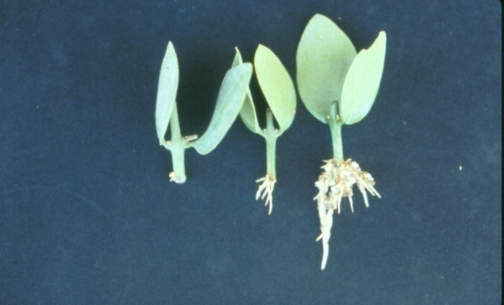
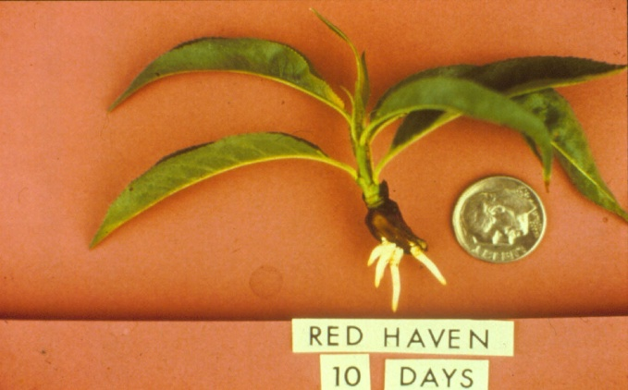
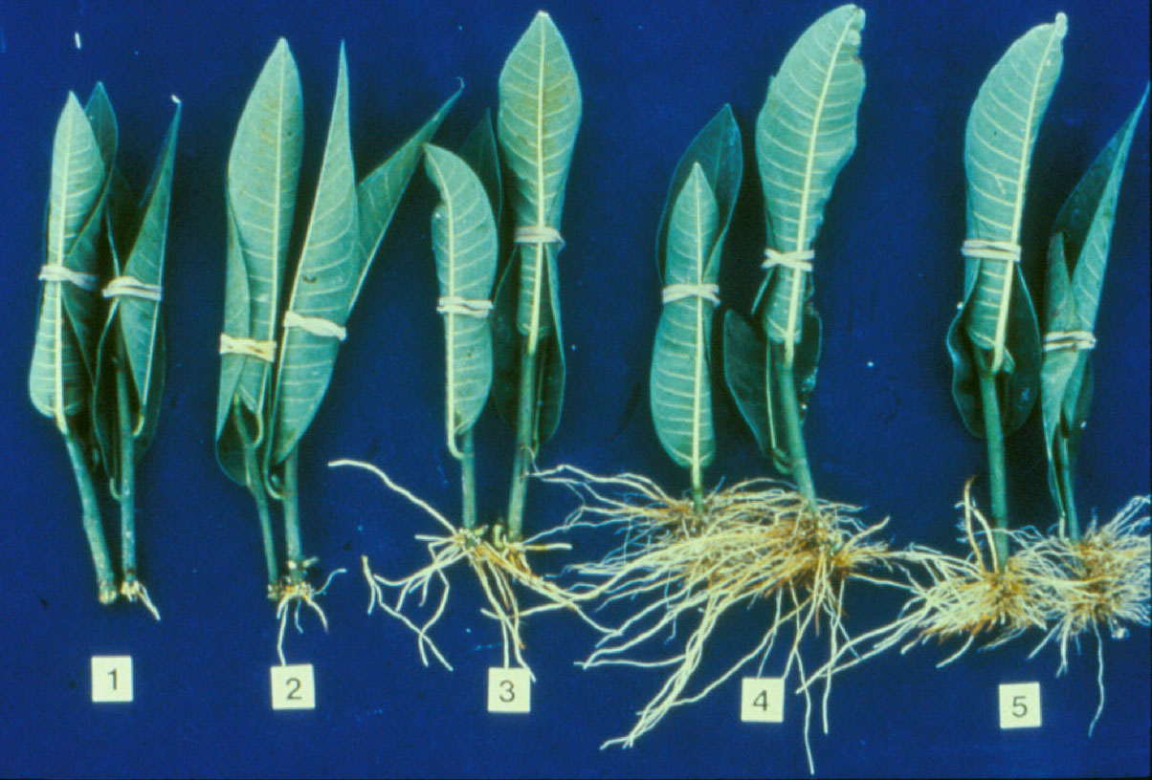
Influence of IBA Treatment on Root Formation
Jojoba
Peach
Ficus
Cuttings treated with IBA: 1-control, 2-50% ethanol, 3-1000 ppm IBA, 4-2000 ppm IBA, 5-4000 ppm IBA

Slide 4
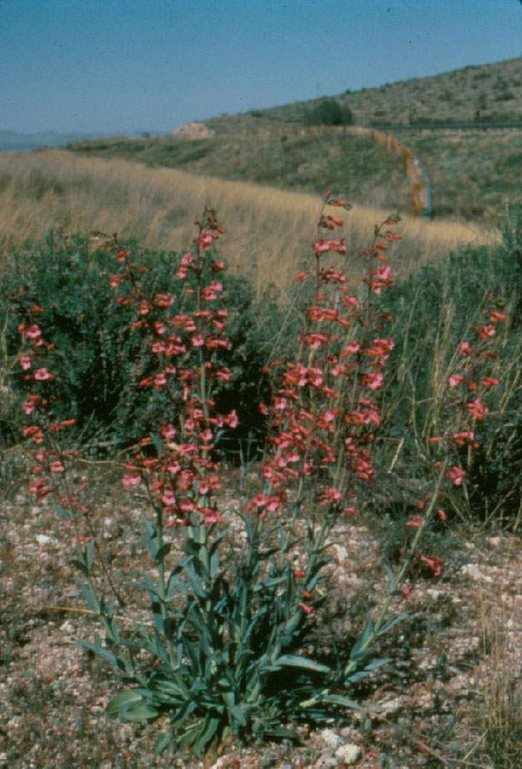
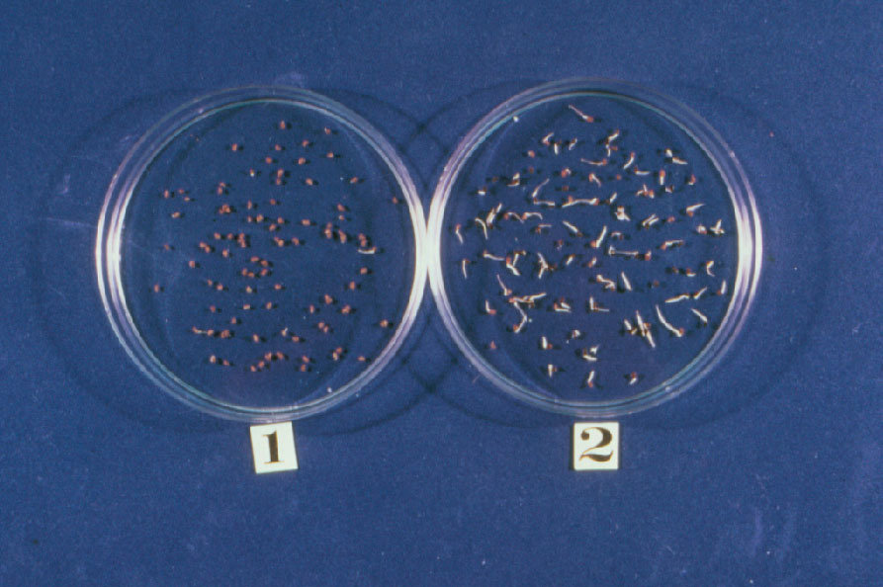
Enhancement of Seed Germination by GA Treatment
Penstemon parryi
Seeds of Desert Beard Tongue (Penstemon parryi) is difficult to germinate due to seed dormancy (see 1 above). Treatment of seed with 200 ppm GA₃ for 24 hours leads to 95% germination (see 2 above).

Slide 5
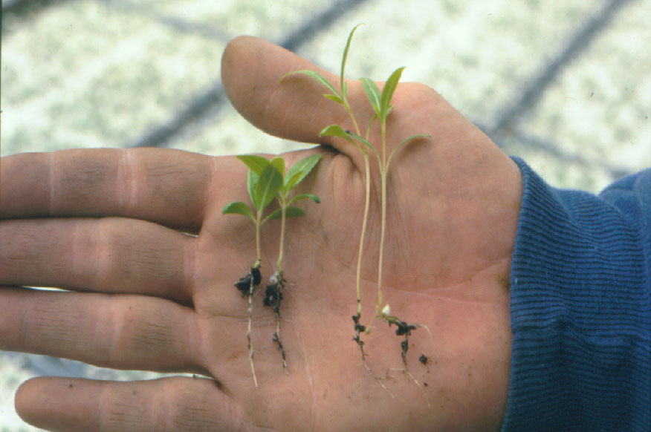
Seed treatment with GA₃ often ends up with elongated seedlings: control (left), GA₃ treated (right)

Slide 6
Use of Plant Hormones in Tissue Culture
Cytokinin- Stimulates shoot differentiation
Auxin- Stimulates callus and root formation

Slide 7
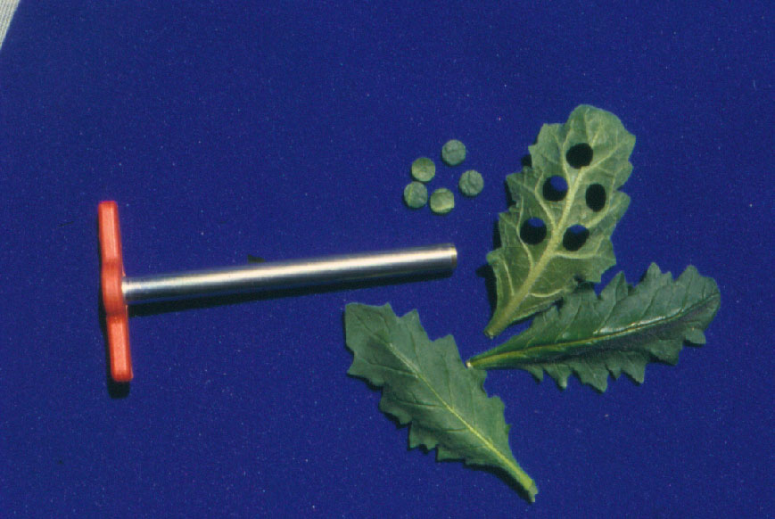
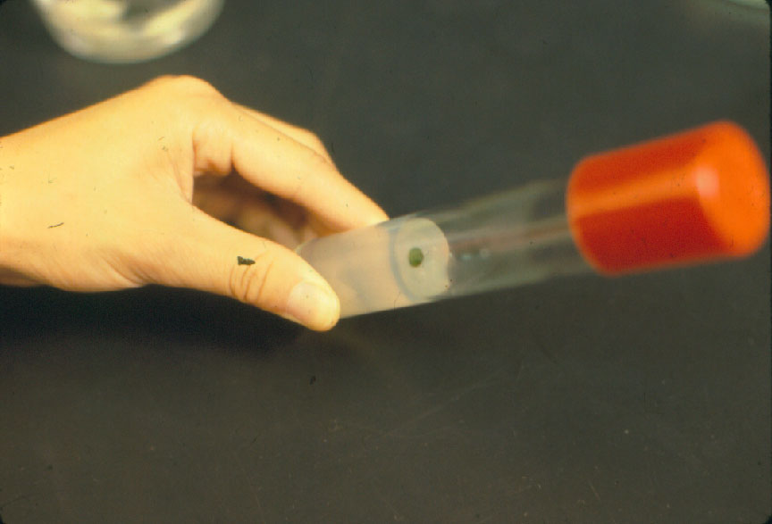
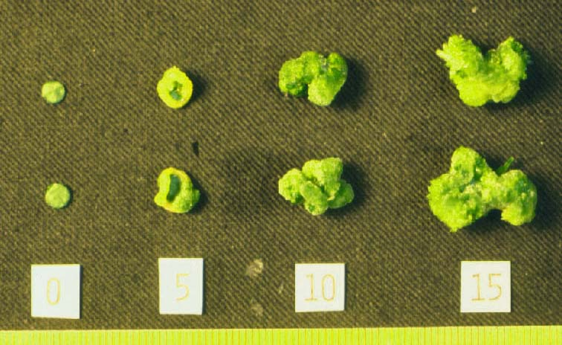
Leaf disc culture of Salpiglossis

Slide 8
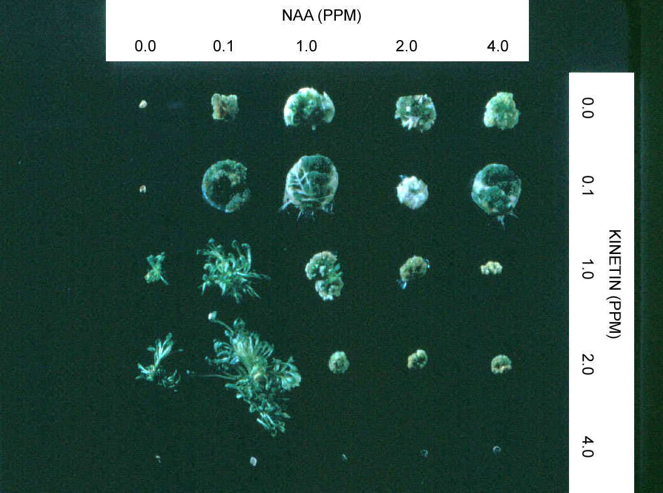
Influence of cytokinin and auxin on differentiation of callus tissues in Salpiglossis

Slide 9
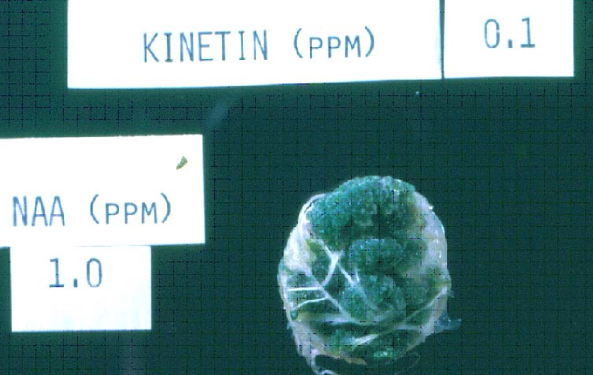
Callus proliferation and root production occur under a combination of low cytokinin and high auxin concentrations in the medium

Slide 10
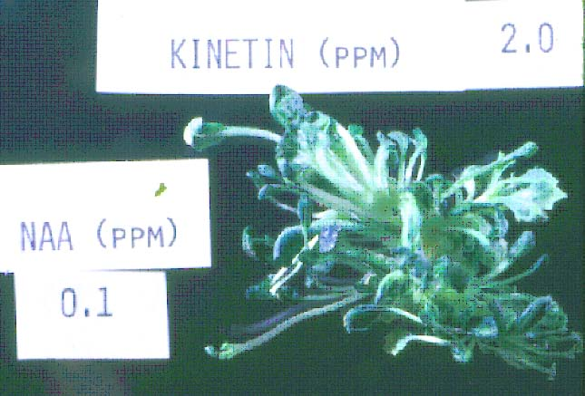
Shoot differentiation occurs under a combination of high cytokinin and low auxin levels in the medium

Slide 11
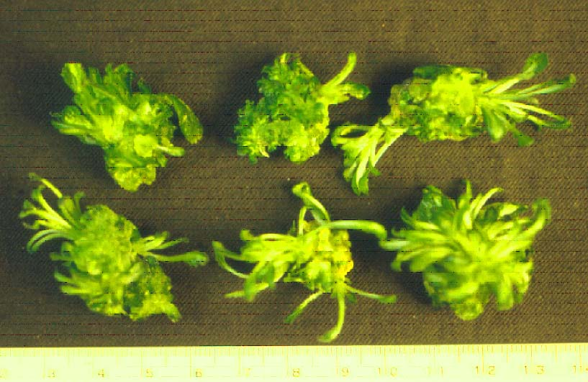
Shoots differentiated from callus are divided and rooted for use in clonal propagation

Slide 12
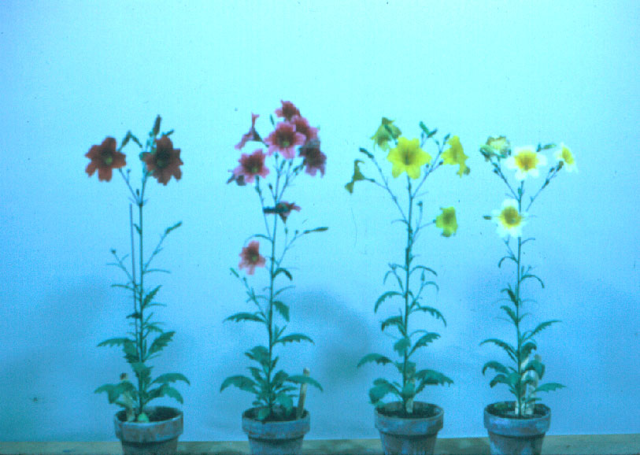
Flowering Salpiglossis plants which have been cloned from leaf disc cultures

Slide 13
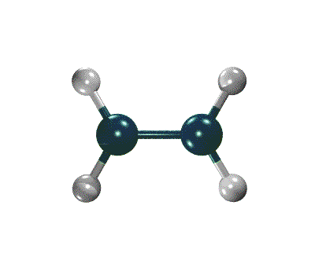
Chemistry and Mode of Action
Ethylene Gas
Chemical Form: C₂H₄
  Plant Hormone
  - fruit ripening
  - senescence
No color or odor
Natural, gaseous
Not toxic to human
Carbon
Hydrogen

Slide 14
Agricultural Uses of Ethylene as a Plant Hormone
Leaf abscission
Hastens fruit ripening
Flower induction
Conversion of flower sex expression
Germination enhancement
Shorter plants
Increase rubber content in plantation

Slide 15
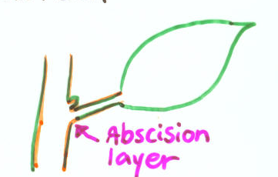
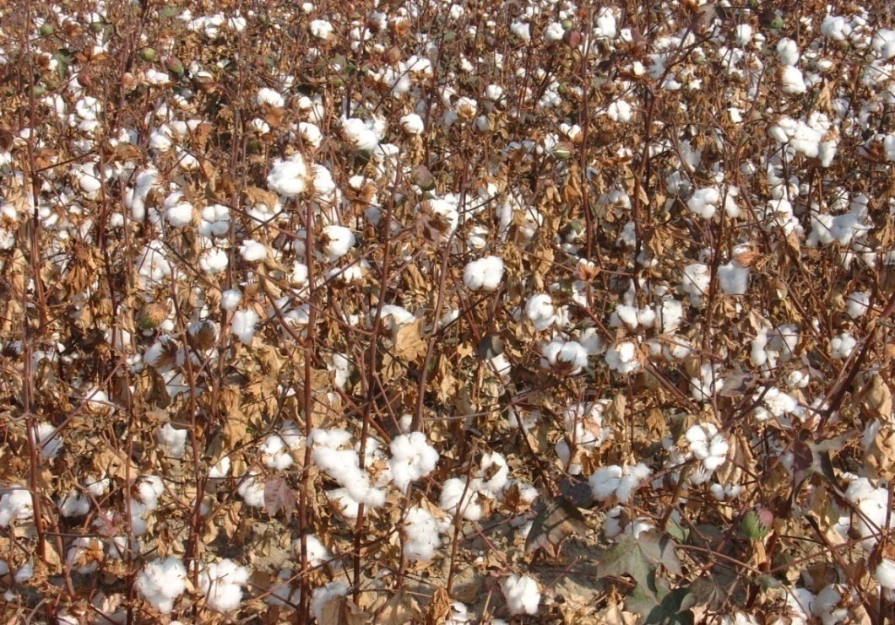
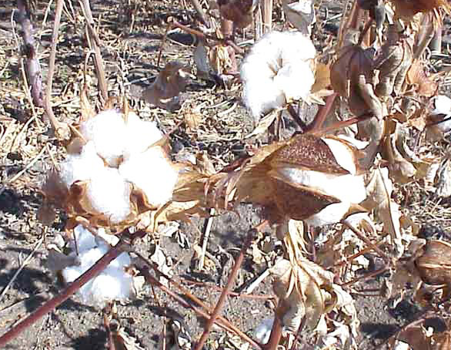
Defoliation in Cotton and Potato
- Chemicals: Abscissic Acid (natural)
Ethephon (ethylene)
- Defoliants: Ceron, Ethrel, etc.
- Used in cotton and potato field before harvesting
Cotton field ready to be harvested (lest-control, right-ethephon treated)

Slide 16
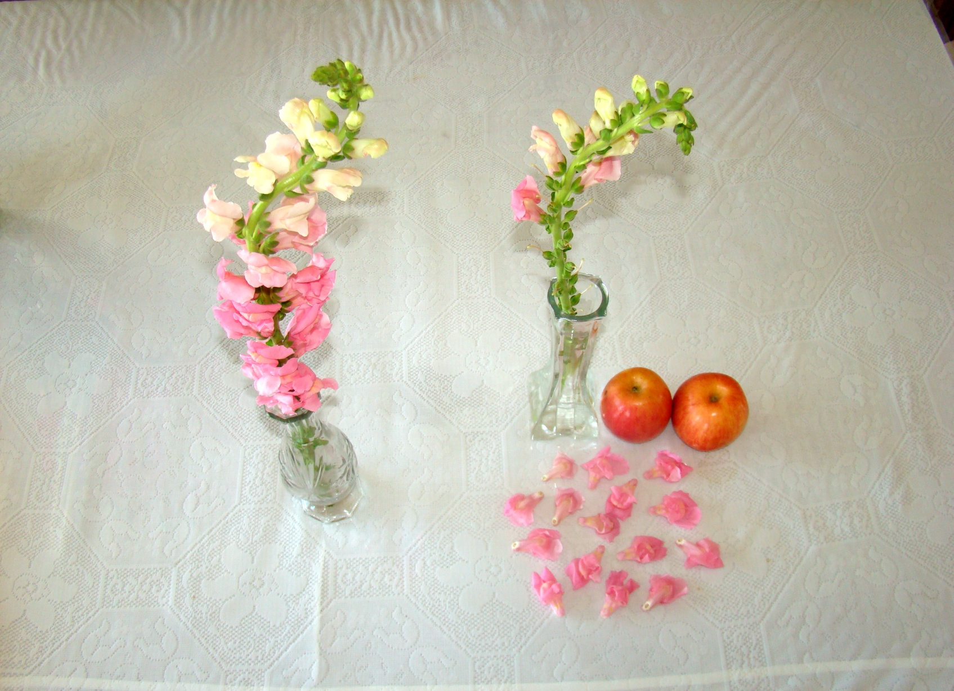
A
B
Responses of cut snapdragon flowers exposed to ethylene source for one night: A-flower stem placed in a plastic bag (control), B-flower stem placed in a plastic bag containing two apples.

Slide 17
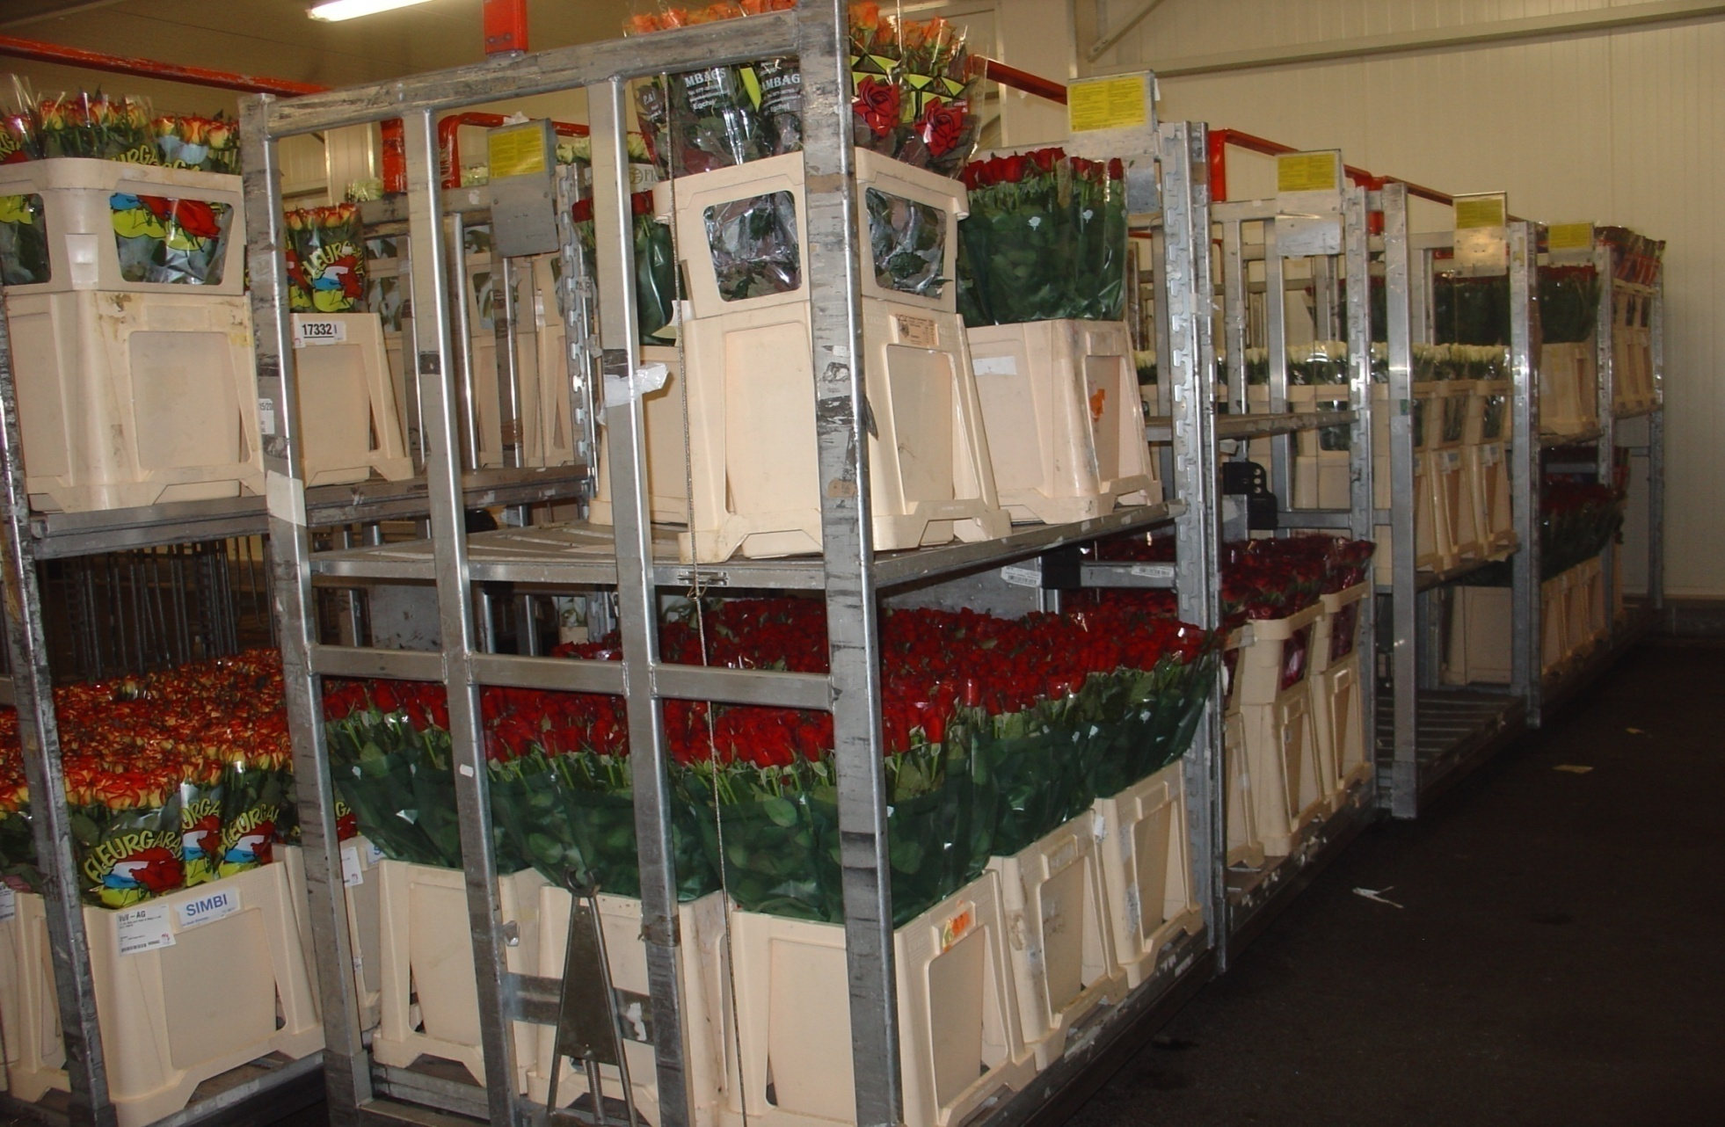
Most cut flower stems are dipped in preservative solution containing silver thiosulfate (STS), inhibitor of ethylene gas effect.

Slide 18
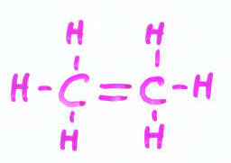
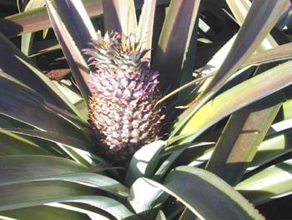
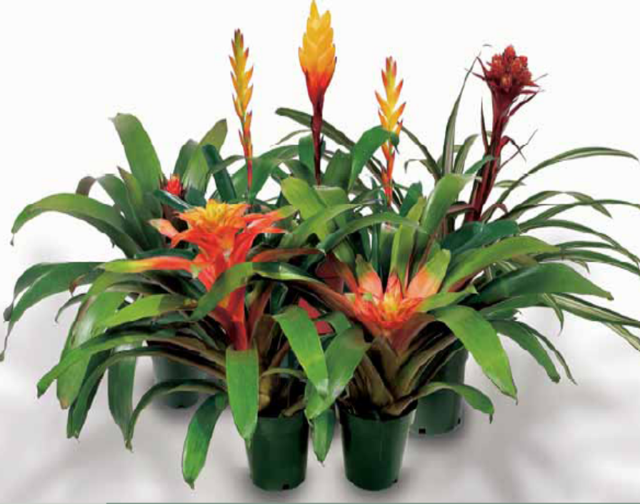
Induction of Flowering
- Use ethephon, an ethylene releasing chemical
- Flower induction in pineapple and bromeliads
Silver Vase
Pineapple
Ethephon is applied to young plants of pineapple and bromeliads to induce flowering
Silver Vase

Slide 19
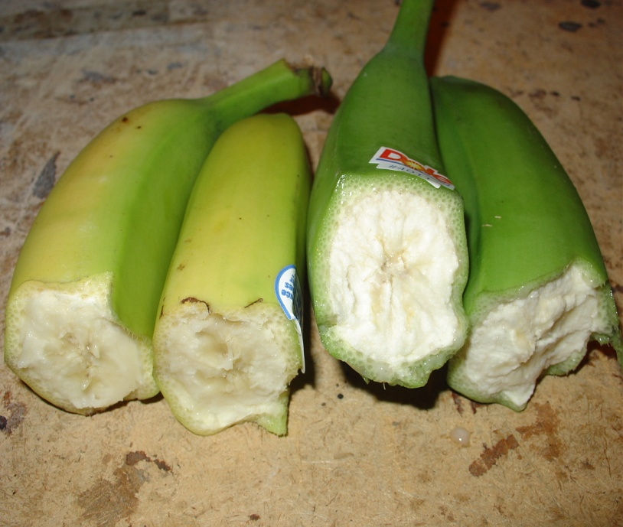
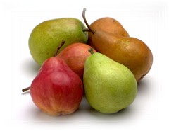
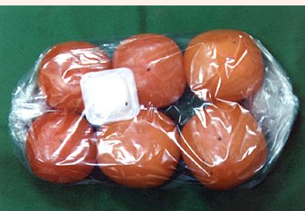
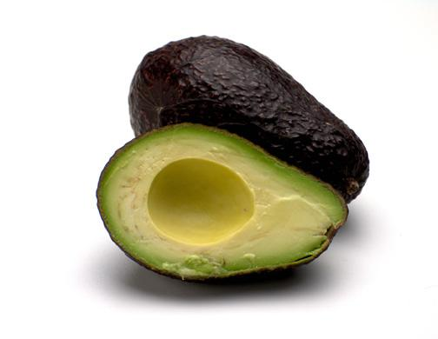
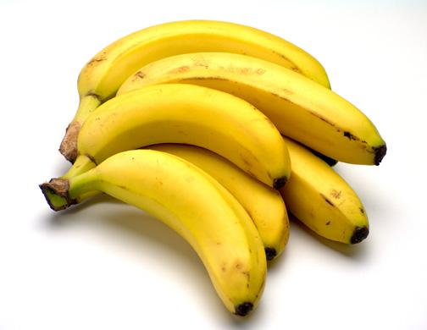
Ripening of Fruits
- Chemical: Ethephon (ethylene)
- Ripening of green banana, tomatoes, persimmons

Slide 20
Use of ethylene gas in fruit ripening and degreening
Ethylene promotes fruit maturation and ripening
a. Crops: tomatoes, banana, pineapple, dates, persimmons, pears, apples, honeydew melons, mango, avocados, papaya, jujubes
b. Doses: Internal tissue concentration of 0.1-1.0 ppm
Ambient level of about 10 ppm is often used for ripening
2. Chlorophyll elimination (Degreening)
a. Crops: citrus crops, including orange, grapefruit
b. Does: 1-20 ppm ethylene
It is clear that ethylene is a ripening hormone - a chemical substance produced by fruits with the specific biological phenomenon of accelerating the normal process of fruit maturation and senescence.

Slide 21
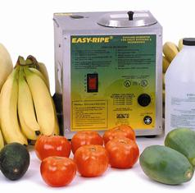
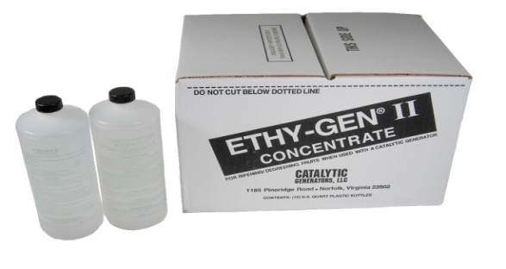

Some commercially available ethylene gas applicators

Slide 22
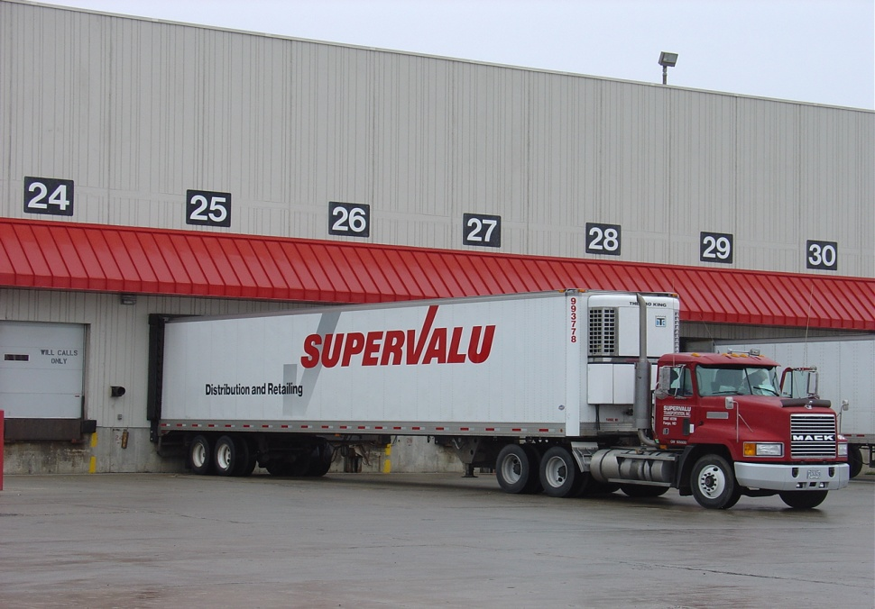
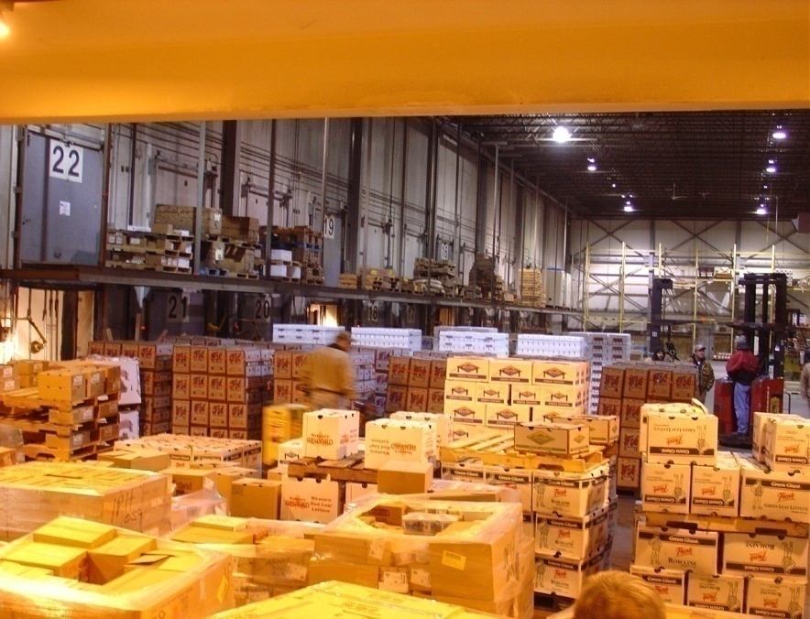
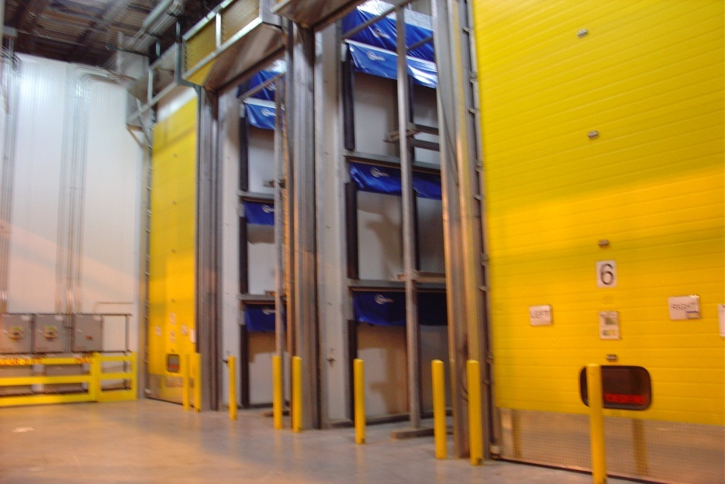
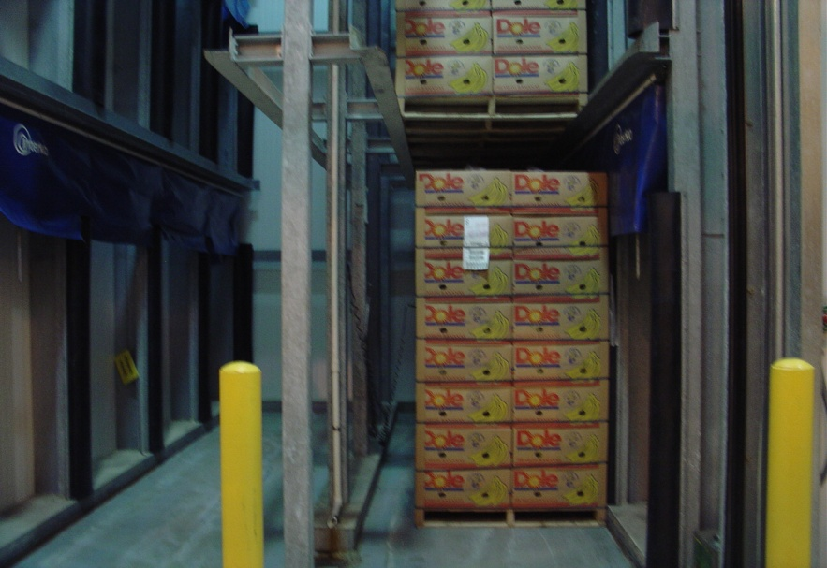
Fruit Ripening in Gas Chambers, SuperValu, Fargo

Slide 23
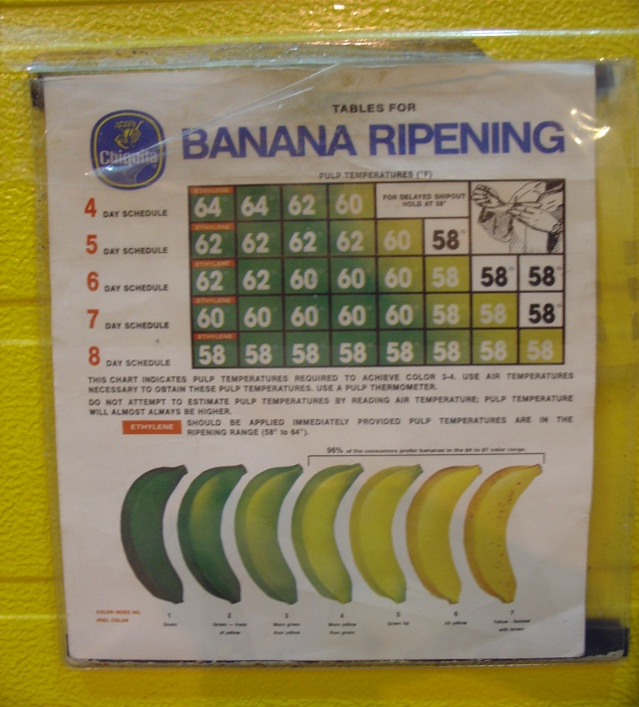
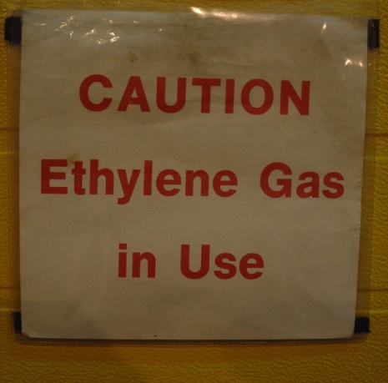
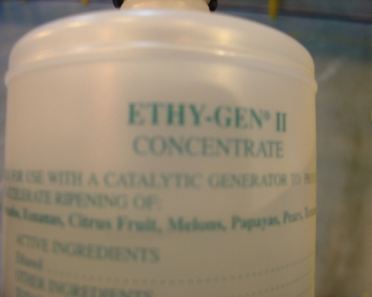
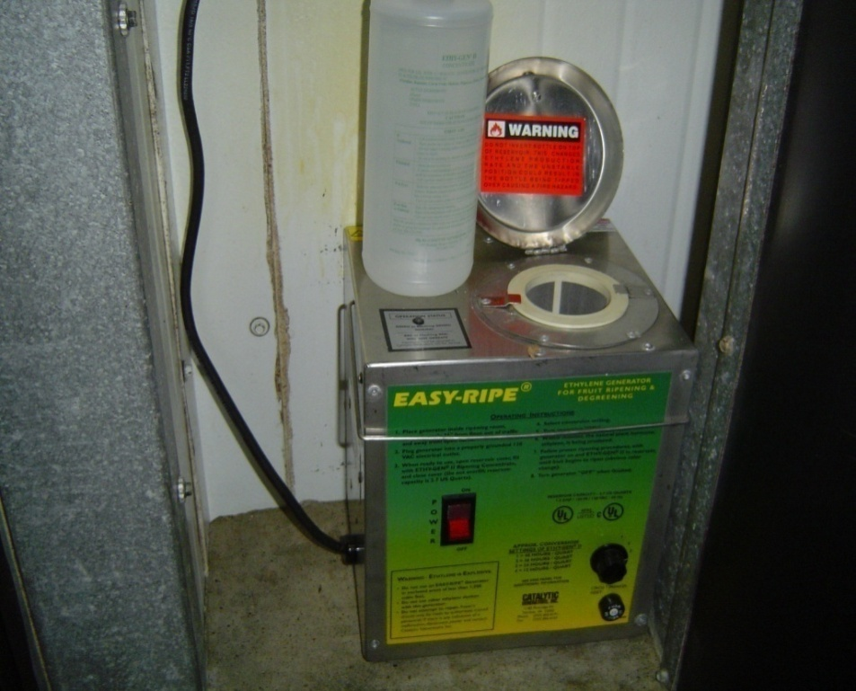
A
B
C
D
Ethylene gas used in ripening bananas (SuperValue): A-instructions on ripening procedures, B-source of ethylene (ethanol), C-warning signe, D-ethylene gas generator (Easy-Ripe) in use.

Slide 24
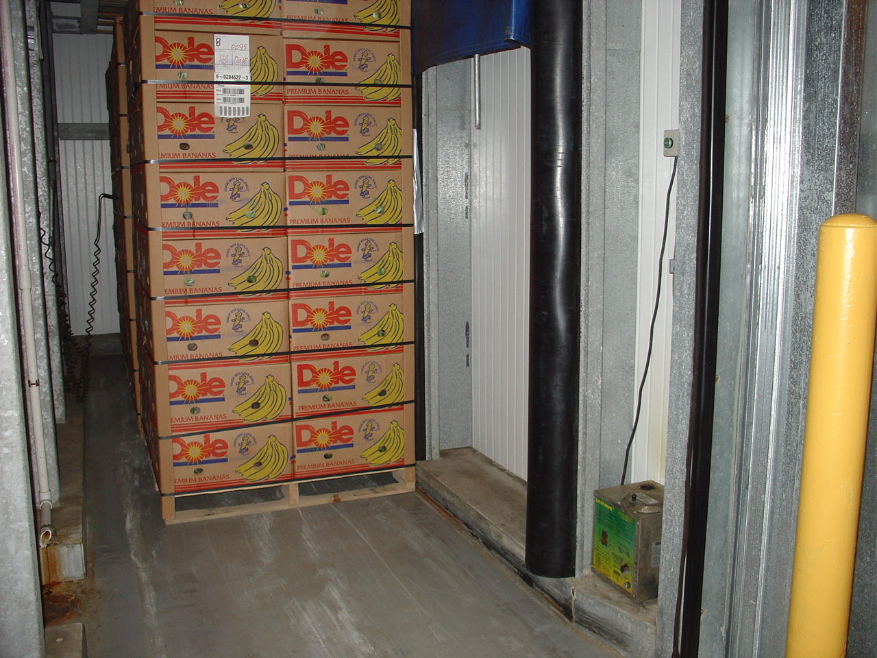
Ripening of green banana using ethylene gas, Super Value store in Fargo

Slide 25
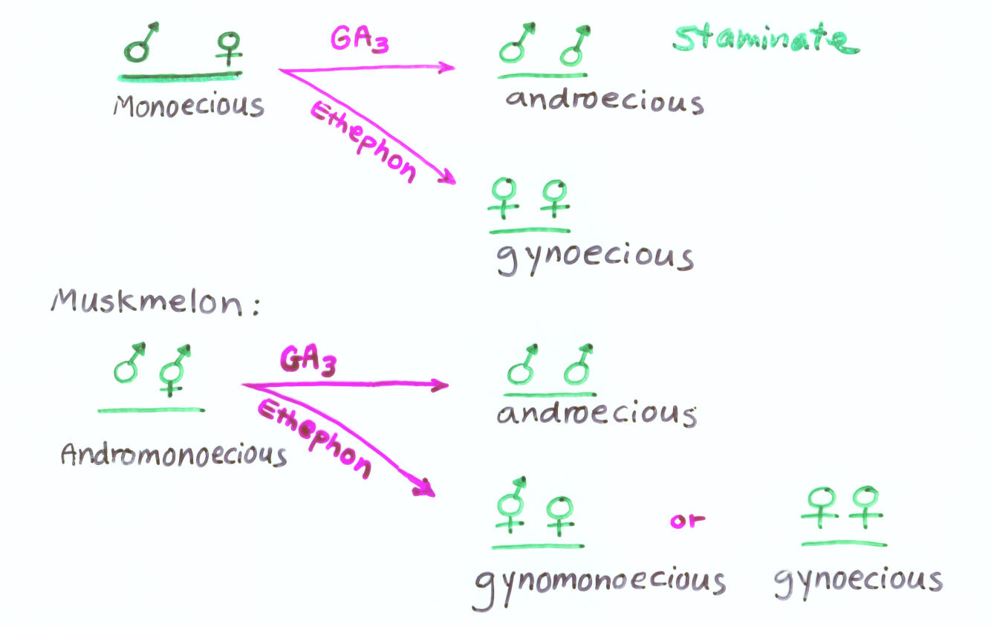
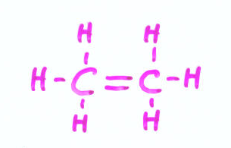
Conversion of Flower Sex Expression in Cucurbits
- Gibberellins (GA₃) promote maleness
- Ethylene promotes femaleness

Slide 26
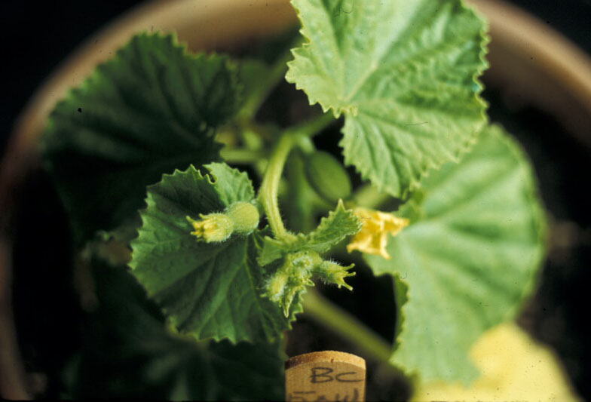
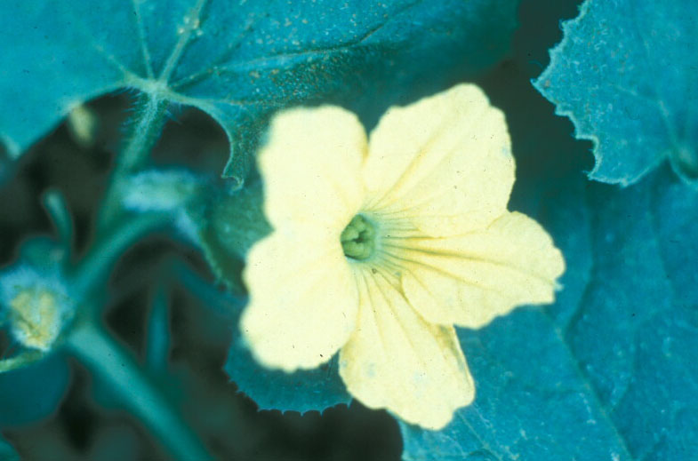
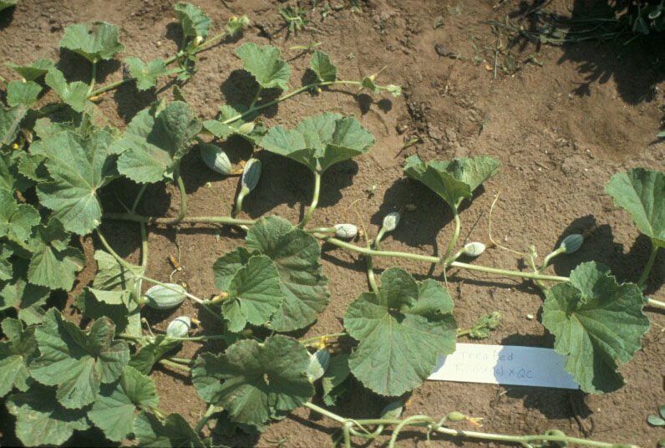
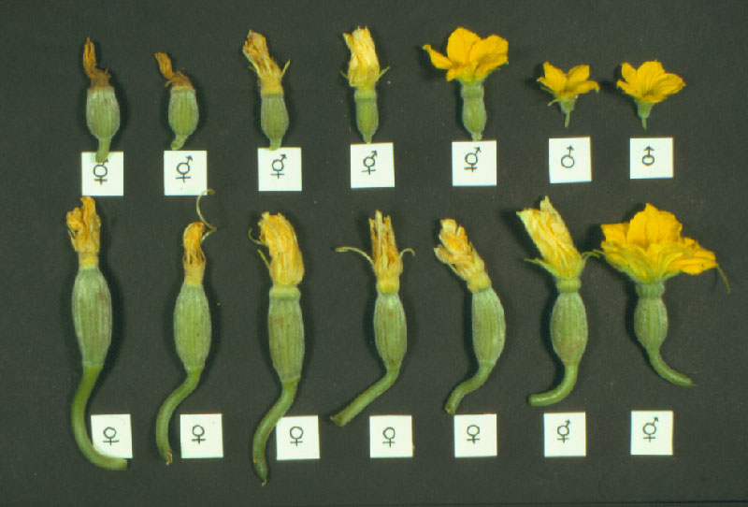
Conversion of Flower Sex in Muskmelon
A
B
D
C
D
A-First flower flowers induced by ethylene are female flowers; B-a close-up of pistillate flower induced by ethylene; C-vines showing pistillate and hermaphroditic flowers only on a treated plant. D-pistillate, perfect and male flowers formed on ethylene treated plants.

Slide 27
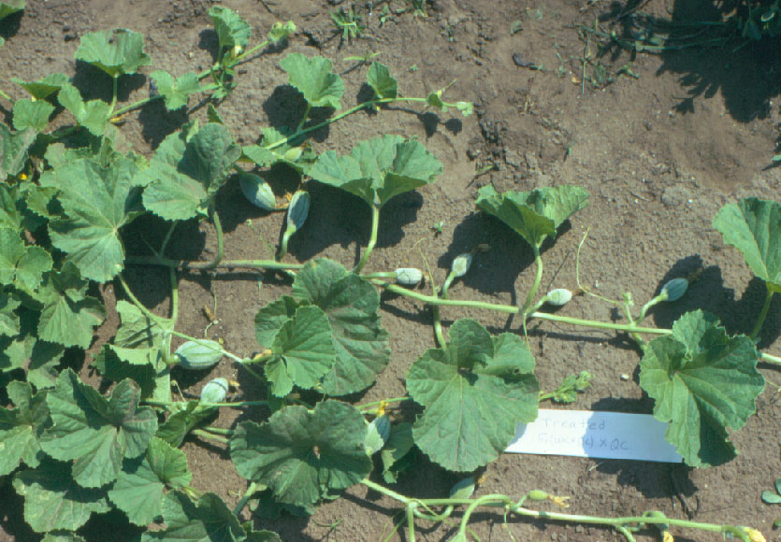
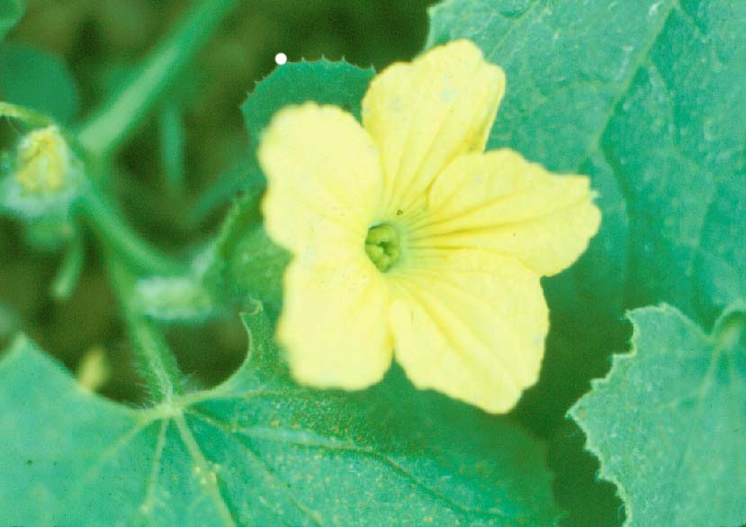
Ethephon application converts male flowers to female flowers in muskmelon

Slide 28
An example of flower sex expression in a muskmelon plant after treatment with ethephon

Slide 29
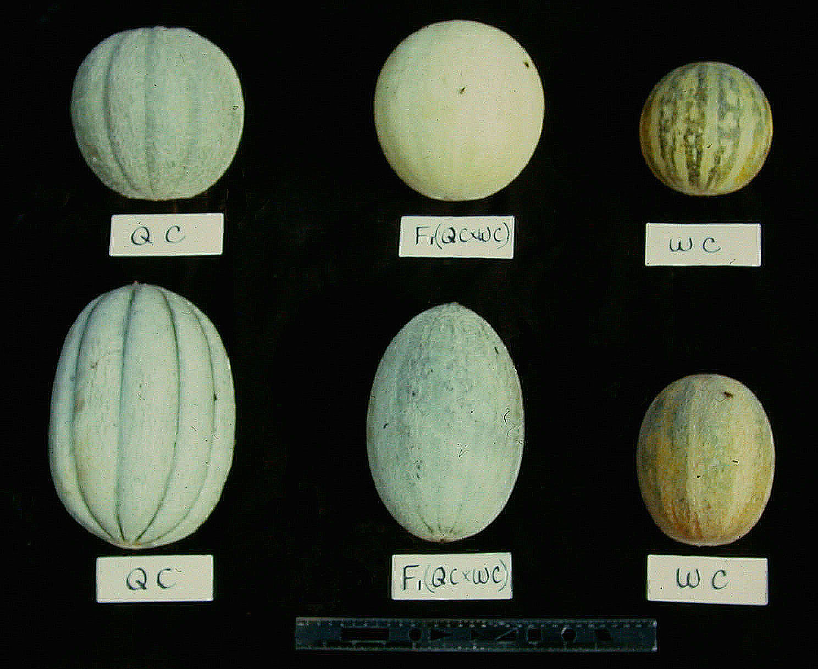
Muskmelon Fruits Developed from Ethylene-Induced Flowers
Top row-control (not treated), Bottom row-elongated fruits developed from ethylene induced female flowers

Slide 30
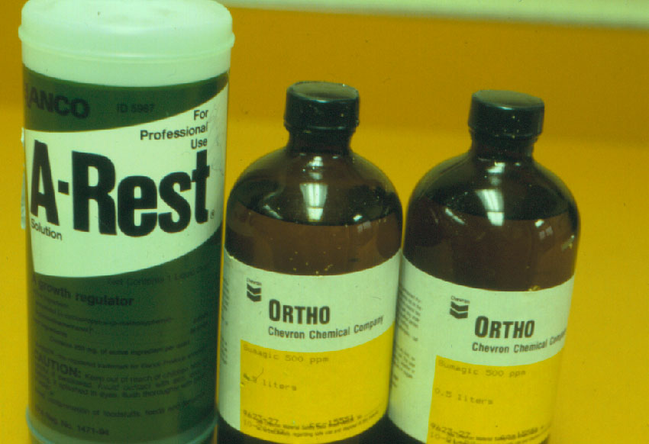

Some Chemical Growth Retardants
Short-lasting
Phosphon (B-9)
Chlormequat (CCC)
Ancymidol (A-Rest)
Long-lasting
Bonzi - Paclobrutrazol
Sumagic - Uniconazole
Uniconazole

Slide 31
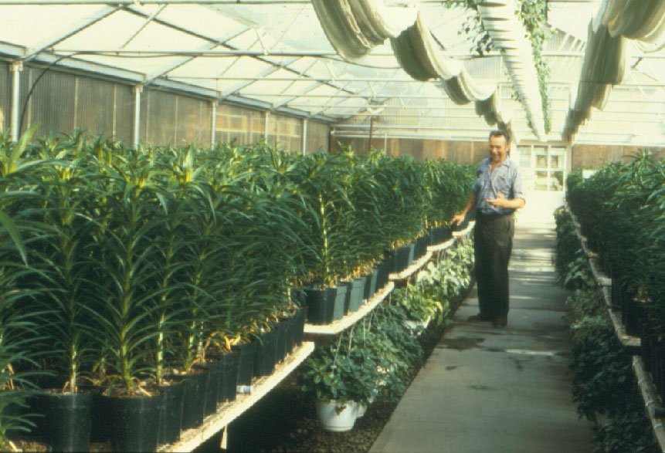

Easter lily plants grown in this Colorado greenhouse were too tall to fit into boxes for mass marketing and had to be thrown away
Greenhouse Production of Easter Lily

Slide 32

Easter Lily Height Control by Uniconozole (Sumagic)
Easter lily pots receiving increasing amounts of Uniconazole (from L to R: 0, 0.04. 0.08, 0.12, 0.16, 0.20 mg)

Slide 33


Influence of DIF
Difference between Day and Night Temperatures
Positive DIF – Plants become tall
Negative DIF – Plants become short

Slide 34

Plant height control on Liatris (gay feather) by growth retardant application (left-treated, right-control)

Slide 35

Metaxenia
Influence of Pollination on Fruit Set

Slide 36

Influence of pollination on aggregate fruit development in strawberry
Growth of receptacle into fruit was influenced by number of individual flowers pollinated and fertilized (left to right: one, two, numerous achenes developing after pollination

