Slide 1
Environmental Scan of Youth Asset
Development in the F/M Area
Venture Youth Alliance:
Youth Development Conference
“Building a Community Blueprint for Youth Success”
Fargo, ND
Dec. 1, 2011
Dr. Richard Rathge
Professor and Director
North Dakota State Data Center

Slide 2
Presentation Objective:
1. To present an overview of youth asset development in the F/M area.
2. To discuss findings from the youth development environmental scan.
3. To briefly discuss characteristics of youth served.

Slide 3
Availability of data on assets
A rich database for the F/M metropolitan area:
  Survey conducted in 2007 by Search Institute for Moorhead Healthy Community Initiative (now Metro Youth Partnership)
  Students in grades 4 through 12 in Fargo, West Fargo, and Moorhead school districts

Slide 4

Search Institute’s
Developmental Asset Framework
40 assets divided into two main groups with subsectors
  Positive experiences and qualities that help influence the choices young people make in their development to adulthood
  20 external assets:
    Support
    Empowerment
    Boundaries and expectations
    Constructive use of time
  20 internal assets:
    Commitment to learning
    Positive values
    Social competencies
    Positive identity

Slide 5
Examples of EXTERNAL assets
Support – Positive family communication
    “Young person and her/his parent(s) communicate positively, and young person is willing to seek advice and counsel from parents.”
Empowerment – Community values youth
    “Young person perceives that adults in the community value youth.”
Boundaries and expectations – Adult role models
    “Parent(s) and other adults model positive, responsible behavior.”
Constructive use of time – Creative activities
    “Young person spends three or more hours per week in lessons or practice in music, theater, or other arts.”

Slide 6
Examples of INTERNAL assets
Commitment to learning – Reading for pleasure
    “Young person reads for pleasure three or more hours per week.”
Positive values – Restraint
    “Young person believes it is important not to be sexually active or to use alcohol or other drugs.”
Social competencies – Cultural competence
    “Young person has knowledge of and comfort with people of different cultural/racial/ethnic backgrounds.”
Positive identity – Self-esteem
    “Young person reports having a high self-esteem.”

Slide 7
Search Institute’s
Types of Risky Behavior
Substance abuse
Alcohol, tobacco, illicit drugs
Sexual intercourse
Anti-social behavior
Violence
School truancy
Attempted suicide
Eating disorder

Slide 8
Figure 1. Average Number of Risk-Taking Behaviors (out of 24) by Asset Level for Students in Grades 6-12 in Fargo, Moorhead, and West Fargo Schools: May 2007
Notes:
Report Figure 8

Slide 9
Search Institute’s
Types of Thriving Behavior
Succeeds in school
Helps others
Values diversity
Maintains good health
Exhibits leadership
Resists danger
Delays gratification
Overcomes adversity

Slide 10
Figure 2. Average Number of Thriving Indicators (out of 8) by Asset Level for Students in Grades 6-12 in Fargo, Moorhead, and West Fargo Schools: May 2007
Notes:
Report Figure 9

Slide 11
External: Support
Figure 4. Percent of Students in Grades 4-12 Who Report Having Each External Asset, by Grade, in Fargo, Moorhead, and West Fargo Schools: May 2007
Notes:
Report Figure 6 (section 1)

Slide 12
Internal: Social competencies
Figure 9. Percent of Students in Grades 4-12 Who Report Having Each Internal Asset, by Grade, in Fargo, Moorhead, and West Fargo Schools: May 2007
Notes:
Report Figure 7 (section 3)
Table 3

Slide 13
Presentation Objective:
1. To present an overview of youth asset development in the F/M area.
2. To discuss findings from the youth development environmental scan.
3. To briefly discuss characteristics of youth served.

Slide 14
Methodology
244 organizations/programs in F/M area
  Excluded schools and churches
Mail survey in early March 2010
  Response rate of 37%
  Sample size large enough to give 90% confidence with error less than 7%
Financial characteristics from IRS 990 forms
  Source National Center for Charitable Statistics
Follow-up calls for qualitative context

Slide 15
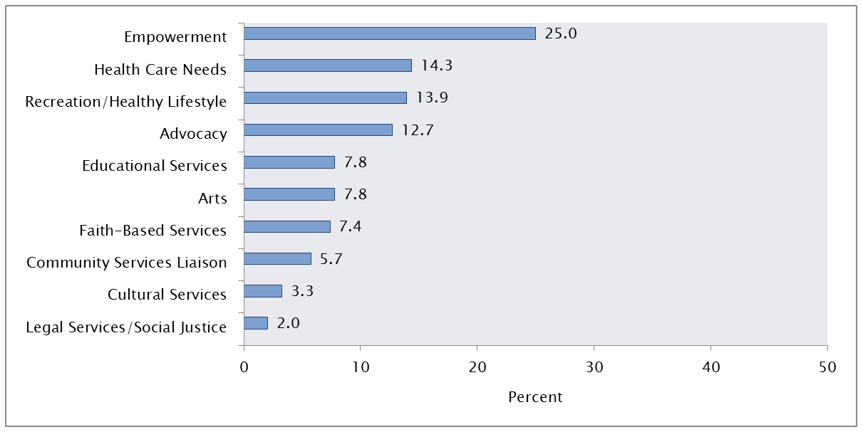
Top Mission Themes
Percent of youth development organizations/programs in the F-M Area by mission theme*
N=244
*The mission theme came from the stated mission by survey respondents, by the mission stated by nonprofit organizations on their IRS 990 form, or inferred from the organization’s name and additional information available on the web.

Slide 16
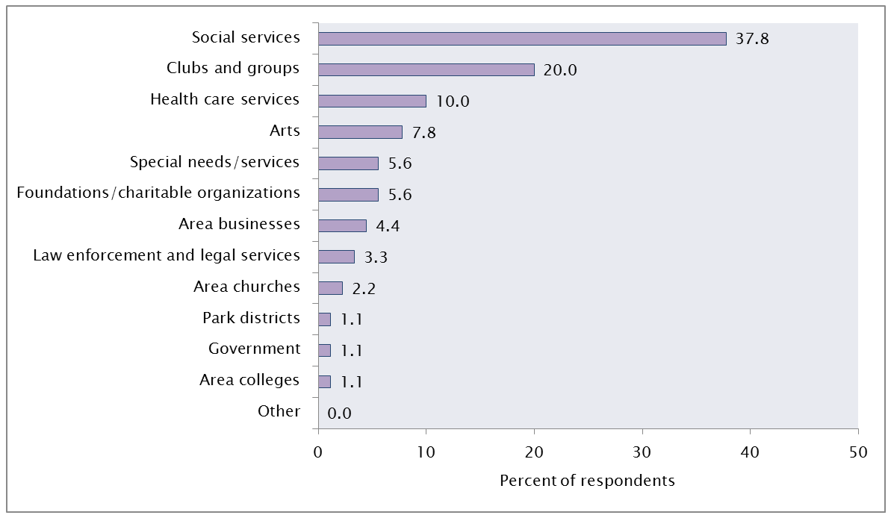
Types of Organizations
Categories of youth development organizations/programs in the F-M Area
N=90

Slide 17
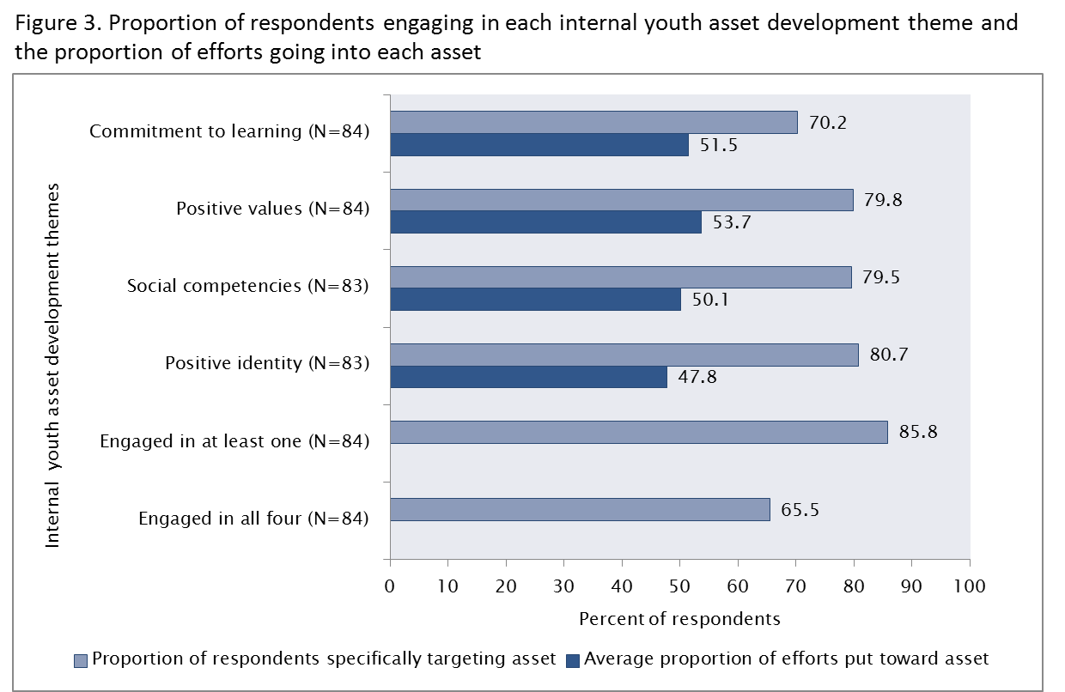
Internal Asset Development

Slide 18
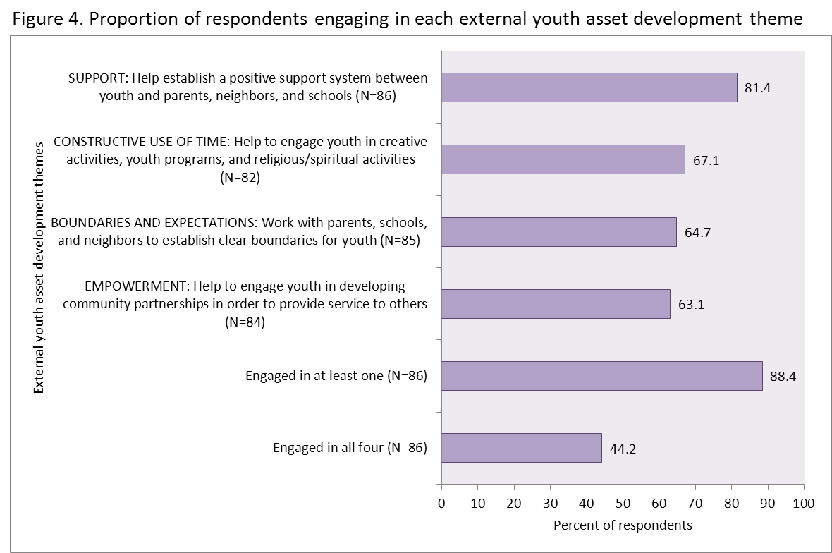
External Asset Development

Slide 19
Organizational Budgets
Total budget and proportion of budget organizations spend on youth ages 10 to 18 in a typical year
Budget Characteristics |  | Respondents
 |  | Number | Percent
Annual total budget | Less than $25,000 | 17 | 34.0
 | $25,000 to $150,000 | 13 | 26.0
 | More than $150,000 | 20 | 40.0
 | Total | 50 | 100.0
Percent of annual total budget spent on youth development | Less than 5% | 10 | 19.2
 | 5% to 35% | 14 | 26.9
 | 36% to 75% | 17 | 32.7
 | More than 75% | 11 | 21.2
 | Total | 52 | 100.0

Slide 20
Presentation Objective:
1. To present an overview of youth asset development in the F/M area.
2. To discuss findings from the youth development environmental scan.
3. To briefly discuss characteristics of youth served.

Slide 21
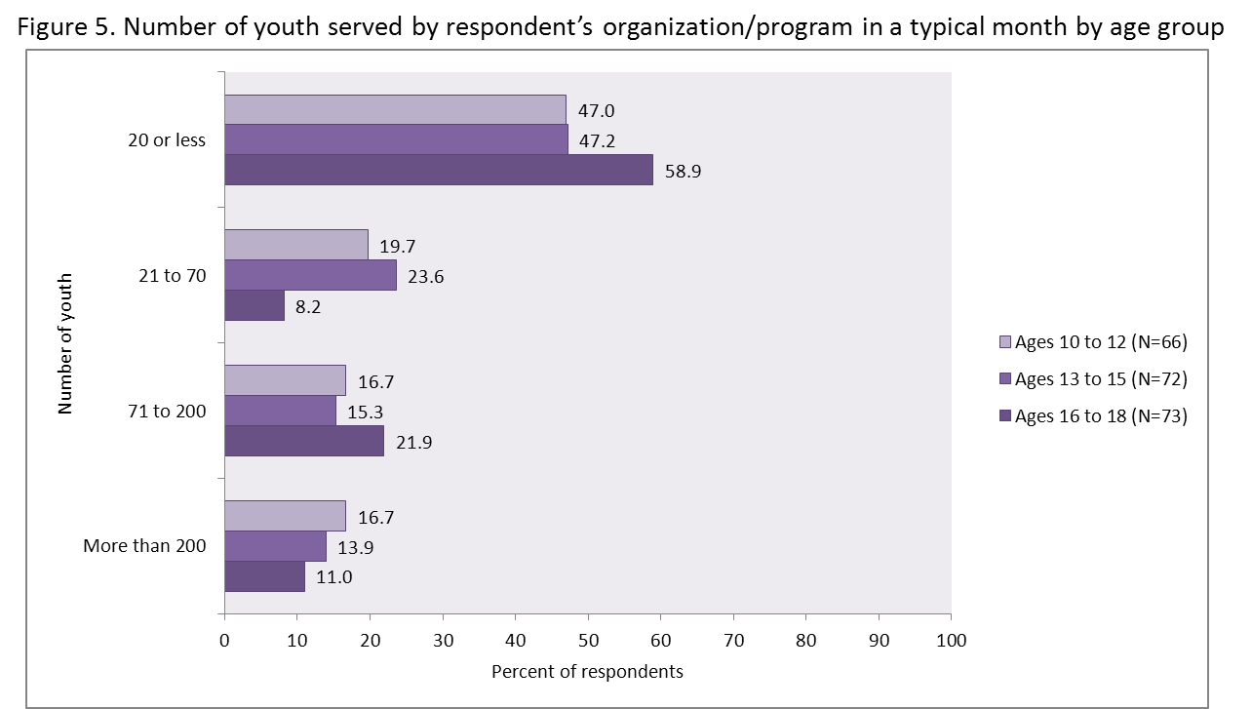
Youth Development Capacity

Slide 22
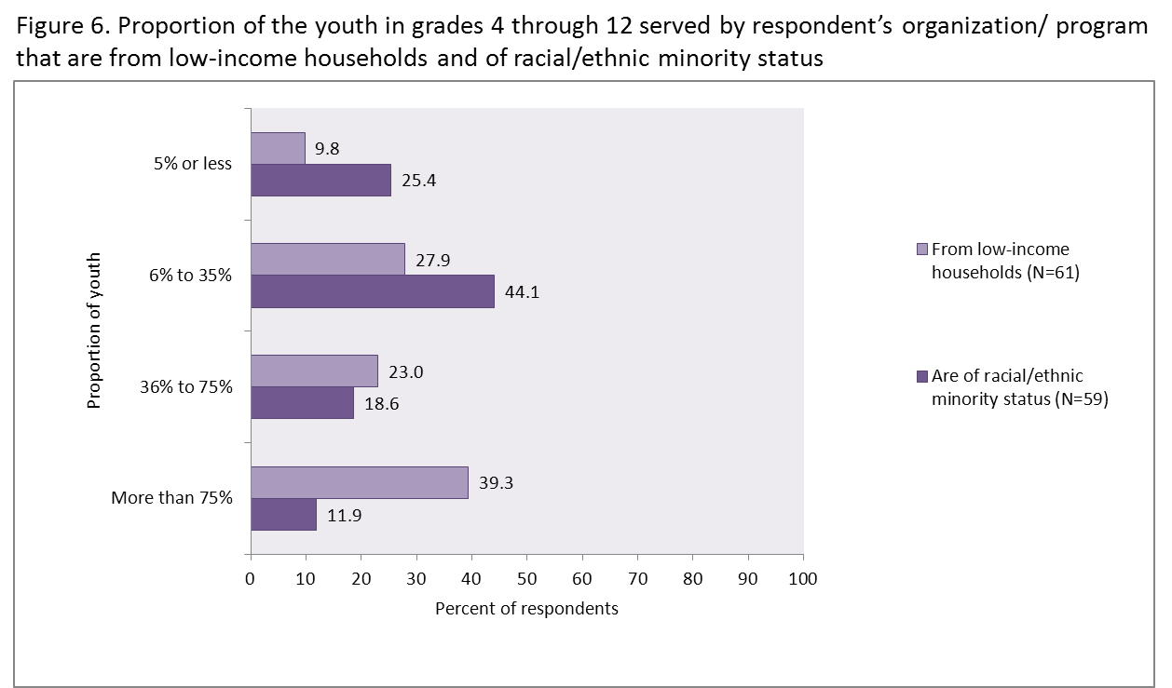
Characteristics of Youth Served

Slide 23
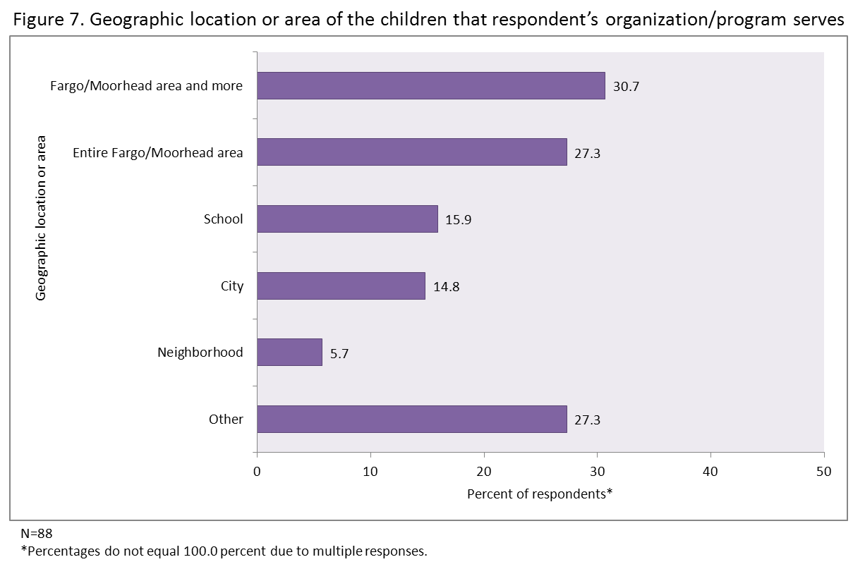
Location of Youth Served

Slide 24
FM Youth Development
Dr. Richard Rathge, Director
  North Dakota State Data Center, Fargo, ND NDSU, IACC 424, Fargo, ND 58108-6050
  Richard.Rathge@ndsu.edu
  Phone: (701) 231-8621 Fax: (701) 231-9730
  URL: www.ndsu.edu/sdc

