Slide 2
Graduate Program Name
Graduate Program Contact Info & Social Media Platforms

Slide 3
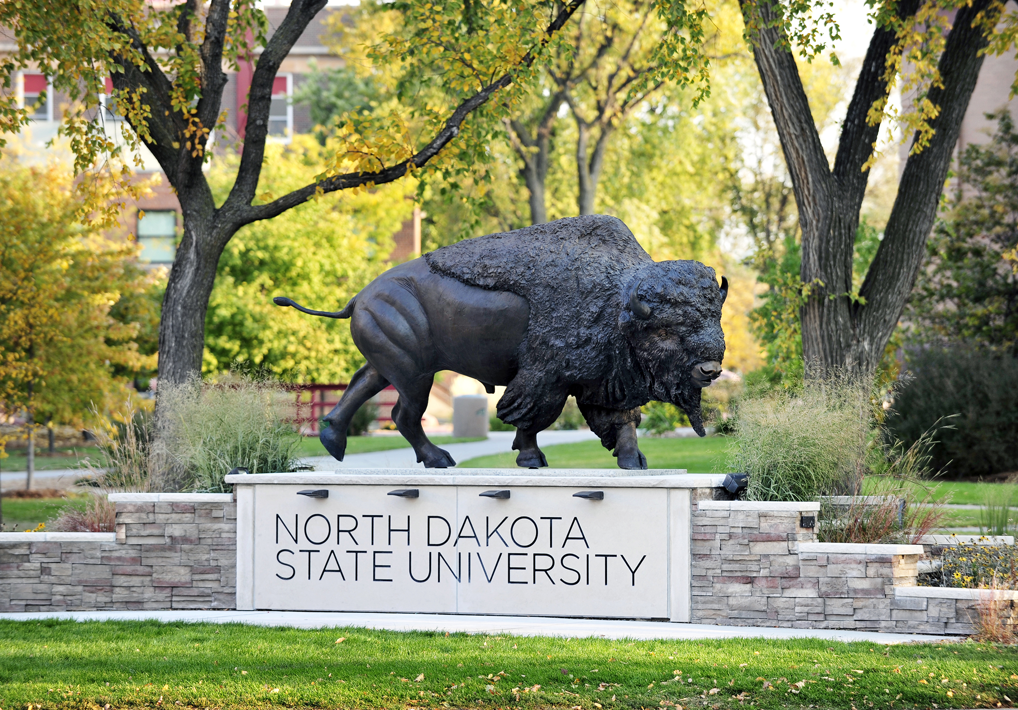
NDSU Profile
Located in Fargo, ND
NSF Top 100 Research University
Enrollment: approx. 14,000 (approx. 2,000 graduate students)
75+ graduate programs
700 graduate faculty

Slide 4
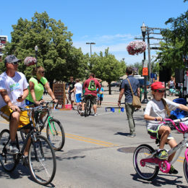

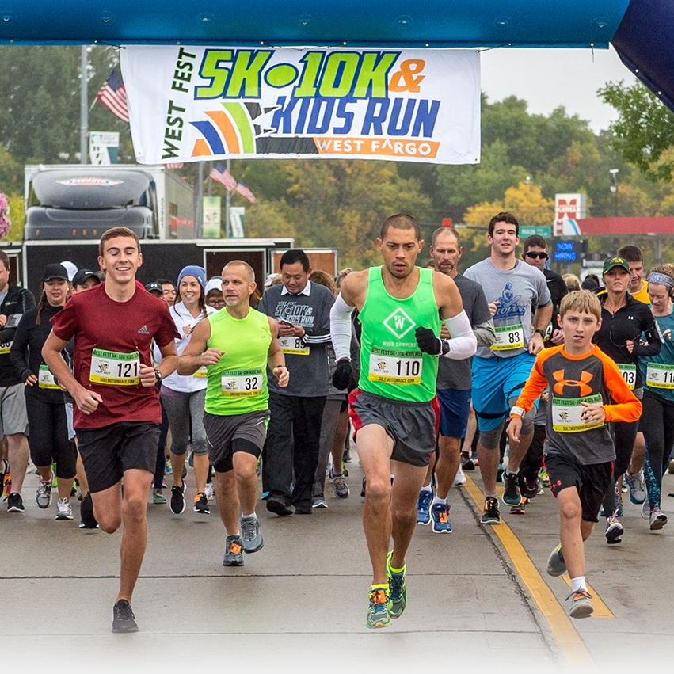
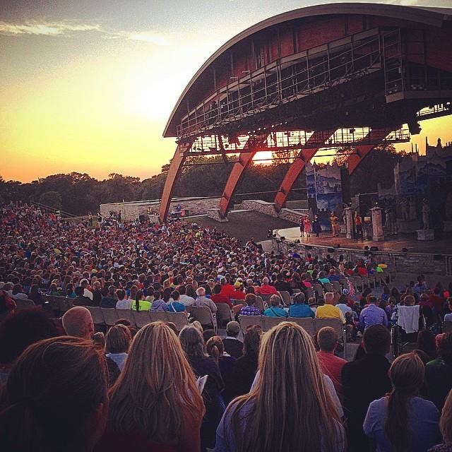
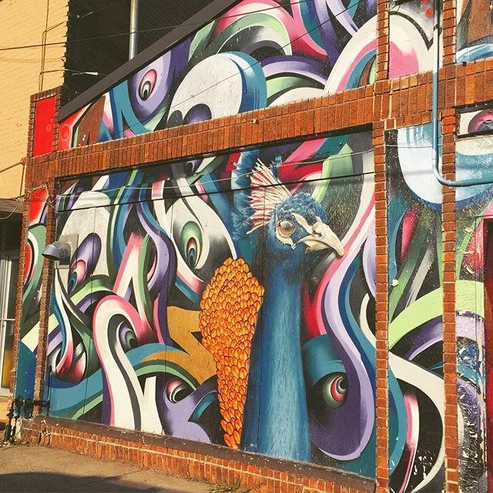

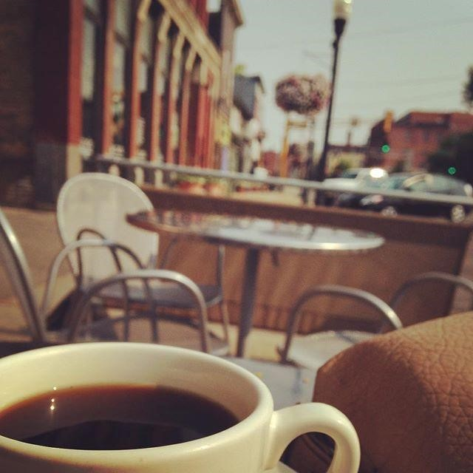
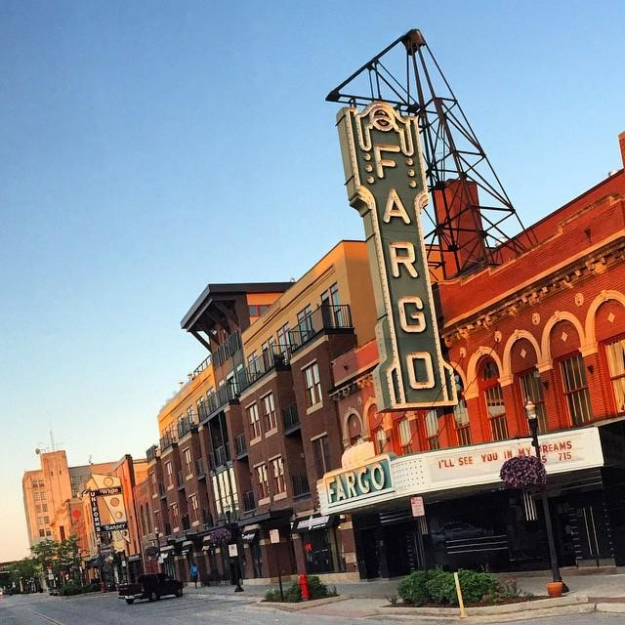


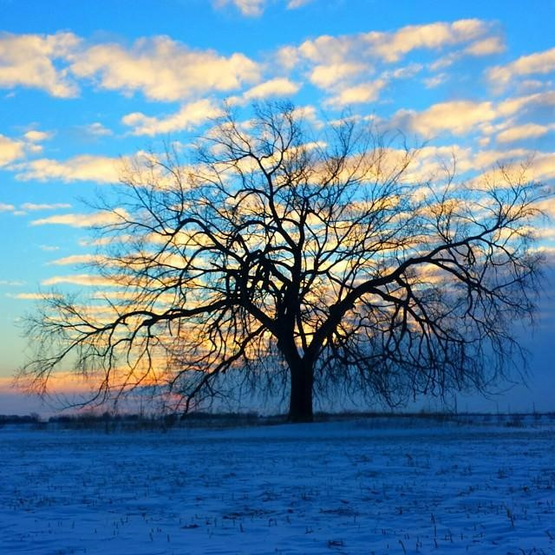
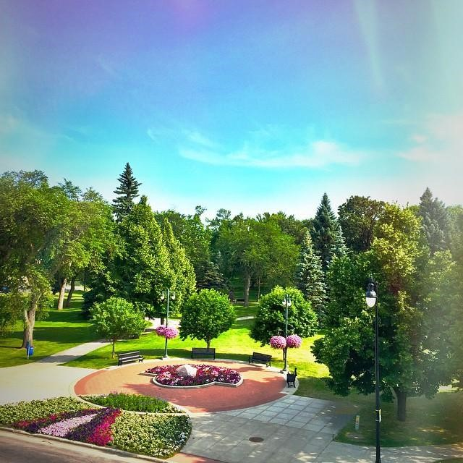
Fargo-Moorhead Community
Family Friendly Environment
Excellent Schools  Safe Neighborhoods  Low Crime
Active Arts & Cultural Scene Symphony  Civic Opera  Art Museums  Theatre
Lively Downtown District
Unique Shops  Local Restaurants  Urban/Residential
A Variety of Outdoor Activities
Many Parks & Trails  Close to Lakes  Outdoor Sports

Slide 5
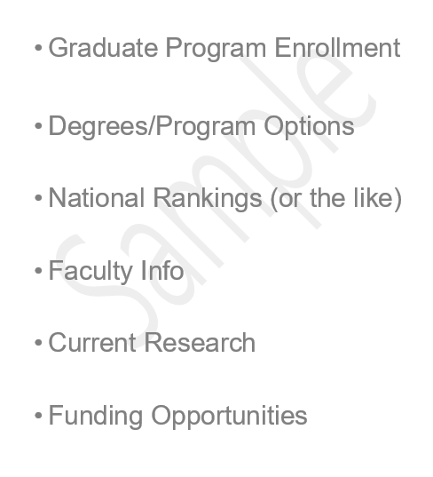
Graduate Program Profile
Graduate Program Enrollment
Degrees/Program Options
National Rankings (or the like)
Faculty
Current Research
Funding Opportunities
Insert Program Photo Here

Slide 6
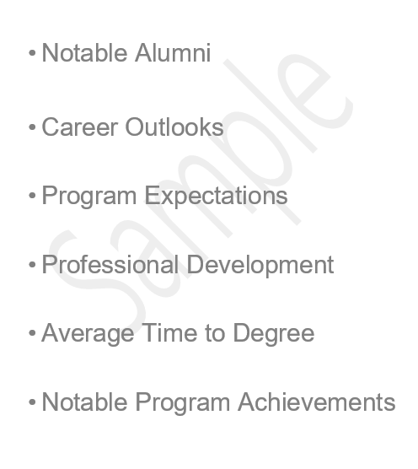
Graduate Program Profile
Insert Program Photo Here
Notable Alumni
Career Outlooks
Program Expectations
Professional Development
Average Time to Degree
Notable Program Achievements

Slide 7
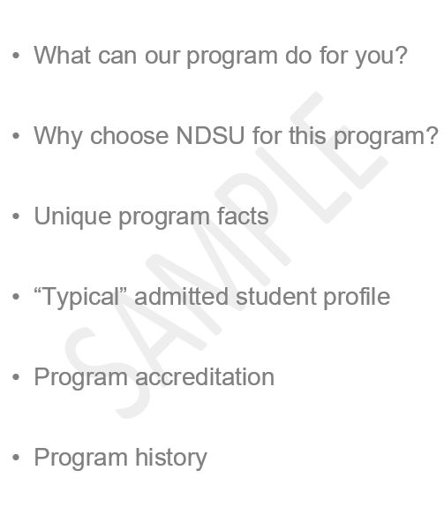
Graduate Program Profile
What can our program do for you?
Why choose NDSU for this program?
Unique program facts
“Typical” admitted student profile
Program accreditation
Program history
Insert Program Photo Here

Slide 8
General Admission Requirements
CGPA – minimum 3.0 on a 4.0 scale
Baccalaureate degree from recognized university
Adequate preparation in the chosen field
English proficiency
  IELTS 6.0 or TOEFL 71 or Duolingo 100
      - OR -
  Raised in or earned recognized degree from approved country
  https://bulletin.ndsu.edu/graduate/admission-information/

Slide 9
Application Instructions
Application and $35 fee
  Statement of Purpose
  Resume
3 Recommendations
All official transcript(s)
GRE or GMAT (if required by program)
English-language proficiency test (if applicable)
https://www.ndsu.edu/gradschool/apply

Slide 10
Application Review Process
Our program’s application deadlines are XXX for fall and XXX for spring.
Applications are considered only after all required official materials have been received by the Graduate School.
Once we receive an application file, we review all information and make a recommendation to the Graduate School.
The Graduate School will process your final admission decision and notify you via email.

Slide 11
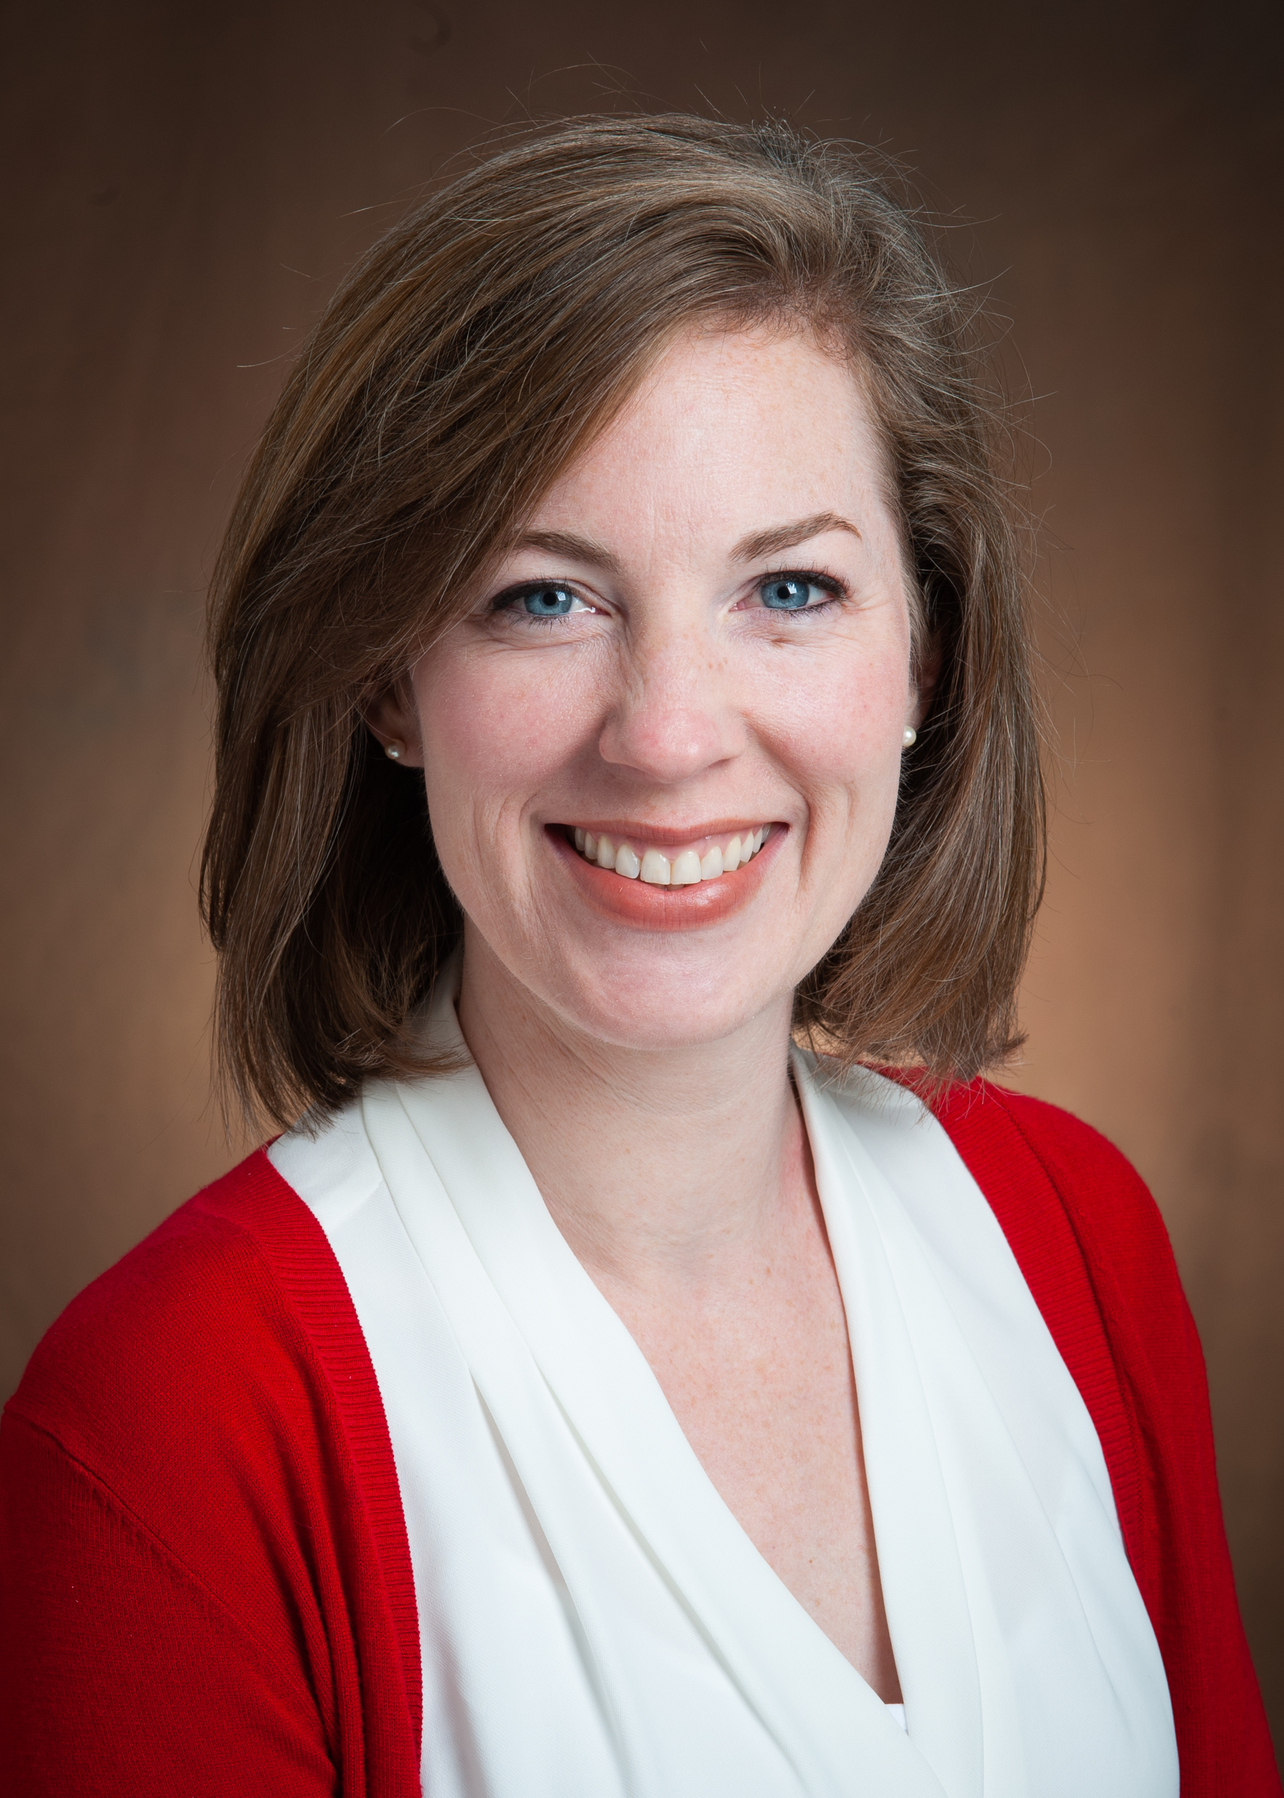
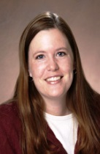
Graduate School Admission Staff
Neely Benton
Student Recruitment Coordinator
Neely.Benton@ndsu.edu
Melissa Ostby
Graduate Admissions Coordinator
Melissa.J.Ostby@ndsu.edu
Direct general questions to ndsu.grad.school@ndsu.edu.

Slide 12
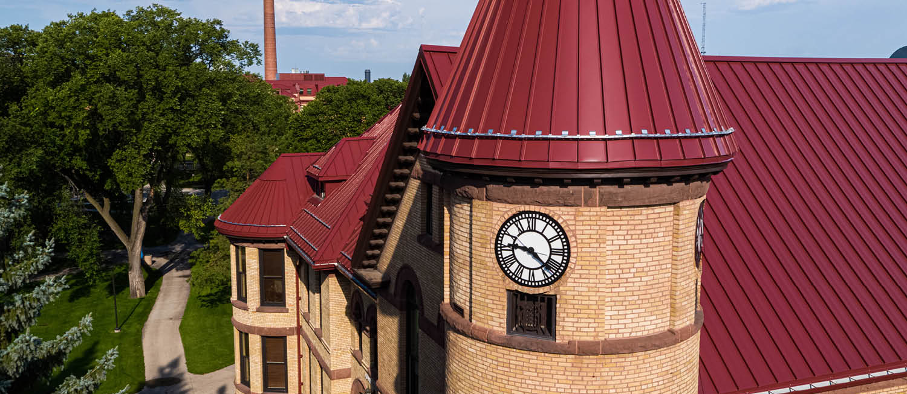
Questions?

