Slide 1
Maximizing
Academic
Options
Tri-College.org
August 2023
Tim Flakoll ~ Tri-College Provost
Deanne Sperling ~ Communications Coordinator
Johnny Cooper ~ Tri-College Student Ambassador

Slide 2
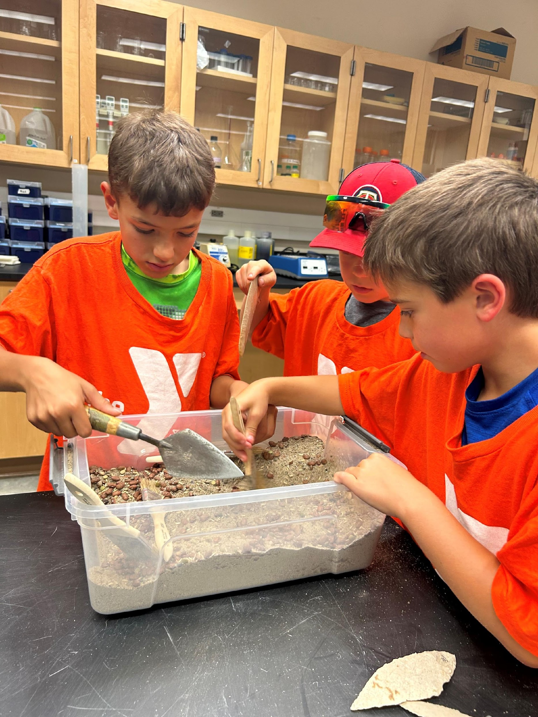
Tri-College Programs
Course exchange / Tri-College minor - $300 million savings
Walk into My Future
Library
ROTC
Faculty Excellence in Innovation and Adaptive Education Awards
Reading for Recovery
NDSU Archeology booth
2023 Walk into My Future

Slide 3

Launchpad for
New Programs
Educational Leadership
Vaccinology

Slide 4

Marketing & Promotion
Marketing the Metro
Parent’s Guide
Videos /print materials
Billboards
Student Ambassadors
Yard signs
Youth Activity/Coloring Book

Slide 5

Funding
Campus assessment formula
Endowment covers ~~ 10%
Grants and advertising ~~ 10%
NDSU’s share – less than in 2003
High water mark –
  $275,000/FTE in external funding/grants for 3 yr. rolling average

Slide 6

Events & Activities
A.I. Fall series
Professional Development
CIO collaboration
Student Government - Body transition meetings

Slide 7

2. The Course Exchange Option

Slide 8
maximizing academic options
What do students need to know & when
Step 1: Basic understanding
Step 2: I NEED a class . . . .
A unique & FREE benefit
Take up to 2 classes at a partner campus
For a class(es) or a Minor not available at NDSU
A specialized process requiring additional time and planning
https://www.ndsu.edu/onestop/tri-college-university-registration
How to find a class
What kind of class will work?
Where do I start the process?
Getting started sooner is so much better . . . .
Briana Kautzman – NDSU – Registration Assistant – 1-5474 - NDSU.Registrar@ndsu.edu
Due to the unique nature of the Tri-College Course Exchange, each campus has 1 registration specialist working with Tri-College requests (Jodi Pierce - backup)

Slide 9
From March 2023 survey
#1 Reason – Needed the class /wasn’t available on my campus
#1 Impact – kept me on track in my program/on track for graduation
#1 Resource – Advisors and Professors
One student said: “make sure advisors are informed about the options . . .
Actually execute the process . . The SHOULD be a great resource as [advisors] are the #1 contact for students . . .
Why do students need the
course exchange option?
Notes:
Example – student failed the lab in one of his sequential nursing course. Was able to pick up the lab during the same and stay in sync with the program.
A small business owner at the EDC annual meeting – told me –
Thought I wanted to be a teacher.
Took 2 Tri-College courses at MSUM
Well, after 2 classes, he know that was not his future.
So, I want to emphasize this as a perfect example – a student is struggling with their major – do we let them continue to struggle – or do we give them the tools to make decisions.

Slide 10

Cost of Course Exchange
NDSU Retains Tuition Income and Student
Student cost = $0
Student pays the home tuition campus
No additional enrollment fees
Effective 1/1/2020, course exchange includes online courses
President Cook and Provost Flakoll presenting at the F-M-WF Chamber Public Policy meeting.

Slide 11

Basic Facts & Forms
Eligibility
Tuition and Financial Aid
Home Campus vs. Host Campus
Must be an enrolled at the home campus
Exchange is for classes not offered at the home campus
2 classes per semester
Flows through NDSU
Tuition at the NDSU rate
Special course fee DO APPLY - paid to host campus
Host campus:
  Start / end dates
  Holiday / breaks
  Final exam schedule
  Code of Conduct
  Grade appeal procedure
  Grade posting date
Home campus
  Retains the tuition
  Financial Aid disbursement
  Drop/add, refund
  Prerequisites – Corequisites
  Code of Conduct
  Repeat class policy
  Withdrawal
Grades
Calculated into GPA
Listed on home campus transcript with an “ * ”
Direct registration questions to the home campus registrar – don’t refer students to the host campus
Calculated into the GPA
Listed on the home campus transcript

Slide 12
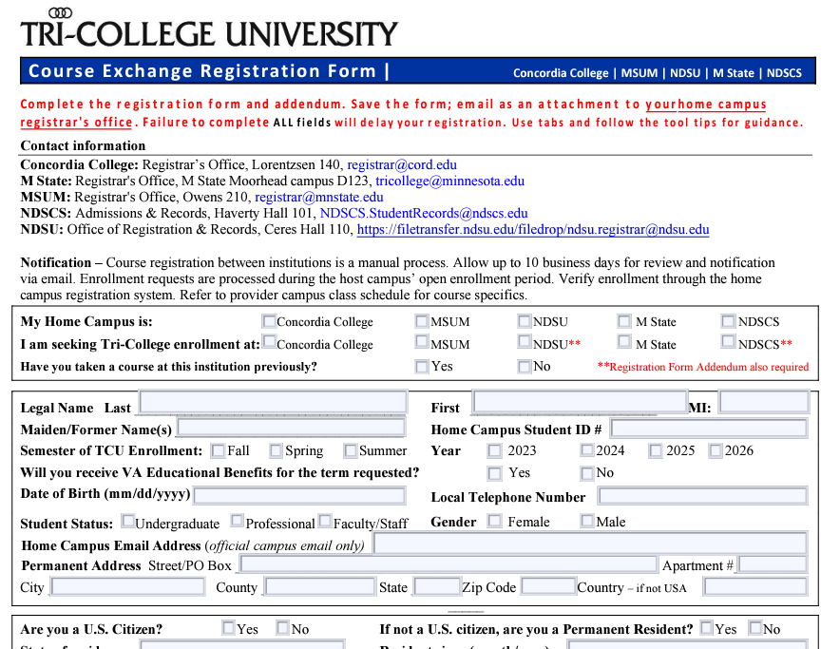

Slide 13
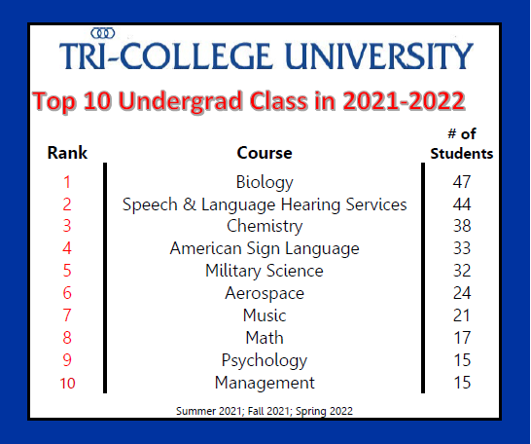
Notes:
Actual data from 2021-22.
Every college has their specialty that may enhance the students studies and/or tie into specific career goals.
I have had concerns expressed that students are going to different colleges to take Biology/Chemistry/ etc. that they struggle with here at NDSU. Each student has different needs. If these classes transfer, I am not one to micromanage intent.
If enhancing your education means making it through a challenging situation which is your Achilles heel and moving ahead to graduation, my vote goes to the student.

Slide 14
A Tri-College Minor
Research
Submit the form to Host Campus
Unique opportunities
Does it complement the major field of study?
Does it expand the student’s resume?
Will it extend graduation?
Does it have financial aid implications?
Allow plenty of time to process with the host campus registrar’s office and host campus advisor
The request is approved by both campuses
The student is provided the approved curriculum
TCU registration form is required every semester a class is taken
Concordia
  Languages
  ?
MSUM
  Education
  ?
NDSU
  Agriculture
  Engineering
  ?

Slide 15
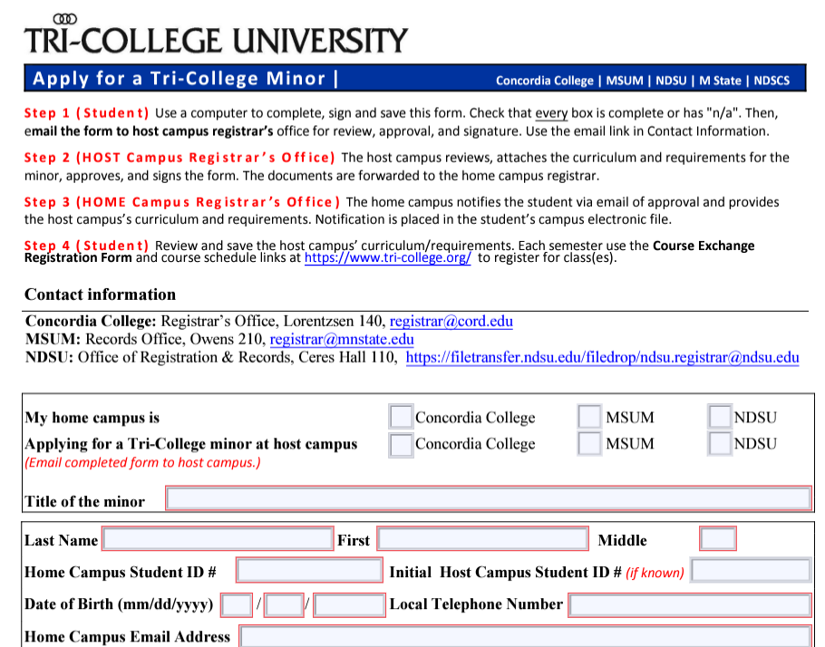

Slide 16
An Appeal Process
Appeal to the home campus registrar’s office
Examples
Automatic exceptions
👍
Schedule conflict
Does it create a hardship?
Falling out of sequence
Jeopardizing on-time graduation
Conflict with work that directly applies to the course of study or career plans
Most recently, childcare issues
Declared minor
Enrollment in Aerospace Studies/Air Force ROTC/ Military Science/Army ROTC
If there is a question of eligibility, student should submit the registration and appeal form together.
Advisor signature is required.
At the discretion of the home campus.

Slide 17
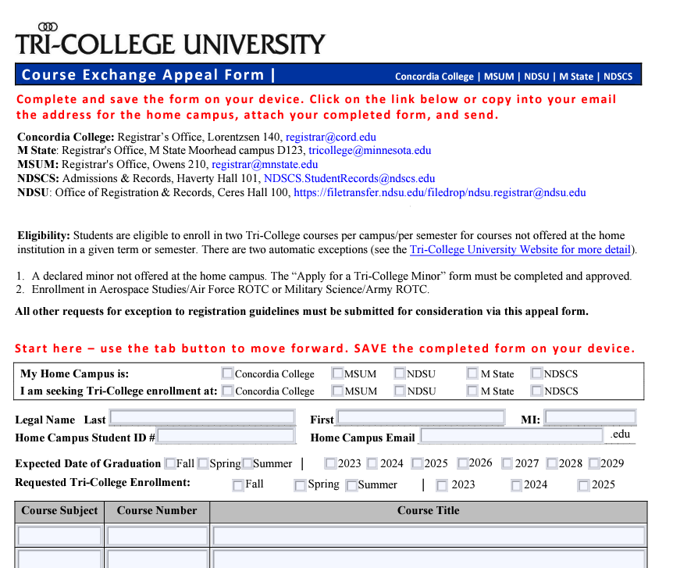

Slide 18
Spring 2024 open enrollment Nov 1 - Nov 20
Step 1 at least 1 month before registration or earlier
Step 2 Research
What are the NDSU graduation requirements?
Find equivalent courses
Does the student meet home campus prerequisites and corequisites
Is the student eligible? If not, complete the appeal form which requires advisor signature
What is the need?
Enhance?
Excel?
Explore?
Step 3 Submit form to HOME CAMPUS Registrar
Step 4 Registration
WAIT: Processed during host campus open enrollment
Confirmed by email when approved/declined
Shows in student’s schedule
Allow time for Registrar’s office review – incomplete forms slow down the process for everyone
Processed on a first come-first serve basis at the BOTH campuses, getting forms in early is critical

Slide 19

Thank you
Thanks to your commitment to your students!
We look forward to working together.
Tri-College University
Tri-College.org Tri-College@ndsu.edu 701-231-8170

Slide 20
Home Campus – where the student is registered and will graduate
Host Campus – where the student wants to take the class
Tri-College class – a class taken at partner campus using the Tri-College course exchange
Definitions

