Slide 1

Pandemic of Grief
Jodi L. Tangen, PhD, LAPC, NCC, ACS

Slide 2
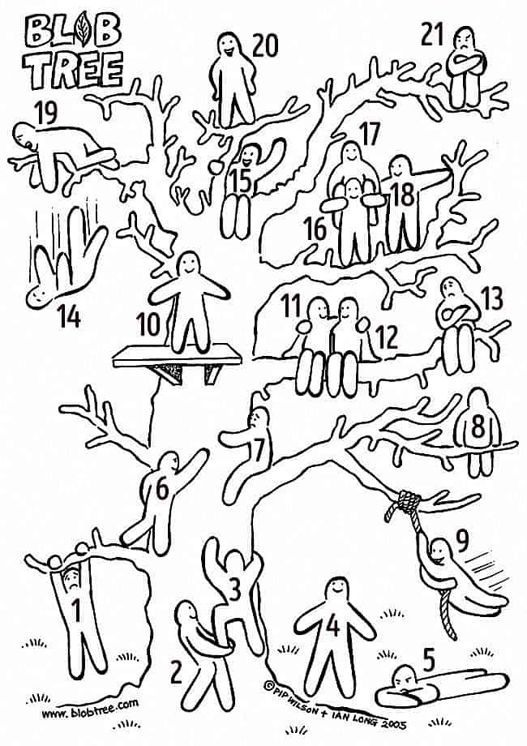
Blob Tree
Which Blob were you before the pandemic?
Which Blob are you now?

Slide 3

Grief – Slide 1
“We’re not safe all the time, but we operate under the illusion that we are” ~ Claire Bidwell Smith
Grief is not just about death.

Slide 4
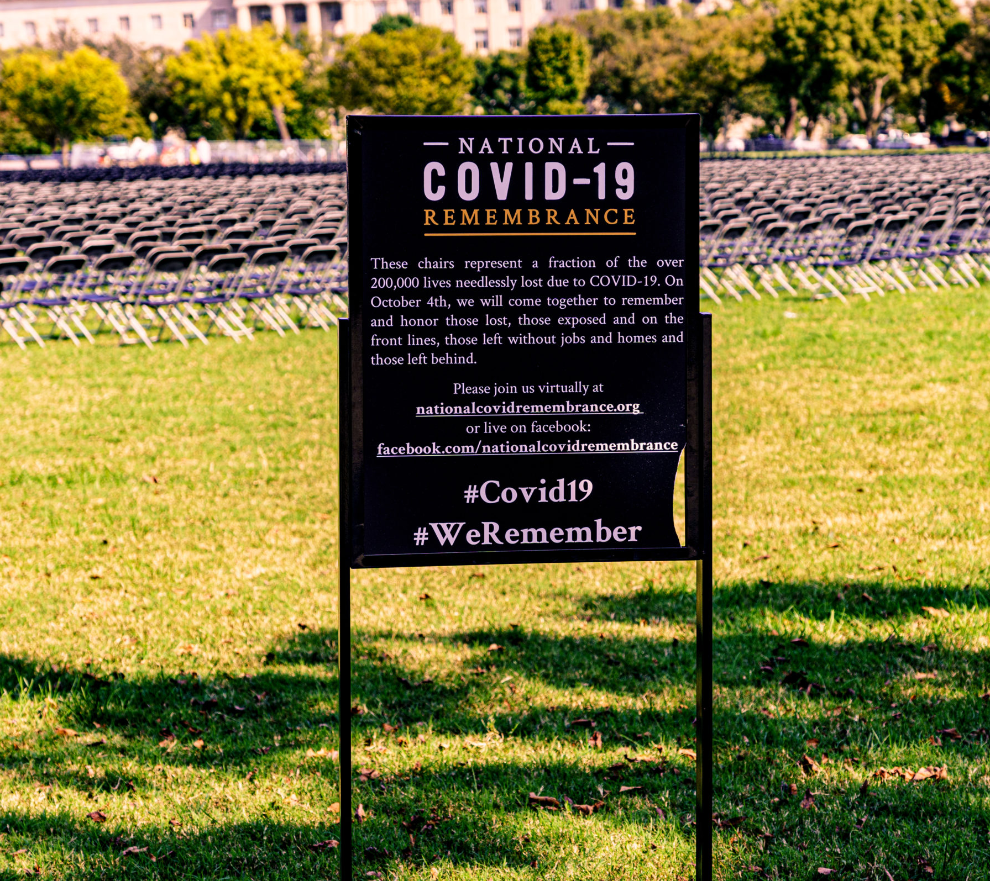
Grief – Slide 2
What do you remember??
  Diamond Princess ship
  Spring break, March 2020
  Toilet paper shortage
  White house briefings
  How-to create your own masks
  Shared Zoom accounts

Slide 5
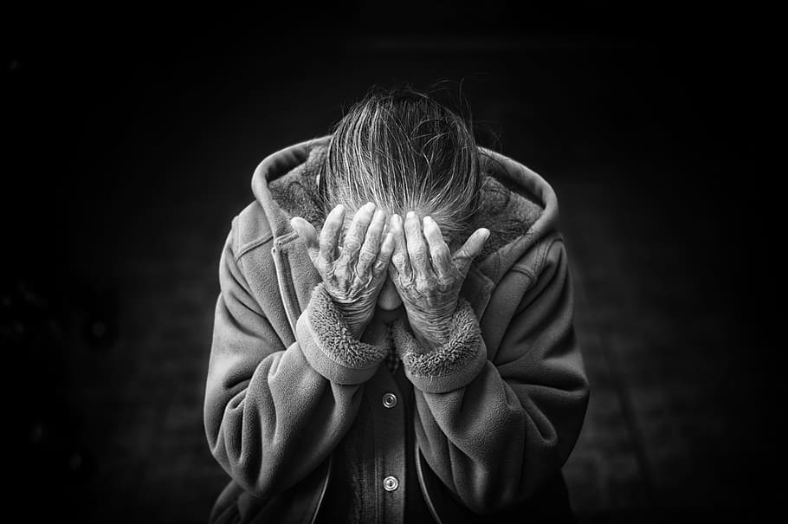
Five (or Six) “Stages” of Grief
Denial
Anger
Bargaining
Depression
Acceptance
Meaning (Kessler)
Kubler-Ross, 1969
*End of life

Slide 6
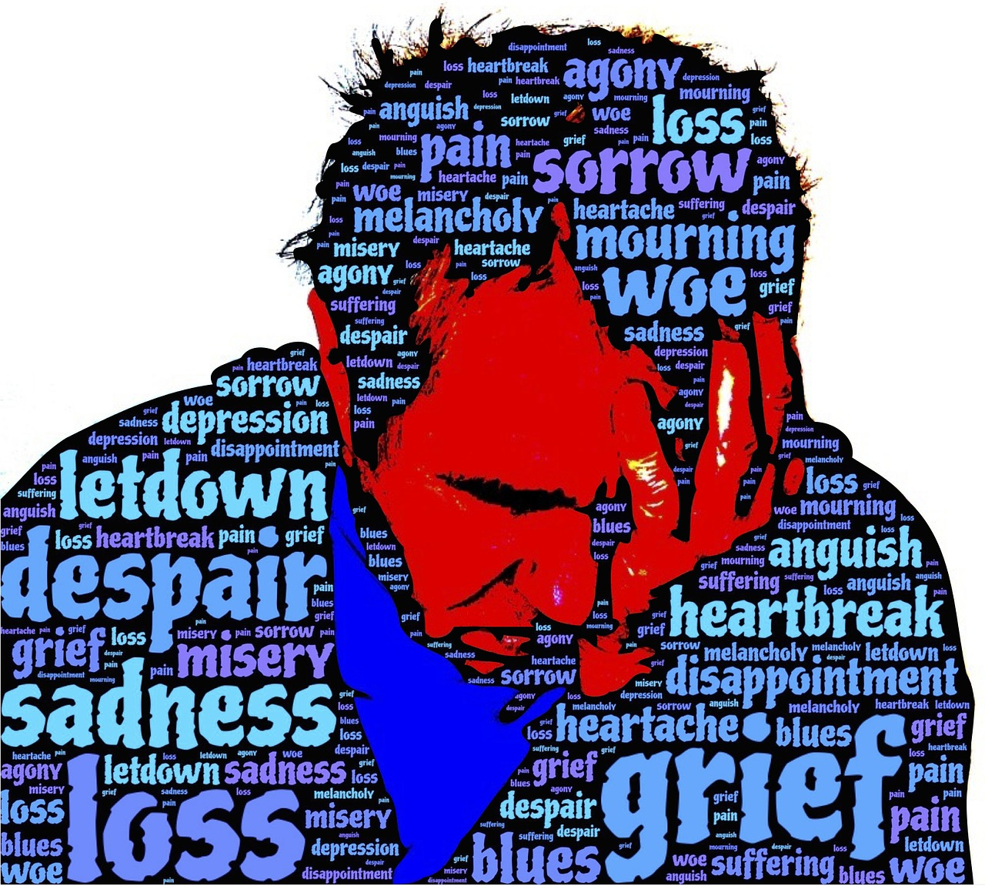
Reactions to Grief
Emotional: Shock, numbness, disbelief, denial, disorientation, mood swings, guilt, anxiety, fear, anger, sadness, despair, depression, yearning, calm, relief
Physical: Weakness, muscle tension, change in appetite, change in sleep, stomachaches, headaches
Cognitive: Confusion, memory loss, difficulty concentrating, difficulty making decisions, death preoccupation
Hospice of the Red River Valley, 2021

Slide 7
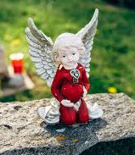
Reactions to Grief - Continued
Behavioral: Avoidance, reactionary, change of activity, lack of interest, neglected hygiene, increased use of drugs/alcohol
Spiritual: Struggling to find meaning, anger at spiritual source, spiritual confusion, increase/decrease in faith, change in faith
Hospice of the Red River Valley, 2021

Slide 8

Pandemic and Loss
Increased isolation
Loss of social support
Loss of face-to-face contact and physical comfort
Loss of control of everything
Loss of rituals
Sirrine, 2021

Slide 9
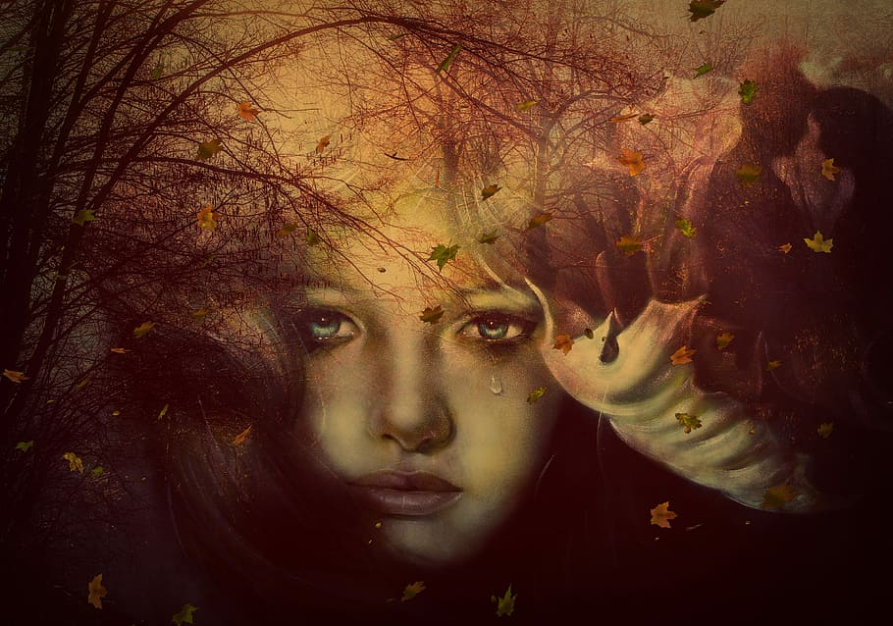
Four Tasks of Grieving
Accepting the reality of the loss
Experiencing the pain of grief
Adjusting to the environment without the “deceased”
Finding a long-lasting connection to the “deceased” and re-investing in life
Worden, 2019

Slide 10
Dual Process Model
Loss Oriented
Grief work
Intrusion of grief
Breaking bonds/ties
Denial or avoidance of restoration or change
Restoration Oriented
Confronting changes
Doing new things
Distracting/ avoiding from grief
New roles and relationships
Stroebe & Schut, 1999

Slide 11
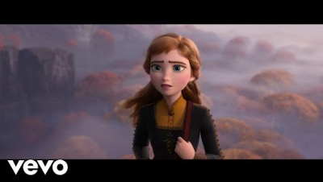
Moving with and through Grief
Tell the story of the loss(es).
Make amends. (Examine realistic expectations, write letters to the person, visualize saying goodbye or experiencing forgiveness, engage in self-compassion and self-forgiveness.) *Releasing guilt does not mean letting go of the loved one*
Write - letters to the loved one, memories, etc.
Find ways to stay connected to what was lost
Try to practice resilient grieving (moving forward without moving on) (The Next Right Thing) Find meaning in the loss (giving to a cause, growing spirituality, etc.)

Slide 12

Next?
What’s the next right thing for moving forward amidst the grief of this pandemic?

Slide 13
References
Hospice of the Red River Valley. (2021). Common grief reactions. Retrieved from https://www.hrrv.org/grief-support/common-grief-reactions/
Kübler-Ross E (1969). On Death and Dying. Routledge. ISBN 0-415-04015-9.
Sirrine, E. H. (2021). Anticipatory grief: Helping clients face impending loss and uncertain futures. Online training through PESI, Inc.
Stroebe, M., & Schut, H. (1999). The dual process model of coping with bereavement: Rationale and description. Death Studies, 23(3), 197–224. https://doi.org/10.1080/074811899201046
Worden, J. W. (2019). Grief counseling and grief therapy: A handbook for the mental health practitioner (5th ed.). New York, NY: Springer.

