Slide 1

Constructing system models to bolster threshold concept mental model accuracy
Michelle Murphy, MS, PhD
Associate Professor, Lake Region State College
Community Faculty, UND School of Medicine and Health Sciences
Woei Hung, PhD
Professor, University of North Dakota

Slide 2
Overview
Research framework
Brief overview of studies
Systems modeling with Google Jamboard

Slide 3
Research Framework

Slide 4
Threshold Concepts
Threshold concepts
  Those concepts essential to deep understanding in a field
  Student progress toward understanding is guided by their mental model of the problem space
  Mastery is demonstrated when a learner can think both forwards and backwards throughout a functioning system
  Boersma et al., 2011; Jonassen, 2011 ; Land et al., 2005, 2014; Meyer & Land, 2005; Michael, 2001
THRESHOLD CONCEPTS
The Liminal Tunnel – Land & Meyer
Superficial
Learning
Mental Model Formation
Deep
Understanding

Slide 5
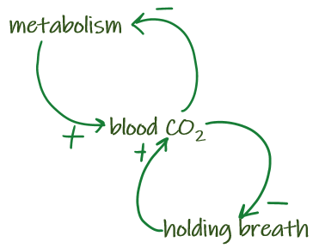
General Systems Theory
Physiological processes are non-linear, dynamic, and complex
  Thinking in systems supports deep conceptual understanding
  Capra, 1996; Hung, 2008; Modell et al., 2005; von Bertalanffy, 1969, 1972; Weiss, 1977
Cognitive tools
  Help students to represent their mental models as systems models
  Systems modeling, as a cognitive tool, supports visualization of mental models a learner is using to support understanding
  Gentner & Stevens 1983; Jonassen, 1992, 2003

Slide 6
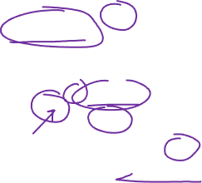
Systems Modeling
Systems modeling supports learning by providing a notation system whereby dynamic balancing (negative) and reinforcing (positive) feedback loops may be visualized.
  Mental model complexity increases as expertise increases
  Therefore, systems modeling may be used to visualize student understanding and allow for evaluation and correction of misconceptions
  Dauer et al., 2019; Jeong & Lee, 2012; Mancinetti et al., 2019; Richardson, 1995

Slide 7


Conceptual Framework
Systems modeling can be a powerful cognitive tool for visualizing dynamic mental models to support deep understanding of threshold concepts
THRESHOLD CONCEPTS
The Liminal Tunnel – Land & Meyer
Superficial
Learning
Mental Model Formation
Deep
Understanding
Systems
Modeling
Problem Solving /
Cognitive Tools
Jonassen
Systems Thinking
Weiss, vonBertalanffy

Slide 8
Studies

Slide 9
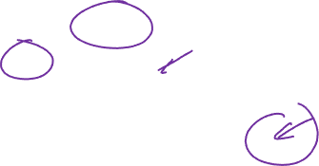
Undergraduate
Physiology
MD = -0.036
Undergraduate physiology students demonstrated improved multiple choice question performance after systems modeling, compared with a writing control condition
  n = 111
The performance gap between the conditions widened over time
Systems modeling is an unfamiliar technique to most students
  As a new technique, students may need time to overcome the initial cognitive load increase
MD = 0.209
MD = 0.243
 | Systems Modeling |  | Written report |  | Mean Diff.
 | Mean | SD | Mean | SD
Unit Exam EN | 5.164 | 0.913 | 5.200 | 0.797 | -0.036
Unit Exam IM | 5.155 | 0.804 | 4.946 | 1.026 | 0.209
Unit Exam AB | 4.214 | 1.062 | 3.971 | 1.071 | 0.243
Final Exam EN | 5.480 | 0.747 | 5.543 | 0.701 | -0.063
Final Exam IM | 5.268 | 0.894 | 5.189 | 0.877 | 0.079
Final Exam AB | 4.306 | 1.218 | 4.000 | 1.219 | 0.306

Slide 10

Graduate Physiology – Part 1
Graduate physician assistant physiology students ranked systems modeling as the top beneficial strategy for learning physiology
  Of fifteen ranked strategies, n = 64
They also ranked it in second place for benefit in retaining physiology content knowledge into clinical studies
Rank the following techniques in order from most helpful (1) to least helpful (15) | Didactic M | Didactic SD | Clinical M | Clinical SD | t, df = 52
Constructing systems diagram drawings | 4.53 | 3.06 | 4.33 | 2.81 | 0.63
Explaining a concept to myself in my own words | 4.83 | 3.09 | 4.02 | 2.58 | 2.207*
Working with a study group or partner to ask and answer "why" questions | 5.59 | 3.88 | 4.98 | 3.22 | 1.492
Pausing during study to form a mental image of the content | 5.85 | 3.04 | 6.02 | 3.19 | -0.341
Listening to lecture recordings more than once | 6.19 | 4.09 | 7.3 | 4.18 | -2.491*
<.05 *; <.01**; <.001***

Slide 11
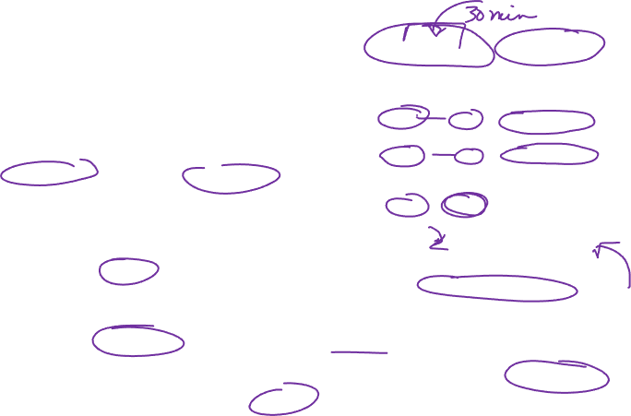
Graduate Physiology
 | 1: Pre % | 1: Post % | 2: Pre % | 2: Post % | Clin % | Total
injuri | 19 | 29 | 21 | 16 | 17 | 103
infect | 13 | 16 | 14 | 14 | 13 | 70
homeostasi | 14 | 9 | 7 | 10 | 10 | 50
cell | 12 | 3 | 9 | 16 | 10 | 49
damag | 10 | 3 | 15 | 10 | 10 | 47
tissu | 8 | 5 | 9 | 13 | 9 | 44
respon | 12 | 8 | 9 | 5 | 10 | 43
foreign | 4 | 0 | 9 | 10 | 13 | 35
stress | 3 | 21 | 5 | 1 | 3 | 32
disea | 6 | 5 | 3 | 6 | 6 | 26
Graduate physician assistant physiology students demonstrated increasing systems understanding after peer group systems modeling
  Increase process terms over structure terms pre-instruction
  Increase descriptions of cell-cell communication after instruction
stress, damage, infection occurs, cytokines
a tissue, cell or organ is no longer in homeostasis, which is usually triggered by some type of trauma/outside source of injury, stress, chemical/ion imbalance, or infection/pathogens
Session 1,
Post systems modeling
injury of some form occurs, signals release of histamines, cortisol, constant state of stress in body, state of homeostasis not present
Environmental or internal stressors cause cytokines and complement cascade to vasodilate, increased vascular permeability, bring about pain, and secrete chemicals inducing higher flow of rbcs [red blood cells] and wbcs [white blood cells]

Slide 12
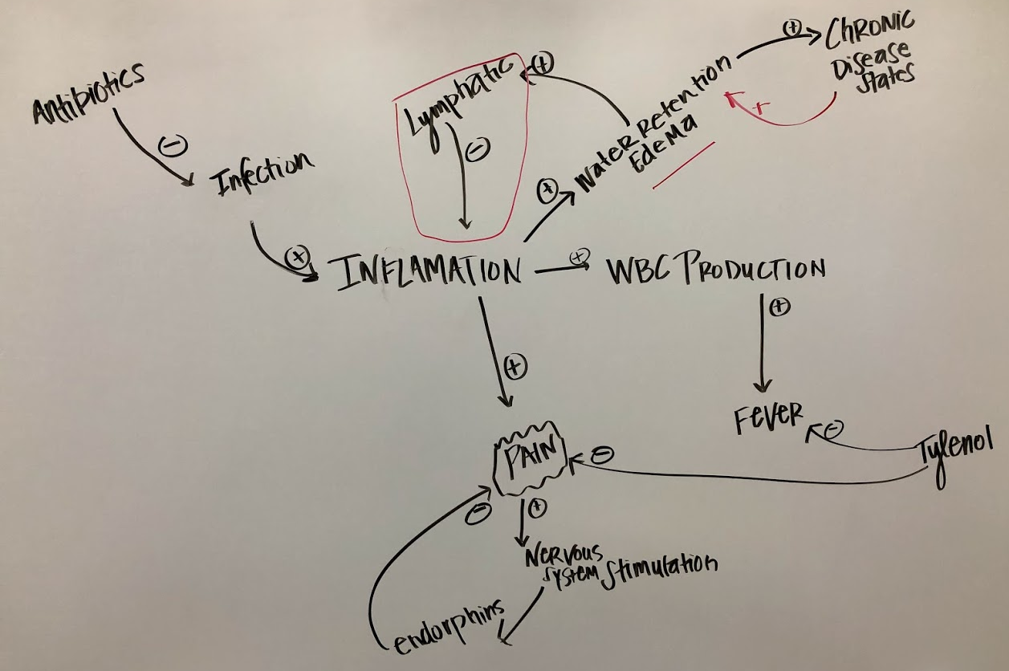
Creating Systems Models:
Blood Pressure

Slide 13

Google Jamboard
https://bit.ly/3lyqlp8
https://jamboard.google.com/d/14HYbXkKeoGdHgWVGK2vlufkgyYZ6VaquOzCiZPdCh8A/viewer

Slide 14


Thank you!
michelle.murphy@lrsc.edu
woei.hung@und.edu

